Slide 1
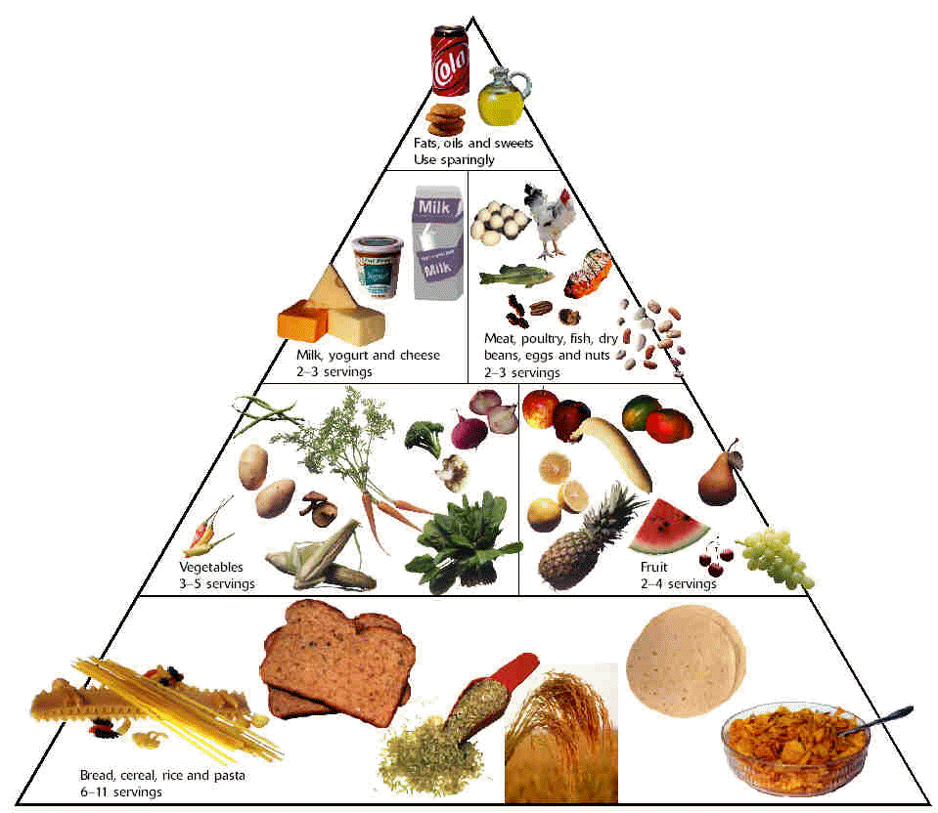
Healthy Food Around the World
Done by the students:
1.Issa Hamad
2.Dawood Suleiman
3.Talal Saleem
4. Ali Hamad
Grade: 8
Al-Basheer bin Al-Munther Basic
Education School (5 – 8 )
Teacher: Majid Ambusaidi - Oman

Slide 2
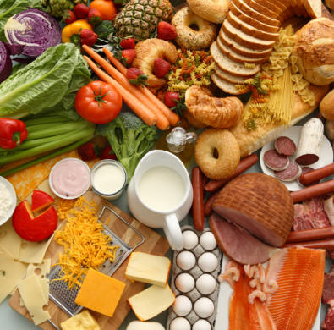
Eating the healthy food is the main factor for living without diseases. Most schools always advises students to choose the best and healthy food and I really like that. Also I really appreciate that when students are not allowed to eat fast food in schools and do not sell any junk food. Some schools have different corners especially for posters and leaflets about the benefits of the healthy food.
The Healthy Food and
the School Life

Slide 3
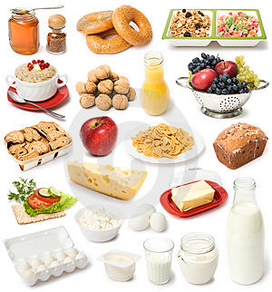
Most of the school subjects have particular sections about the healthy food especially science and sport. Each subject has a certain part in the textbook for the benefits of the healthy food. Even in English there is at least one unit about food.
School Subjects
Some school only provides the best food for their students. There is one day a week which is special for selling different fruit and milk. When students bring junk food to the school they will be warned not to do it again.

Slide 4
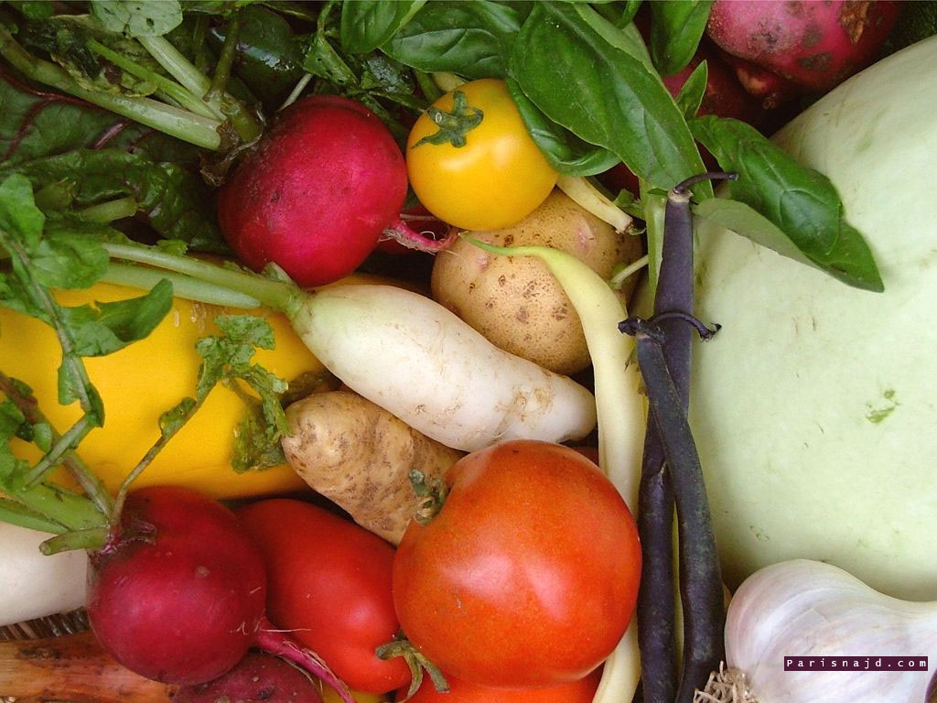
In our school we have a teacher who is responsible to conduct workshops for teachers and students about the eating the healthy food and how to prevent ourselves from diseases. At the end of each year our school enter a competition for these workshops and fortunately last year we got the second medal. In fact doing such workshops will definitely inform student more and more about living in a comfortable way.

Slide 5
Do students get enough information about the healthy food?
I think that students get good information about healthy food. All of our teachers always talk about the best food for us. They don't let us eat any junk food inside school ( no chocolate, no fizzy, no chips ..) and this helps us to react in a positive way in our real life. Also some subjects have specific sections for that. The school sometimes invites some doctors from the M.O.H. to present lectures about how to deal with food and they advises us to do exercises as well.

Slide 6
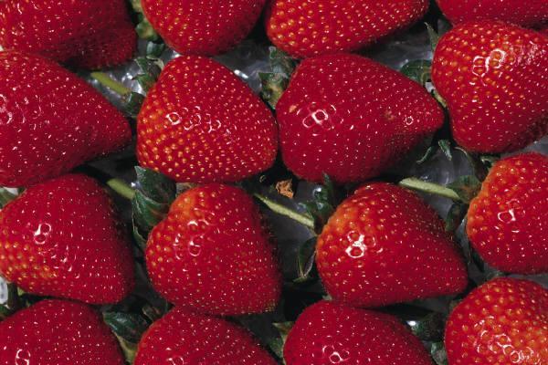
Once a child starts kindergarten or school, life takes on a new routine. A regular intake of food is needed throughout the day to keep the child active and help his/her concentration while learning. Giving the child a breakfast that contains fibre (such as oatmeal, shredded wheat, berries, bananas, or whole-grain pancakes) should keep adrenaline levels more constant and make the school day a more wondrous experience. Moreover, healthy eating patterns in childhood and adolescence promote optimal childhood health, growth, and intellectual development.
However, when a school child fails to meet the nutrition requirement needed by the body, he/she is prone to health problems like iron deficiency anaemia, obesity, including long term health problems such as coronary heart diseases, cancer or even stroke. This results when there is an imbalanced diet consumed by the child for a consecutively long period of time.
Let`s take a look about Bangladesh Schools and the healthy food.

Slide 7
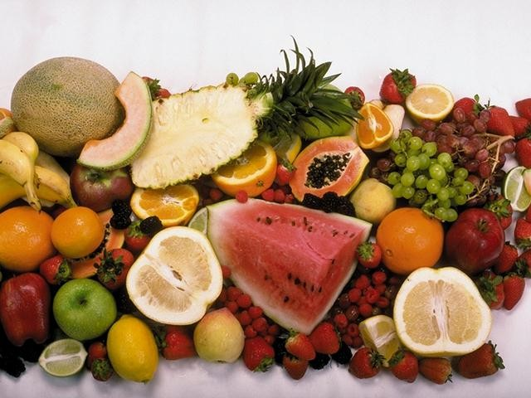
School life is the time-period where a child develops his knowledge, nurtures his mind and matures his soul into believing what is right for him and vice versa. During this learning age, he should agree to the most unwanted saying of today’s generation, “Say no to Junk food!” It’s no wonder, trips to fast-food restaurants have become the pinnacle of gastronomic delight for most preschool children today. But here, in these fast-food restaurants, children miss out on important nutrients and fill their tummies (and arteries) with things they don't need. We need to be very clear about what they need and what they don't in order to avoid being knocked over by the junk food current.

Slide 8
On the other hand, Bangladesh being a less economically developed country, fails to meet the education required to promote the consumption of healthy food by students in schools. Here, addressing the health and climate impacts of our diet will be a huge educational and cultural challenge. No arena of food policy could be more critical to success than food in schools. To add more, hardly any of the thousands of educational institutes meet the classroom based lessons on the importance of healthy food for a healthy living. Thus, youngsters have miscarried themselves in acknowledging the essential needs of a healthy diet. Now, this has increased the rate at which youngsters are falling victim to health disorders like, diabetes, obesity, heart failures and high blood pressure in the country today.
Schools in Bangladesh, which includes my school, usually provide the students with their most beloved junk food items like fried chicken, chicken sandwich, fried rolls and hot dogs covered with dripping cheese served widely in cafeterias and food corners nearby the school premises. This has furthermore declined the sense of healthy living amongst the students studying here and thus they are unaware of the hardships that they may have to encounter in their futures due to their carelessness of not maintaining a healthy balanced diet now, which strictly prohibits the intake of junk food! Today, the neglect of practical food education and skills in schools means that young people still emerge with little interest in food and no notion of where food on the supermarket shelves has come from. It would appear that climate change resonates more with young people than healthy eating messages, and yet no effort is being made to capitalise on this to move their eating habits in a direction that is both healthier and more climate-friendly.

Slide 9
Moreover, in order to introduce a healthy living amongst youngsters today in this less economically developed countries, the government should give clear and urgent priority to the role that school meals and practical food education can play in delivery of public health and climate change goals. The five steps below will deliver this joined-up vision, and put the school meal service back onto a sustainable footing.
Healthy Meals and the Less Economically Developed Countries.
Five steps to transform school food culture:
1 . Every pupil to eat healthy and climate friendly school meals by 2015.
2 . School meals to be run as an education service, not a commercial business.
3. More paid hours for school cooks to prepare fresh food.
4 . Every pupil to have direct experience of food growing and production, in school gardens and on farms, by 2011.
5 . Government to invest 50BDT per pupil per school meal to achieve a 100BDT ingredient spend while allowing take-up to rise.

Slide 10
Given that school meals are the only direct route by which the Government can influence the eating habits of young people in line with obesity and climate change imperatives, there should be a clear commitment to achieving 100% take-up of healthy and climate-friendly school meals by a chosen deadline. This commitment, to both 100% take-up and the goal of healthy and climate friendly meals, is needed to give a clear framework within which all decisions relating to school meals will be made. In order for school meals to be both healthy and climate-friendly, Government policy needs to look beyond the important new nutrient-based standards to ensure that meals are freshly prepared from largely unprocessed, seasonal, locally sourced and organic ingredients, with meat and dairy served in moderation.
Due to lack of government concern and initiatives to create awareness for the need of good health, today’s youngsters have failed to gain the knowledge of the vital importance of maintaining a healthy diet in their everyday lives, which also plays a significant role in their student careers.

Slide 11
Bahrain and the Healthy Food
Our ancestors were at first nomadic . They got their food from animals and fish they and from plants they collected around them.
When they settled in one place , they grew crops and saved good seeds to plant and improve crops.
Food in Bahrain
Falafel
As a main dish, it is served as a sandwich, stuffed in pita bread with lettuce, tomatoes, and tahina. As an appetizer, it is served on a salad, or with hummus and tahina. Falafel is a favorite among vegetarians.
Jabood
It consists of cows liver or chicken's with spices, black pepper, onions and every thing puts inside a piece of bread.

Slide 12
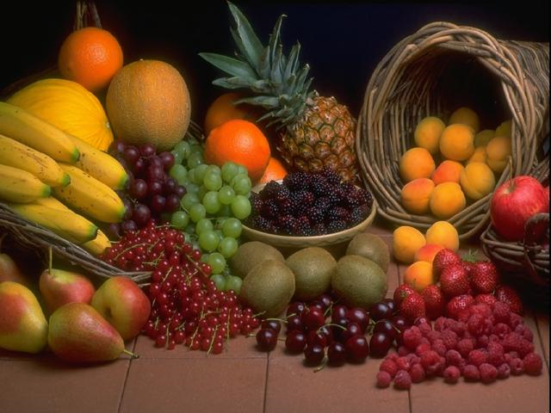
Healthy Food in Palestine
Palestinian cuisine consists of foods from or commonly eaten by the Arabs of historical Palestine — which includes those living in the Palestinian territories, Israel, refugee camps in nearby countries as well as by Palestinians living abroad. The cuisine is a diffusion of the cultures of civilizations that settled in Palestine, particularly during and after the Islamic era beginning with the Arab Ummayad conquest, then the eventual Persian-influenced Abbasids and ending with the strong influences of Turkish cuisine, resulting from the coming of the Ottoman Turks. It is similar to other Levantine cuisines, including Lebanese, Syrian, and Jordanian.
Palestinians eat several times during the day, with lunch being the largest meal. Cooking styles vary by region and each type of cooking style and the ingredients used are generally based on the climate and location of the particular region and on traditions. Rice and variations of kibbee are common in the Galilee, the West Bank engages primarily in heavier meals involving the use of taboon bread, rice and meat and coastal plane inhabitants frequent fish, other seafood, and lentils, Gaza's inhabitants heavily consume chili peppers too. Meals are usually eaten in the household but dining out has become prominent particularly during parties where light meals like salads, bread dips and skewered meats are served.

Slide 13
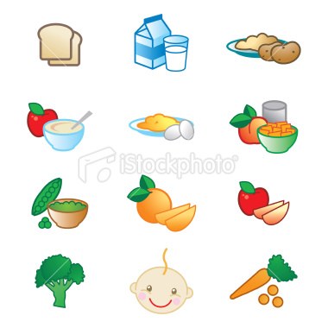
Healthy Food in Palestine
The area is also home to many desserts, ranging from those made regularly and those that are commonly reserved for the holidays. Most Palestinian sweets are pastries filled with either sweetened cheeses, dates or various nuts such as almonds, walnuts or pistachios. Beverages could also depend on holidays such as during Ramadan, where carob, tamarind and apricot juices are consumed at sunset. Coffee is consumed throughout the day and liquor is not very prevalent amongst the population, however, some alcoholic beverages such as arak or beer are frequented by Christians and less conservative Muslims.

Slide 14
The End
Done by:
Issa Hamad
Dawood Sulaiman
Talal Saleem
Grade : 8
Teacher: Majid Ambusaidi - Oman

