Slide 1
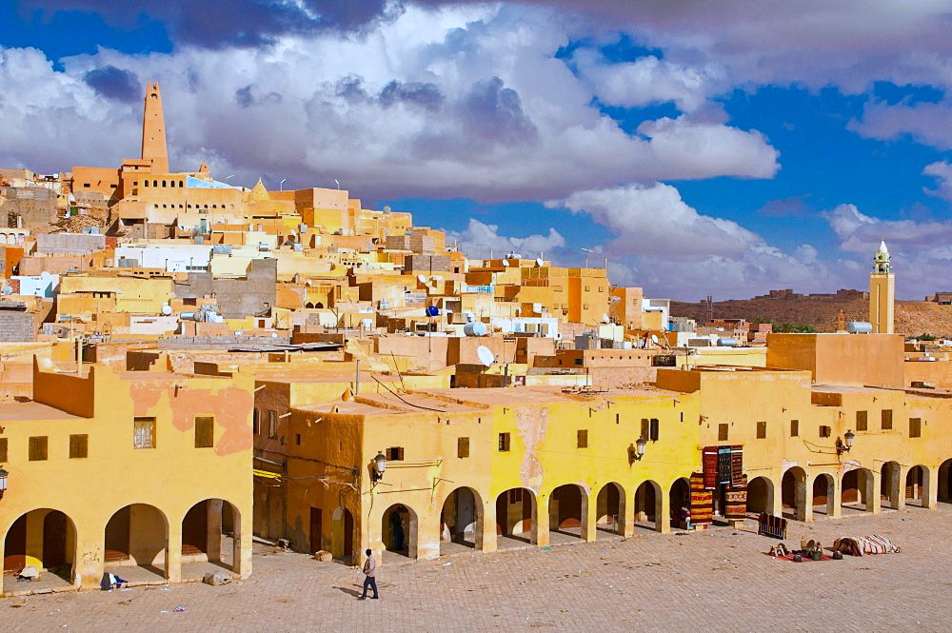
Welcome to

Slide 4
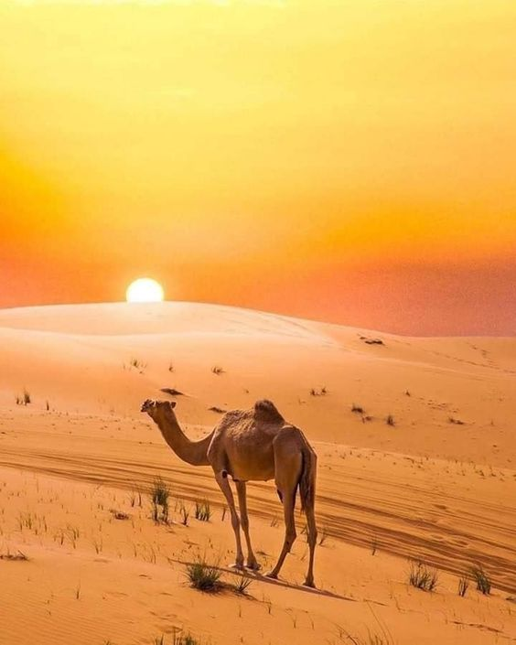
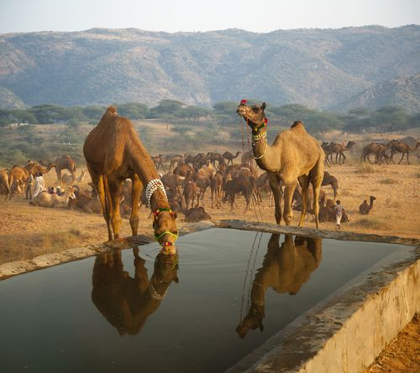
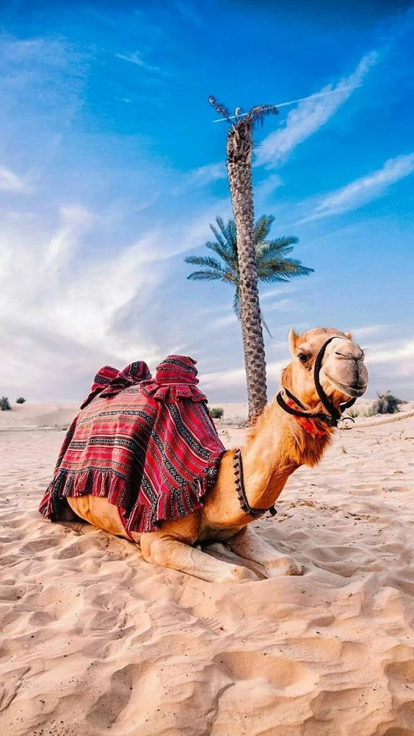
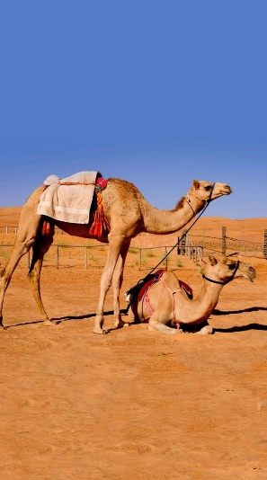
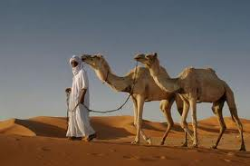
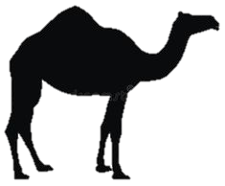
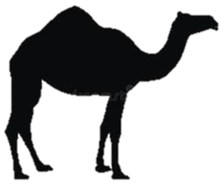
definition
What is it mean camel ?
The camel animal in Ghardaia represents the most wonderful types of coexistence
between the Mozabites,
and this pet is a means
of transport and mobility,
and for fetching water and the various actions
of the Mozabite man,
and it is a symbol of patience and
enduring difficulties in various circumstances
camels

Slide 5
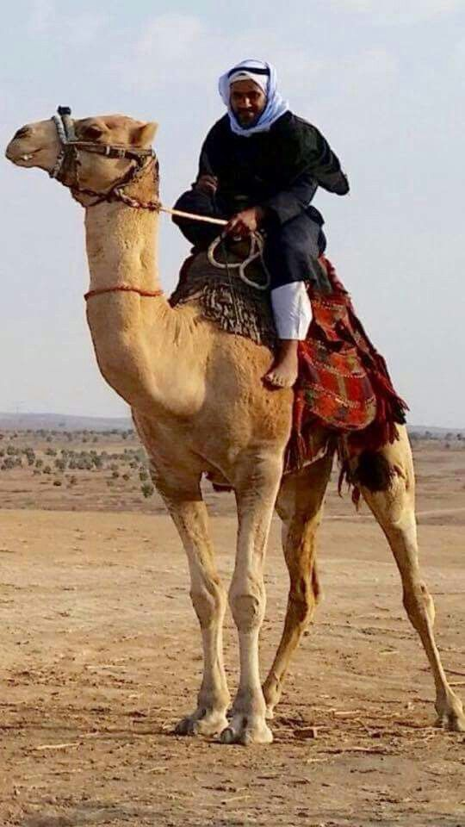
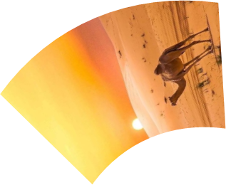
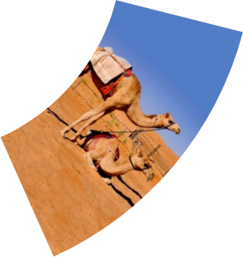
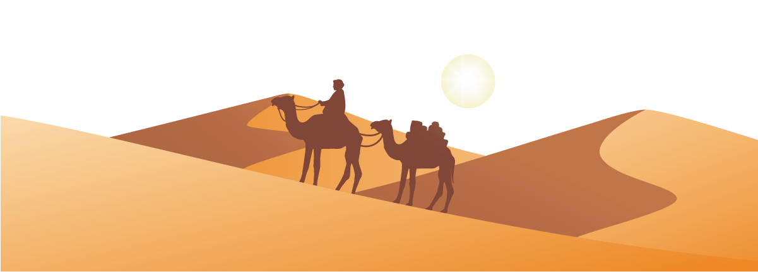
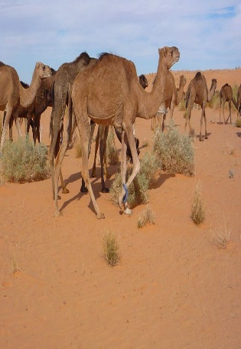
Its services
The services provided by the camel: are represented in the following :
Transportation The camel is used to transport items to and from the Mzab, especially heavy objects, as the desert ship crosses it, and it was used in the old days to transport goods, goods, wheat and dates ... and it appeared in their poetry (Tishli Neilman Atwanciten ... Tazri de Atran), with which the Mozabites travel to the cities of the north, to the pilgrimage, and to the desert
It was also used to drain water from wells until the opposite street named the well after it (Aglad Ulm). And It is the main way of extracting water from wells and water in the old days, and it is still the backbone of life
camels

Slide 6
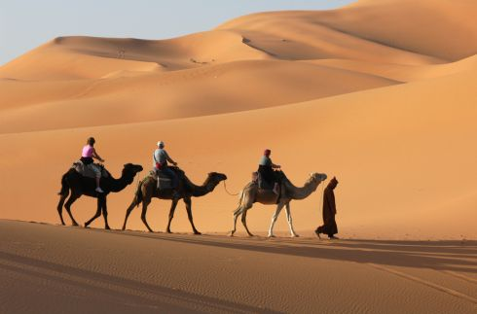
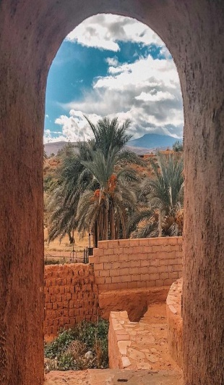
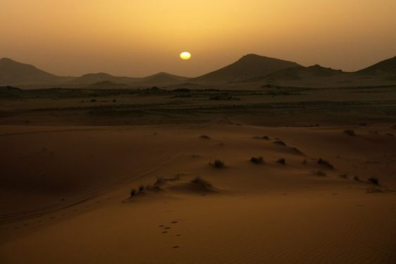
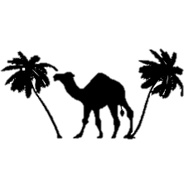
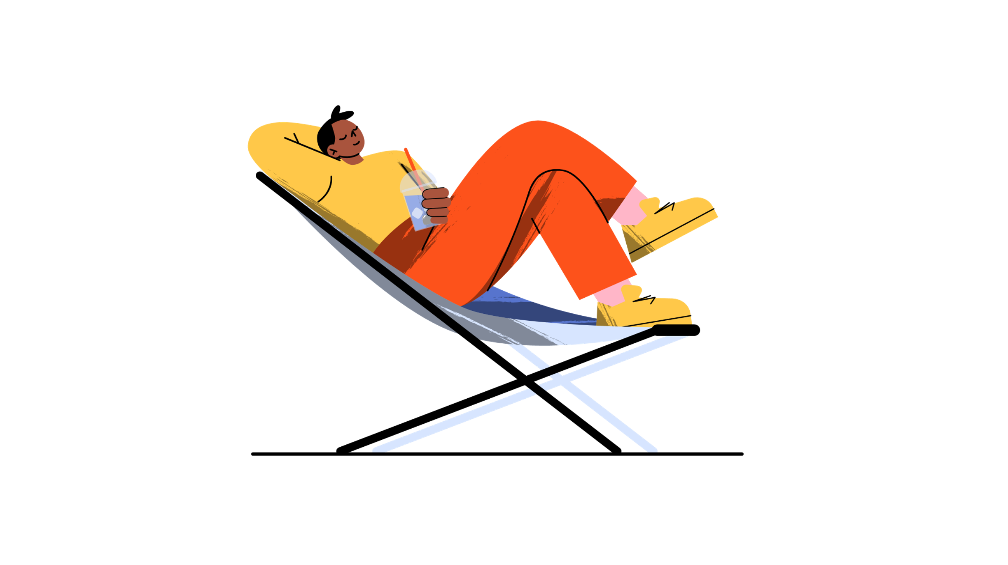
its benifits
there are several benefits extracted from camel, as it is mentioned in the Holy Qur'an,
[Shall they not look at the camels how they were created * and to the skies how they were lifted up * and to the mountains how they were erected * and to the Earth how they were flattened]{Al-ghashiya:17-20}
including Naqa milk It is made from the lint of clothes, and its skin is used as a cover for several pots or tools, in addition to the fact that the mazabians eat camel meat, it is food and as a metod for them at the same time.
camels
The mention in the holy quran

Slide 7
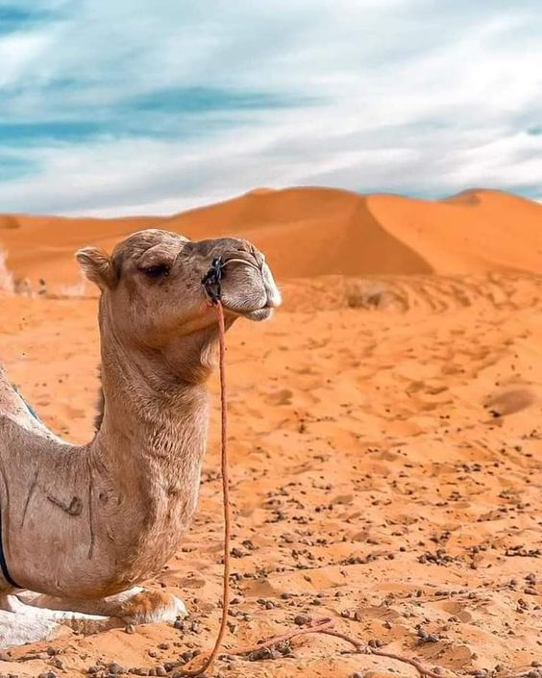
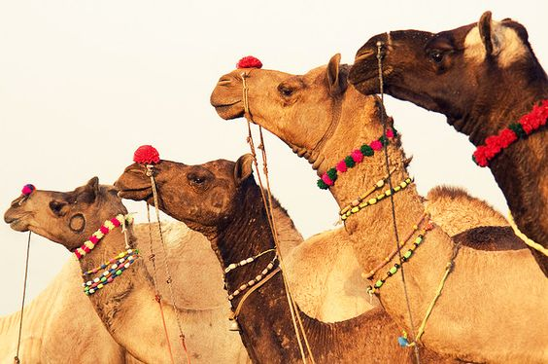
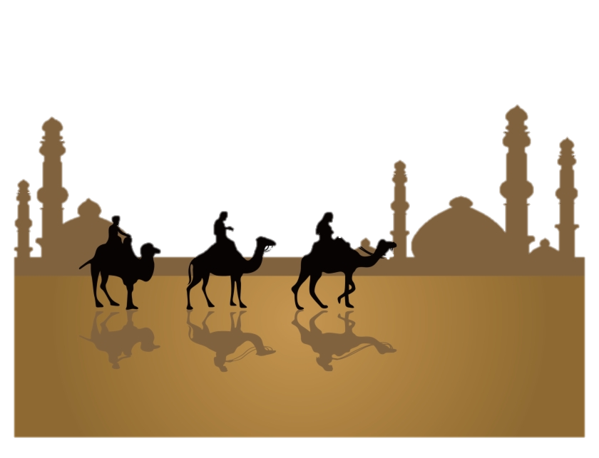
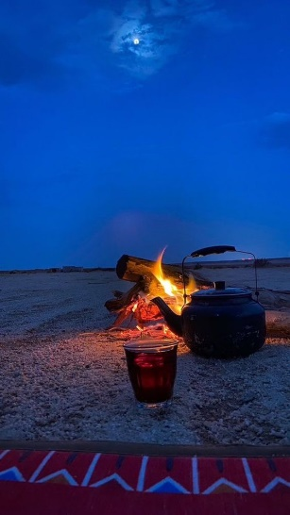
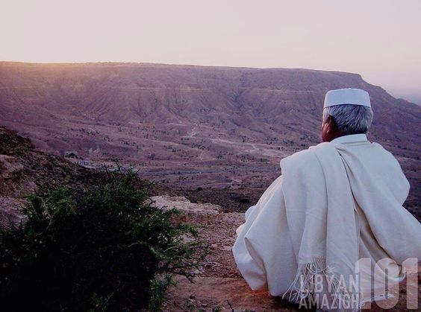
Preserve it
To keep the animal alive and in order to preserve it, the farmers allocated a special place for it in their homes to be close to them, and they also took care of its health and care by bringing types of hashish and leftover household foods to it
camels

Slide 8
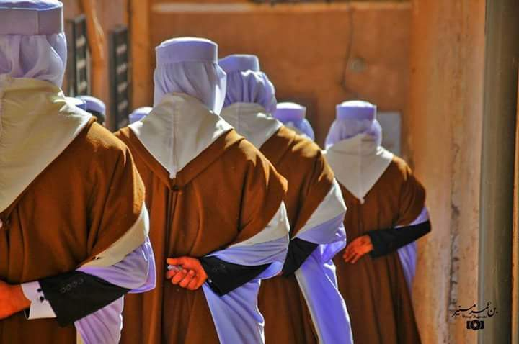
THANK
YOU!
2022 /2023
ERIDDOUNE HIGH SCHOOL
HDJ IBRAHIM ABDALLAH

