Slide 1
Moroccan food
Everything about Couscous

Slide 2
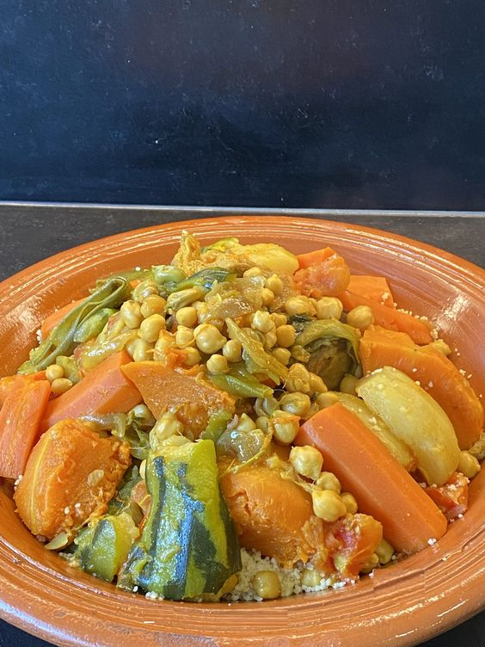
Is the most famous traditional dish that is prepared in Morocco .
A healthy and tasty dish that contains a mixture of vegetables, spices and meat.

Slide 3
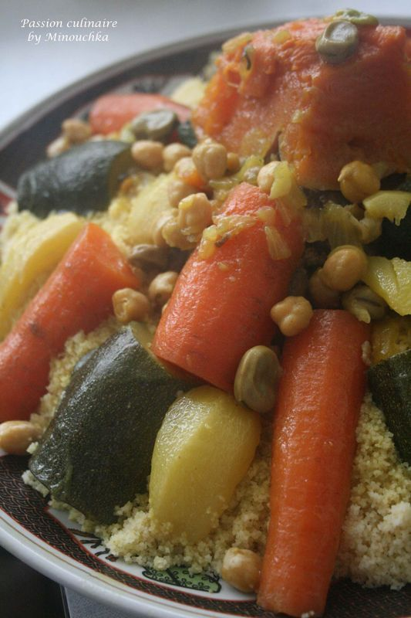
Usually, Friday is a holy day in Islam and we call it the “ Eid of the believers”.
Vegetable Couscous is prepared in most Moroccan households every Friday, to be eaten after Friday prayers.

Slide 4
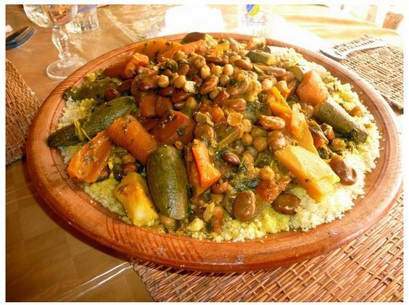
1 teaspoon of black pepper
1 teaspoon of turmeric
1 teaspoon of salt
1 teaspoon of ginger
Pinch of saffron threads
½ cup of olive oil
Enough water (about 3 liters)
500 g of couscous
1 kg of lamb meat
4 carrots peeled cut lengthwise
3 turnips peeled and cut lengthwise
2 medium squares of pumpkin
Some roughly chopped cabbage
2 zucchinis
1 cup of chickpeas, tinned or soaked overnight
2 tomatoes, grated
1 onion, chopped
1 tablespoon of chopped cilantro and parsley

Slide 5
