Slide 1
In the name of god

Slide 2
Hello, hope you are doing great we want to introduce ourselves to can have better communication.
Our group project topic is (my hero)and we live in Iran.

Slide 3
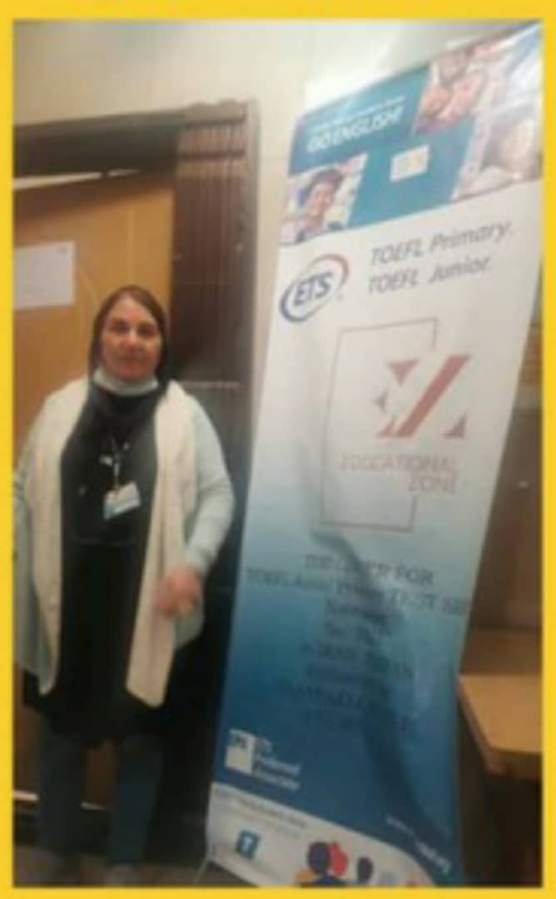
First we want to introduce you our dear teacher(MS.Abedi) who first gave some information about Powerschool and then she helped us so we could participate in meetings ,courses and so on.
We really appreciate you MS.Abedi thank you for helping us☺

Slide 4
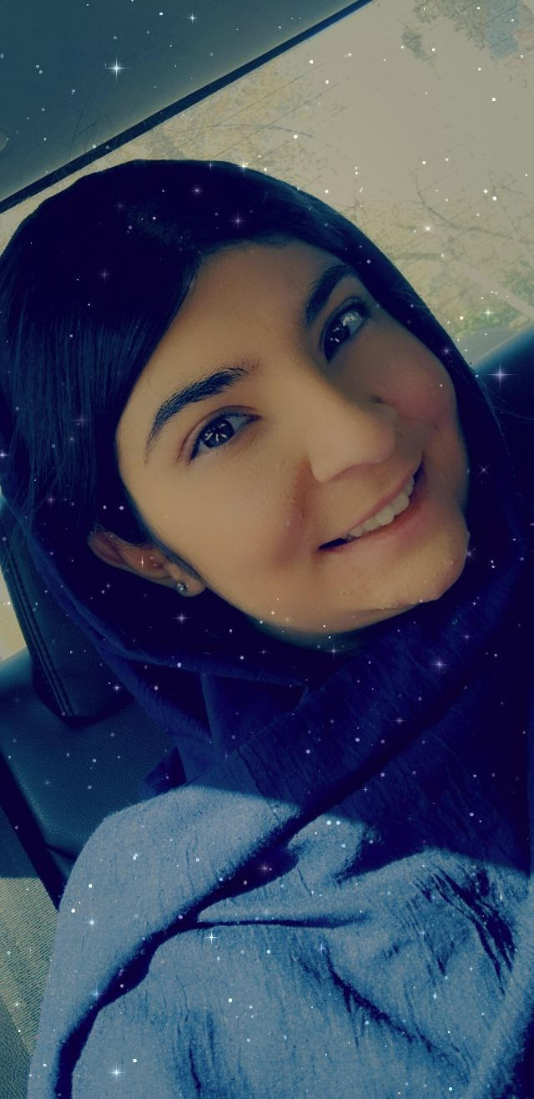
Hi ,my name is Reyhaneh Keshavarz . I'm 16 years old. I'm from Iran . This is the first year that I'm studying in high school. I like to read novels, listen to music, and watch Netflix series like money heist and the Witcher. Sometimes I'm interested in supernatural things because these things can make me excited and I love this feeling.

Slide 5
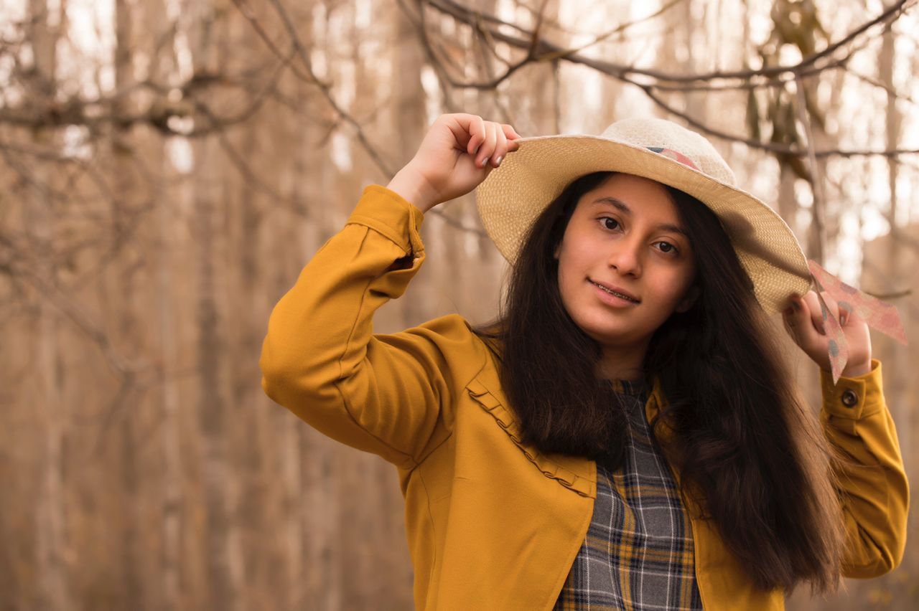
Hi my name is Asal 😇I'm from Iran🇮🇷 I'm 16 years old and I study in high school. In my free time I like to read novels , chat whit my friends , play with little cousin, help my mother for cook, listen to my favorite music and dance. I like to learn new things like different languages, different lessons and etc. also like to travel around the world and see and enjoy all over the world.🌎

Slide 6
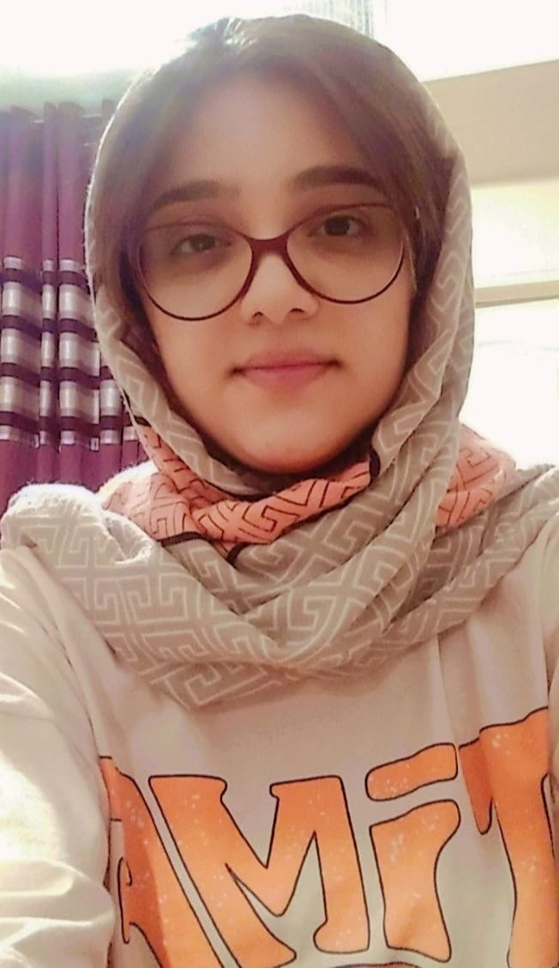
Hi, glad to joining this project. My name is Sana Jalili. I'm from Iran 🇮🇷.I'm 16 right now. This is the first year that i study in sampad school (Nodet).I'm interested in experience all kinds of teamwork specially with my best friends. I'm always ready for learning new information or languages, because of that i spend my free time participate in different classes English, Turkish, math, biology...

Slide 7
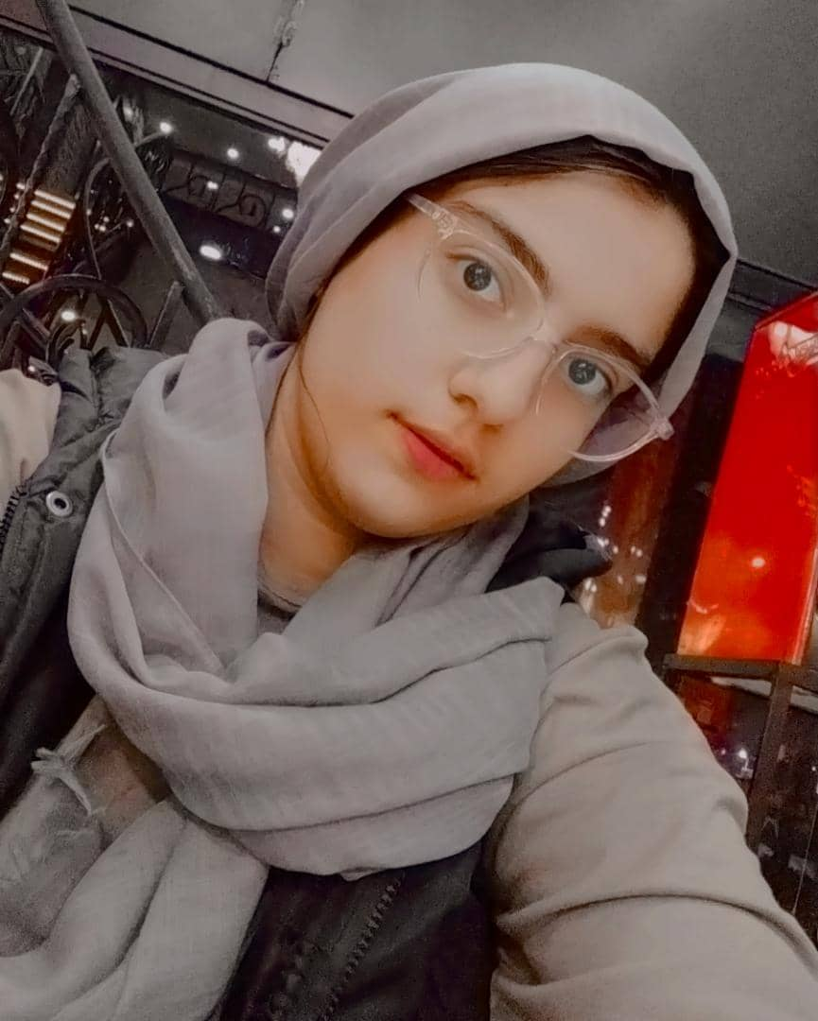
Hello, I am Rojan, 15 years old from Iran :)some of my favorite activities are listening to music that I like and going to the amusement park and shopping and ....But among all of them, I like listening to my favorite music the most because it gives me a lot of peace. I love school because we learn a lot from it and in the end, I hope you are always healthy and do not forget kindness and love!)

Slide 8
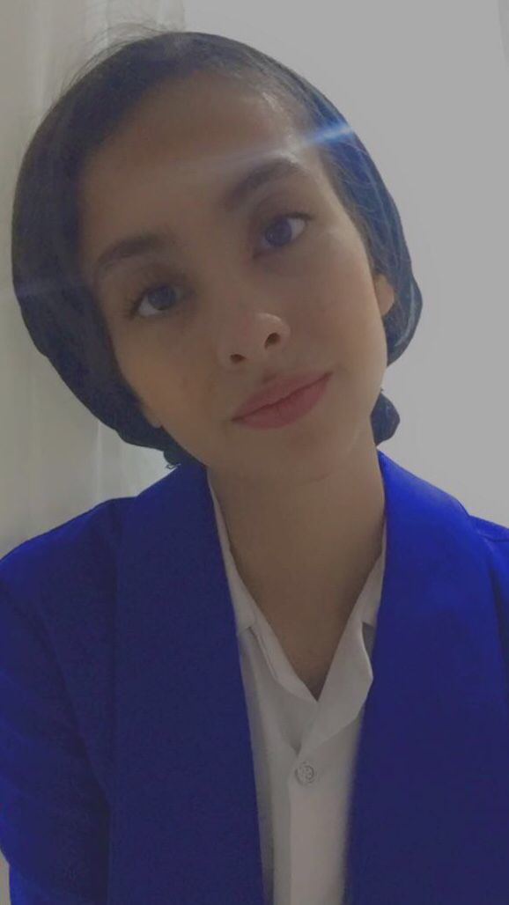
Hello ,l hope you’re well. My name is Mahta I'm from Iran .I like to listen to music while exercising and I like researching Harlow's disease and only sometimes I'm interested in some philosophical issues such as indoctrination

Slide 9
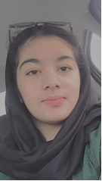
Hi! My name is Samin Jalali. I am 16 years old and high school student. I love school because it teaches us good things. Sometimes, I do some different work like reading book doing exercise watching TV and …

Slide 10
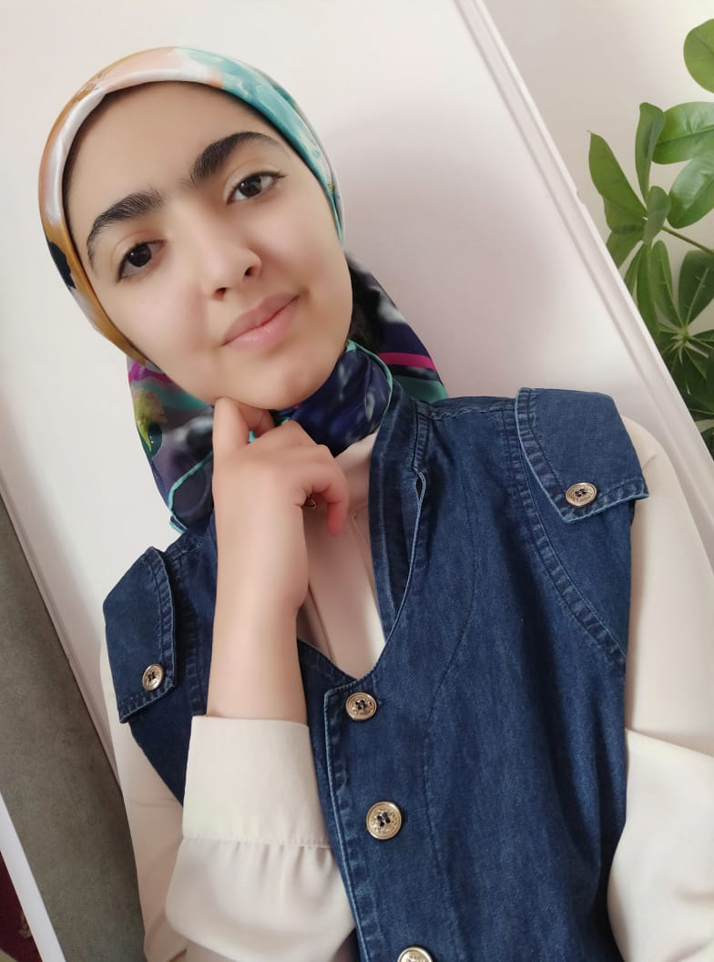
Hi, I am Nazanin Fatemeh Mahdizadeh from Iran. I am 15 years old but I am going to be 16 in about a week:) I really enjoy drawing and reading. I am also such a huge fan of marvel movies. I am interested in speaking in foreign languages and that’s what makes excited about learning them .I can speak English and a little bit Turkish and because of THAT I am satisfied that I can participate in this project :D

Slide 11

Right now we want to talk a little bit about powerschool that has given us this interesting chance to participate in this projects

Slide 13
As you know our topic is
{MY HERO}
And our hero is
{Maryam Mirzakhani} and we are going to introduce our hero and the reason that she has became our hero to you but before that we explain you why did we chose this topic?
Hope you enjoy it

Slide 14
Here is The reason of choosing this topic and a short summary of it

Slide 15
When we know what exactly we want from world from a young side we try for it harder and so the chance of being wrong in our decisions decrease.
Nowadays most of teenagers are disappointed and unfortunately according to statistics there are such a huge number of people who commit suicide and a huge number of them include teenagers. but according to researches people who have a person to imitate from her get less disappointed because they know each hero had has such a bad events in their life and it helps people to keep being hopeful.

Slide 16
When we have a hero that we love her we try to get to our purpose whatever it costs and so it is so important to don’t give up your goal.
Our hero that we want to introduce is an Iranian hero so we can declare her to so many people in all around the world and it is so satisfying for us.
We hope that we can help teenagers all around the world to go ahead and find their hero and find the way of their life.At the end I want to say a positive sentence that I love it so much
‘try enough hard that one day you can become your own hero’

Slide 17
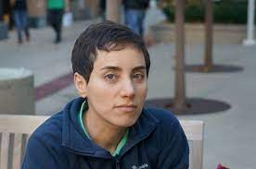
And finally our hero biography:)

Slide 18
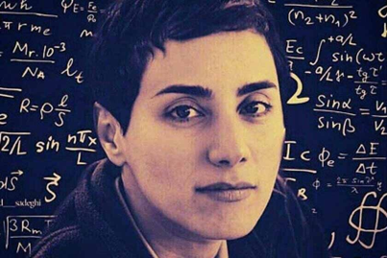
Maryam Mirzakhani was an Iranian mathematician and professor at Stanford University .In 2014, Mirzakhani branded Riemann surfaces dynamics and geometry and their modular spaces due to their activism in the field of "dynamics and geometry."
Maryam Mirzakhani won the Gold Medal of the World Mathematical Olympiad in 1994 (Hong Kong) and 1995 (Canada) while studying at Farzanegan High School in Tehran, and this year became the first Iranian student to complete a grade.

Slide 19
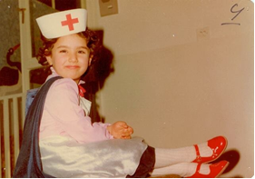

Slide 20
After completing his primary education, he entered Farzanegan High School in Tehran by participating in the entrance exam of Sampad schools. [16] Regarding the positive impact of the high school environment on his academic life, he said, "I went to Mumtaz Farzanegan High School.
And then he went to Harvard, where he would take classes with Curtis McMullin( winner of the Fields Prize).McMullin remembers Mirzakhani during this time as he asked a lot of questions about his classes

Slide 22
In July 2017, it was announced that Mirzakhani had been hospitalized in the United States with cancer. She had been suffering from breast cancer for the past four years, and the cancer had spread to her bone marrow. His parents went to the United States to take care of him. Maryam Mirzakhani finally died on July 14, 2017 at the age of 40 in a hospital in California.
Nominations of Maryam Mirzakhani
Sharif University School of Mathematics Library
Amphitheater and library building of Farzanegan 1 High School, Tehran
Isfahan Mathematics House
One of the streets of Berlin

Slide 23
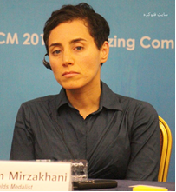
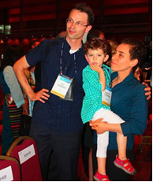

Slide 24
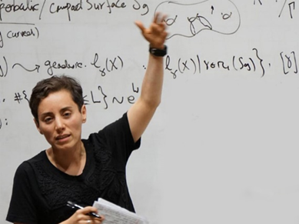
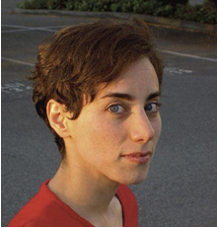

Slide 25
When we were searching about Maryam Mirzakhani, we realized important features that help us move in the direction of our goal stronger than before.
One of those features was trying to reach our goal. Maryam Mirzakhani was able to achieve many successes with a lot of effort. We learned from this Iranian hero that effort and hardworking to achieve a goal is one of the most important things.
One of those features is not to be disappointed. Maryam Mirzakhani taught us that in every path, some difficulties and obstacles make us tired and discouraged but we should not despair, but continue on our path more powerfully than before, because, in the end, we will see the result of our efforts.

Slide 26
We introduced you our hero but that’s not enough among doing this project we were curious to know about other people opinion about their hero so we interviewed one of our classmates about her hero:

Slide 28
We all have different heroes whom we adore and love and believe in . But they are self - conscious , not only they , but all humans have a hidden hero . And this hero is very powerful and can get the greatest honour by choosing the right choice , and at the same time it can be our greatest enemy . And we have only to pay its and believe in .it is not the hero of any one but ourselves☺

Slide 29
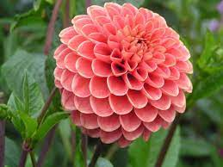
we all are so happy that we are a part of this project and hope that we can enjoy and learn together:)

