Slide 3
Planting

Slide 4
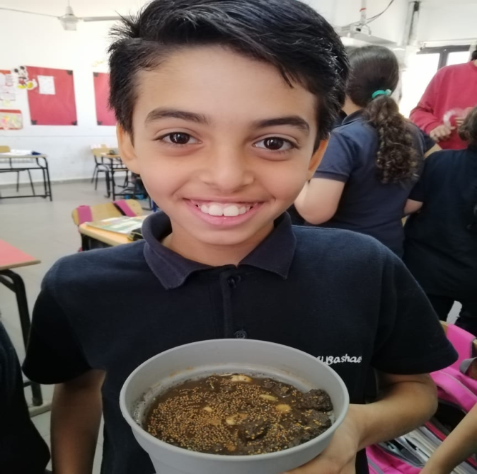
together, proud to announce the role of nature in the race to zero. We need to reach net-zero greenhouse gas emissions by mid-century to keep the global temperature below 1,5°C. While the focus has primarily been on reducing fossil fuel dependency, there is no viable route to limiting global warming and building resilience without urgently protecting, managing, and restoring nature.

Slide 5
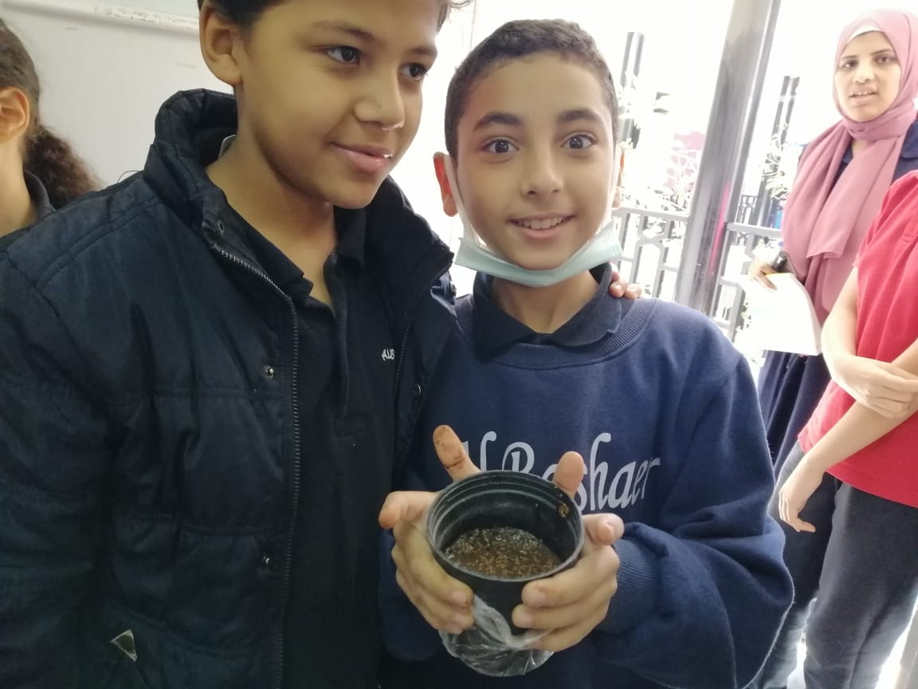

Slide 6
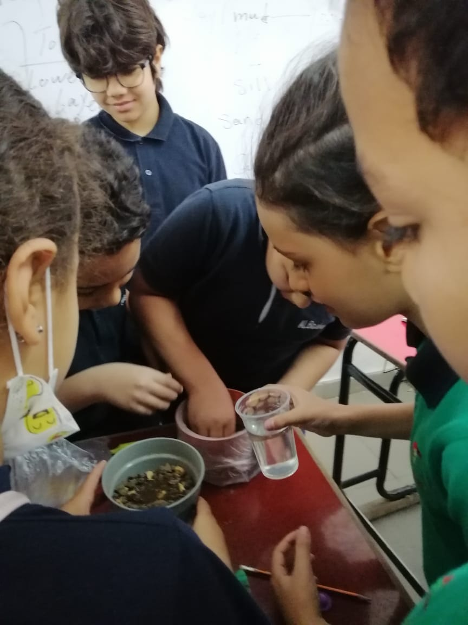

Slide 7
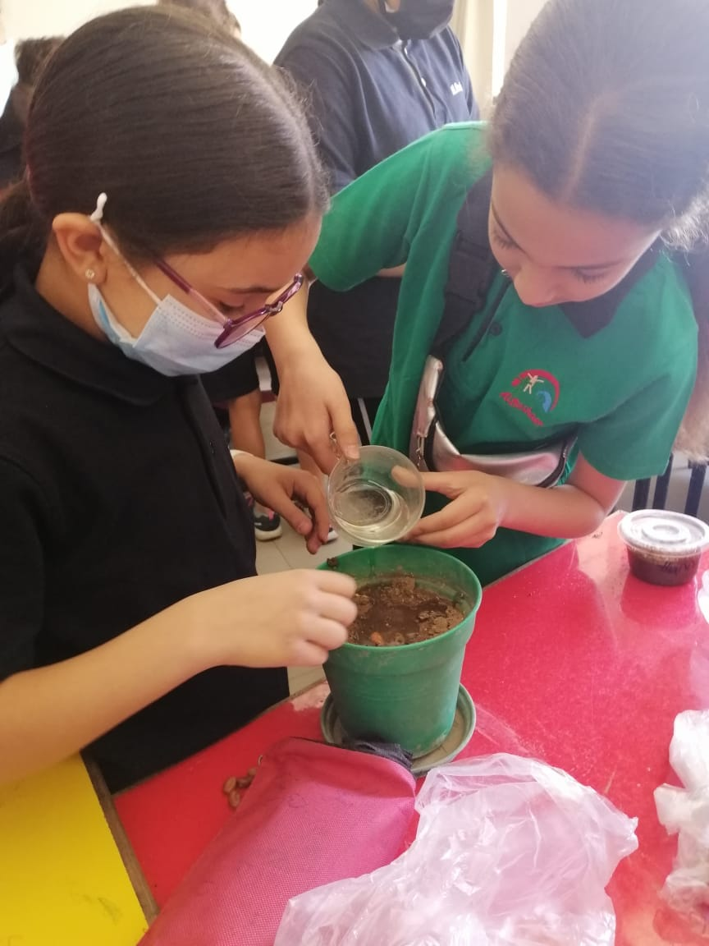

Slide 8
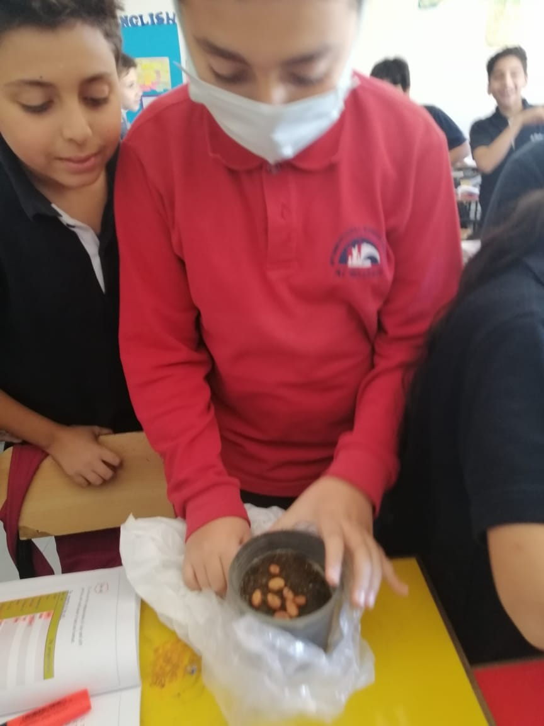

Slide 9
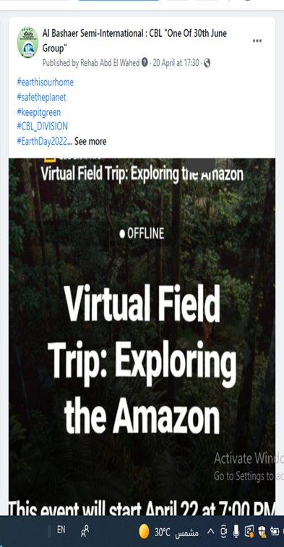
Virtual Field Trip

Slide 10
Maps MUN Global Connection
MUM
Conference

Slide 11
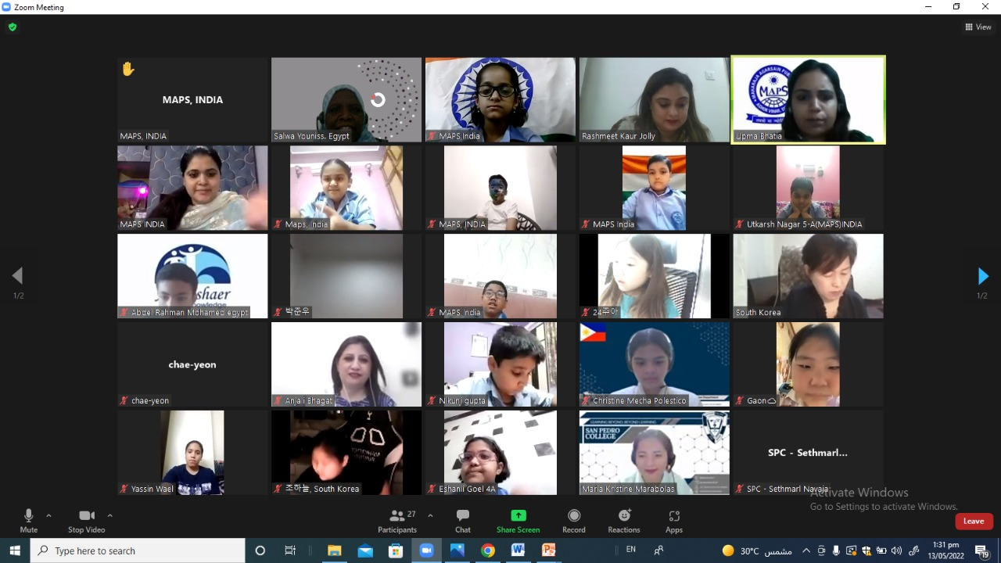

Slide 13
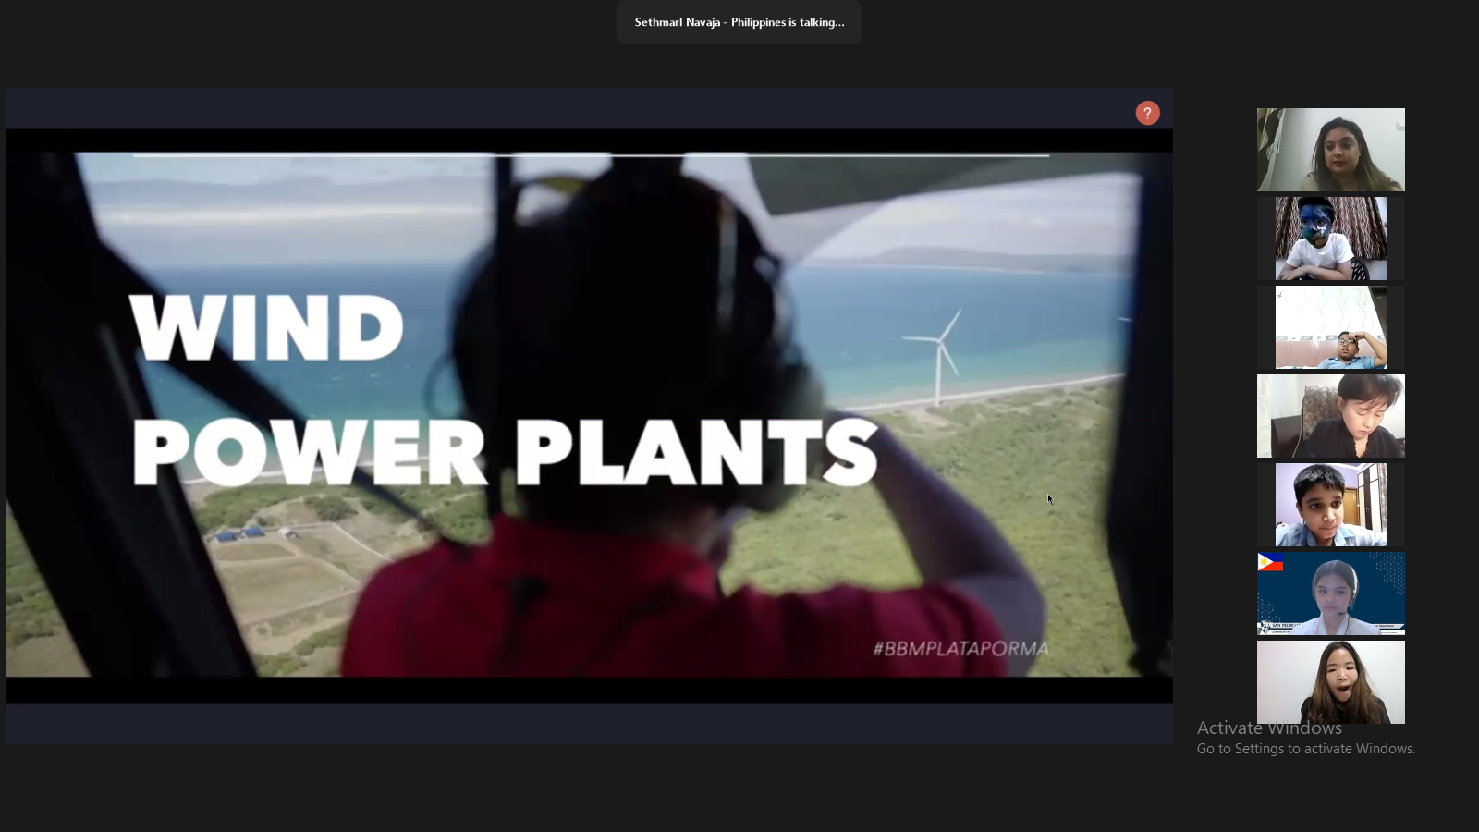

Slide 15
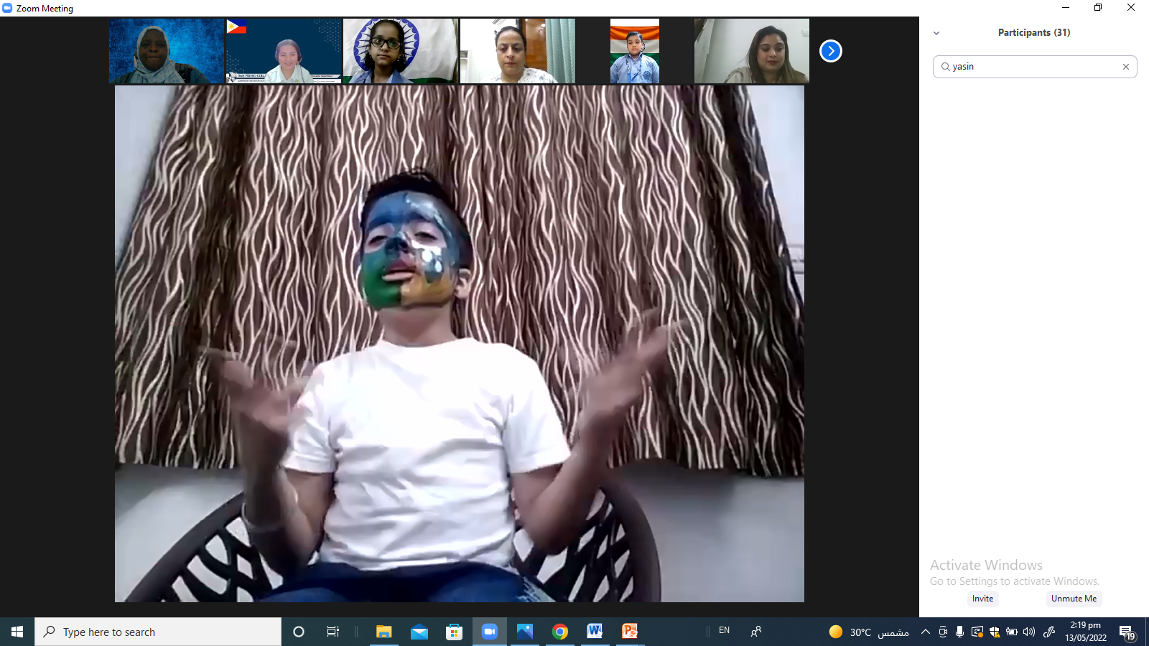

Slide 16
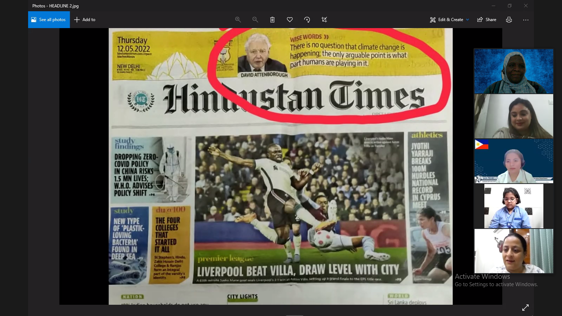

Slide 17
AlBashaer Semi –international
CBL
Thank you

