Slide 1
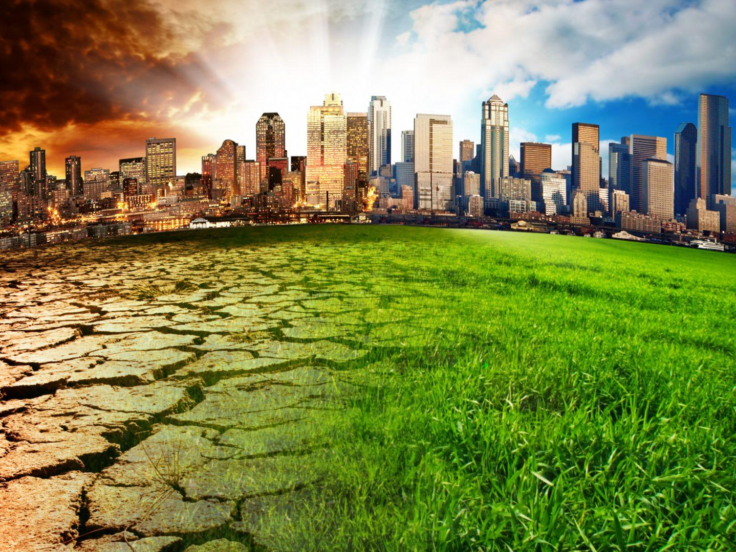
Climate change

Slide 2
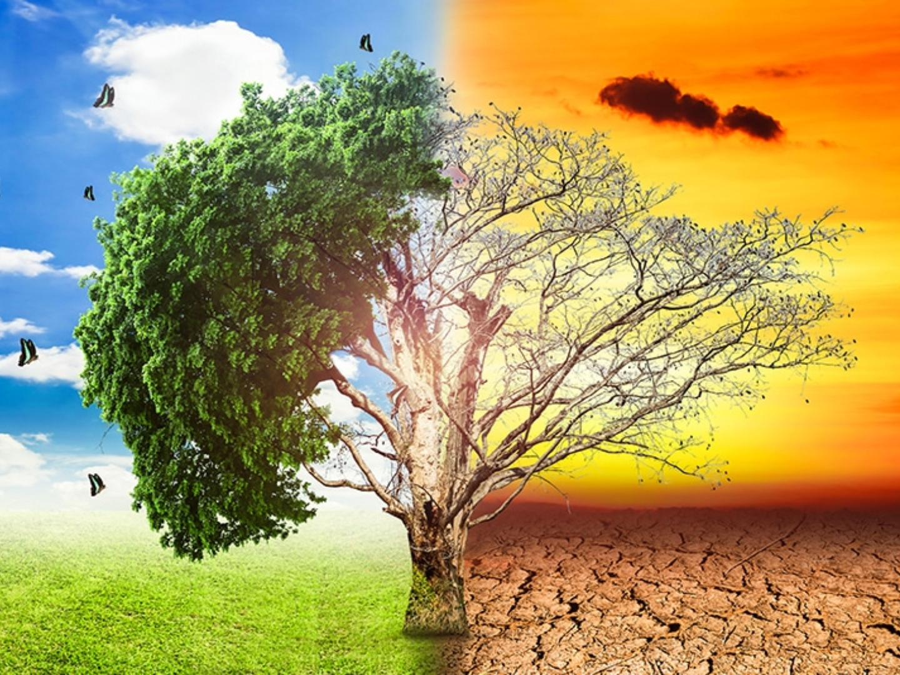
Trees
Trees are one of the major reasons of climate change
These plants help in decreasing the temperature of earth by decreasing the amount of green house gases or carbon dioxide gases
Also they are homes for unlimited amount of creatures
And by chopping trees we increase the percentage of carbon dioxide in air
Which leads to the disaster that we call desertification
Trees are our source of food , if we keep cutting them we may run out of food which will be the disaster that will lead to our end

Slide 3
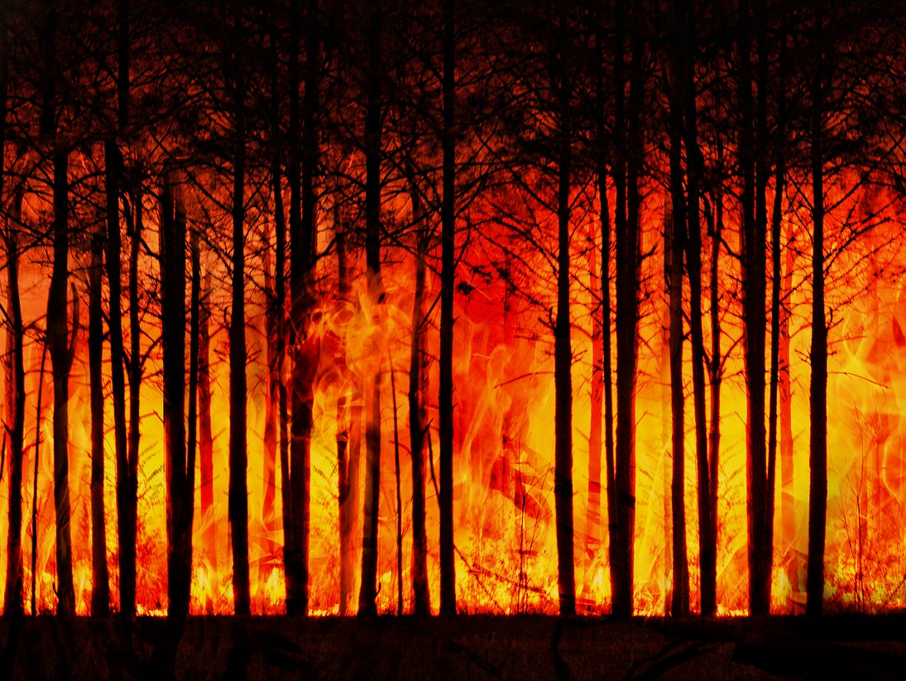
Rather that trees we have natural disasters
The disaster that will happen the most due to climate change is forests burning, and then we will have the other disasters that will increase also by the way which are {hurricanes, tornados, tsunamis, etc……….)
But the problem is that polar regions will suffer increasing in temperature which is absolutely a huge disaster! Huge amounts of ice will melt in the two poles that will lead to the increase in the sea level, and as a consequence the cities at the coasts of seas will be turned into an underwater city which is not fun at all!

Slide 4
But what shall we do?

Slide 5
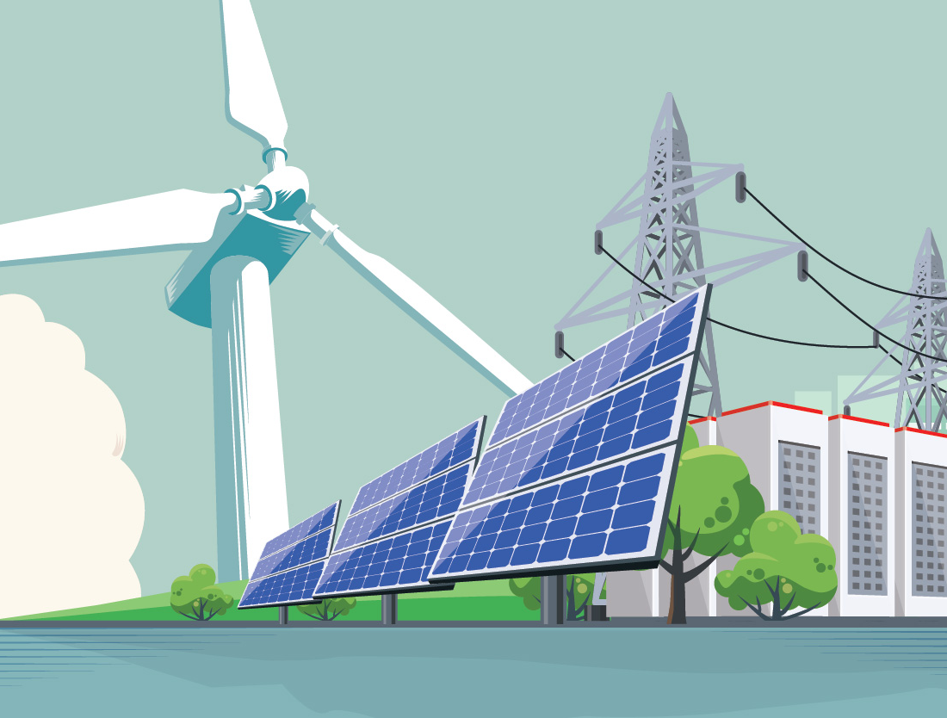
We can help by:
.Power your home with renewable energy
.Speak up! Try to make people do like you
.Get better light bulbs that require less energy .reduce fuel burning (cars, trains, factories, etc….)
.Don’t throw trash in water, it will kill innocent animals

Slide 6
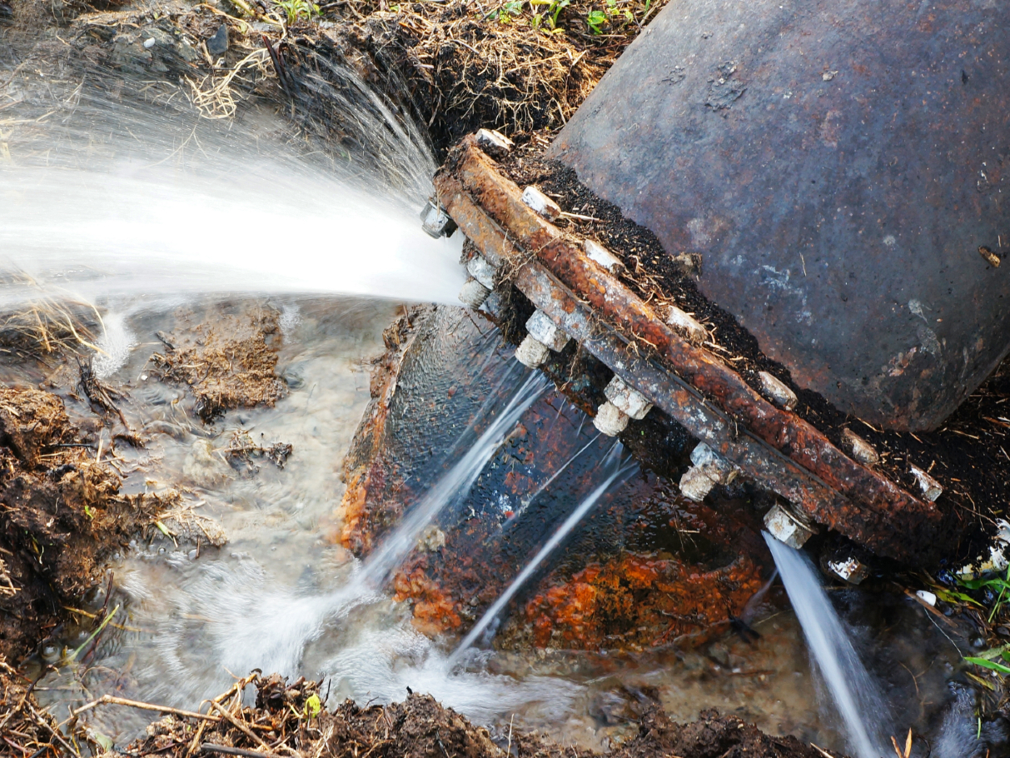
What has Egypt done for climate change?
In October 2020, the World Bank approved a $200 million project for Egypt to improve air quality, combat climate change and reduce emissions of air pollutants and global warming.
And also Egypt has one of the world’s biggest amount solar panels and also has got a lot of wind farms to produce clean and renewable energy
Another thing is that the government invested billions of dollars; To raise the level of power generation capacities in 2018, the Ministry of Electricity and Renewable Energy completed the installation of three modern combined cycle power plants to help reduce fuel burning

Slide 7
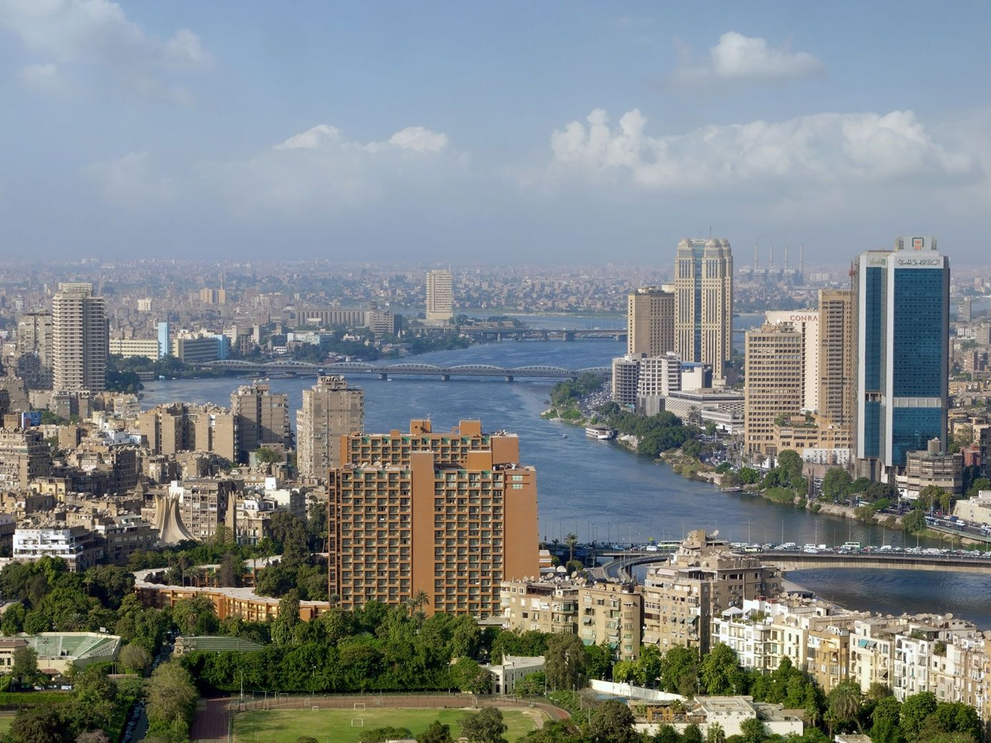
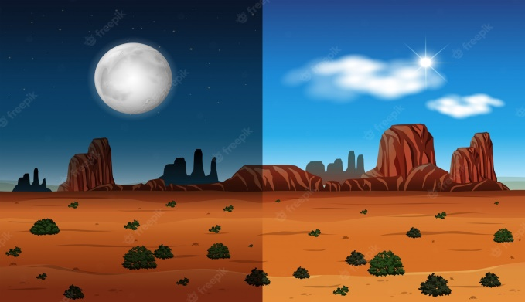
What about Egypt?
What type of climate in Egypt?
Egypt essentially has a hot desert climate (Köppen climate classification BWh). The climate is generally extremely dry all over the country except on the northern Mediterranean coast which receives rainfall in winter.
What is the climate like in Egypt today?
The average annual temperature is 20° C (69° F), reaching an average of 27° C (80° F) in the summer. Temperatures vary widely in the inland desert areas, especially in summer, when they may range from 7° C (44.6° F) at night to 43° C (109° F) during the day

Slide 8
Thanks for your time and attention
Goodbye

