Slide 1
Global issue:
Air pollution in Taiwan

Slide 2
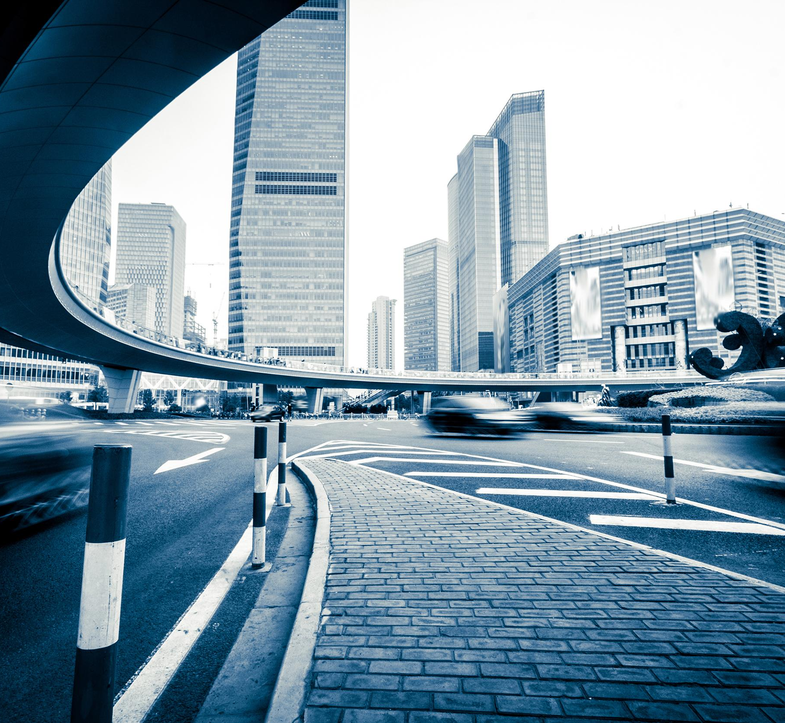
Type of Pollution
PM10
PM2.5
NO₂

Slide 3
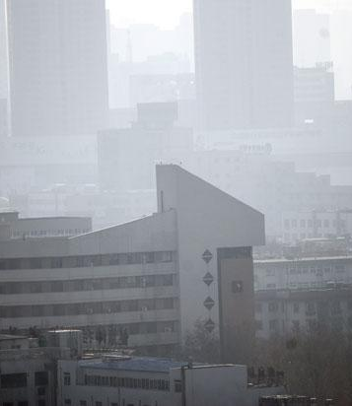
Type of Pollution
PM10&PM2.5
Microscopic particles of solid.They have impacts on climate.It bad for the healthy to breath it.The numbers “10" and “2.5” are their size.

Slide 4
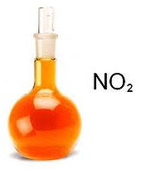
Type of Pollution
NO₂
A reddish-brown gas.It a pollution from the factory or power plant because it is by-product of industrial products.

Slide 5
Source of Pollution
Cross-border pollution from China
The Taichung Power Plant
Religious rituals
Motorcycles

Slide 6
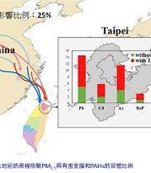
Source of Pollution
Cross-border pollution from China
Air pollutants brought in from China by strong winds in the winter.

Slide 7
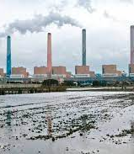
Source of Pollution
The Taichung Power Plant
Taichung Power Plant, emitting large quantities of sulfur oxides.

Slide 8
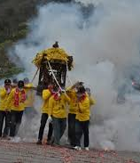
Source of Pollution
Religious rituals
Due to the burning of ghost money and incense, the households of communities with a nearby temple show an increase in PM2.5 particles value.

Slide 9
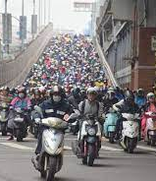
Source of Pollution
Motorcycles
Motorcycles with two-stroke engines were claimed to be the biggest single source of vehicular pollution in Taiwan.

Slide 10
The impact of worsening air pollution in the Taiwan
Improvement of industrial pollution sources
Improvement of mobile pollution sources

Slide 11
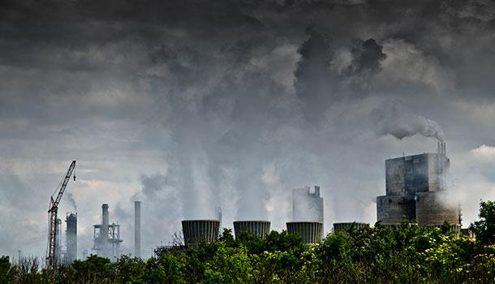
The impact of worsening air pollution in the Taiwan
Improvement of industrial pollution sources
Promote the use of low-pollution clean fuels, the de-service of old high-pollution generator sets, the assembly of air pollution control equipment for natural gas engines, the improvement of the efficiency of air pollution prevention and control of generator sets, and the reduction of load in poor seasons.

Slide 12
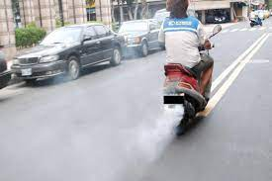
The impact of worsening air pollution in the Taiwan
Improvement of mobile pollution sources
Encourage accelerated phase-out and set up a net air quality area to prohibit or restrict the use of subsidy amounts by reducing the amount of subsidies year by year.

Slide 13
The impact of worsening air pollution on the world:
1,Good health and well-being
2, climate action
3,clean water and sanitation
4, affordable and clean energy
5,zero hunger

Slide 14
Good health and well-being
About 700 causes of death globally each year are related to indoor and outdoor air pollution.

Slide 15
climate action
Some pollutants can exacerbate climate deficits and accelerate Arctic warming and melting glaciers.

Slide 16
clean water and sanitation
Air pollution affects rainfall paths, intensity of storms and regional rainfall.

Slide 17
affordable and clean energy
Dust and smog from air pollution reduces solar energy production by up to 25%.

Slide 18
zero hunger
Air pollution costs global agricultural products 15% of soybean and wheat production, and 5% of corn production.

Slide 19
Thank you for watching

