Slide 1
Poverty and Violence
their effect on the general population

Slide 2
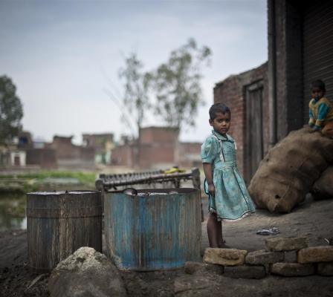
What is poverty?
Poverty is generally defined as “the state of one who lacks a usual or socially acceptable amount of money or material possessions”
Poverty leads to malnutrition as people cannot buy food or water without money. This leads to their desperate turn to crime and leads to a surge in violence
Poverty is caused by various reasons which are going to be explained in the following slides

Slide 3
Causes of Poverty
Individualistic causes
Social Causes
Alcohol and Drug Abuse
Laziness
Poor Money Management
No Self-Improvement if Unskilled
High Taxes
Failure to Provide Good Education
Low Wages/Salaries
Discrimination
Sickness/Handicap

Slide 4
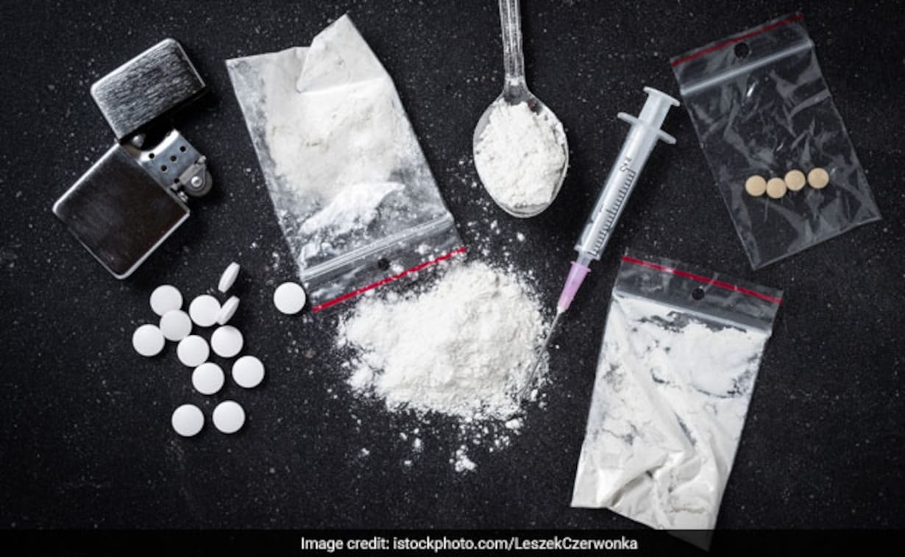
Alcohol and Drug abuse
Alcohol and drugs are highly addictive substances and, once tried, people are tempted to buy more and more of them
This leads to most of their pay going towards alcohol and drugs, until they become poor and are forced to live in poverty

Slide 5
Discrimination & racism
Racism leads to discrimination which affects the chances of people in minorities getting accepted to jobs
This leads to them not having stable income and makes them poor and homeless
Also, discrimination doesn’t only come in the form of racism, it can be in the form of sexism among other forms

Slide 6
High taxes/low income
Sometimes, poverty is not entirely the fault of an individual or a society, but instead is one of the government
This is due to a bad economy and corrupt officials. Corrupt officials want more and more money so they impose high taxes and keep the money that was collected to themselves

Slide 7
How poverty affects the daily lives of people
People living in poverty face various deadly diseases and have lower life expectancies than those of privileged people.
These people become desperate for money and upon not finding jobs, they turn to their last resort, crime
Criminal activities lead to a surge in violence, murder, kidnappings and, generally, death, which affects the lives of all citizens

Slide 8
How to combat poverty

Slide 9
Effective methods to combat poverty
Eradicate corruption
Combat unemployment
Provide free education
Provide free healthcare
Promote equality
Industrial development

Slide 10
Combatting unemployment
Governments can counter this problem by opening up more and more posts
Corporations can also hire more frequently to counter unemployment
Universities should offer scholarships to talented individuals who come from low income families so that they may obtain an education and may get good jobs

Slide 11
Providing Free education
People unfortunate enough to be born in poverty have a high likelihood to not go to school as nowadays many schools’ fees are alarmingly high, and people may not be able to afford an education
Educated people have a higher likelihood to be selected for jobs than those who don’t have an education, especially for skilled jobs (which usually pay more)

Slide 12
What we, as a society, can do to help against poverty
We can donate to local charities to help the people in our neighborhood
We can use social media to promote donations to charities and get the government’s attention so that they, too, may take interest in the campaign to the eradication of poverty

Slide 13
Thank you for reading our presentation

