Slide 1
JUBAIL INTERNATIONAL SCHOOL
SAUDI ARABIA
Prepare By: Wan Ahmad Mikhail

Slide 2
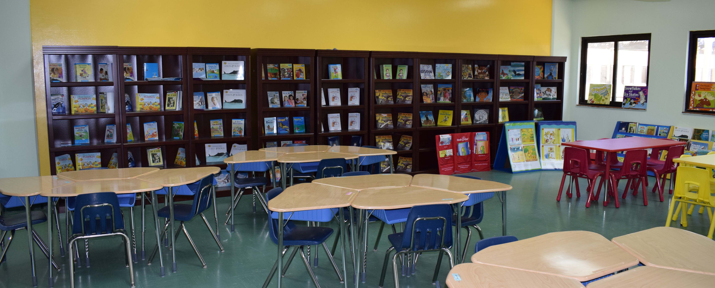
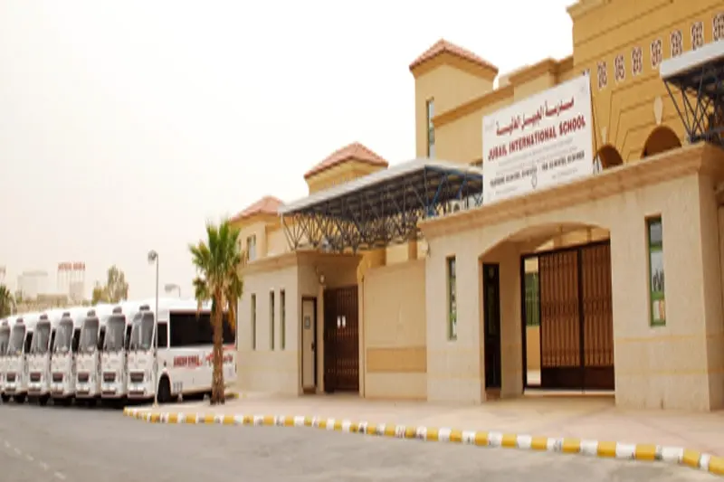
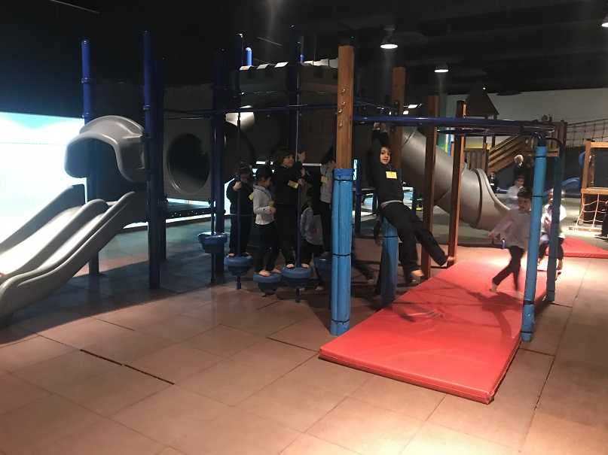
View My School

Slide 3
About My School
Located in the Huwaylat District, in Jubail Industrial City, Saudi Arabia, Jubail International School serves as an ideal site for teaching and learning. Its location offers the community easy access in an area which is a part of the Royal Commission.
The school's location has many advantages. First of all it is located in Royal Commission which is a very secure area with constant surveillance for security with patrol cars etc. It is adjacent to a hospital fully equipped with up to date facilities. The area is clean and is close to a commercial area. It is not on any main road; therefore decreasing the chance of traffic accidents. The school is ideally located near the Beach side which is helpful while doing ecosystem studies.
The school itself is housed on a 19700 sqm plot of land. Jubail international School opened in 1999.It was originally located on much smaller premises. It was a coeducation school system. In 2009 by the decree of the Ministry of Education, it was separated into two separate locations, boys sections' and girls' section. Over time, the number of students increased and the then existing premises was deemed inadequate. Construction of a new building was an essential part of School's progressive plan and its mission and vision. Hence a new building was constructed just for the purpose of housing a school, and we moved in it in January 2011.
The Jubail International School is housed in a new purpose-built centrally air-conditioned campus. It opened its doors to the students, staff and parents on the 7th of January, 2011. The students, parents and our staff had been anxiously waiting for the new campus which offers a safe and stimulating environment to about 1300 students at present. The school has three sections, with separate entrances, for Boys' Section, Girls' Section and one for Administration Offices.
A well-maintained school building is essential for a proper learning environment. Our new building has large, shared work spaces as well as classrooms that are equipped with latest technology like projectors. The building contains four fully-equipped science laboratories, two rooms for art and design, two clinics, two laboratories for information and computer technology, two spacious libraries, four covered play areas, two canteens, two gymnasiums and an outside sports area. Thus, the school is purpose built with teaching and learning concepts in mind. The new building was inspected by Royal Commission of Jubail and Yanbu, Ministry of Education and Fire & Safety Department and was found to be meeting, and in some instances exceeding, their standards. The girl's gymnasium has a stage, electronically operated stage curtains and a state of the art music/sound system. It provides the perfect setting for various activities and events like Graduation Ceremonies of Reception and Grade 12.
At Jubail International School, the co-operation and camaraderie among all stakeholders has been a significant factor for its success. The responses we have received are very favorable and there is an overwhelming positive view of the school premises as parents are very happy with facilities. The resources and facilities at the school provide ideal learning opportunities to students.

Slide 4
Why I like my school?..
I starting school at JIS from KG3 until now Grade 2.
I like school here because I can get many friends from others countries.
I like Math subject.
I like my school because my teachers are very kind to me.
I have a lot of friends in my school.
My school has a very big playground, I play with my friends in it.

