Slide 1
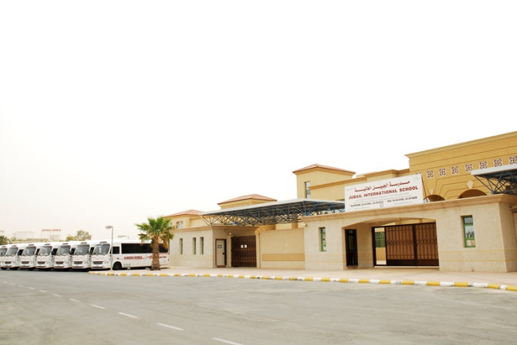
My school special and unique
Hossam A. Omar

Slide 2
Location The location offers the community easy access in an area which is a part of the Royal Commission. The school's location has many advantages. a very secure area with constant surveillance for security with patrol cars etc. adjacent to a hospital fully equipped with up to date facilities. The area is clean and is close to a commercial area. It is not on any main road; therefore decreasing the chance of traffic accidents. The school is ideally located near the Beach side which is helpful while doing ecosystem studies
Hossam A. Omar

Slide 3
My School
large, shared work spaces as well as classrooms that are equipped with latest technology
four fully-equipped science laboratories,
two rooms for art and design,
two clinics,
two laboratories for information and computer technology,
two spacious libraries,
four covered play areas,
two canteens,
two gymnasiums and an outside sports area.
The girl's gymnasium has a stage, electronically operated stage curtains and a state of the art music/sound system.
It provides the perfect setting for various activities and events like Graduation Ceremonies of Reception and Grade 12.
The classrooms are spacious and can accommodate 20 to 25 students comfortably.
Hossam A. Omar

Slide 4
In 1999. Jubail International School (JIS) was established in Jubail Industrial City. It was our second International School, which consists of separate Boys and Girls sections
Hossam A. Omar

Slide 5
School Facility
Hossam A. Omar

Slide 6
School ACTIVITY
Hossam A. Omar

Slide 7
Graduation Day
Hossam A. Omar

Slide 8
Thank you
Hossam A. Omar

