Slide 1
What makes your school special and unique ?
By Antony Mikhael
Grade 2-O

Slide 2
History of Al-Hussan Education
The tradition of Al-Hussan Education in Saudi Arabia began in 1956 when Sheikh Abdel Aziz Rashid Al-Hussan started the Arab Cultural Institute for Adult Education. In the following year Al-Hussan Modern Girls School, the first girls’ school in the Eastern Province of Saudi Arabia was opened. Today there are nineteen schools and other educational institutes throughout the Eastern Province rated among the best in Saudi Arabia, with enrolment of over 10,000 students.
Today his son Rashid Abdel Aziz Al-Hussan is the president of the Al-Hussan Group of Companies continuing his father’s vision of ‘Education for All’. The Al-Hussan International Schools are the most recent addition to the organization and although young in age they have grown steadily.

Slide 3
Eastern Province
Our first International School, Al-Hussan International School Khobar (AHISK) is located in the Eastern Province of Saudi Arabia and was opened in September 1998. It has two separate section for Boys and Girls on the same campus; however, the pre-school which is at a separate location is in the same vicinity. A year later, Jubail International School (JIS) was established in Jubail Industrial City. It was our second International School, which consists of separate Boys and Girls sections. In June 2006, Orbit International School (OIS), the third International School was added to the group with separate boys and girls sections. In the Eastern Province our fourth International School, Al-Hussan International Grammar School (AHIGS) was added to the group on August 23, 2015.

Slide 4
Central Province (Riyadh)
Carrying the vision forward, Al-Hussan Education launched “Al-Hussan International School –Riyadh (AHISR)’ in the Central Province. AHISR is housed on a new purpose-built air-conditioned campus. It opened its doors to the students, staff and parents in 2011. The school has four sections, with separate entrances for Boys Section, Girls Section, Pre School and for the Administration Offices.

Slide 5
Western Province (Yanbu)
The Al-Hussan Education further spread its wings into the Western Province due to huge demand by the communities in Yanbu. Al-Hussan International School –Yanbu (AHISY); is the latest addition to the Al-Hussan International Schools Group opened on September 18, 2016.
Al-Hussan International Schools are English medium day schools, catering to the educational needs of students from Kindergarten to Grade 12.

Slide 6
Al Hussan International School( my school ) Located in the Huwaylat District, in Jubail Industrial City, Saudi Arabia, Jubail International School serves as an ideal site for teaching and learning. Its location offers the community easy access in an area which is a part of the Royal Commission. The school's location has many advantages. First of all it is located in Royal Commission which is a very secure area with constant surveillance for security with patrol cars etc. It is adjacent to a hospital fully equipped with up to date facilities. The area is clean and is close to a commercial area. It is not on any main road; therefore decreasing the chance of traffic accidents. The school is ideally located near the Beach side which is helpful while doing ecosystem studies. The school itself is housed on a 19700 sqm plot of land. Jubail international School opened in 1999.It was originally located on much smaller premises. It was a coeducation school system. In 2009 by the decree of the Ministry of Education, it was separated into two separate locations, boys sections' and girls' section.

Slide 7
Over time, the number of students increased and the then existing premises was deemed inadequate. Construction of a new building was an essential part of School's progressive plan and its mission and vision. Hence a new building was constructed just for the purpose of housing a school, and we moved in it in January 2011. The Jubail International School is housed in a new purpose-built centrally air-conditioned campus. It opened its doors to the students, staff and parents on the 7th of January, 2011. The students, parents and our staff had been anxiously waiting for the new campus which offers a safe and stimulating environment to about 1300 students at present. The school has three sections, with separate entrances, for Boys' Section, Girls' Section and one for Administration Offices. A well-maintained school building is essential for a proper learning environment. Our new building has large, shared work spaces as well as classrooms that are equipped with latest technology like projectors. The building contains four fully-equipped science laboratories, two rooms for art and design, two clinics, two laboratories for information and computer technology, two spacious libraries, four covered play areas, two canteens, two gymnasiums and an outside sports area.

Slide 8
Thus, the school is purpose built with teaching and learning concepts in mind. The new building was inspected by Royal Commission of Jubail and Yanbu, Ministry of Education and Fire & Safety Department and was found to be meeting, and in some instances exceeding, their standards. The girl's gymnasium has a stage, electronically operated stage curtains and a state of the art music/sound system. It provides the perfect setting for various activities and events like Graduation Ceremonies of Reception and Grade 12. At Jubail International School, the co-operation and camaraderie among all stakeholders has been a significant factor for its success. The responses we have received are very favorable and there is an overwhelming positive view of the school premises as parents are very happy with facilities. The resources and facilities at the school provide ideal learning opportunities to students. Some of these facilities are mentioned below:

Slide 9
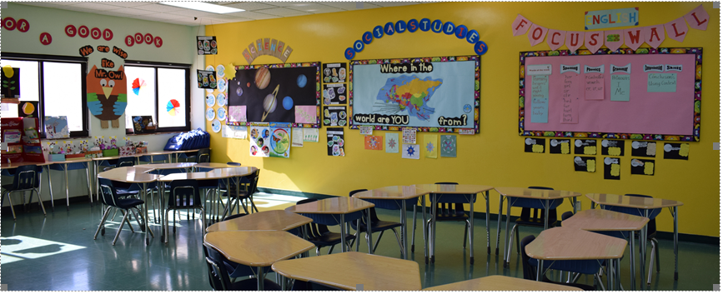
Classrooms:
The classrooms are spacious and can accommodate 20 to 25 students comfortably. Each classroom has a built in infra structure for technology as well as a white board, which can be easily transformed into a "smart board" with the help of Mimeo technology. Interactive teaching is made possible with these technologies.

Slide 10
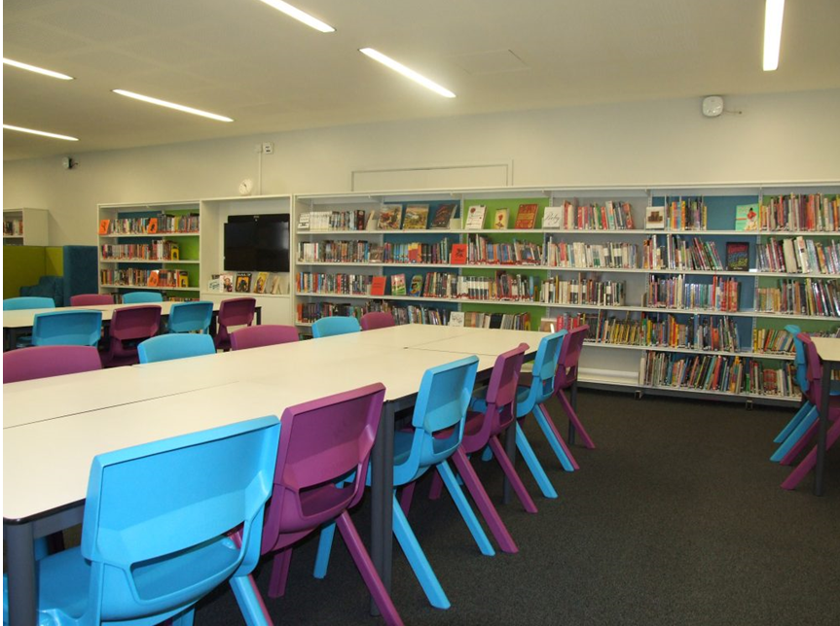
School Libraries:
The school has two well-established and modern libraries which house an array of books suitable for all age groups and provide a serene atmosphere for reading, with quick and easy Internet access. These air-conditioned libraries carry more than 7000 books on a variety of subjects and topics.

Slide 11
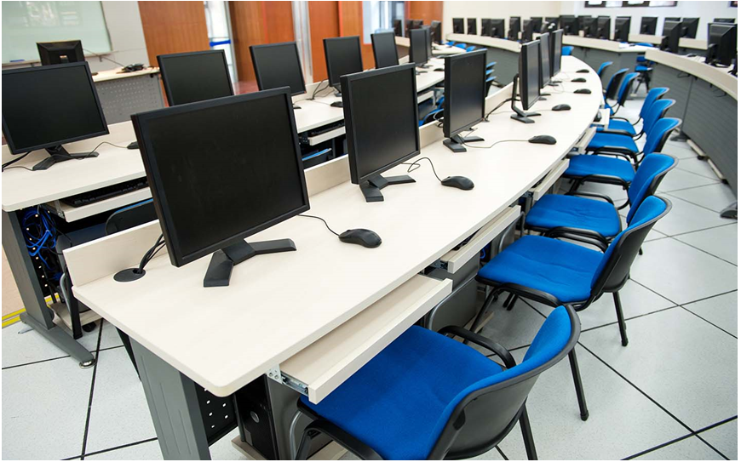
Computer Laboratories:
The school has two fully equipped computer laboratories; each lab offers the students an access to audio-visual and printing facilities. Medical Services: Two full-time registered nurses provide first aid treatment and maintain students' health records.

Slide 12
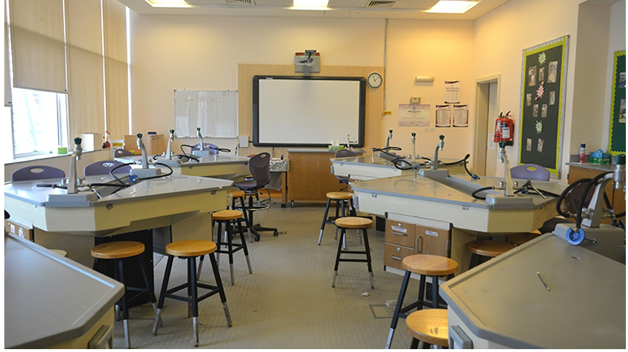
Science Laboratories:
For students to clearly develop and understand scientific concepts, it is essential to practically experiment whenever required. The school has 4 adequately equipped science laboratories with essential apparatus, chemicals and required instruments for Biology, Physics and Chemistry experiments.

Slide 13
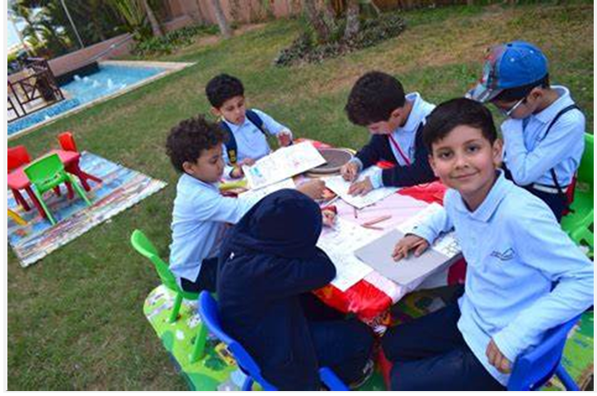
Art:
The school's well-equipped art rooms provide the environment where students are facilitated to show their creativity through different mediums of expressions.

Slide 14
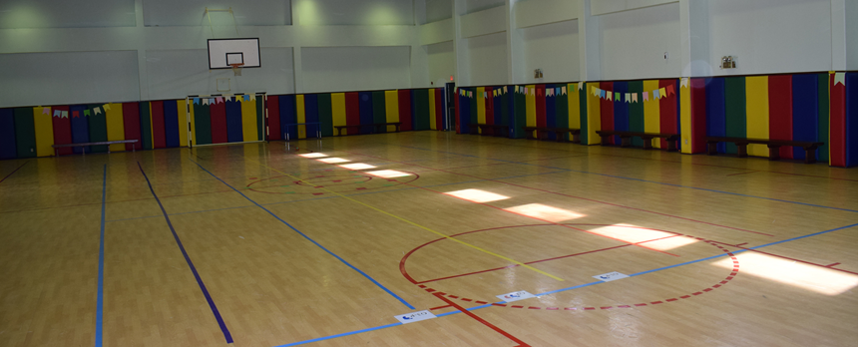
Sports Facilities:
At the school, sport is an integral part of school activities, supported by necessary resources. JIS is equipped with two gyms, which are used for various sporting and cultural activities. There are separate courts for basketball and volleyball as well. Among the indoor games, table tennis and badminton facilities are available. Qualified, male and female, physical training instructors supervise students' physical training and all classes have regular sports periods during the week.
Jubail International Schools is accredited by CIS and AdvancED.

Slide 15
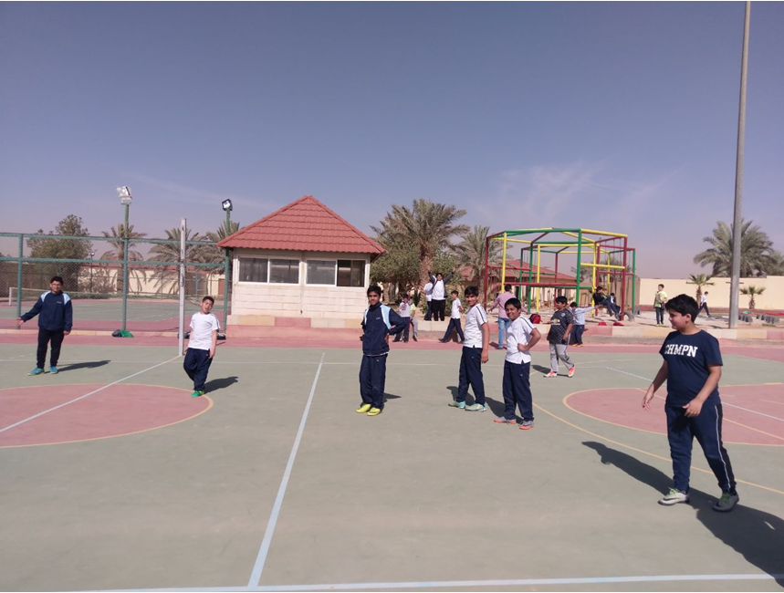
Because of all these reasons my school is special and unique .
I love my school as I spend good times in it , it’s my second home .

