Slide 1
Computer Chronicles - “Places and Perspectives” Learning Circle The Heroes of the Pandemic
“Petru Movila” Lyceum
Chisinau, Moldova
January to May, 2021

Slide 2
What Does It Mean To Be A Hero?
What does it mean to be a hero? What does it take to help
those in need, the poor and at-risk communities, those who
are most vulnerable when a disaster strike? Why should we
hold up as heroic the deeds of those who everyday continue
to extend a helping hand? We think If there’s ever been a time that we need heroes, it’s
now. The COVID-19 pandemic has created unprecedented
health and economic challenges, especially for the most
vulnerable among us. The good news is that many people
from all walks of life are doing their part to help them.
Doctors and nurses. Taxi drivers. Teachers. Farmers. Priests.
We think it would be right to call them heroes, because it is they, who despite the risks, continue to work every day. Their efforts must not be forgotten.

Slide 3
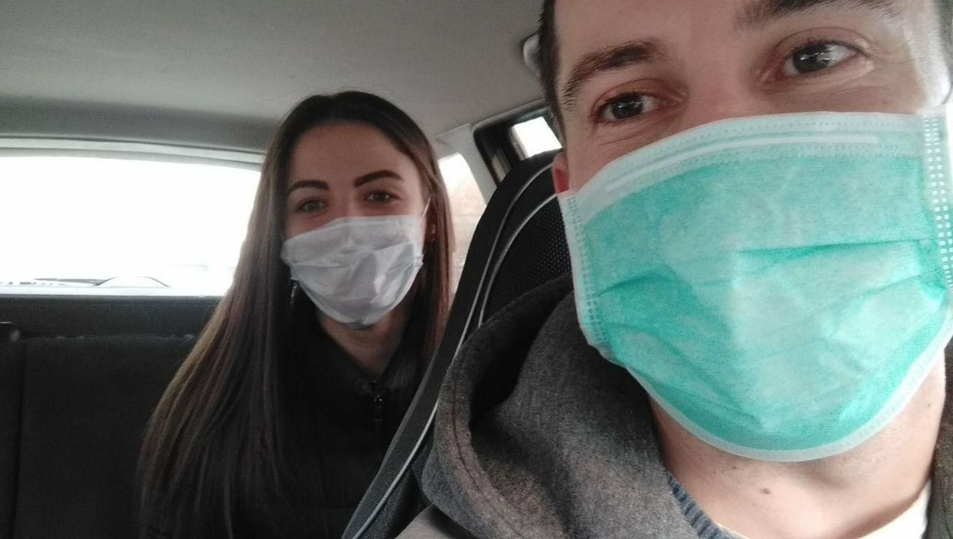
The Heroes Of The Pandemic
An ordinary driver thought that the pandemic would bring him more orders, but then he realized that there were fewer passengers, and the traffic in the city decreased significantly, that the pandemic was not a joke. Ion Mirza (33 years old) is a taxi driver who works in Chisinau and lives with his family in the village of Vesieni. He raises two children, 8 and 12 years old. They had to observe the regime of self-isolation and not leave the house.
"Neither my wife nor I could leave the house,
so we had to give up work temporarily. Friends
constantly brought food and even water from
the well. It turns out that thanks to them, we
were able to survive this period of quarantine,”
says the driver.
Perhaps this help turned out to be the same
boomerang that always returns. Now Ion Mirza
is one of the taxi drivers who provide free rides to
doctors on the front lines of the fight against the
pandemic. Daria Beleva,
“Petru Movila” Lyceum
Chisinau, Moldova

Slide 4
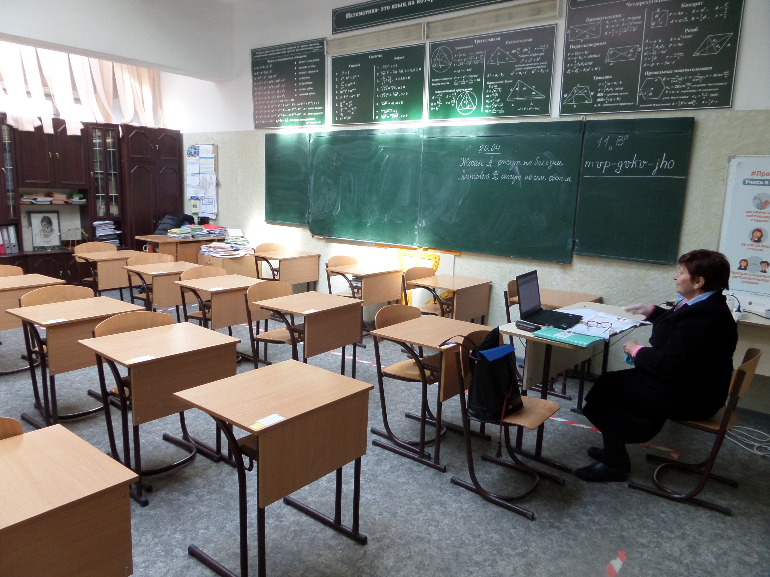
The Heroes Of The Pandemic
2020 and 2021 have become years of resilience and solidarity, full of challenges from the COVID-19 pandemic. The further work of schools in the distance mode threatens a catastrophic drop in the level of education. Teachers, who are studying information
technology day and night to provide children with education,
have come to the rescue. The coronavirus pandemic has
shown how important the profession of a teacher is. The
teacher, however, has always been an enlightener. No matter
how much teachers are criticized, no matter how many "stones
are thrown at them," a teacher is still a teacher facing a serious
task - to educate people. Our teachers have become heroes not
only teaching us, but proved themselves as true citizens and
patriots who fight for health. Having shown they are not
indifferent, the teachers of “Petru Movila” Lyceum donated one
day wages to the city's health care fund. It has become the
norm for them to treat their students and one another with maximum empathy, acceptance, love.
Daria Beleva,
“Petru Movila” Lyceum
Chisinau, Moldova

Slide 5
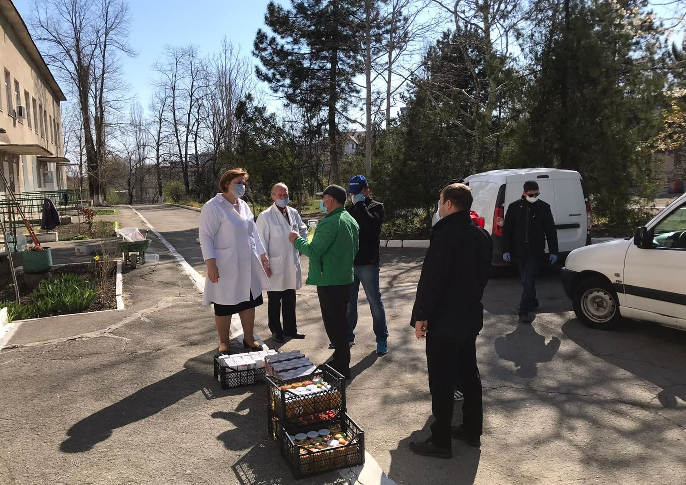
The Heroes Of The Pandemic
Domestic honey producers have become ones of those who have joined in the measures to help
doctors working in dangerous conditions in the fight against
coronavirus. The desire to provide assistance appeared
when it became clear that the spread of the coronavirus was
a serious matter, and this problem could not be simply
dismissed, besides, the state's resources were limited.
«Initiatives to help physicians have merged in some places
almost at the same time. Several organizations, including
Regina Naturii, Asociatiei Apis Mellifera (Kalarash Honey
Producers Association), Aromeda, promptly collected and
delivered several hundred kilograms of natural honey - an
extremely important product for health, as well as tea made
from natural herbs. The natural products were sent to the “Toma Chorbe” Clinical Hospital for Infectious Diseases, “St. Michael the Archangel” Municipal Clinical Hospital, and the Municipal Children's Clinical Infectious Disease Hospital», - reports Sputnik Moldova.
Daria Beleva,
“Petru Movila” Lyceum
Chisinau, Moldova

Slide 6
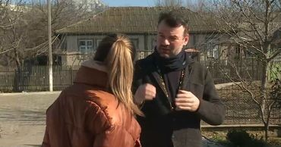
The Heroes Of The Pandemic
Priests and parish communities in Moldova support people in self-isolation, lonely old people, single mothers with a large number of children, pregnant women, large families with limited material
resources and other vulnerable people. "Within the framework of the
"Table of Joy" program more than 50 tons of food were received as a
gift in just one day, and in total during this period we distributed food
to those in need in the amount of 20 thousand euros," said the
secretary of the Bessarabian Metropolitanate Andrey Buklish. The
Balti diocese raised money for a clinical hospital and bacteriological
laboratory in Balti, as well as for a medical clinic in Glodeni. In total –
45 thousand lei. "And the southernmost diocese collected about 450 thousand lei, as well as sanitary-hygienic and food products ", - said Buklish. According to the Bishop of Soroki Ioann Mosnegutsu, priests help people in need with food: "Every day they bring food and hygiene products to the elderly and lonely people, families with little income". Through the site "Antivirus of Mercy" the Church of St. Nicholas in Vicenza (Italy) belonging to the Russian Orthodox Church collected five thousand dollars. With this money they bought food sets which included rice, buckwheat, sunflower oil, tinned food - in total 18 types of products.
Daria Beleva,
“Petru Movila” Lyceum,
Chisinau, Moldova

Slide 7
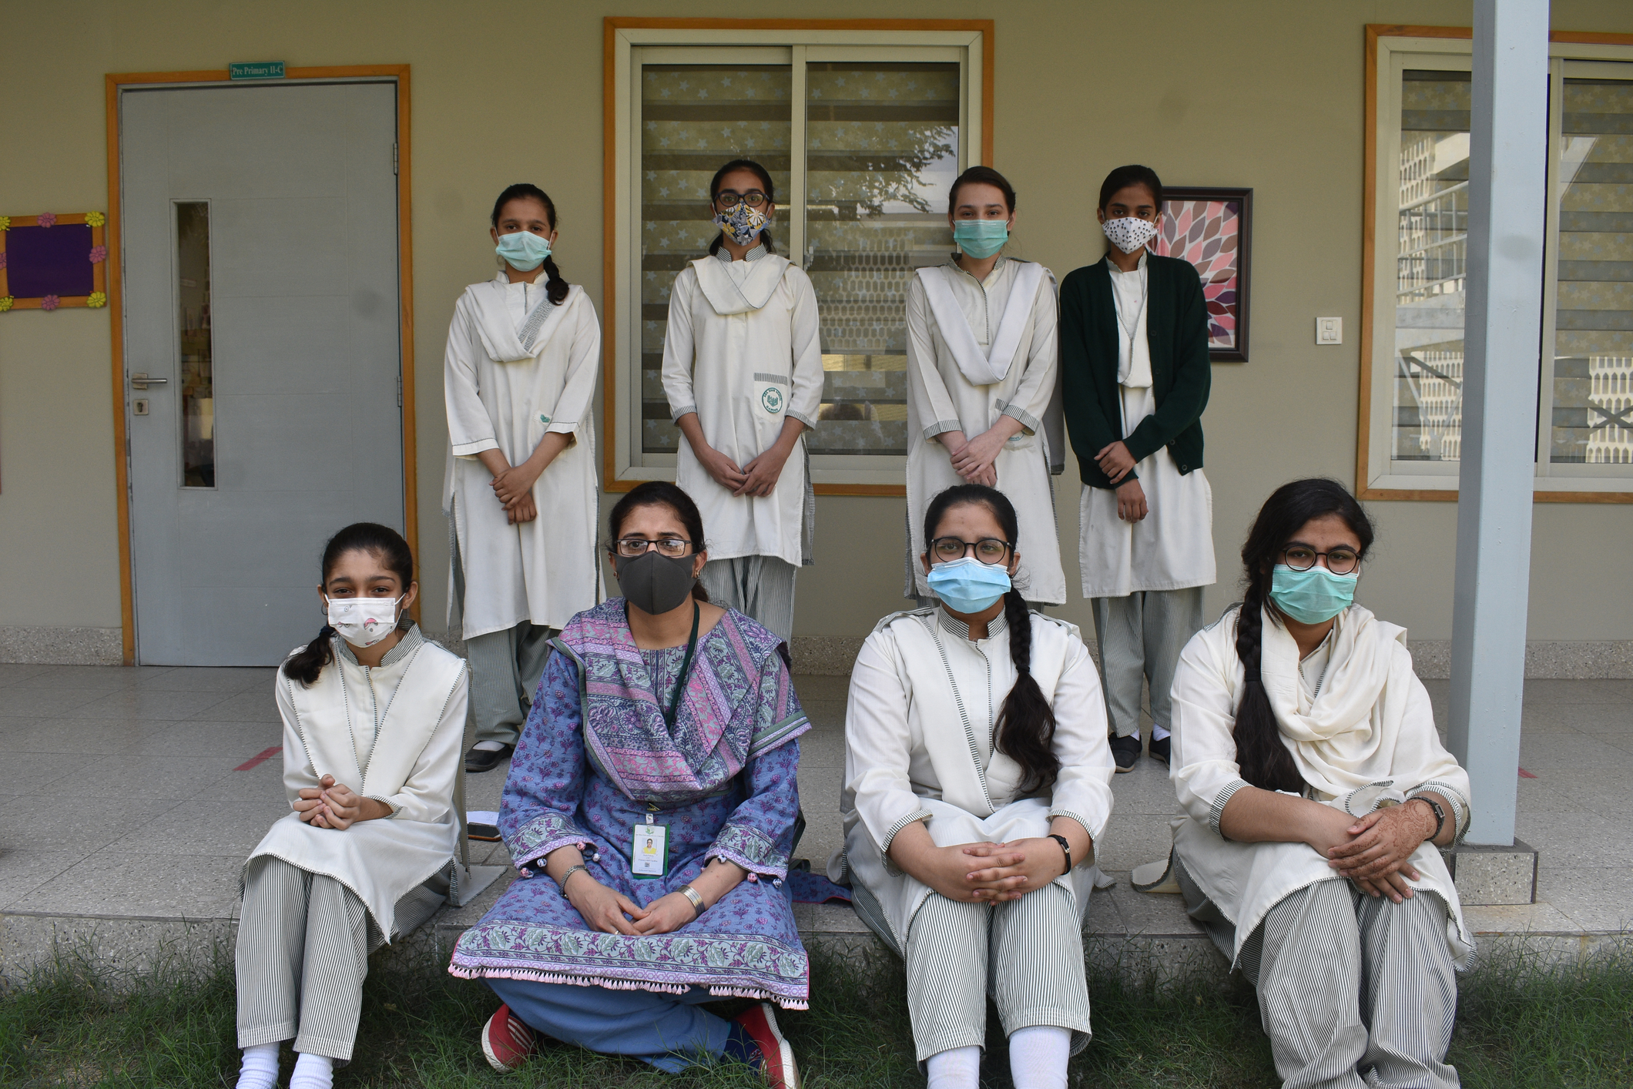
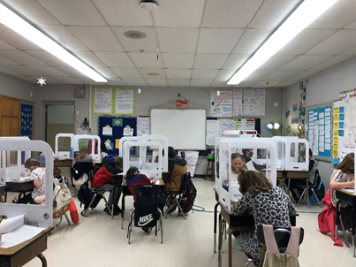
The Way Schools Do Things
Daisy Elementary School, TN, the USA Aga Khan School, Karachi, Pakistan
Grade 3 class with Dividers for covid 19 protection.
There is a film between the sides of the dividers
for students safety.

Slide 8
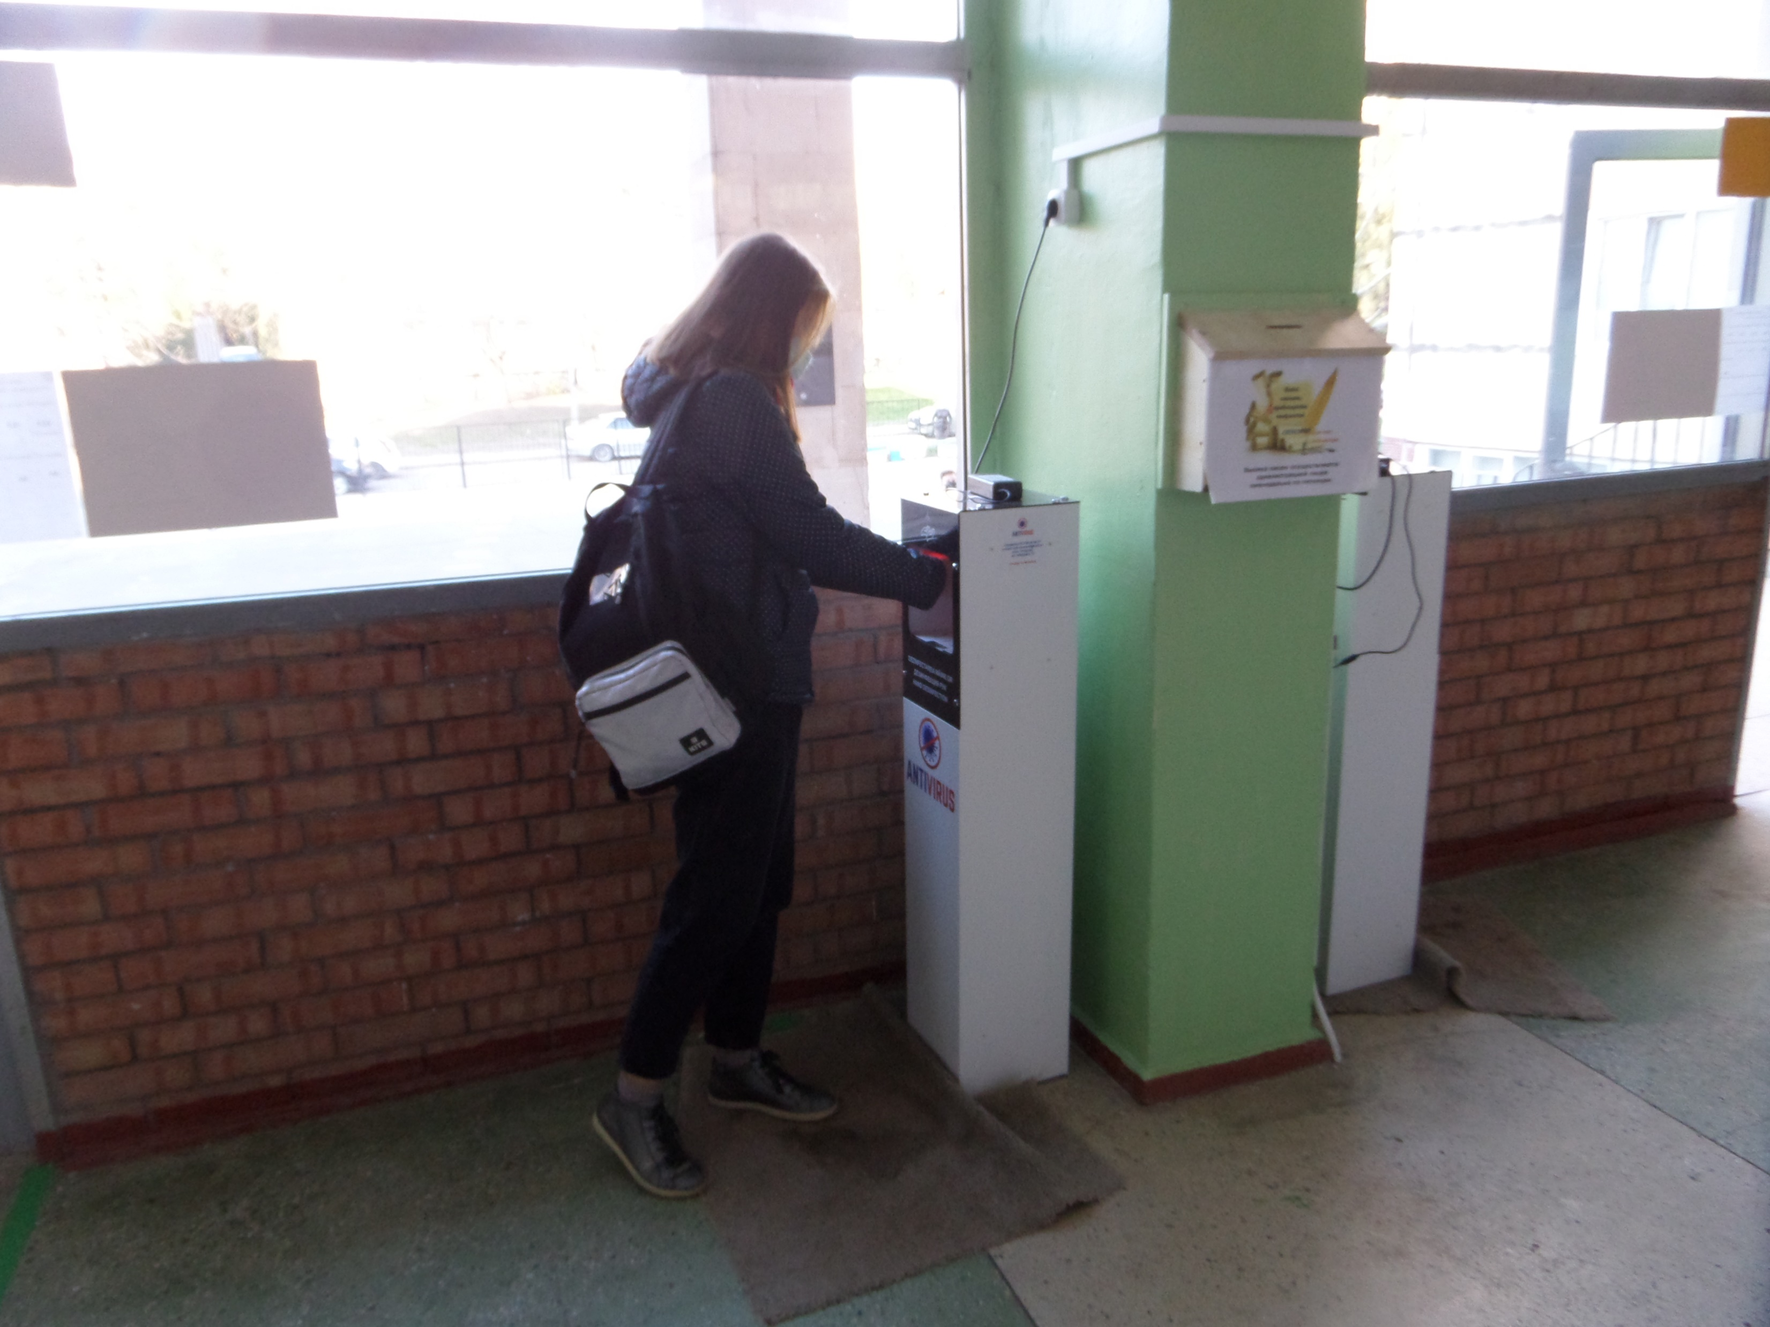
The Way Schools Do Things
"Petru Movila" Lyceum, Chisinau, Moldova
"Petru Movila" Lyceum, Chisinau, Moldova

Slide 9
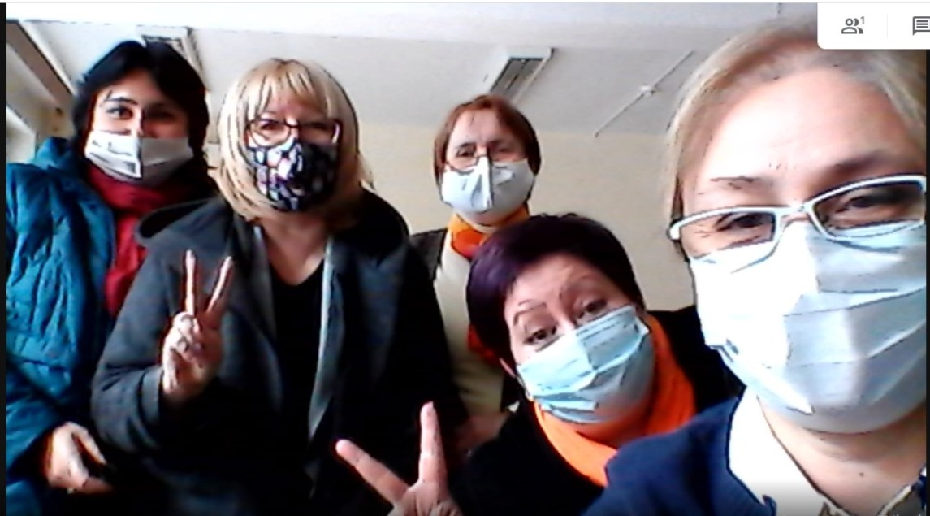
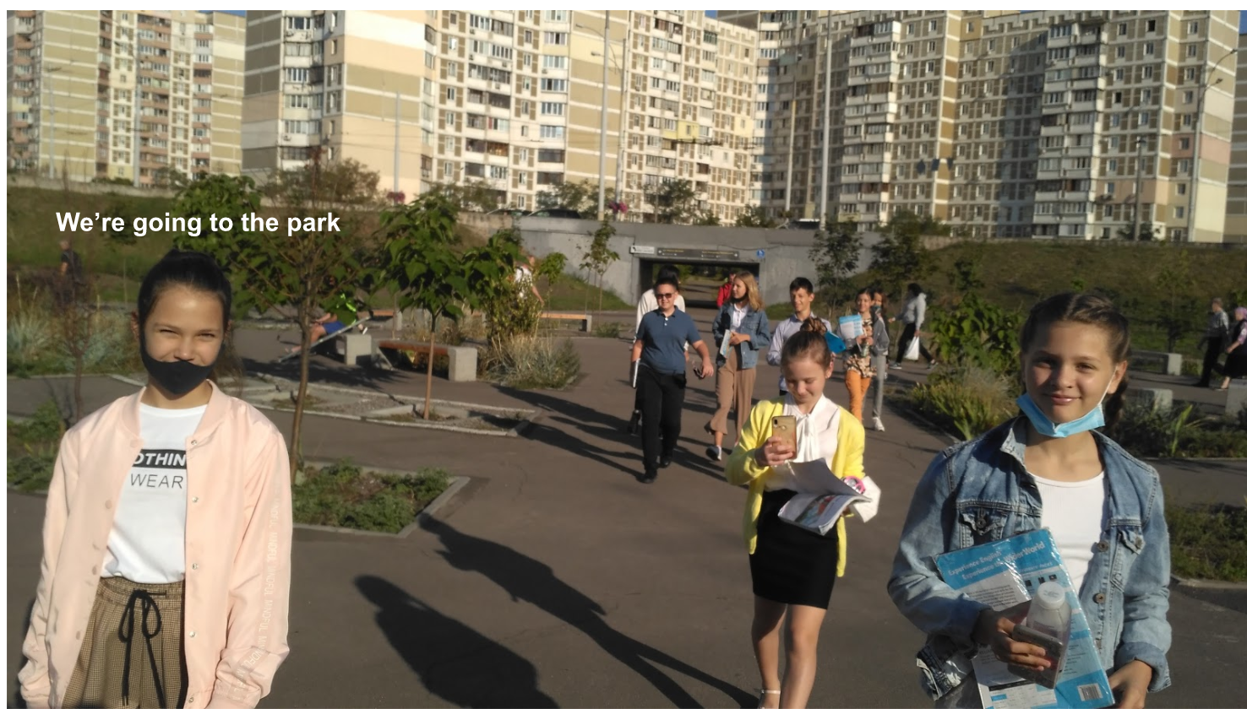
The Way Schools Do Things
Troyeshchyna Gymnasium, Kiev, Ukraine
"Petru Movila" Lyceum, Chisinau, Moldova

Slide 10
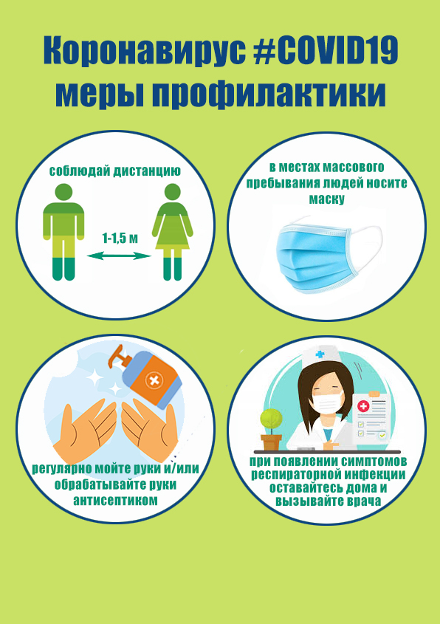
The Way Schools Do Things
“There are some differences in Belarus with Covid-19 than in other countries. For example, we go to schools, to the kindergartens, we can visit the doctors, some
entertainments, but with the following of some measures:
we have to wear mask, use antiseptic, keep the distance 1 – 1,5
meters”.
Pavlov Matvei,
Gymnasia № 1,
Starye Dorogi, Belarus

Slide 11
What We Have Learned

Slide 12
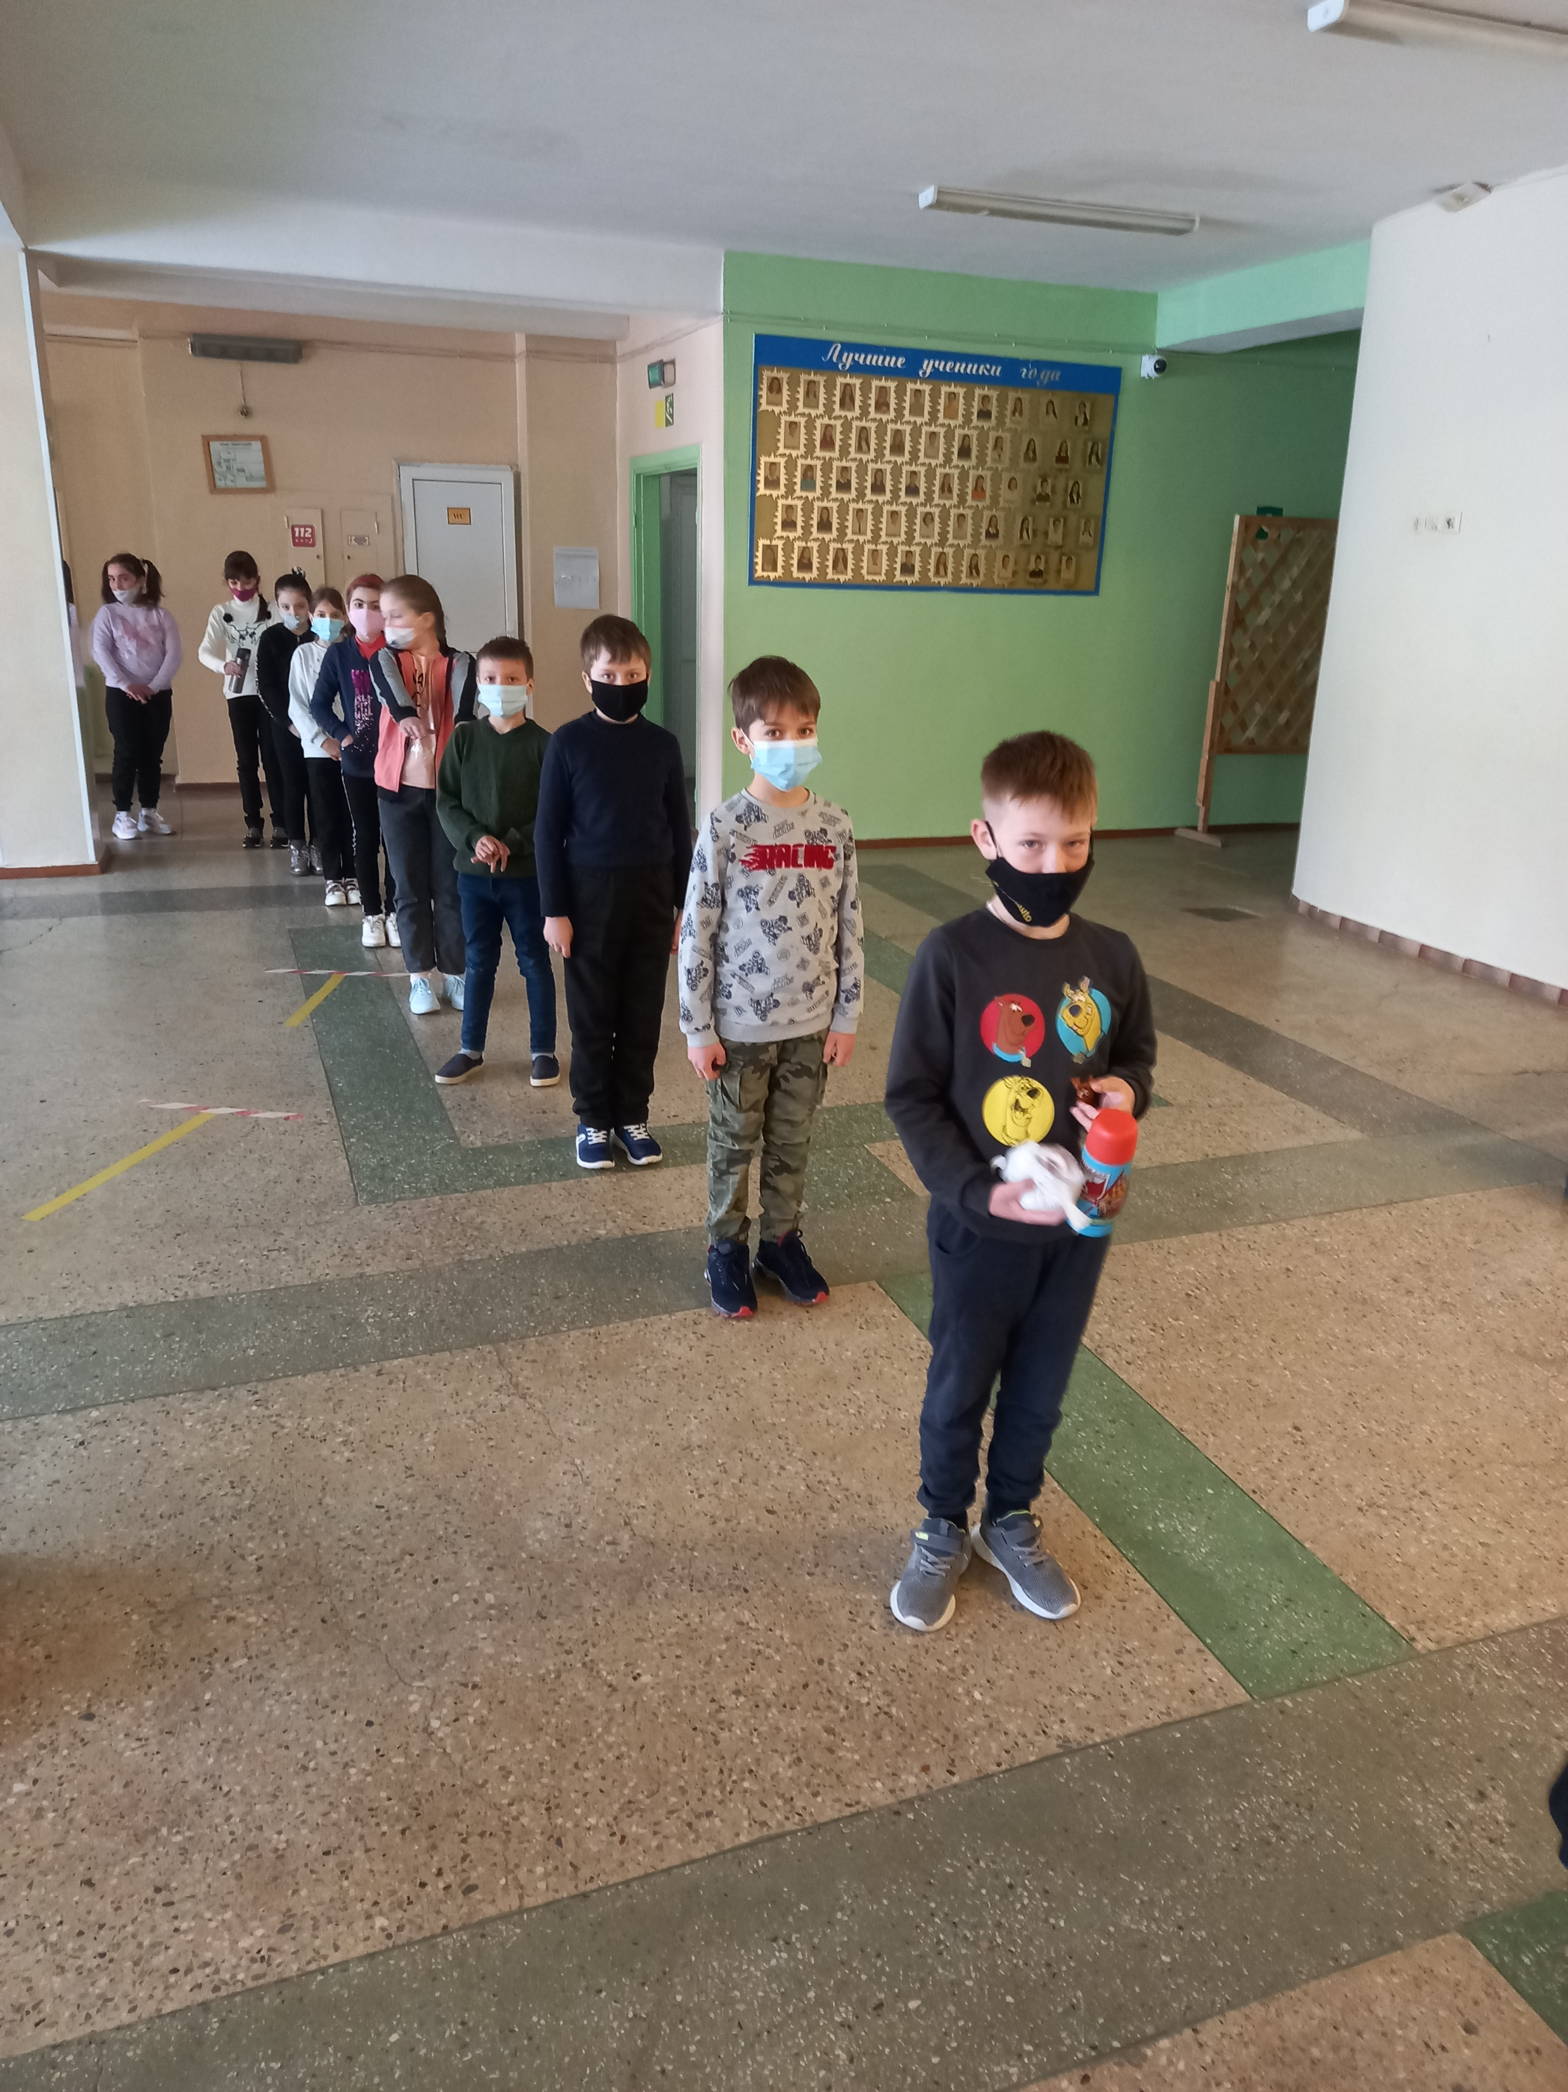
What We Have Learned
Daisy Elementary School, TN, the USA.
"Petru Movila" Lyceum, Chisinau, Moldova
The third grade students are going to have lunch in the canteen.
The third grade students read two articles about how Covid 19 has changed the way schools do things.

Slide 13
Positive And Negative Impacts
As the coronavirus pandemic unfolds across the globe, threatening lives and upending the world economy, it’s also had a profound impact on the environment.
The outbreak of COVID-19 (corona virus) in the world has both positive and negative impacts. Positive or good impact on the environment and negative impact on human beings.
But no matter how strange it may seem, the coronavirus pandemic also had positive effects, especially on the environment. So, for example, in Italian Venice, due to the lack of a large number of tourists, the water in the canals became transparent. A similar story unfolds in Spain and the UK. Air pollution in most parts of the countries in recent weeks has decreased by 30% compared to the average.
In my country, we can see the same situation: due to quarantine, many citizens stayed at home, so they used less cars, and, accordingly, there was a decrease in the emissions of various gases into the atmosphere.
To prevent the spread of the coronavirus, worldwide air, rail and road traffic has been restricted, production has been suspended, and people from offices have switched to telecommuting.
Do not forget about the negative consequences of the coronavirus. As more people choose to stay at home, the demand for home entertainment has skyrocketed, leading to an increase in energy consumption.
Some of the changes that the Covid-19 virus has brought about that are positive for the environment - for example, a big reduction in CO2 emissions when many factories have closed, while others are negative - piles of potentially infectious waste are growing, such as used gloves and old face masks.
Pavlov Matvei,
Gymnasia № 1,
Starye Dorogi, Belarus

