Slide 1
Final Project: Advantages and Disadvantages of Our Communities
Learning Circles
PPM1
7 “B” form
Gymnasia №1
Starye Dorogi
Belarus

Slide 2
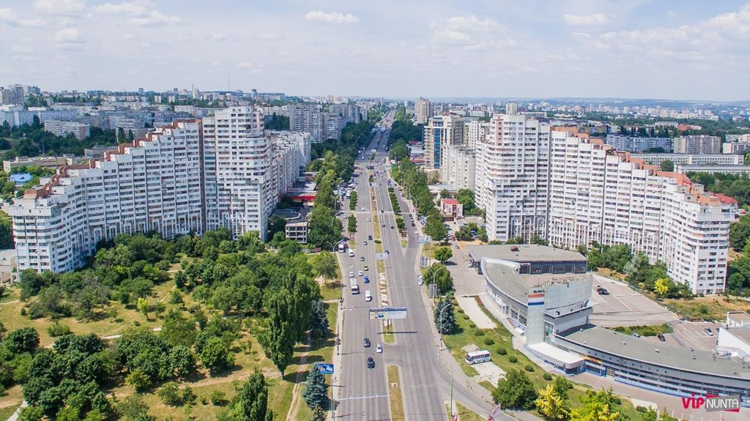
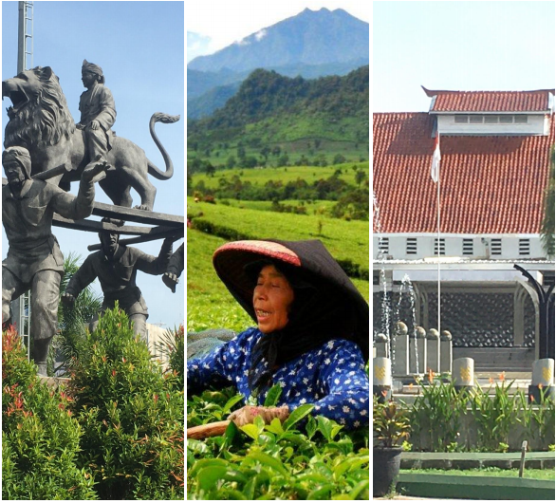
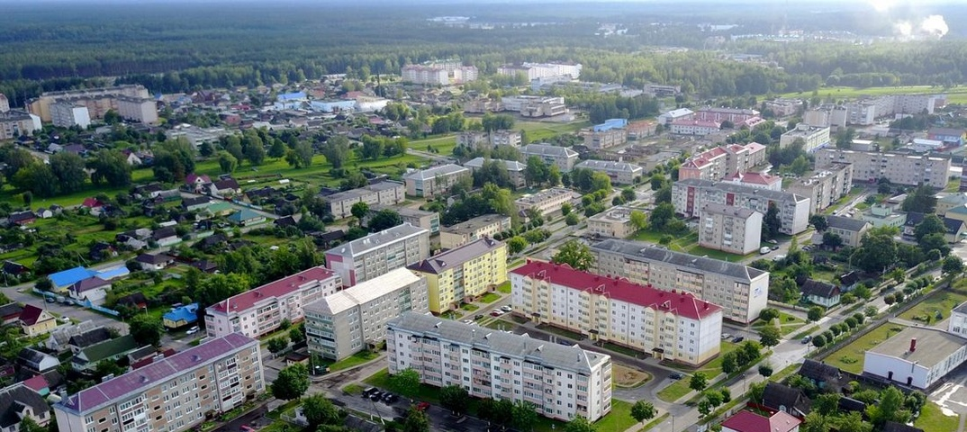
What is my town like?
Starye Dorogi
Starye Dorogi is a small town which has a big history. It was a village earlier, but things changed and then it became a town. I guess that with the speed of its improving my town will become a city one day. Now there is a lot of houses, shops and other important buildings that make our life easier. There are some green zones in my town like the park, some forests and so on. In our forests there also are some lakes, near which I and my family love spending time together. Talking about shops, the items’ prices aren’t usually very high. Our town is small, after all. I’ve heard that the bigger city or town is, the higher are prices in the shops, but I’m not sure whether it’s true or not. I like living here, because I’ve learnt it by heart and I know how to get anywhere I want. I used to get lost very often when I was a little child, but now I never get lost. Starye Dorogi is convenient to live in, easy to explore, and I would recommend to visit it one day.
Chisinau
Chisinau is the capital and the largest city of the Republic of Moldova. It is located in the centre of the country and is the main commercial, political and industrial center of the Republic of Moldova. Chisinau is neither small, nor large city. It is bigger than Paris, but much smaller the Kiev, for example, and the total area of Chisinau is 123 km2 (48 mi2). The population of Chisinau municipality is approximately 1 000 000 people, about
25% of Moldova’s total population.
Subang
Subang is a small town in West Java but has a fairly wide area, there are sea, mountains, hills, valleys and land which is quite wide. Subang is very suitable to be used as a place to live. because as an area Subang has complete natural resources and Subang is also not as crowded as in big cities. It is small and beautiful, but a little bit noisy. I like living in my town, even though the weather is hot and there are a lot of people. Bird park, sport centre, walking zone, foodcourt centre also there.

Slide 3
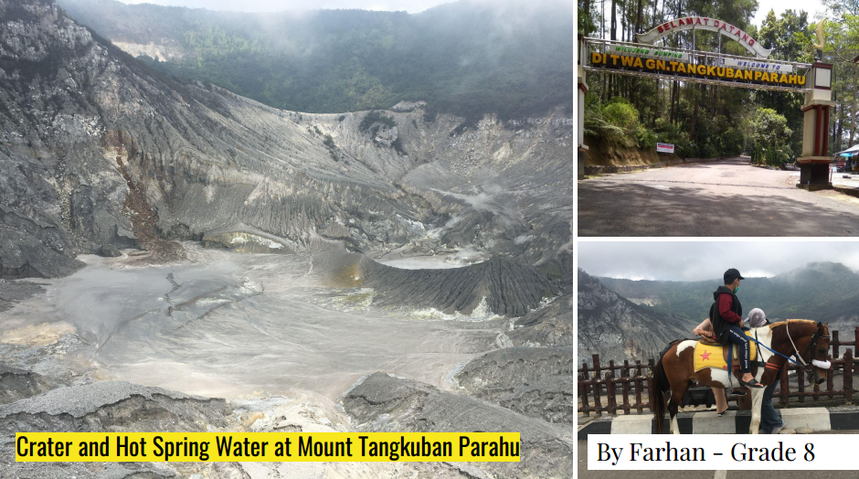
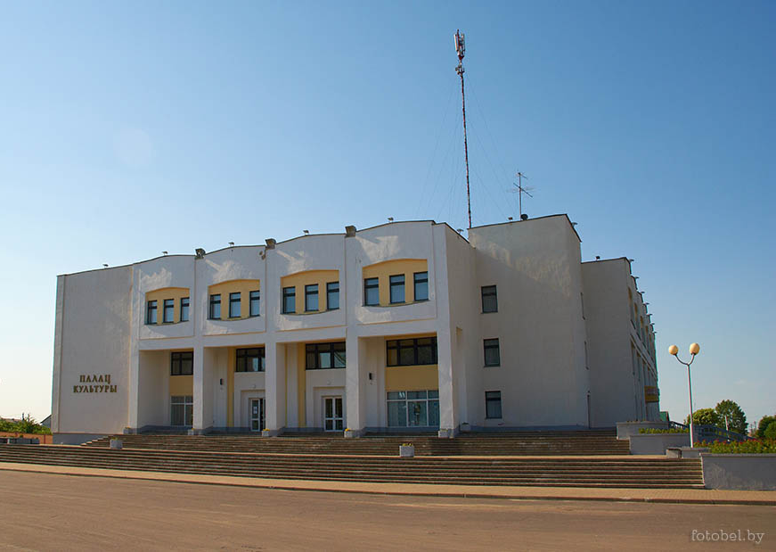
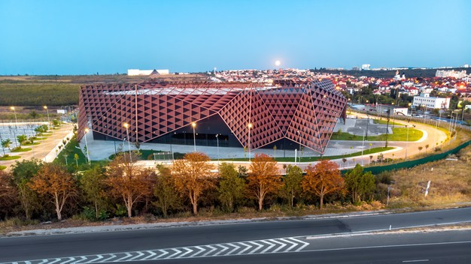
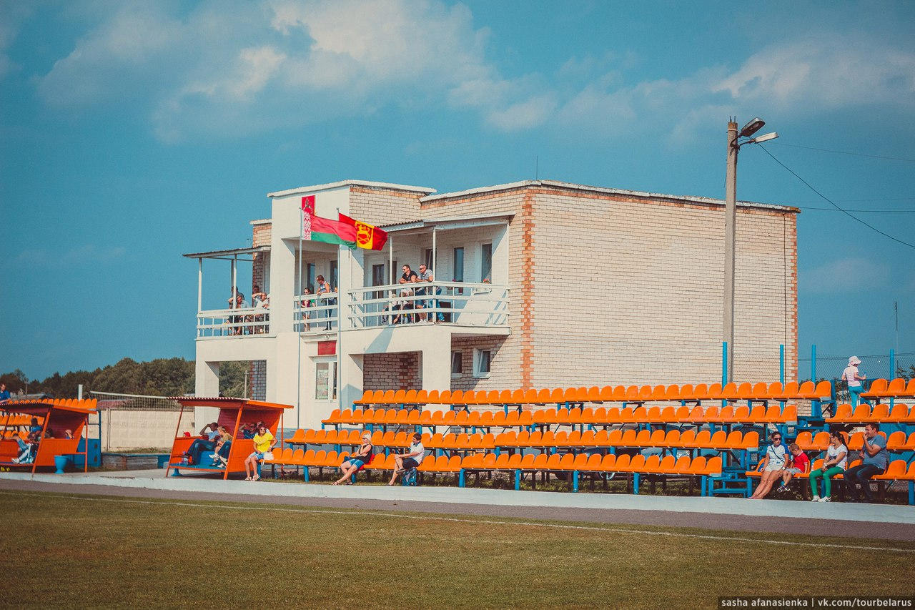
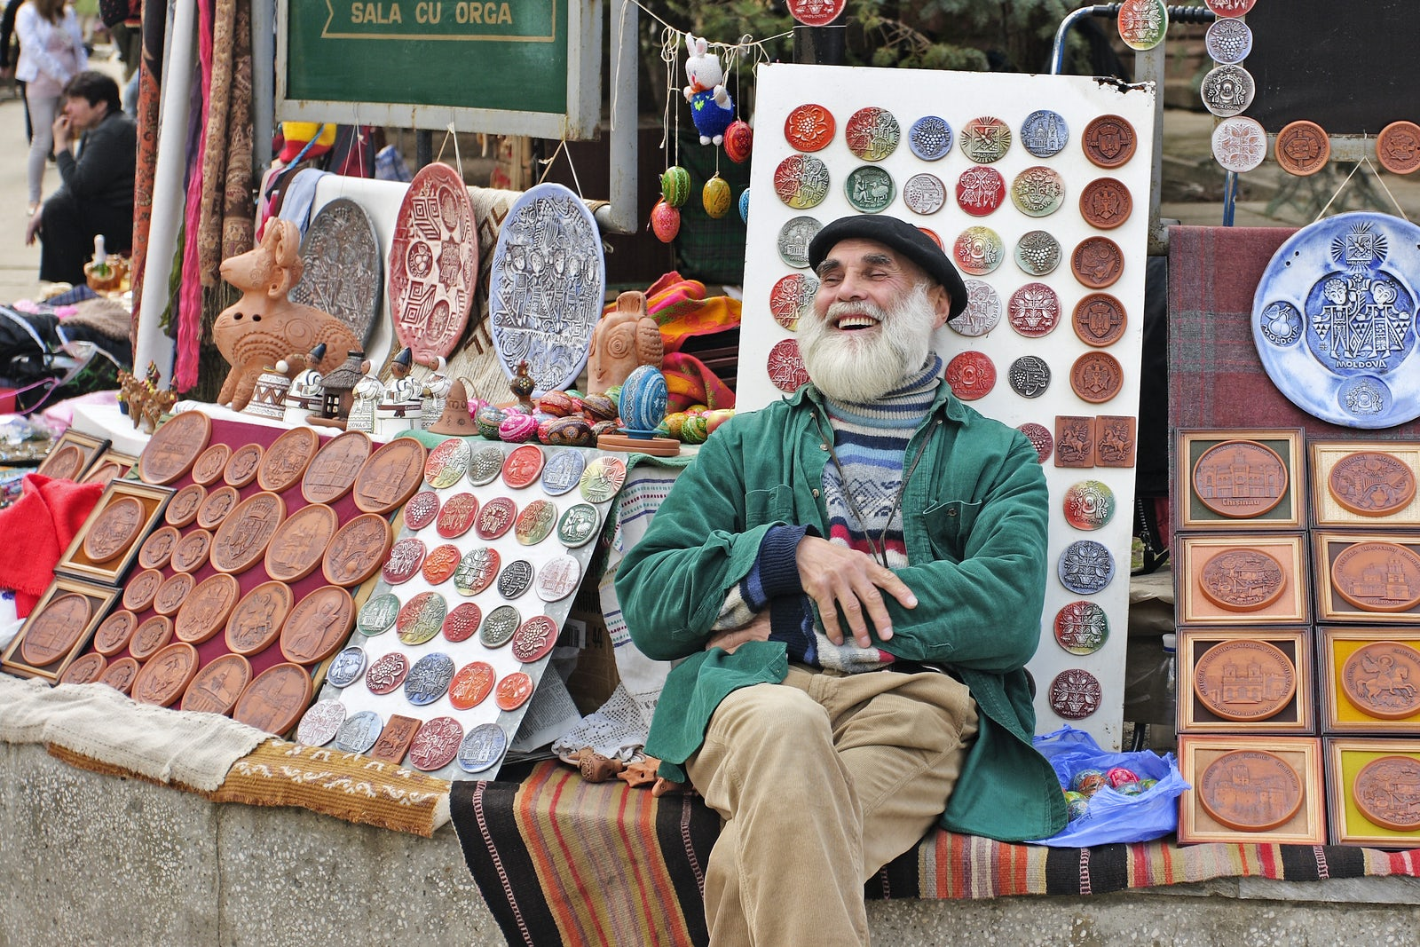
Are there any entertainment facilities?
Starye Dorogi
Of course. What city or town does not have at least one of them? There is a cinema, where you can watch some new interesting films. The cinema is located in a big building that is called “The Palace of Culture”, where concerts and exhibitions are usually held. We also have a stadium, where people hold football matches and some other sport events. There’s not much, but enough.
Chisinau
While it still isn’t as grand and spectacular as other European metropolises, I found Chisinau quite pleasant. Karaoke fans will enjoy a nice karaoke-club VIVALDI. "Napoleon palace" is the largest entertainment center in the eastern Europe. Among the city's cinemas auto cinemas, Gaudeamus, Odeon and Patria are the brightest ones. It's best to start shopping in Chisinau from visiting shopping malls, and the largest one in town is shopping MallDova. Theaters still remain one of the most popular ways to spend your leisure time. In the theaters of Chisinau you will be able to fully appreciate the performance of highly talented actors in original plays directed by Moldovans.
Subang
Lots of tourist attractions in Subang, especially natural attractions such as mountains, sea, beaches, waterfalls, hot springs, tea gardens and so on.

Slide 4
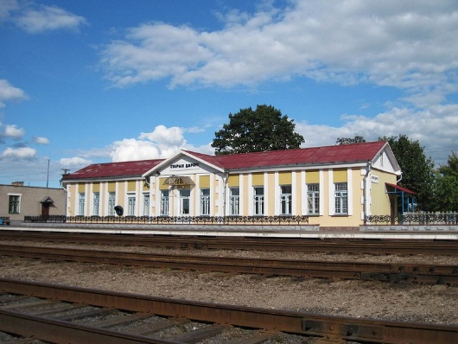
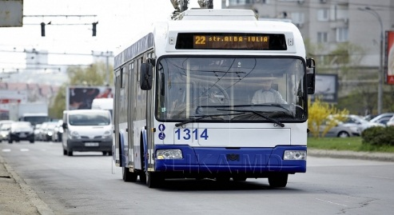
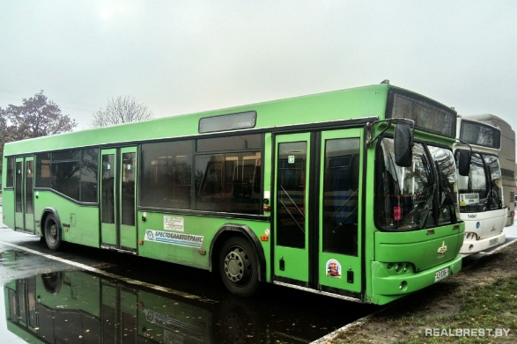
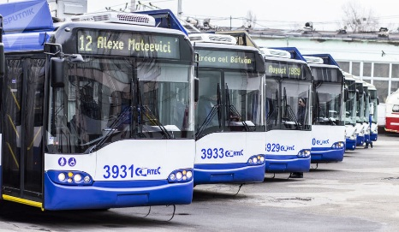
Is there a good public transport system?
Starye Dorogi
Personally, I very rarely travel by public transport, because it’s usually more convenient for me to use a bike or just go somewhere on foot. But my friends say that the public transport system in our town is quite good. As our town is little, we have buses, minibuses and taxi. There is also a railway station in our town. I wouldn’t say it’s excellent, but it’s still good.
Chisinau
The largest part of the public transportation network is trolleybuses network. Today the system comprises 30 routes and it connects all the city’s sectors and the nearest settlements, also one route connects Chisinau with another city, Ialoveni. Every day about a quarter of million people uses trolleybuses in our city. Approximately 320 of them operate every day. The most of trolleybuses are new and modern, and every six months our municipal council buys new trolleybuses. Also we have buses network, but it’s much smaller than the trolleybuses network. I would like to notice that the major part of our public transportation system runs on electric energy.
Subang
The transportation system in Subang is not yet good because there are not many choices to be used as a means of transportation. At this time in Subang a large seaport is being built, hopefully with this port it will make Subang more advanced. I hope that someday there will be a bus school for teachers and students.

Slide 5
Do I want to stay in my town or do I want to leave it, when I grow up?
Starye Dorogi
I wouldn’t want to stay in one place forever. Despite the fact that I know my town by heart, I still love travelling and when I grow up, I want to travel around the world. My English is pretty good, but I think it is still not great enough to communicate with people without the Internet, and travelling abroad is a great way to improve my English skills. I will never forget Starye Dorogi and the people, who has been always supporting me, though. I can visit them sometimes anyways.
Chisinau
Our city is not an ideal city, but it is really a good one. We have many problems, but I believe our city will continue to develop and it will become better. Our city has become one of the participants in «European Youth Capital- 2024» contest and that means a lot for our city. I would like to continue to live in my city because it has everything to live here: a lot of schools and kindergartens, wonderful transportation system, parks, memorable places, restaurants, workplaces, universities and research institutes. I love my city very much.
Subang
Maybe someday I will leave my town because of work.I hope the earring will be more advanced.
In the future I really want to leave my town, but big career, new hope, good job, unfortunately my town is changing slowly.

