Slide 1


IEARN Global Learning Circles
January-May 2021
Places and Perspectives
Learning Circle 1
(Middle/High School)

Slide 2
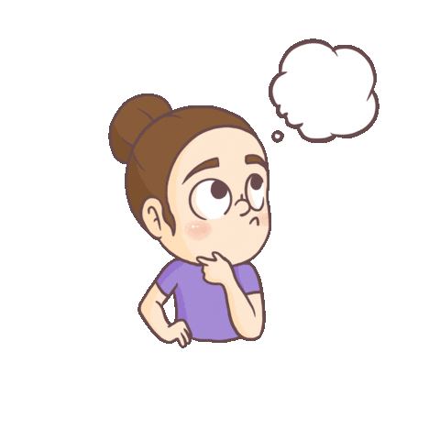
What is iEARN Global Learning Circle:
Places And Perspectives??
iEARN Global Learning Circles are highly interactive, project-based partnerships among a small number of schools located throughout the world. There are two sessions each year, September - January and January - May.
Places and Perspectives encourages students to explore regional history, culture, government, and geography by sharing their knowledge with people from different locations.

Slide 3


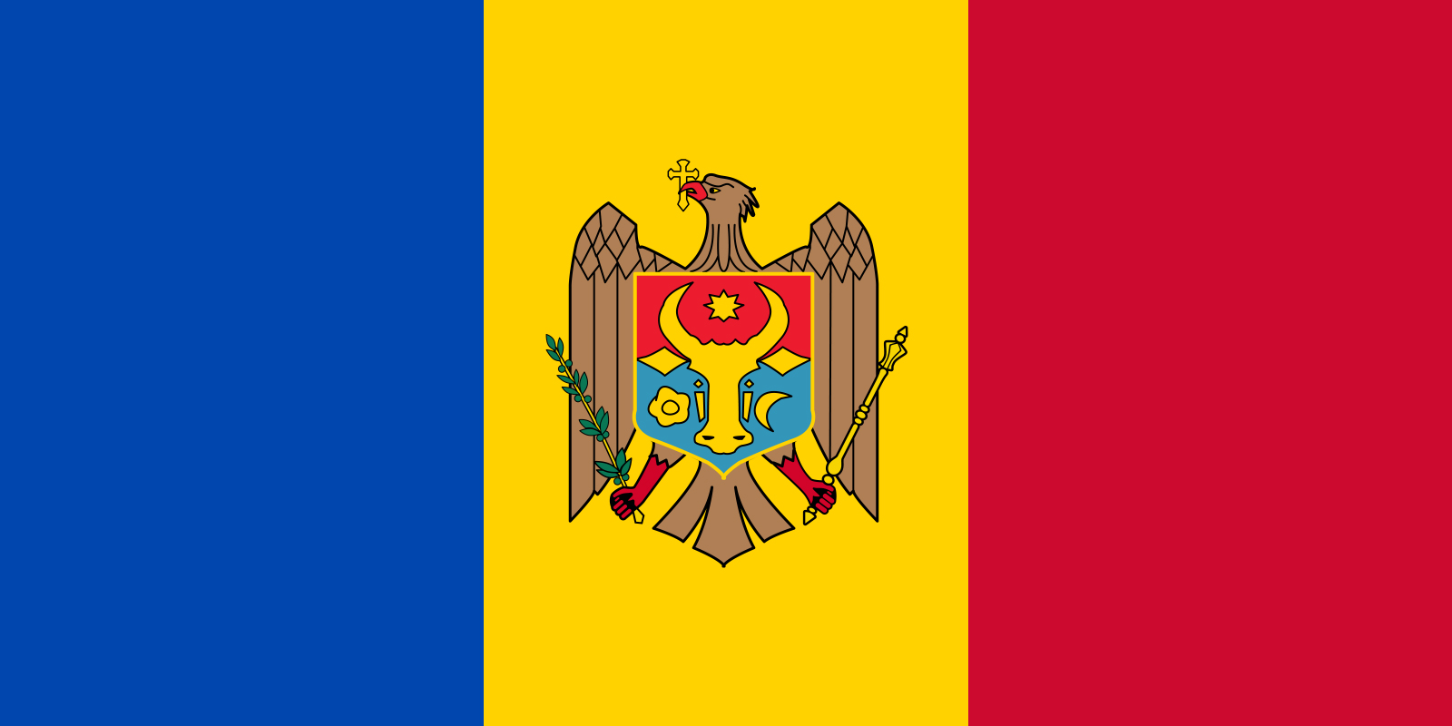

Participating countries
PAKISTAN
UKRAINE
MOLDOVA
EGYPT

Slide 4

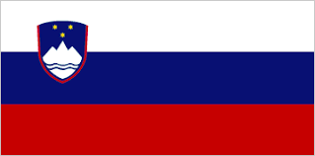

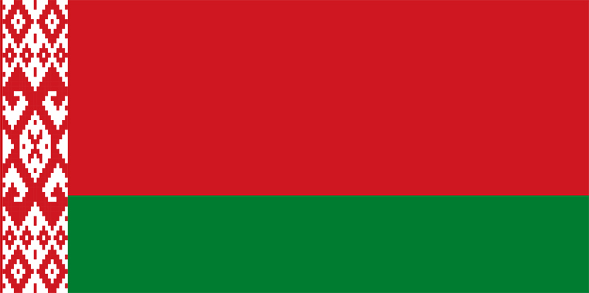
Participating countries
USA
SLOVENIA
INDONESIA
BELARUS

Slide 5
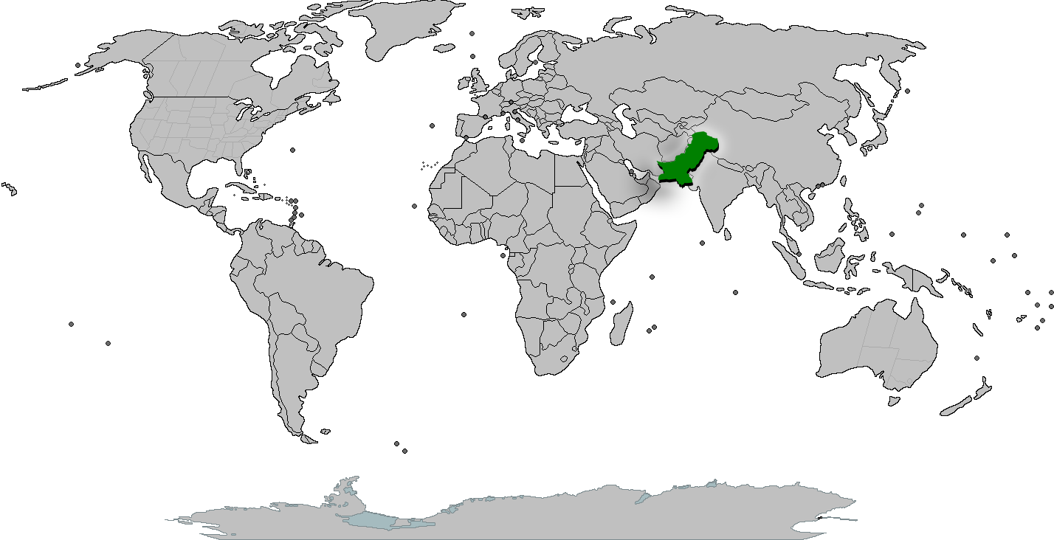


OUR COUNTRY

Slide 6

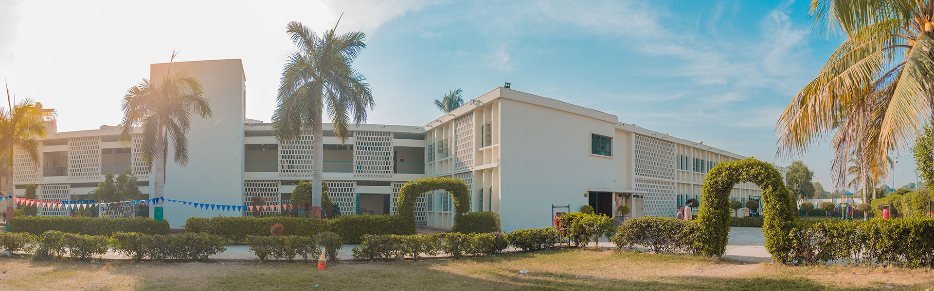
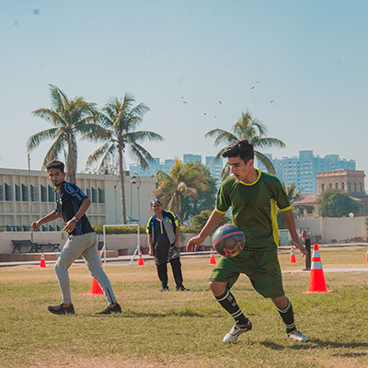
OUR SCHOOL
AGA KHAN SCHOOL GARDEN,
KARACHI, PAKISTAN

Slide 7
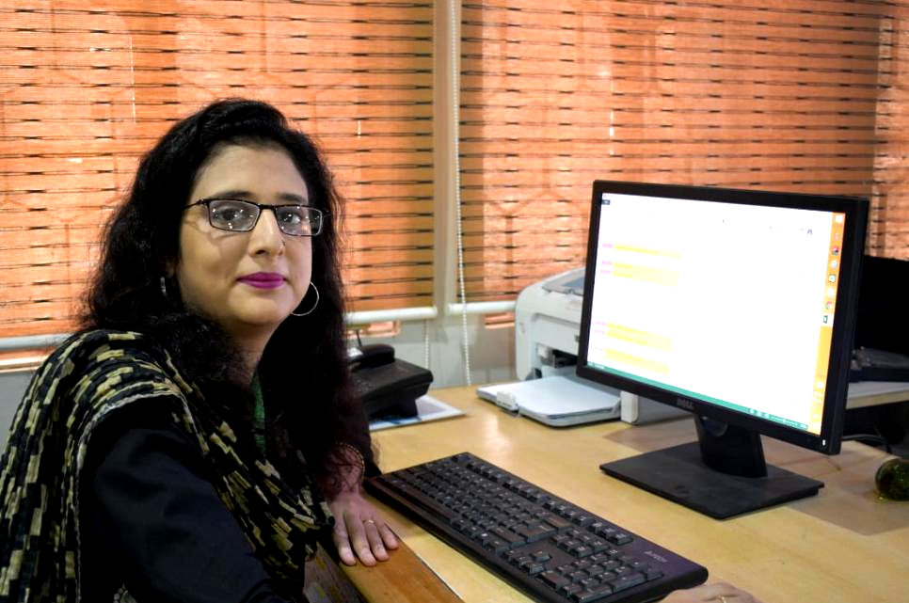
OUR INSTRUCTOR
Learning Circle Teacher
Ms. Naila Fahim,
Learning Technology Facilitator,
Aga Khan School, Garden, Karachi, Pakistan

Slide 8
Let’s Start Our Virtual Tour To International Countries

Slide 9
Karachi, Pakistan
Karachi is the largest city in Pakistan and the twelfth largest city in the world. It is the capital of the Pakistani province of Sindh.

Slide 10
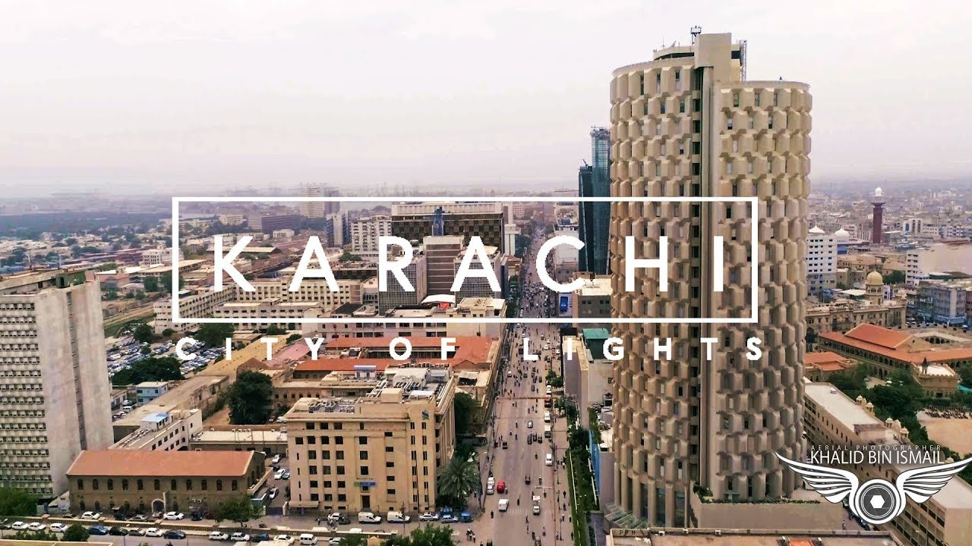

Slide 11
Stop #1: Jinnah's Mausoleum
Mazar-e-Quaid also known as Jinnah Mausoleum or the National Mausoleum, is the final resting place of Quaid-e-Azam ("Great Leader") Muhammad Ali Jinnah, the founder of Pakistan.
Designed in a 1960s modernist style, it was completed in 1971, and is an iconic symbol of Karachi as well as one of the most popular tourist sites in the city.

Slide 12
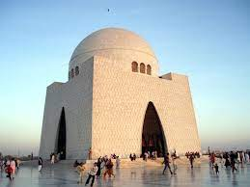
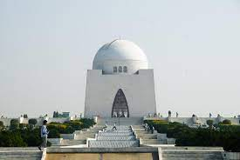

Slide 13
Stop #2: Clifton Beach/Sea View
Clifton Beach, also known as Sea View, in Karachi, Sindh, Pakistan is located on the Arabian Sea.
The beach is very popular in Pakistan and remains opened 24/7 for the general public.
Clifton Beach is purported to give the best value in leisure and recreational opportunities for fun seekers and beach lovers.
The beach is now home to multiple local leisure activities including camel rides, buggy rides, horse rides, plastic plane flying among others.

Slide 14
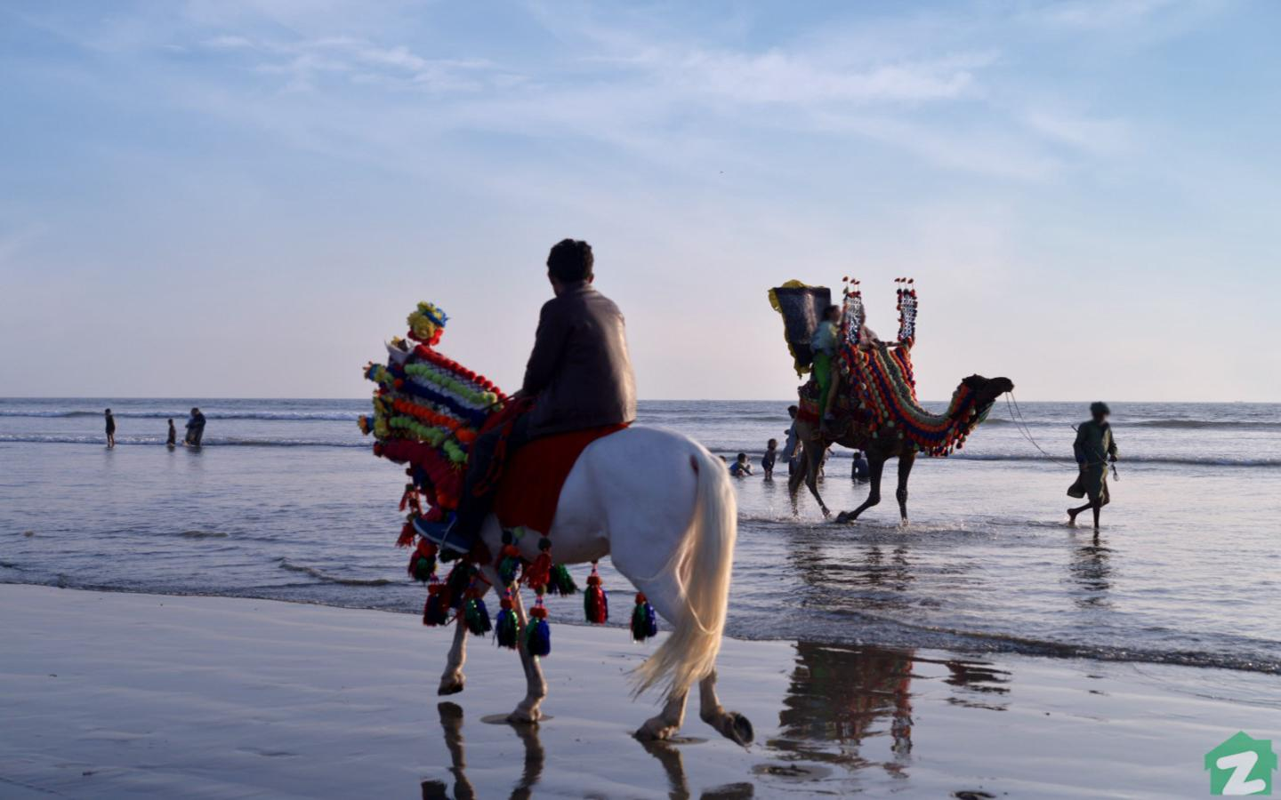
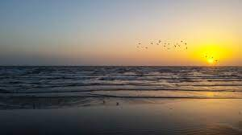

Slide 15
Chișinău, Moldova
Chișinău is the capital of Republic of Moldova. The city is Moldova's main industrial and commercial center, and is located in the middle of the country, on the river Bâc, a tributary of the Dniester.

Slide 16
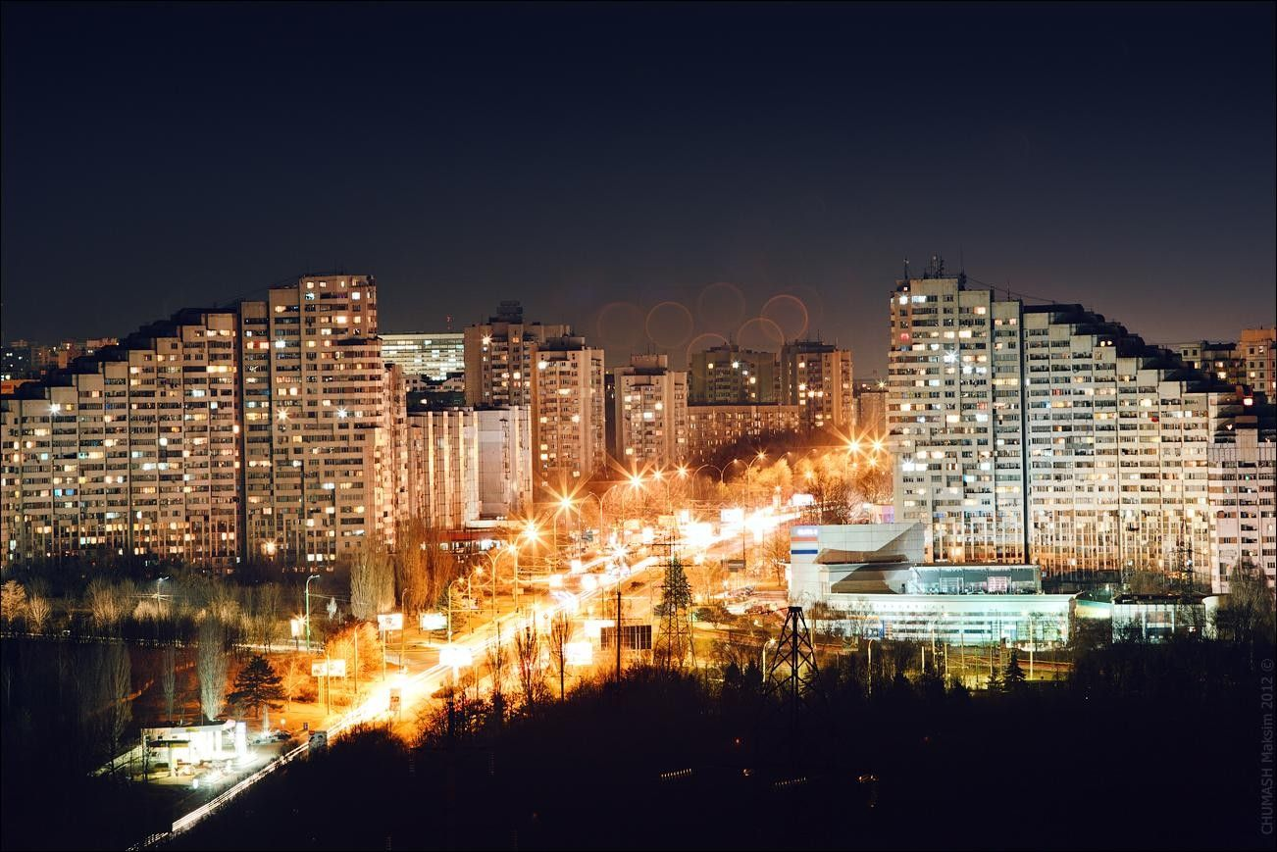
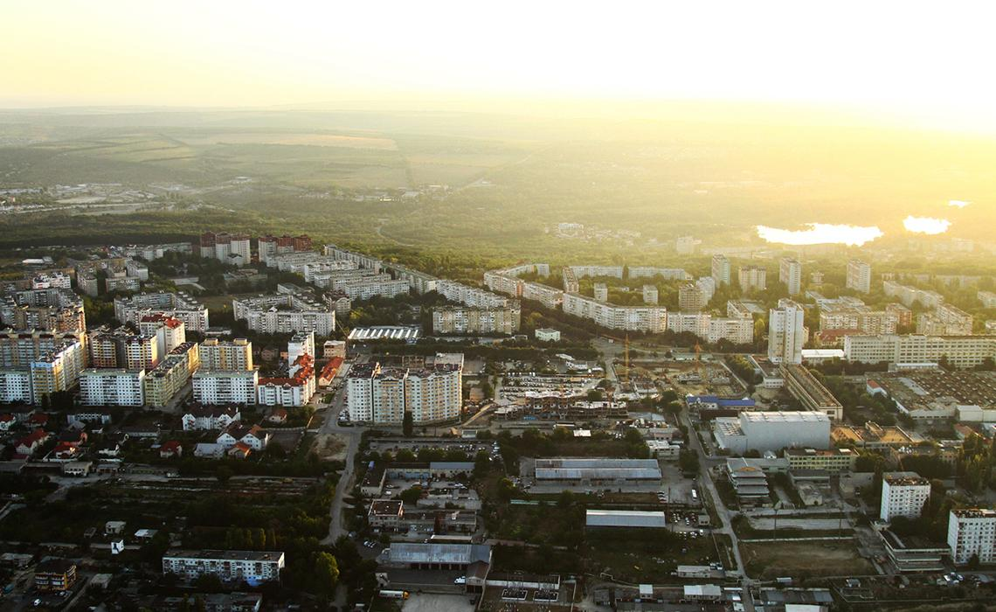

Slide 17
Stop #1: Stephen the Great Central Park
Stephen is the main park in Central Chișinău, Moldova, formerly known as Pushkin Park, is the oldest park in Moldova and sickname "The Park of the Lovers" in Chișinău due to itpans about 7 hectares (17 acres).
It has gained the ns popularity as a meeting spot for couples.
The park contains 50 species of trees, some of which are quite old, the mulberries and acacias being between 130 and 180 years.

Slide 18
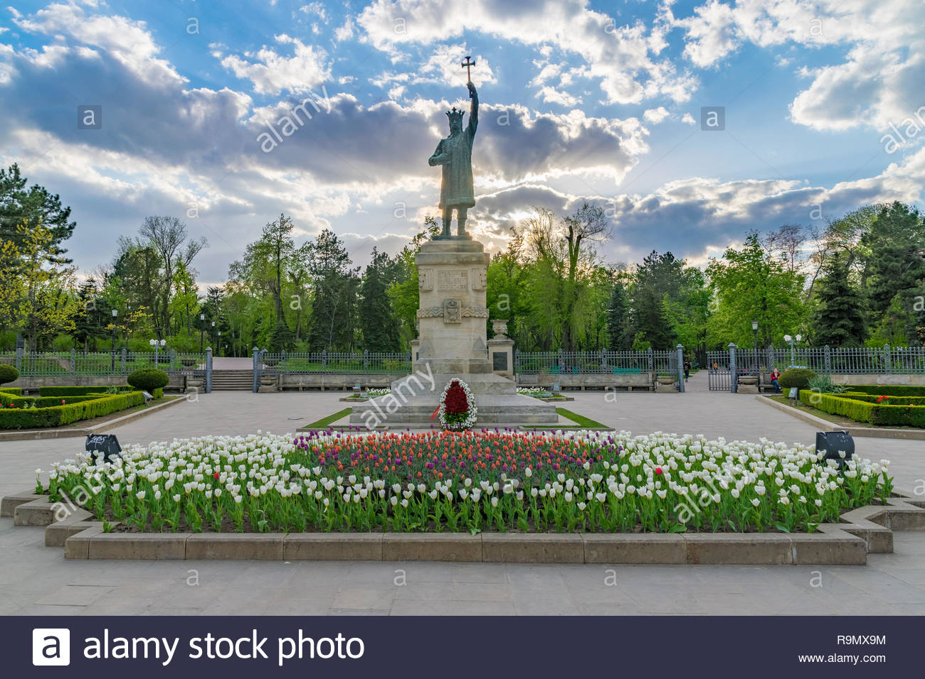
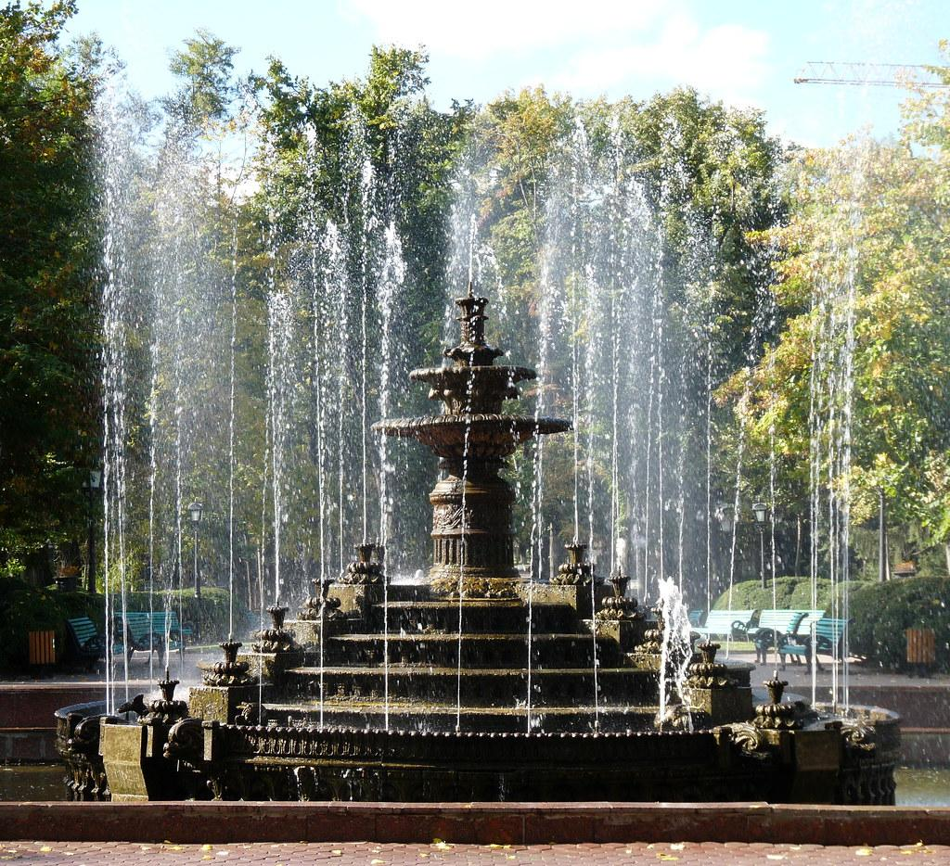

Slide 19
Stop #2: National Museum of History of Moldova
National Museum of the History of Moldova. The national museum was established in 1983 when Moldova was part of the USSR
The beautiful architecture of this museum is one of the reasons you’ll want to visit in the first place. With an amazing façade on the outside and an interesting exhibition about the history of Moldova throughout the centuries inside, this is one of the top museums in the city. Make sure not to miss the diorama behind the entrance hall and the treasure room in the basement
The National Museum of Archaeology and History of Moldova is one of the most important museum institutions of the Republic of Moldova, in terms of its collection and scientific prestige.

Slide 20
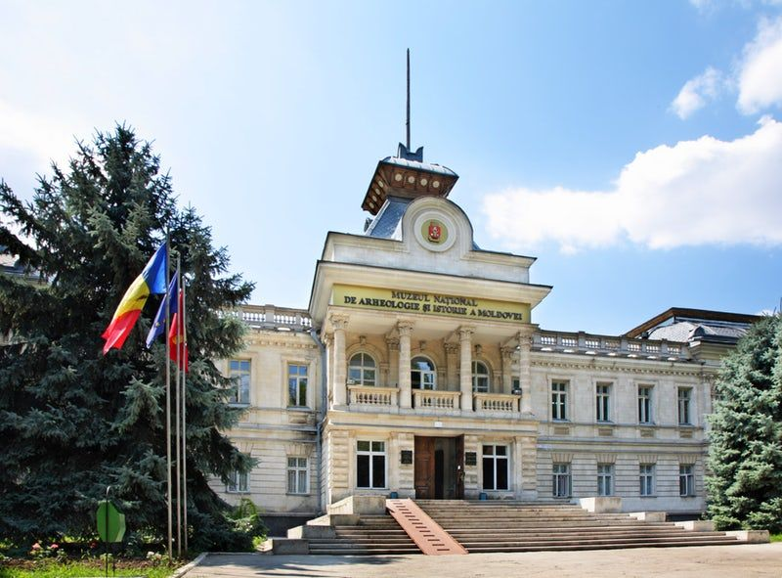
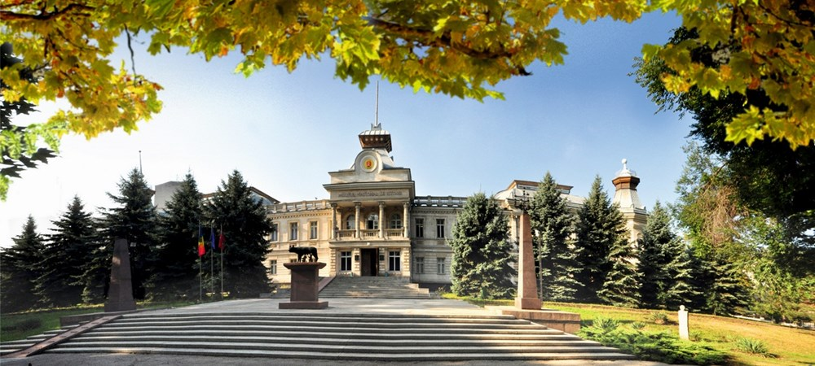

Slide 21
Subang, Indonesia
Subang is a town and the capital of the Subang Regency in West Java, Indonesia. Subang is known for its natural spots, ranging from the high mountains, to clear and bluish river.

Slide 22
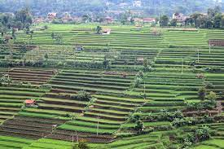
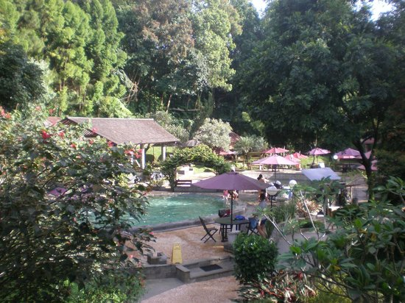

Slide 23
Stop #1: Ratu (Queen) Crater
Ratu Crater is an interesting place that can be visited by lovers of nature tourism
the crater of the Queen is crossed by the Cikuluwung River for about 1 km.
Viewed from a distance, the river water looks blueish. However, as we approach, there will be a yellow color at the bottom of the river that is clearly visible. The yellow color is sulfur deposit
The location of the crater of the Queen itself is in the belly of Mount Salak. If you continue the journey from this place, you will get to the Peak Salak 1 (2221 mdpl) and Peak Salak 2 (2180 mdpl) the famous haunted.

Slide 24
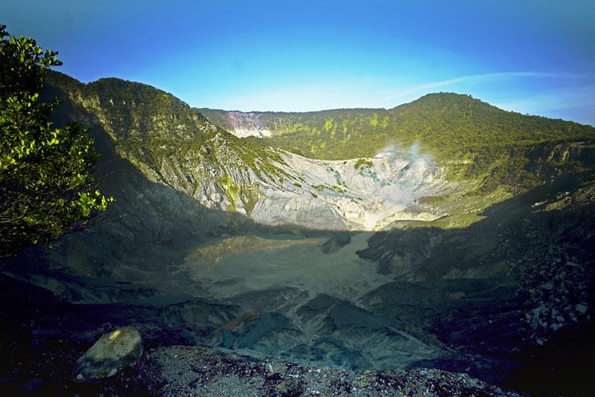
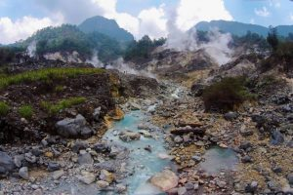

Slide 25
Stop #2: Ciater Hot Spring
scenery of Nature which is very beautiful because it is in the location of tea plantations and mountain expanse
Hot water in ciater contains minerals, aluminum, calcium, magnesium, thermo, sulfate, and chloride. These elements can help to nourish and refresh the body and very effective for the cure of skin diseases. So, although for every place of entertainment in the ciater you are required to pay the Ciater hot water admission price separately but the entertainment facilities and comfort you can get are quite comparable. Very healthy.

Slide 26
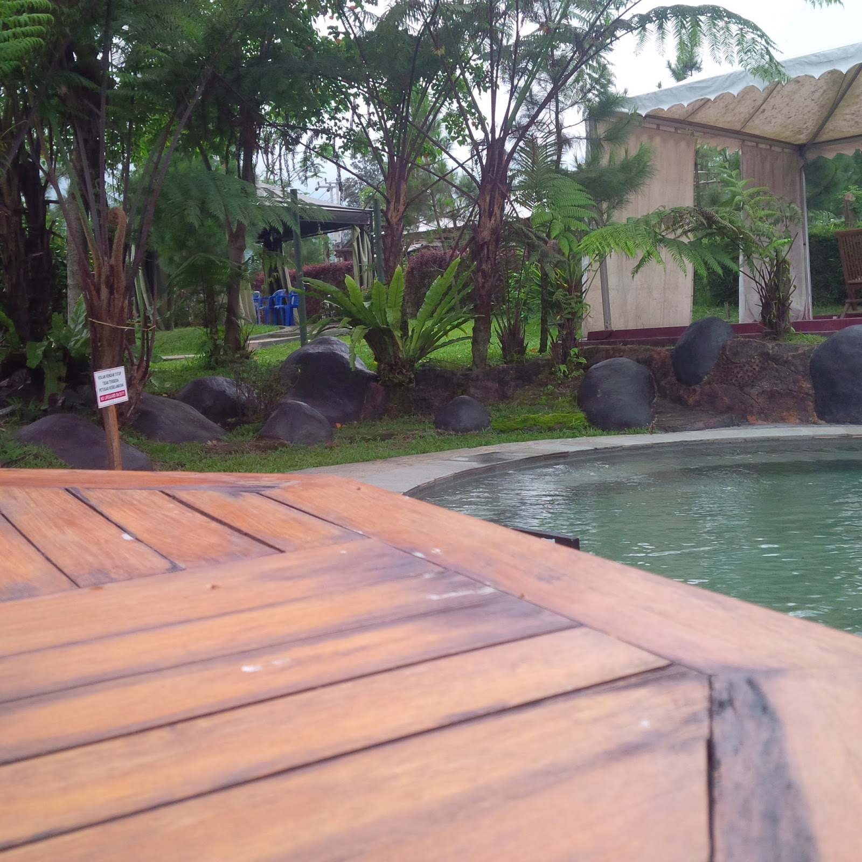
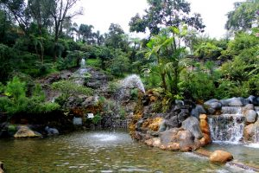

Slide 27
Cairo, Egypt
Cairo, Egypt’s sprawling capital, is set on the Nile River. At its heart is Tahrir Square and the vast Egyptian Museum, a trove of antiquities including royal mummies and gilded King Tutankhamun artifacts.

Slide 28
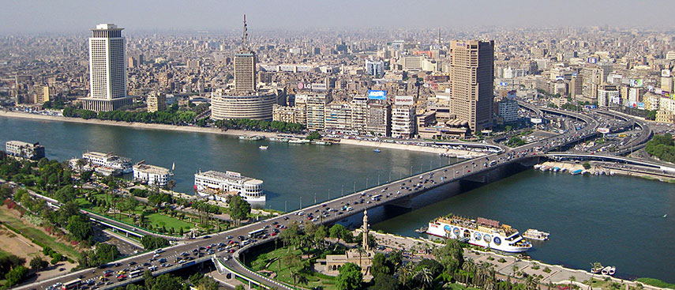
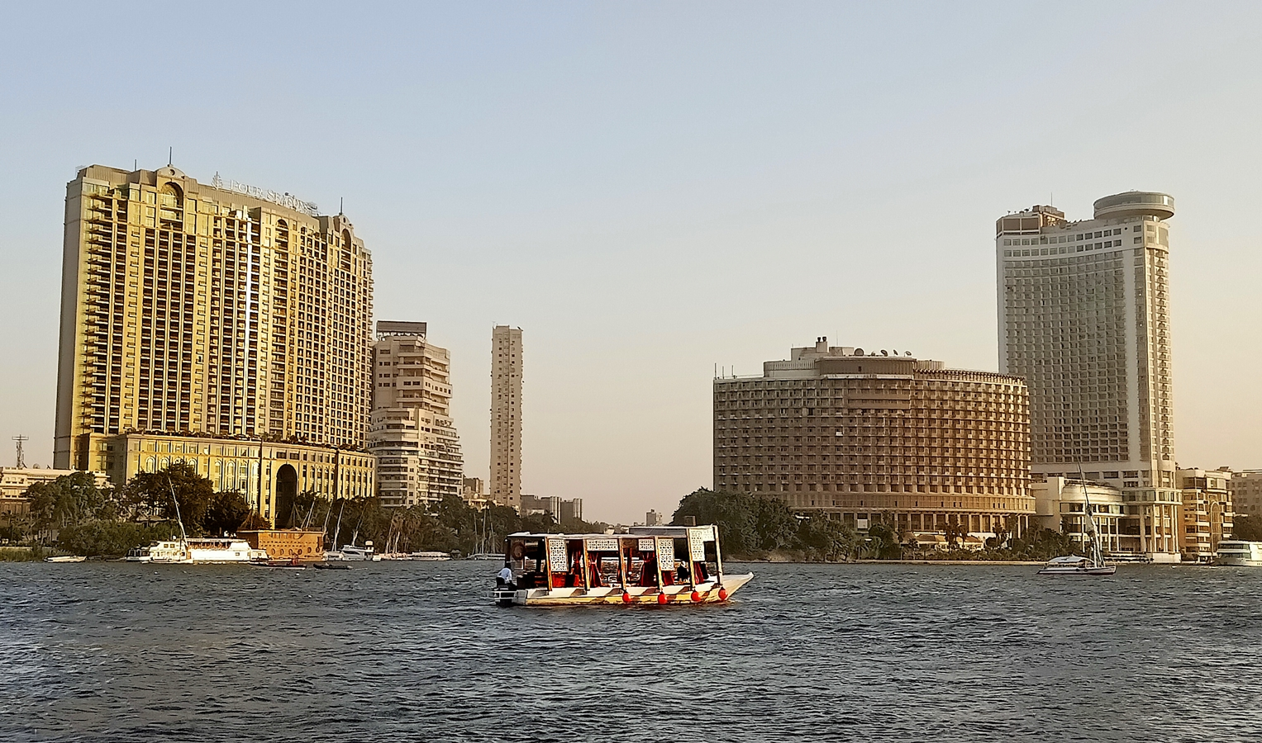

Slide 29
Stop #1: Giza Necropolis
The Giza Pyramid Complex, also called the Giza Necropolis, is the site on the Giza Plateau in Greater Cairo, Egypt that includes the Great Pyramid of Giza, the Pyramid of Khafre, and the Pyramid of Menkaure, along with their associated pyramid complexes and the Great Sphinx of Giza.
All were built during the Fourth Dynasty of the Old Kingdom of Ancient Egypt.

Slide 30
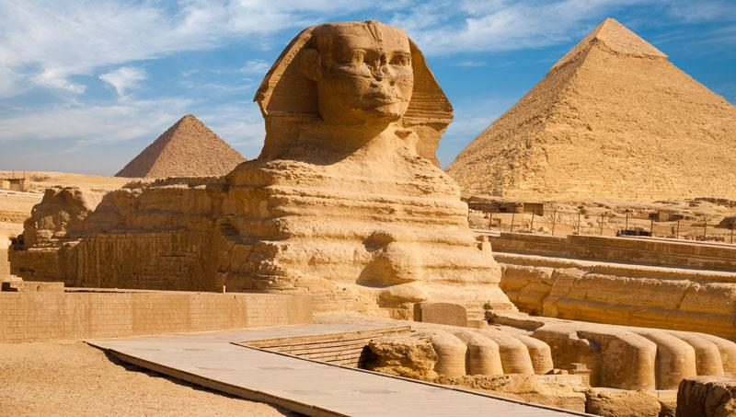
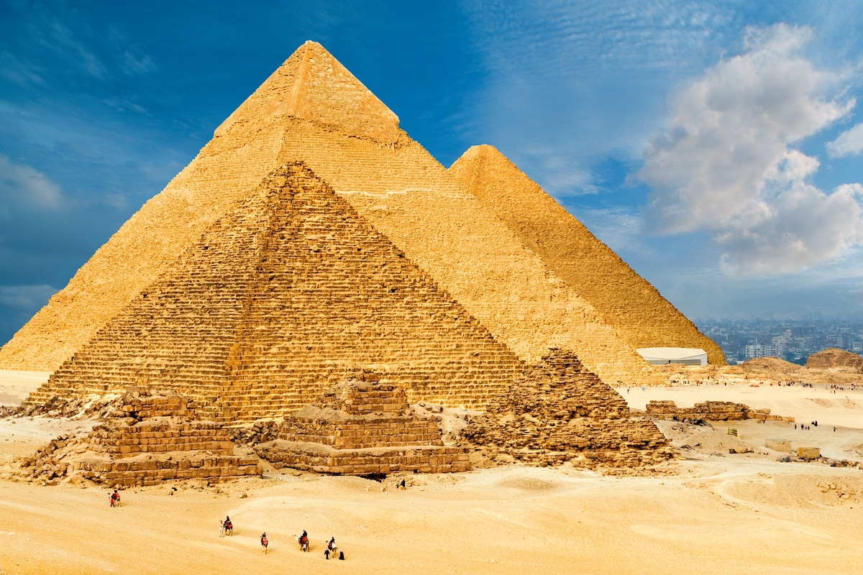

Slide 31
Stop #2: The Egyptian Museum
The Museum of Egyptian Antiquities, known commonly as the Egyptian Museum or Museum of Cairo, in Cairo, Egypt, is home to an extensive collection of ancient Egyptian antiquities.
It has 120,000 items, with a representative amount on display and the remainder in storerooms. Built in 1901 by the Italian construction company, Garozzo-Zaffarani, to a design by the French architect Marcel Dourgnon, the edifice is one of the largest museums in the region.
As of March 2019, the museum was open to the public. In 2021, the museum is due to be superseded by the new Grand Egyptian Museum at Giza.

Slide 32
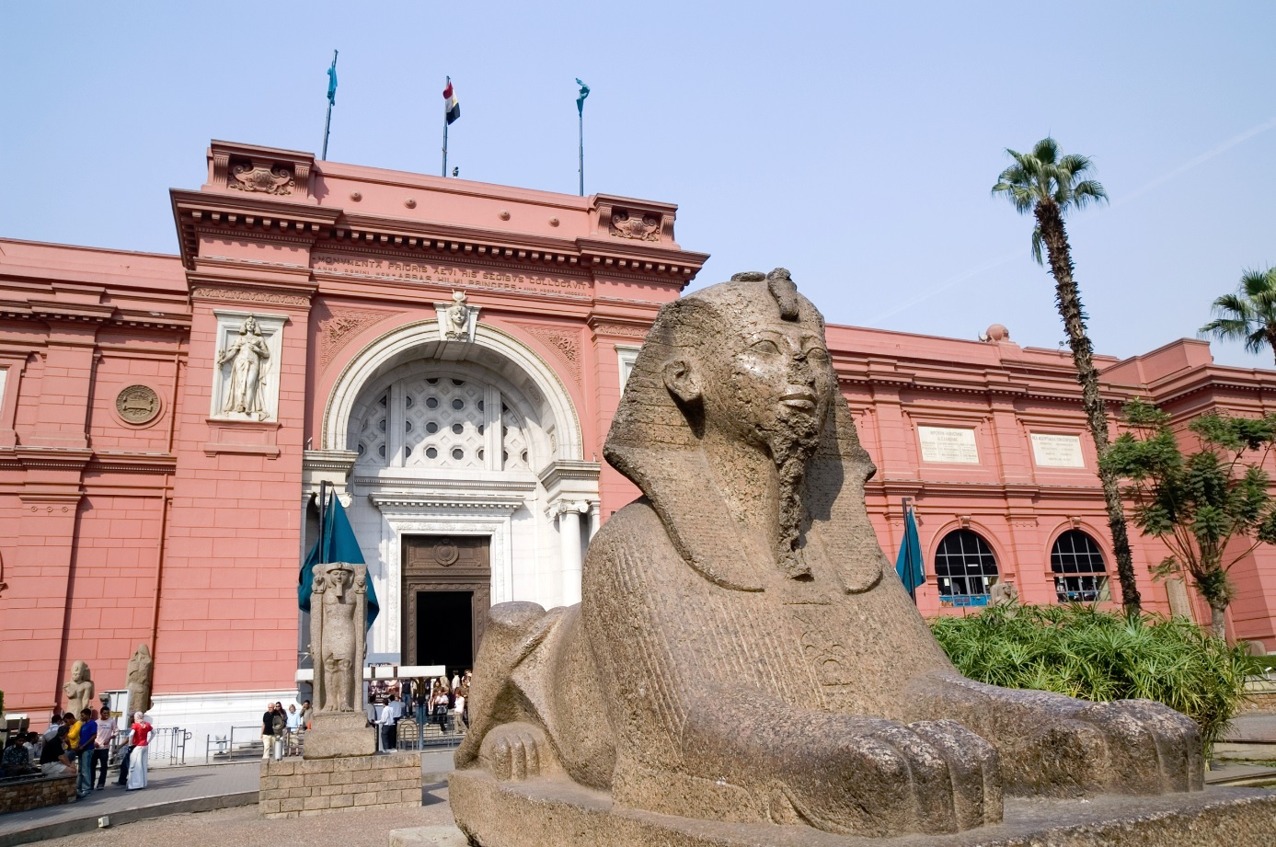
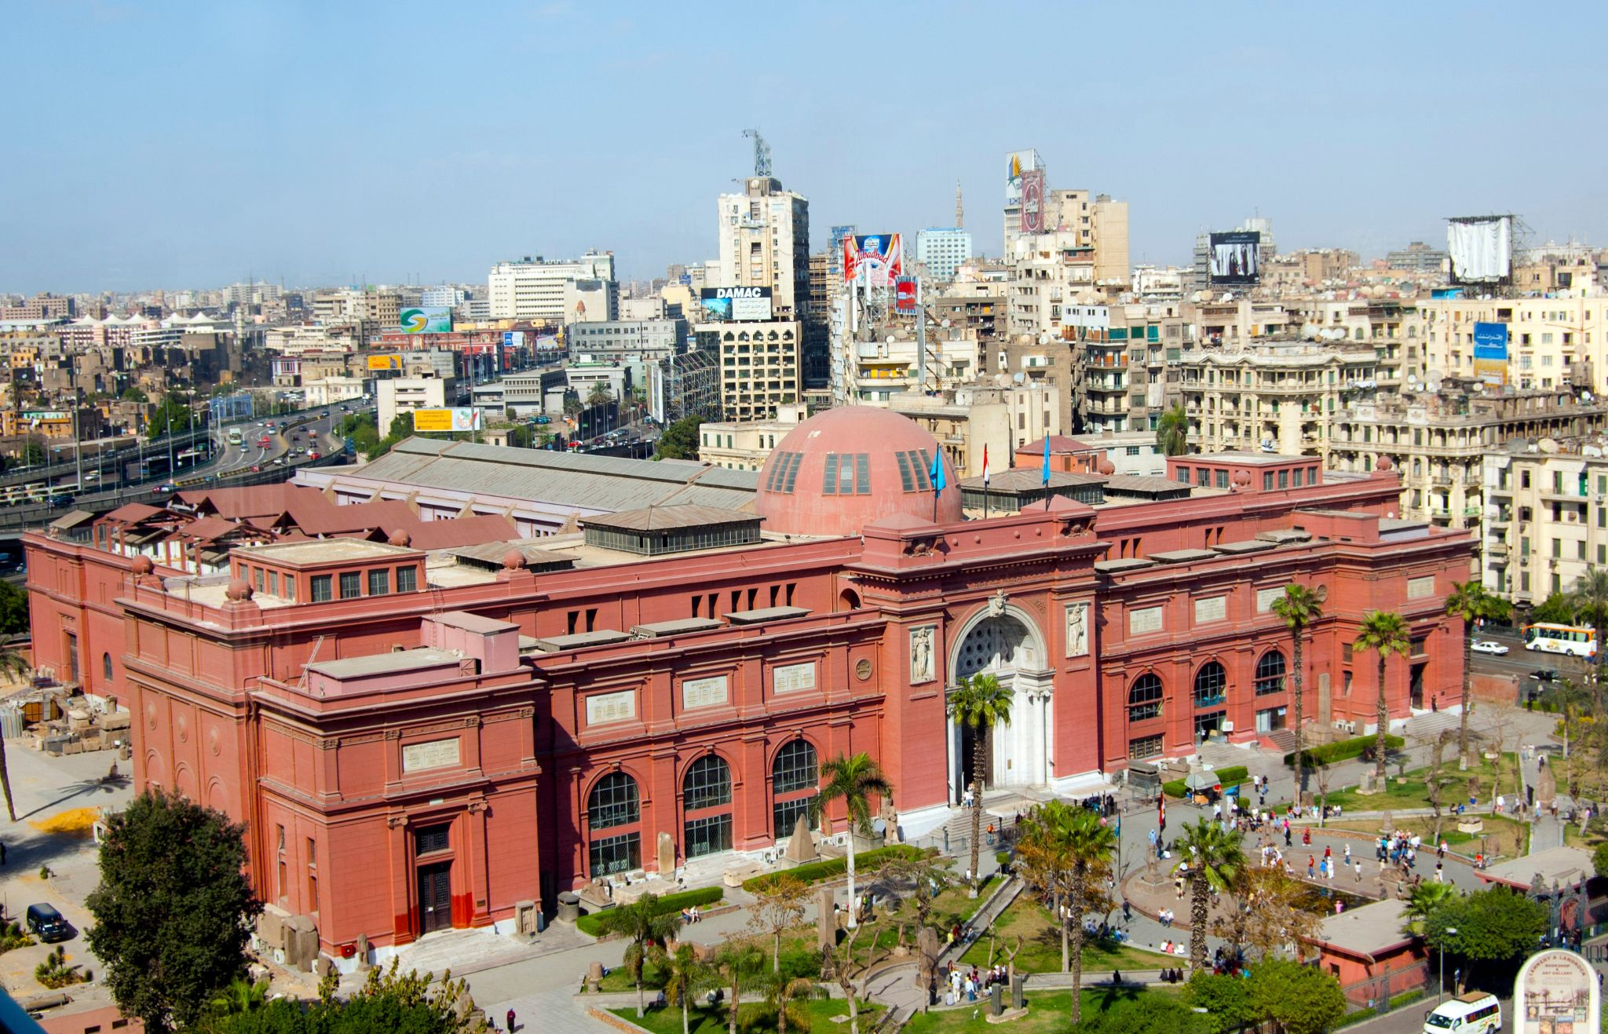

Slide 33
Kyiv, Ukraine
Kyiv or Kiev is the capital and most populous city of Ukraine. It is in north-central Ukraine along the Dnieper River. Kyiv is an important industrial, scientific, educational and cultural center of Eastern Europe.

Slide 34
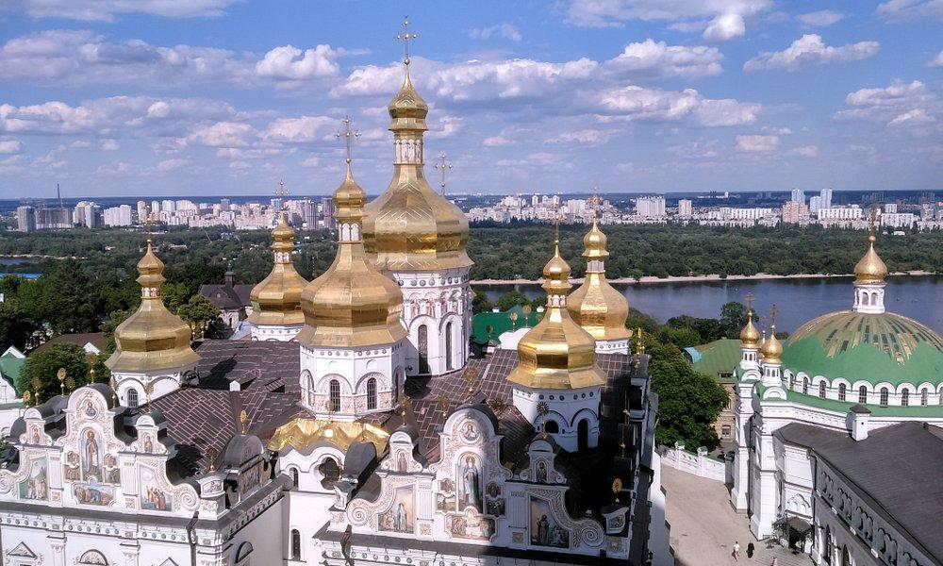
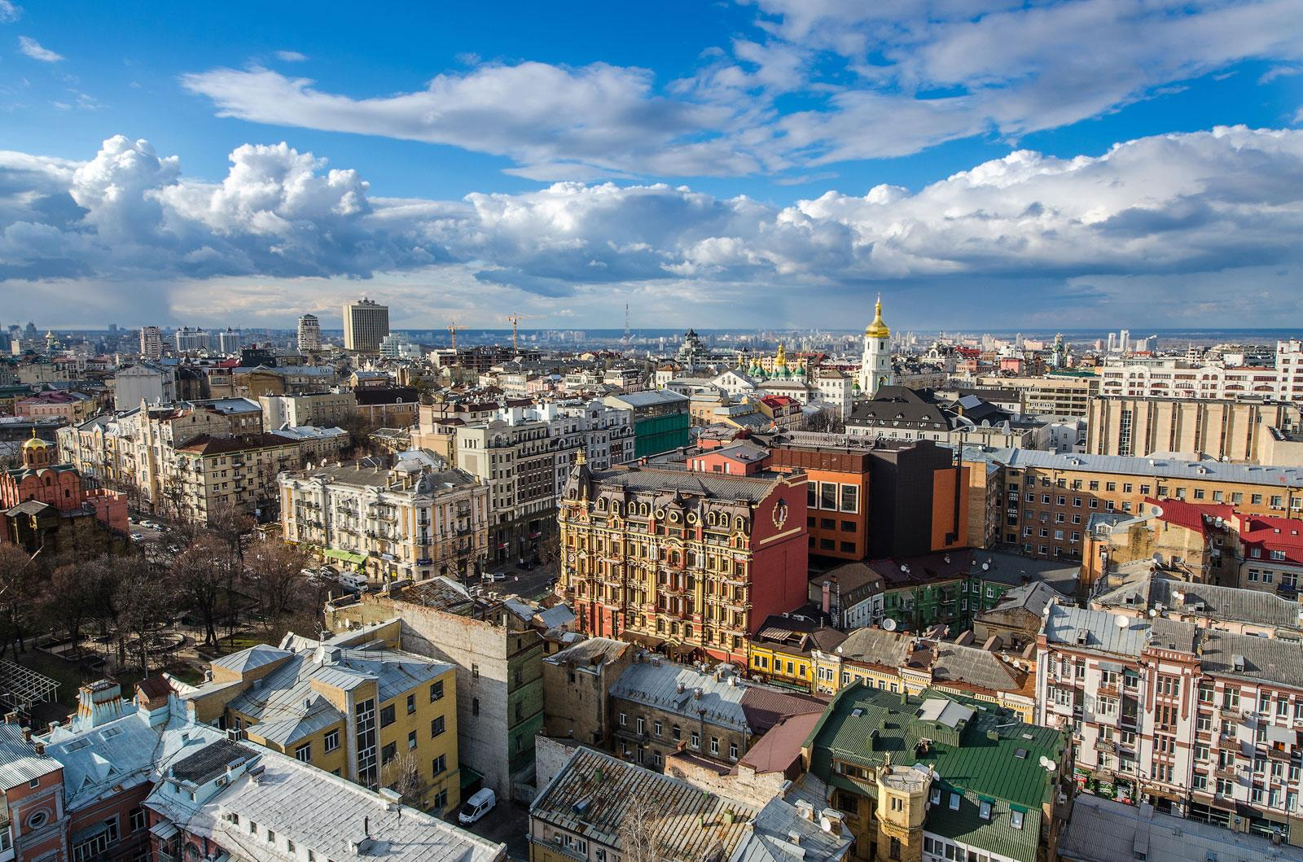

Slide 35
Stop #1: Khreschatyk Street
Khreshchatyk is the main street of Kyiv, Ukraine. The street has a length of 1.2 kilometres
. It stretches from the European Square through the Maidan and to Bessarabska Square where the Besarabsky Market is located.
Along the street are the offices of the Kyiv City Council which contains both the city's council and the state administration, the Main Post Office, the Ministry of Agrarian Policy, the State Committee of Television and Radio Broadcasting, the Central Department Store, the Ukrainian House, and others

Slide 36
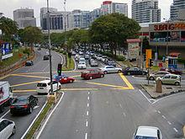
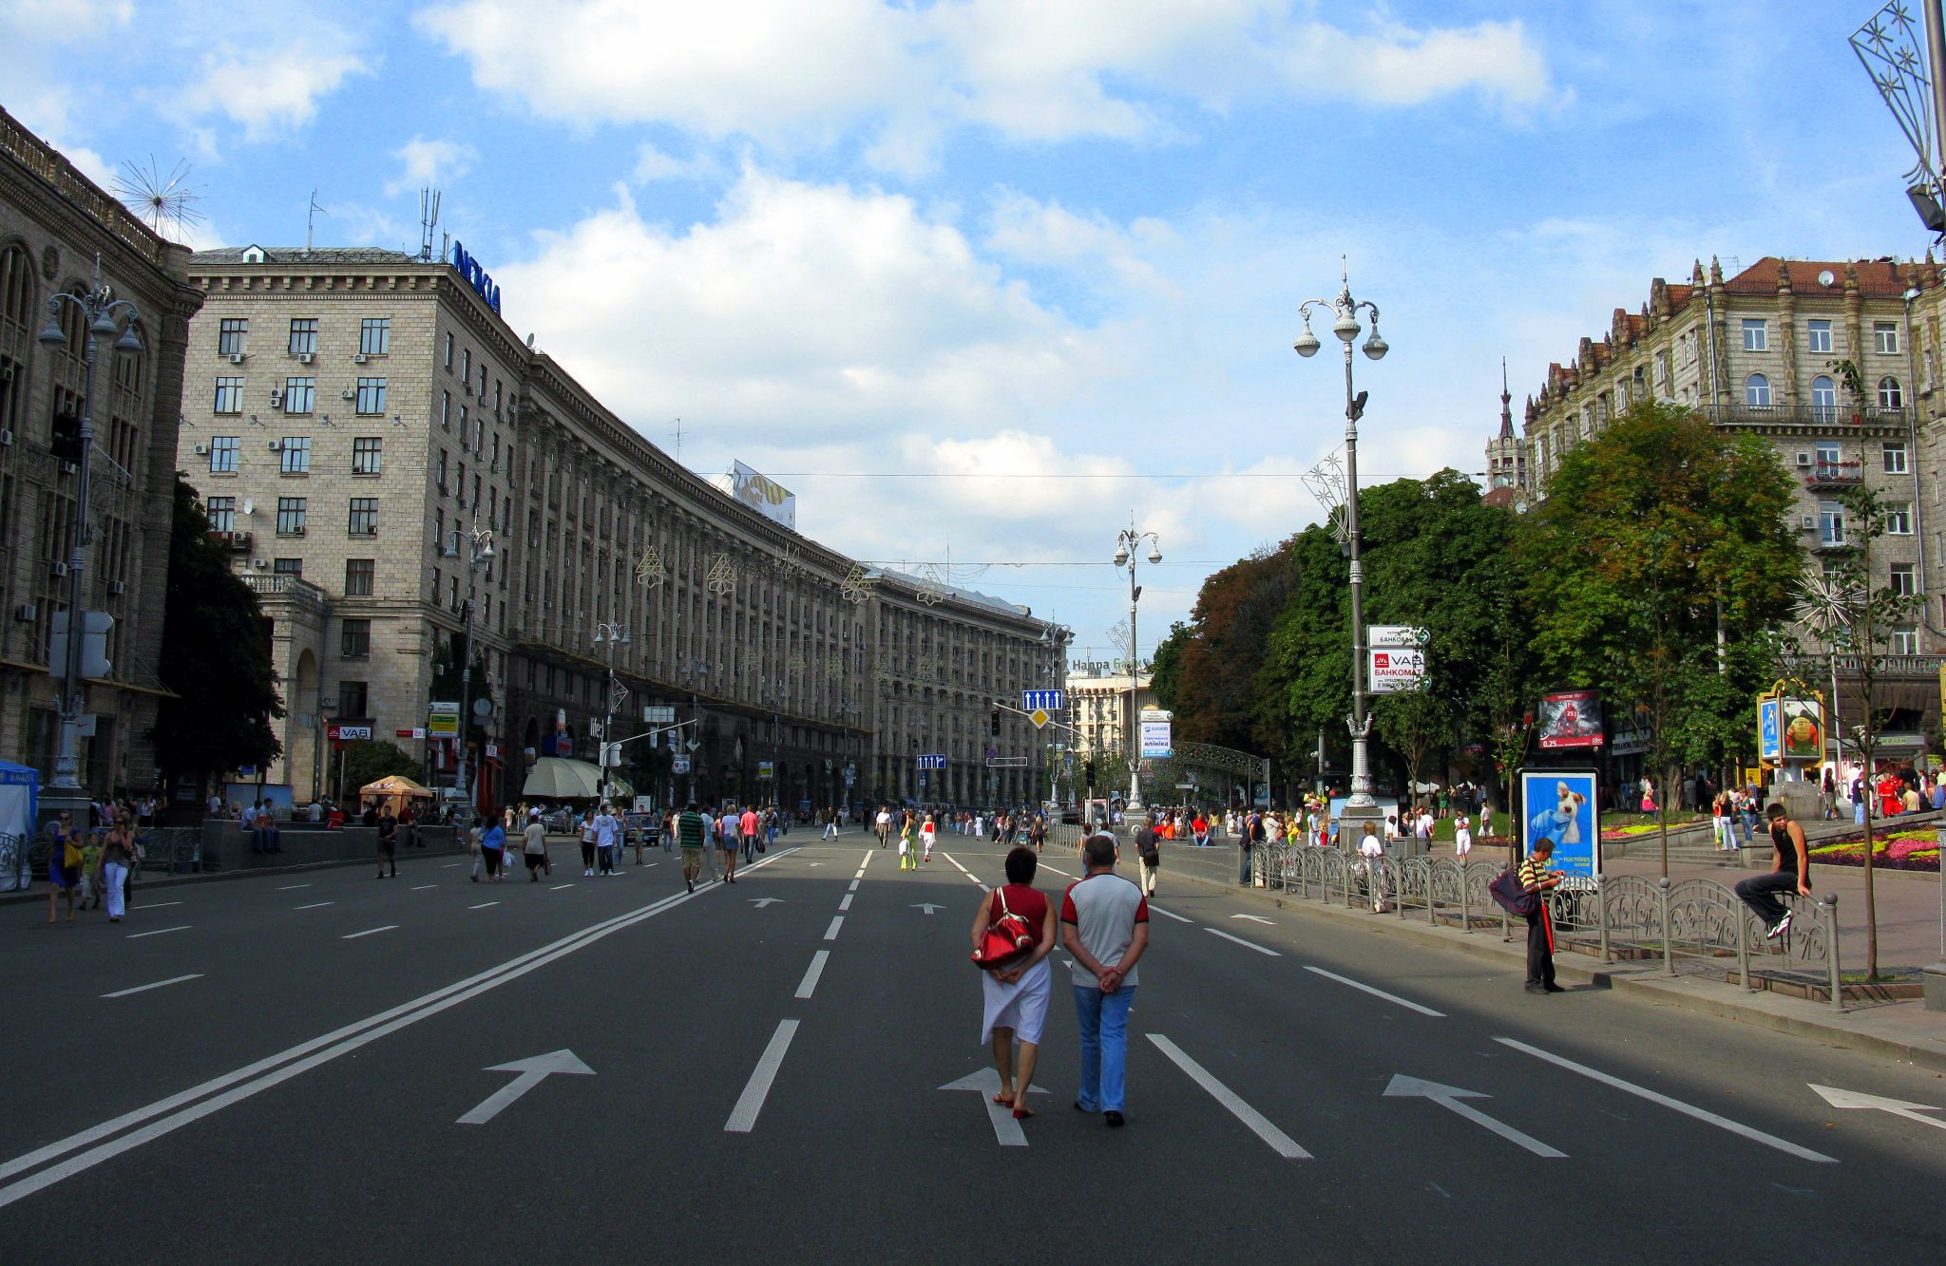

Slide 37
Stop #2: Independence Square
Maidan Nezalezhnosti is the central square of Kyiv, the capital city of Ukraine. One of the city's main squares, it is located on Khreshchatyk Street in the Shevchenko Raion.
The square has been known under many different names, but often it is called simply Maidan. In the 19th century, the square contained buildings of the city council and noble assembly. Since the start of Ukraine's independence movement in 1990, the square has been the traditional place for political rallies, including four large-scale radical protest campaigns: the 1990 student "Revolution on Granite", the 2001 "Ukraine without Kuchma", the 2004 Orange Revolution, and the 2013–14 Euromaidan.

Slide 38
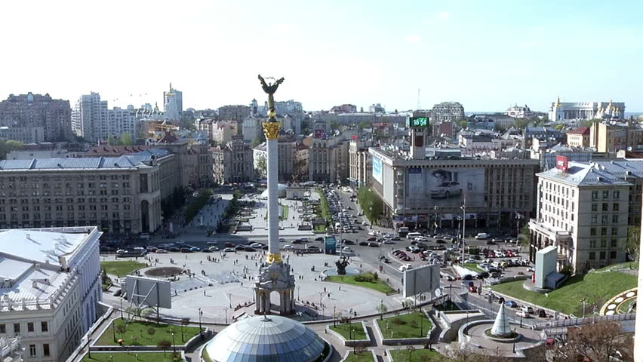
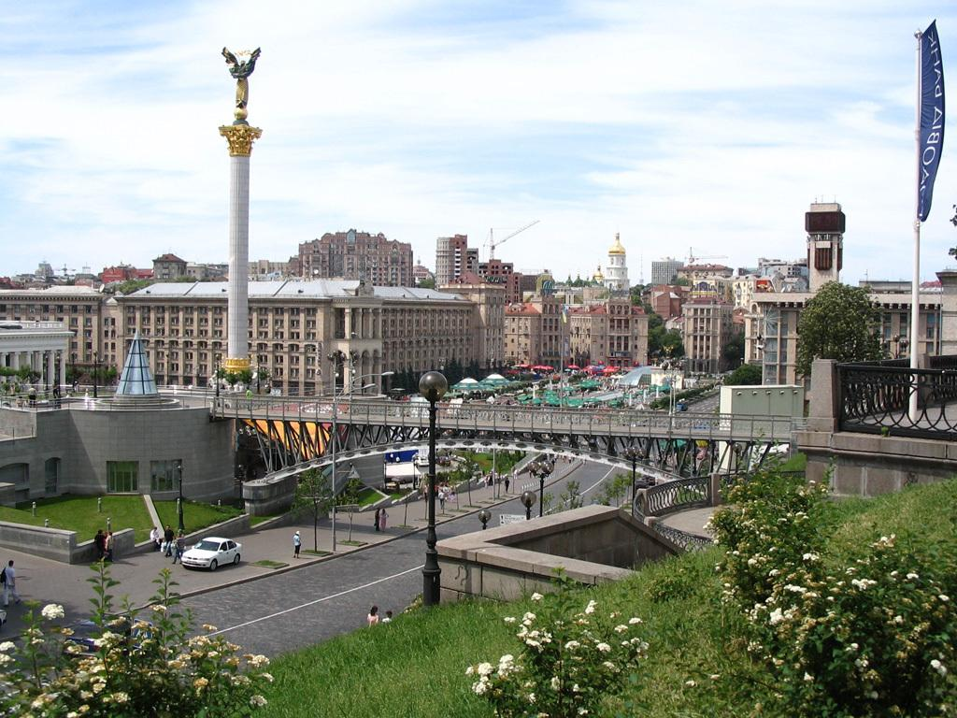

Slide 39
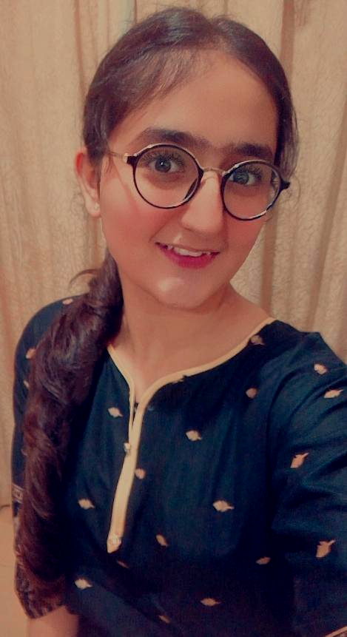
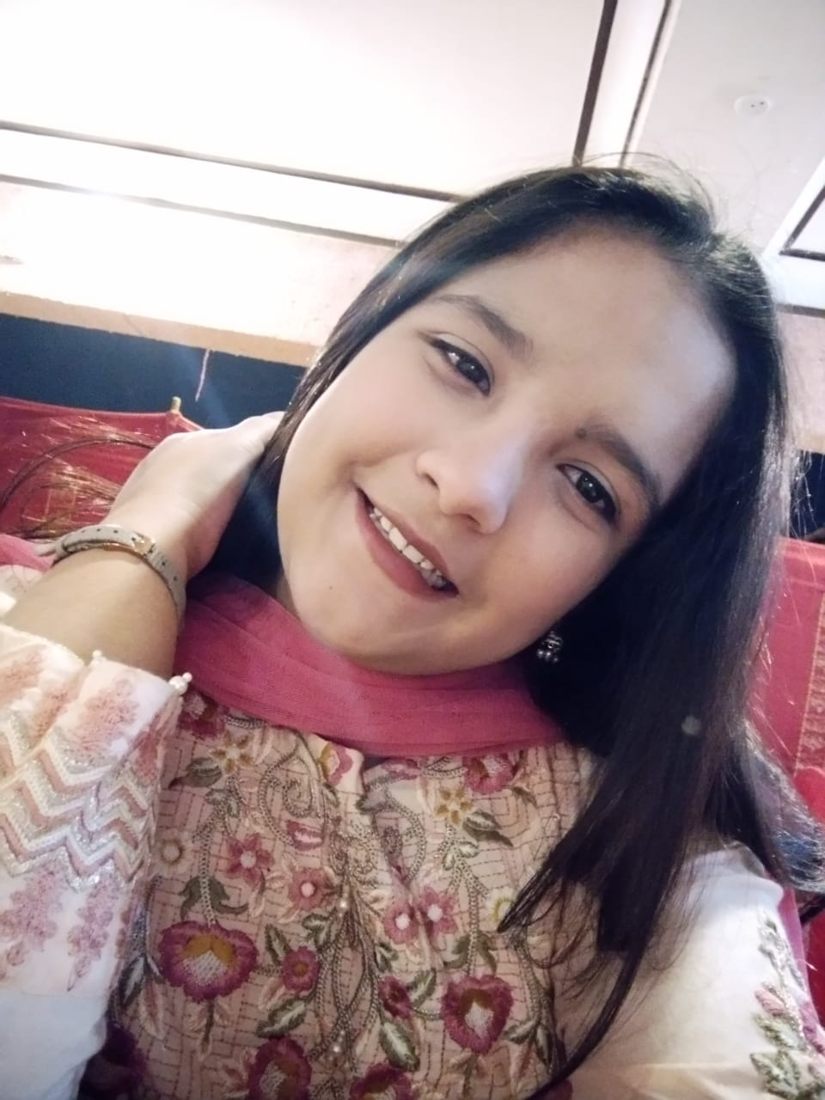
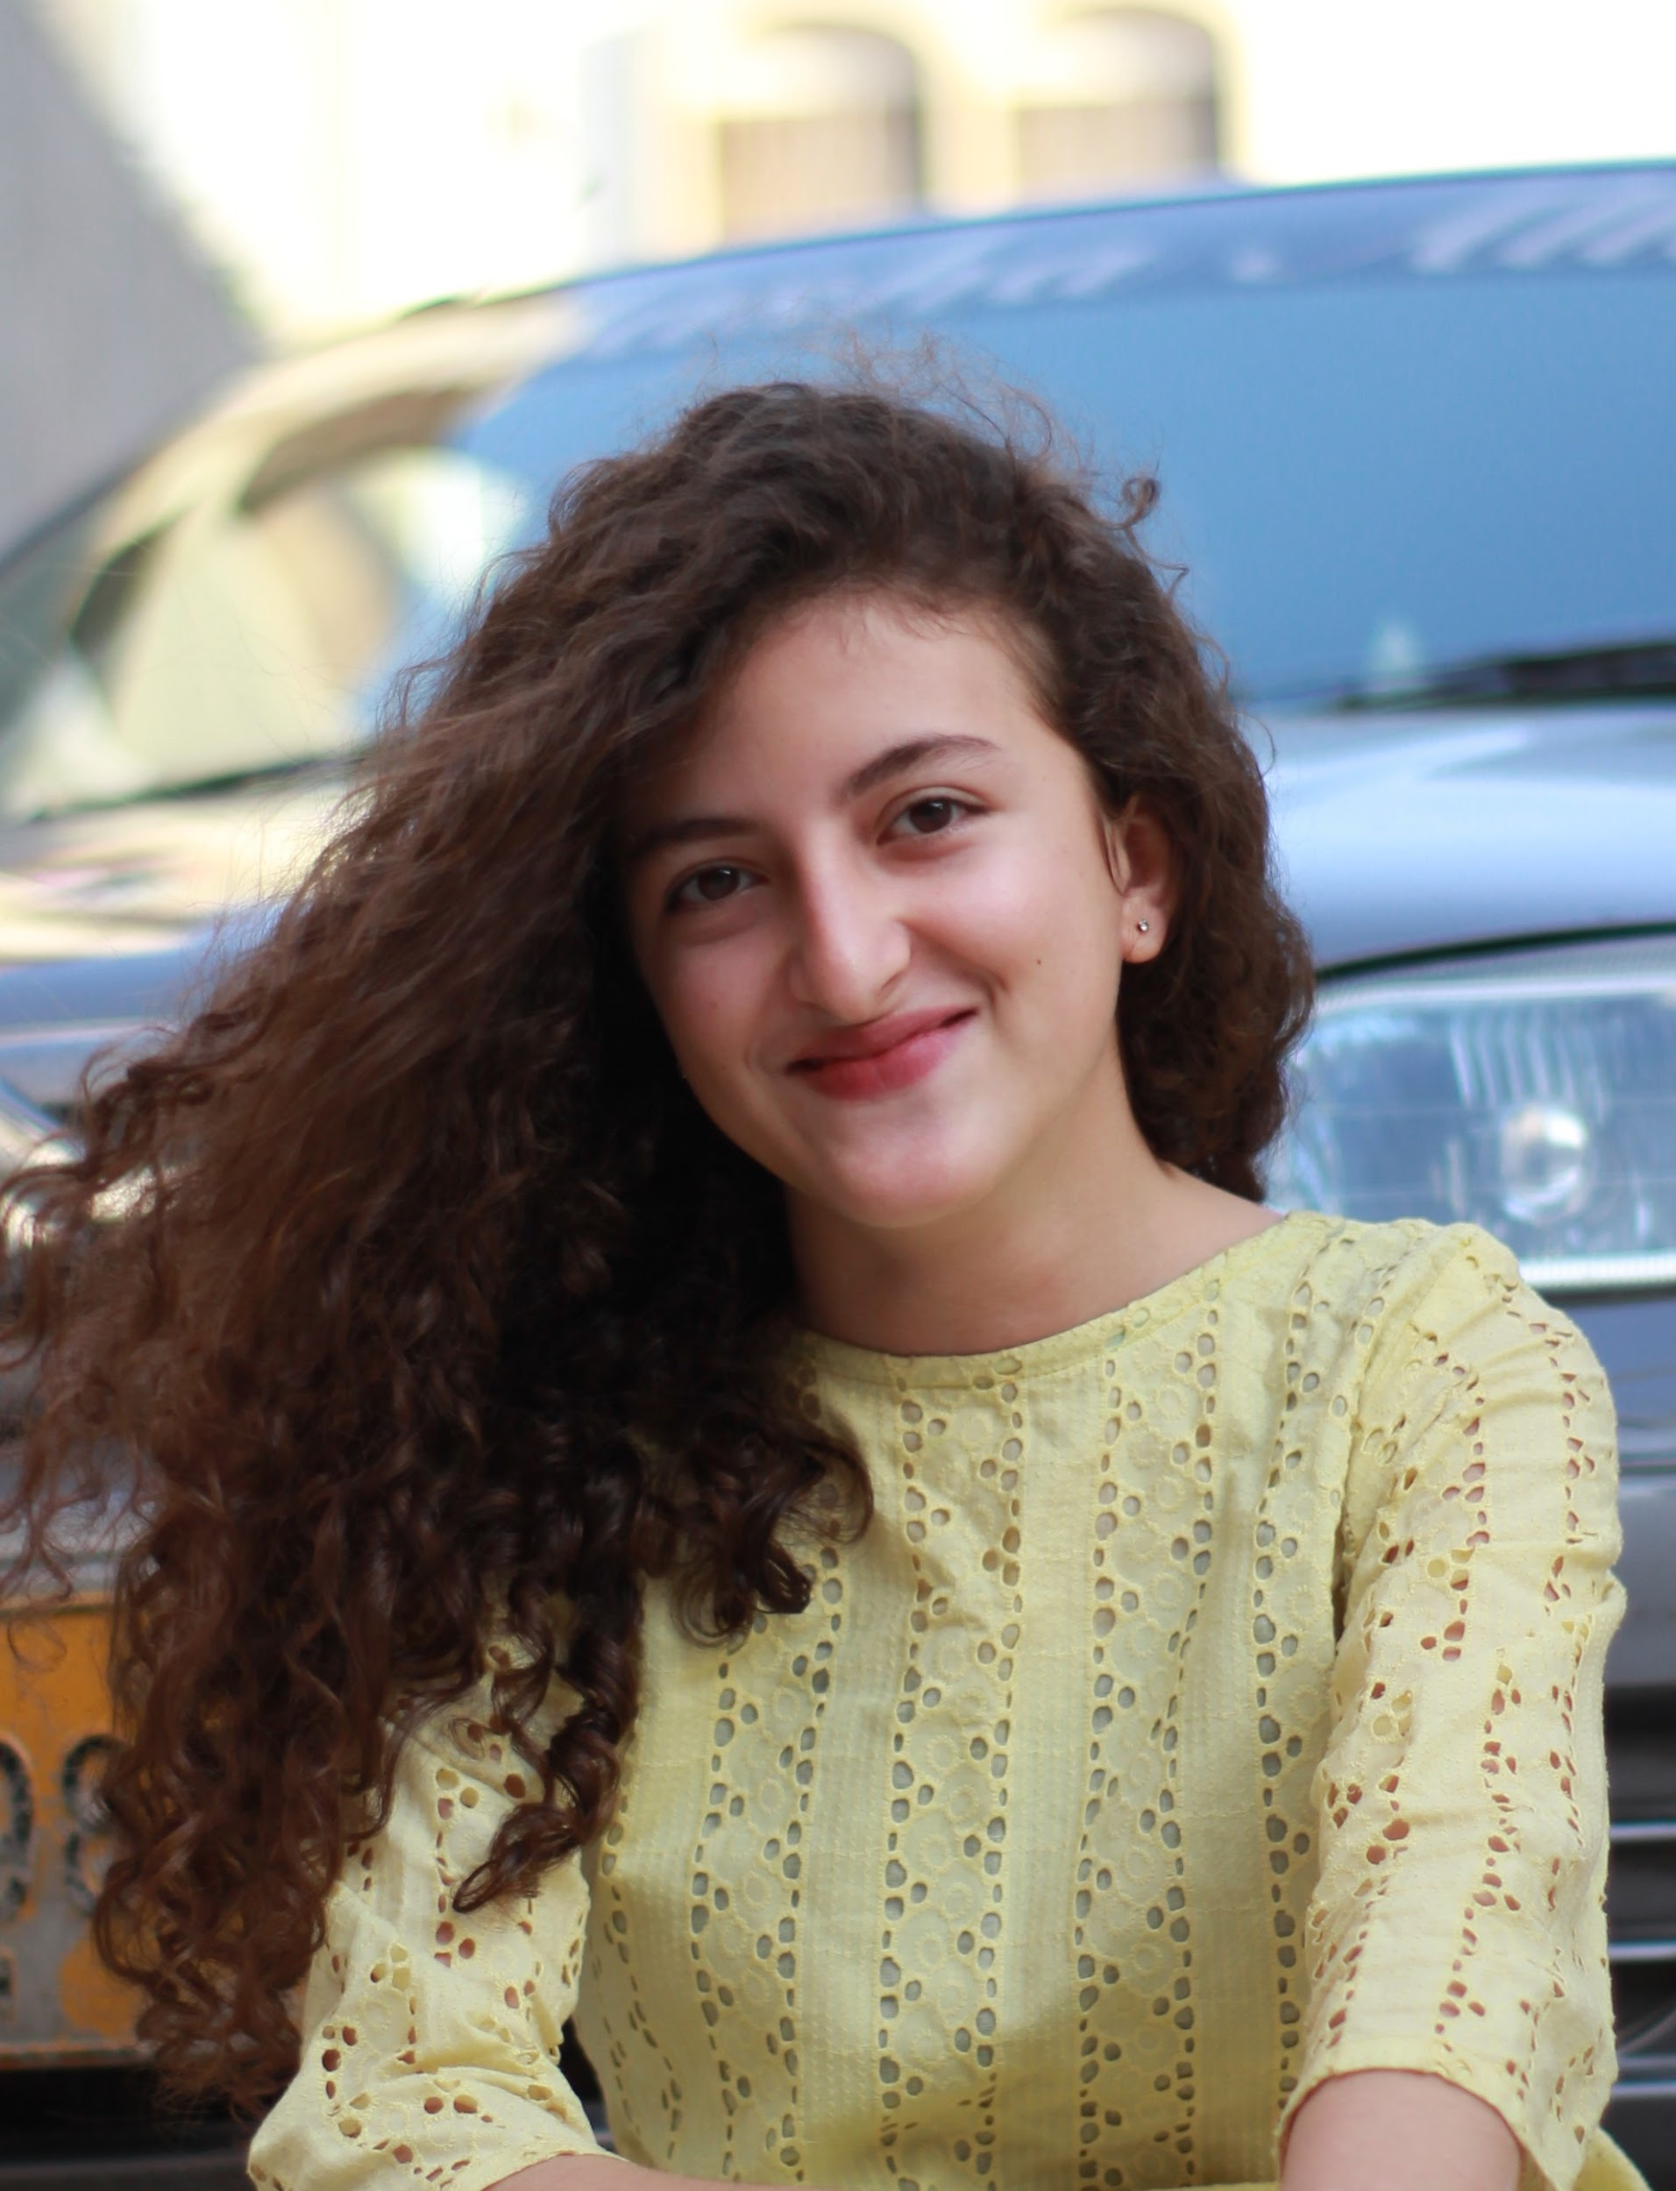
OUR TEAM
Anseeba Ali
Alishba Aijaz
Samina Khan

Slide 40
THANK YOU ☺

