Slide 1
Learning Circle Group: Places and Perspectives Learning Circle (Middle/High School) January to May 2021

Slide 2
Facilitators and Countries
Project Facilitators:
•Chris Hockert, United States
•Christine Hockert, United States
•Barry Kramer, United States
Participating Countries:
•Belarus, Egypt, Indonesia, Moldova, Pakistan, Slovenia, Ukraine, USA.

Slide 3
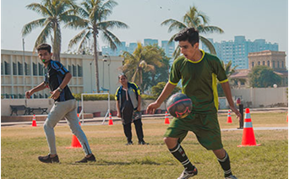
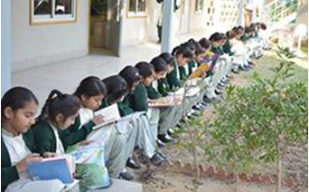
AGA KHAN SCHOOL, GARDEN KARACHI, PAKISTAN

Slide 5
Final Publication: Traditional Games

Slide 6
Traditional Games of Pakistan
1. Chupan Chupayi:
Every Pakistani has played this game once in a life time. It is always fun to play around the house, especially if you know some right hiding spots where nobody can catch you.

Slide 7
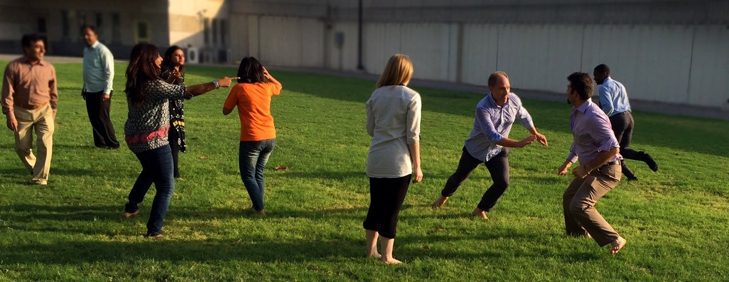
2. Pakram Pakrai:
It is also a very common game played by Pakistanis. This game involves a lot of running around and catching others.

Slide 8
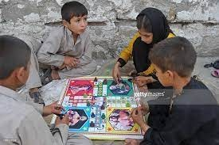
3. Ludo!:
Ludo is an indoor-board game, played by four players at a time. It is a game that can burn even the most reliable friendship bridges.

Slide 9
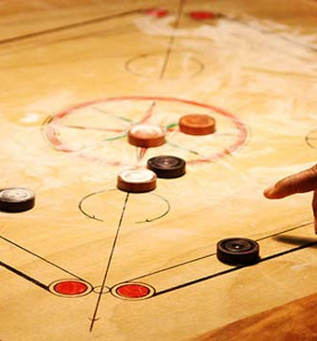
4. Carrom:
Carrom is an easy-to-play multiplayer board game. It's components include a board, pucks, striker, the queen. This game is worth spending time on.

Slide 10
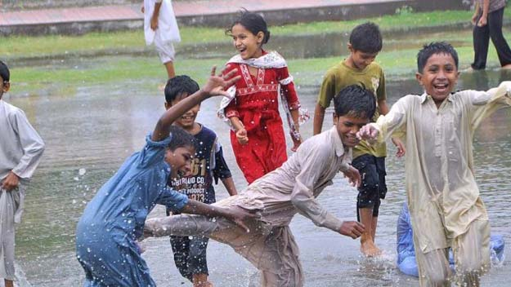
5. Baraf Pani:
A traditional game played in many countries. To play the game, start with two teams that have the same number of players on each team. It is played in a bigger space. One team are the chasers, and the other team are chased. When a chaser tags someone on the chased team, the tagged person turns into “baraf” (ice) and must stand in a designated area at one edge of the playing space. If another member of the chased team touches someone in the baraf area without getting tagged himself, the baraf person becomes “pani” (water) and can leave the baraf area to play again.
When everyone on the chased team is frozen into ice, the teams switch. The chasers become the chased. If the chasers have difficulty tagging everyone, you can make the playing area smaller

Slide 11
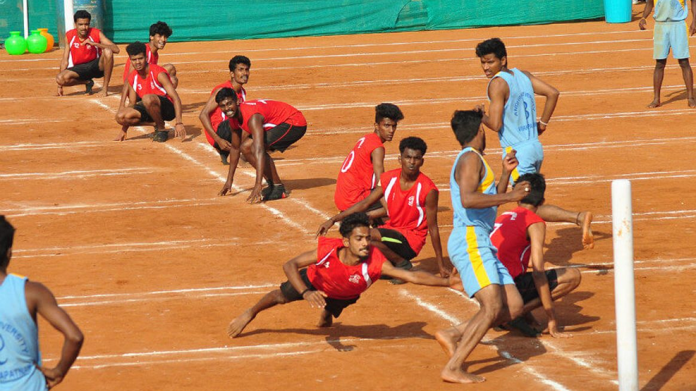
6. Kho-kho :
Kho-kho is one of the traditional Pakistan sport. It is a form of tag which is one of the oldest forms of outdoor sport. Each kho-kho team consists of 12 players, but during a contest, only 9 players from each team take the field. A match consists of two innings. In an innings, each team gets seven minutes for chasing and seven for defending.

Slide 12
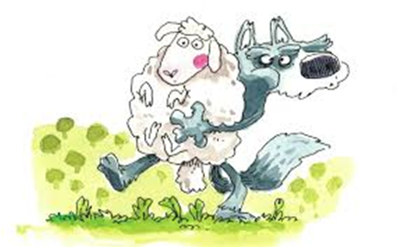
Traditional Games of Moldova
1. Wolf, Shepherd and Sheep:
The minimum number of players is five people among whom the roles will be distributed. The bigger and stronger your company is, the more fun the game will be. The area is divided into three sections: two houses on opposite sides of the playing area and a pastuer.
The shepherd must shout at the top of his lungs, "Wolf!" to protect the herd from the wolf's attack. But he can't touch the wolf, he can only stand in his way.

Slide 13
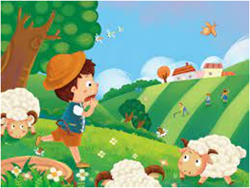
The shepherd lets them out and they scatter on the pastures. They run, they fight, they have fun together until they hear the shepherd's crazy cries. Whoever catches the wolf is out of the game. The game continues until the last living sheep!

Slide 14
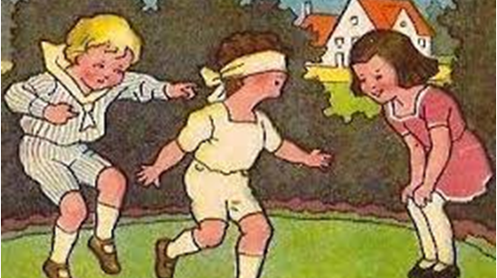
2. Baba Oarba/ Blind Grandmother:
Blind Grandmother is played in a very small and well-defined space. One of the children is so blindfolded that he turns into a "blind grandmother" and tries to catch the other children. When he succeeds in this, he must identify the child by touch and smell. If he guesses, he takes the caught child’s place. And then that child will be blindfolded and so on.

Slide 15
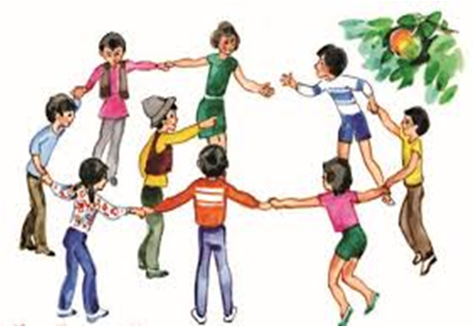
3. An Apple/Mărul:
Up to 15 children can play this game at the same time. Holding hands, they form a circle. A driver is selected at will. He stands in the center of the circle and says: “Apple, wormy apple! The wind blows, the apple falls!” When the driver begins to pronounce these words, the players run in a circle. At the end of the phrase, everyone should quickly squat down. Anyone who fails to do this, takes at least one step or falls, is eliminated from the game. The game continues until there are three players left in the circle. They are announced as winners.

Slide 16
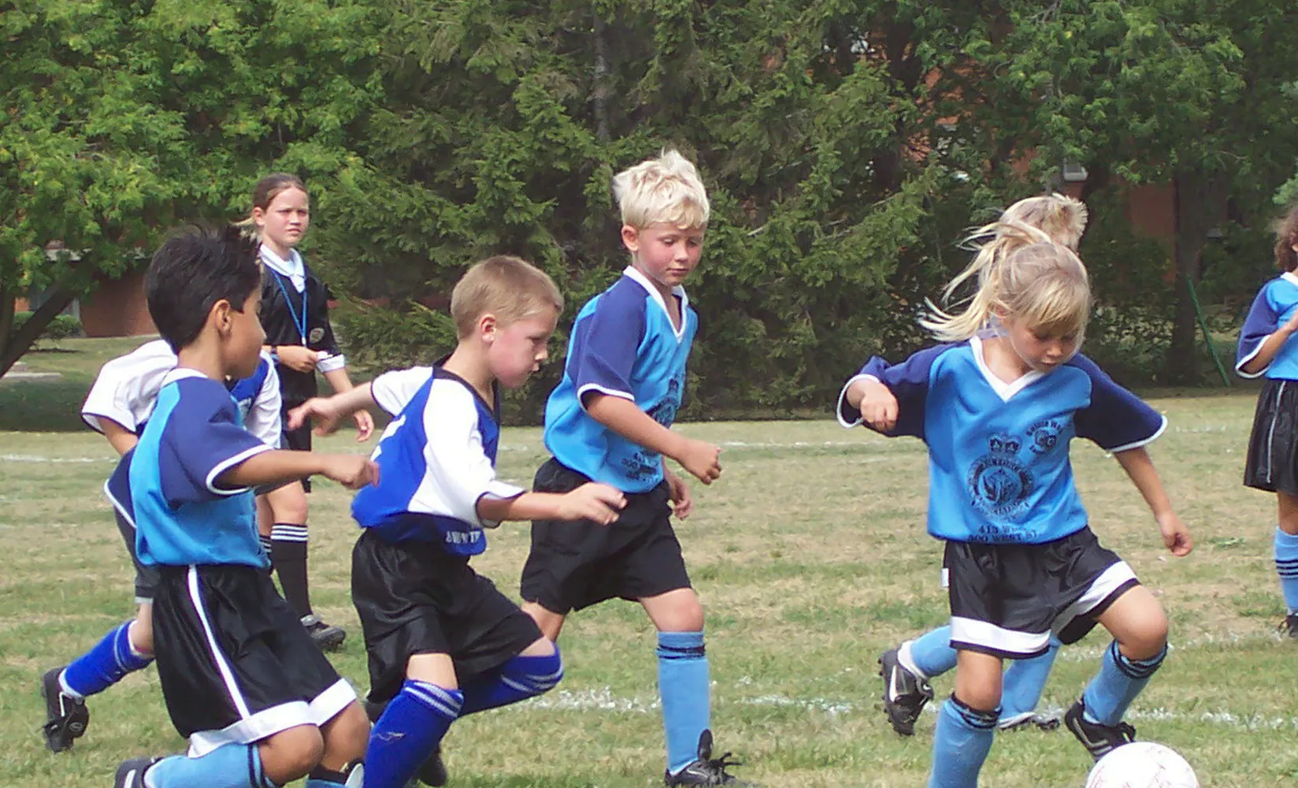
4. Soccer
The sport of soccer is considered to be the world's most popular sport. In soccer, there are two teams of eleven players. Soccer is played on a large grass field with a goal at each end. The aim of the game is to get the soccer ball into the opposing team's goal.

Slide 17
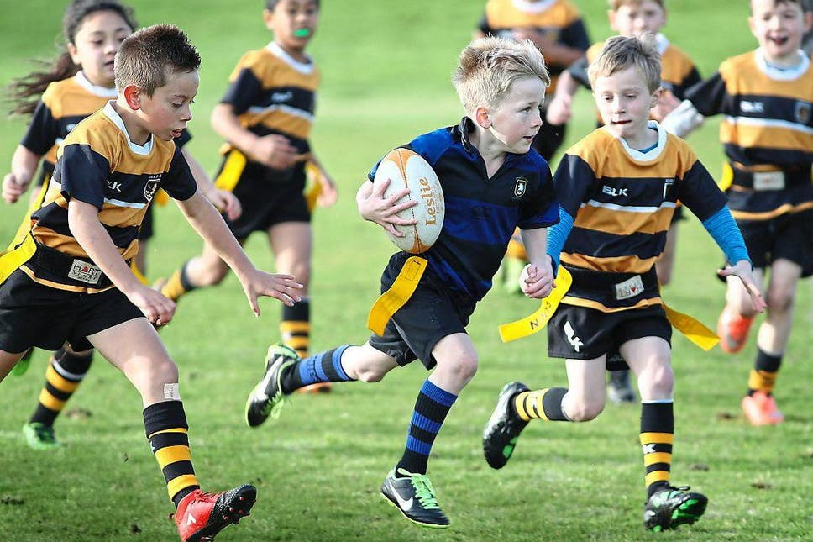
5. Rugby
Rugby is a 15-a-side team sport. The object of the game is to ground the ball behind the opponent's try line, into what is called the in-goal area. Rugby is played both with the ball in hand and by kicking the ball.

Slide 18
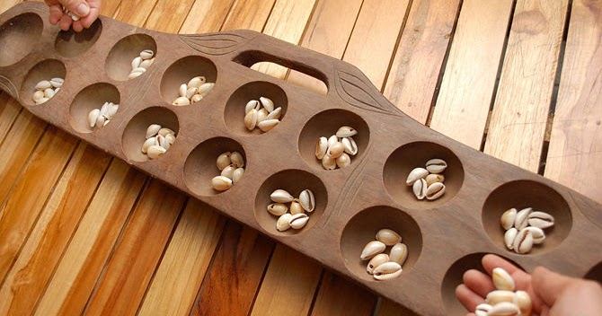
Traditional Games of Indonesia
1. Congklak:
One of the oldest known games in the world. It is played on a board with circular indentations . The game is played with 98 small markers such as shells or beads, which are divided evenly between all the indentations.

Slide 19
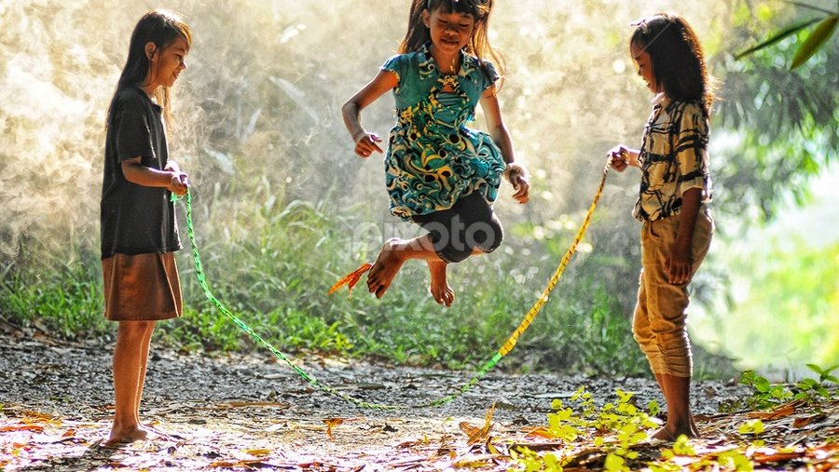
2. Lompat Tali:
This is a very popular game which elementary school girls play at recess time. It is much like skipping rope however the rope that the girls use is made from hundreds of elastic bands that are looped together to form a large ring. The girls take turns trying to jump over the elastic rope which is held by two girls at each end.

Slide 20
3. Gangsing:
This game is normally played by boys. The gangsing is a top made from bamboo with a small opening on the side. String is wound around the dowel that goes through the center of the gangsing . The child then holds onto the flat bamboo handle that is tied to the end of the string and pulls this handle to set the gangsing spinning. Two children play against each other. The object of the game is to try and knock your opponent's gangsing out of the designated circle.

Slide 21
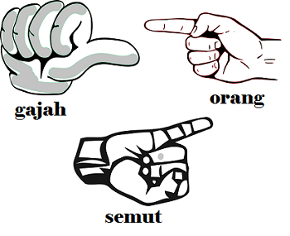
4. Semut, Orang, Gajah:
This game is popular throughout Asia, just as it is throughout the world in all its variations. It's like playing a paper, scissors, stone game of similar design. In Indonesia the game is also known as suwitan and is played by young children to see who goes first in play, or just for fun to see who wins.

Slide 22
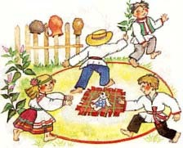
Traditional Games of Belarus
1. Ivanka:
The number of participants could be up to 20 people. A circle is drawn on the land around "Ivanka" . It is called "forest". In the center of "forest" the square is drawn . It is a "house of the forest man". "lvanka" is placed in the house and a person is chosen to play a "forest man". The rest of the players are called "swans". The "forest man" can catch "swans" with his hand or touch swans with his magic branch. Caught "swans" will leave the game. The "swan" who carries out "Ivanka" becomes a "forest man". The "forest man" cannot leave forest. The "swan" cannot transfer "Ivanka" to others. The game is over when all the "swans" are out of the game.

Slide 23
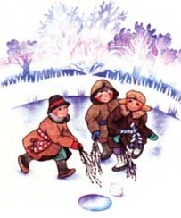
2. Miaciolka:
This game is like pre-historic hockey. The action takes place on the ice-rink, the surface of the frozen pond or lake. Each participants has a broom - "miaciolka" made of branches. 3-5 pieces of ice are used in this game . 190 people can play this game simultaneously.

Slide 24
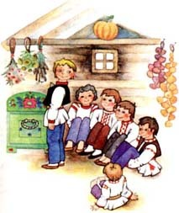
3. Shyla:
In this game an awl is used. There could be up to 20 players in this game. A "leader" is chosen. He stands in the center of the room. The rest of the kids sit down very close to each other on the floor in a half circle behind his back. The legs are bend and hands are hidden under their knees. One of the players has a toy. The players secretly transfer it to one another. The one who has a toy can either transfer it to someone else, or he could touch the leader's shoulder. If the leader guesses right who is the person, then they change places.

Slide 25
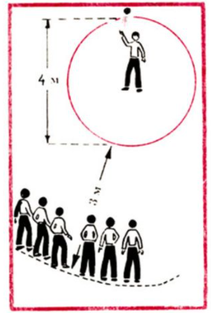
4. Pickup
Belarusians play this game in winter. The place to play is a snowy slope. Inventory - sledges, cones or other small objects. The number of players is unlimited. Cones are laid out on a slope along a rolled sled track. Moving down the mountain in turn, playing on the go collect cones. Whoever picks up most of the cones wins.

Slide 26
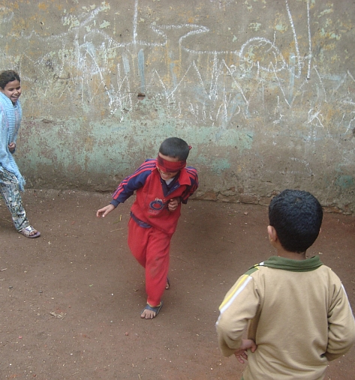
Traditional Games of Ukraine
1. Blind Cat:
Number of players: 5, but 10 players can play too. A cat must be chosen. A mouse covers his eyes with a black handkerchief, and then the cat has to find a mouse and guess the person. A cat becomes an angry mouse and a mouse becomes a blind cat.

Slide 27
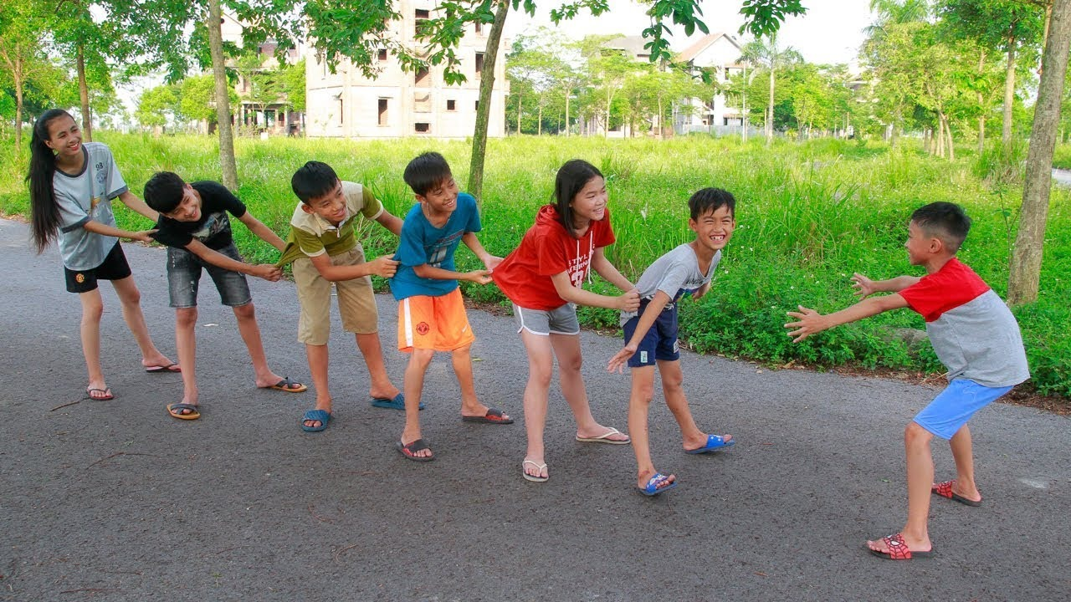
2. Dragon:
All children taking part in a game make a chain and put their hands on friend’s shoulders. First person has name “a head of the dragon” and last one – “a tail of the dragon”. The chain of kids starts running. “The head” tries to catch “the tail”. Using hands is not allowed. If “the tail” has caught “the head”, they switch the spots. “The head” becomes “the tail”.

Slide 28
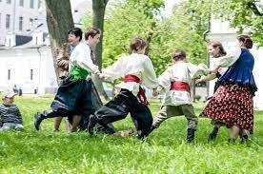
3. Jungle-Jingle
It is a song-game, loved by many Ukrainians. The children sing , when they are moving in the circle and holding their hands. “Jungle” is running in the circle and when the song is over, “Jungle” stands in the circle, then “Jungle – Jingle” will be a new person.

Slide 29
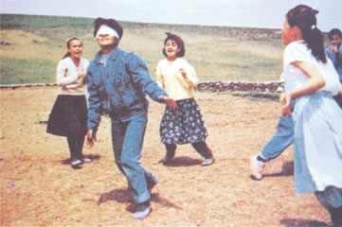
4. Old Woman Kutsia
In this game a person ties a handkerchief on the eyes of another person and turns him around. The other children begin to clap hands together. The person with the blindfold on his eyes must catch the first nearest person, at this time all children around call his name. The first caught man is called “Old woman Kutsia”.

Slide 30
References
https://www.expat.or.id/info/games.html
https://study.com/academy/lesson/traditional-games-in-pakistan.html
https://www.brandsynario.com/10-games-90s-every-pakistani-will-remember-playing/
https://www.belarusguide.com/culture1/holidays/games.html
https://blog.dinolingo.com/ukrainian-language-culture/ukrainian-fun-and-games-ukrainian-culture-for-kids/
https://www.kidsofcourage.com/?p=2290
https://moldova.md/en/content/sport
Images:
Google Images

Slide 31
Sponsoring Teacher
• Ms. Naila Fahim
Learning Technology Facilitator,
Aga Khan School, Garden,
Karachi, Pakistan

Slide 32
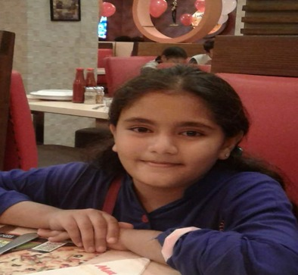
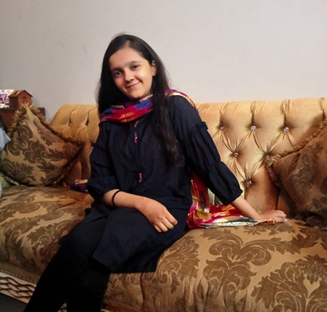
Prepared By:
Rabel Aijaz Ali- 9C
Sana Sohail Meghani- 8D

