Slide 1
IEARN Global Learning Circles January-May 2021 Places and Perspectives
Learning Circle 1 (Middle/High School)

Slide 2
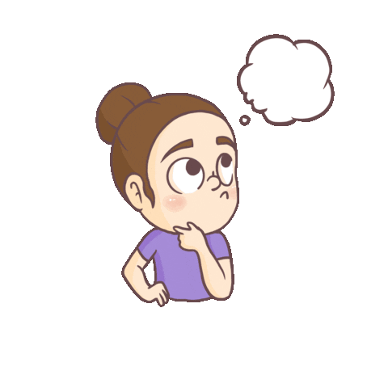
What is iEARN Global Learning Circle: Places And Perspectives??
iEARN Global Learning Circles are highly interactive, project-based partnerships among a small number of schools located throughout the world. There are two sessions each year, September - January and January - May.
Places and Perspectives encourages students to explore regional history, culture, government, and geography by sharing their knowledge with people from different locations.

Slide 3
Participating countries
PAKISTAN
UKRAINE
MOLDOVA
EGYPT

Slide 4
Participating countries
USA
SLOVENIA
INDONESIA
BELARUS

Slide 5
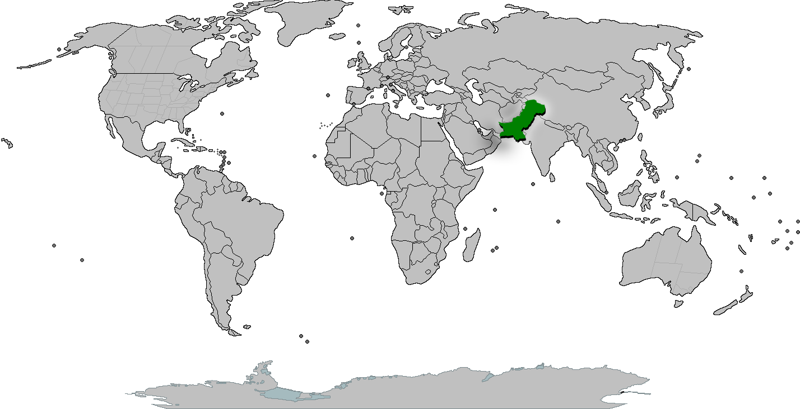
OUR COUNTRY

Slide 6
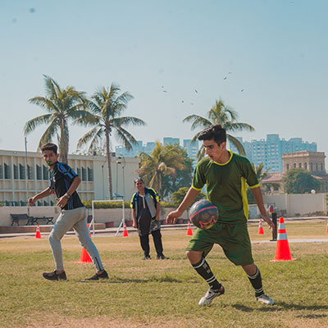
OUR SCHOOL
AGA KHAN SCHOOL GARDEN,
KARACHI, PAKISTAN

Slide 7
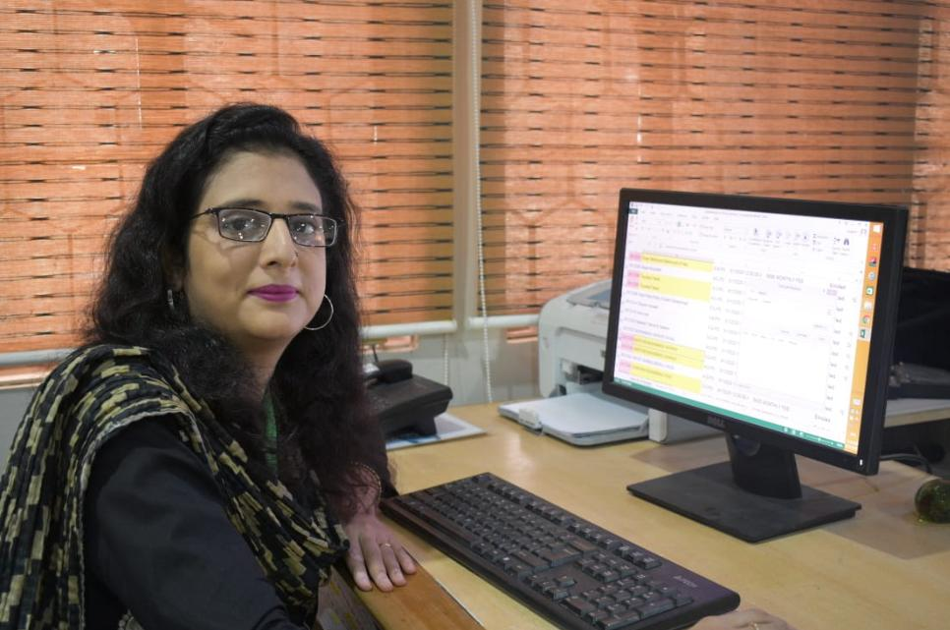
OUR INSTRUCTOR
Learning Circle Teacher
Ms. Naila Fahim,
Learning Technology Facilitator,
Aga Khan School, Garden, Karachi, Pakistan

Slide 8
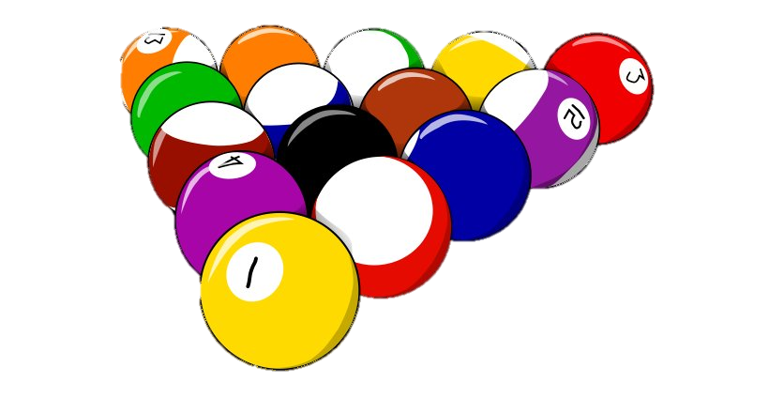
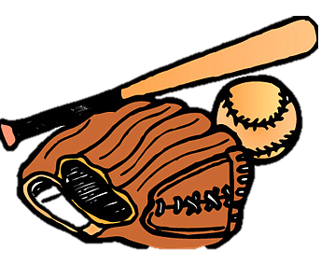
“Traditional games”
“From around the world”

Slide 9
Pakistan
Pakistan is populous multiethnic country of south Asia. Having a predominately Indo-Iranian speaking population.

Slide 10
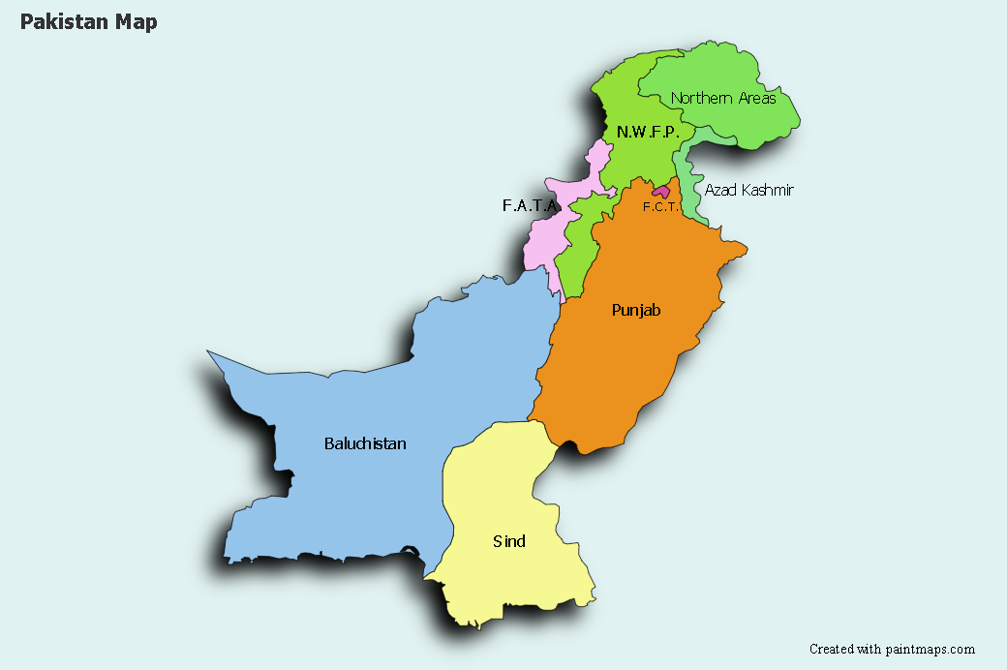

Slide 11
Game #1 “kho-kho”
Kho-Kho is a unique game played in India, Bangladesh and Pakistan.
It is generally a tag sport, and it is played by 2 teams. Every team has 12 players, and these players try to evade being touched by other players of the opponent team.
It must be noted that only nine players are permitted to enter the Kho-Kho field.
It is one of the most popular tag games in entire South Asia.

Slide 12
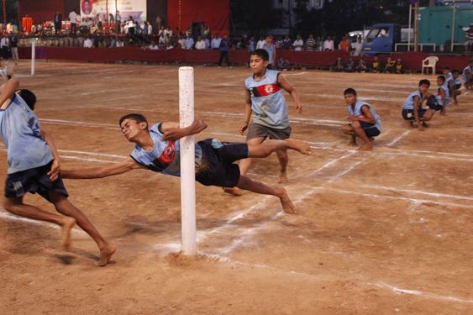
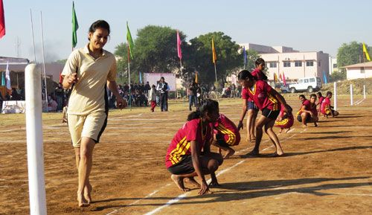

Slide 13
Game #2 “Pittu (Seven Stones)”
Seven stones (also known by various other names) is a game from the Indian subcontinent involving a ball and a pile of flat stones , generally played between two teams in a large outdoor area.
It is played today in villages.
One team has to knock down the blocks and try to restore the pile of blocks, while the other team tries to throw the ball at the opposing team.

Slide 14
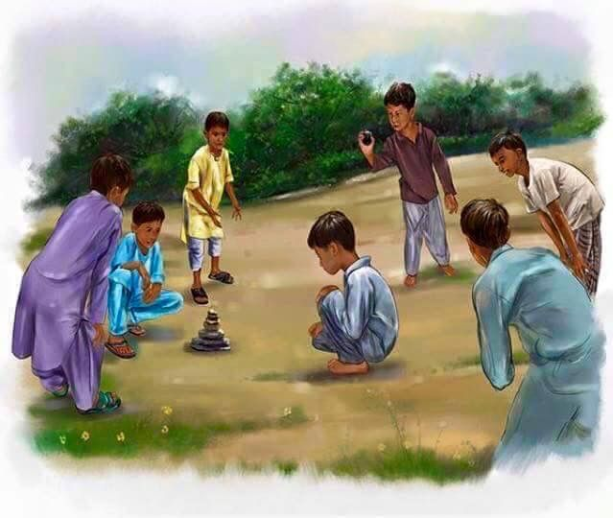
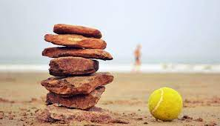

Slide 15
Moldova
Moldova, an Eastern European country and former Soviet republic, has varied terrain including forests, rocky hills and vineyards.

Slide 16
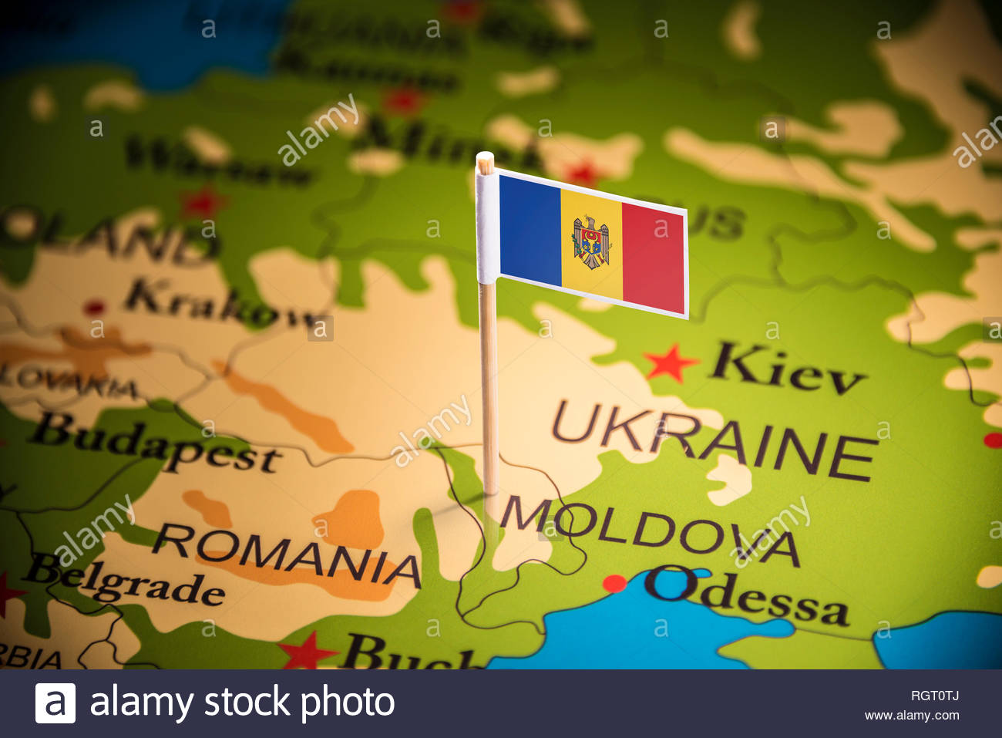

Slide 17
Game # 1 “wolf, shepherd and sheep”
This game is an adapted version of Duck, Duck, Goose. Have all students sit in a circle facing one another.
Choose one person to be it, the “wolf.” The “Wolf” walks around the outside of the circle gently tapping each seated player on the shoulder or head, saying “shepherd” each time.
At random, the “Wolf” picks one player and says “sheep.” The player must get up and chase the wolf around the circle.
If the “wolf” makes it around the full circle and sits down in the player’s spot before getting tagged, the “wolf” is safe, and the other player is the new “wolf.” Play continues until the leader stops the game

Slide 18
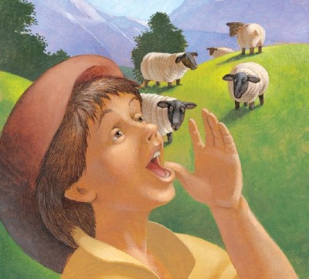
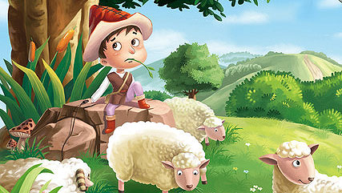

Slide 19
Game #2 “Blind Grandmother”
Blind Grandmother is played is a popular children's game.
One of the children is blindfolded that he turns into a "blind grandmother" and tries to catch the other children. When he succeeds in this, he must identify the child by touch and smell. If he guesses, he takes the caught chid’s place.

Slide 20
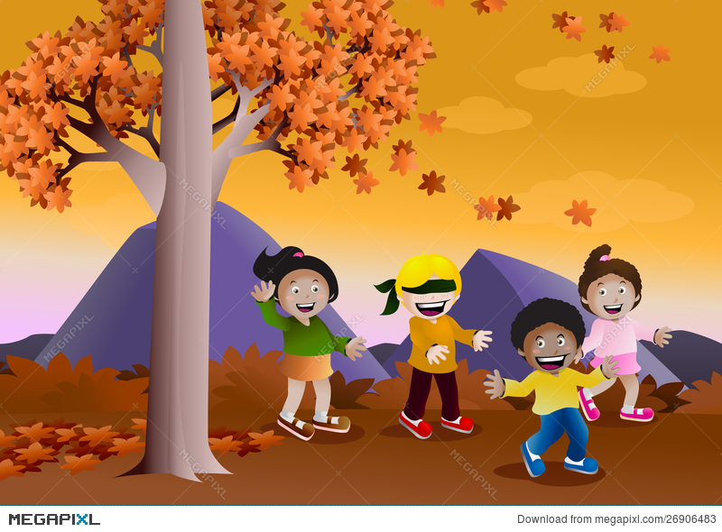
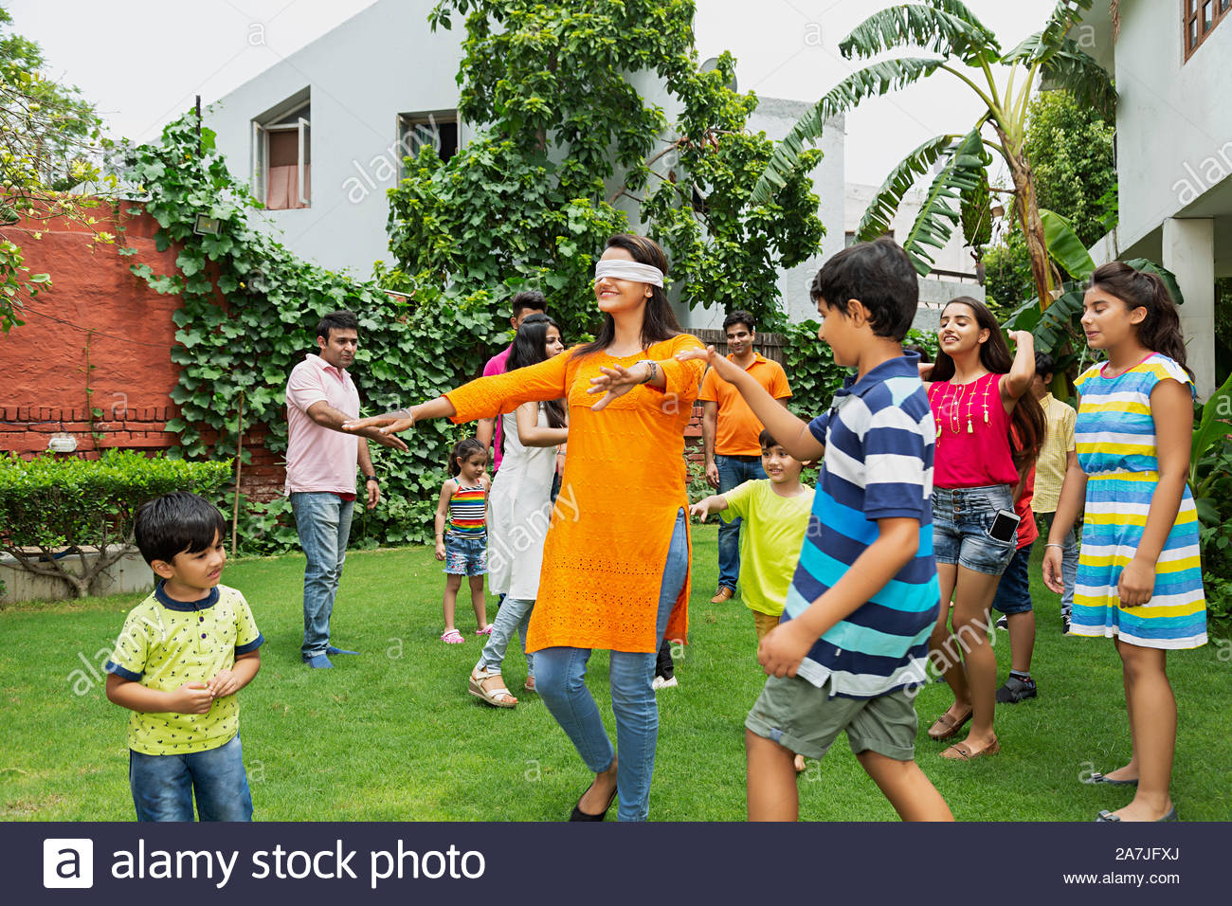

Slide 21
Indonesia
Indonesia, officially the Republic of Indonesia, is a country in Southeast Asia and Oceania between the Indian and Pacific oceans.

Slide 22
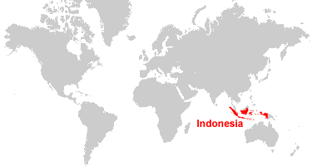

Slide 23
Game #1 “Kelereng or Gundu”
Indonesian marble might have a little bit different rules. In Indonesia, marble is called Kelereng.
In some regions, this game is also called Gundu.
This game is commonly played by boys. You need two players or more to play this game.
There are various types of game with various rules that you can play using Kelereng.

Slide 24
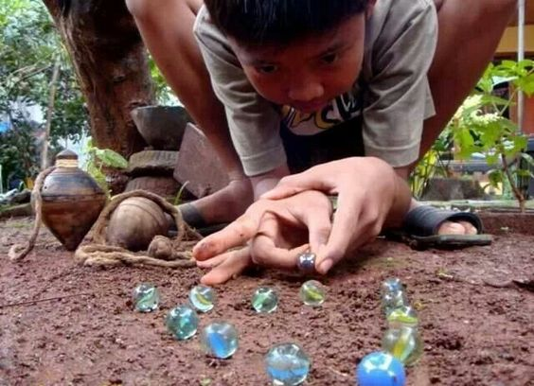

Slide 25
Game #2 “Layang-Layang”
Layang-layang or kite flying is a very popular pastime for Indonesian children.
The main aim of kite fighting is to cut opponent's line.
It can be played between one to many opponents.
The one who is able to have his kite in the air when all else are not due to their lines being cut wins.

Slide 26
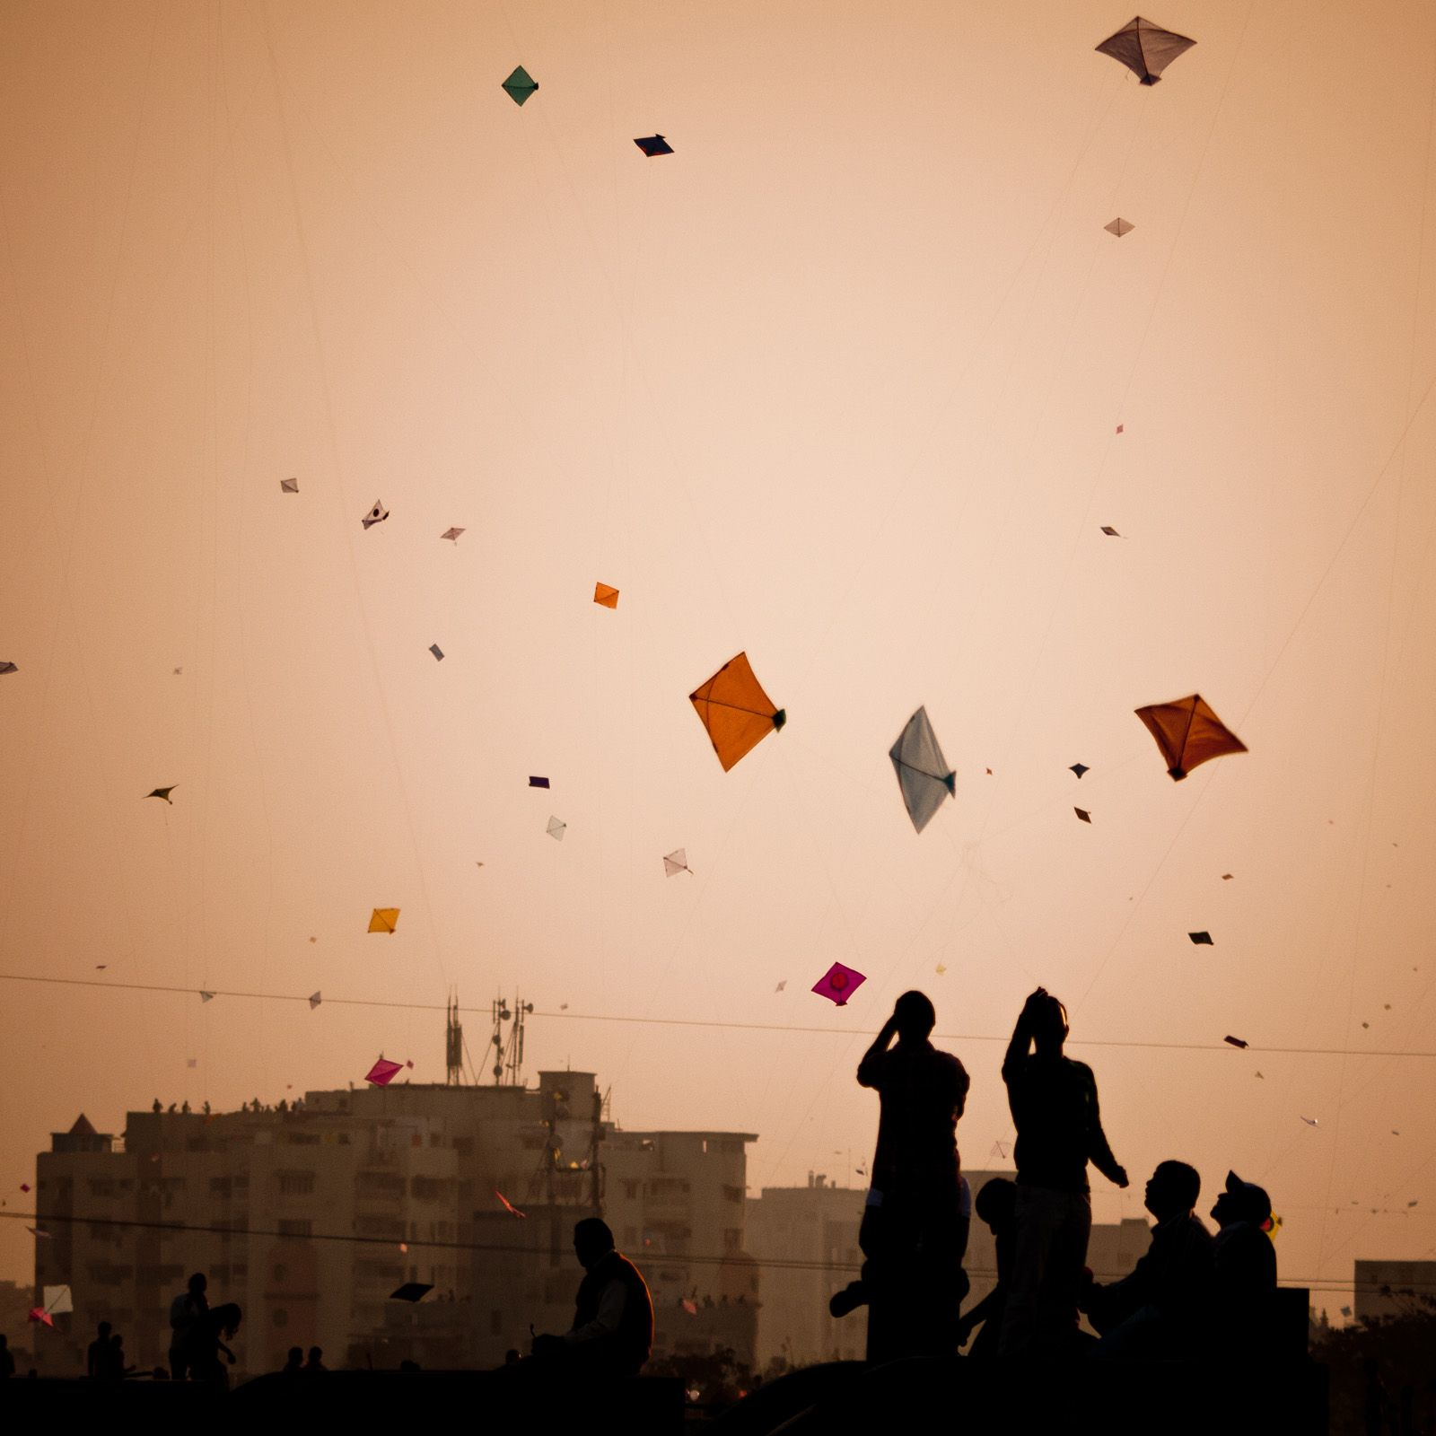

Slide 27
Egypt
Egypt, a country linking northeast Africa with the Middle East, dates to the time of the pharaohs. Millennia-old monuments sit along the fertile Nile River Valley.

Slide 28
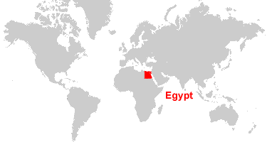

Slide 29
Game #1 “Senet”
The Grand Egyptian Museum in Cairo has indicated that the oldest game from ancient Egypt was called “Senet”.
It is a board game that was played by many of the members of the royal families, including Tutankhamun.
The way the game was played is that each player rolled dice and, using sticks would try to move the board pieces around and eventually off the board, while at the same time keeping the opposite person playing from accomplishing the same thing.

Slide 30
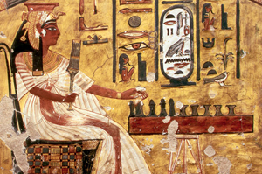
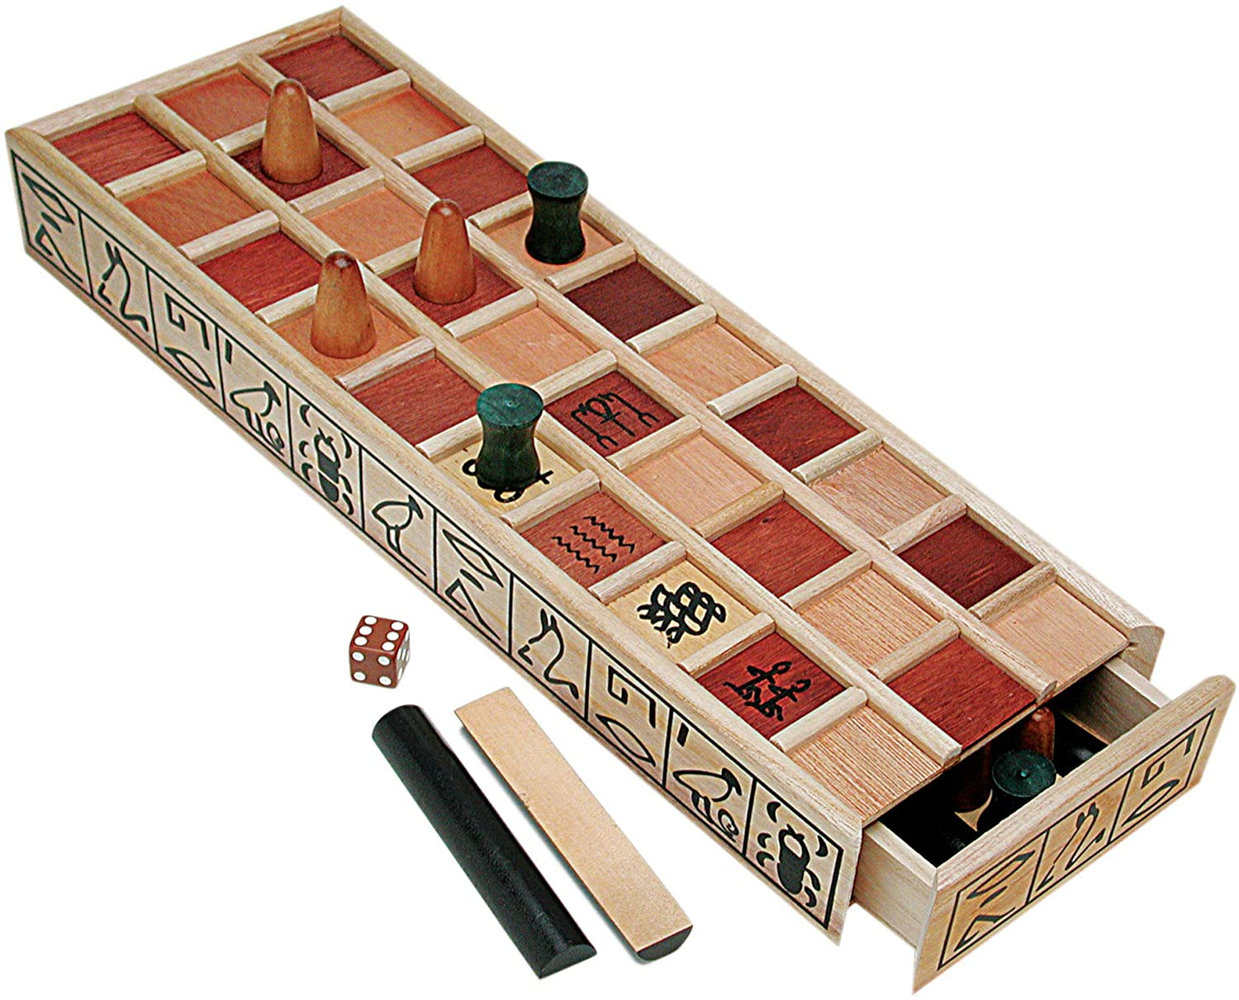

Slide 31
Game #2 “Knuckle Bones”
Knucklebones, also known as snobs, astragalus, tali, dibs, fivestones, jacks, or jackstones, among many other names, is a game of dexterity played with a number of small objects that are thrown up, caught, and manipulated in various manners.
It is ancient in origin and is found in various cultures worldwide.

Slide 32
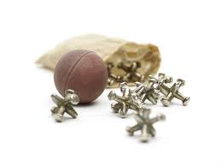
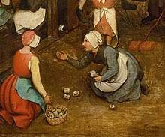

Slide 33
Ukraine
Ukraine is a country in Eastern Europe. It is the second-largest country in Europe, after Russia, which it borders to the east and north-east.

Slide 34
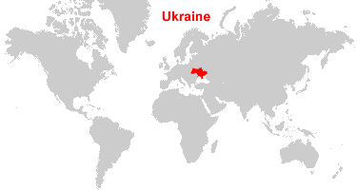

Slide 35
Game #1 “blind cat”
The next game has two names: “Blind Cat”, “Eyes”.
There are about 5 players in this game , but 10 players can play too.
A cat must be chosen. A mouse covers his eyes with a black handkerchief, and then the cat must find a mouse and guess the person.
A cat becomes an angry mouse, and a mouse becomes a blind cat.

Slide 36
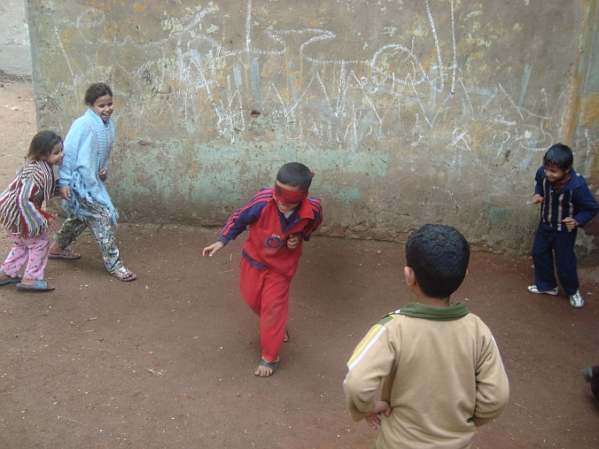
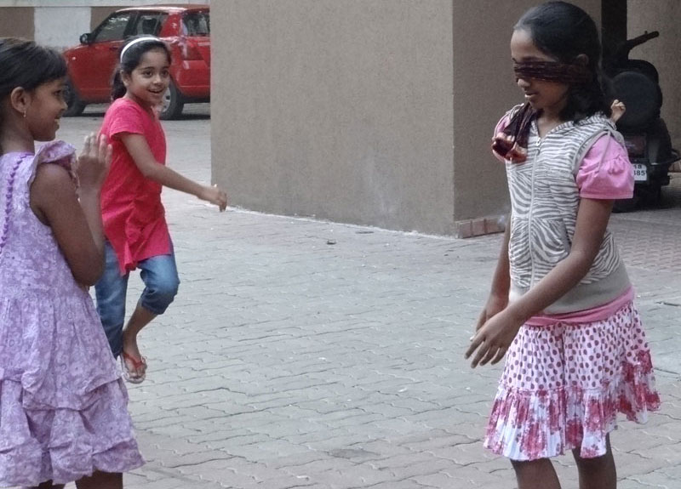

Slide 37
Game #2 “Croquet”
Croquet is a game that involves hitting wooden or plastic balls with a mallet through hoops embedded in a grass playing court.
Croquet can be played by two, four or six players.
The objective of the game is to hit your ball(s) through the course of six hoops in the right sequence in each direction and finish by hitting them against the centre peg.
The side which completes the course first with both balls wins.

Slide 38
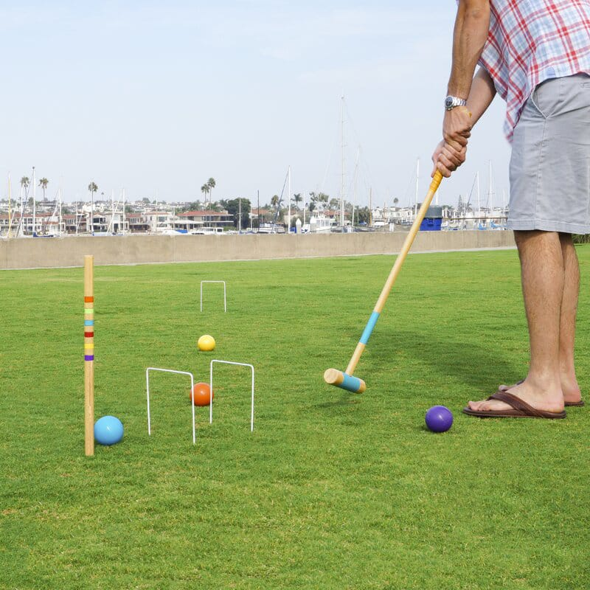
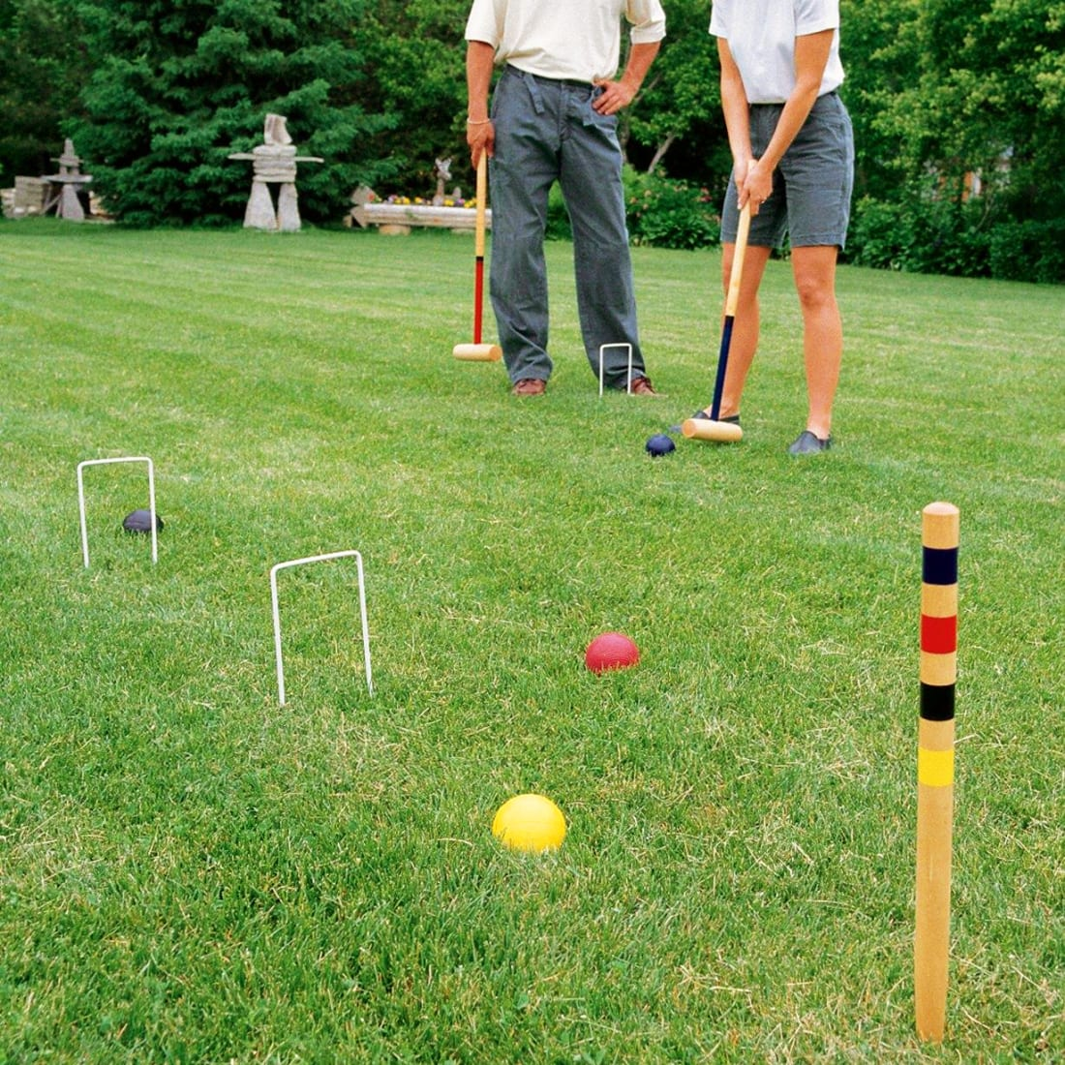

Slide 39
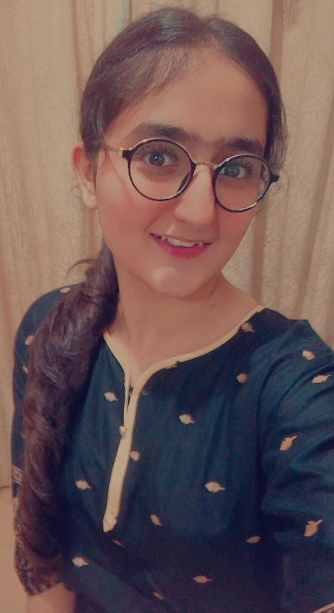
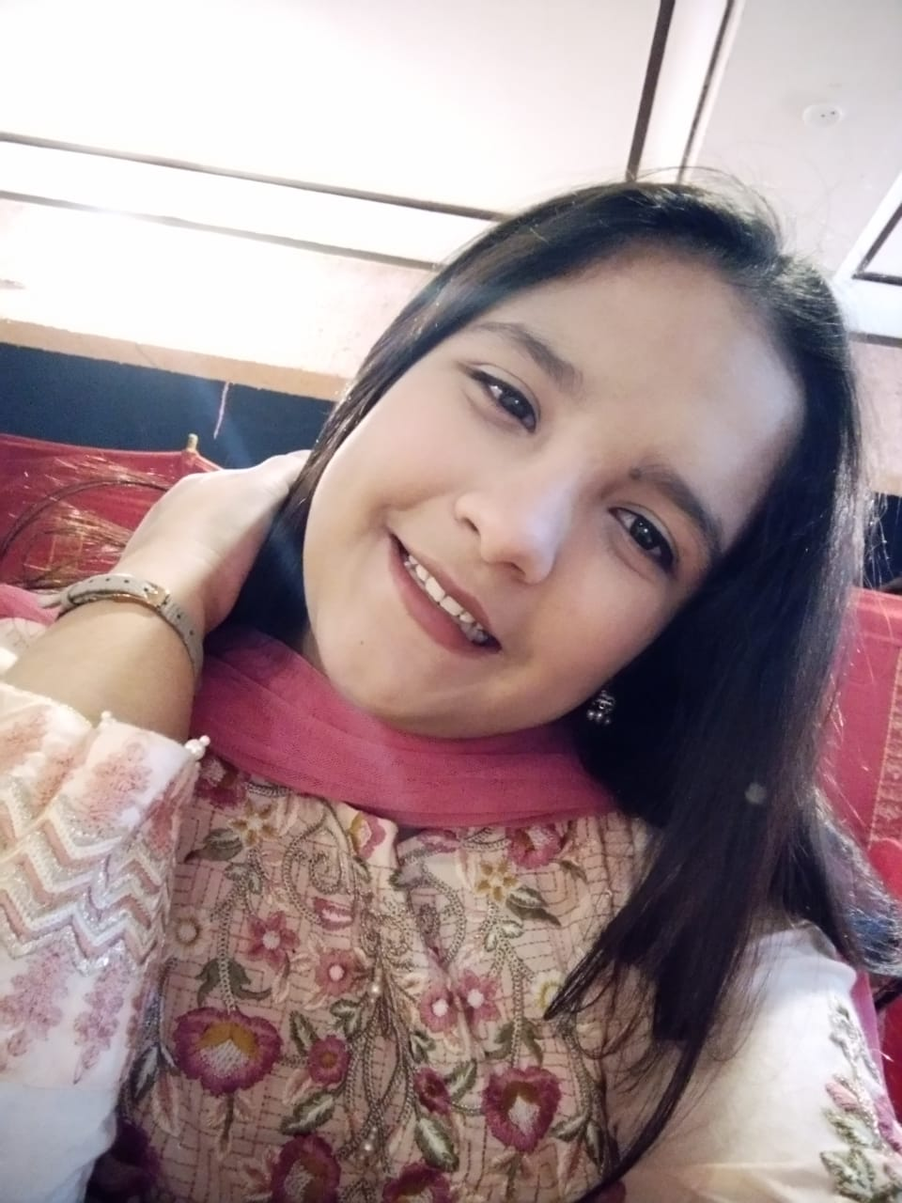
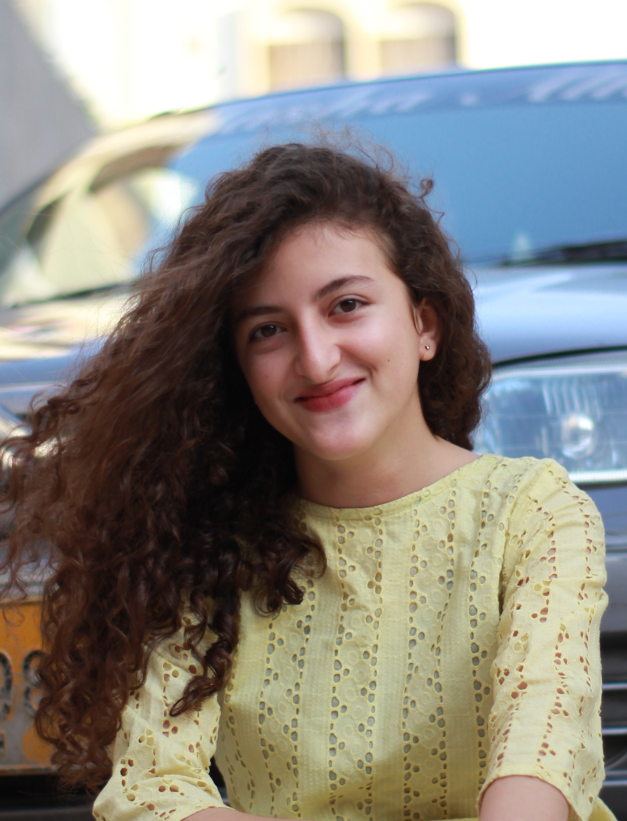
OUR TEAM
Anseeba Ali
Alishba Aijaz
Samina Khan

Slide 40
Thank you
Hope you enjoyed ☺

