Slide 1
Final Project: Favourite Places
Learning Circles
PPM1
Gymnasia №1
Starye Dorogi
Belarus

Slide 2
A favorite place is something very special for every person, how many people so many favourite places. Tastes differ.

Slide 3
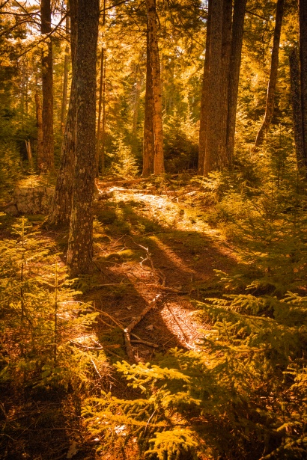
Nature places
Hello, our names are Angelina and Anna (Belarus). We want to tell you about our favourite place. We were thinking about so long, but we already have chosen the forest. It’s not a sight or attraction, it’s just a place where you can walk, listen to different sounds and take a rest. It’s located in eastern part of our town. There are a lot of trees and birds. We like this place for its silence, peace and beauty. We recommend you to visit it, if you have been tired of some things.

Slide 4
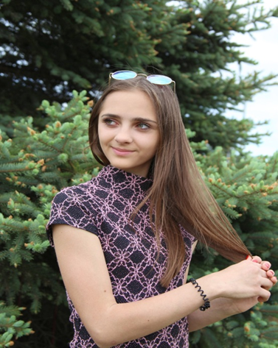
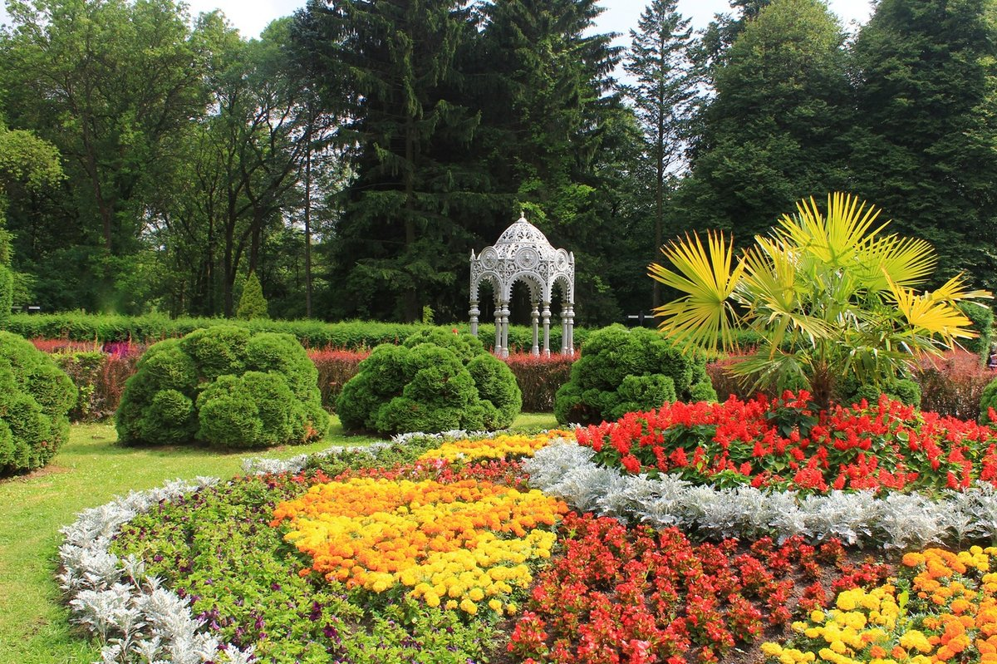
Elizaveta Mekka (Belarus) : The place I’d like to visit again and again is the Botanical Gardens in Minsk. It’s the place full of not only beauty and colour but also of marvelous smell. As I’m very interested in Biology everything was interesting for me: gorgeous trees, blooming shrubs and unusually bright flowers.

Slide 5
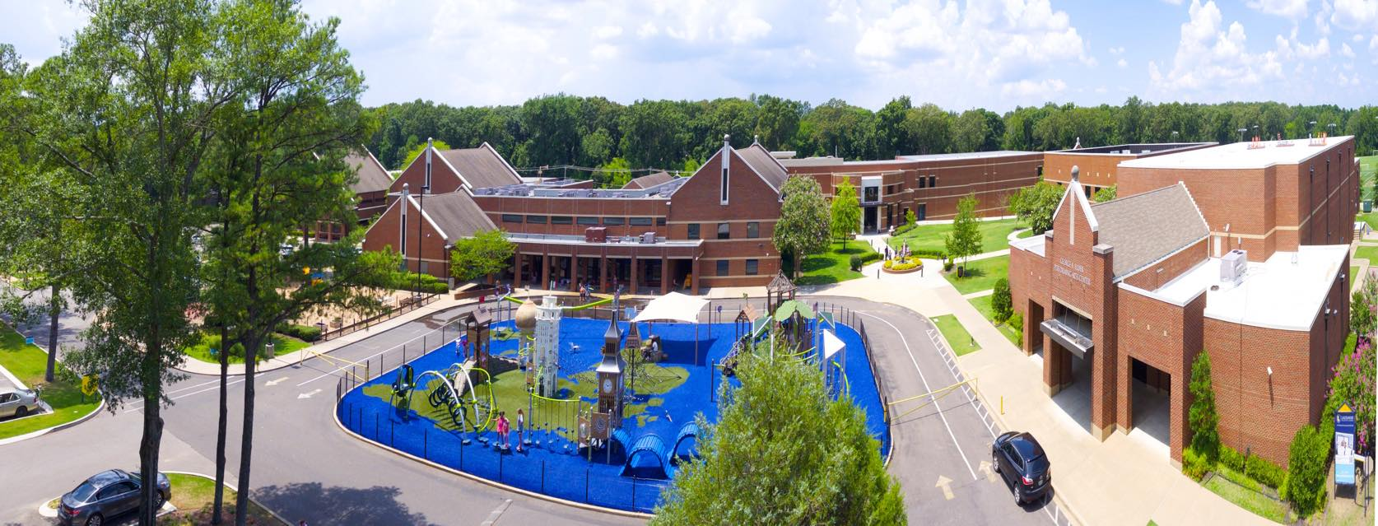
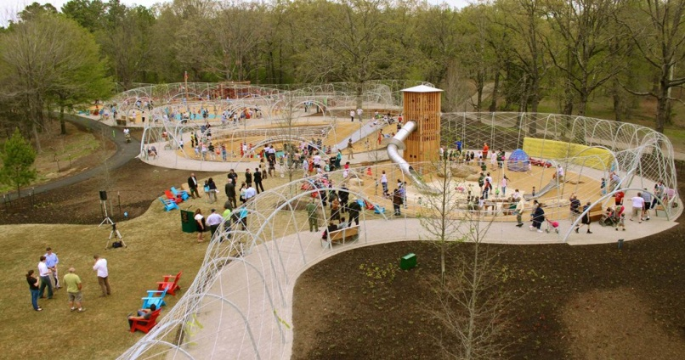
Bri (the USA):
I miss seeing the lake in my neighborhood, Riverwood. I miss seeing the fox that roams around the lake in the trees and the annoying turtles and geese that are blocking the roads causing us to wait centuries for them to move out of the way. I miss going over my friends' houses that live near me and far away from me. Just the freedom of going places when you feel like it is the biggest thing that I think everybody is missing right now. I miss my high school student body. I was excited for a lot of functions my school was holding such as: One Acts which I would have directed a play, Arts Feast Sports Fest which is like a field day for all of Lausanne to participate in fun activities and most of all, prom. A friend and I won free tickets to prom by guessing the theme of the event. Now, it seems like we will not be having a prom at all. Shelby Farms looks like a ghost town as of now because of the quarantining everyone is doing. It is weird to see it look so empty, so I miss when the park was congested full of people.

Slide 6
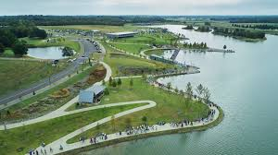
Colyne (the USA): I miss going out and just spending time randomly venturing to different parts of Memphis and spending time with my friends. I naturally enjoy being outside and experiencing nature like forests and creeks that kind of thing, but now even though I can't do that I've had more time to myself to spend on making art, music, and even more meaningful connections with people I wouldn't normally have the time to talk to. The best place for me to go before quarantine was Shelby Farms Park a huge park where I could go on runs or just spend time relaxing with friends and talking about nothing. In the picture you can see the all the paths and huge lake that is in the middle. When I did go out I would walk my dog and skate with my Spongebob Heelys. I miss the feeling of the wind on my face and the deafening sound of my clout as people stared in awe as I rolled by them. I look forward to being able to do all the things I miss and being with my amazing friends, so I can annoy them.

Slide 7
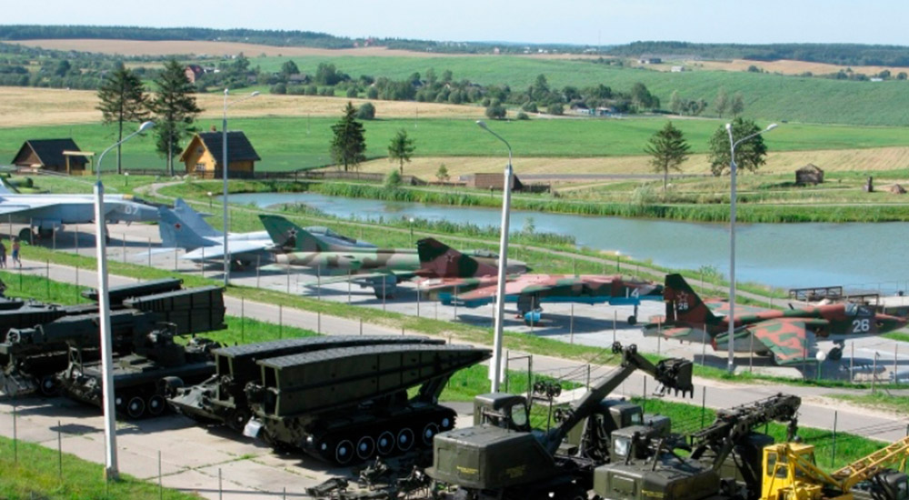
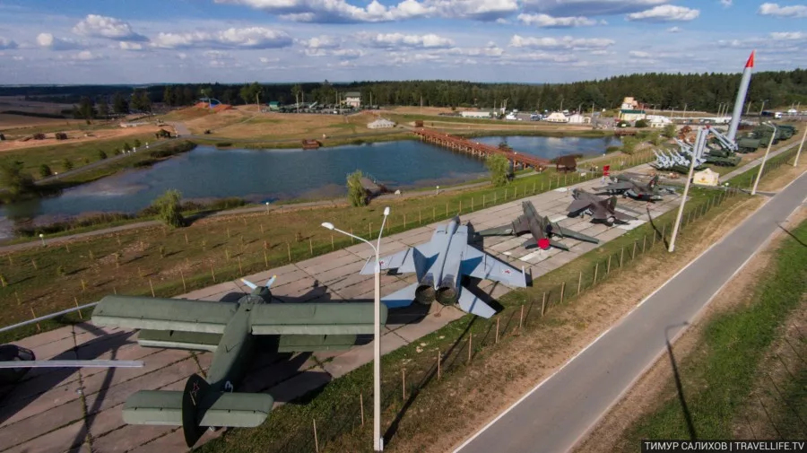
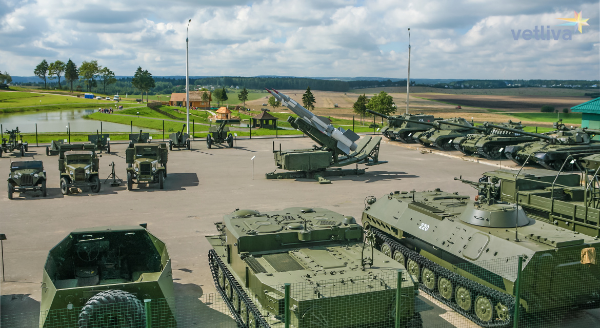
Museums, castles, fortresses
Hi my name is Matvey (Belarus). My favorite place I have ever been to is the Stalin line.There are a lot of military equipment: tanks, planes, missiles and rocket launchers.I advise you to go there:)

Slide 8
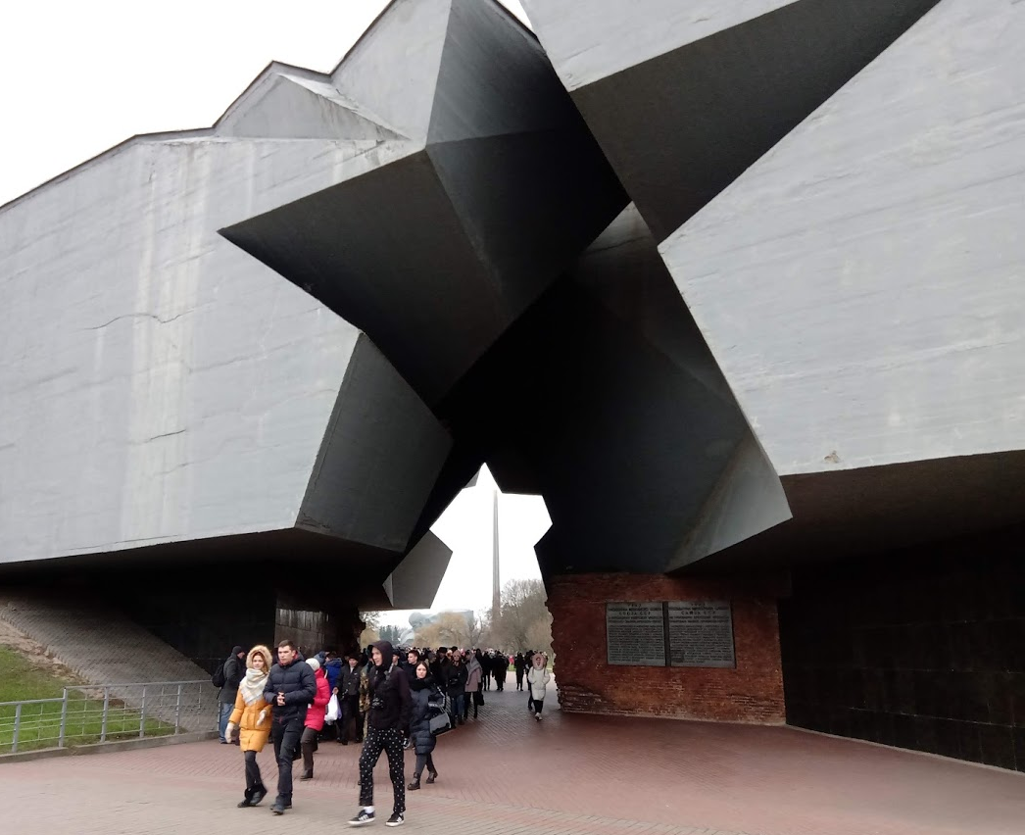
Hello, we are Sofiya and Nastya (Belarus). Our favourite place is the Brest Fortress.It is very beautiful place. Brest Fortress was built in the 1830s-early 1840s at the meeting-point of the rivers Bug and Mukhavyets.
In 1939 Brest Fortress was assigned to the Soviet Union. It earned the title of Hero Fortress for the courage demonstrated by Soviet soldiers when they fought against the German army in 1941. Whilst the Nazis took the town of Brest – 90% of which was destroyed in the fighting – the two regiments garrisoned inside the fortress held out.
For the people of Belarus, Brest Fortress remains a famous symbol of the Soviet resistance during World war 2.

Slide 9
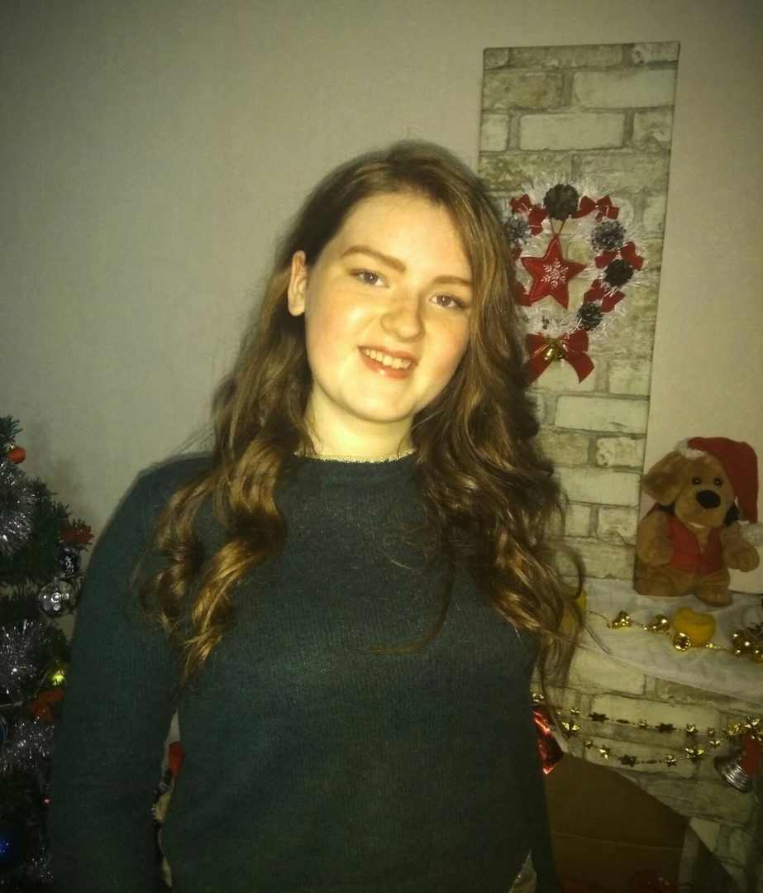
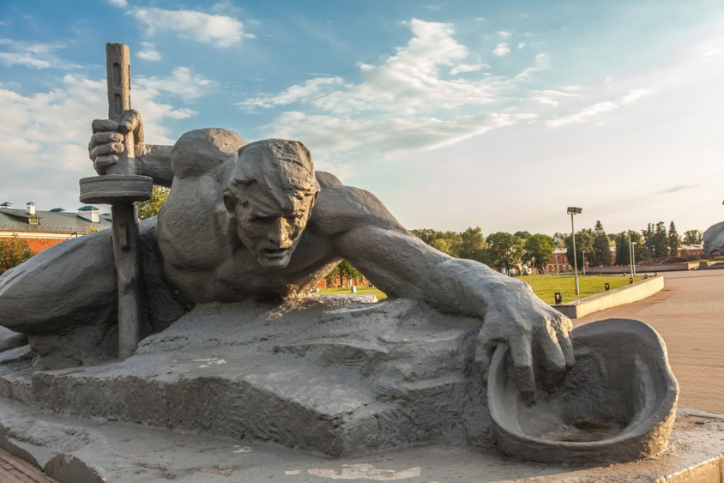
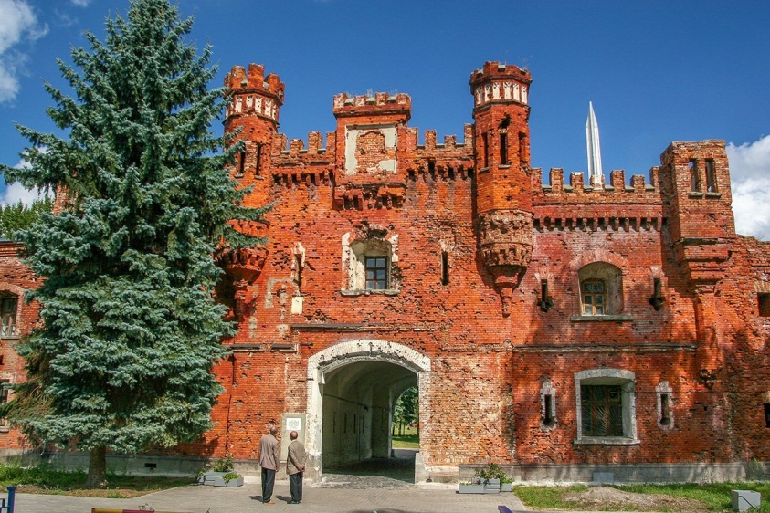
Elyen Vecher (Belarus): Every year I visit my relatives in Brest. Brest is a very beautiful city and it has a lot of sites but most of all I like Brest Fortress. This Fortress, one of the most important places in Belarus, was built in the 19th century and it is one of the symbols of the World War II. The fortress was not rebuilt after the end of the war, but it was turned into the war memorial. You can see the “Thirst” monument on the territory of the fortress and you can also visit a museum there.

Slide 10
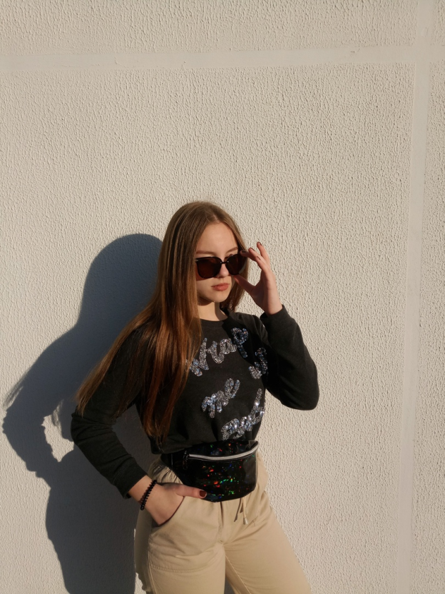
Alena Sobolevskaya (Belarus) : Last summer I visited the Nesvizh Castle and I was impressed by its beauty. The castle was founded in 1583 by Prince Radziwill Sirotka. The castle was built according to the project of the Italian Giovanni Bernardoni. During the XVII – XIX centuries, it was rebuilt several times, incorporating the features of the architecture of the Renaissance, early and late Baroque, Rococo, classicism, neo-Gothic and modern. The Radziwill residence consisted of 170 rooms. The castle housed the most valuable collections of arts and crafts, paintings, weapons, a numismatic collection, a rich library and the famous Radziwill archive, which contained documents both on the history of the family and on the foreign and domestic policies of the Grand Duchy of Lithuania and the Commonwealth. Now it is a museum.

Slide 11
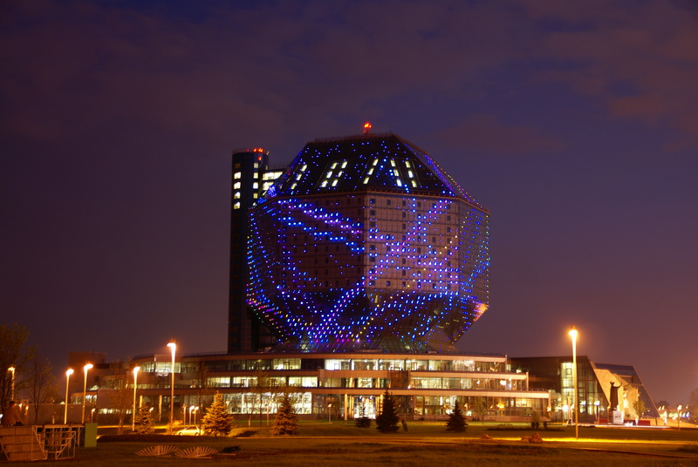
Interesting buildings
Hello, we are Alisa and Lia (Belarus). We want to tell about National Library.
The Library was built in 2006 on a river bank. This building is 74 m high. It glows with different patterns at night. National Library is popular with shape design. There is a viewing place on the roof.

Slide 12
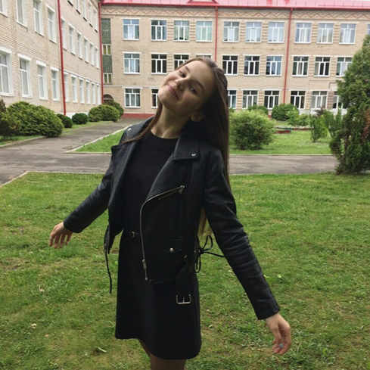
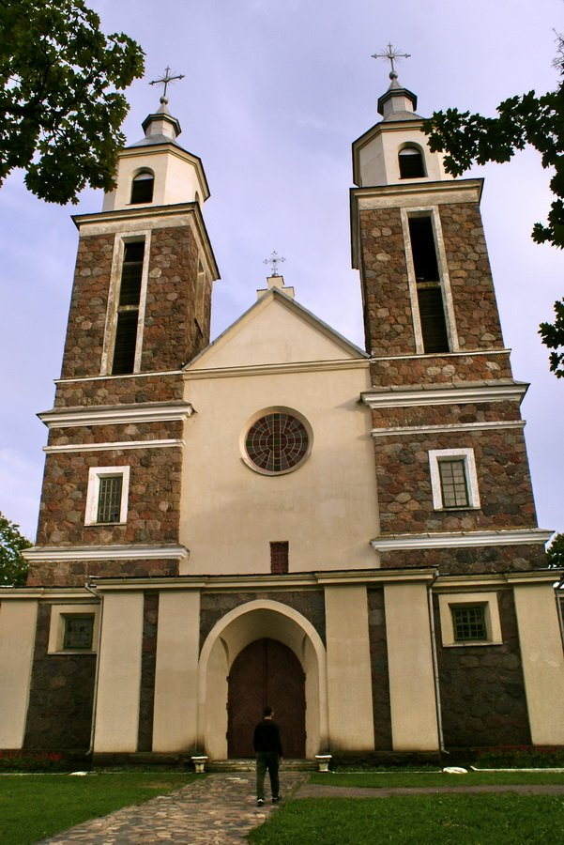
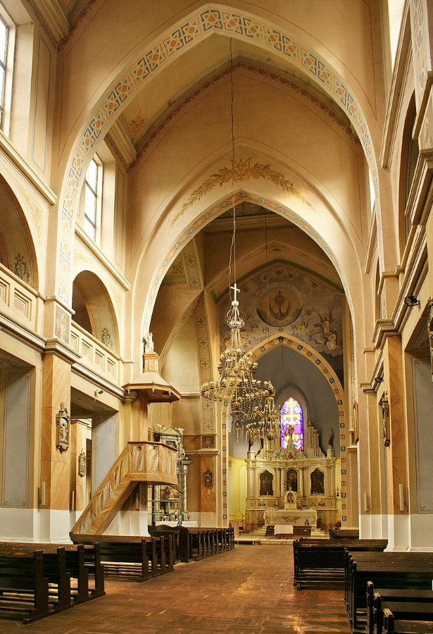
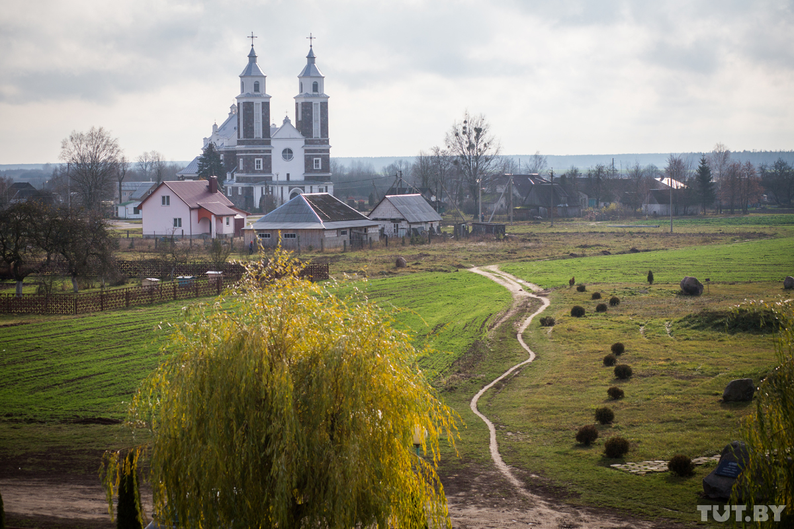
Polina Zhukovskaya (Belarus): I’m a Catholic and every Sunday I go to our local Church. I can’t say that it’s my favourite place, but I can say that it’s the place which gives me strengths and relaxation. Our church was erected in 1929-1933 according to the plan of architect John Borovski from Vilnius. It is build of stone. I am impressed by its beauty both inside and outside. The church can be seen from the windows of our school so I can admire it not only on Sundays.

