Slide 1
Welcome to My School Jubail International school

Slide 2
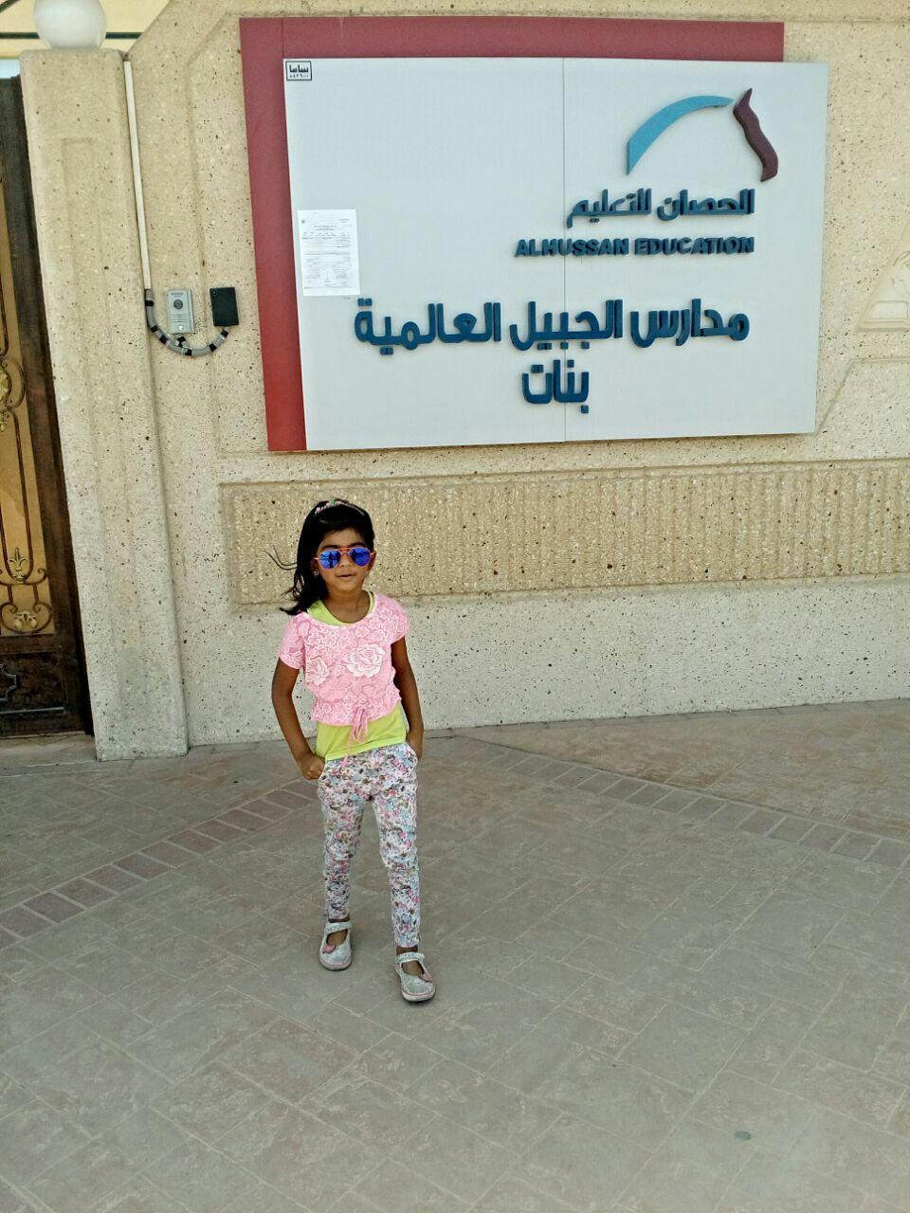
Every day when I enter my school i feel more happy like this. I feel more energetic person. Because my school is filled with learning and fun.

Slide 3
About my school:
Jubail International School also known as Alhussan international school
Located in eastern province Al Jubail.
Our elementary programs are based on the International standards of both Cambridge and Common Core for English, Maths and Science.
We have E-School facility in which parents get all academic details about their children.

Slide 4
My school facilities
Big Smart Classroom
Library
Science Lab
Computer Lab
E-School
Canteen
Clinic
Gym
Play Ground etc

Slide 5
My Favourite place in my school
Library
My most favourite place is Library. Because that place is filled up with interesting books and I love reading. Because my school encourages reading habit. Our school has modern library contains array of books. It carry more than 7000 books.

Slide 6
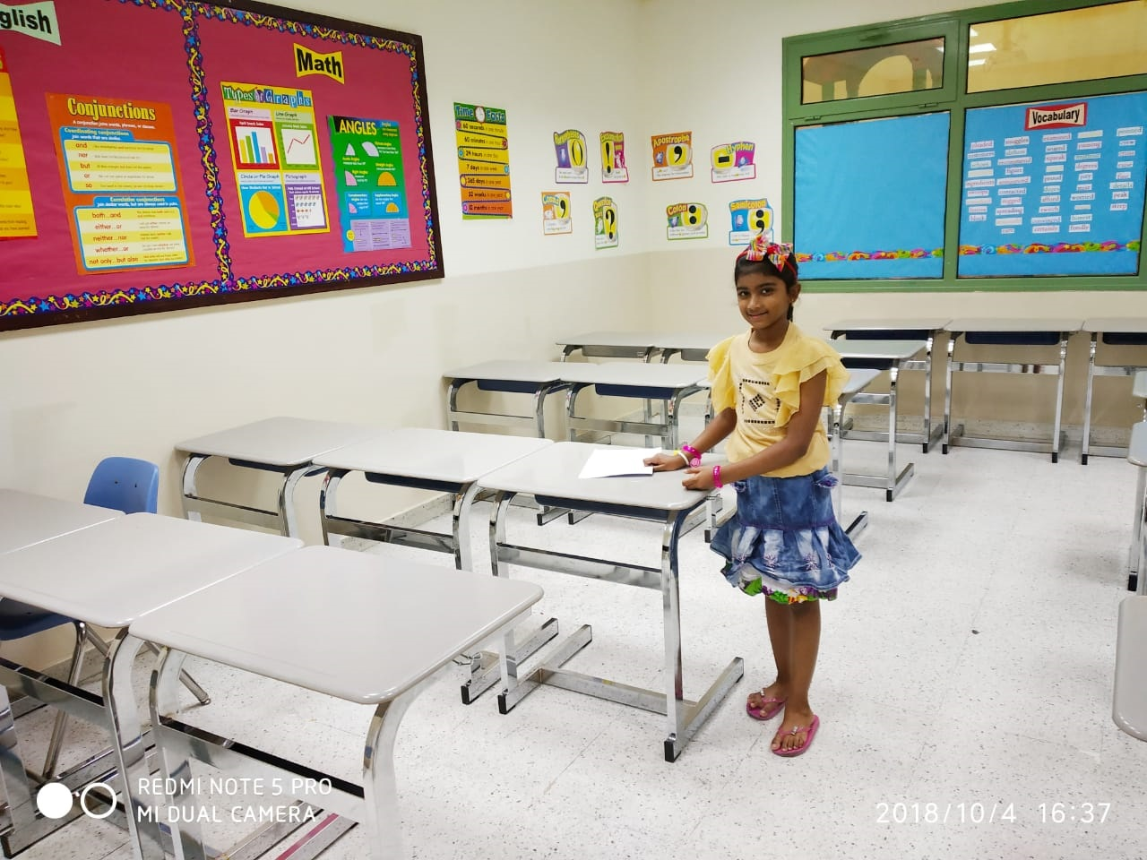
My Classroom:
My classroom is very big with comfortable chairs and tables. we have colorful charts have every week works. Each classroom has a built in infra structure for technology as well as a white board, which can be easily transformed into a "smart board" with the help of Mimeo technology. We have separate lockers so that no need to carry heavy books everyday.

Slide 7
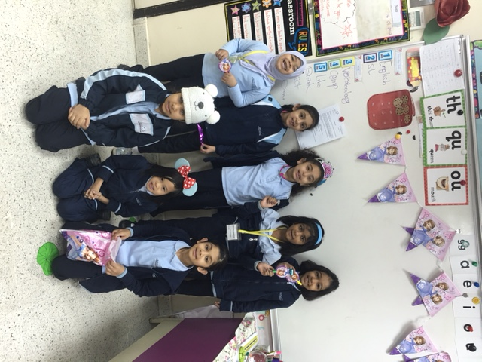
Fun in our Classroom:
We also have fun in our classroom. We have interesting projects to do. In our art class we do paper flowers, painting etc. And also we celebrate special days like Earth Day, Saudi National Day, Teddy Bear Day etc.

Slide 8
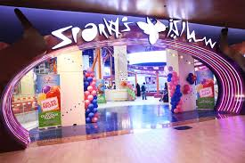
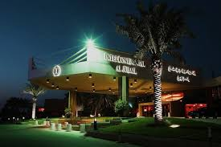
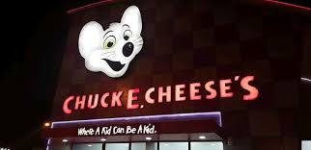
Field trip:
The most exciting part is our field trip. We visit so many places like Sparky’s, Intercontinental hotel... We get relax and develop teamwork activity. I love to go field trip.

Slide 9
School safety:
Our school gives more importance to our safety. They conduct firemock drill to handle the emergency situation. Fire extinguishers kept in important places.They ensure vehicle safety for our safe tranportation. We have clinic facility to give first aid to our students.

Slide 10
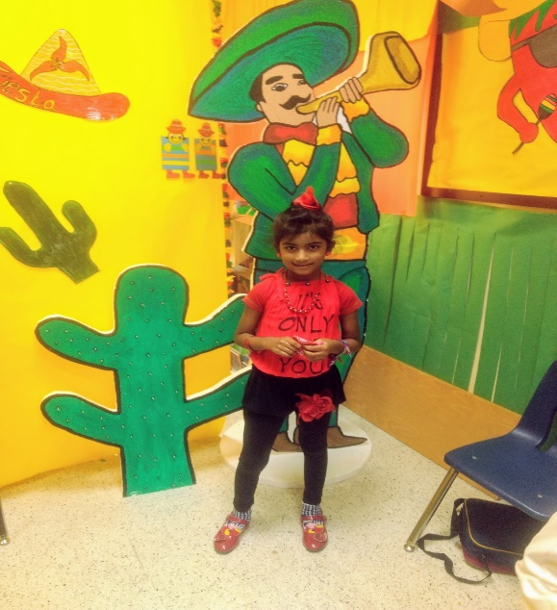
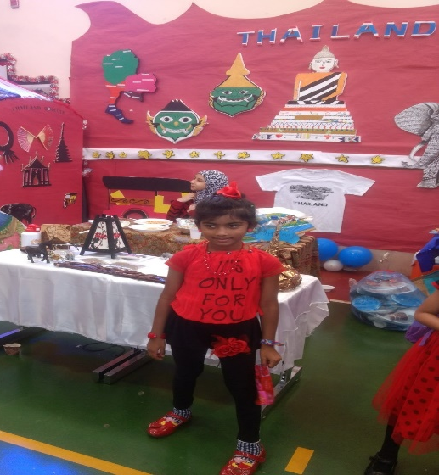
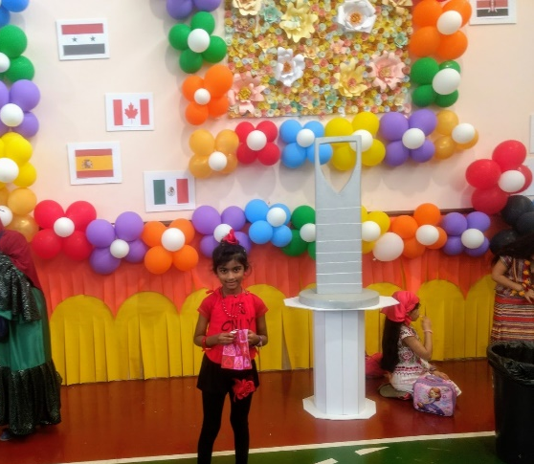
International day:
Every year our school conduct International Day in which we get explore too many countries. Each class has one country theme. We show all specialities about that country. It gives us good opportunity to learn about many countries.

Slide 11
Physical Education:
In our school, sport is an integral part of school activities, supported by necessary resources.
JIS is equipped with two gyms, which are used for various sporting and cultural activities.
We have sports day every year in which we show all of our sports talents. Each and every individual perform on this day
During PE period we play many games and do exercises to boost up our body as well as brain.

Slide 12
Presented by
Varnika

