Slide 1
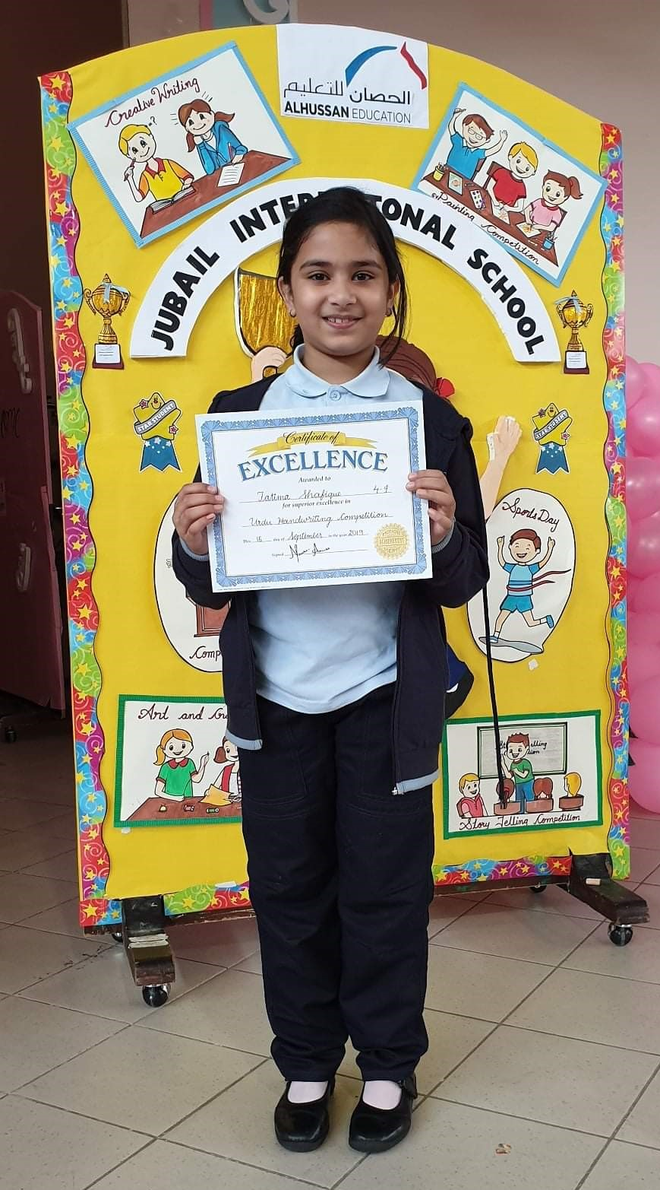
My Elementary School
Fatima S Malik
Al Hussan International School
Jubail, Saudi Arabia
Nov 2019

Slide 2
HOW IS MY SCHOOL?
My school is Alhussan international School Jubail.
It has a very nice building.
It has 2 sections; a Boys Section and a Girls Section. They are connected by the office premises.
Each section has its own Library, Canteen and Gym.

Slide 3
Alhussan SCHOOL Logo

Slide 4
School Events
Twice a year we go on a school field trip which is lots of fun for the whole class.
We also have an international day where classes dress up as different countries. It is very informative to learn about different cultures of the world.
Sports Day is also a very nice function at school.

Slide 5
Saudi National Day
This is celebrated every year

Slide 6
How Did I Feel Initially?
I joined this school in KINDERGARTEN.
I was really nervous on the first day at school but it turned out to be a pretty good year.
I made new friends, met new teachers and I have been taught pretty well.

Slide 7
How Do I Feel today?
I love my school.
Thank You !

