Slide 1
My Elementary School
Final Project Jubail International School
By: Huma Siraj Pandhiani

Slide 2
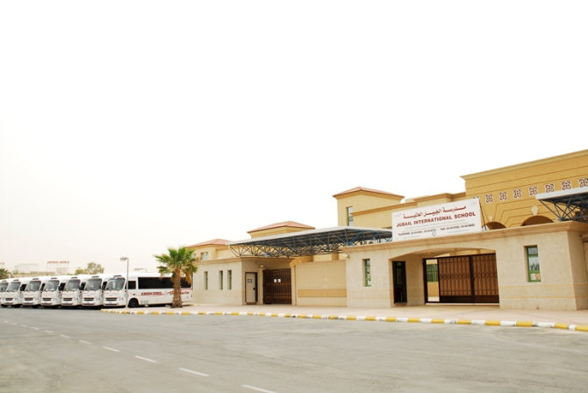
My School (Jubail International School)
My School History
The tradition of Al-Hussan Education in Saudi Arabia began in 1956 when Sheikh Abdel Aziz Rashid Al-Hussan started the Arab Cultural Institute for Adult Education. In the following year Al-Hussan Modern Girls School, the first girls’ school in the Eastern Province of Saudi Arabia was opened. Today there are nineteen schools and other educational institutes throughout the Eastern Province rated among the best in Saudi Arabia, with enrolment of over 10,000 students.

Slide 3
The tradition of Al-Hussan education began in 1956 in the Eastern Province of Saudi Arabia; when Sheikh Abdel Aziz Rashid Al-Hussan started the Arab Cultural Institute for adult education. In the following year Al-Hussan Modern Girls School, the first girls’ school in the Eastern Province of Saudi Arabia was opened. Today there are nineteen schools and other educational institutes throughout the Eastern Province and Riyadh rated among the best in Saudi Arabia. Today his son Rashid Abdel Aziz Al-Hussan is the president, continuing his father’s vision of education for all.
The Al-Hussan International Schools include:
1. Al-Hussan International School – Khobar; 2. Jubail International School – Jubail
3. Orbit International School – Khobar 4. Al-Hussan International School –Riyadh
5. Al Hussan International Grammar School – Khobar 6. AlHussan International School – Yanbu
7. Royal College International Schools – Cairo, Egypt

Slide 4
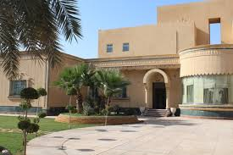
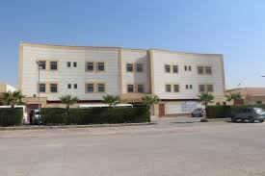
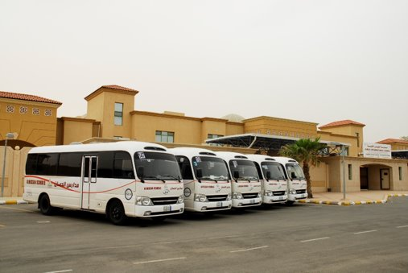
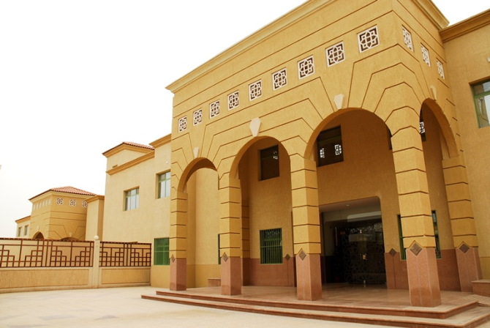
Eastern Province

Slide 5
School Recognition
All Al-Hussan's schools & training centers are licensed to operate by the Ministry of Education of Saudi Arabia.
Jubail International School is:
Accredited by the North Central Association Commission on Accreditation and School Improvement
Accredited by the Council of International Schools
Attached Center to Cambridge International Examination Board through The British Council
Attached Center to Cambridge International Examination Board through The British Council
Al Hussan International Schools (Riyadh, Al Khobar, Jubail)

Slide 6
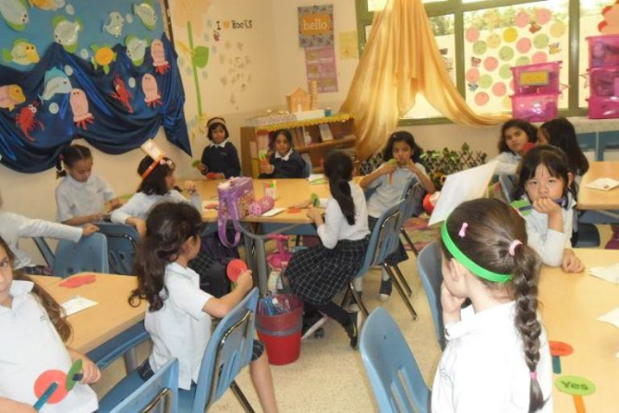
Classrooms
20 – 25 students
Air-conditioned
Interactive teaching using:
White board
Smart board

Slide 7
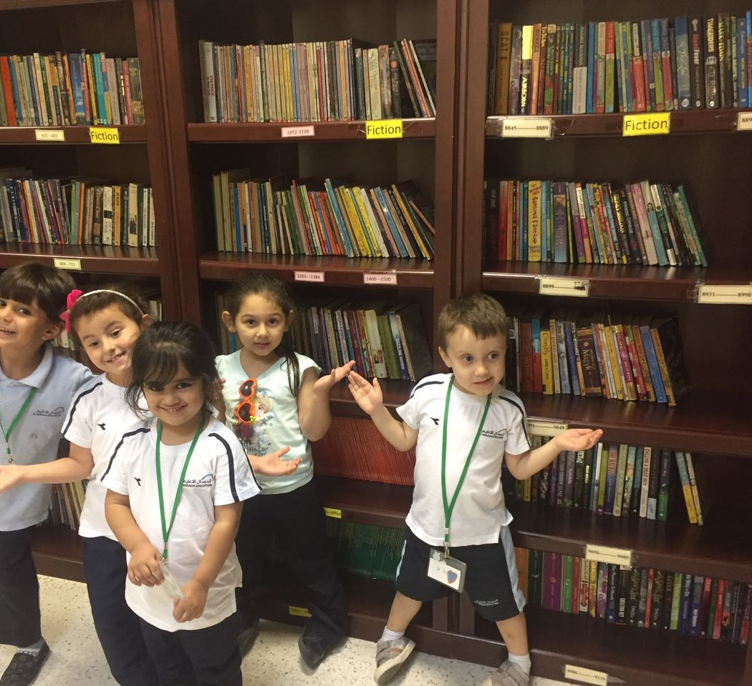
Our Libraries
Books suitable for all ages and groups
Serene atmosphere for reading
Internet Access
Over 7000 books

Slide 8
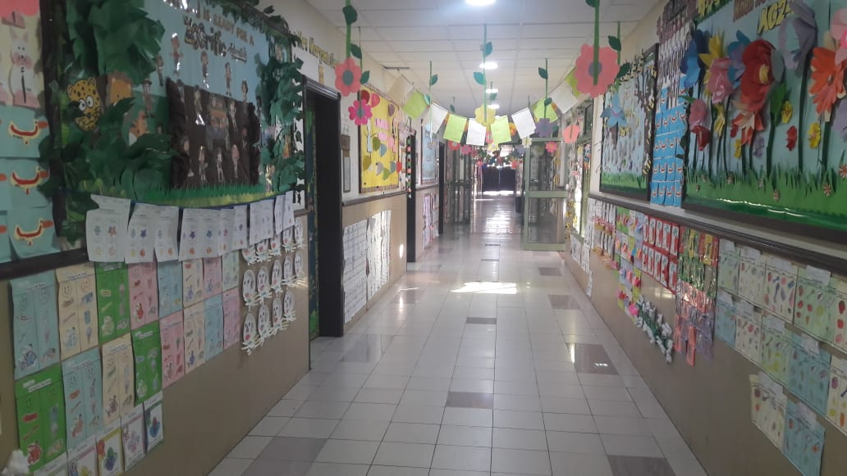
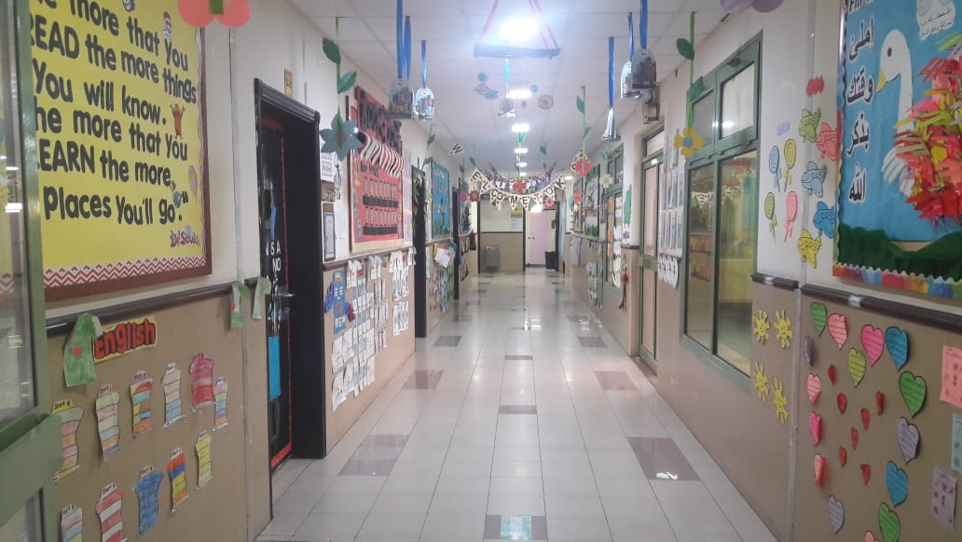
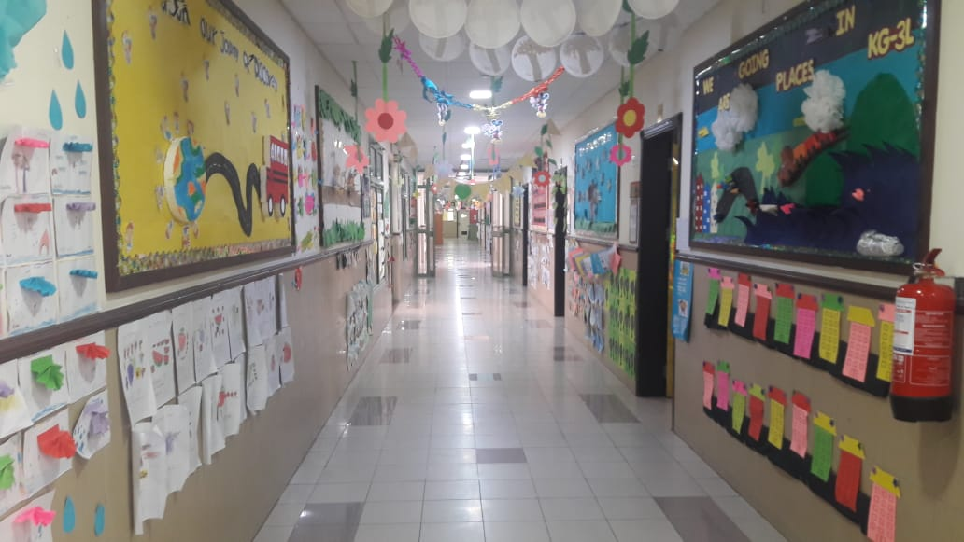
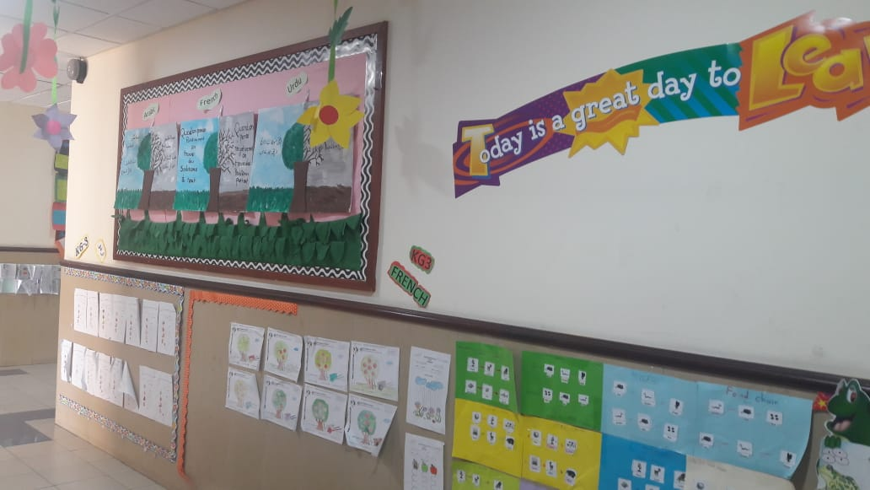
Our Corridors Wide fully decorated with students’ work

Slide 9
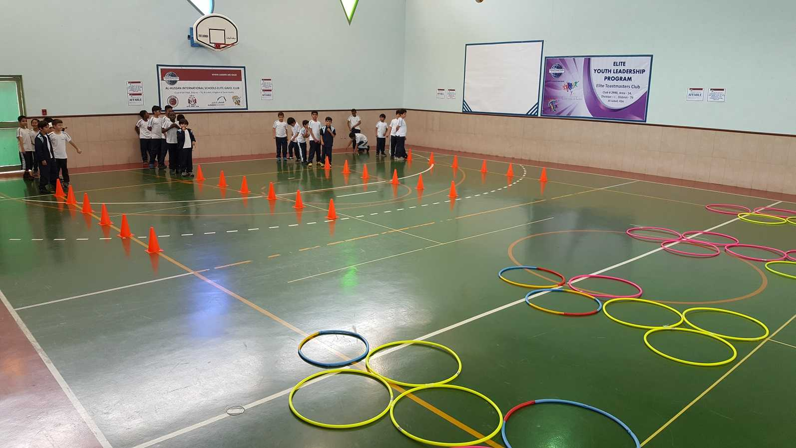
Sports Facilities
Two Gyms
Separate courts for Volley Ball and Basketball
Other indoor games : e.g. Table tennis, Badminton

Slide 10
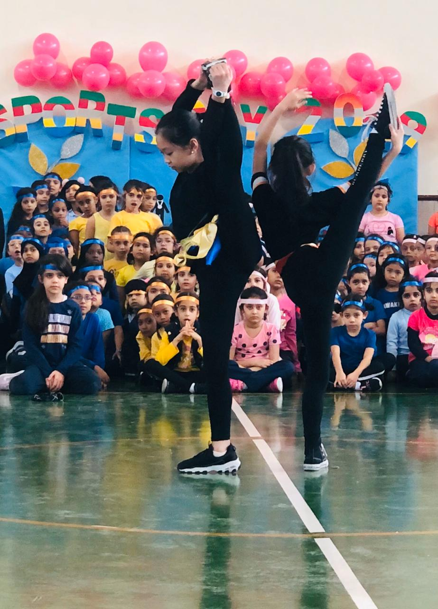
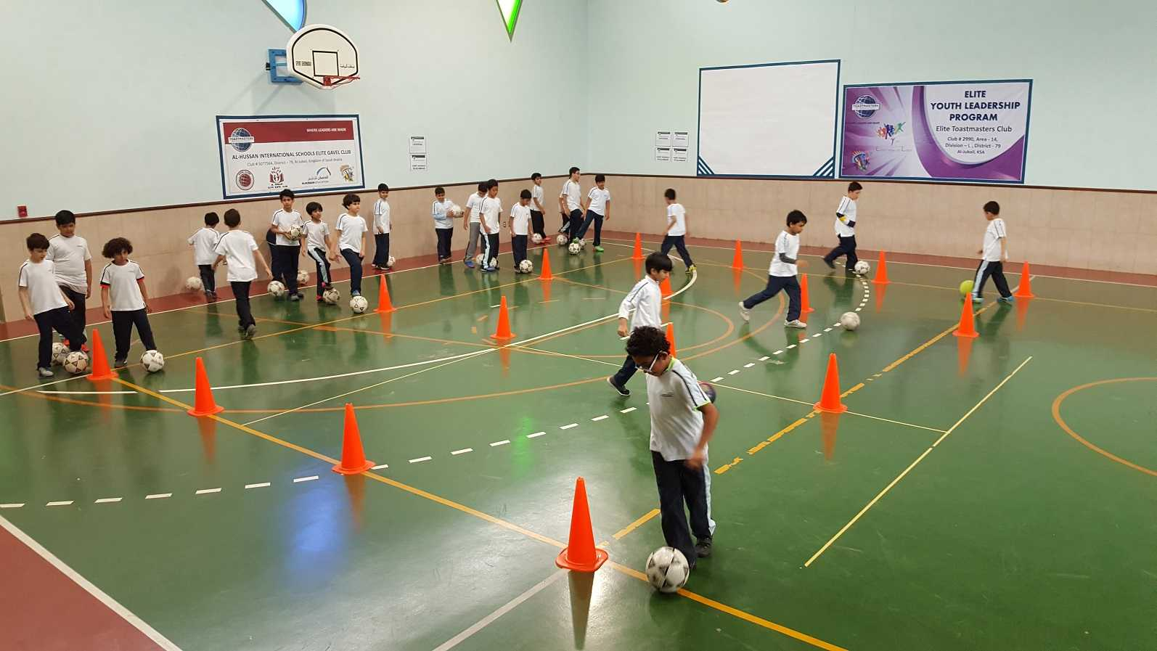
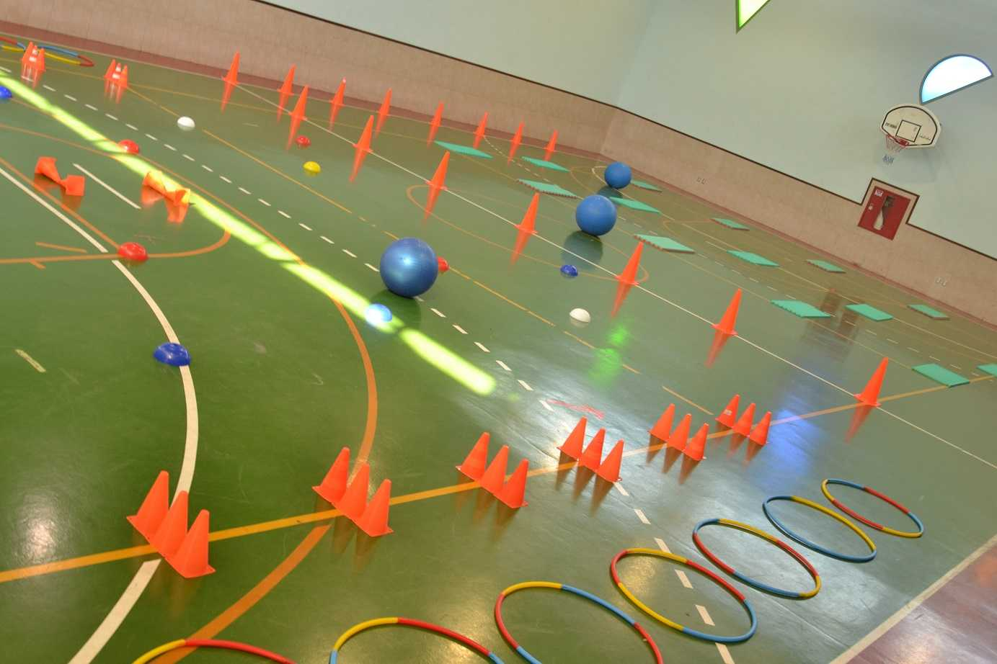
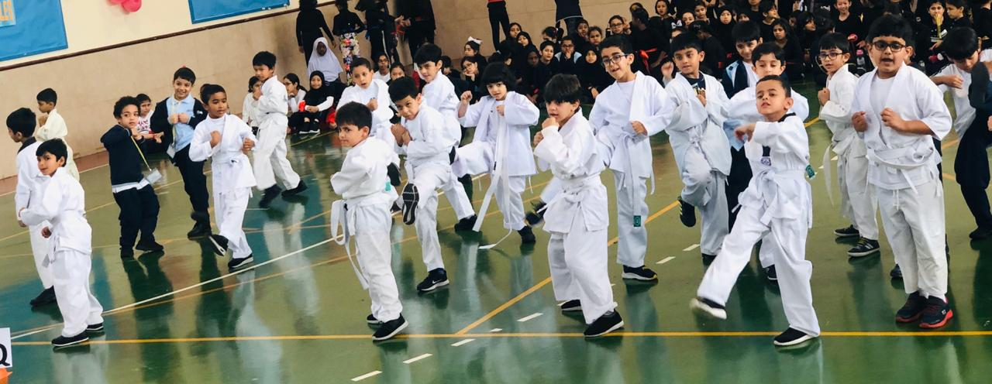
Our Gyms

Slide 11
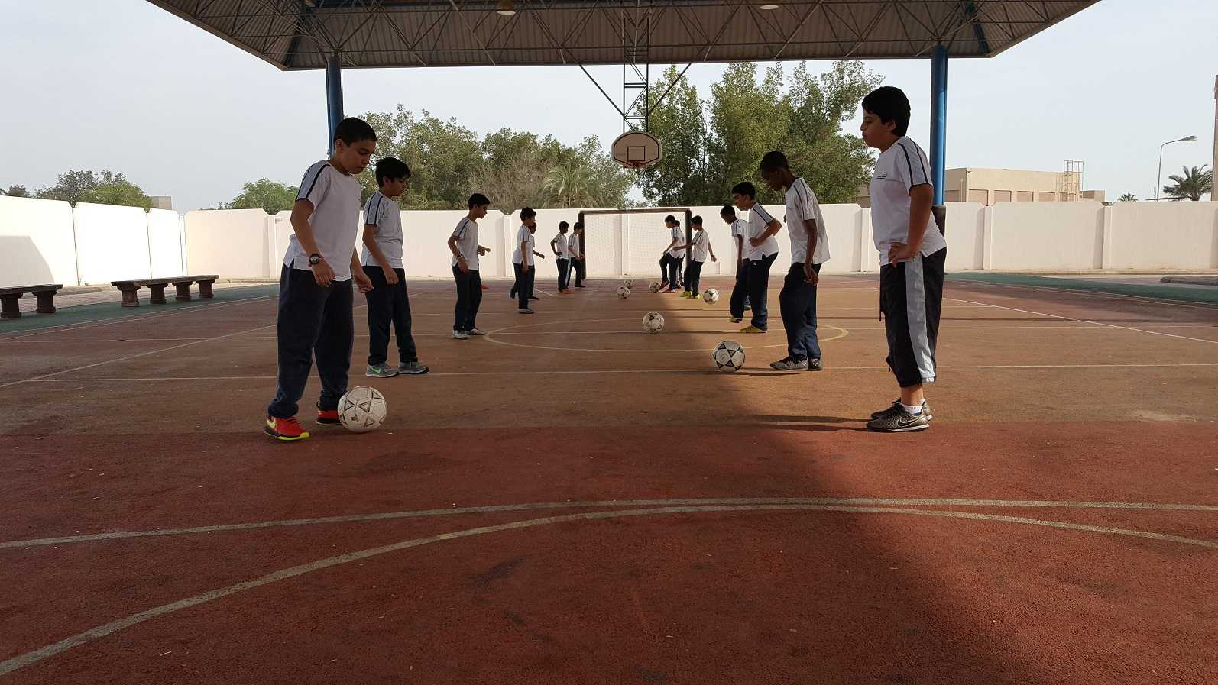
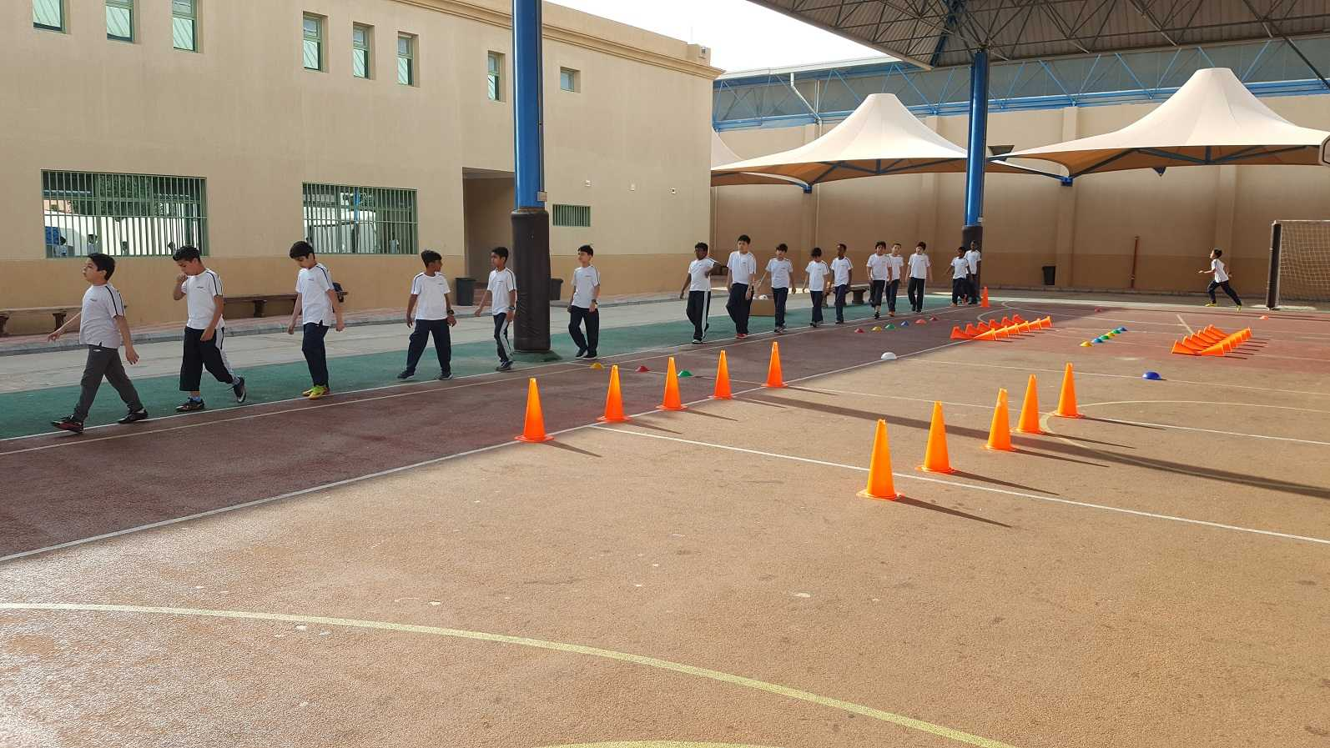
Our Playground

Slide 12
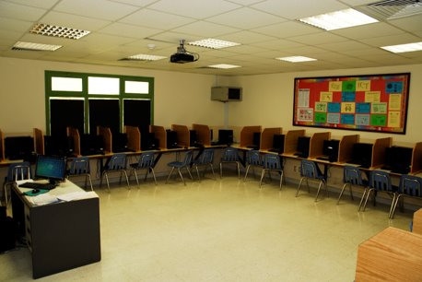
Computer Laboratories
Two fully equipped computer laboratories
Audio-Visual facilities
Printing facilities

Slide 13
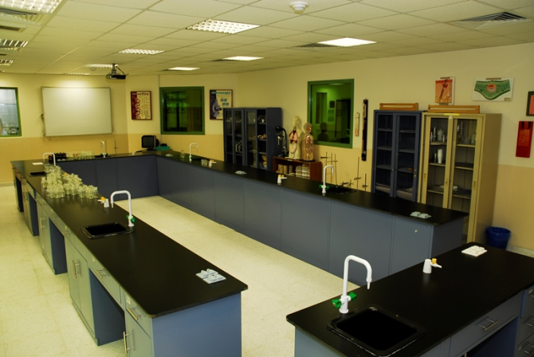
Science Laboratories
Four adequately equipped laboratories
Suitable for Biology, Physics and Chemistry
Experiments

Slide 14
MY Students’ Stories

Slide 15
How can I make my school more beautiful and attractive?
Jubail International School is one of the best schools in the eastern province, Saudi Arabia. Good teachers, facilities and much more. The list can go on and on! To make my School even better, beautiful and attractive I have few ideas.
To add more freshness to the school environment a fruit and vegetable garden is the best option. It will encourage students plant new trees and make them learn the importance of keeping the environment green. The added advantage is that they are learning to eat healthy too. The beautiful flowers will also make the ambience more lively and pleasant such that children will love to be at school…
2. Did you know that music is one of the few activities that utilize the entire brain? Yes, it’s true. Music soothes our mind and creates a calm atmosphere. A music class will help us to improve our concentration and patience in other classes too.
3. We do have the regular subject related competitions like the Math Derby, Science Fair, hand writing and story – telling, etc. But physical activities
such as swimming and football can increase the strength and stamina of a student and improve our health too. Healthy body ensures the students
focus effectively on studies. More physical competitions will inculcate the spirit of participation and team work.
These are just a few of the things that can make our school more beautiful and attractive. If these suggestions are implemented our school can become one of the best schools in the world!
Brindha Arvind Kumar

Slide 16
Name: Kriti Singh
Grade – 4H, Jubail International School
Subject: What makes my school special and unique?
The best thing that happened with me was when I was selected for studying in my school, that is, Jubail International school. Although I can keep on talking about things that are special and unique, but due to lack of time and my slow typing, I will mention the first few that comes to my mind.
The most special and unique about my school are my teachers. The way they teach us, even multiplication and division looks like simple addition and subtraction.
The course is so exciting and informative that I keep talking about the subject even at home.
My classroom is so beautiful that I feel not to leave even during break time (….. perhaps this is too much). But I would certainly like my projector to be replaced with something better.
Last but not least, I got the most terrific friends at school whom I watch growing every day and I hope they watch me too.
I can keep on writing about my Gym class, library and ICT lab but my fingers are really paining.
Thanks
Kriti Singh

Slide 17
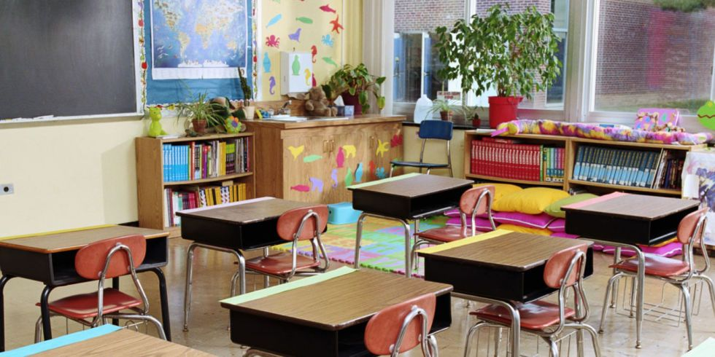
How would you make your classroom more beautiful and attractive?
Good morning everyone
I am Jood from 4 I class
Today I am presenting how to make your classroom more beautiful
and attractive.
Follow these steps to make your classroom look tidy and beautiful and attractive
Put “welcome” mat in front of your classroom door.
Create a comfy reading corner.
Add a desk lamp at your teacher’s desk.
Put some Plant outside your classroom window.
Add shelf for bags and lunch bags.
Lost and found.
Why don`t you make your classroom smell nice so it be the best classroom in the school.
By : JOOD ABDELGALIL

Slide 18
My School is Unique!
I think that my school is very special and unique but what I most like about it are the activities the school arranges for us. We do not do them every day, but they are still very fun to do.
When our teacher tells us we are doing an activity we all shout in excitement! We sometimes do them in the class and sometimes our teacher assigns us to do them at home.
Sometimes we do the activities using playdoh, yarn, and much more. We usually do simpler activities using simpler stuff like colors. Some science activities like germination take time as the results are not visible for days but that makes it even more exciting.
These activities not only take away the boredom from the usual routine but help us learn new things as well.
By: Raneem Fahad

