Slide 1
Places and Perspectives Learning Circle 1 (Middle/High School) - PPM1, 2019: Session 2
The Final Project
“Industries of
Your Village / Town / City”
Made by the students of the state educational institution
“Specialized Lyceum under the University of Civil Protection
of the Ministry for Emergency Situations
of the Republic of Belarus”
Gomel, 2019

Slide 2
Contents
1. Industries in Kyiv, Ukraine
2. Industries in Gomel, Belarus
3. The history of glass industry in the village of Urechye, Belarus

Slide 3
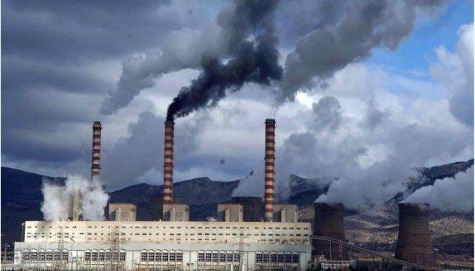
1. Industries in Kyiv, Ukraine

Slide 4
From the response of Illia Hodunok, 11 Grade, Troyeshchyna Gymnasium, Kyiv, Ukraine
Kyiv is the biggest city of Ukraine, its population is about 2.800.000 people. All the citizens throw out tons of litter. This garbage should be recycled and converted into new items, and for this purpose we have some incinerators, which emit harmful pollutants into the atmosphere.
TPP (thermal power plants) are another type of pollution in Kyiv. This is a state-owned industry which supplies city districts with hot water. In spite of being a very important enterprise for the city and people who live here, it isn't ecological enough. These stations burn fossil fuel and emit carbon footprints. Due to this fact, it pollutes the atmosphere.

Slide 5
Furthermore, there are some traditional plants in Kyiv. Some of them make the air and water in the rivers dirty.
As a result, these emissions are the reason of global warming and greenhouse effect.
However, some new factories use modern filters which reduce harmful emissions.
Also, our government is supporting many industries to maintain the environment.

Slide 6
Every year the city of Kyiv becomes bigger and bigger with new houses and flats, but almost nobody plants new parks and deals with reforestation, which can clean our air. It is a huge problem of modern cities.
Unfortunately, our government plans to build a new incinerator not far from the place where the author of the article lives. (The picture at the beginning of the article). It has positive and negative sides. On the one hand it will help to reduce the amount of litter, but on the other hand it will pollute the air more and create an unpleasant smell.
As a result the community needs to defend the ecology of the place where the citizens live and keep the nature and environment healthy.

Slide 7
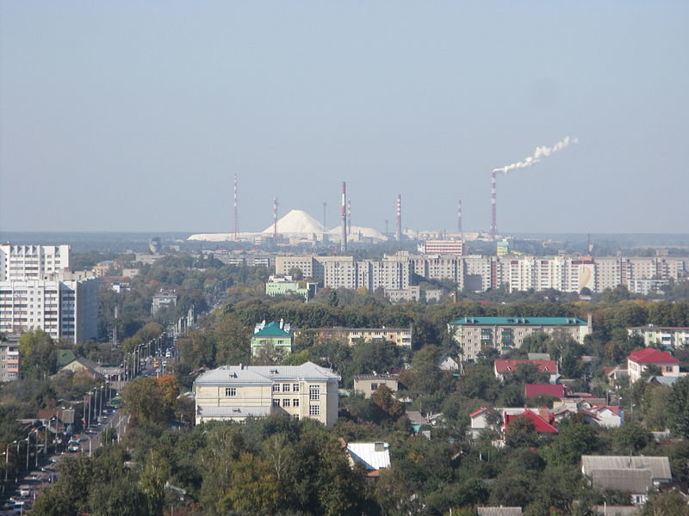
2. Industries in Gomel, Belarus

Slide 8
Gomel is the centre of Gomel region.
Gomel is the second largest city in Belarus. It is situated in the south-east of Belarus.
Gomel suffered a lot from the Chernobyl catastrophe, and now in addition to this it has a lot of plants. One of such plants is Gomel Chemical Plant that produces fertilizers, pesticides, medical and technical oxygen, sulfuric acid, sodium sulfate, etc. Chemical garbage creates huge mountains that can be seen from many places of the city and its outskirts.
However, here is the bright side of this problem: photographers use these mountains as a place for taking photos – these mountains look unusual.

Slide 9
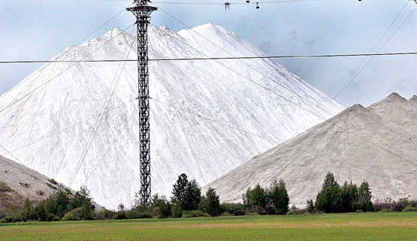
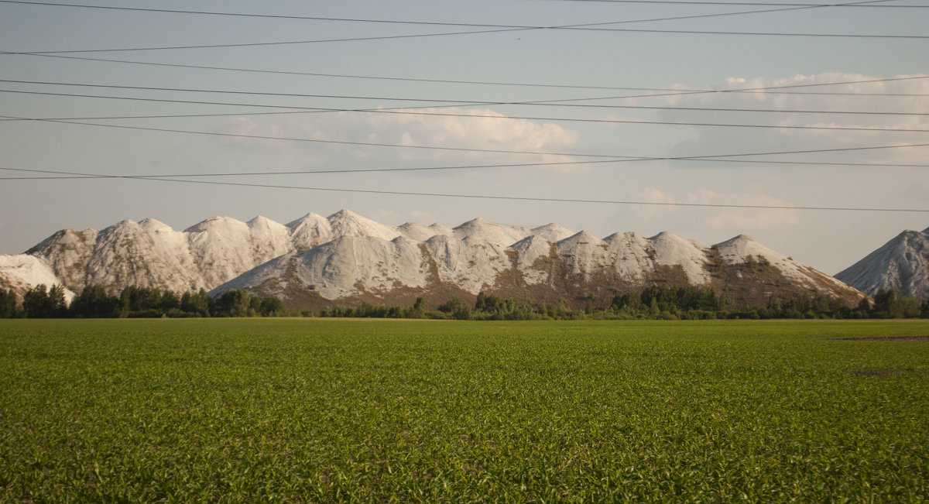
These mountains
are called “Gomel Alps”.
They pollute the atmosphere, water and nearby forests.

Slide 10
There are several foundries in Gomel. Foundry industry is one of the causes of the pollution in the city. They use a lot of acids that lead to chemical waste. All these plants are either in the city or near the city, so it is harmful for the citizens.
Gomel has plants that deal with plastic – one of the most dangerous pollutant that can be found everywhere on the Earth, even in the depth of the oceans.
Gomel Fat Factory produces an unpleasant smell and the citizens from the nearby areas suffer from it.

Slide 11
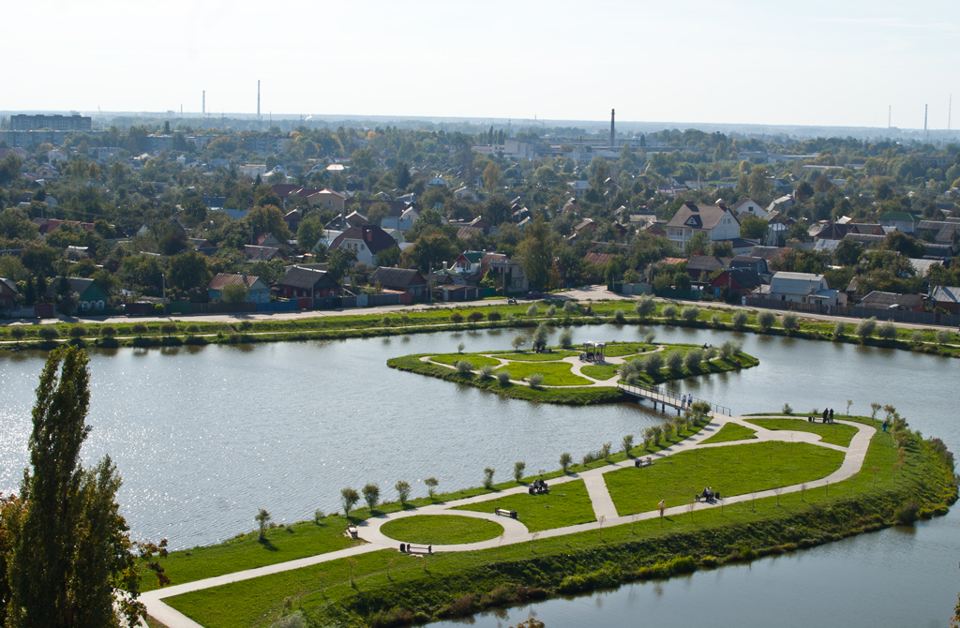
Concerning all these factors the government does a lot to improve the air and the environmental situation in the city: there are many parks and recreational areas.

Slide 12
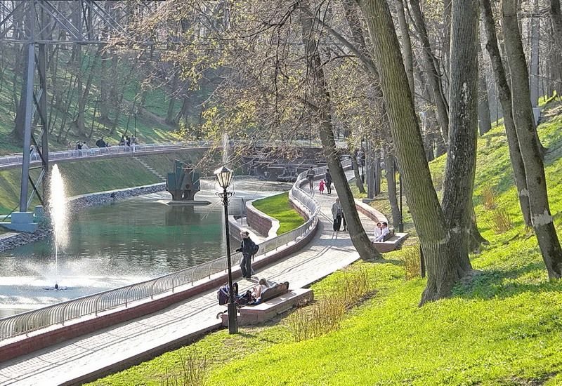
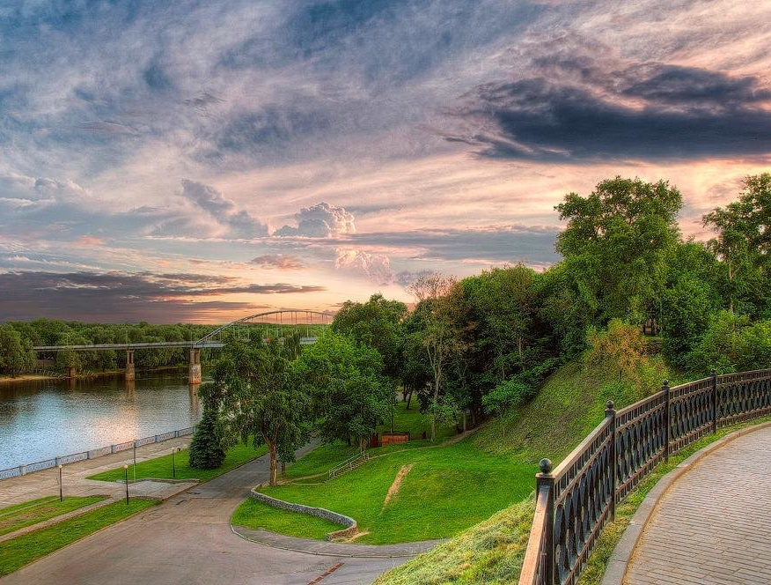
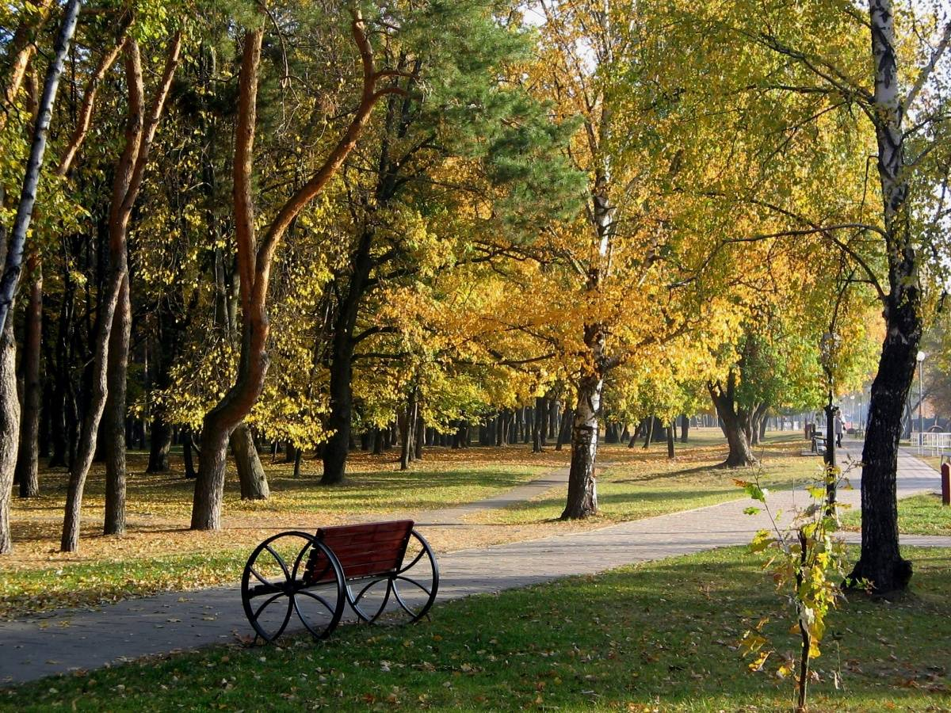
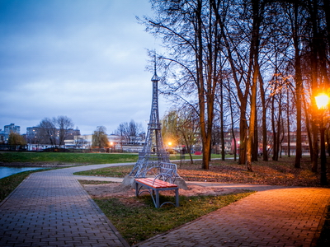

Slide 13
3. The history of glass industry in the village of Urechye, Belarus
The village of Urechye is located 120 kilometers from the capital of Belarus - Minsk. The nearest towns to Urechye are Osipovichi, Salihorsk, Slutsk, Glusk, Lyuban.

Slide 14
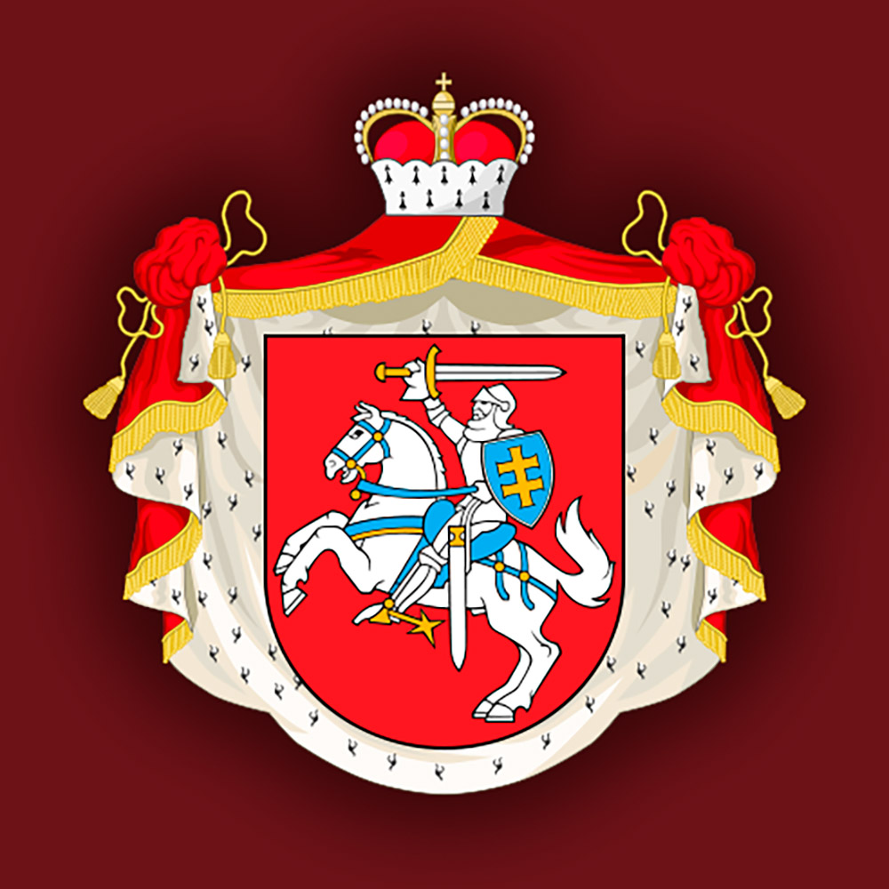
The first mention of the village of Urechye dates back to 1635.
At that time,
these lands belonged
to the Olelkovichi
family.
In 1793, Urechye became part of the Russian Empire.

Slide 15
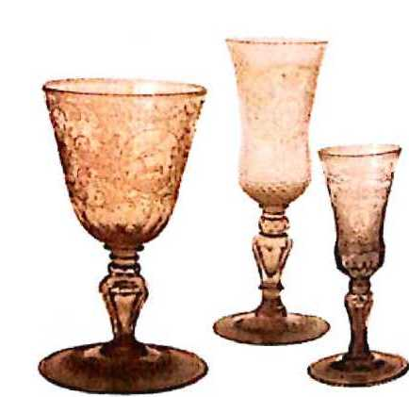
Urechye glass can be attributed to treasures. Now, samples of products from the old Urechye glass factory
are stored in museum collections in Moscow,
St. Petersburg, Lviv, Krakow, Warsaw and some museums in our country.
The works of Urechye craftsmen were bought by bourgeoisie, magnates and kings.

Slide 16
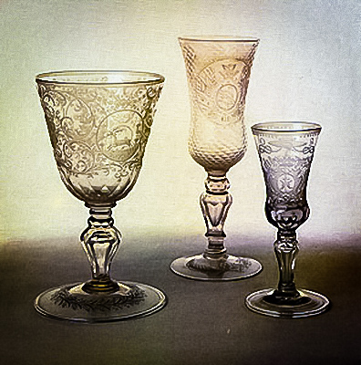
Glassworks in Urechye was founded in 1737. Then, contracts were signed with the masters of the Sentenberg
factory in Saxony, and they agreed to work on condition to teach local residents engraving and polishing glass.

Slide 17
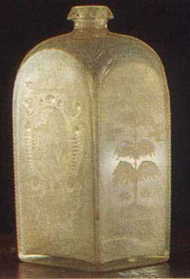
In Urechye, they counted on the production of window glass and mirrors, that is why the factory was first called a mirror
factory. In Urechye, sheet glass, mirrors, crystal chandeliers and
other all kinds of lamps were made.
There was a particular demand for utensils - glasses, cups, wineglasses, wine glasses, bowls, decanters, which were made of colored and colorless glass, as well as crystal. Products were decorated with faceting, engraving, high-relief carvings, painted with platinum, gold, silver, paints, decorated with patch medallions.

Slide 18
For twenty-five years, the manufacture was led by T. Sherber.
He introduced the achievements of German, French, Bohemian, English masters.
The forms borrowed from the Saxons changed with time and acquired distinctive local outlines. The dishes were decorated with engraved ornaments, the motives of which contained images of cornflowers, tulips, local architectural and landscape elements, and inscriptions.

Slide 19
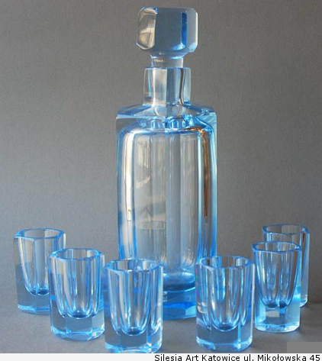
In addition to glass products, tiles were produced at the manufactory, there were pottery, carpentry, and
locksmith workshops, and craftsmen worked with metal, wood, and ceramics.

Slide 20
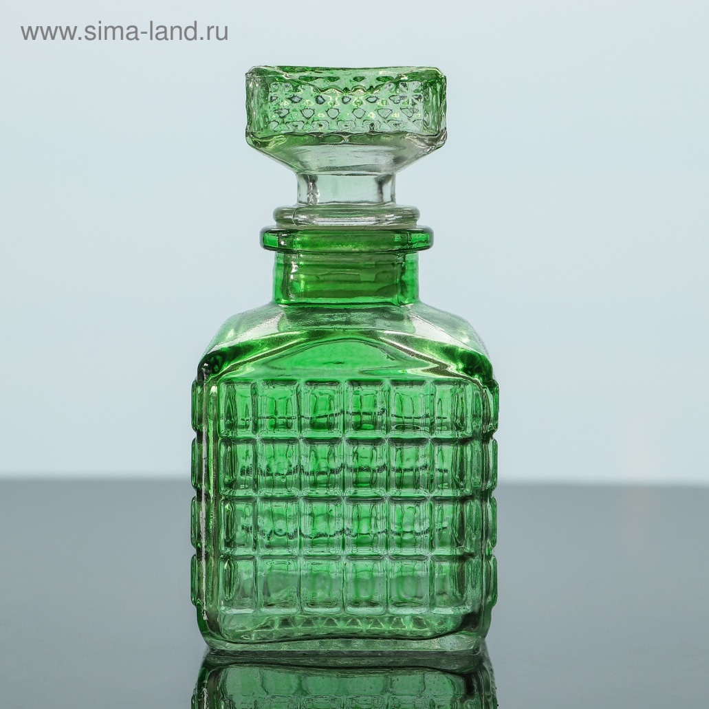
The Urechye glass factory worked until 1846. The products of the Urechye glass factory were of a high
artistic quality. Urechye glass occupies an independent place in European glass-making, and this phenomenon
is significant in the history of Belarusian culture.

Slide 21
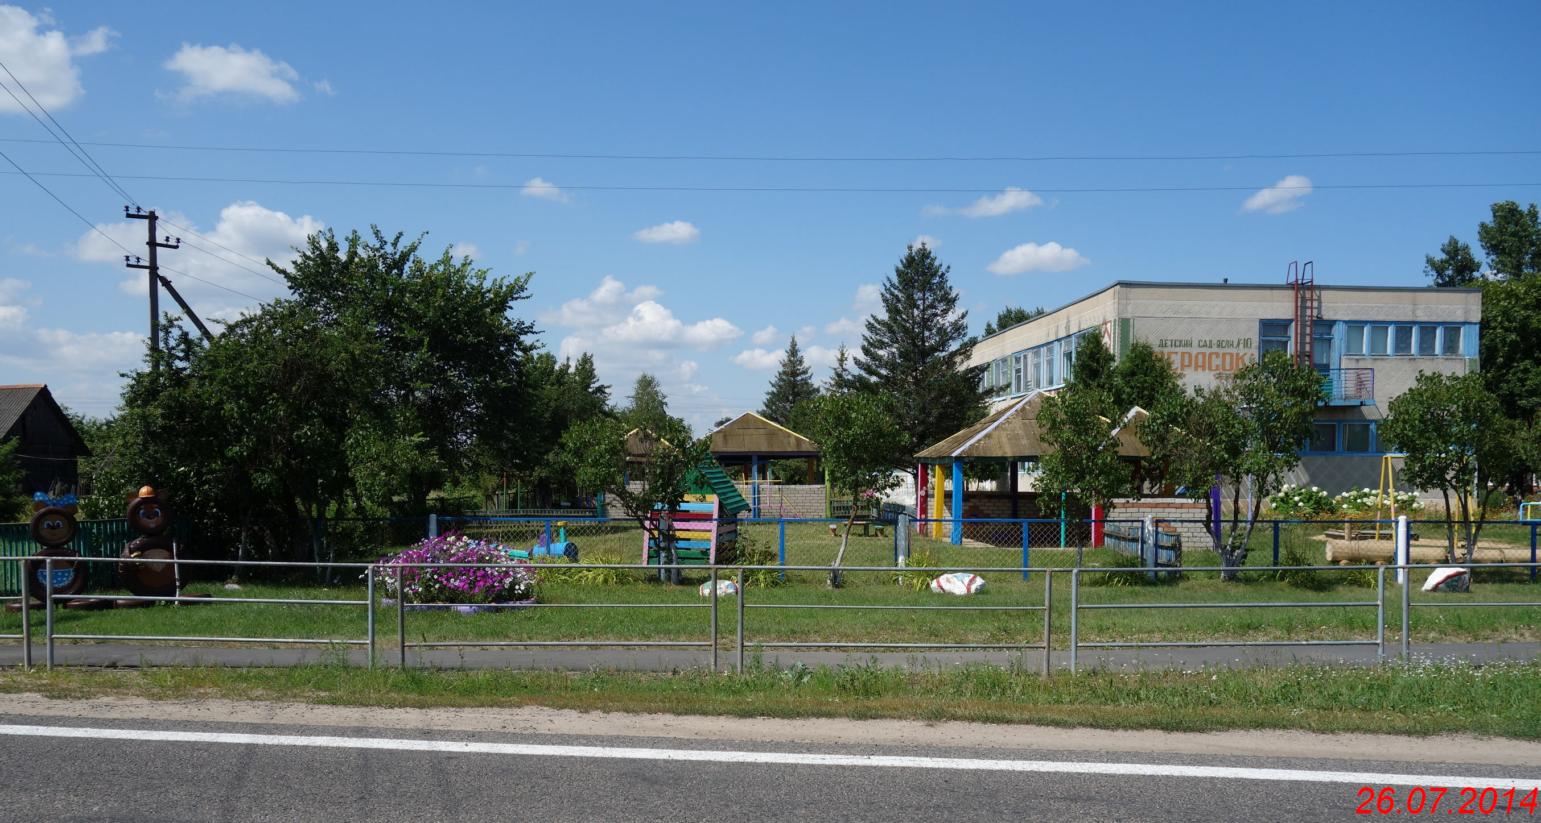
Although there is currently no glorious glass factory in Urechye, it is still proud of its factories. The village has
everything necessary for a comfortable life: libraries, shops, factories, schools and kindergartens.

Slide 22
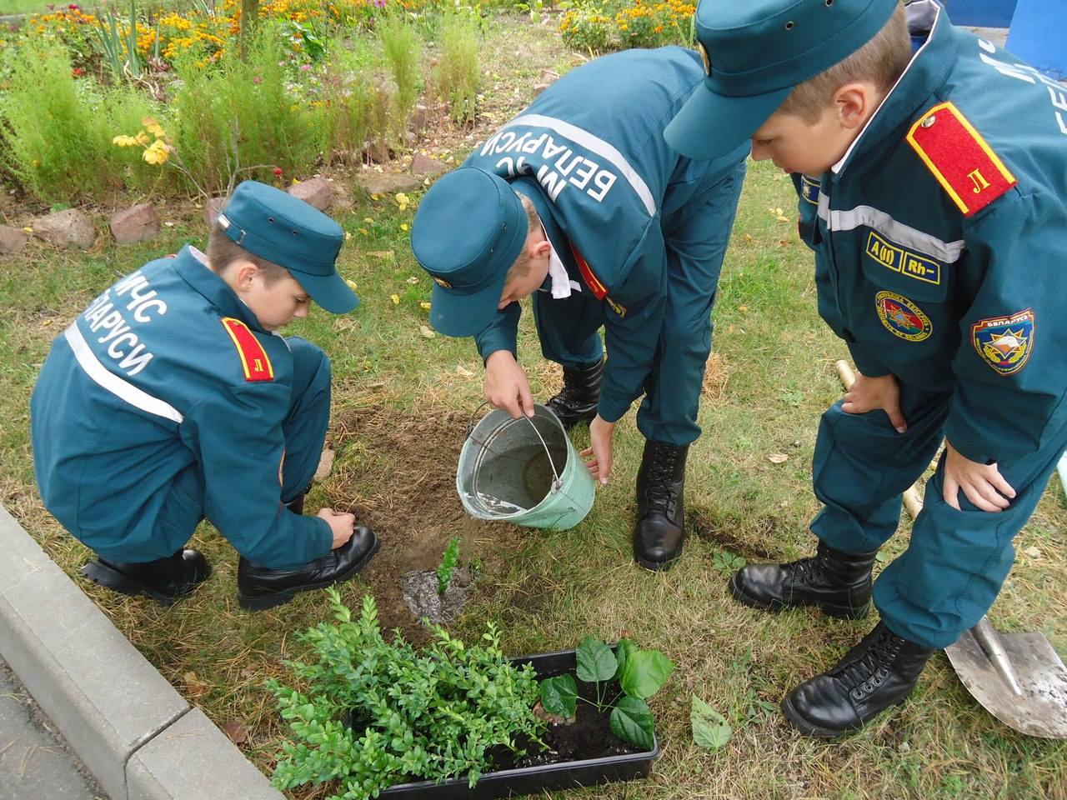
At Lyceum we popularize environmental protection: we plant trees, clean the surrounding area and take part in Clean-up Your Town activities.

Slide 23
Together we can make a difference in the environmental protection.

Slide 24
