Slide 1
How to make schools better ?
High School Students
Boualem – ALGERIA
Iearn 2019-2020

Slide 2
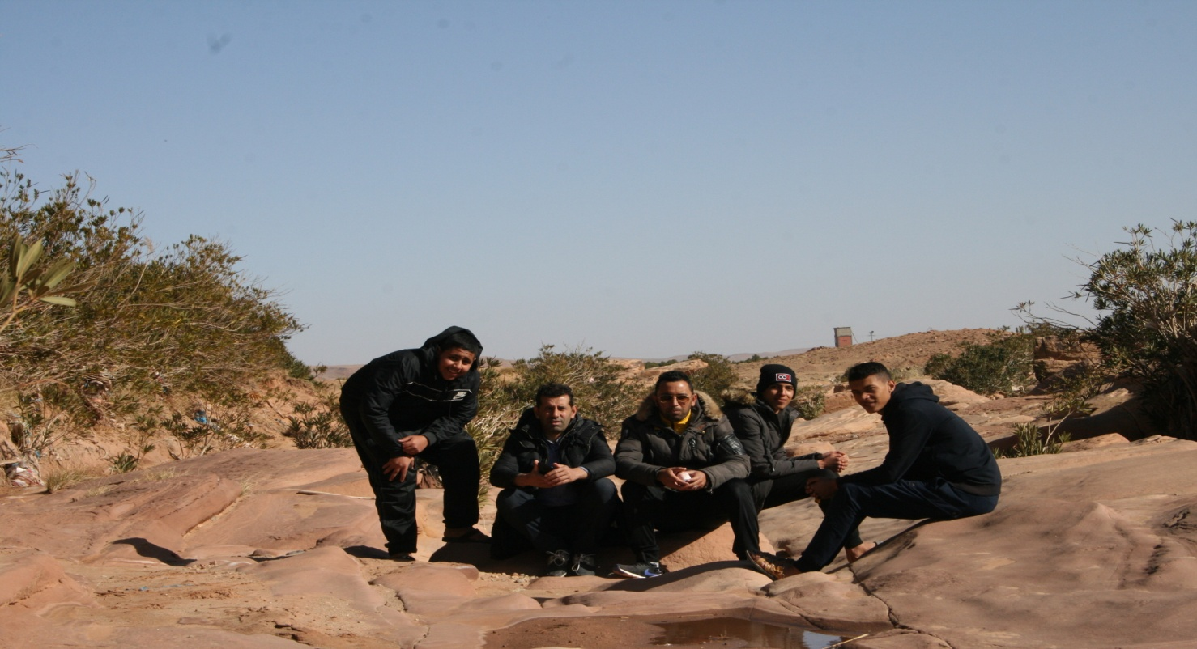
To make school better, you need to:
Have Good Relationship with the your teachers

Slide 3
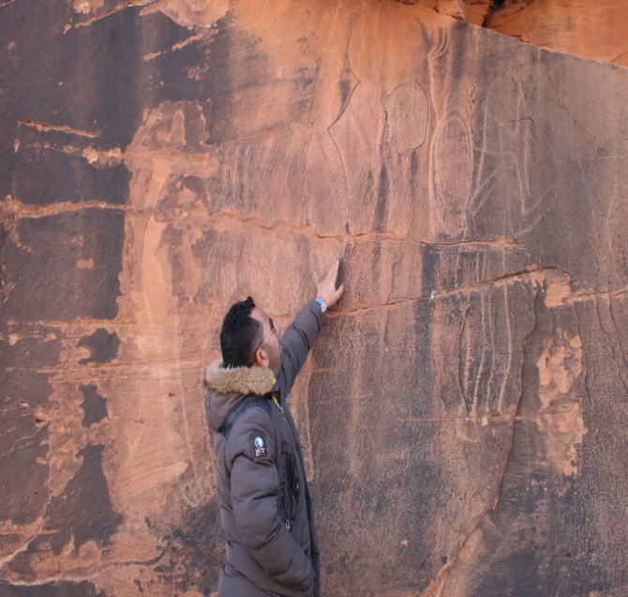
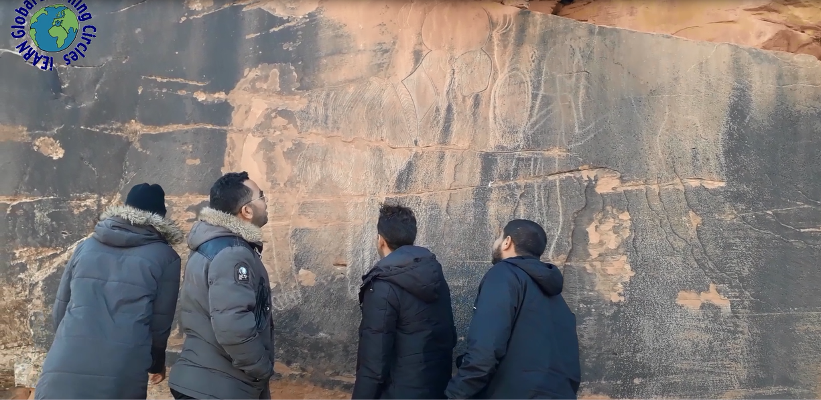
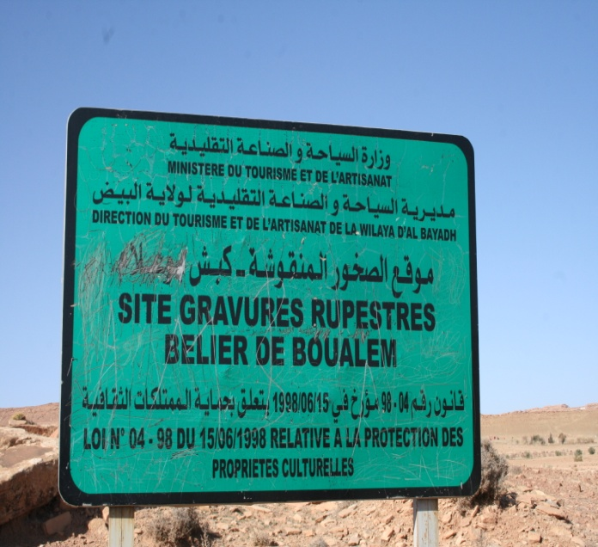
Engage in Outdoor activities (as you see in pictures we are doing a visit to a monument)

Slide 4
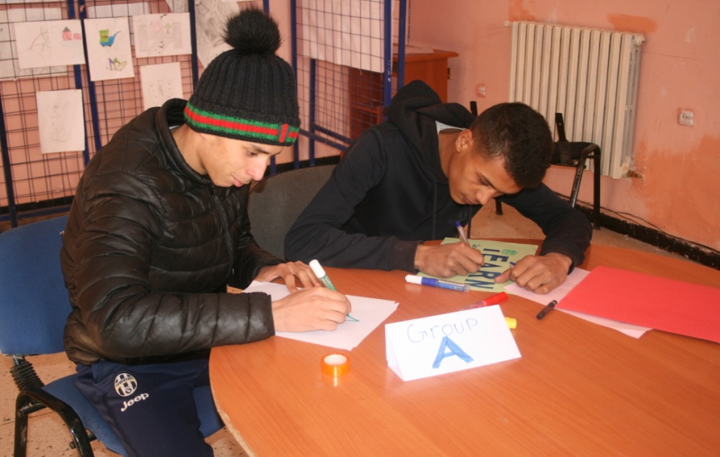
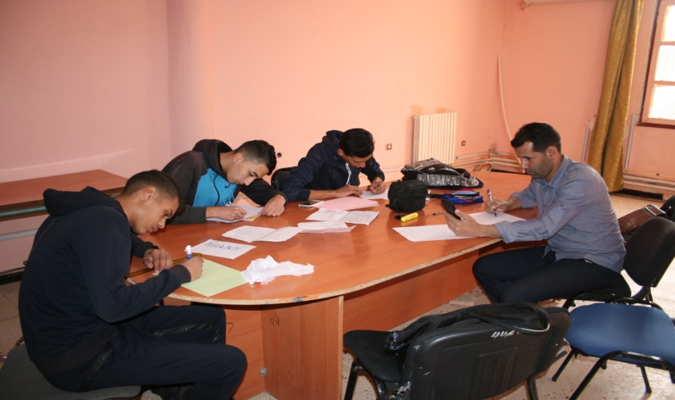
Engage Learners in Creative works ( students are drawing and trying to share their creativity)

Slide 5
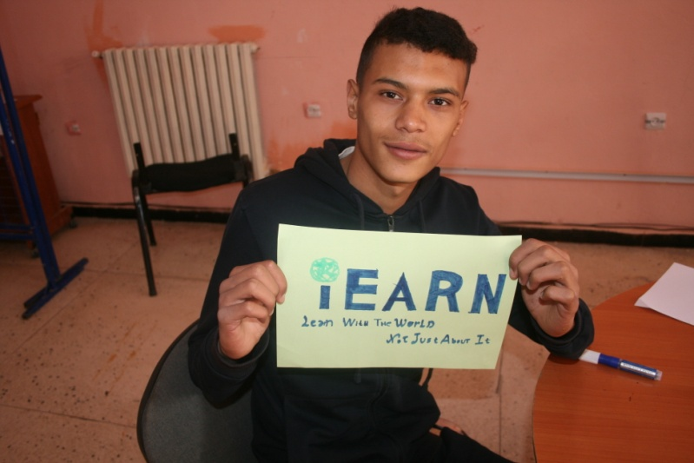
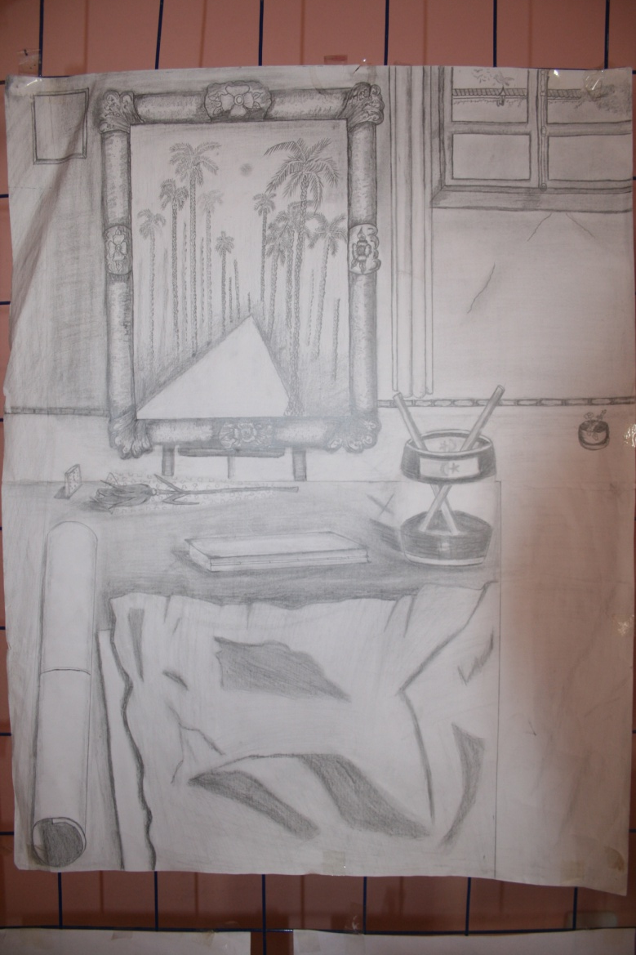
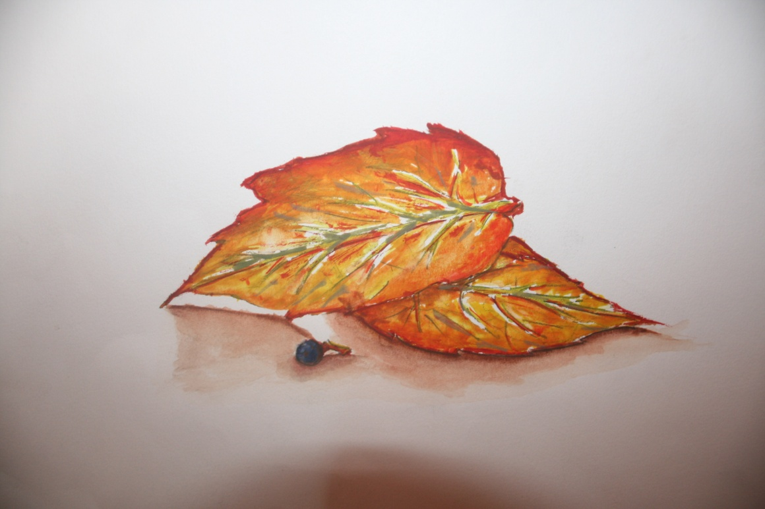

Slide 6
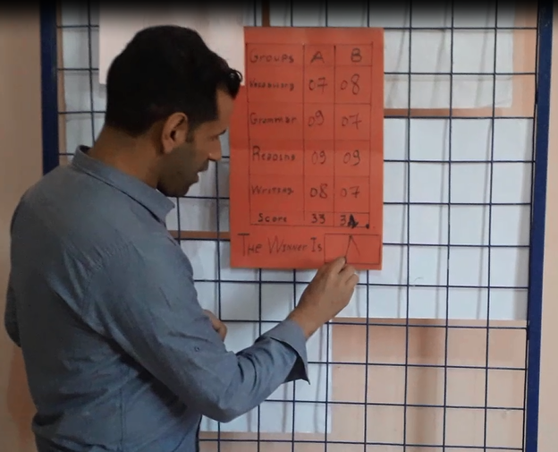
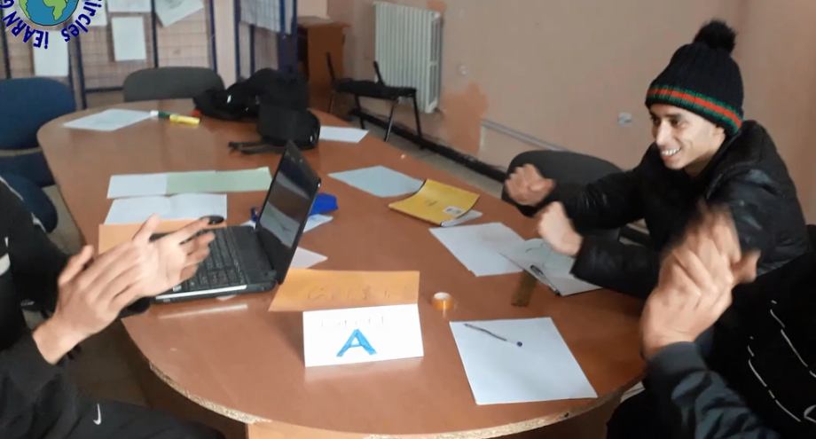
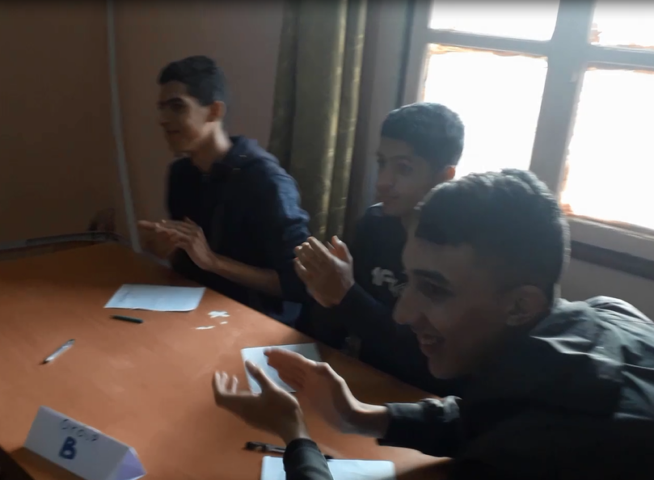
Motivate students and make studies more fun (we organise a competition to acheive it )

Slide 7
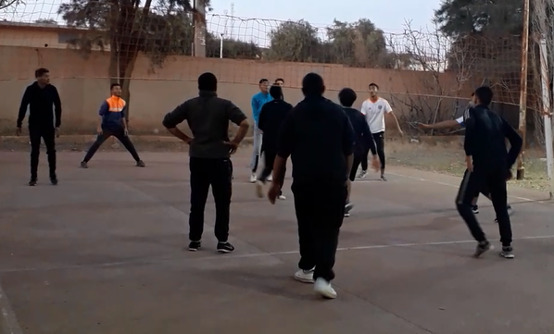
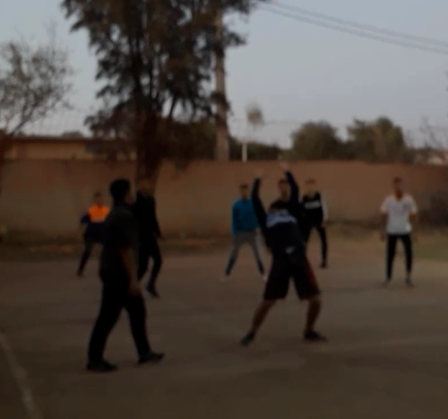
Practice sports Together
(we all share volleyball love)

Slide 8
Thank you for your kind attenion

