Slide 1
Welcome, My School!
My name is Denis Dolghi
I am learning in class 5

Slide 2
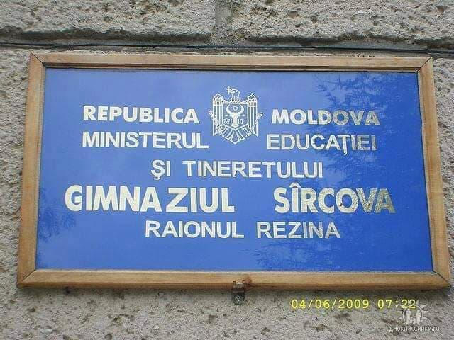
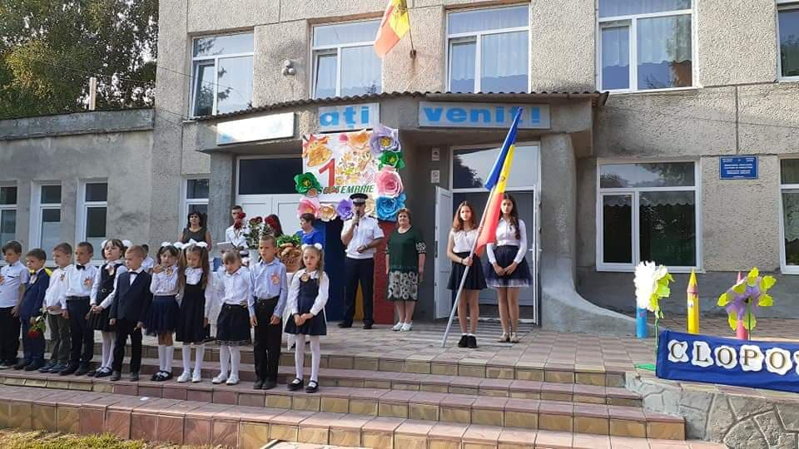
I love my school!!!

Slide 3
My school is called the Public Institution Sîrcova gymnasium, located in Sîrcova, Rezina Rayon

Slide 4
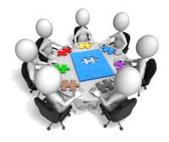
About my school ...
In my school I teach 175 students. We have 9 classes of students. We have cabinets in all disciplines and sports hall.We have a library and a resource center for children with educational needs. Children are involved in different activities.

Slide 5
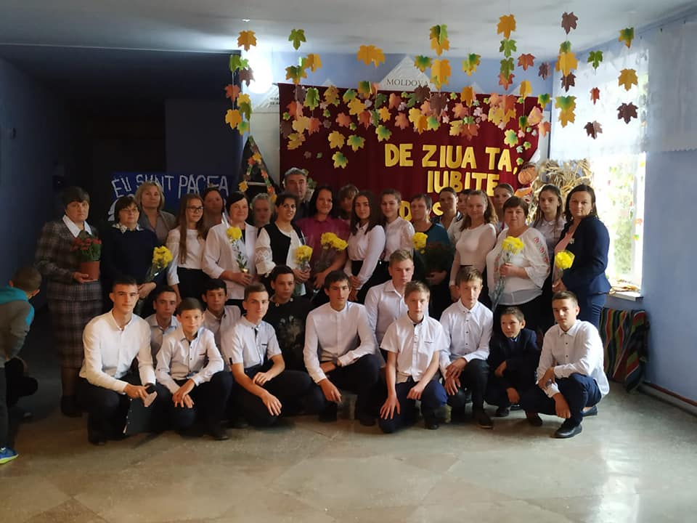
Extracurricular Activities
In the school there are many interesting activities:
The first sound
Golden Autumn
Teacher's Day
Christmas
International Women's Day
Online Safety Day
Children's Rights Day
The last sound
etc.

Slide 6
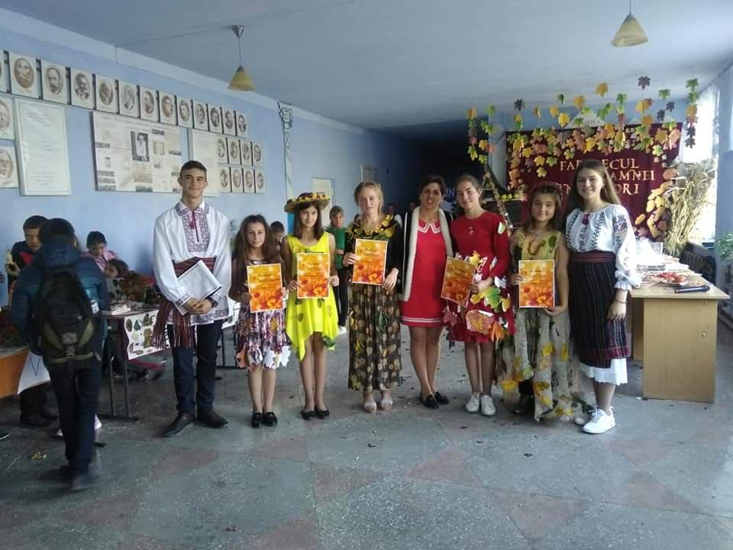
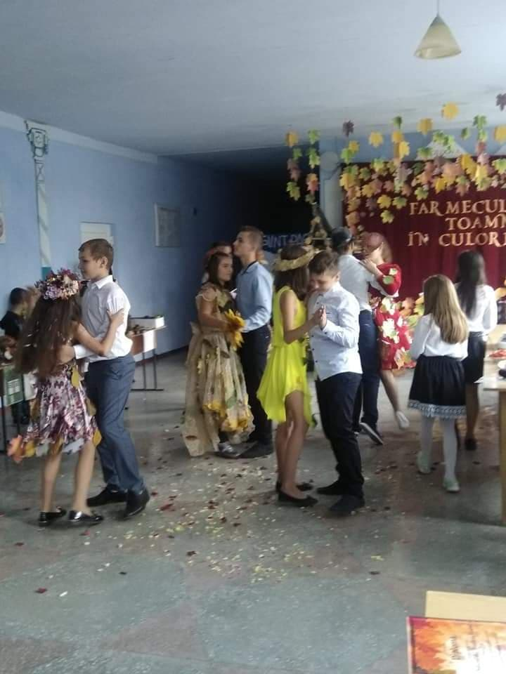
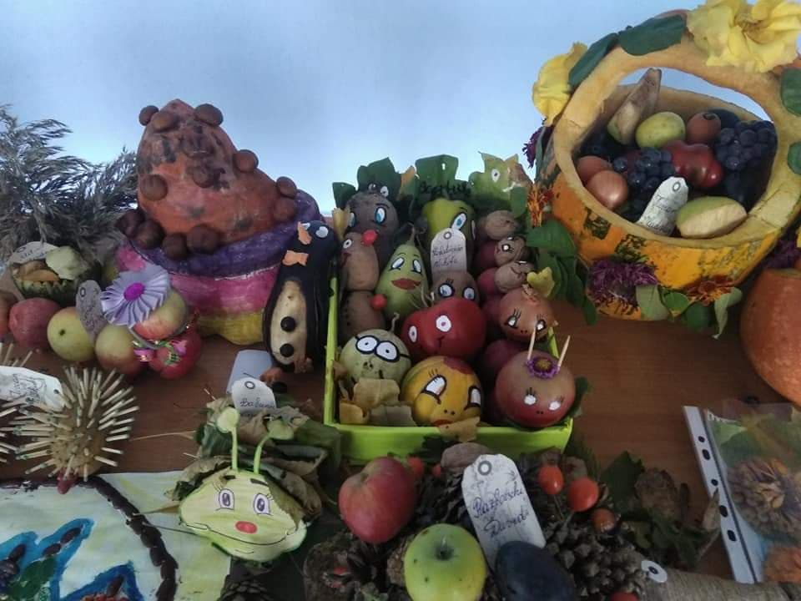
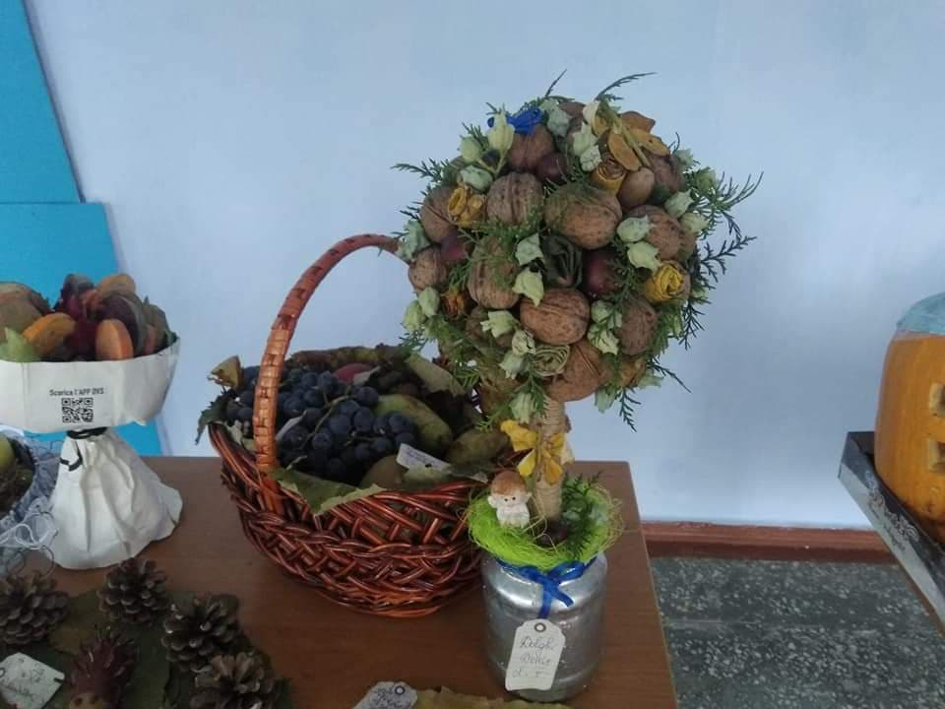
Here are some pictures from my school activities

Slide 7
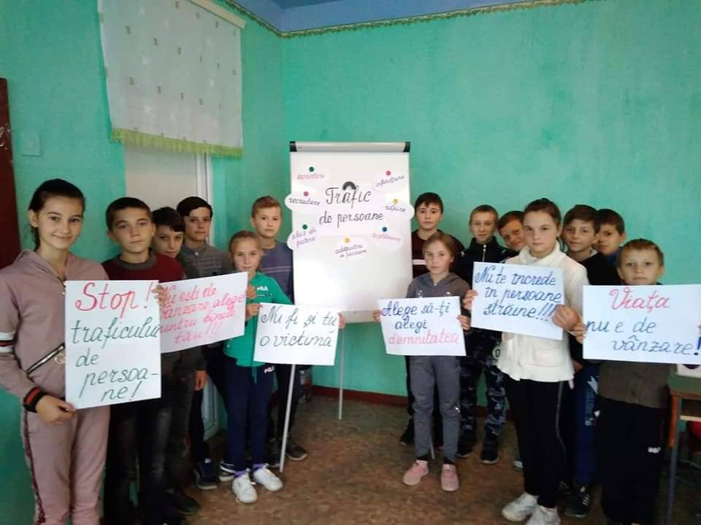
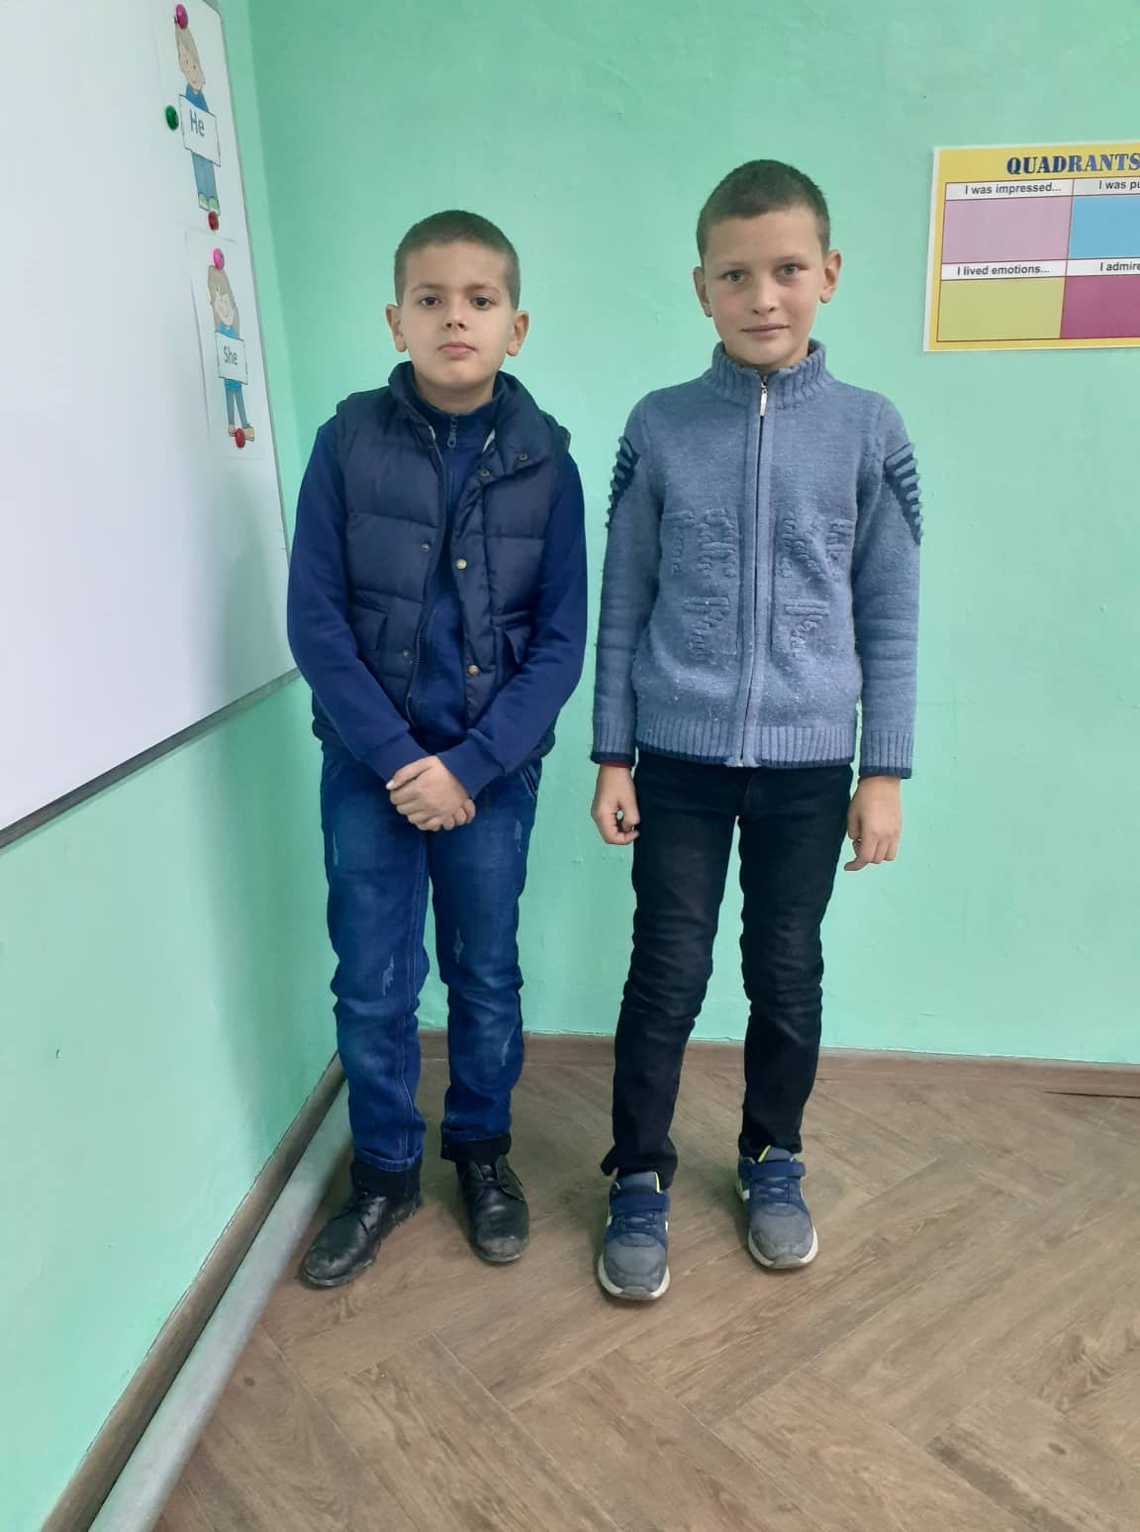
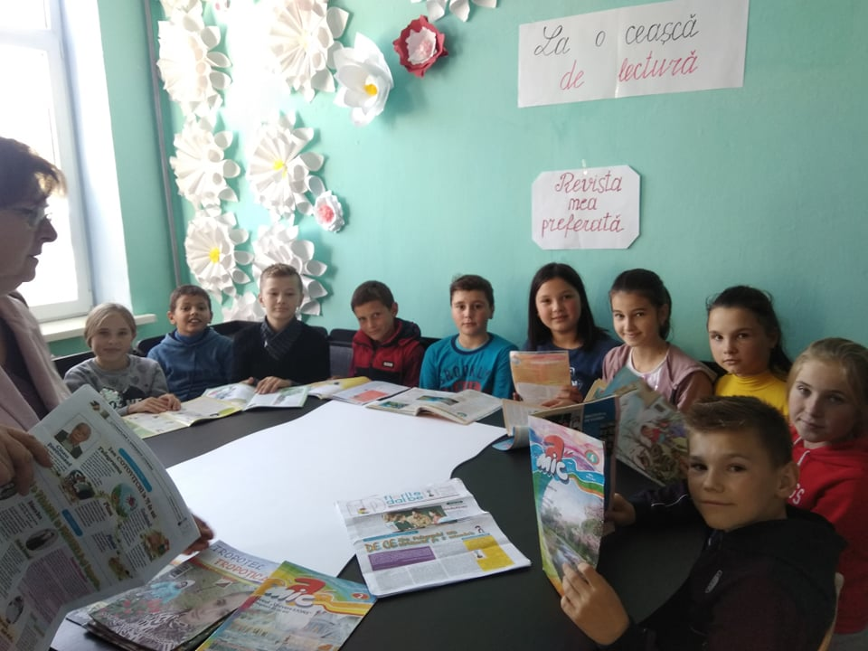
It's my class (5th class )

Slide 8
THANK YOU !!!!!!!!!!!!!!!
PROJECT BY DOLGHI DENIS

Slide 9
Let’s Have a Great Year!

