Slide 1
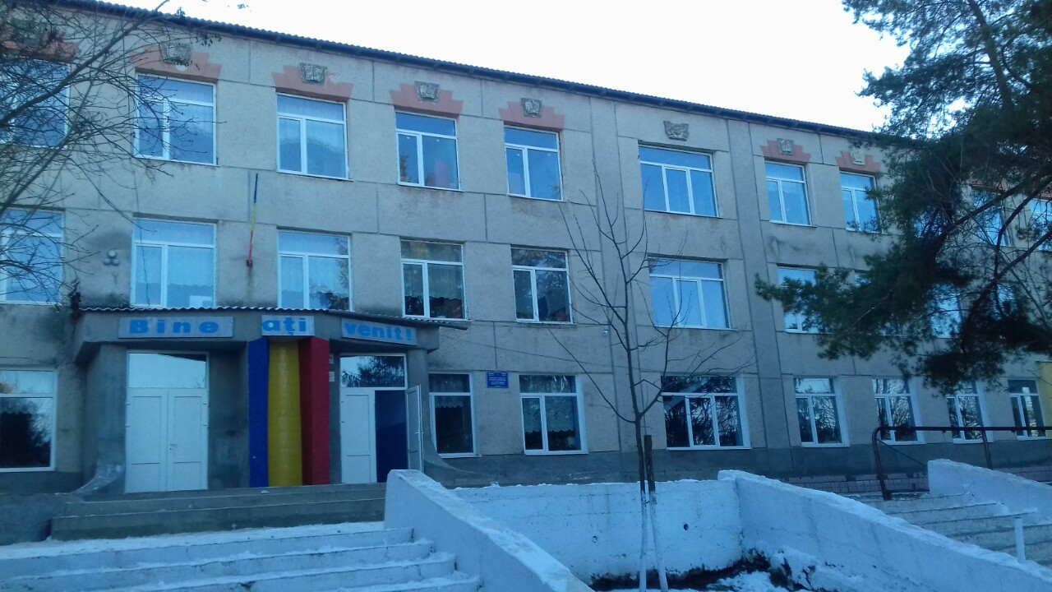
My School «Gimnaziul Sircova»

Slide 2
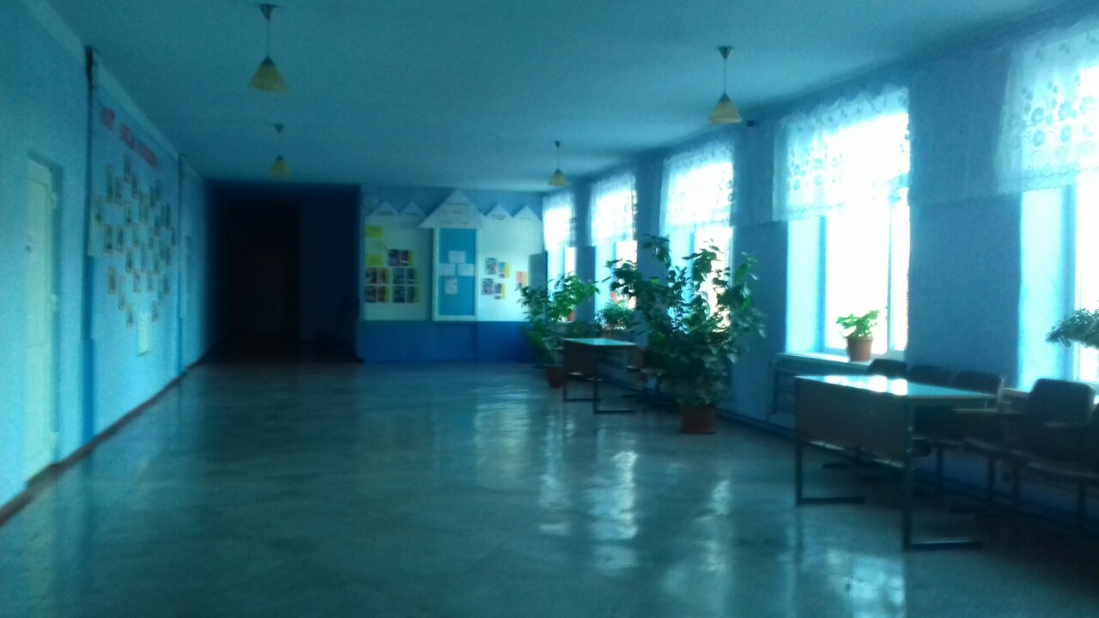
It is assembly hall

Slide 3
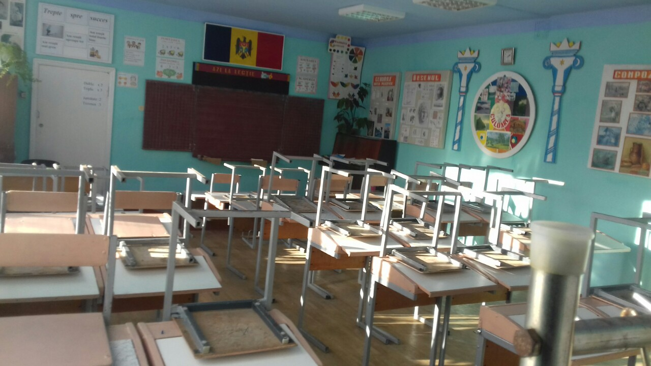
It is art classroom

Slide 4
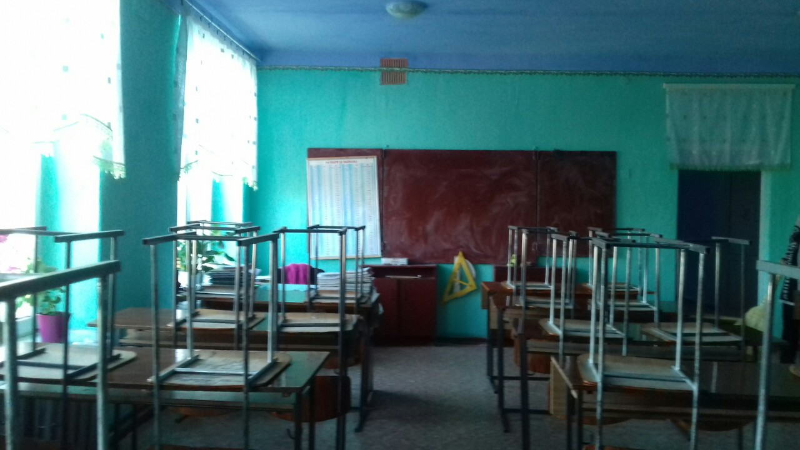
It is math classroom

Slide 5
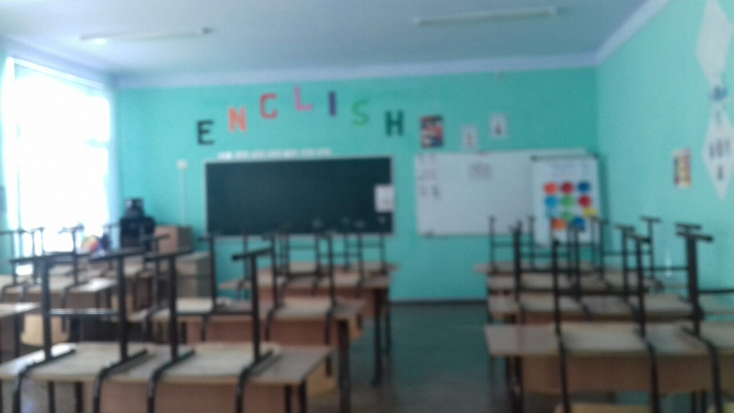
It is English classroom

Slide 6
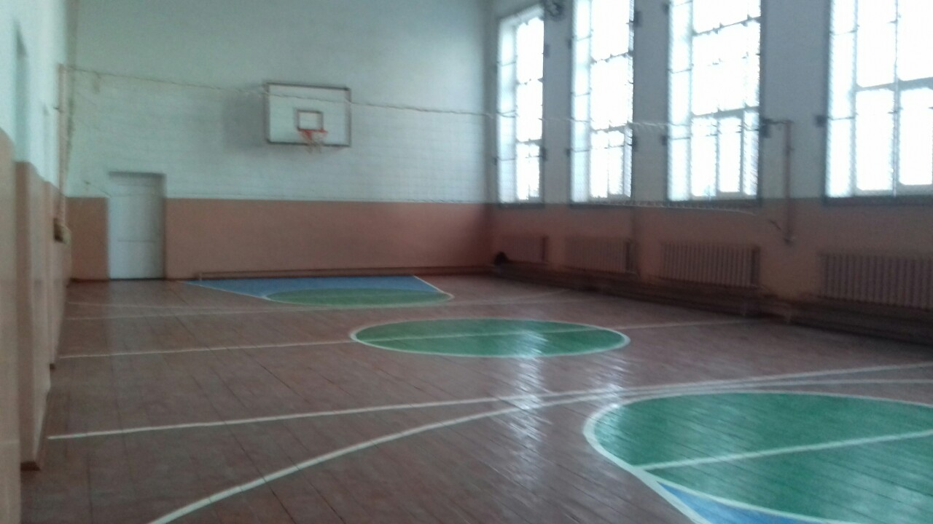
It is playground

Slide 7
Thank you for your attention!!!
Elaborated: Dolghi Vasile

