Slide 1
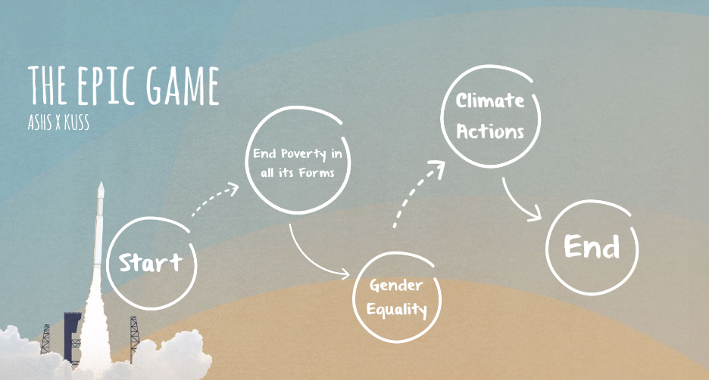
Google 帶你去探險 (生手版)

Slide 2
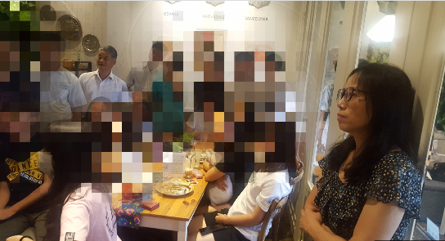
向志豪老師
葉中如老師
Sophie Tai
曾信閔老師
吳美樺老師
林育倩老師
許純華老師
姜叡璟老師

Slide 3
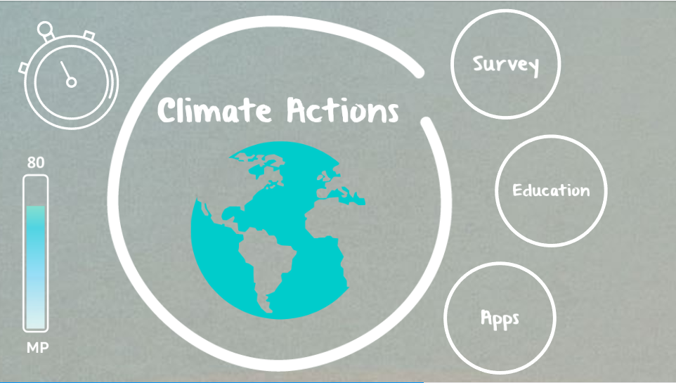

Slide 4
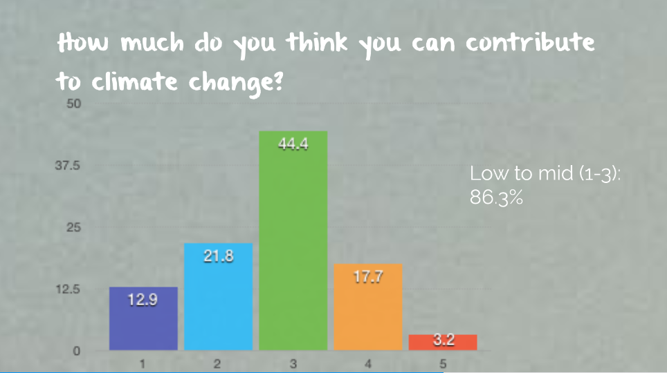

Slide 5
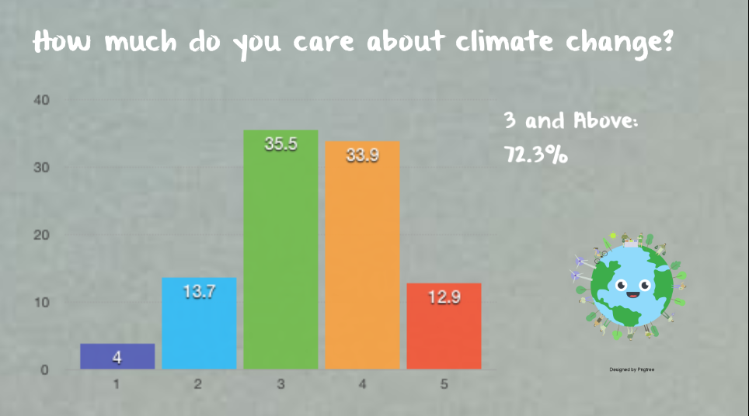
Elements of Argumentation
Claim
The Point You Want to Prove
Counter Claims
Claims that Contradict your claim
Evidence
Facts that support your argument
Reason
Logic that connects the evidence to your argument
Conclusion
The summary of your argument or the final argument you have reached through your argument.
Ocean Cleaning Project

Slide 6
Assessment
Peer Evaluation
Group Work
Oral Presentation
Ocean Cleaning Project

Slide 8
Thank you

Slide 12
