Slide 1
Jubail International School

Slide 2
Profile…..
School Community
Students from more than 35 nationalities
Professionals and staff from 15 nationalities
State of the Art Campuses
Growth Path: School and Institute at
Provincial Level
National Level
And now want to share our experience at the international level- in other countries

Slide 3
Motto
Foundations for a Better Future
Philosophy
Every individual is unique and to be equipped for the challenging environment at University

Slide 4
Vision
Network of high quality international schools
Uncompromising commitment to prepare leaders of tomorrow Environment where students are exposed to the latest technology and teaching methods
Mission
Commitment to providing high-quality education
Internationally recognized curriculum
Disciplined, safe, nurturing and positive learning environment.

Slide 5
International Schools
Catering the needs of students from around the world
Al Hussan International School in Khobar- 1998
Jubail International School- 1999
Orbit International School in Khobar- 2006
Al Hussan International School in Riyadh – 2011
*All schools have been segregated into Boys ad Girls Sections since 2009

Slide 6
Accreditation & Affiliation
Ministry of Education | AdvancEd | Council of International Schools |  | Cambridge International Examination
IB Diploma Program | College board | International Arab Baccalaureate | Mawhiba | Western Association of School an College

Slide 7
What makes us unique?
Commitment to Excellence
International Curriculum
Student from International Community
Students Character and Confidence Building
E-School
Well Trained & Dedicated Professionals
Job satisfaction and Encouraging/ Congenial Environment
on Job Facilities as per the Labor Law
Parents Council & –Student Council –Elected Bodies

Slide 8
School Stages
Early Childhood –Pre K to KG 2
Primary School- Grade 1-5
Middle School- Grade 6-8
High School- Grade 9-12

Slide 9
Academic Programs
Pre –K: Early Years Foundation Stage (EYFS) from QCA of the Ministry of Education of England and Wales
Cambridge International Primary Program
Cambridge Secondary Program
IGCSE
A Level
IB

Slide 10
School Community
Multinational Parent and Student Body
Teachers
General Staff
Parents Council – Elected Body
Students Council –Elected Body

Slide 11
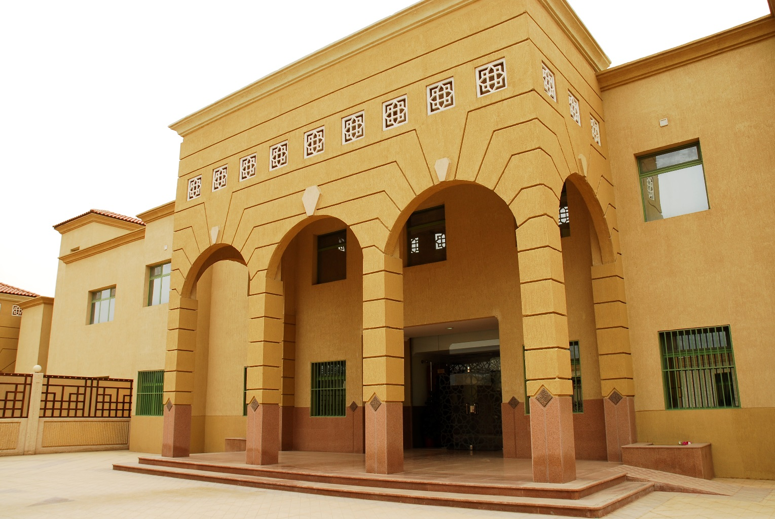
Facilities
Building
State of the Art Campuses

Slide 12
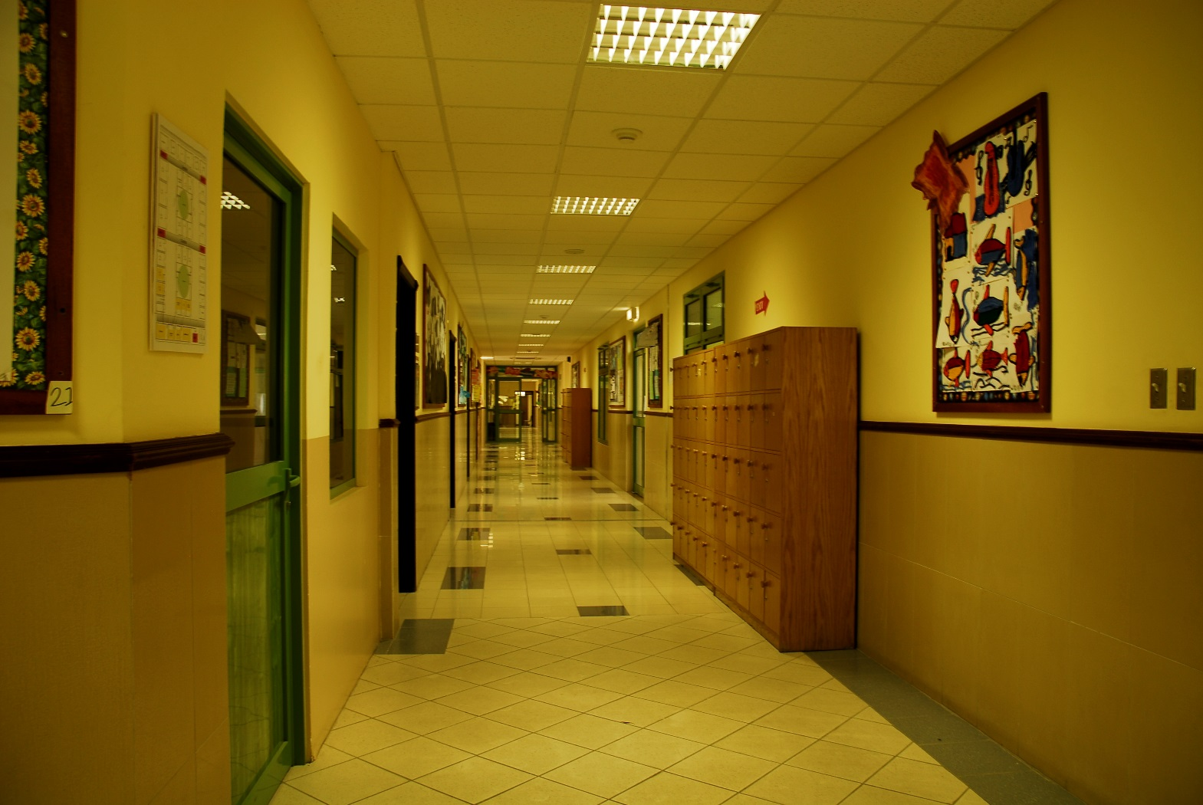
Facilities …
Health and Safety
Cleanliness
Security Guards
CCTV Surveillance (Pictures)

Slide 13
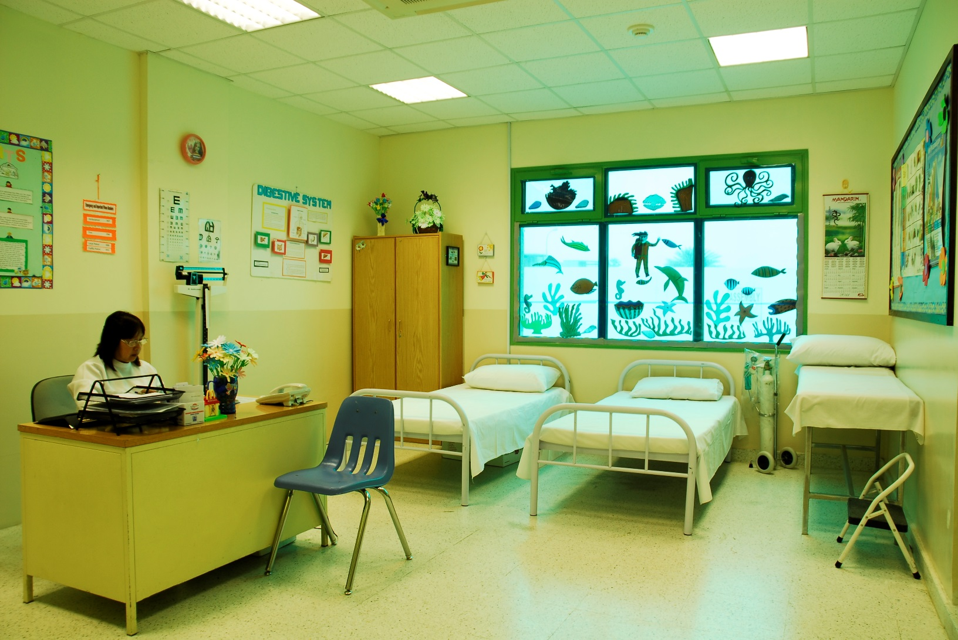
Facilities …
Health and Safety
School Clinic

Slide 14
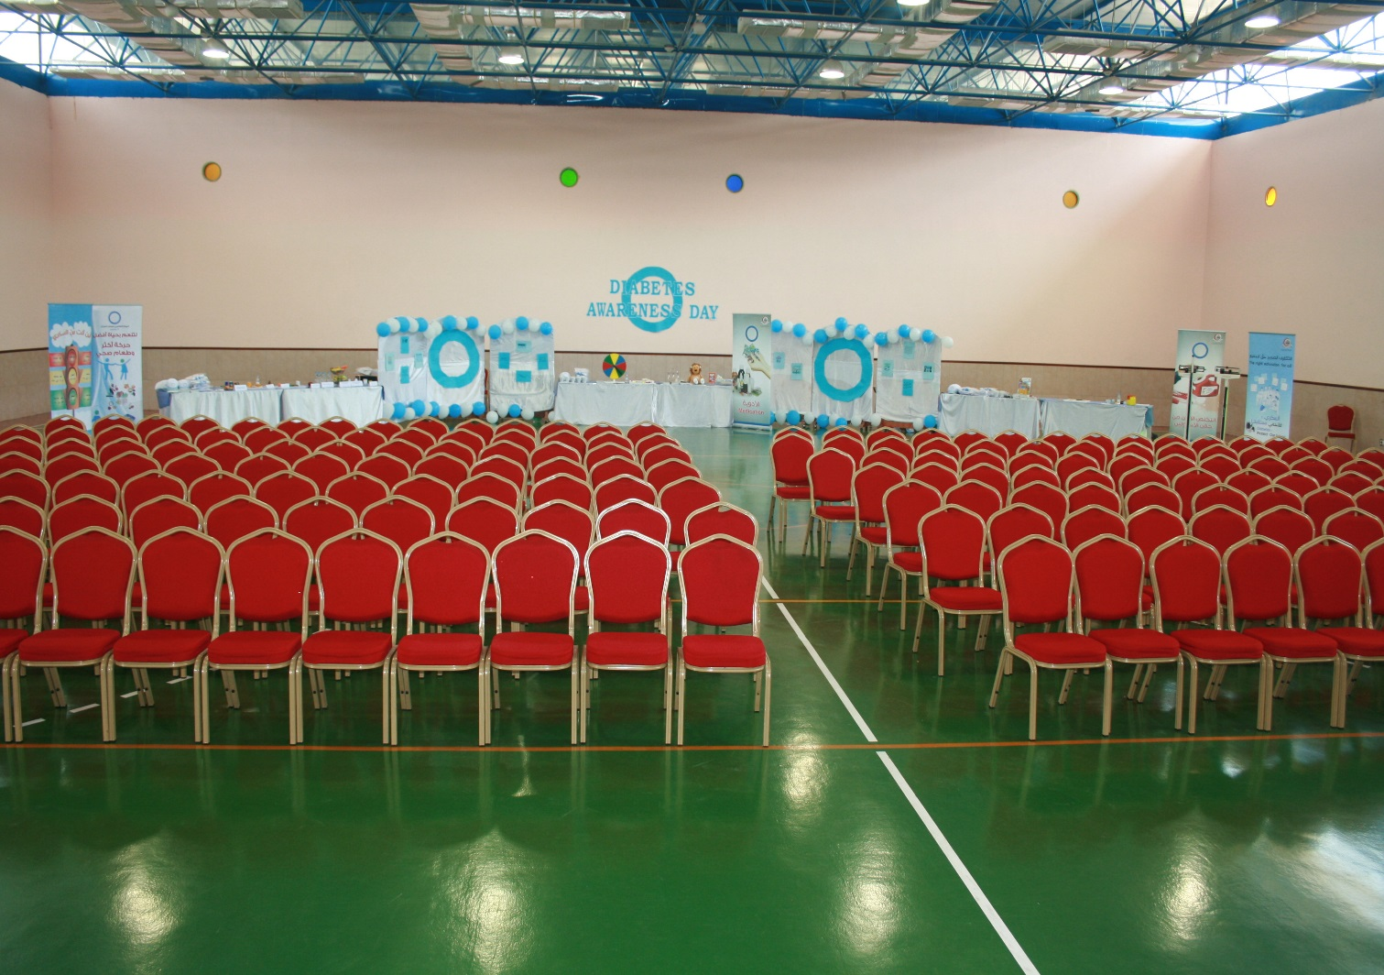
Facilities …
Multi Purpose Hall Reception

Slide 15
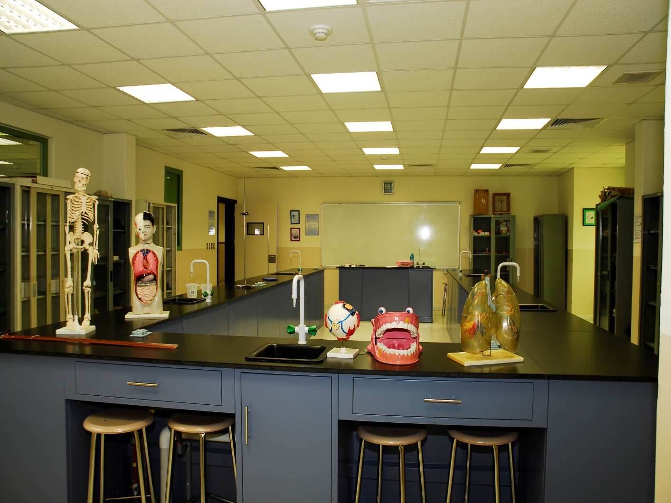
Science Lab ICT Lab

Slide 16
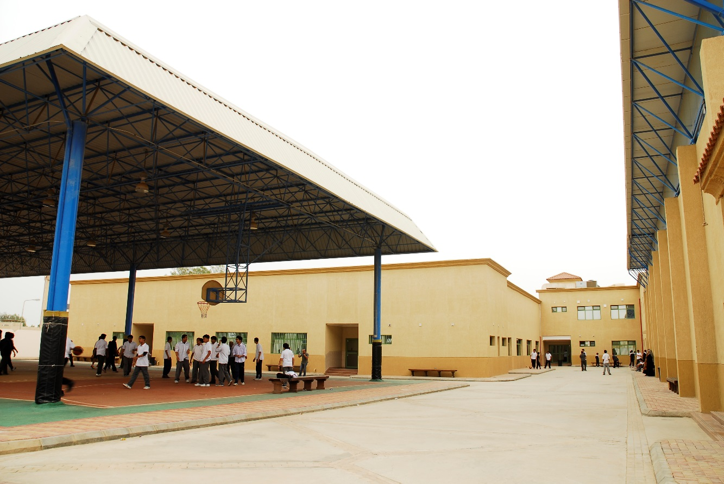
Play Areas

Slide 17
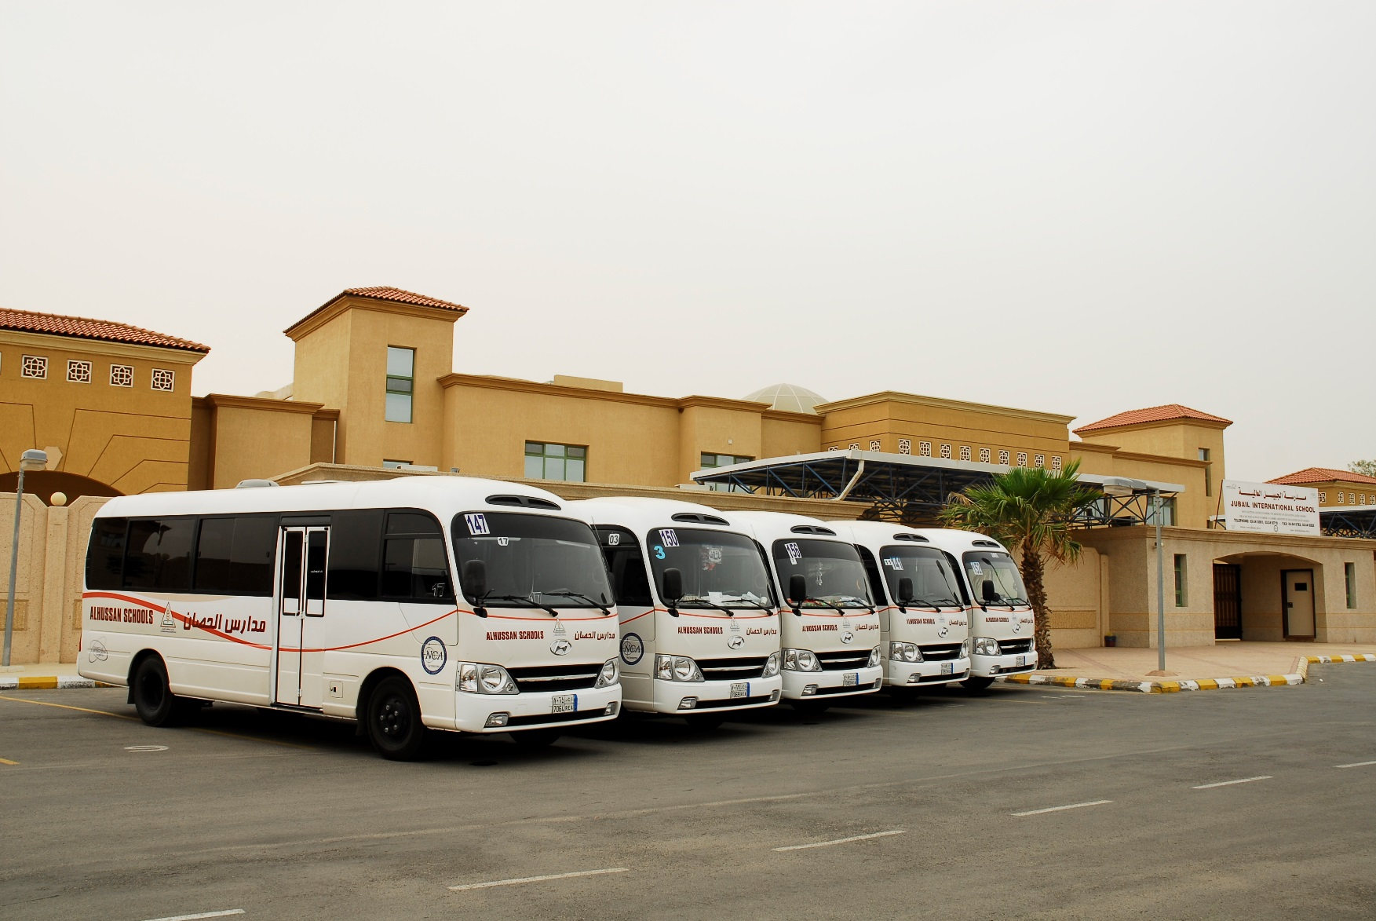
Transportation
Buses Fleet (Pictures)
Speed Control-
GPS System (central system)
Traffic Control and Parking

Slide 18
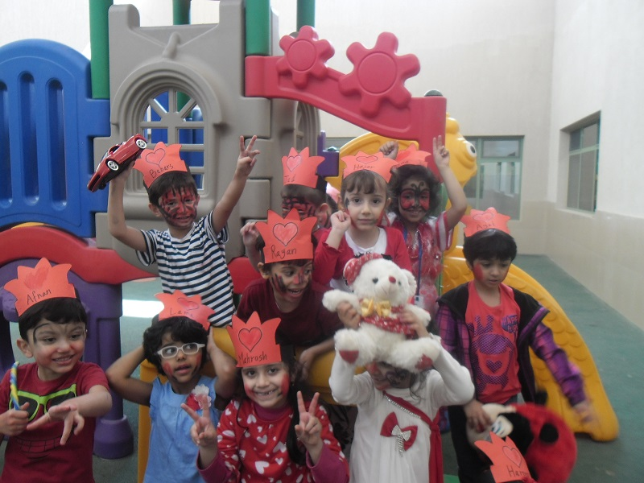
Activities

