Slide 1
Cinema
in Belarus and Moldova

Slide 2
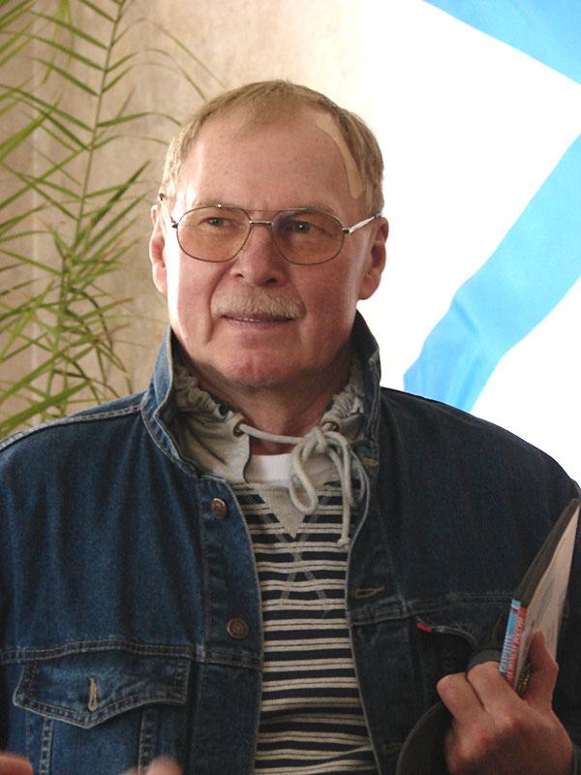
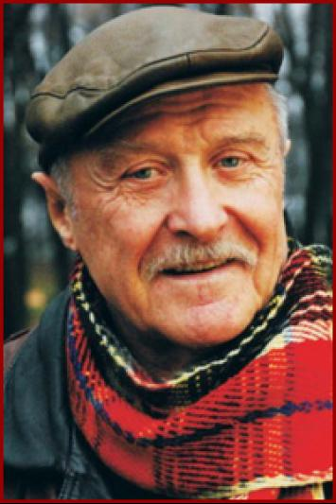
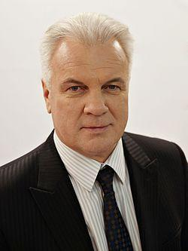
Famouse Belarusian actors
Gennady Mikhailovich Garbuk
Anatoly Vladimirovich
Kotenev
Vladimir Vasilyevich
Gostyukhin

Slide 3
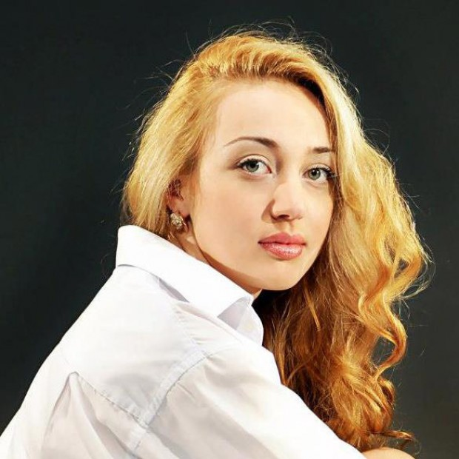
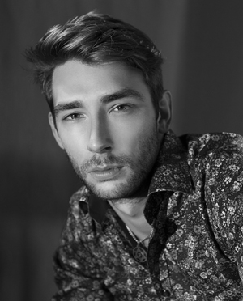
Famouse Moldavian actors
Daniela
Burlacu
Dumitri
Dubina

Slide 4
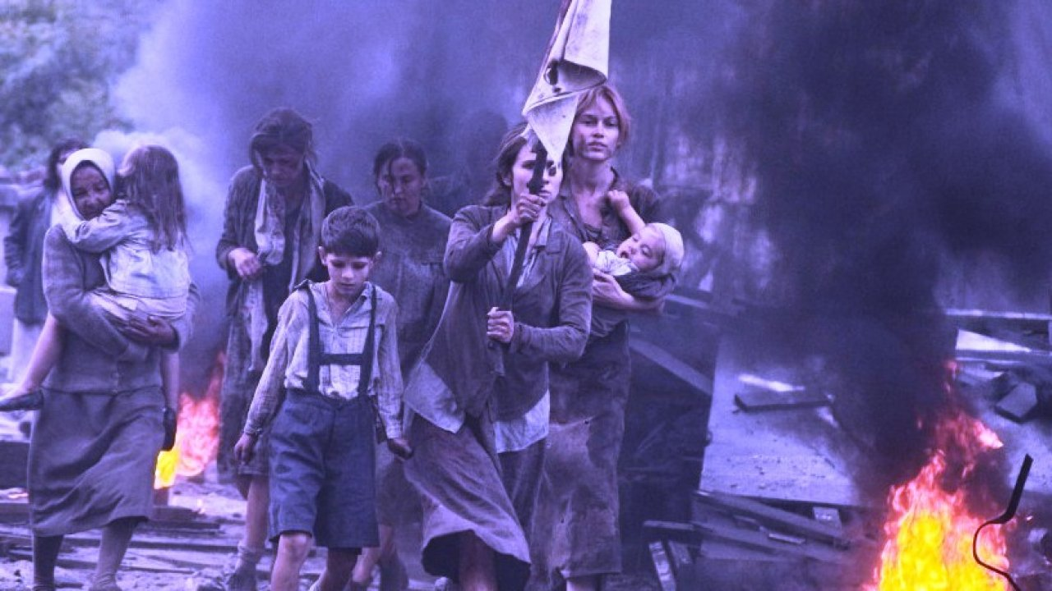
Belarusian cinema
I will tell you about one of the most famous films and my favorite film, which is called Brest Fortress.The film is about the first truly heroic battle of the Great Patriotic War - the defense of the Brest Fortress.

Slide 5
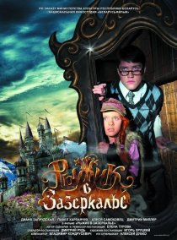
Ryzhik through the Looking Glass
This is another Belarusian film.
In the fairy kingdom of Nedalia, the evil wizard Mortis enchanted all the mirrors. The inhabitants of Nedalia could not see their reflections even in the water, because they immediately disappeare. It is seemed not enough for Mortis. And evil began to penetrate from the fabulous into the real world.
Defeating Mortis is not easy - a person of royal blood can stop him. And such a person is a 12-year-old mischievous girl Ryzhik.

Slide 6
Moldavian films
Beautiful Corruption
The director of the film is Evgeniy Damaskin.
The film was shot on real events. The actor Igor Babich has played the main role.
The main character of the film looks for justice and uses unfair ways.

Slide 7
A classroom survey
 | Belarus | Moldova
Do you like going to the cinema? | yes | yes
How often do you go to the cinema? | once a months | once a months or less
When did you go to the cinema last time? | a month ago | in summer
What are your favorite movies? | Guardians of the galaxy, We bought a zoo, Fast and furious 8 | By the sea, Rampage, The fate of the furious, Bad boys
Who are your favorite actors? | Arnold Schwarzenegger, Angelina Jolie, Jason Statham | Angelina Jolie, Dwayne Douglas Johnson, Will Smith, Jason Statham
Do you like to go to the cinema with your friends or relatives? | With friends. | With friends and always with families.

Slide 8
Film studios in Belarus
We have a national film studio - Belarusfilm. It’s one of the leading studios in Eastern Europe.
It was founded in 1924.
The first film “A forest story” was made in 1926.
Every year Belarusfilm produce about 50 different types of films, documentaries and cartoons.
A lot of films about Great Patriotic War are produced here.

Slide 9
Film studios in Moldova
Moldova-film was founded in 1952.
Before 1982 Moldova-film produced 120 films and 800 documentaries.
Till present days it had difficult times but they have a good potential.
Nowadays it can produce 3-4 films and 50 documentaries a year.

