Slide 1
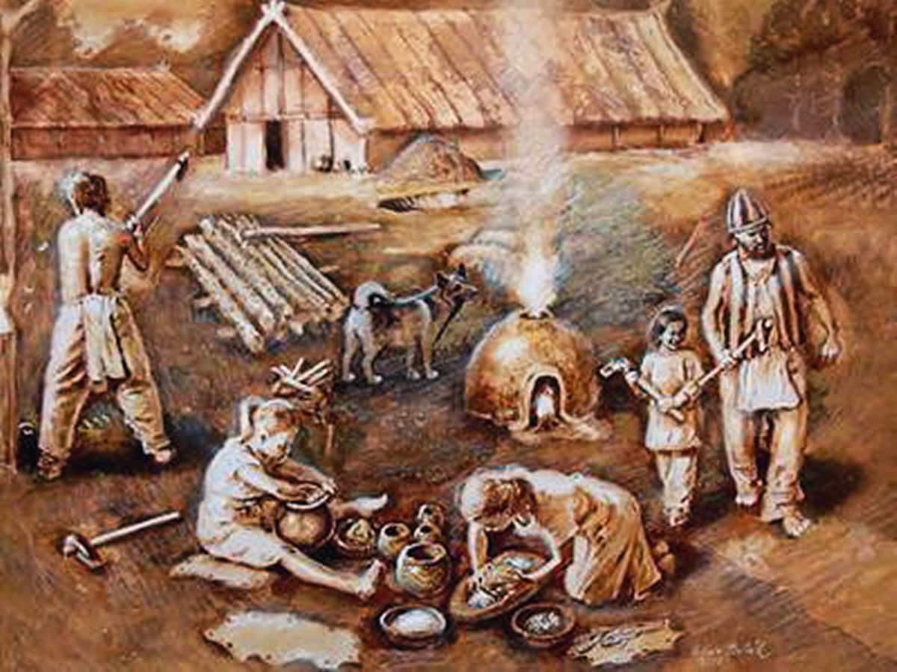
The Geto –Dacians-Early
people on the territory
Republic of Moldova
Made by the fourth grade students and the teacher Tirsina Nina,primary school-kindergarten nr 90
November 2017

Slide 2
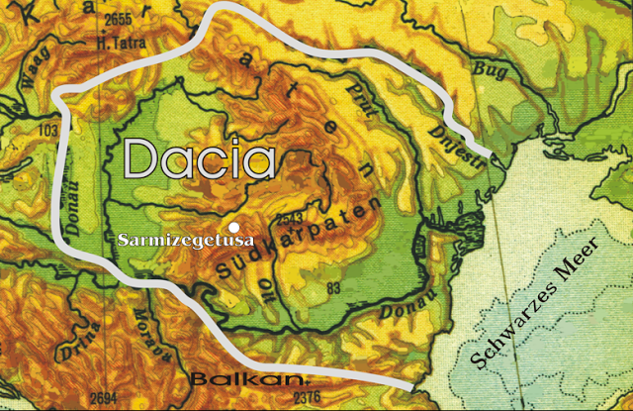
The geto- dacians
The oldest inhabitants, who lived with over 2 500
years ago on the territory of our country today,were Geto-Dacians (the Greeks called them
Getae, and the Romans -Gauls). They were part of a larger nation, worthy and brave who were called the Thracians. Who lived three centuries before Christ in more than 40 tribes and occupied the area between northern Greece, southern Russia and north-west Turkey.

Slide 3
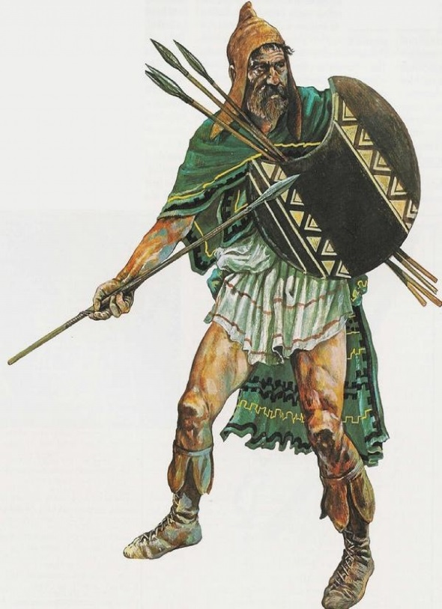
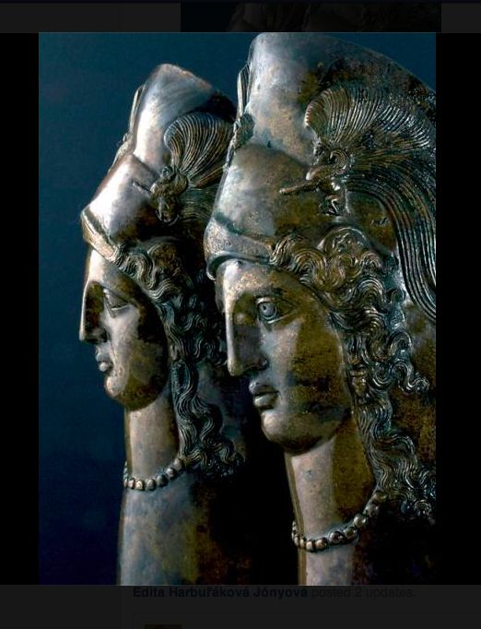
The Dacians were an Indo-European people, part of the tribes of Thracians. Dacians were the ancient inhabitants of Dacia, located in the area in and around the Carpathian Mountains and west of the Black Sea.
The Thracian conquest
The Thracian worrier
The Thracian queens

Slide 4
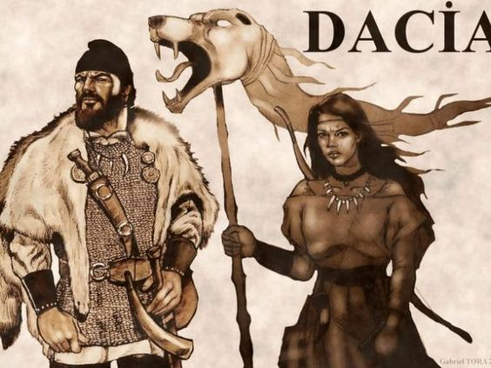
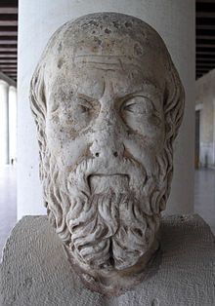
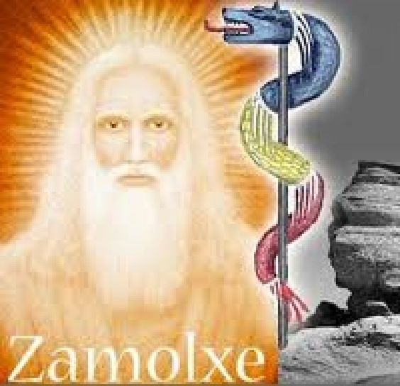
Geto –dacians ‘ territory
The territory of Dacia, the Getae's country, was roughly that of today's Romania, Moldova, Hungary and parts of Bulgary and Ukraine. During the reign of king Burebista (1st century BC), the western border advanced to the Constanta lake, situated in today's Switzerland.Their flag was a dragon.
The Dacians were a warrior people, and their polytheist religion saw death as a liberation. Their belief in the supreme god Gebeleizis made them fearless on the battlefield, and this virtue was passed on even after the old religion was replaced by the cult of Zalmoxe.

Slide 5
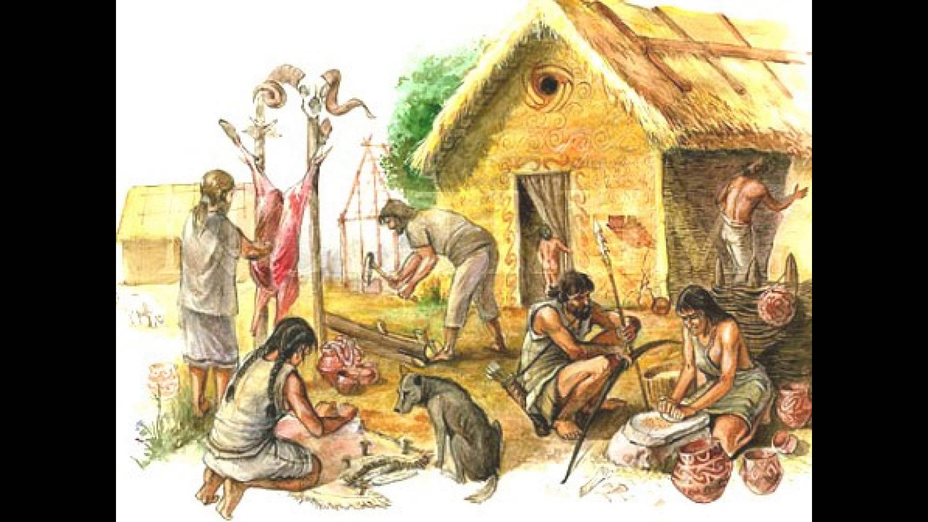
Their houses were made of wooden rods which were tied to wooden poles and built with
rammed wet earth,.

Slide 6
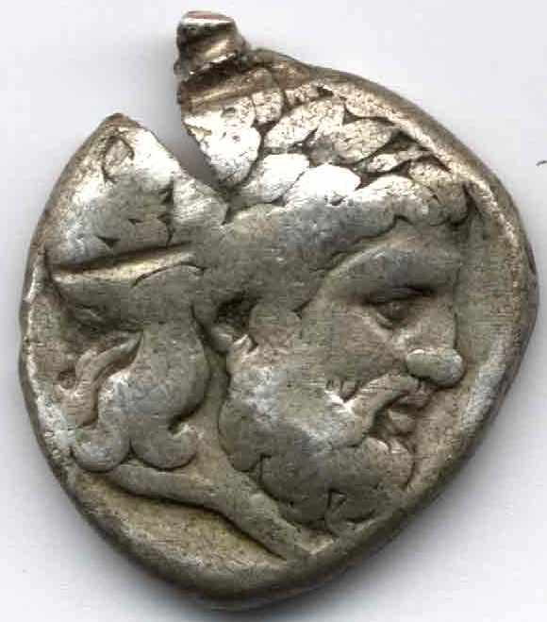
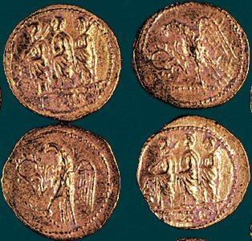
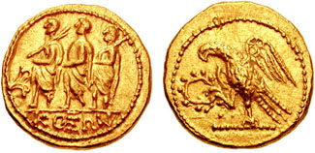
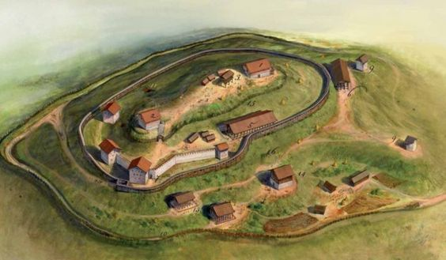
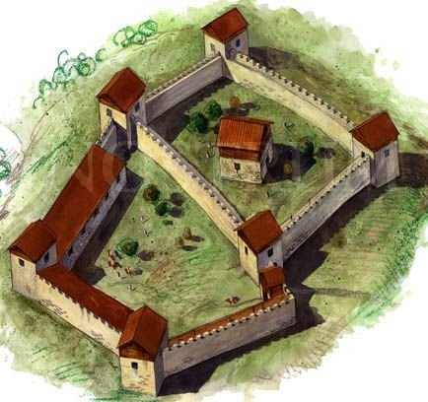
The first geto-dacian coins appeared a the beginning of third century BC and were made of silver .These are two dacian fortresses (nowadays in Romania

Slide 7
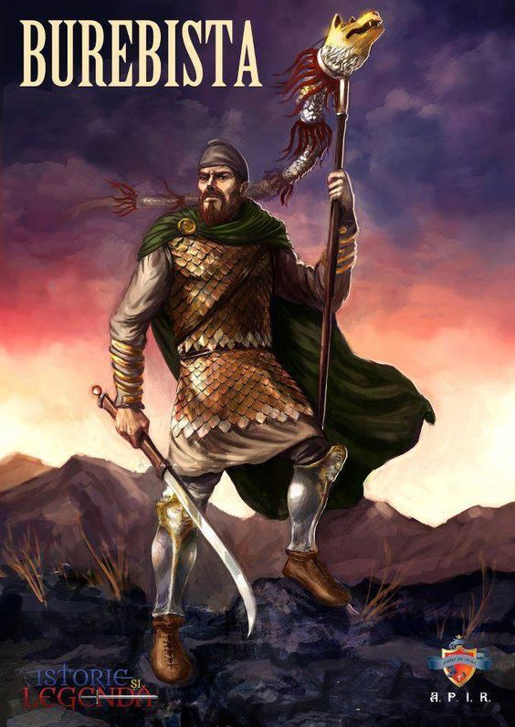
Burebista is the first king who unified all the tribes in one state
The one who unified all the Getae-Dacian tribes in a single and powerful state was Burebista(82 BC-44BC), who was helped by the great priest, Deceneu.
That unification was made through diplomacy or through war, and his state was centralised, being a military monarchy.
The capital of the Dacian kingdom was Sarmizegetusa Regia, located in the mountainson the territory of Romania. Sarmizegetusa was defended by some fortresses, like Costești, Blidaru and Red Stone.he has the flag in his hand.

Slide 8
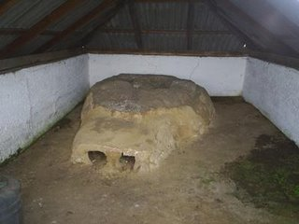
What did they eat?
The Geto-Dacians were sedentary tribes; for centuries they had eaten mostly plant foods and animal products: ground cooked grains, millet porridge with milk, boiled meat. Also Dacians ate wild edible plants, such as mushrooms, garlic, quinoa, sorrel and others. They fished as well.. The Dacian food was simple to cook; roasted meat .They cooked dairy dishes: various grades of sheep cheese (smoked, dried), sweet goat cheese, and lower quality cheese (Urda).
According to archeological relics,ancient Dacians not
only drank the wine but also ate it,
keeping it in a solid state during winter
time. These were Dacian pottery
making ovens

Slide 9
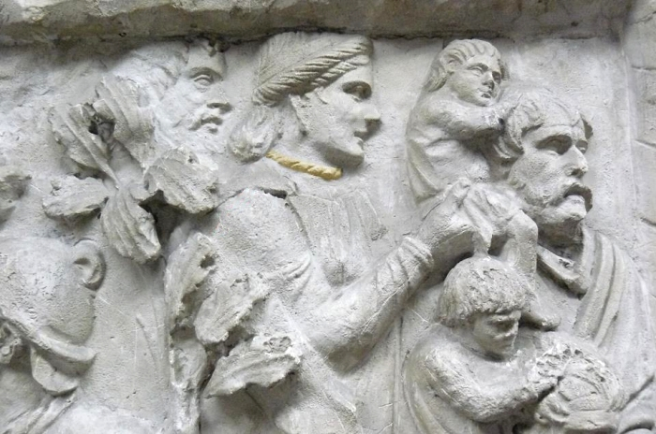
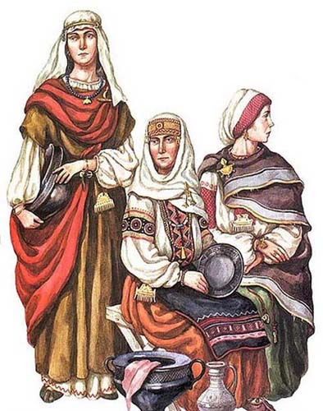
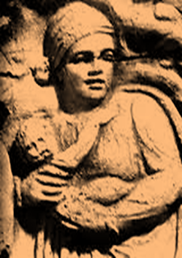
The woman would take care of children , would cook and clean the house, care for the animals and work in the fields and garden, gather forest fruits and help their husbands at fishing and hunting. Also, they would weave and sew, make clothes and decorate them with embroideries.Men were warrier.
The roofs were made out of tiles, shingle or thatch. Around the houses there were holes for storing food - they had burned walls- it is also thought that some granaries were placed near the houses. Food and drink were stored in large jars buried in the ground.
Burebista, om de stat inzestrat cu remarcabile calitati de organizator, strateg militar si diplomat, reuseste sa unifice formatiunile politico-militare geto-dace din spatiul carpato-dunareano-pontic sub autoritatea sa si sa puna astfel bazele unui puternic regat cu centrul, probabil, in Podisul Transilvaniei. In intreaga sa actiune, Burebista a fost sprijinit de marele preot Deceneu, colaboratorul si sfetnicul cel mai apropiat.

Slide 10
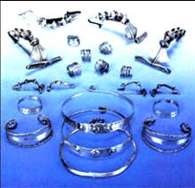
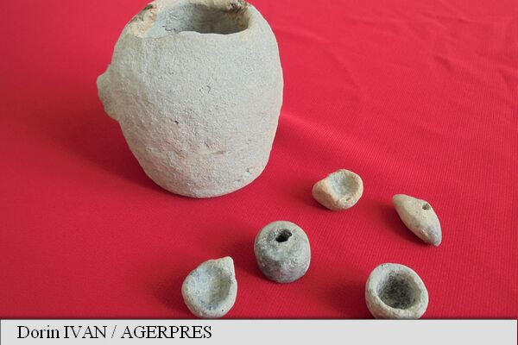
Bronze or silver necklaces, skillfully made decorated their necks. Their hands were full of thick, silver threads and chains knitted and with their extremities shaped as snake heads. On their fingers they wore spiraled or simple rings . Their hairpins had various shapes but the most popular were those in the shape of a shield or a spoon placed on the spring. Earrings that have been found are in the shape of a thin circle with a small and fine pendant at one end . All these jewels were discovered by archaeologists with a great number of very colorful glass beads which, show us how stylish the Dacian women were.
Dacian children’s toys founded on the territory of Romania,because we have the same history

Slide 11
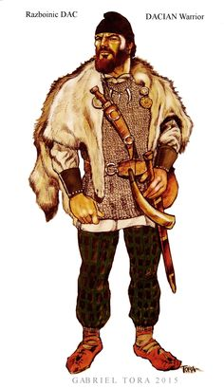
Dacian warrier
Their clothes consisted of shirts tightly tied up at the necks, resembling a 'ia' with large and long/short sleeves, a skirt reaching the ground and possibly a cloak. for their feet they had 'opinci' (peasant sandals) made of leather in the summer and fur in the winter. heir jewelry was very varied and showed good taste.

Slide 12
