Slide 1
The Final Project Endangered Animals In Your Region
iEARN projects
Learning Circles
September 2017 – January 2018
Circle Name -Global Issues: Environment Learning Circle 1 (Middle/High School)
The state educational institution
“Specialized Lyceum under the University of Civil Protection of the Ministry for Emergency Situations of the Republic of Belarus”
School Address: 247006, Belarus, Gomel region, Gomel district, Ilyich village, 1 Skovorodina st.
Gomel, 2018

Slide 2
Endangered Animals In Algeria

Slide 3
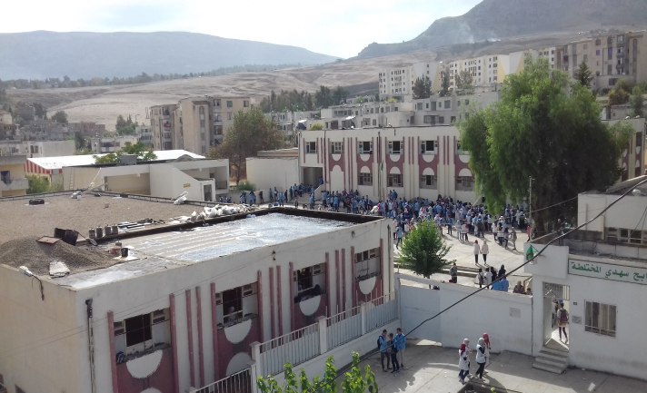
Rabeh Sehdi High School Constantine, Algeria Work achieved by the students Nawel Rouini, Nahla Chiraz Chaabane, Nihal Kaabouche , Darine Nouioua, Ahmed Nadjib Alikeche Supervised by their teacher Fatiha Touafek
Animals in their way of extinction in Algeria In Algeria many creatures are threatened of extinction.
The authorities declared that more than 3000 animal species are endangered due mainly to illegal business and hunting. The animals we have chosen to present and
inform you about are:

Slide 4
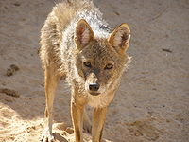
A/ Carnivoran mammals 1/ The Saharan Jackal Jackals are nocturnal, omnivorous scavengers. With their long legs and curved canine teeth, they are well adapted for hunting. They hunt animals such as antelopes, gazelles, small mammals, birds, amphibians and reptiles.

Slide 5
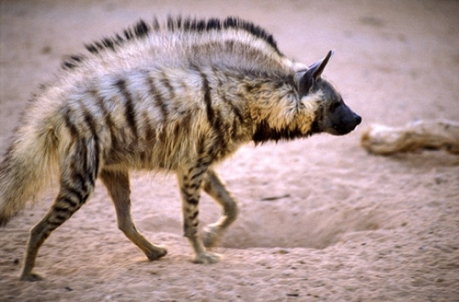
2/ Hyaena Hyaena is a flesh-eating mammal, resembling a dog, but with hind limbs shorter than forelimbs.

Slide 6
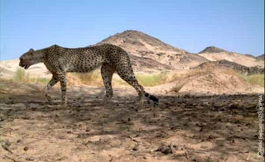
3/ Saharan Cheetah (in Hoggar Tassili South east of the Algerian Sahara) The Northwest African cheetahs ranges around the central and western Sahara desert and the Sahel in small, fragmented populations. The largest of these populations is believed to exist in the Ahaggar highlands of Algeria. Tassili n'Ajjer. More than 50 cheetahs are thought to live in Algeria. The total world population is estimated to be about 250 mature individuals. This animal has an important physiological and behavioral adaptation that allows it to survive in the extreme conditions of the Sahara desert, where temperatures may reach up to 45 degrees Celsius and there is no standing water. The Northwest African cheetah is even more nocturnal than other cheetahs, which helps it to conserve water and stay out of the daytime heat of the desert.

Slide 7
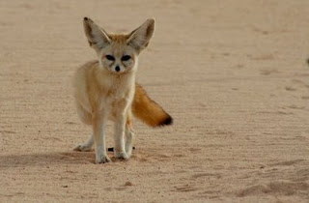
4/ The fennec The fennec fox or fennec is a small nocturnal fox found in the Algerian Sahara. Its most distinctive feature is its unusually large ears, which also serve to dissipate heat.

Slide 8
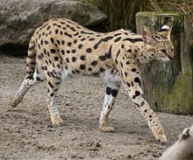
5/ Serval or Tierboskat. It’s a wild cat The serval is a slender, medium-sized cat that stands 54–62 cm at the shoulder and weighs 9–18 kg. It has a small head, large ears, a golden-yellow to buff coat spotted and striped with black, and a short, black-tipped tail. The serval has the longest legs of any cat relative to its body size. It is active in the day as well as at night, and tends to be solitary with minimal social interaction. Servals are carnivores which prey on rodents especially rats, small birds, frogs, insects, and reptiles.

Slide 9
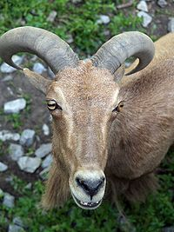
B/ Herbivorous mammals 1/ The Barbary sheep Barbary sheep are found in arid mountainous areas where they graze and browse grasses, bushes, and lichens. They are able to obtain all their metabolic water from food, but if liquid water is available, they will drink and wallow in it. Barbary sheep are crepuscular. That is they are active in the early morning and late afternoon and rest in the heat of the day. They are very agile and can achieve a standing jump of over 2 metres (7 ft). They are well adapted to their habitat, which consist of steep rocky mountains and canyons. They often flee at the first sign of danger, typically running uphill. The Barbary sheep are extremely nomadic and travel constantly via mountain ranges. But their populations now are mainly threatened by humans.

Slide 10
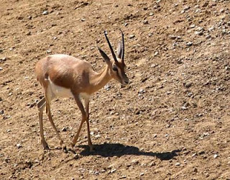
2/ Gazelle This animal is in its way of extinction because of hunting, urbanization, and drought which reduces the area where this animal lives.

Slide 11
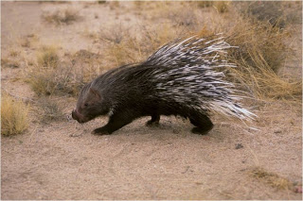
3/ The crested porcupine The adult crested porcupine has an average head and body length around 60 to 83 cm (24 to 33 in) long, discounting the tail, and weighs from 13 to 27 kg. Almost the entire body is covered with bristles which are either dark brown or black and rather coarse. This mammal is recognizable by the quills that run along the head, nape, and back that can be raised into a crest.. These quills are used for defense and are usually marked with light and dark bands which alternate. This porcupine has a shorter tail which has rattle quills at the end. The rattle quills broaden at the terminal end and the broad portion is hollow with thin walls. When these quills are vibrated, they produce a hiss-like rattle. The crested porcupine food is roots, bulbs, and leaves, but occasionally they do consume insects, small vertebrates, and carrion. Their life is in risk because of hunting and clearing up forest and fires.

Slide 12
All these mammals’ life is threatened. Their population is decreasing because of hunting, over grazing deforestation, fires, lack of rain, shortage of water and human carelessness. Consequently all these animals deserve protection to conserve the biodiversity and the ecosystem of our planet. The Algerian authority and environmental associations are doing their best to save these animals from disappearance by editing laws to regularize hunting to protect them and sensibilizing the community to be more responsible and act swiftly and collectively and do concrete actions to save these animals.

Slide 13
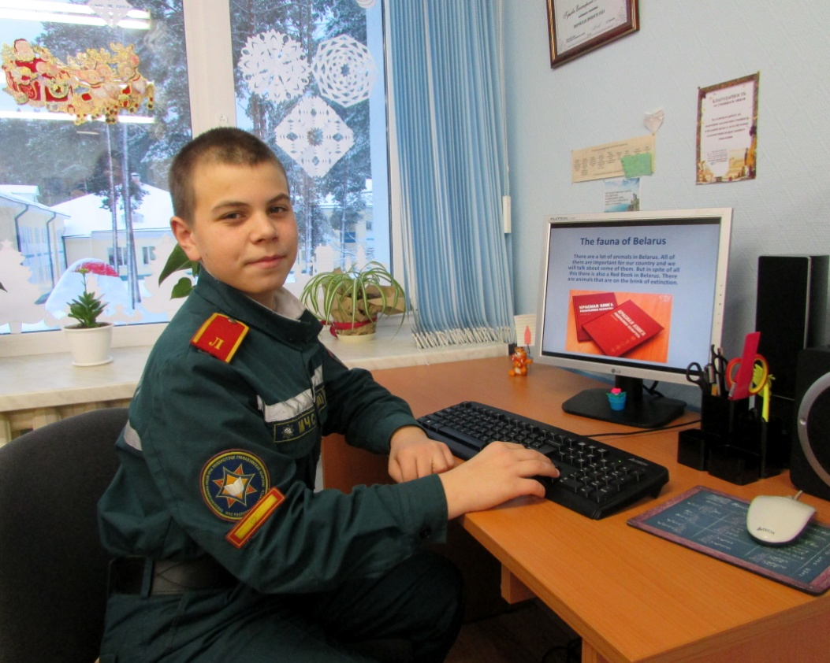
Endangered Animals In Belarus
Prepared by the 1st year student Vlad Naumovich
Supervised by his teacher Catherine Gutseva

Slide 14
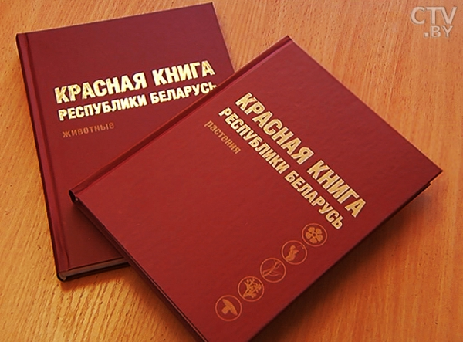
The fauna of Belarus
There are a lot of animals in Belarus. All of them are important for our country and we will talk about some of them. But in spite of all this there is also a Red Book in Belarus. There are animals that are on the brink of extinction.

Slide 15
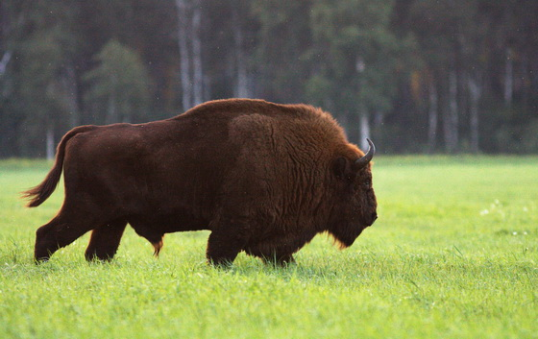
Animal symbol
In Belarus, an animal symbol is a bison. This is a big, beautiful and powerful animal. The bison lives in the Belarusian national zoo and in the Belovezhskaya Pushcha. The bison is included into the Red Book.

Slide 16
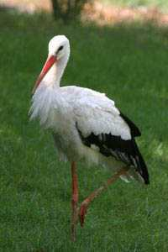
Bird symbol
Also in our country there is a bird that has always been associated with our country - it's a stork. In Belarus, the white stork is a very popular bird, but besides it there is also a black stork. Like a bison this bird is on the verge of extinction. The bird is very beautiful and can settle near our houses, but does not let people come close to itself.

Slide 17
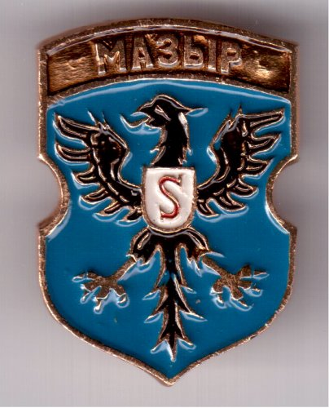
The coat of arms with animals
In addition to symbols, many animals are depicted on the coats of arms of our country. For example: Slonim coat of arms has a lion, Mozyr coat of arms has an eagle, Pruzhany coat of arms has a snake.

Slide 18
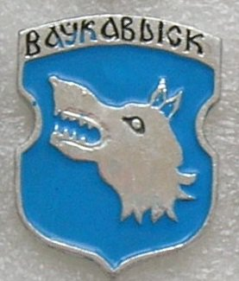
Volkovysk coat of arms
There are a lot of wolves in Belarus, especially in the town of Volkovysk. And the people of this town decided that it was necessary to give this animal honor. And that's why from the sixteenth century on the coat of arms of the town
we can see a wolf.

Slide 19
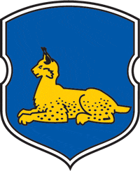
The coat of arms of Gomel
On the coat of arms of the city of Gomel there is a lynx. The lynx in Belarus is the only kind of the wild cat. The largest population of these cats is in the Polesie radiation reserve.
Lynx is a very
beautiful animal,
it has tassels on its ears.

Slide 20
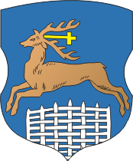
The coat of arms of Grodno.
Grodno coat of arms originates from the Catholic saint, who met this animal in the forest and became a clergyman. Thanks to this belief the deer is depicted on Grodno coat of arms. Between the horns it has a cross.

Slide 21
I hope you have learned a lot. And now you know that Belarusian people care of the animals of their country very much, honor them and do their best to save them from extinction. In Belarus there are many encyclopedias, coats of arms with animals. My short research shows some coats of arms that have rare animals depicted on them.
Thank you for your attention! Let`s protect the animals of our counties!

