Slide 1
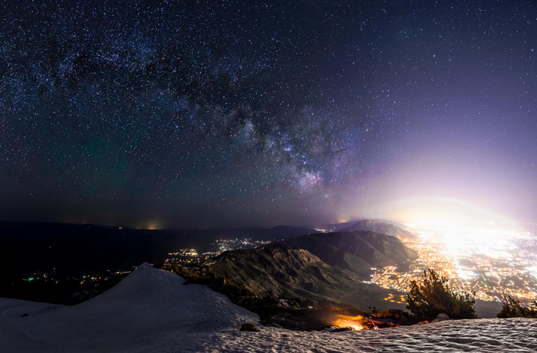
Light pollution
Information about
Created by: David, Will, Amelia, Mira, Megan, Samantha, and Jack

Slide 2
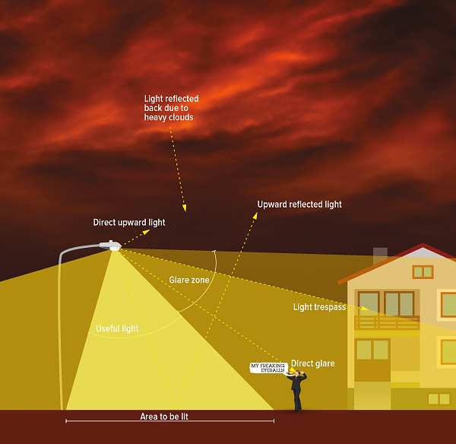
What is light pollution?
Light pollution is extensive and inappropriate light.
It is when there is such a large amount of light that it affects the sky, making it harder and harder to see the stars.

Slide 3
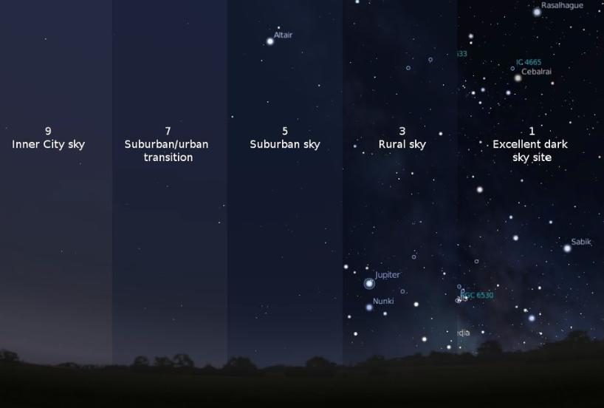
What are the different types and amounts of light pollution?
Light pollution producers:
Types of light pollution:
Vehicle
Industry
Home
Street lights
Fires
Urban Sky Glow
Light trespass
Glare
Clutter

Slide 4
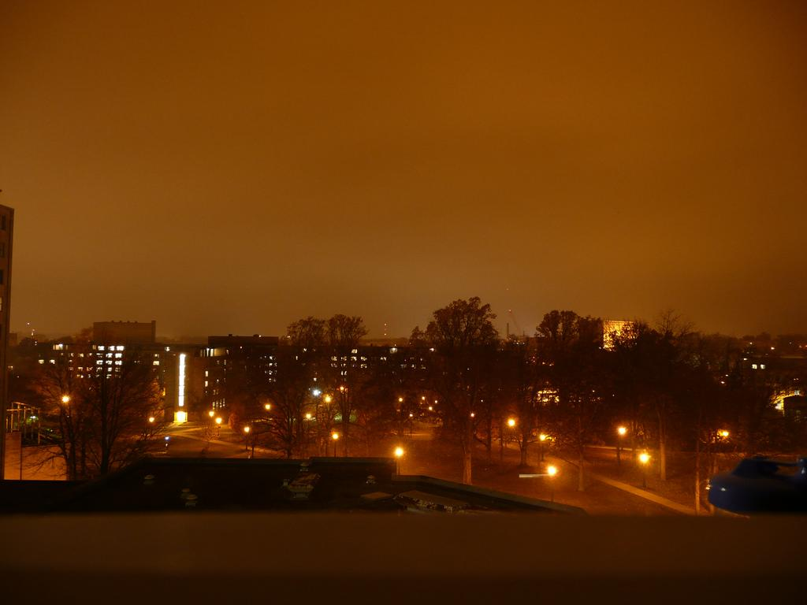
What does it do?
It takes the extra light from urban areas, or any light source, and makes the sky brighter at night so it's harder to see the stars.

Slide 5
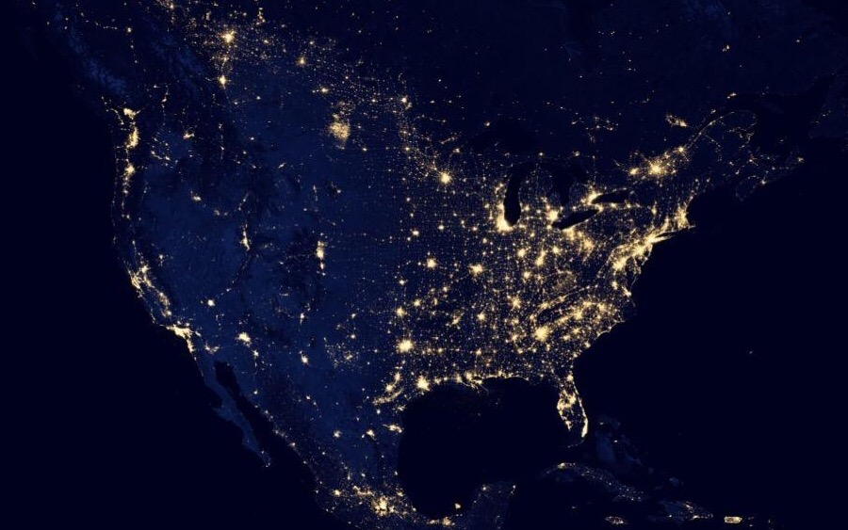
Where/ why/ when does light pollution happen?
Light pollution can happen anywhere where there is a lot of light.
It happens because there is a large amount of unneeded light.
It happens at night, when there is unneeded light.

Slide 6
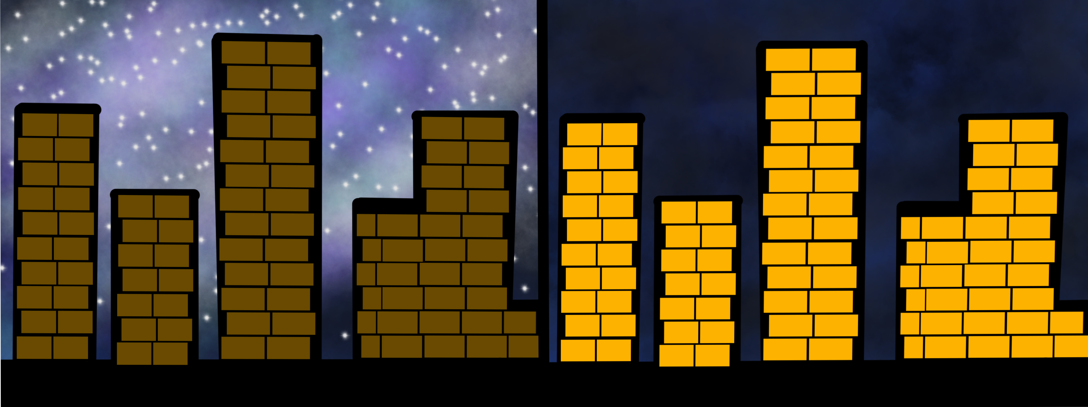
How can we reduce light pollution
We can turn out lights at night, especially when we are not using them. This also saves electricity. We can so avoid driving at night.
No Light Pollution
Light Pollution

Slide 7
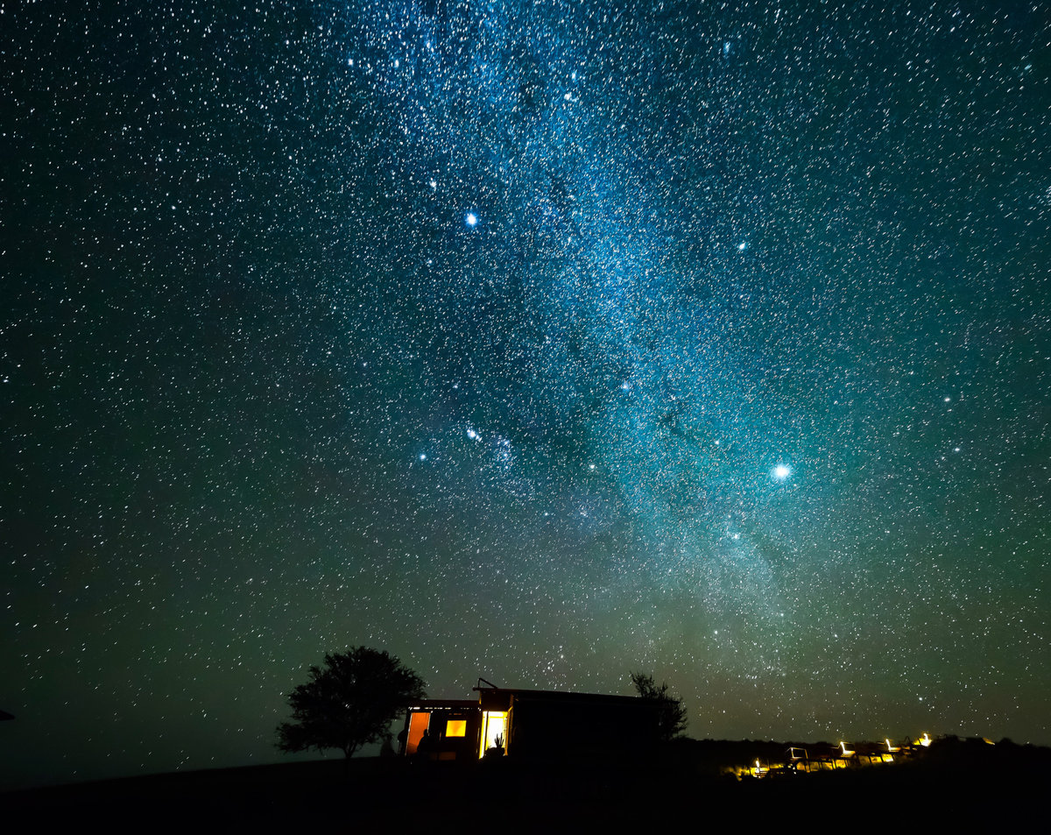
How does light pollution affect our national parks?
Light pollution changes the environment, especially how well people and animals can see the stars.
Light pollution can harm some types of animals and bugs that some National Parks might be trying to protect.

Slide 8
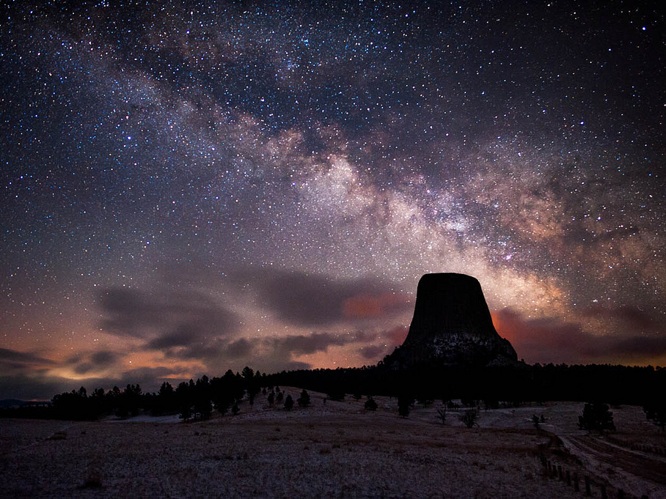
Sources:
http://darksky.org/wp-content/uploads/2017/02/NorthForkPark-featured-Casey-Grimley700px-460px.png
http://darksky.org/wp-content/uploads/2014/09/Light_Pollution_Diagram_680px.jpg
https://static1.squarespace.com/static/558cc50ee4b00cc962c6fabf/t/55adc574e4b0e40497b86187/1437451638602/
https://www.google.com/search?q=golden+gate+bridge+at+night+pics&rlz=1C9BKJA_enUS707US707&hl=en-US&prmd=ivn&source=lnms&tbm=isch&sa=X&ved=0ahUKEwi8_f3B473TAhUL4YMKHZ8OC20Q_AUIBygB&biw=1024&bih=653#imgrc=8atqCMUq3L2DNM:&spf=174
https://www.google.com/search?q=golden+gate+bridge+at+night+pics&rlz=1C9BKJA_enUS707US707&hl=en-US&prmd=ivn&source=lnms&tbm=isch&sa=X&ved=0ahUKEwi8_f3B473TAhUL4YMKHZ8OC20Q_AUIBygB&biw=1024&bih=653#imgrc=8atqCMUq3L2DNM:&spf=174
http://cescos.fau.edu/observatory/lightpol-astro.html
https://www.nps.gov/deto/planyourvisit/images/Milky-Way-over-Tower.jpg
http://www.npr.org/sections/goatsandsoda/2016/06/15/482019483/-nprnightsky-send-us-your-pix-of-the-worlds-least-light-polluted-skies
http://sociable.co/technology/google-brings-nasas-black-marble-to-google-maps-in-amazing-detail
http://cdn.downtoearth.org.in/library/large/2016-06-13/0.68921300_1465794941_light-pollution.jpg
http://cescos.fau.edu/observatory/lightpol-astro.html
Drawing on slide 6 made by Amelia
Devil's Tower, Wyoming

