Slide 1
Animals of Washington State
(Cascade Mountains and Okanogan Highlands).
By: Claire R, Sophia M, and Zack H, Max R, Katherine J, and Katherine K.

Slide 2
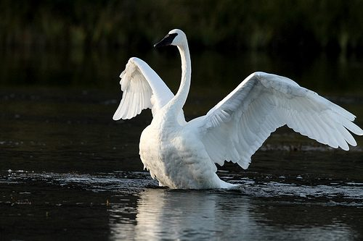
Trumpeter Swan
Scientific name: Cygnus buccinator
Higher Clasification: Swan
These swans are impressively large, adult swans will grow about 138-165 cm in length and are one of the heaviest living birds that are able to take flight.
In the 1960’s the federal endangered species act came into being, the Trumpeter Swan was considered for this list.

Slide 3
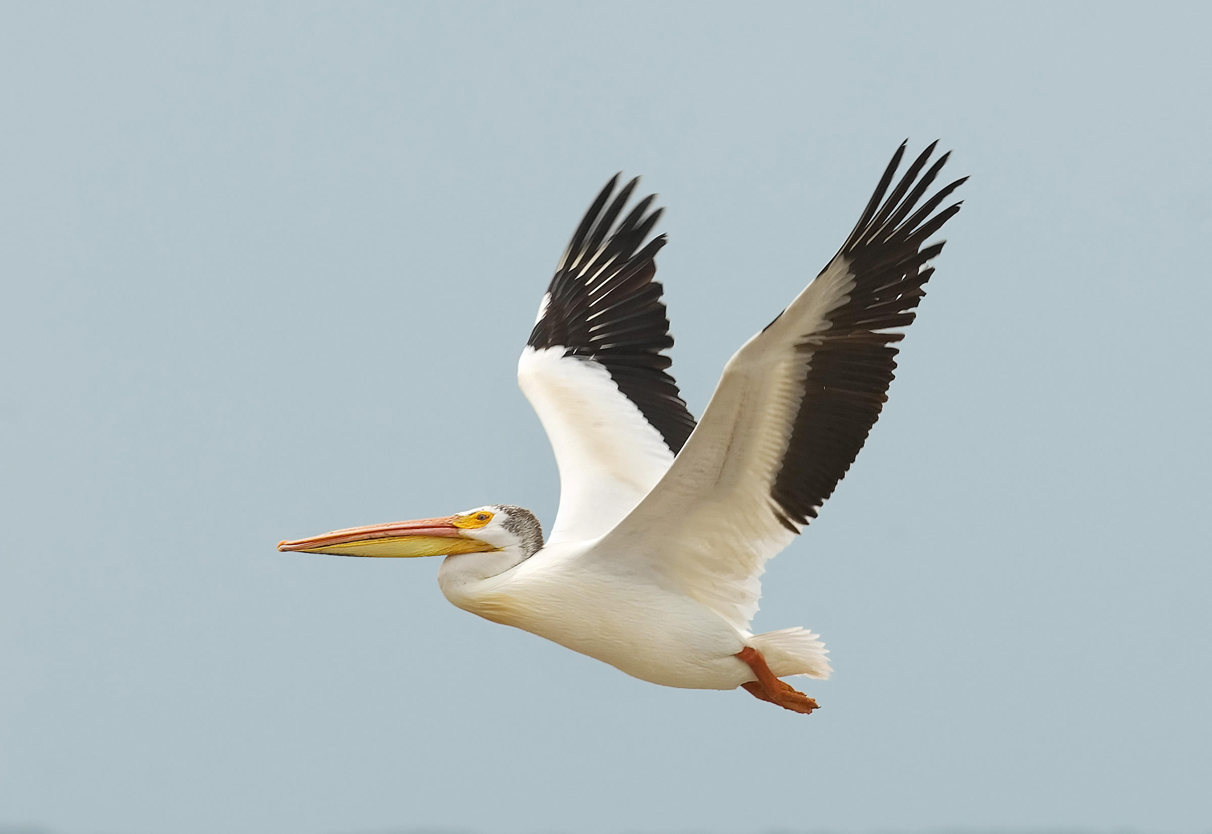
American White Pelican
Scientific Name: Pelecanus erythrorhynchos
Length: 127-165 cm
Wingspan: 244-290 cm.
Pelicans are skillful food thieves.
The American White Pelicans are quite common.

Slide 4
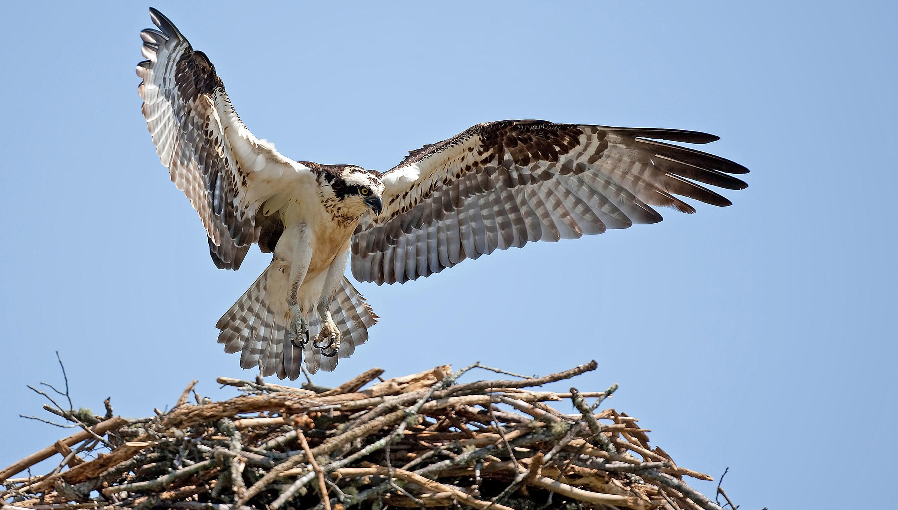
Osprey
Scientific name: Pandion haliaetus
Length: 50-66 cm
Wingspan: 60 cm
One of the most widespread birds of prey (can be found on every continent except Antarctica)
Also called fish eagle, sea hawk, river hawk, and fish hawk

Slide 5
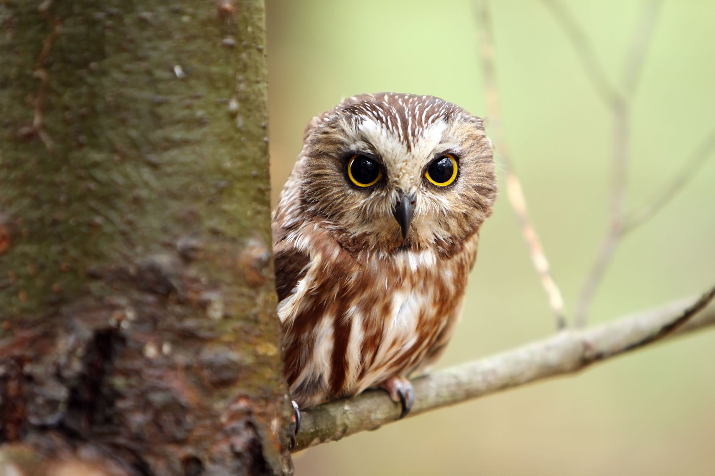
Saw-Whet Owl
They have small bodies with a large heads
They have large wings
They are nocturnal
They are predators
Their scientific name; Aegolius acadicus
They are about 5’’ tall
They eat mice and small rodents
They produce multiple eggs at a time.

Slide 6
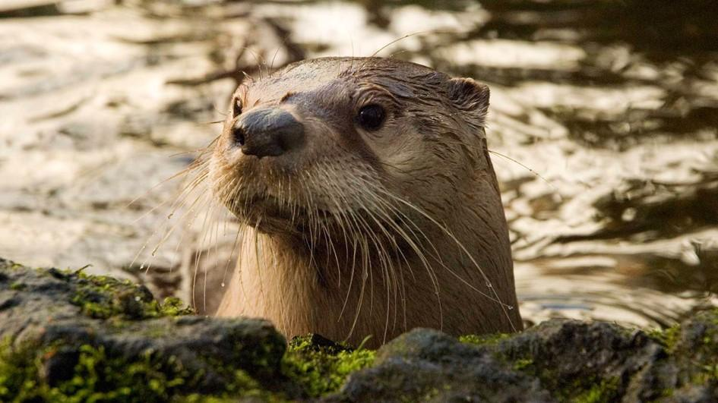
River otters
The species present around us is the North American otter
The scientific name is lontra canadiense
River otters habitat need a permanent food supply and access to water. They like coastal and marine habitats including rivers and lakes.
They reproduce only during mating season.
They bear 2-3 children at a time

Slide 7
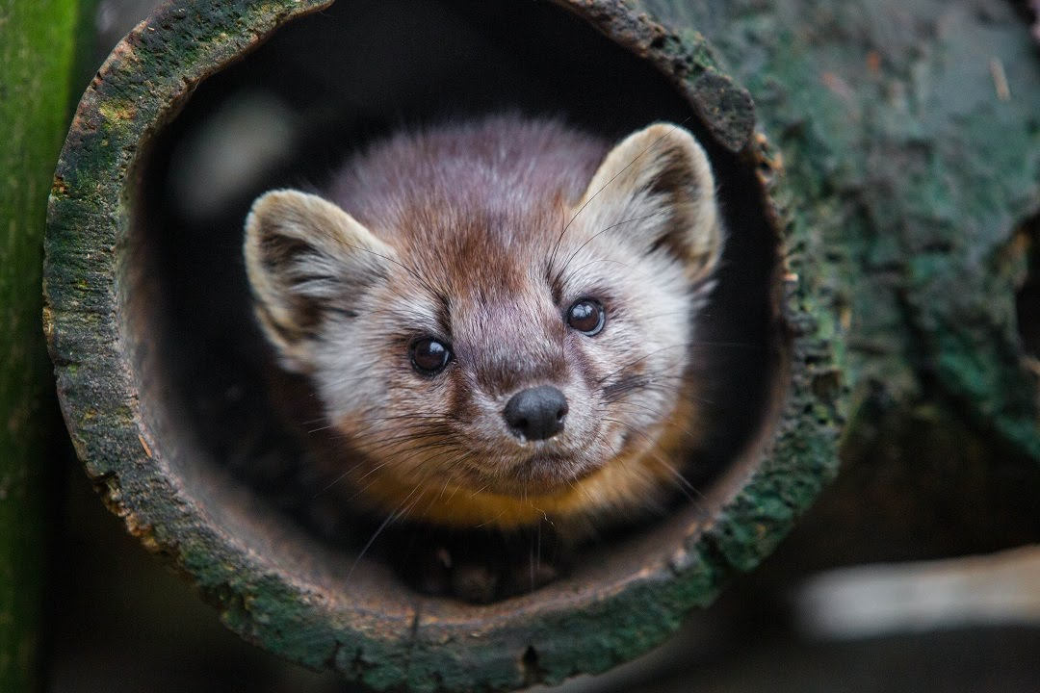
Marten
The species around us is the American marten.
The scientific name for the marten is martes.
Their habitat is a number of mature mixed or coniferous forests in the Pacific Northwest.
How they reproduce- One male may mate with many females during a year. When females are ready to breed, they alert males by making scent markings in their territories. Before mating, a pair will wrestle and play together.
They bear 3 children at a time.

Slide 8
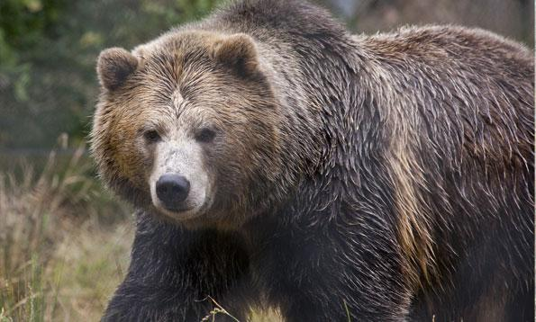
Grizzly Bear!
The grizzly bear, is native to North America
It is a brown furry bear weighing at 180-360kg. The average height is 200cm.
This fearsome animal is very popular in Native American myths and legends.

Slide 9
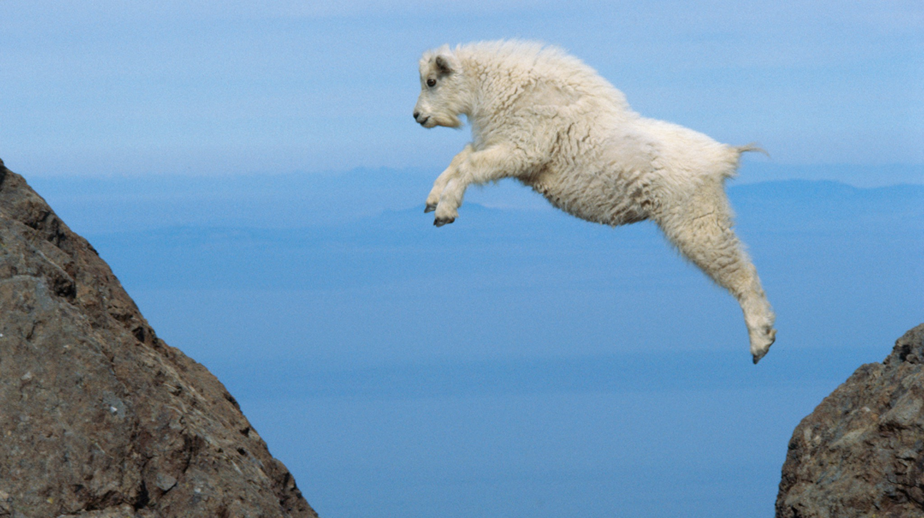
Mountain Goat
The mountain goat, native to North America, is a climber found on cliffs and ice.
Mountain goats are herbivores meaning they eat plants like grass, moss, and ferns.
Mountain goats live in the Rocky Mountains and the Cascades.
They are the largest mammal found in their altitude the altitude can be of 4km

Slide 10
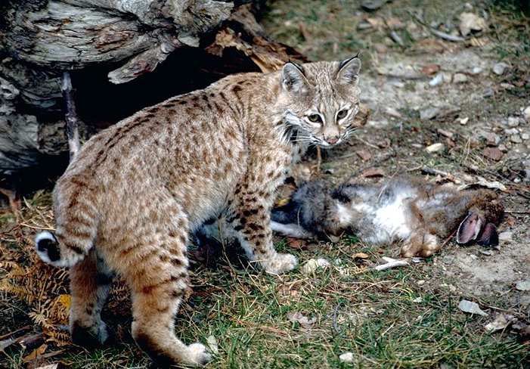
Bobcat
Name of species: Bobcat
Scientific name; Lynx rufus
Bobcats can exist in many Different climates and habitats
The litter size can be 1-6 kittens
They are pregnant for 50-70 days
They can live in forest`s,deserts, and brush land
They hunt rabbits and hares
Also eat birds and baby farm animals

Slide 11
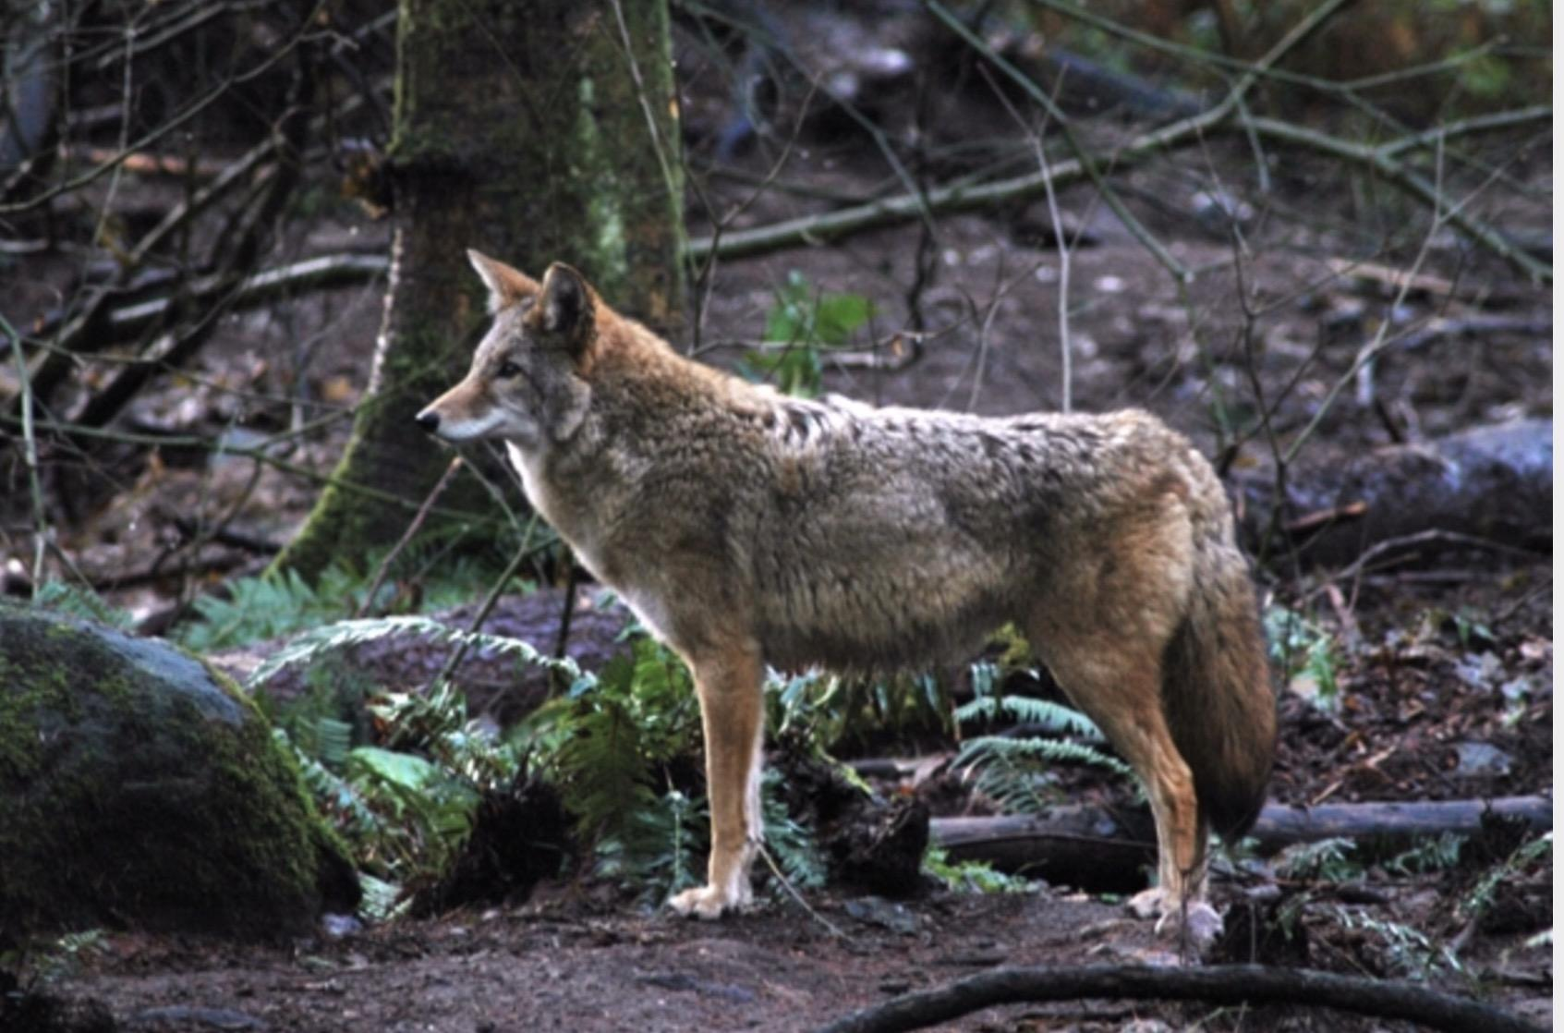
Coyote
Their scientific name is Canis latrans
They live in dens that they usually they dig from other roots of a tree
Breeding is in the late winter
They can have between 1 and 19 pups but the average is 6 pups
The coyotes are pregnant for 60-63 days
Coyotes can live up to 10 years in the wild and even longer(up to 18 yrs.) in captivity
Coyotes mostly live in forests

Slide 12
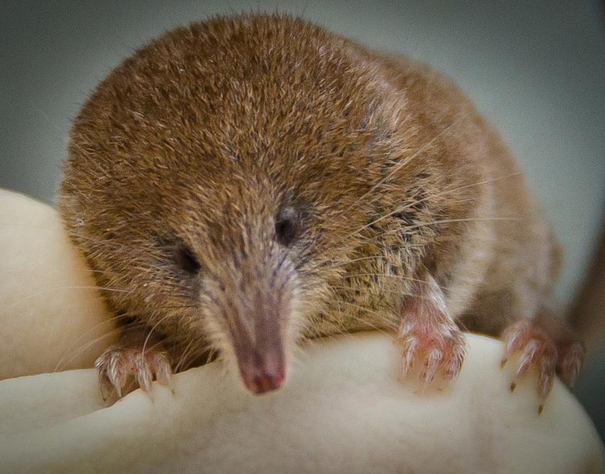
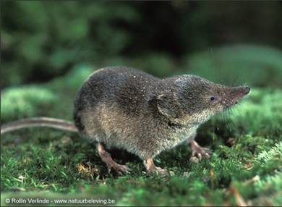
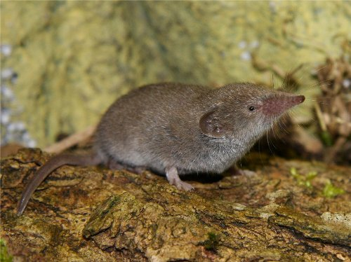
Pygmy Shrew
Scientific name: Sorex Hoyi
Due to its fast metabolism, it needs to eat constantly
Believed to be the second smallest mammal in the world
Has a extremely large appetite for its size
About 5cm in length including a 2cm long tail.
Weighs about 2 - 4.5g
Pygmy shrews are distributed throughout the boreal areas of North America.
Although S. hoyi prefers moist habitats, it has been recorded to live in areas with both wet and dry soil
Females produce a litter of 3-8 young, and only give birth once a year from November through March. They are independent by 25 days old.

Slide 13
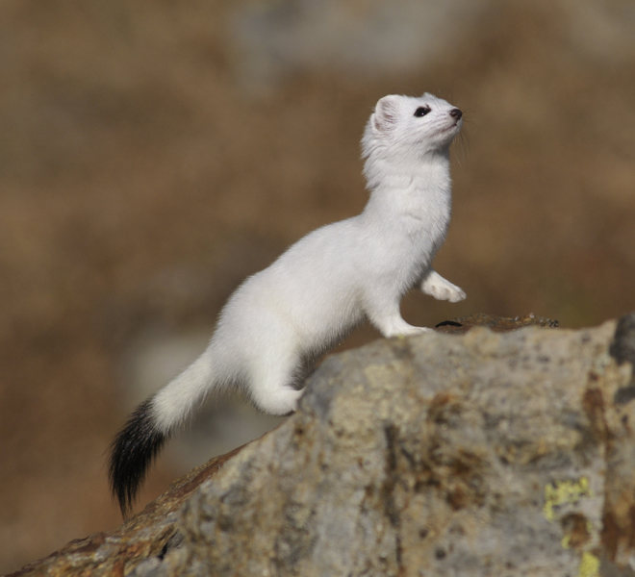
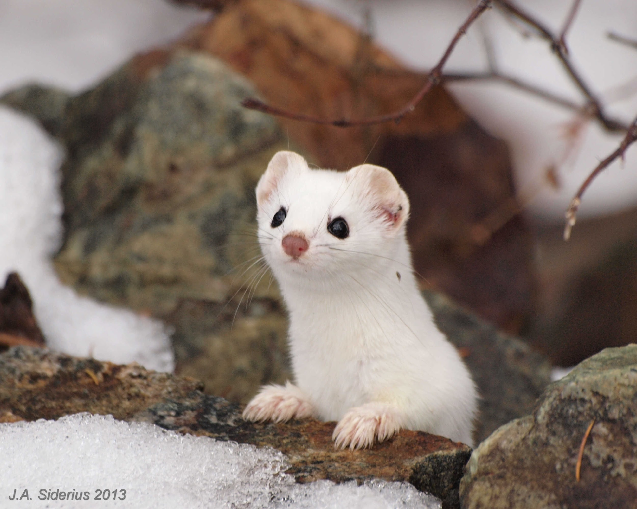
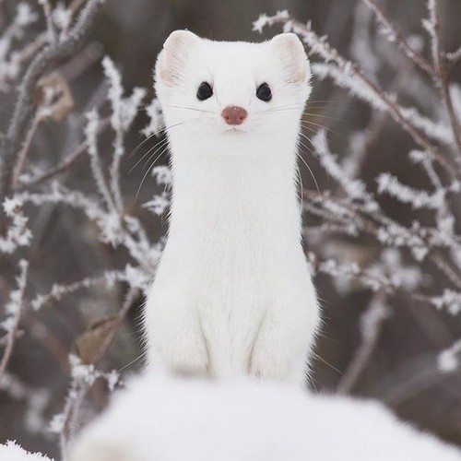
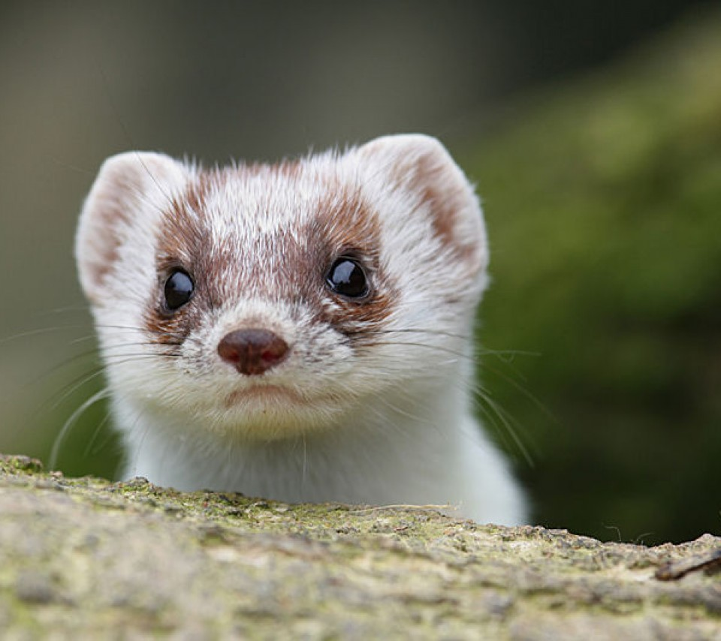
Ermine
Scientific name: Mustela erminea
Though the name Ermine is used often, Stoat is the official name.
Habitat and Ecology: The Stoat occupies a wide range of habitats. It is often found in successional or forest-edge habitats, in scrub, alpine meadows, marshes, riparian woodlands, hedgerows, and riverbanks that have high densities of small mammals.
The female bears her annual litter of 4-18 (average 6) in April or May. Their eyes open at 28-48 days, the females first.

Slide 14
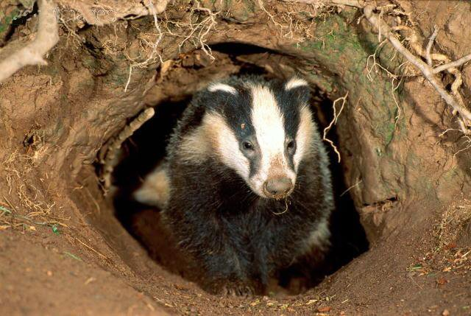
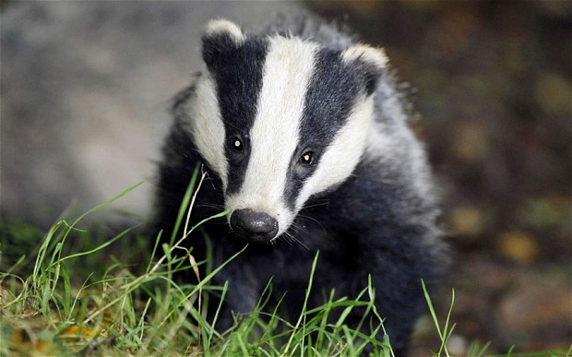
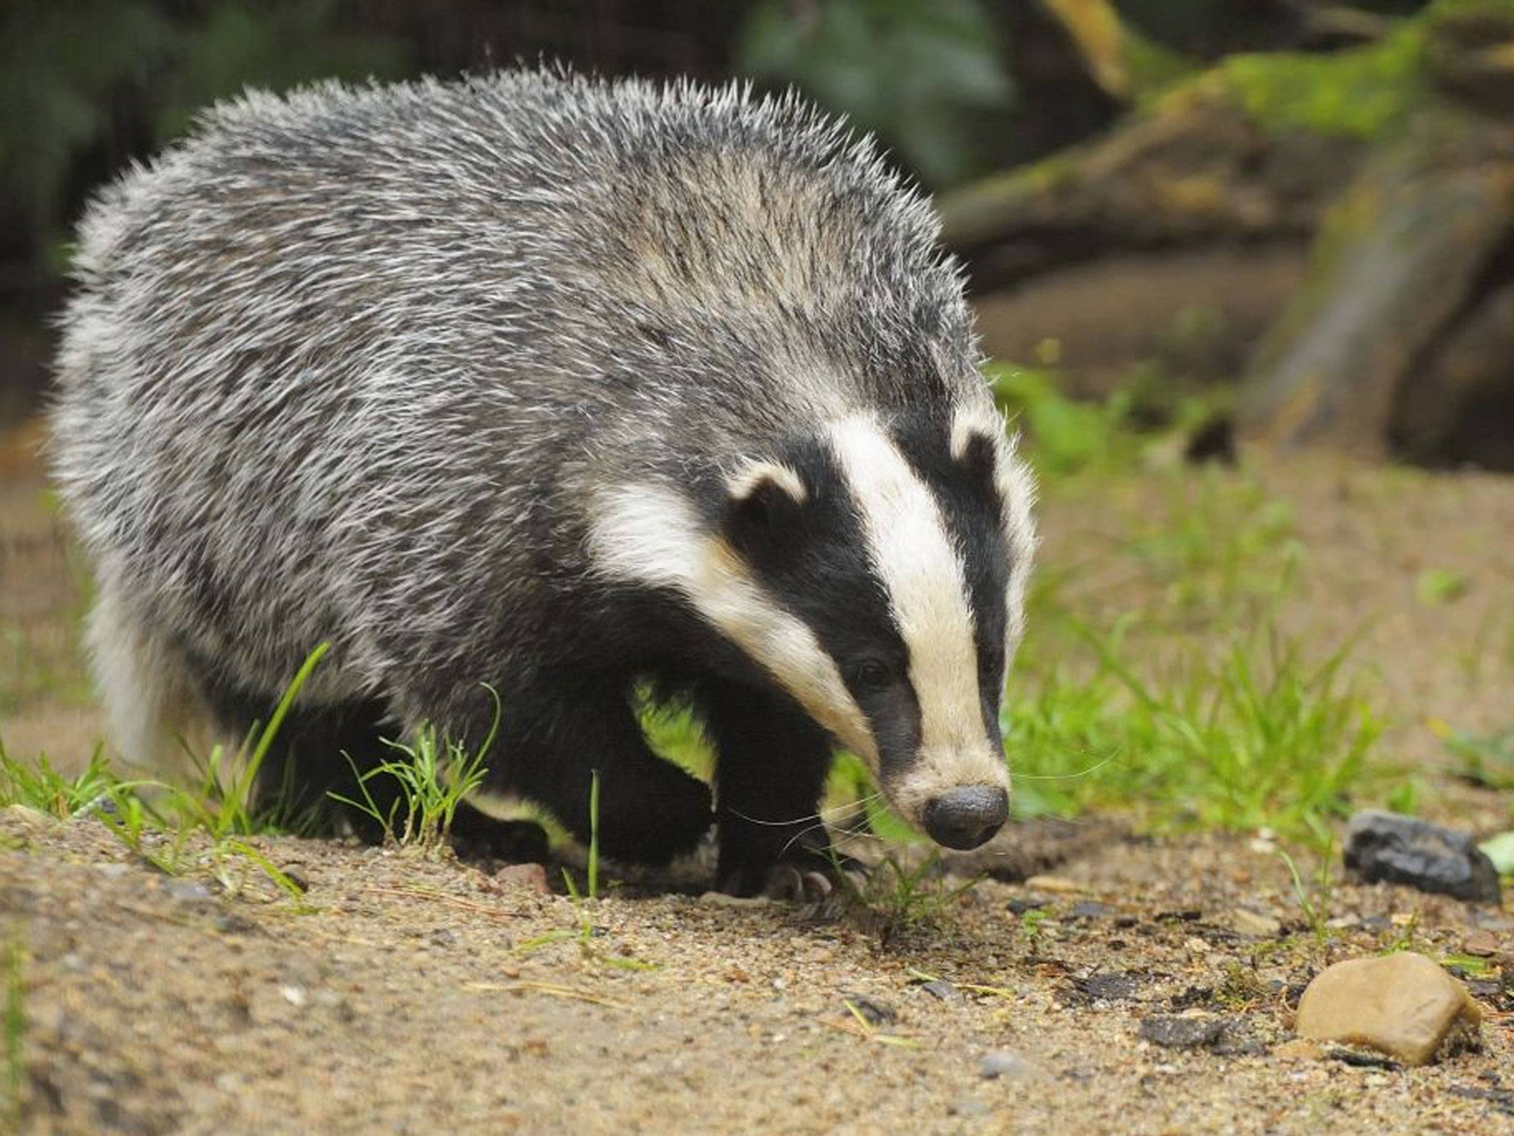
Badger
The species near us is the American Badger
The scientific name is Taxidea Taxus
They like to live in dry, open grasslands, fields, and pastures they can be found high up and lower closer to sea level
They have about 3 kids at a time

Slide 15
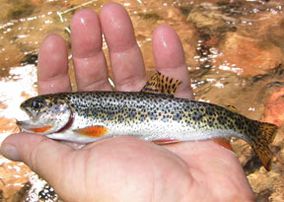
Resident cutthroat
Other names: Sea-Run Cutthroat, Harvest Trout
Average size: .5-1.8 kilograms, and up to 2.7 kilograms and are 1.5 meters long

Slide 16
Sources:
http://okanoganhighland.blogspot.com/p/wildlife-of-okanogan-highlands.html
http://www.conservationnw.org/what-we-do/columbiahighlands/wildlife
http://www.defenders.org/bobcat/bobcats
http://naturemappingfoundation.org/natmap/facts/coyote_712.html
http://wdfw.wa.gov/living/bobcats.html
http://www.thepetitionsite.com/takeaction/698/443/706/
http://pugetsoundbirds.org
http://wdfw.wa.gov/fishing/salmon/cutthroat.html
`

Slide 17
Sources:
https://en.m.wikipedia.org/wiki/American_pygmy_shrew
https://en.m.wikipedia.org/wiki/Stoat#
https://en.m.wikipedia.org/wiki/Northern_pygmy_owl
https://en.m.wikipedia.org/wiki/American_marten
http://kids.nationalgeographic.com/animals/river-otter/#river-otter-swimming.jpg
https://m.youtube.com/watch?v=6bFD0rc9b-Y
http://wyominguntrapped.org/tag/american-marten/
https://www.giantbomb.com/badger/3015-4629/
http://www.animalsandenglish.com/badgers.html
http://animalsadda.com/badger/
http://www.flyfishinginsidernewsletter.com/021906/

Slide 18
https://weather.com/photos/news/mountain-goats-how-do-they-do-itl
http://www.sfzoo.org/explore/animals/mammals-2/grizzlybear.htm
http://www.audubon.org/field-guide/bird/american-white-pelican
http://www.audubon.org/field-guide/bird/osprey
http://animalstime.com/trumpeter-swan-facts/

Slide 19
THANKS FOR WATCHING!

