Slide 1
Unique Buildings in Our Community
By Joey and Ned

Slide 2
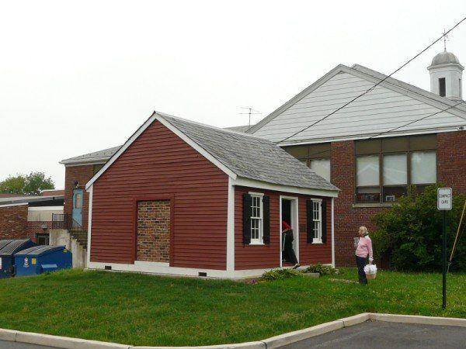
The Little Red School House
This is the Little Red School House. It was built in 1837 and is a one room 18-foot square one-room school. In 1836, it was unofficially called the Maple Grove School. In 1871, it was replaced by a more modern building 200 feet away, but was used until 1936. It is now called the Franklin Township School Little Red School House. The Little Red School House remains today because it was preserved and restored to its former glory.

Slide 3
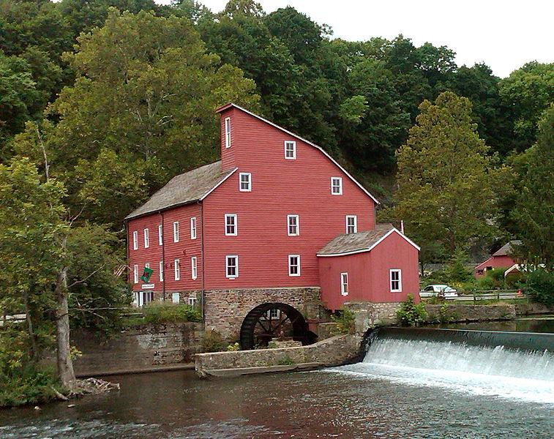
The Red Mill Museum Village
The Red Mill is located in
Clinton, New Jersey. It was
built in 1812 to process wool.
It was very dangerous to work in factories back then so lots of workers were injured. The wool process failed and somebody else bought it. A milling family at the time changed the town's name to Clinton after New York governor, DeWitt Clinton. The name stuck, but yet again, the business failed. A few other people tried to revive the business, but all of them failed. Many people thought the Old Mill was cursed and haunted. Today it is a symbol of New Jersey.

Slide 4
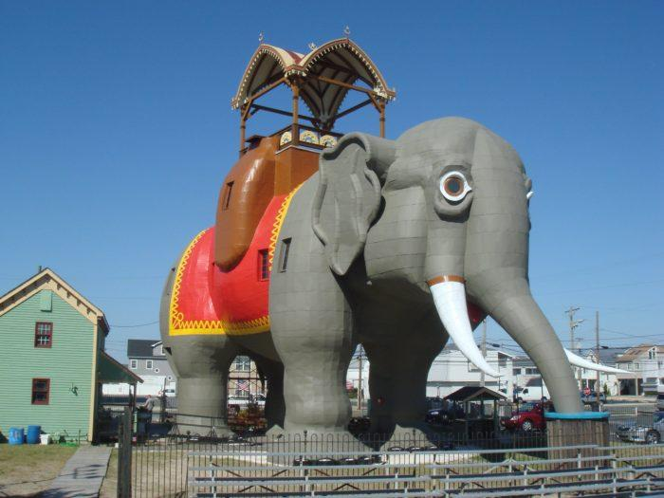
Lucy the Elephant
Lucy, The Elephant, is a giant 6 story elephant. She is located on Atlantic Avenue in Margate City, New Jersey. Lucy the Elephant was built by real estate developer, James Lafferty, in 1881, to attract people to his land holdings along the coast of South Atlantic City. Eventually, a popular hotel business was built around Lucy. You can still go inside Lucy today to see amazing views of the Jersey Shore.

Slide 5
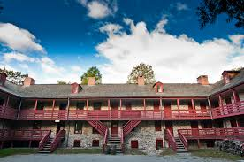
Old Barracks Museum
The Old Barracks Museum is located on Barrack Street in Trenton, New Jersey. It is the only remaining colonial barracks in New Jersey and is the last of five barracks built during the time of the thirteen original American colonies. To today it is museum that recreates colonial history. .

Slide 6
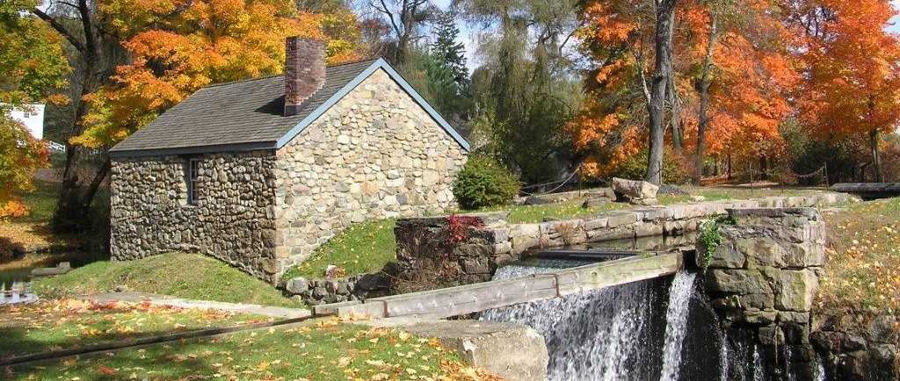
Waterloo Village
Waterloo Village is a restored 19th-century canal town in Byram Township, Sussex County in northwestern New Jersey. The community was approximately the halfway point in the 102-mile long trip along the Morris Canal, which ran from Jersey City (across the Hudson River from Manhattan, New York) to Phillipsburg, New Jersey, (across the Delaware River from Easton, Pennsylvania). Waterloo had all the necessary facilities to serve the needs of a canal operation, including a general store, a church, and a blacksmith shop.

Slide 7
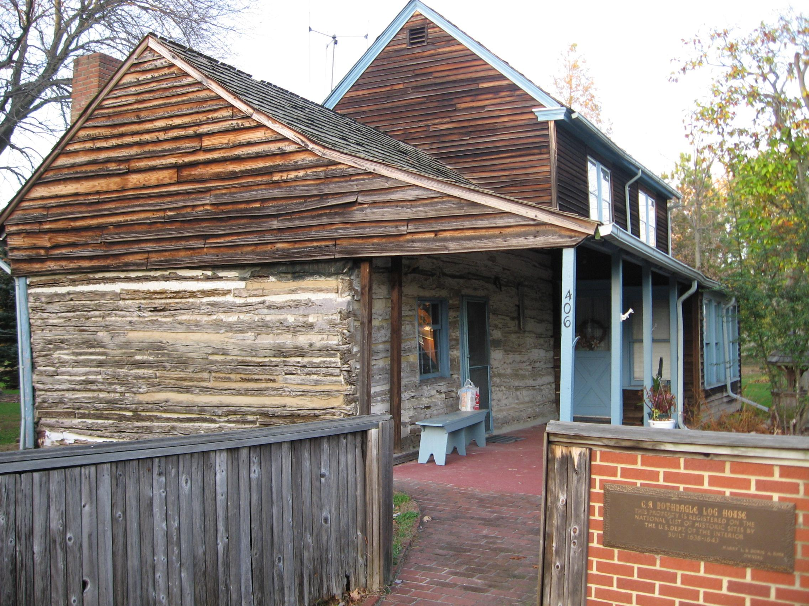
C. A. Nothnagle Log House
The C. A. Nothnagle Log House Is located on Swedesboro Road in Gibbstown, New Jersey. The C. A. Nothnagle Log House is oldest log house in the United States. It was once part of New Sweden, and is now a historic attraction in New Jersey.

Slide 8
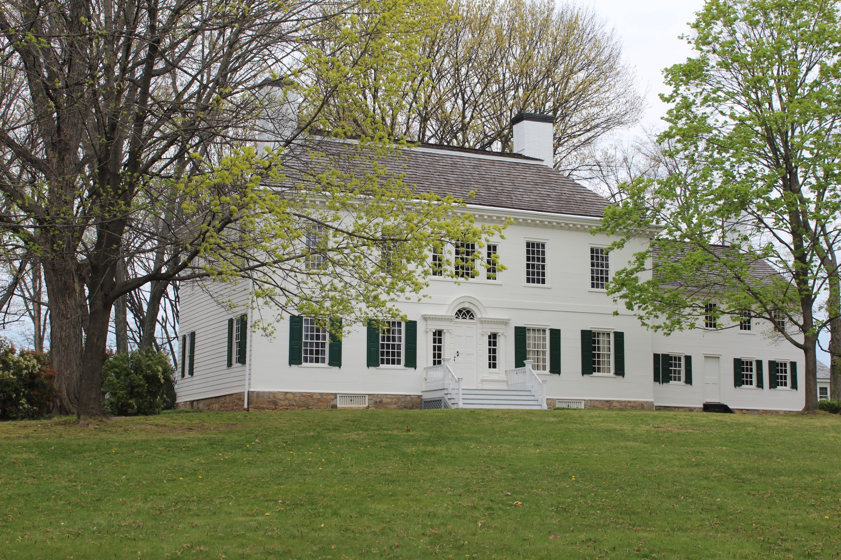
The Ford Manor
This building was used as a manor house by men who ran the Mount Hope Iron Works. It was known as the Ford-Faesch Manor House, and was named from two men who were very good in the iron industry before and during the Revolutionary War. Jacob Ford, Jr. and John Jacob Faesch were very good in the iron industry.
It became famous when General George Washington used it as his winter headquarters during the American Revolutionary War.

Slide 9
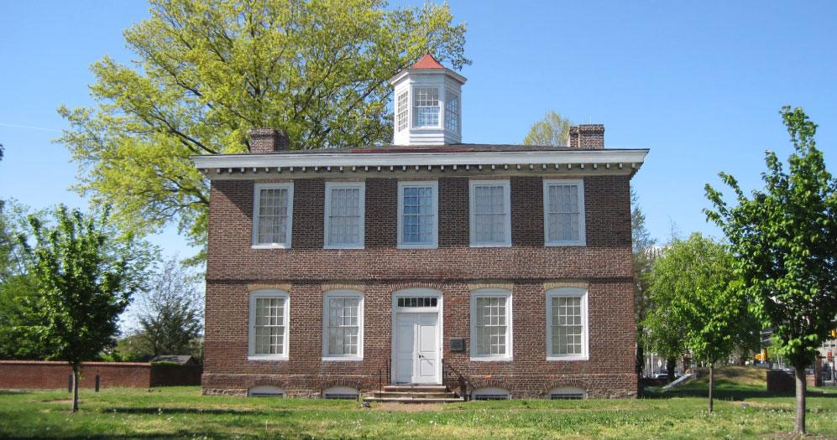
The William Trent House
The William Trent House is the oldest house in Trenton, Mercer County, New Jersey. It was built for William Trent who found the town which became the capital of New Jersey. It has served as the residence for three New Jersey Governors.

Slide 10
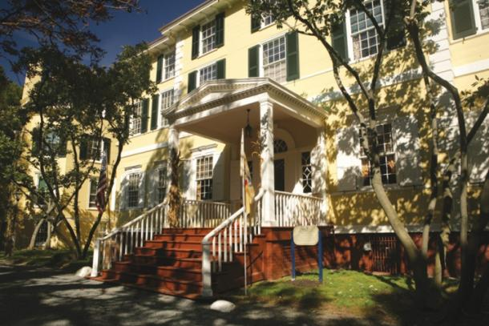
Liberty Hall
The Liberty Hall Museum in Union County, New Jersey, United States, is an American historic site. Built in 1772 as a fourteen-room house, Liberty Hall stands today a fifty-room huge mansion.

Slide 11
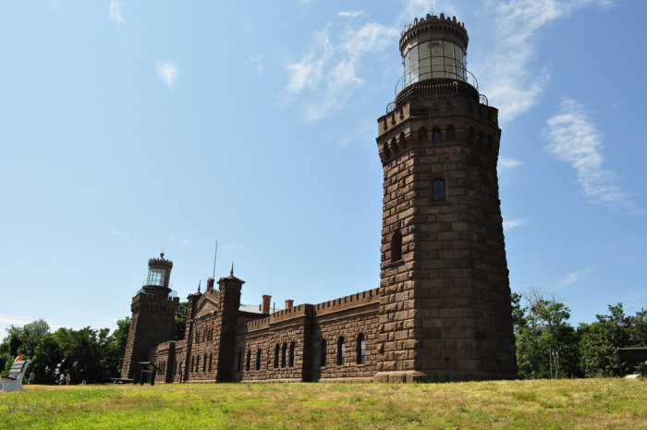
Navesink Twin Lights, Highlands
The Twin Lights are a pair of beacons located 246 feet (75 m) above sea level on the headlands of the Navesink Highlands near Sandy Hook, New Jersey. In 1962, the State of New Jersey acquired the Twin Lights. The current museum facility features tours of the lighthouse and an ocean view from the North Tower.

Slide 12
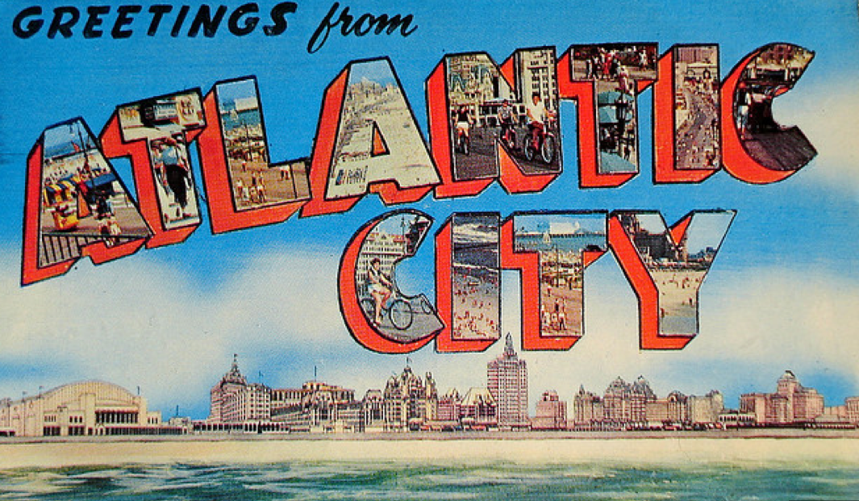
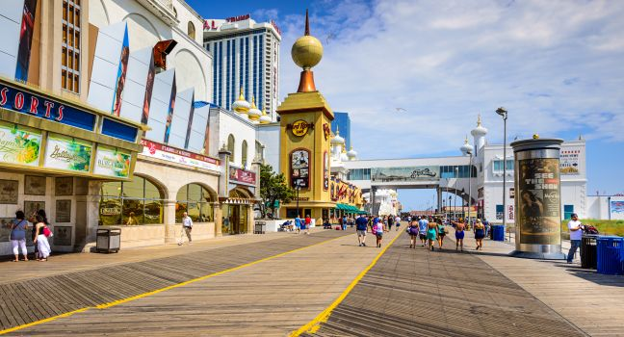
Atlantic City Boardwalk
Atlantic City is a resort city located along the Atlantic Ocean in Southern New New Jersey. The Boardwalk opened on June 26, 1870, as a way from beachgoers to transition from the sand to the shops, restaurants, and hotels located near the beach.

Slide 13
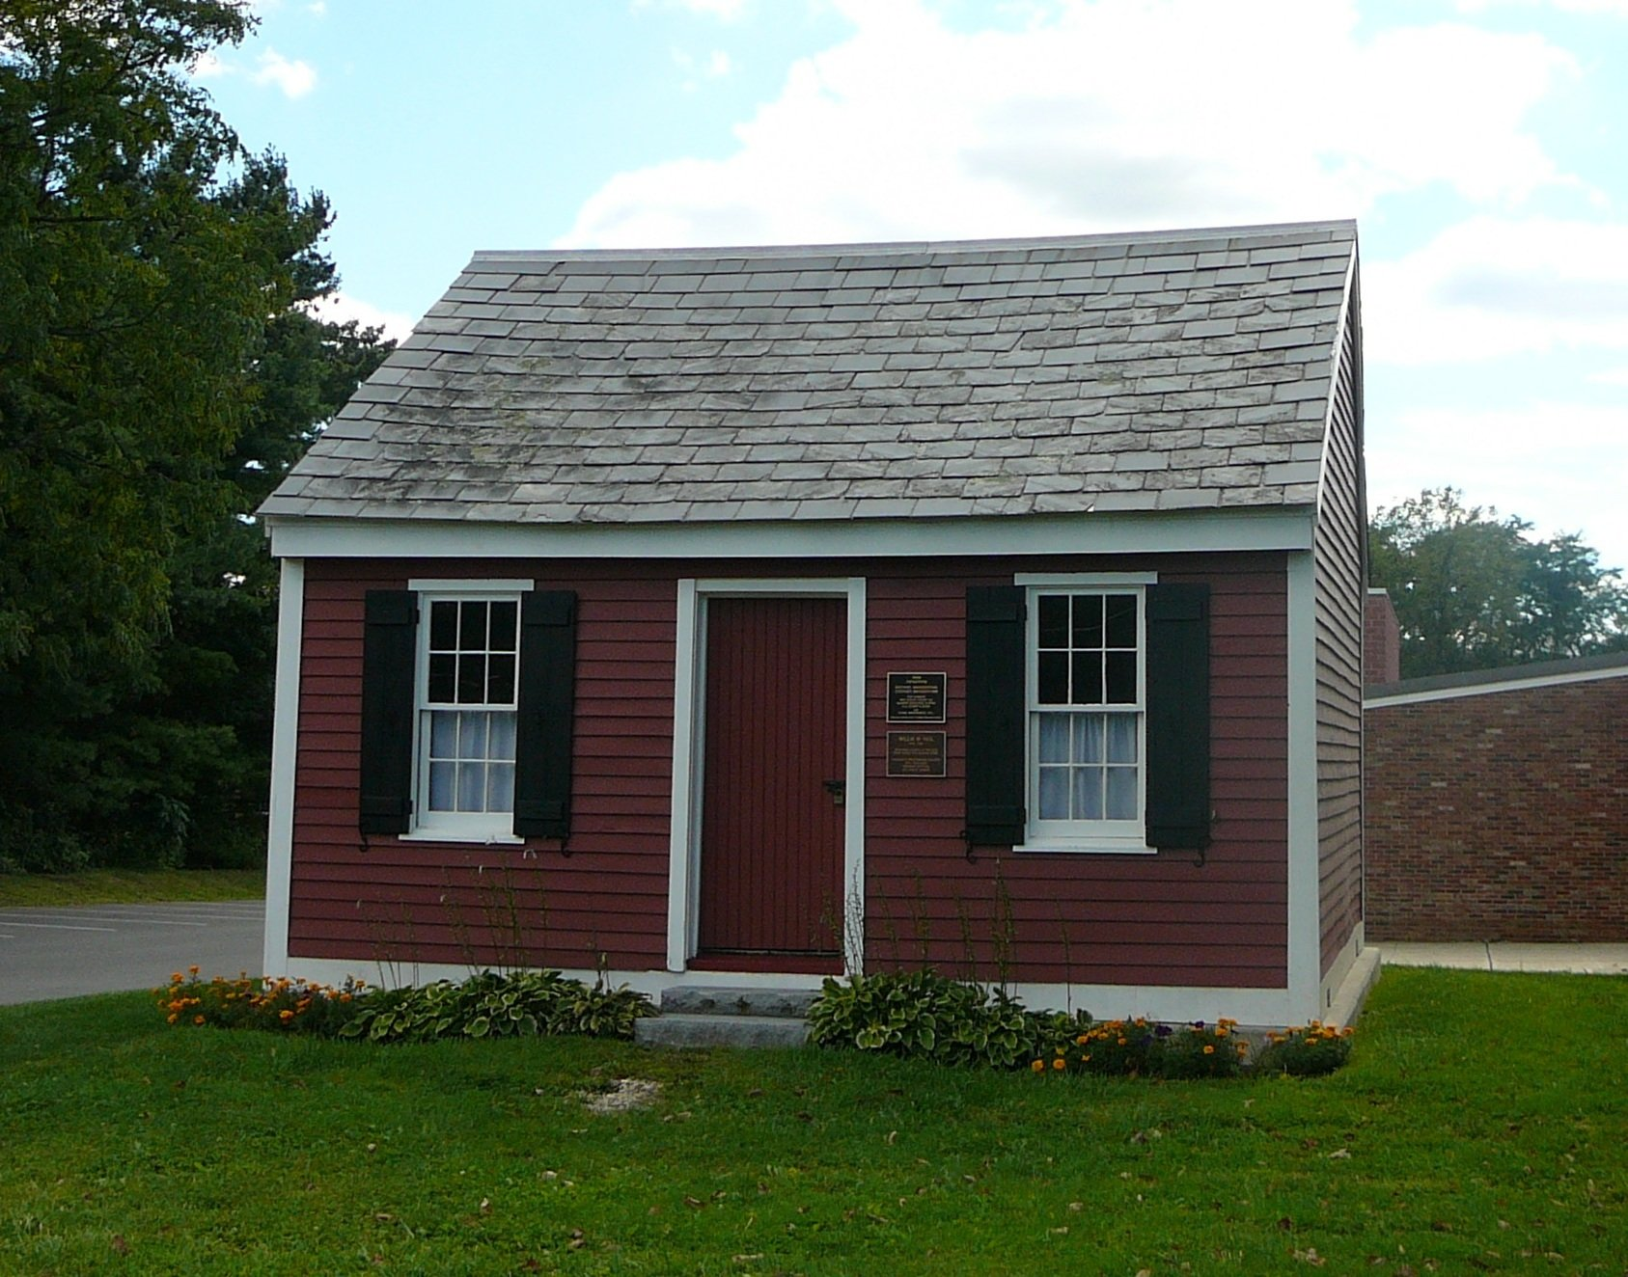
By:
Ned Scannell and
Joey Edwards
Grade 5
Dr. Kramer’s Class
Franklin Township School
Quakertown New Jersey

