Slide 1
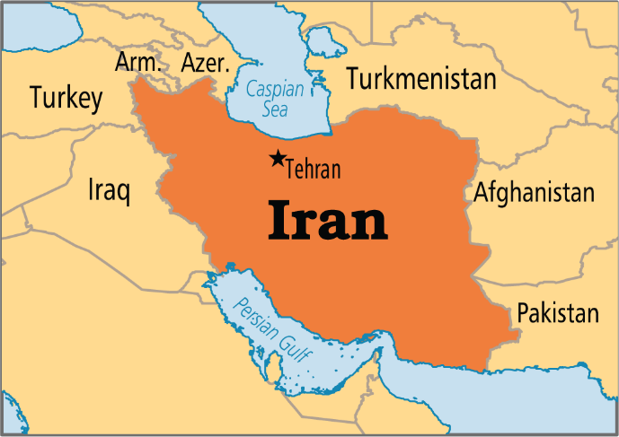
In The Name Of God
Global Issues:
Environment Learning Circle 1 (Middle/High School)
Unemployment
Mehr Aein School
Iran - Tehran

Slide 2
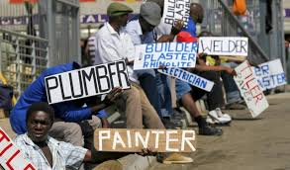
By : Sam, Parsa, Salim
Teachers :
Ms. Mirkhosravi
MR. Rahmati(computer teacher)

Slide 3
What is unemployment?
Unemployment is defined by the Bureau of Labor Statistics (BLS) as people who do not have a job, have actively looked for work in the past four weeks, and are at present time available for work. Also, people who were temporarily laid off and were waiting to be called back to that job are included in the unemployment statistics.
Those who have not looked for work within the past four weeks are no longer counted among the unemployed.

Slide 4
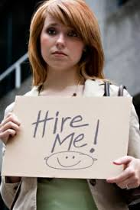
Why is unemployment important?
Unemployment is important because it serves primarily as a measurement of economic health on a local, state and national scale. Unemployment is studied and quantified as a measurement of economic health to demonstrate what sectors are most affected by unemployment as well as correlations between lower rates of employment and people of certain ages, ethnicity and socioeconomic status.
That adds up to a rather alarming fact: that the longer you're out of work, the lower your prospects of ever finding a new job become. The reasons are simple: in an employer's market one of the criteria that firms use to screen out resumes, is to eliminate those from people who are not currently, or have not recently been, working. While the reasons for doing so may be logical—people who haven't worked recently are less likely to be up on current technologies, skills and industry knowledge, and therefore less likely to be able to hit the ground running—it's clear that someone who is stuck in the limbo of wanting to work but having been out of a job for too long is going to need to try to fill the gaps on their resume.

Slide 5
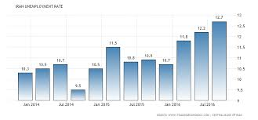
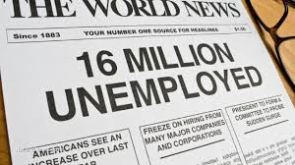
Types of unemployment and what are the causes?
There are three main types of unemployment :
Frictional
Structural
Cyclical
. The first two make up the natural unemployment rate. The third rises when demand falls, usually during a recession. Some economists define as many as five additional types of unemployment, such as seasonal and classical.

Slide 6
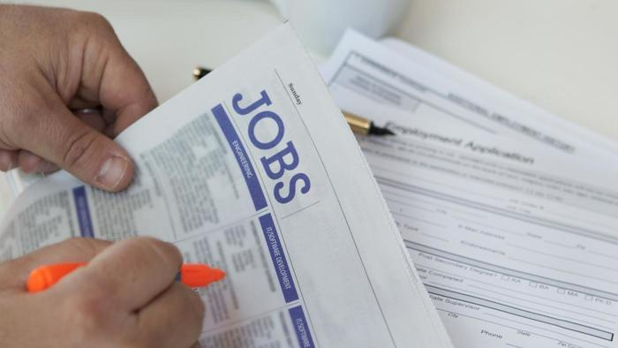
Structural unemployment
This kind of unemployment is when there is no demand for a definite type of worker.
It happens when there is no match between the skills employers want and
the skills that workers have.

Slide 7
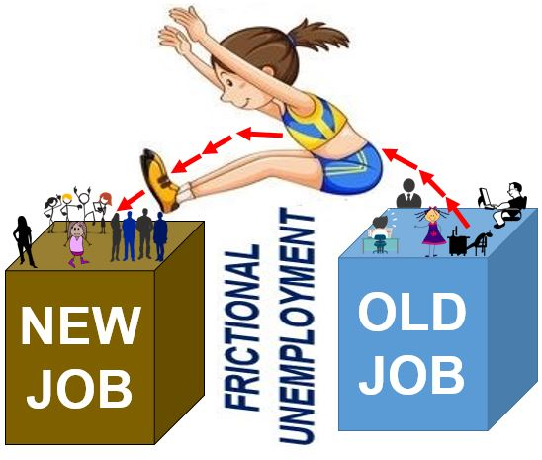
Frictional unemployment
This kind of unemployment happens when a person moves from one job to another. It happens because he/she doesn’t have enough information in labor market and just wants to get a job without losing time. They wouldn’t spend time to find a particular job vacancy.
They just want to escape from unemployment. They can not be hired for their favorite job. So they are ready to change their job with a new one.

Slide 8
Cyclical unemployment
This kind of unemployment is when there is a greater number of workers than job vacancies.
It happens when there is less demand for products because of the lack of consumer confidence, no interest, consumer’s low income.

Slide 9
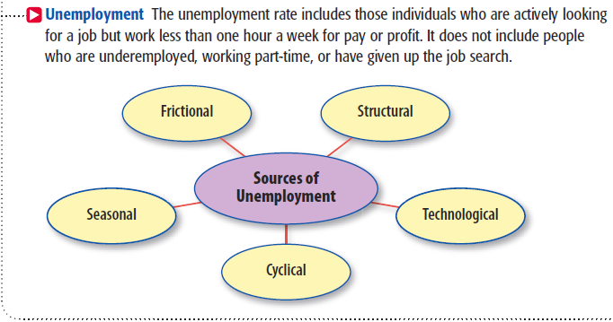

Slide 10
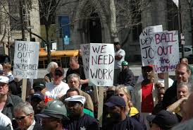
What is the solution for it ?
Nearly 500 million new jobs will need to be created by 2020 to provide opportunities to those currently unemployed and to the young people who are projected to join the workforce over the next few years.
At the same time, many industries are facing difficulty hiring qualified staff. One 2015 survey found that, globally, 38% of all employers are reporting difficulty filling jobs, a two-percentage point rise from 2014.
Put simply, we need jobs for the hundreds of millions of unemployed people around the world, and we need the skilled employees that businesses are struggling to find.

Slide 11
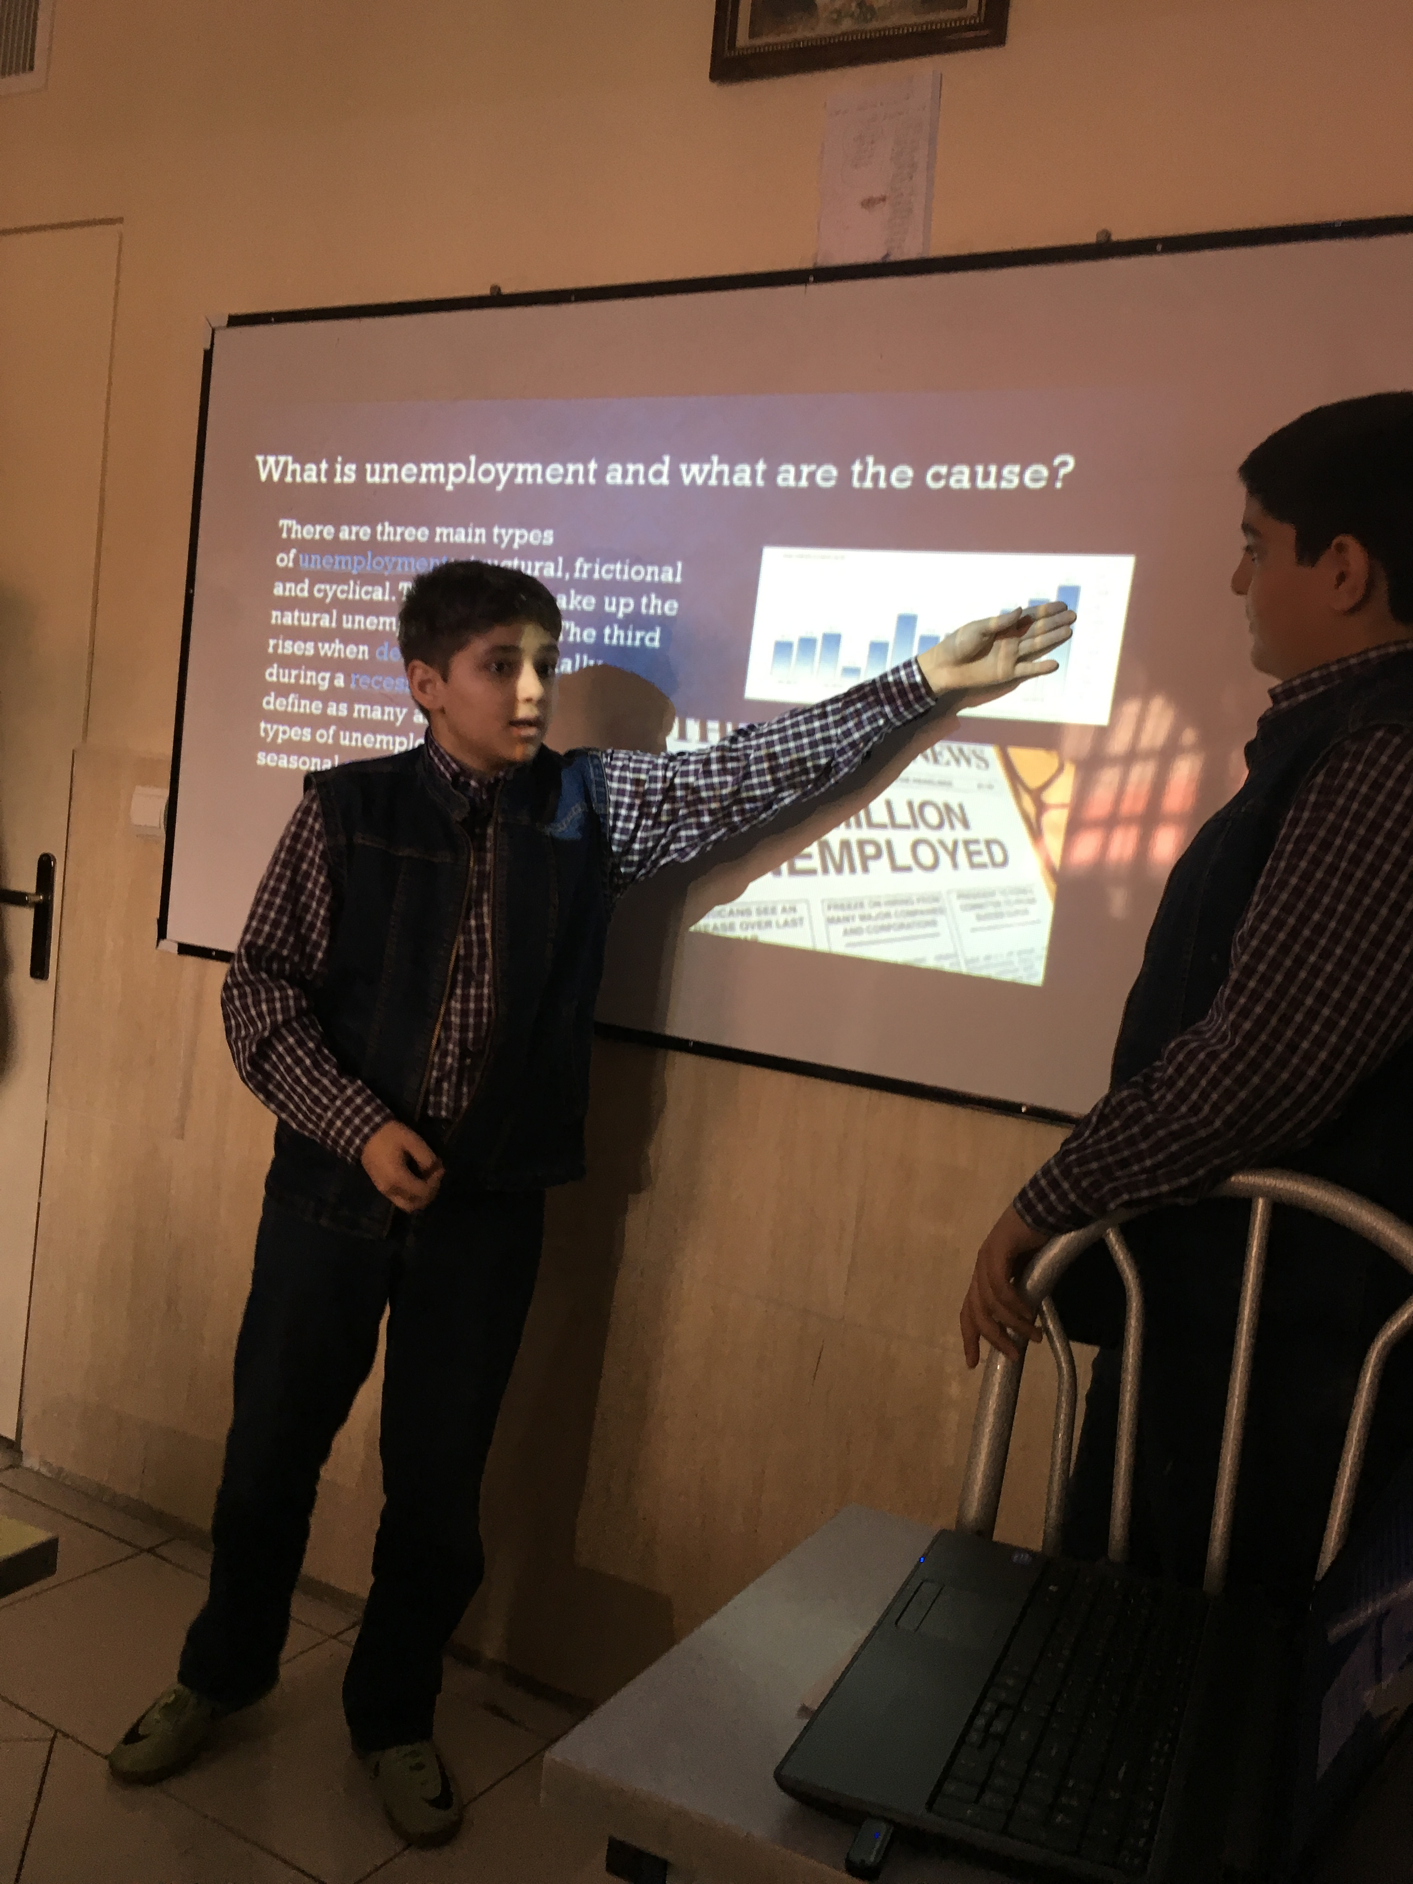

Slide 12
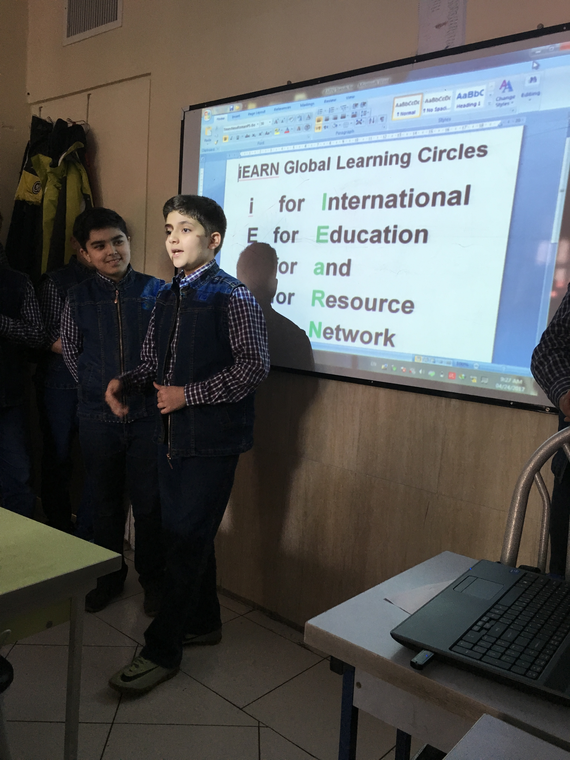

Slide 13
As we told unemployment is a terrible issue for economy and human beings ….
Let’s hope unemployment will decrease day by day…

Slide 14
Thank you for your attention.
We hope you enjoyed it .
THE END

