Slide 1
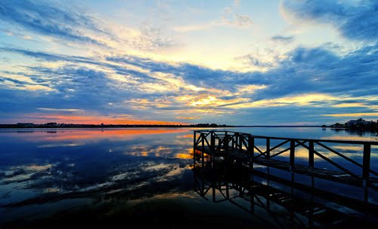
The Siutghiol Lake

Slide 2
The Siutghiol Lake

Slide 3
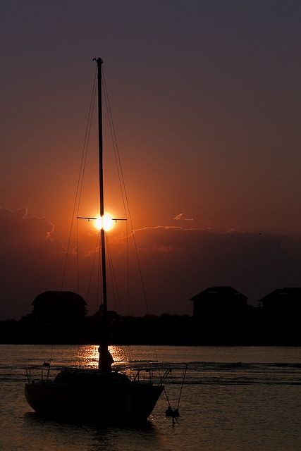
The Siutghiol lake has a length of 7,5 km and a width of 2,5 km. The lake has an island (dubbed Ovidiu) that is primarily comprised out of limestone and has a surface area of 2 hectares. On the side of the western and southern part of the lake, numerous springs can be seen fueling the lake with sweet water, contributing to the aquatic animals' ecosystem. On the shores of the Siutghiol, Constanta's Maritime Research Institution created a fish unit to conduct certain investigations. Likewise, a fishery named SC Marin has exclusive rights to the lake; they have taken measures to ban fishing so that the dwindling number of fish in the lake may be given an opportunity to grow. The ban they enforced will be in effect for the next five years.

Slide 4
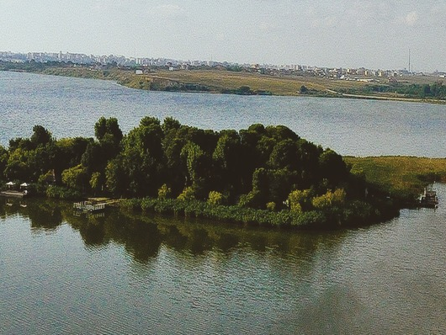
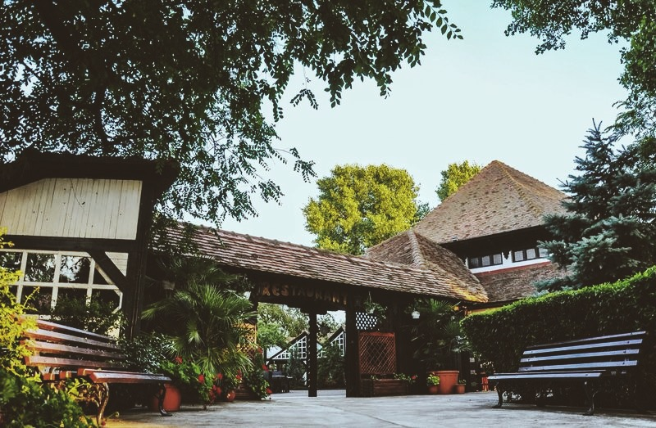
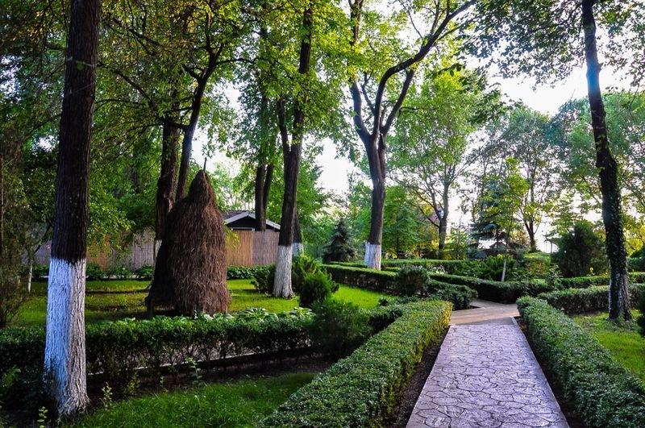
The island is also a very popular touristic attraction seeing as it's affordable and offers a great variety of food at a local restaurant with fish as it's main dish, coupled with a beautiful landscape and a small place arranged for children alongside a view showcasing a few species of rare and beautiful birds and animals.
All in all, it is a great place for people to relax far away from the noise of the city or the business that engulfs the coasts and it's business' during summer time. The boat ride itself from the docks to the island is twenty minutes; the roundway ticket is priced at 20 ron (as a reference, that would be 5$).

Slide 5
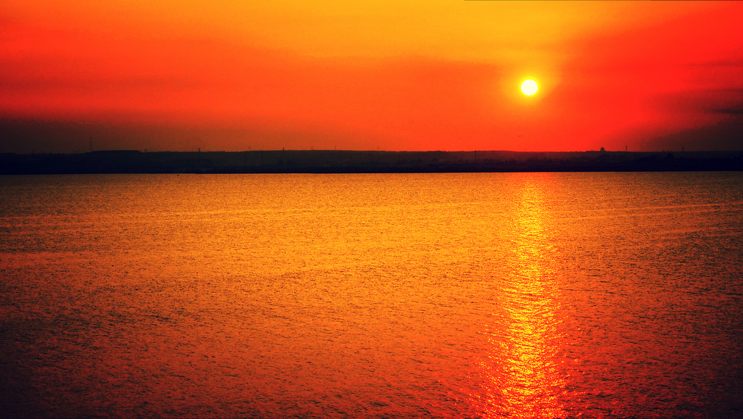
The main profits of Siutghiol come from the boat which takes tourists on the island ( a ticket being 20 LEI ) and the island's restaurant. The main dishes of the restaurant are of course sea food like Fish or Sea Fruits (shrimp,octopus etc)
For example a plate of octopus can reach up to 55 lei.

Slide 6
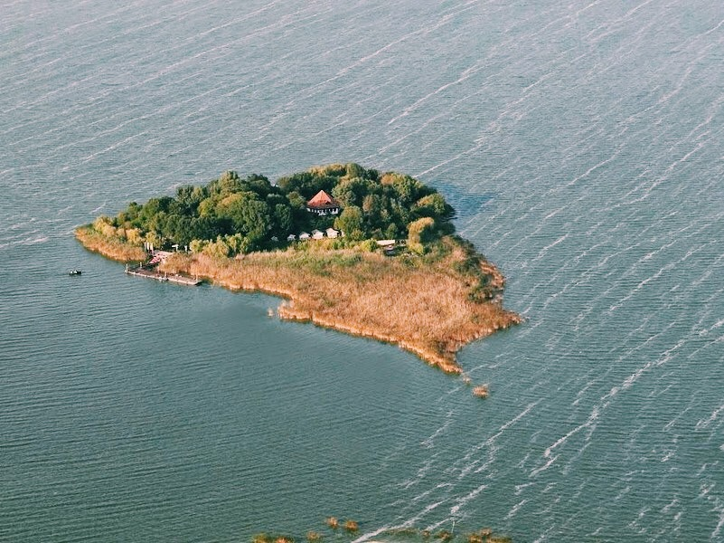
The Island Ovidiu is named after a famous Latin poet that lived in exile in an area near the lake called Tomis approximately two thousand years ago. Rumor has it that while he was exiled to Tomis, he himself (Ovidius) built a home on the island, ultimately becoming the site of his grave. This theory has never been confirmed by any archeological findings, however this notion is still alive and circulated to the younger generations

Slide 7
Bibliography
http://www.imperialtransilvania.com/2016/06/28/read-more/argomenti/places-of-interest-1/articolo/the-legends-of-lake-siutghiol.html
http://www.romaniajournal.ro/ovidiu-island-a-unique-attraction-near-mamaia/
http://lataifas.ro/destinatii-turistice-unice/64109/lacul-siutghiol-atractia-litoralului-romanesc/
http://m.ziuaconstanta.ro/stiri/actualitate/lacul-siutghiol-va-fi-administrat-de-primariile-constanta-navodari-si-ovidiu-43315-279046.html
http://salut-constanta.ro/lacul-siutghiol/10618
http://www.turistderomania.ro/lacuri-si-baraje/lacul-siutghiol-mamaia/
http://www.ziuaconstanta.ro/stiri/social/legenda-lacului-siutghiol-un-sat-cu-oameni-rai-s-a-scufundat-in-loc-a-aparut-o-apa-mare-si-adanca-451425.html
http://radioconstanta.ro/2017/03/04/mamaia-actiune-de-ecologizare-pe-malul-lacului-siutghiol/
http://www.turismland.ro/lacul-siutghiol-constanta/

Slide 8
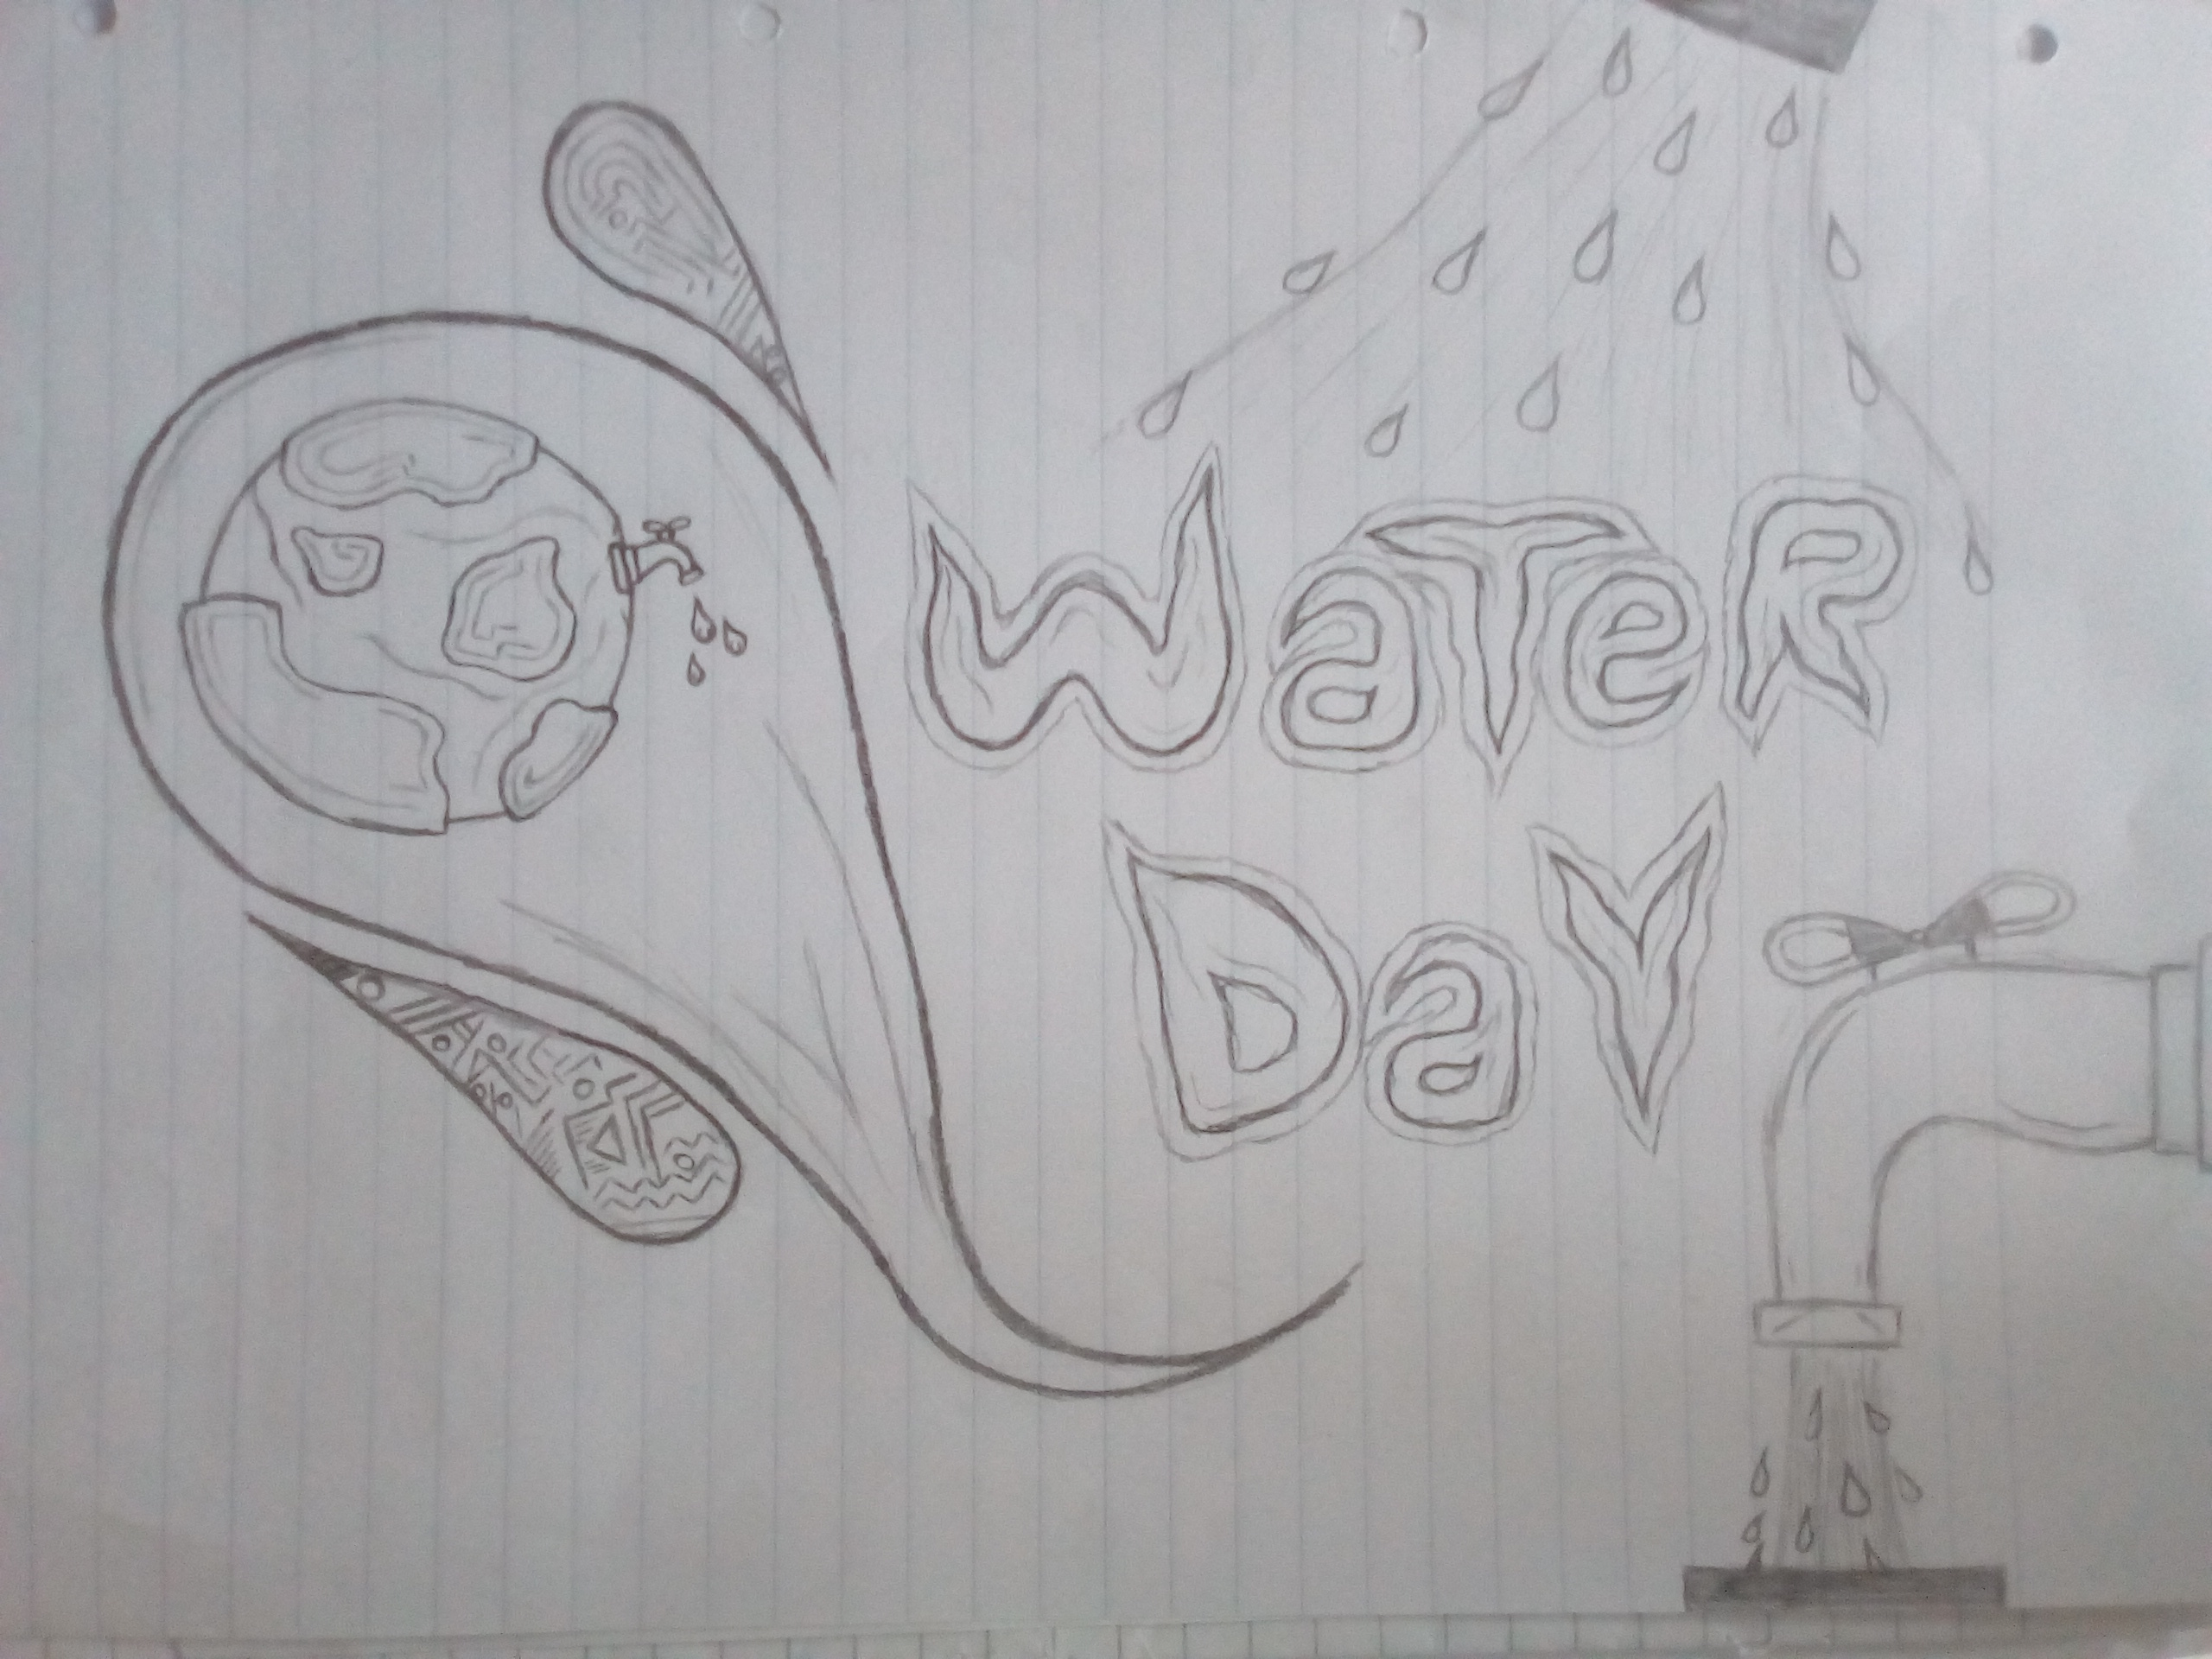

Slide 9
