Slide 1
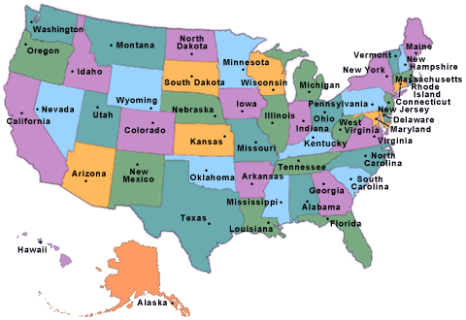
Top 10 Famous American National Symbols

Slide 2
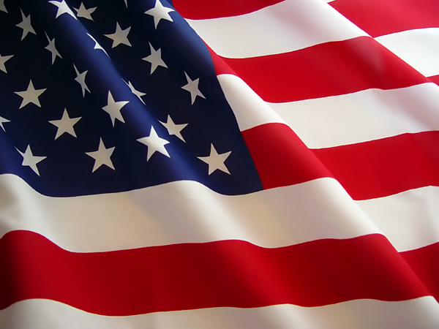
The United States Flag
The colors of the pales (the vertical stripes) are those used in the flag of the United States of America; White signifies purity and innocence, Red, hardiness and valour, and Blue, the color of the Chief (the broad band above the stripes) signifies vigilance, perseverance & justice.

Slide 3
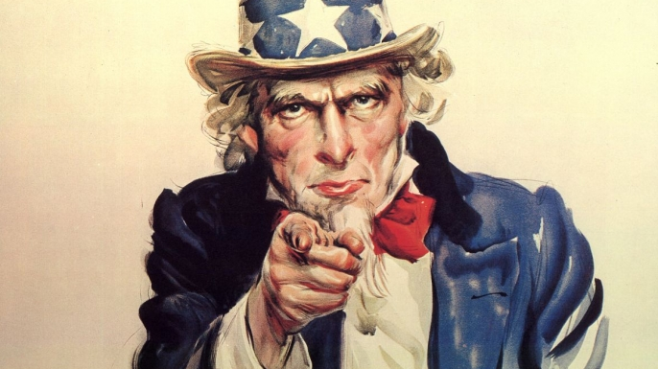
2. Uncle Sam
Uncle Sam (initials U.S.) is a common national personification of the American government or the United States in general. That, according to legend, came into use during the War of 1812 and was supposedly named for Samuel Wilson. Its actual origin is obscure. Uncle Sam represents a manifestation of patriotic emotion.
The first use of Uncle Sam in formal literature (as distinct from newspapers) was in the 1816 allegorical book "The Adventures of Uncle Sam in Search After His Lost Honor" by Frederick Augustus Fidfaddy, Esq. An Uncle Sam is mentioned as early as 1775, in the original "Yankee Doodle" lyrics of the American Revolutionary War. It is not clear whether this reference is to Uncle Sam as a metaphor for the United States, or to an actual person named Sam. The lyrics as a whole celebrate the military efforts of the young nation, besieging the British at Boston.

Slide 4
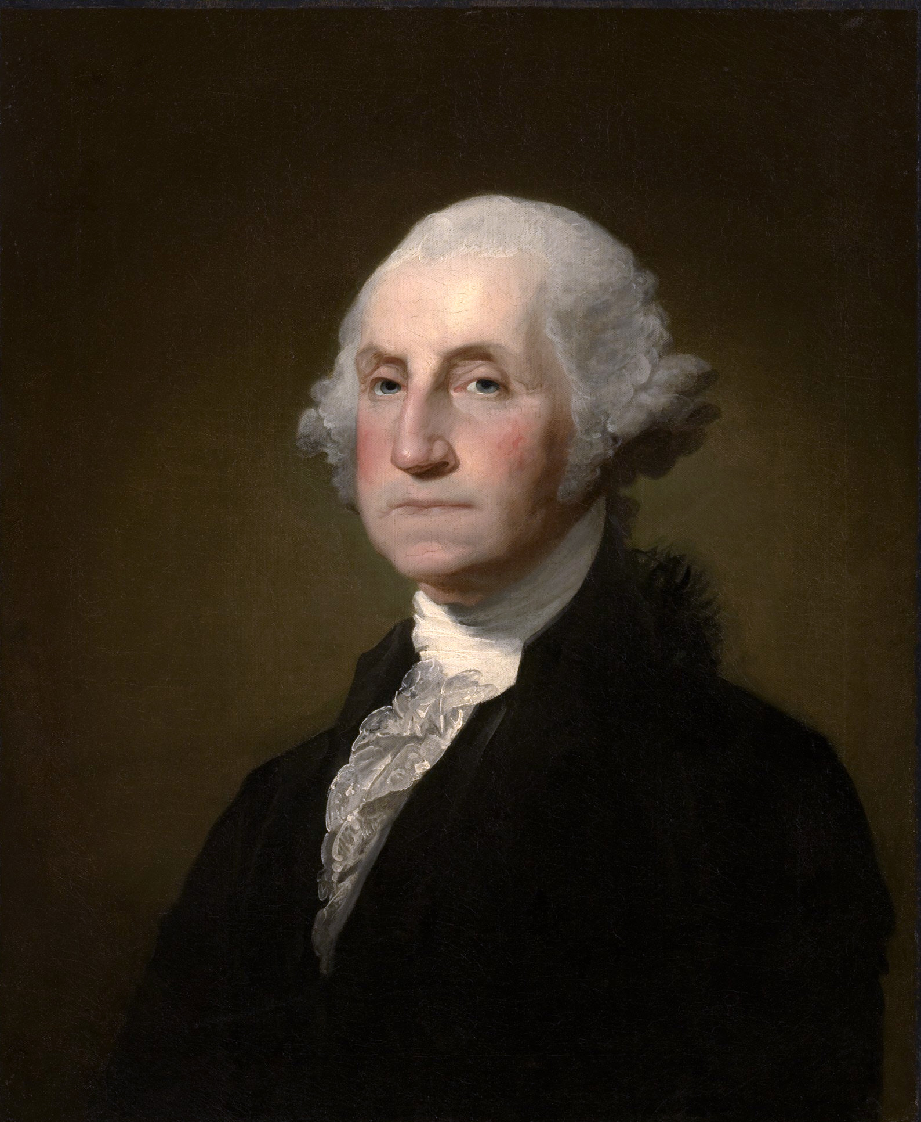
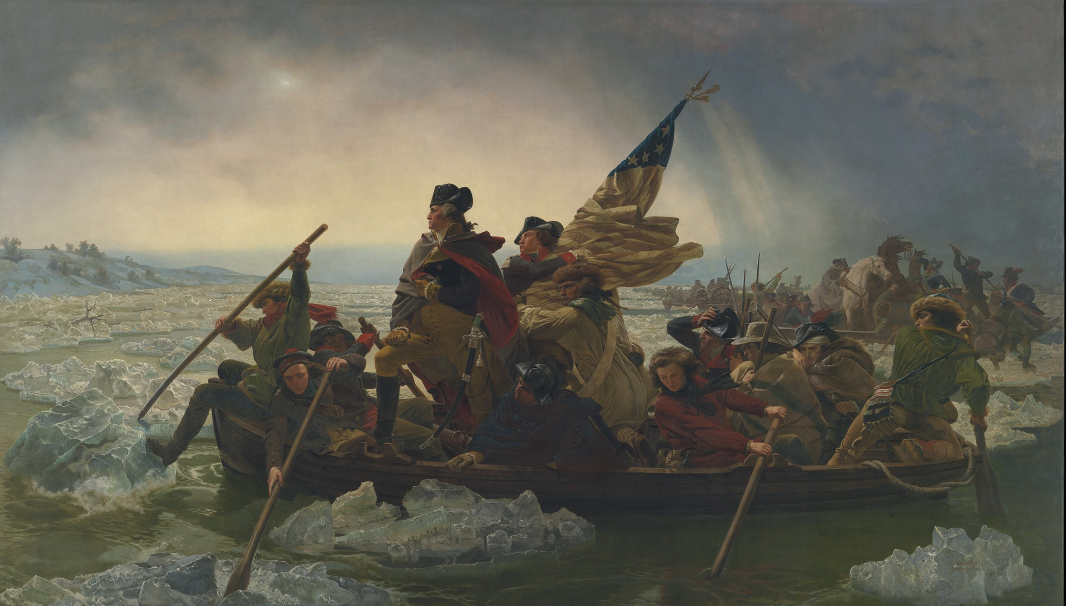
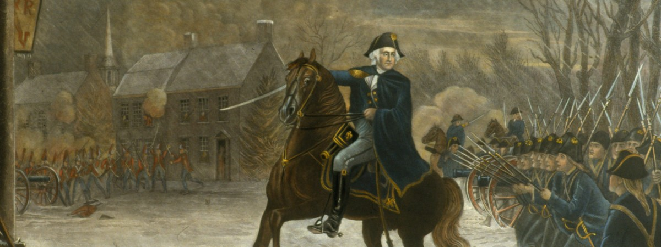
3. George Washington
George Washington was born on February 22, 1732 [O.S. February 11, 1731 – December 14, 1799) was an American politician and soldier who served as the first President of the United States from 1789 to 1797 and was one of the Founding Fathers of the United States. He served as Commander-in-Chief of the Continental Army during the American Revolutionary War, and later presided over the 1787 convention that drafted the United States Constitution. He is popularly considered the driving force behind the nation's establishment and came to be known as the "father of the country," both during his lifetime and to this day.

Slide 5
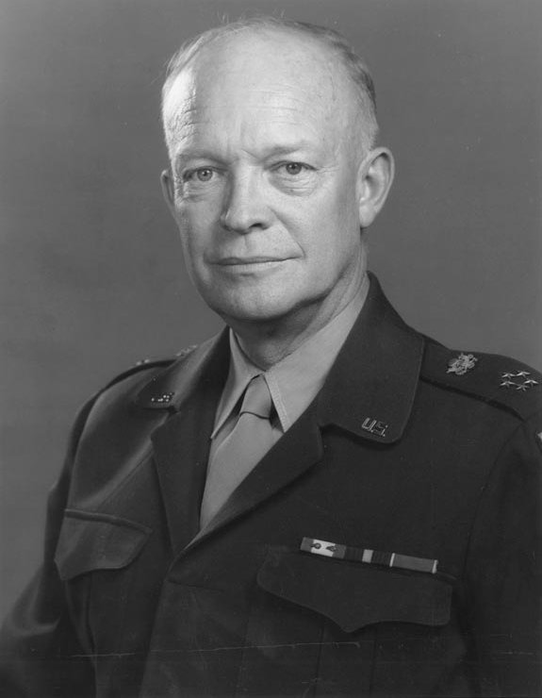
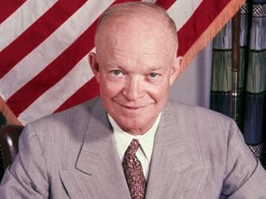
Dwight D Eisenhower was probably the most famous American general in World War II. He became the 34th president of the United States of America.
4. Dwight D Eisenhower
Dwight D. Eisenhower - D-Day Pre Invasion Address to Soldiers (Order of the Day). Soldiers, Sailors, and Airmen of the Allied Expeditionary Force: You are about to embark upon the Great Crusade, toward which we have striven these many months.

Slide 6
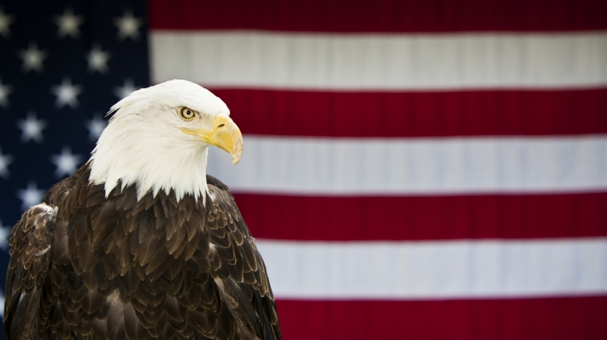
5. Bald Eagle
The bald eagle is important in various Native American cultures, and as the national bird of the United States. It is prominent in seals and logos, coinage, postage stamps, and other items relating to the U.S. federal government. Bald eagles were once hunted, but now it is illegal to hunt them in the United States.

Slide 7
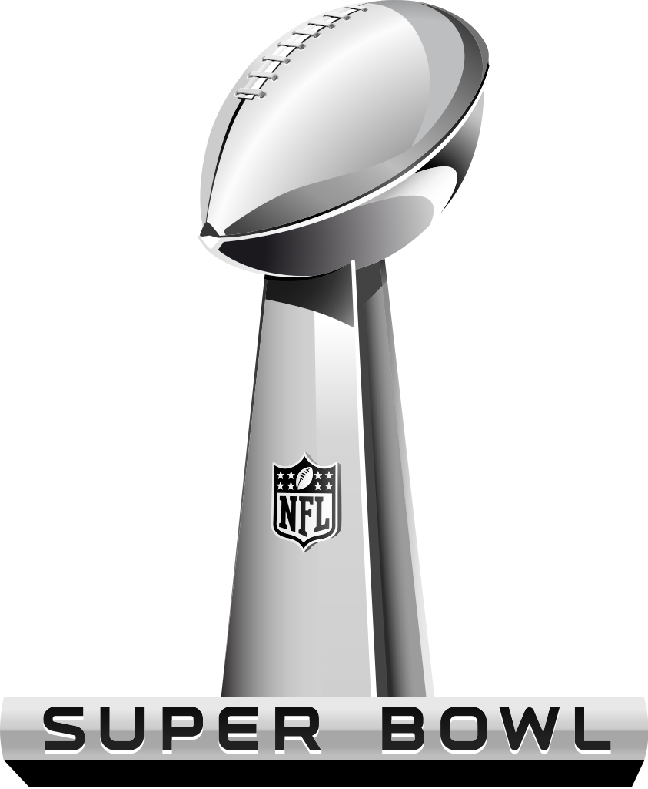
6. Super Bowl
The Super Bowl is probably the most recognized sporting contest in the United States because athletes from the two best football teams compete against each other to determine who is best. Did you know that 1 million chicken wings are eaten on Super Bowl Sunday in February each year?

Slide 8
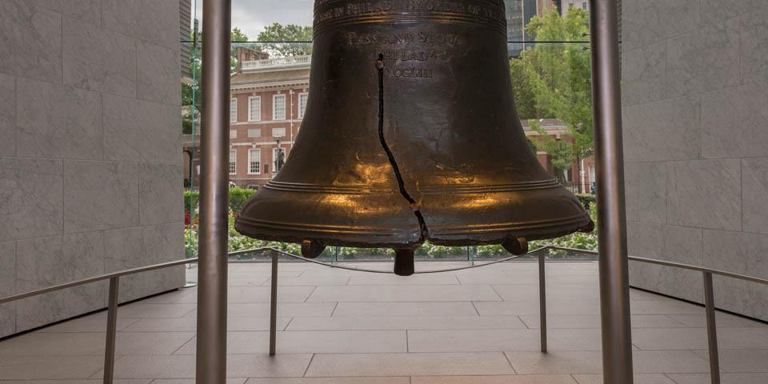
7. Liberty Bell
The Liberty Bell is an American symbol of freedom. It is located in Philadelphia, Pennsylvania. The bell first cracked when rung after its arrival in Philadelphia, and was twice recast by local workmen John Pass and John Stow, whose last names appear on the bell.

Slide 9
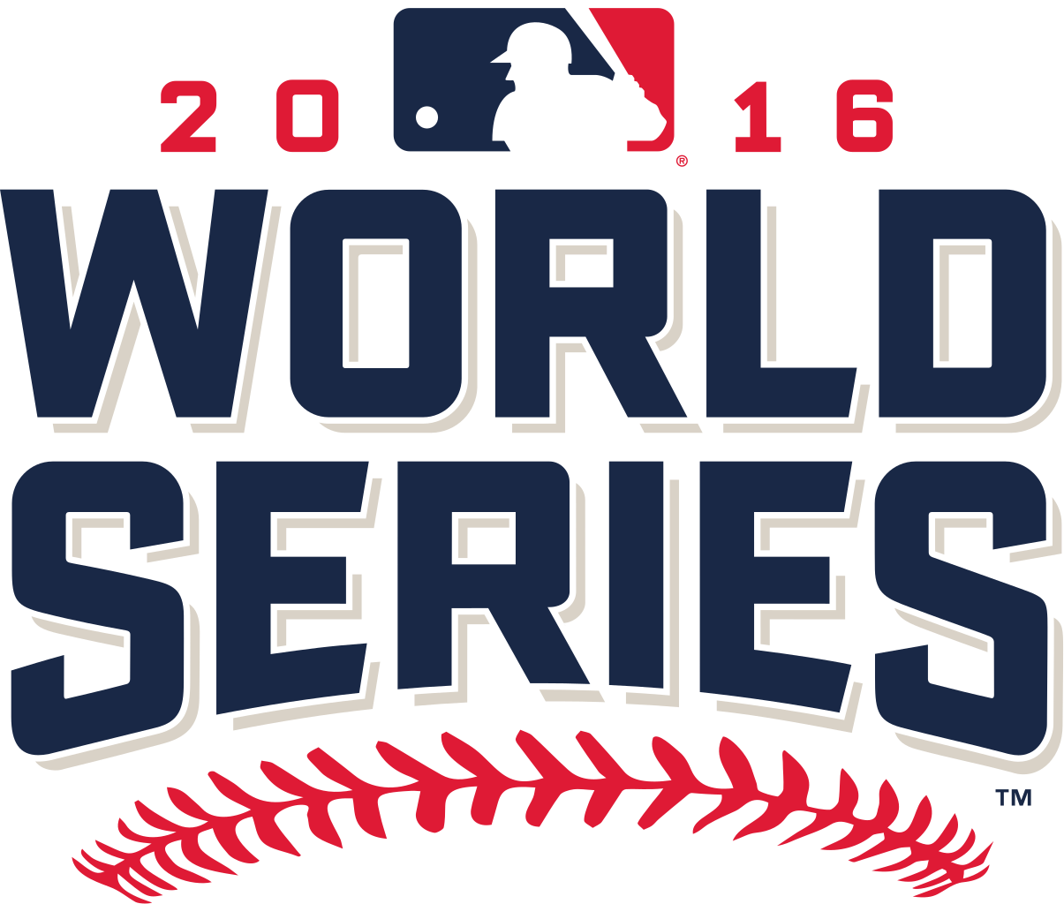
8. The World Series of Baseball
The World Series is the annual championship series of Major League Baseball in North America, contested since 1903 between the American League champion team and the National League champion team. The winner of the World Series championship is determined through a best-of-seven playoff.

Slide 10
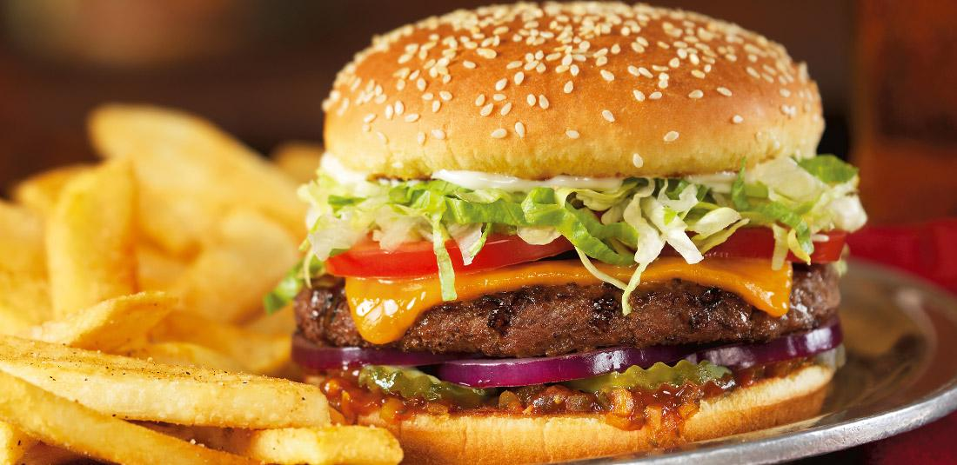
9. National Food
Hamburgers, hot dogs, apple pie, and Chicago-style pizza.
Our favorite American food is the hamburger. Taylor ham is popular in New Jersey because it is made in New Jersey.

Slide 11
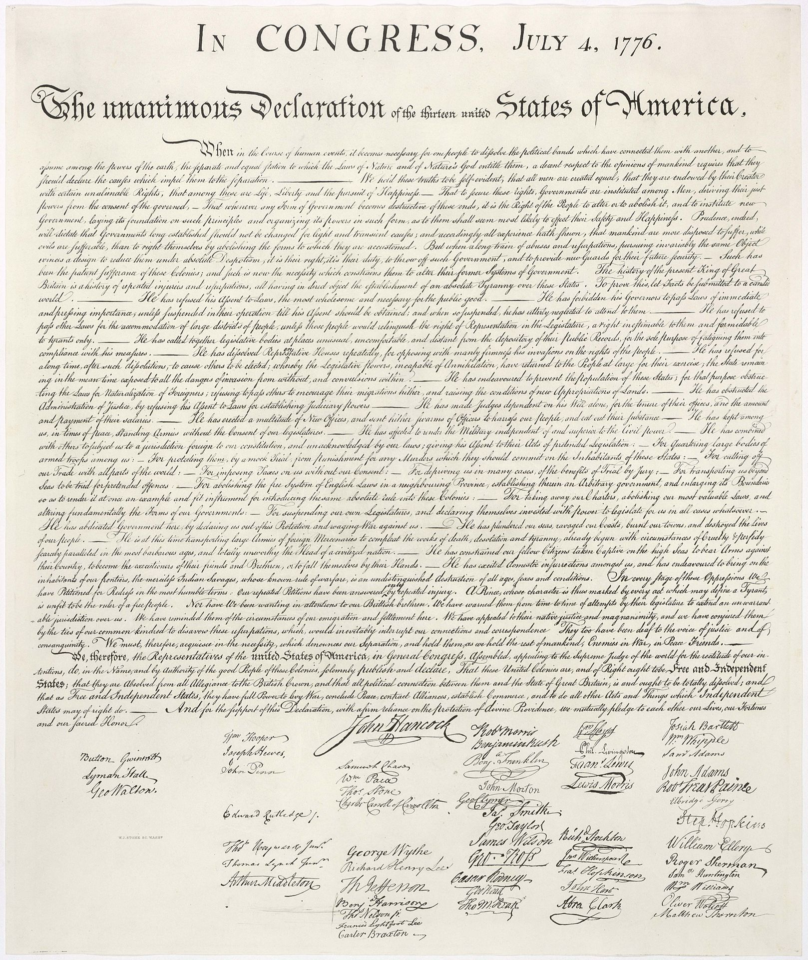
10. Declaration of Independence
Declaration of Independence is probably the most famous American document. It was written in the year 1776, but wasn’t signed until August 2, 1776. The Declaration of Independance was signed by many amazing founders of the United States. It declares our independence from England. The Declaration is now on display in Washington, DC.

Slide 12
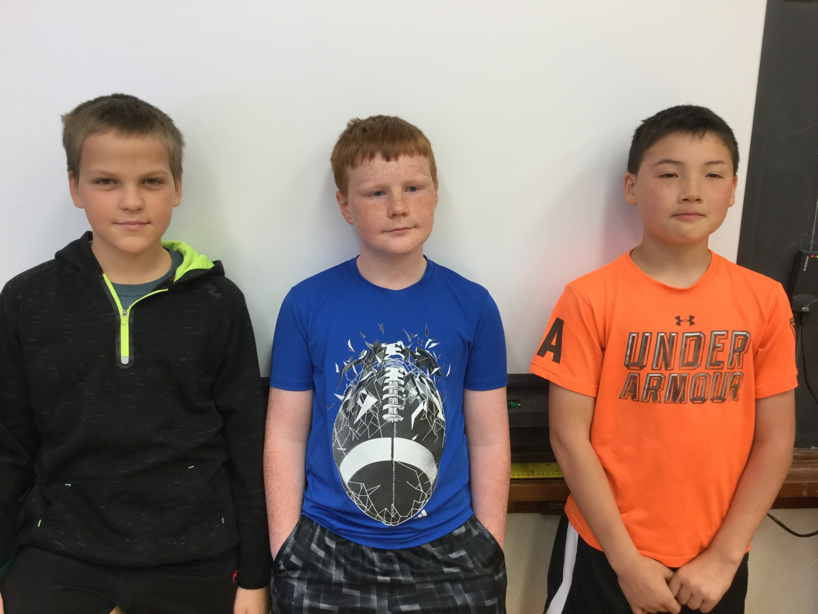
Creators
Ben H. Joshua E. and Aaron L.

