Slide 1
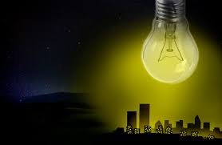
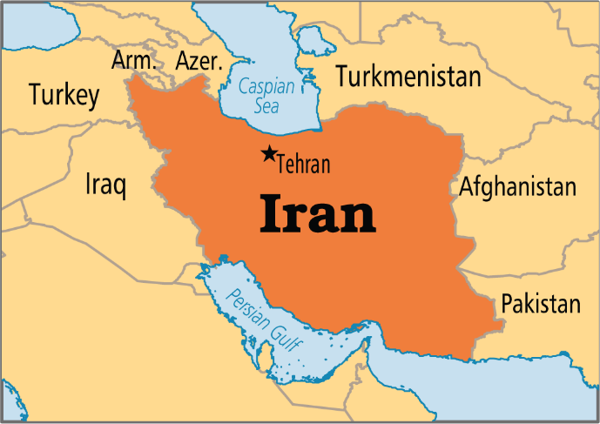
In the name of god
Global Issues: Environment Learning Circle 1 (Middle/High School)
Mehr Aein School
Iran - Tehran
Light Pollution

Slide 2
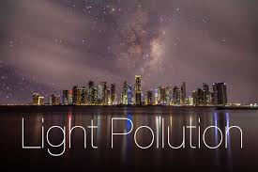
By: Artin Farajollahi
Kourosh Nejati

Slide 3
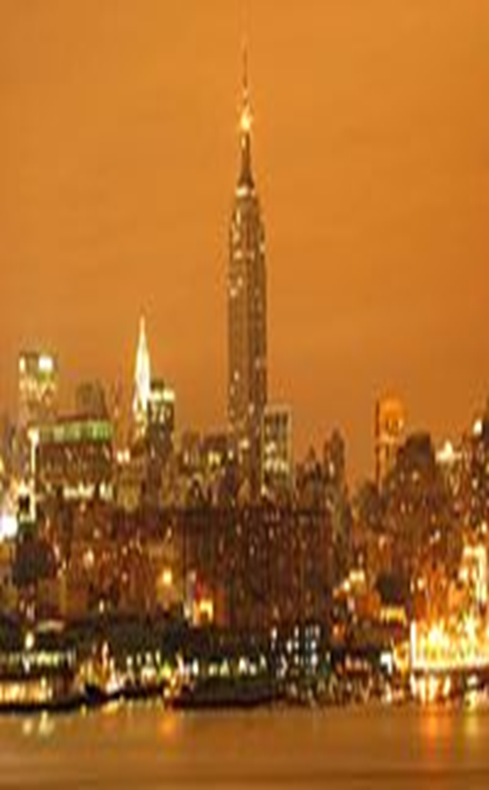
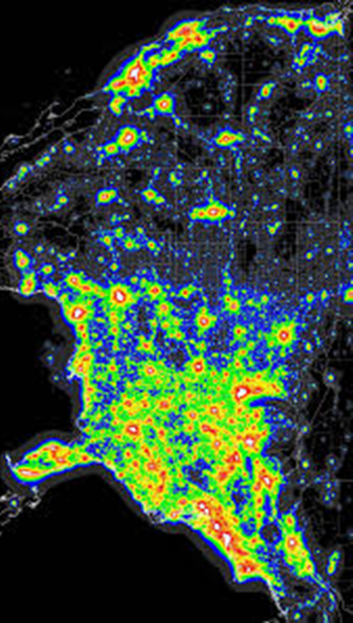
What is light pollution ?
Light pollution, also known as photo pollution, is excessive, misdirected or obtrusive artificial light. As a major side-effect of urbanization, it is blamed for compromising health, disrupting ecosystems and spoiling aesthetic environments.

Slide 4
what does light pollution do ?
Effects of Light Pollution
While many people choose to dismiss light pollution as being the price of modern life, it has serious effects on everything around it.
Animals – Lights can attract or repel animals and insects. Most animal life functions on a diurnal or nocturnal system that is thrown out of sync by light pollution. This can place entire species in danger, or attract unwanted species into human areas.
People – The wrong kind of light, or too much light has been proven to have an impact on your health and quality of life. Light pollution also increases danger to people as it can interfere with important navigational systems for trains, planes and even automobiles.
The Earth – The Earth’s ecosystem is dependent on cycles of natural light. Sky Glow alone can cause a loss in growth protection as the reflected light off the atmosphere will prevent the natural UV rays from reaching the Earth. This disrupts growth and decay cycles that our food, air and water supply is dependent on.

Slide 5
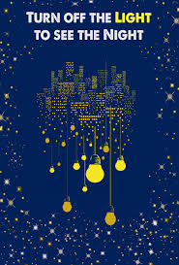
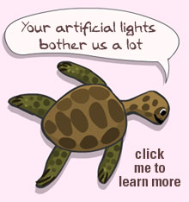
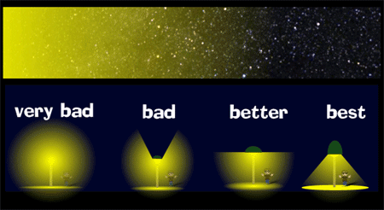

Slide 6
Why/ When/where does it happen?
Light pollution is unique as it is caused by man only. There is no comparable natural form of the pollution like there is with carbon dioxide. The main causes of light pollution are:
Poor Planning – The placement of signage and street lights is planned by engineers, if they do not take into account the effect placement has on the surrounding environment they can create glare, light trespass and light clutter.
Irresponsible use – You may love Christmas lights but leaving them on all night is a form of pollution, as is leaving a room with the lights still on or setting the timers on streetlamps and not adjusting the timer for the season. Not actively choosing to minimize is really a zoning issue. Too many businesses, or too many residences, grouped in energy waste is a huge source of light pollution.
Overpopulation – That one area can cause light pollution of many kinds.

Slide 7
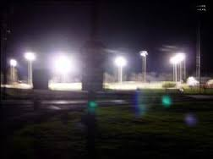
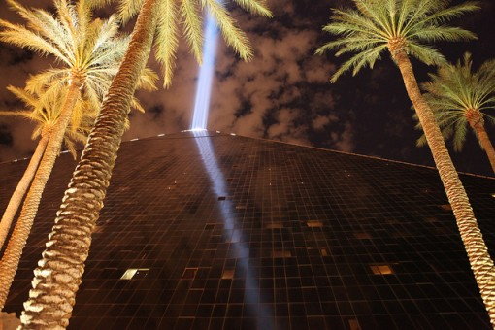
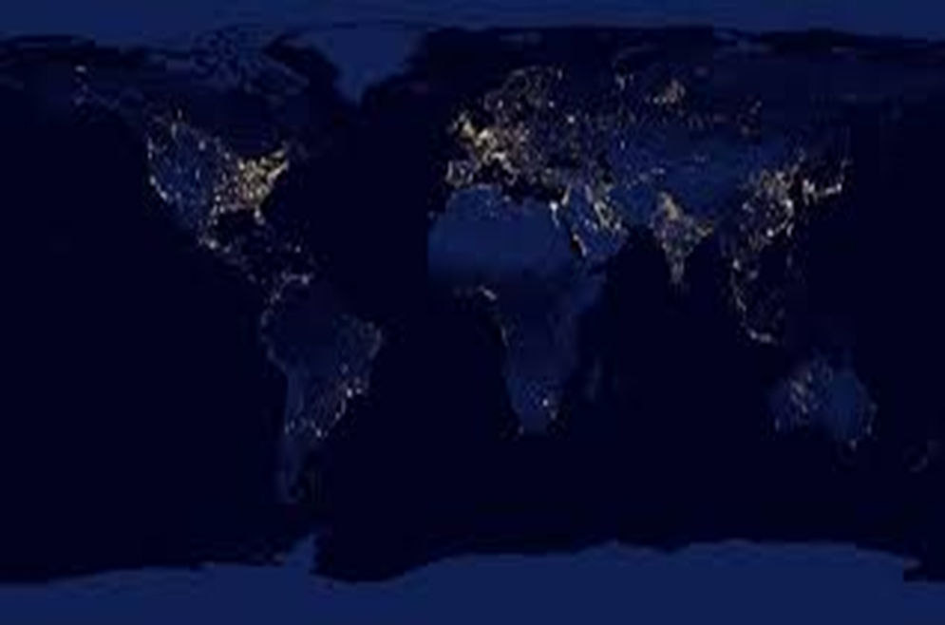

Slide 9
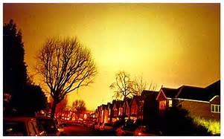
How many kinds of light pollutions do we have?
There are 5 different kinds of light pollution:
SKY GLOW
Sky glow refers to the diffuse glow that can be seen over populated areas. It arises from light reflected from illuminated surfaces and from light escaping directly upward from incompletely shielded or upward-directed light fixtures, which then is scattered (redirected) by the atmosphere back toward the ground.

Slide 10
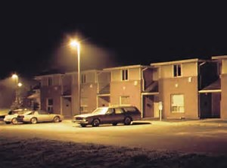
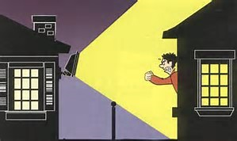
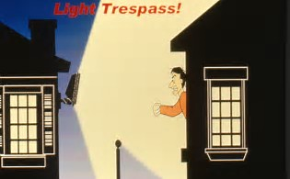
LIGHT TRESPASS
Light trespass occurs when unwanted light enters one's property, for instance, by shining over a neighbor's fence. A common light trespass problem occurs when a strong light enters the window of one's home from the outside, causing problems such as sleep deprivation. A number of cities in the U.S. have developed standards for outdoor lighting to protect the rights of their citizens against light trespass. To assist them, the International Dark-Sky Association has developed a set of model lighting ordinances.

Slide 11
Over-illumination
Over-illumination is the excessive use of light. It is the presence of lighting intensity higher than that which is appropriate for a specific activity. Over-illumination was commonly ignored between 1950 and 1995, especially in office and retail environments. Since then, however, the design community has begun to reconsider this practice. Over-illumination would cause two separate concerns:
Unnecessary electric lighting is expensive and energy-intensive. Lighting accounts for approximately 9% of residential electricity use as of 2001 and about 40% of commercial electricity use.
Excessive levels of artificial light may adversely affect health. These detrimental effects may depend on the spectrum as well as the overall brightness level of light.
Over-illumination can be reduced by installing occupancy sensors, using natural sunlight whenever possible, turning off lights when leaving a room, or changing the type of light bulb. Over-illumination does not refer to snow blindness where high exposure to ultraviolet light causes physical damage to the eye. Too little light, the opposite of over-illumination, is associated with seasonal affective disorder.

Slide 12
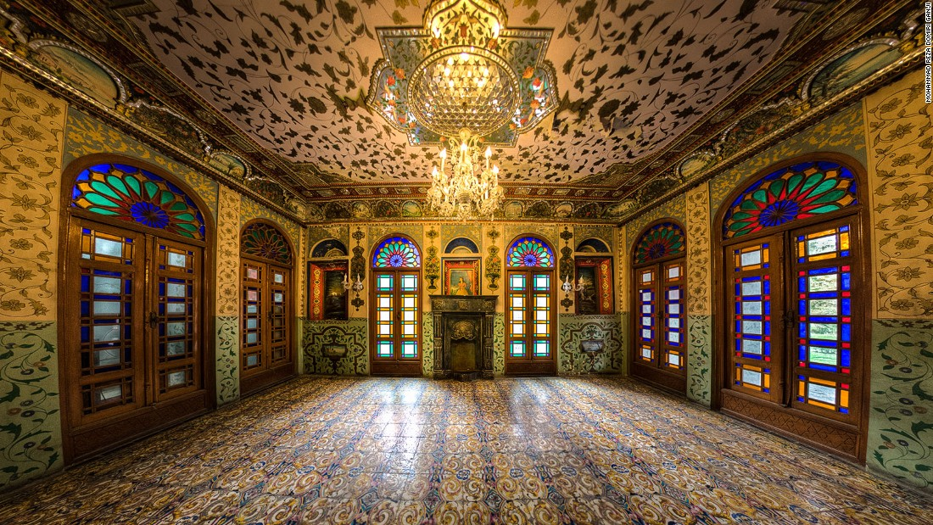
Emarat e Badgir in Tehran:
An example of traditional architecture in Iran, which represents the usage of natural light in a building. Tall columns, a lot of windows and colorful mirrors were used in it. It is full of positive energy.

Slide 13
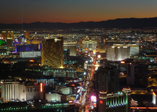
LIGHT CLUTTER
Light clutter
The Las Vegas Strip displays excessive groupings of colorful lights. This is a classic example of light clutter.
Light clutter refers to excessive groupings of lights. Groupings of lights may generate confusion, distract from obstacles (including those that they may be intended to illuminate), and potentially cause accidents. Clutter is particularly noticeable on roads where the street lights are badly designed, or where brightly lit advertising surrounds the roadways. Depending on the motives of the person or organization that installed the lights, their placement and design can even be intended to distract drivers, and can contribute to accidents.
Clutter may also present a hazard in the aviation environment if aviation safety lighting must compete for pilot attention with non-relevant lighting. For instance, runway lighting may be confused with an array of suburban commercial lighting and aircraft collision avoidance lights may be confused with ground lights.

Slide 14
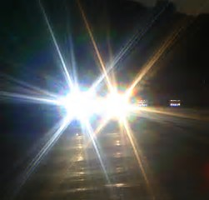
GLARE
Glare can be categorized into different types. One such classification is described in a book by Bob Mizon, coordinator for the British Astronomical Association's Campaign for Dark Skies, as follows:
1-Blinding glare describes effects such as that caused by staring into the Sun. It is completely blinding and leaves temporary or permanent vision deficiencies.
2-Discomfort glare does not typically cause a dangerous situation in itself, though it is annoying and irritating at best. It can potentially cause fatigue if experienced over extended periods.

Slide 16
How can we reduce light pollution?
Solutions for Light Pollution
There are two basic ways for solving light pollution :
planning and education.
Planning means more consideration about how areas are zoned and where lights are placed. It also means changing the types of lights used within the home, signs and streetlamps to more efficient bulbs and with a light output that is not so disruptive.
Education is also key. The more people understand the importance of turning off lights to conserve energy and reduce light pollution the faster change will be seen.
Why aren’t solutions being put in place faster?
It is difficult to change habits with people and expensive to redesign and replace what already exists. Slowly people and governments are recognizing the long term impact of exposure to light pollution and are seeing that preventative costs provide long-term savings over the long run. Light pollution is getting more attention these days and as education and awareness improves, so will efforts to reduce light pollution.

Slide 17
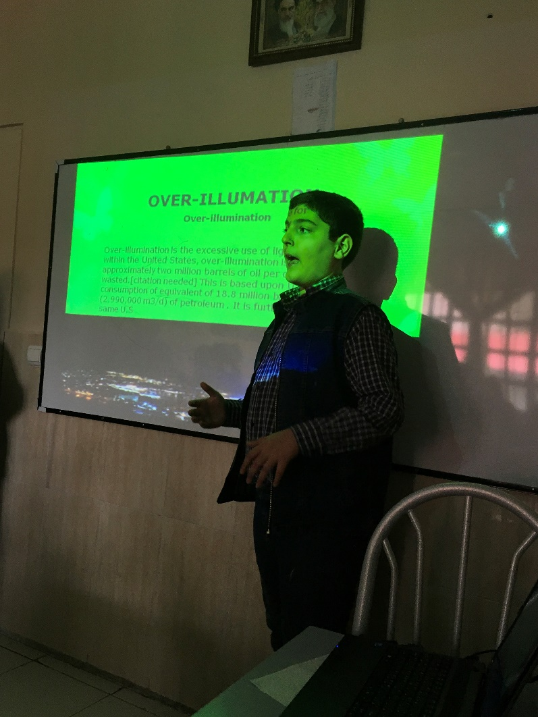
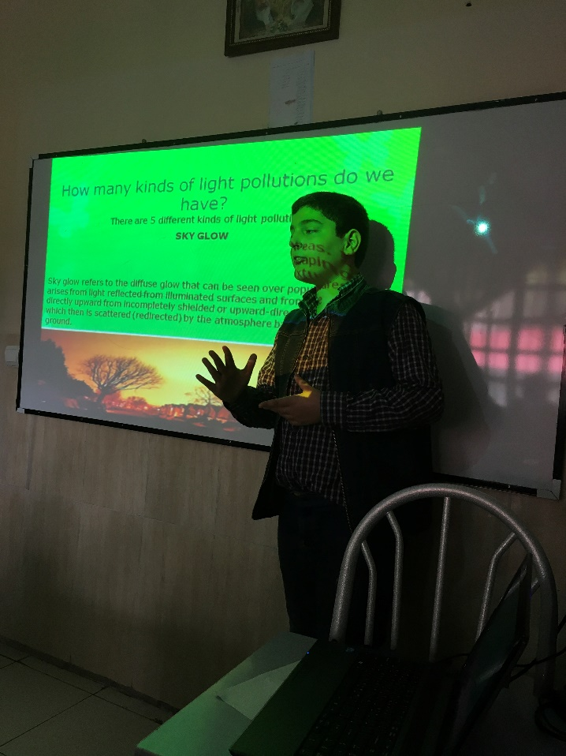

Slide 18
Thanks to iEARN, our parents, and teachers who helped and motivated us specially Ms. Mirkhosravi GOOD Bye see you guys again

