Slide 1
We Help Our Environment!

Slide 2
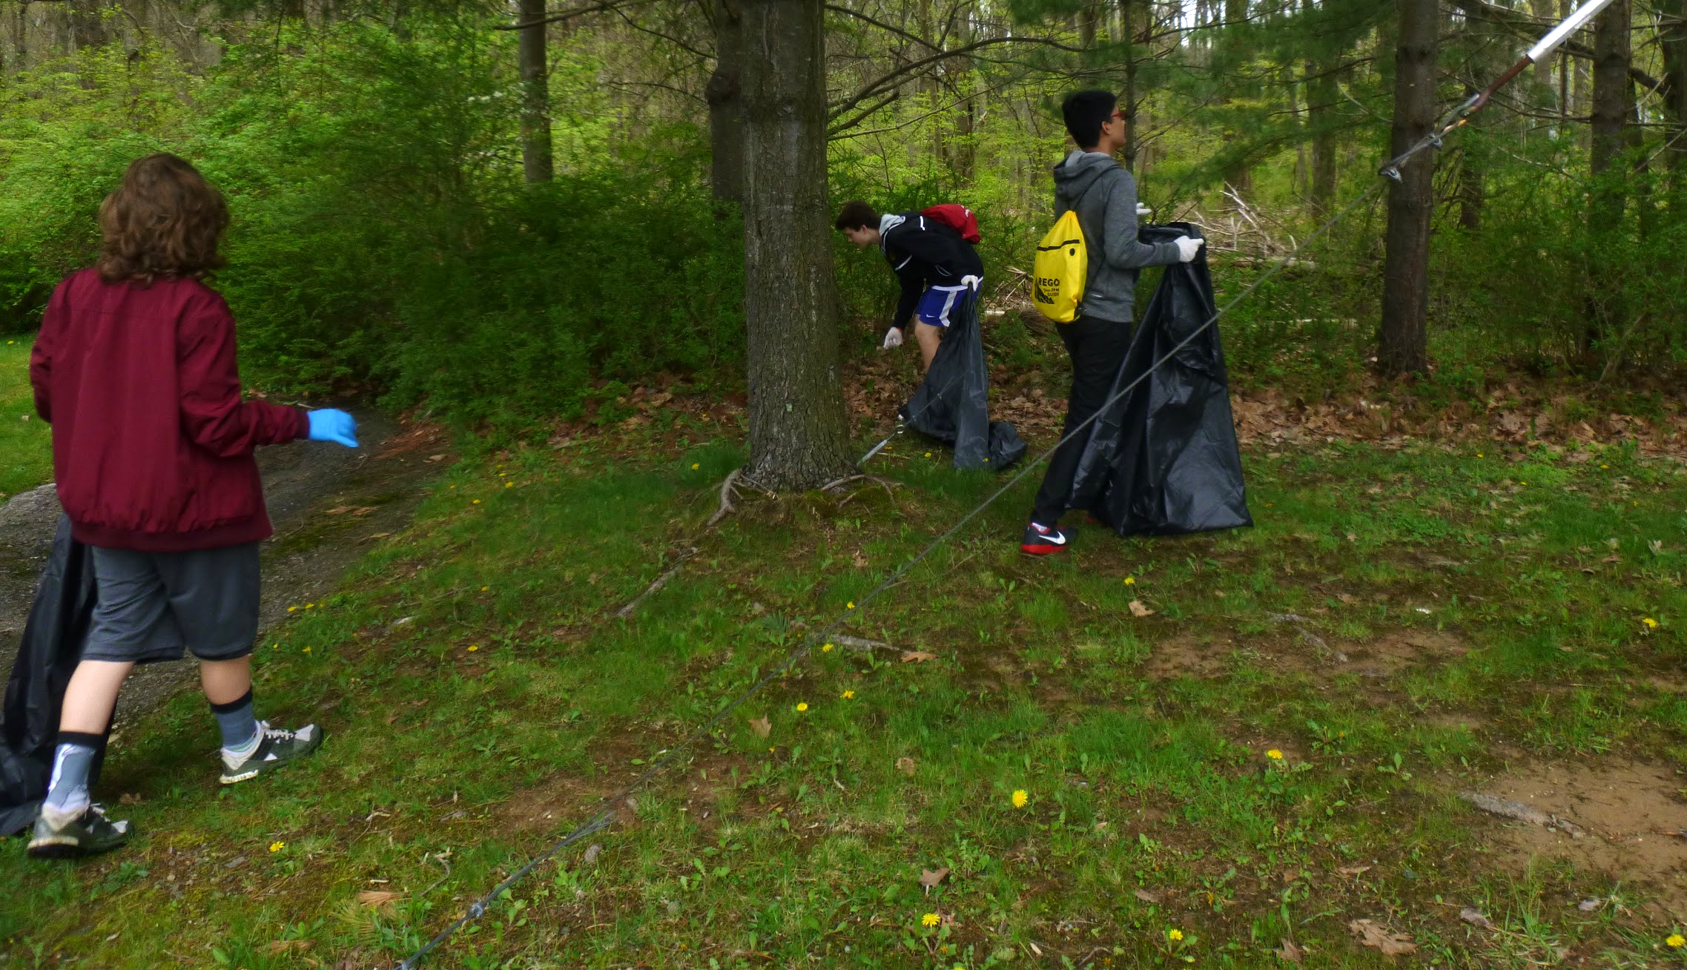
The Global Collaboration class picks up trash by Memorial Pond!
The U.S. Produces more trash than any other country-
1642.5 pounds of trash each year per person.
Mexico is the second most trash producer in the world.
Mexico produces 32.17 million tons of trash a year.
Moldovans produce about 1.7 pounds of trash per day.

Slide 3
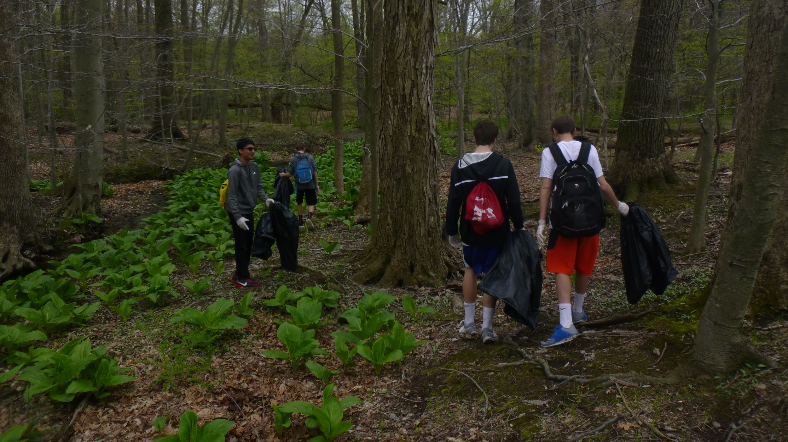
We filled up four big black garbage bags.
The forest is cleaner now that we helped it.

Slide 4
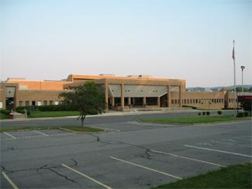
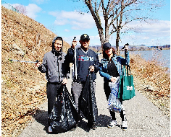
Response of North Rockland High school part 1.
What are some other ways to reduce garbage locally?
North Rockland: Use reusable objects and recycle more often.
Mountain View: Ways to reduce garbage is to use more reusable objects and find more ways to reuse objects instead of throw them out.
Do you think that littering matters?
North Rockland: Littering has a huge impact on the environment, animals can eat this garbage and die therefore leading to possible extinction.Students from are on a path in the park cleaning up trash, such as water bottles, cans, wrappers, plastics bags and anything that can’t decompose. The area gets polluted because people throw their trash instead of in garbage cans or recycling bins. We can participate in local clean ups in our neighborhood and always remember to recycle, and we can place more garbage cans and recycling bins.
Mountain View: Littering is a huge problem. It has lead to Global Warming which has affected the world greatly.

Slide 5
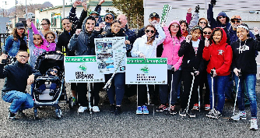
Response of North Rockland High School Pt.2
What is the most common type of trash you see on the sides of the streets?
North Rockland: Ours are Bottles, paper bags, cigarette buds…
Mountain View: In Mendham, we really don’t see much trash on the streets. The only thing that is sometimes in the most popular areas are cigarette buds. Paper bags and bottles are sometimes around.
Does your country, town, school recycle?
North Rockland: Yes, there are recycling bins scattered around the lunch rooms.
Mountain View: Our town, country, and school recycles. Almost every family within their home has at least one recycling can which eventually is recycled on recycling day. Mountain View also spends time recycling. There are bins within classrooms and in the cafeteria. The United States of America also recycles as well. Most towns have a recycling program which helps our environment.

Slide 6
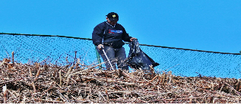
Response of North Rockland High School Pt.3
How do you dispose of trash in your area?
North Rockland: We walk to the nearest garbage can
Mountain View: There is a local dump which the trash goes to. There are trash cans in all of our local parks so that trash is not left to pollute the environment.
What are some projects that your community does to reduce trash and litter?
North Rockland: Keep Rockland Beautiful is an organization dedicated to local clean ups.
Mountain View: A project we did within our school was called the Trex Recycling Challenge. Kids in our school brought in plastic bagging and put it into a box at the front of our school.

Slide 7
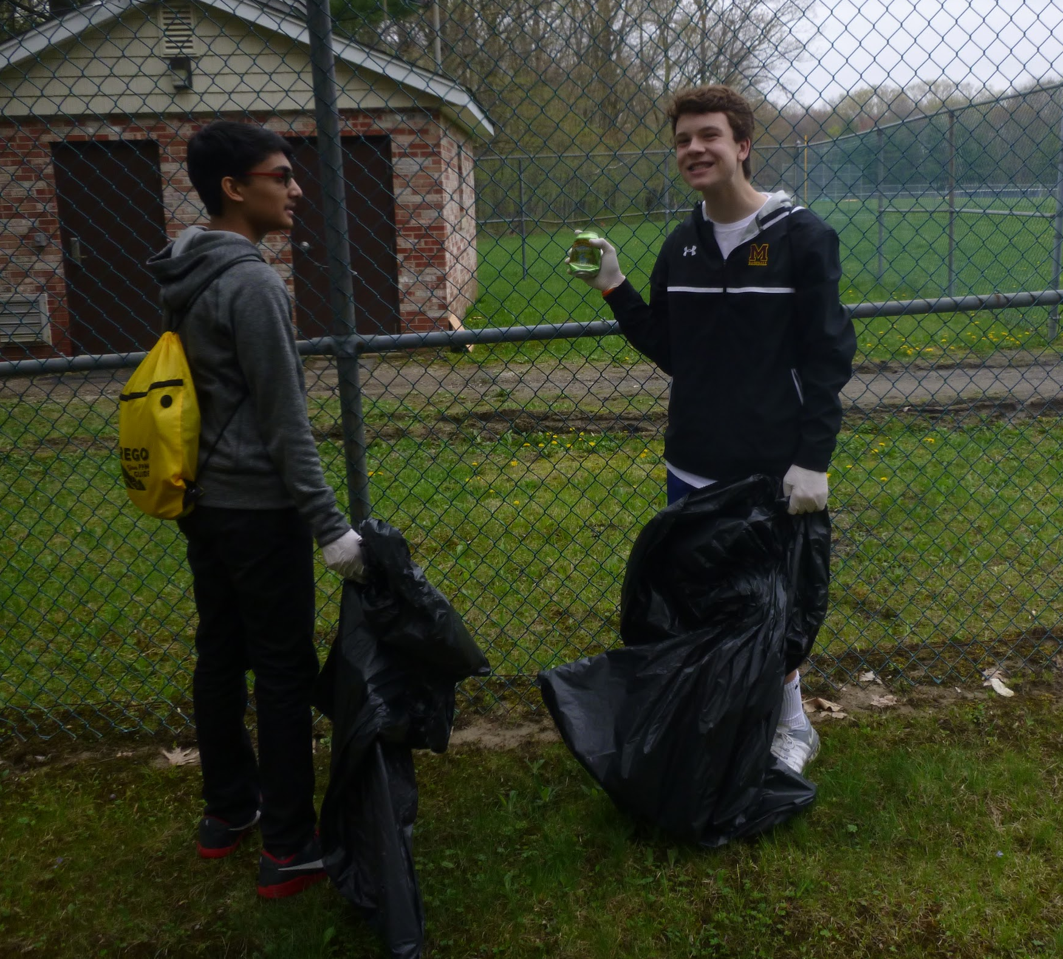
We left school just so that we could help our local nature. These are two of our students by the baseball field collecting garbage.
Trash!

Slide 8
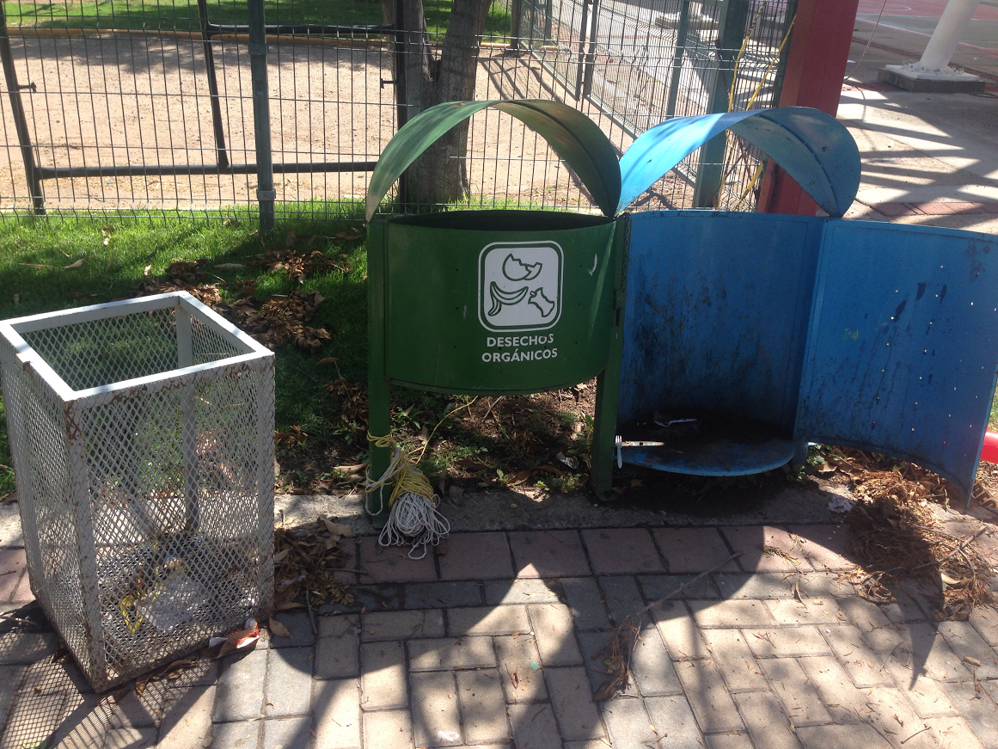
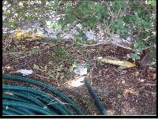
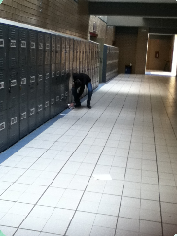
Response of Instituto Lux part 1
What classifies as trash? What are the different types of trash that your country Produces?
Trash is everything that it is no longer used, eaten, recycled or reused.
How much waste/trash does your country produce every year? Per person.
According to INEGI,in México 86, 343 tons of garbage are collected daily.Approximately 770 grams per person.
What is the most common type of trash you see on the sides of the streets?
Plastic and paper products
Does your country, town, school recycle?
There are several strategies in process both in the country as well as in our city. In our school trash is separated in organic, inorganic, paper and electronics and treated accordingly.

Slide 9
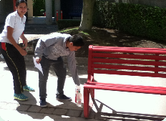
Response of Instituto Lux part 2
How do you dispose of trash in your area?
Trash is taken to “centros de acopio” where garbage is separated, some is put in landfills. Some of it is recycled.
Are there any other ideas that you have to reduce the amount of trash worldwide?
Campaigns for people to understand the problem and more strict laws for factories and industries that pollute.
Do you think that littering matters?
Yes, litter creates a huge problem of pollution, waste and even disease.
How many people in your class have littered? (anonymous collection is recommended so that people will respond honestly)
Everybody at one time or another. Although people are more conscious now and try not to do it.

Slide 10
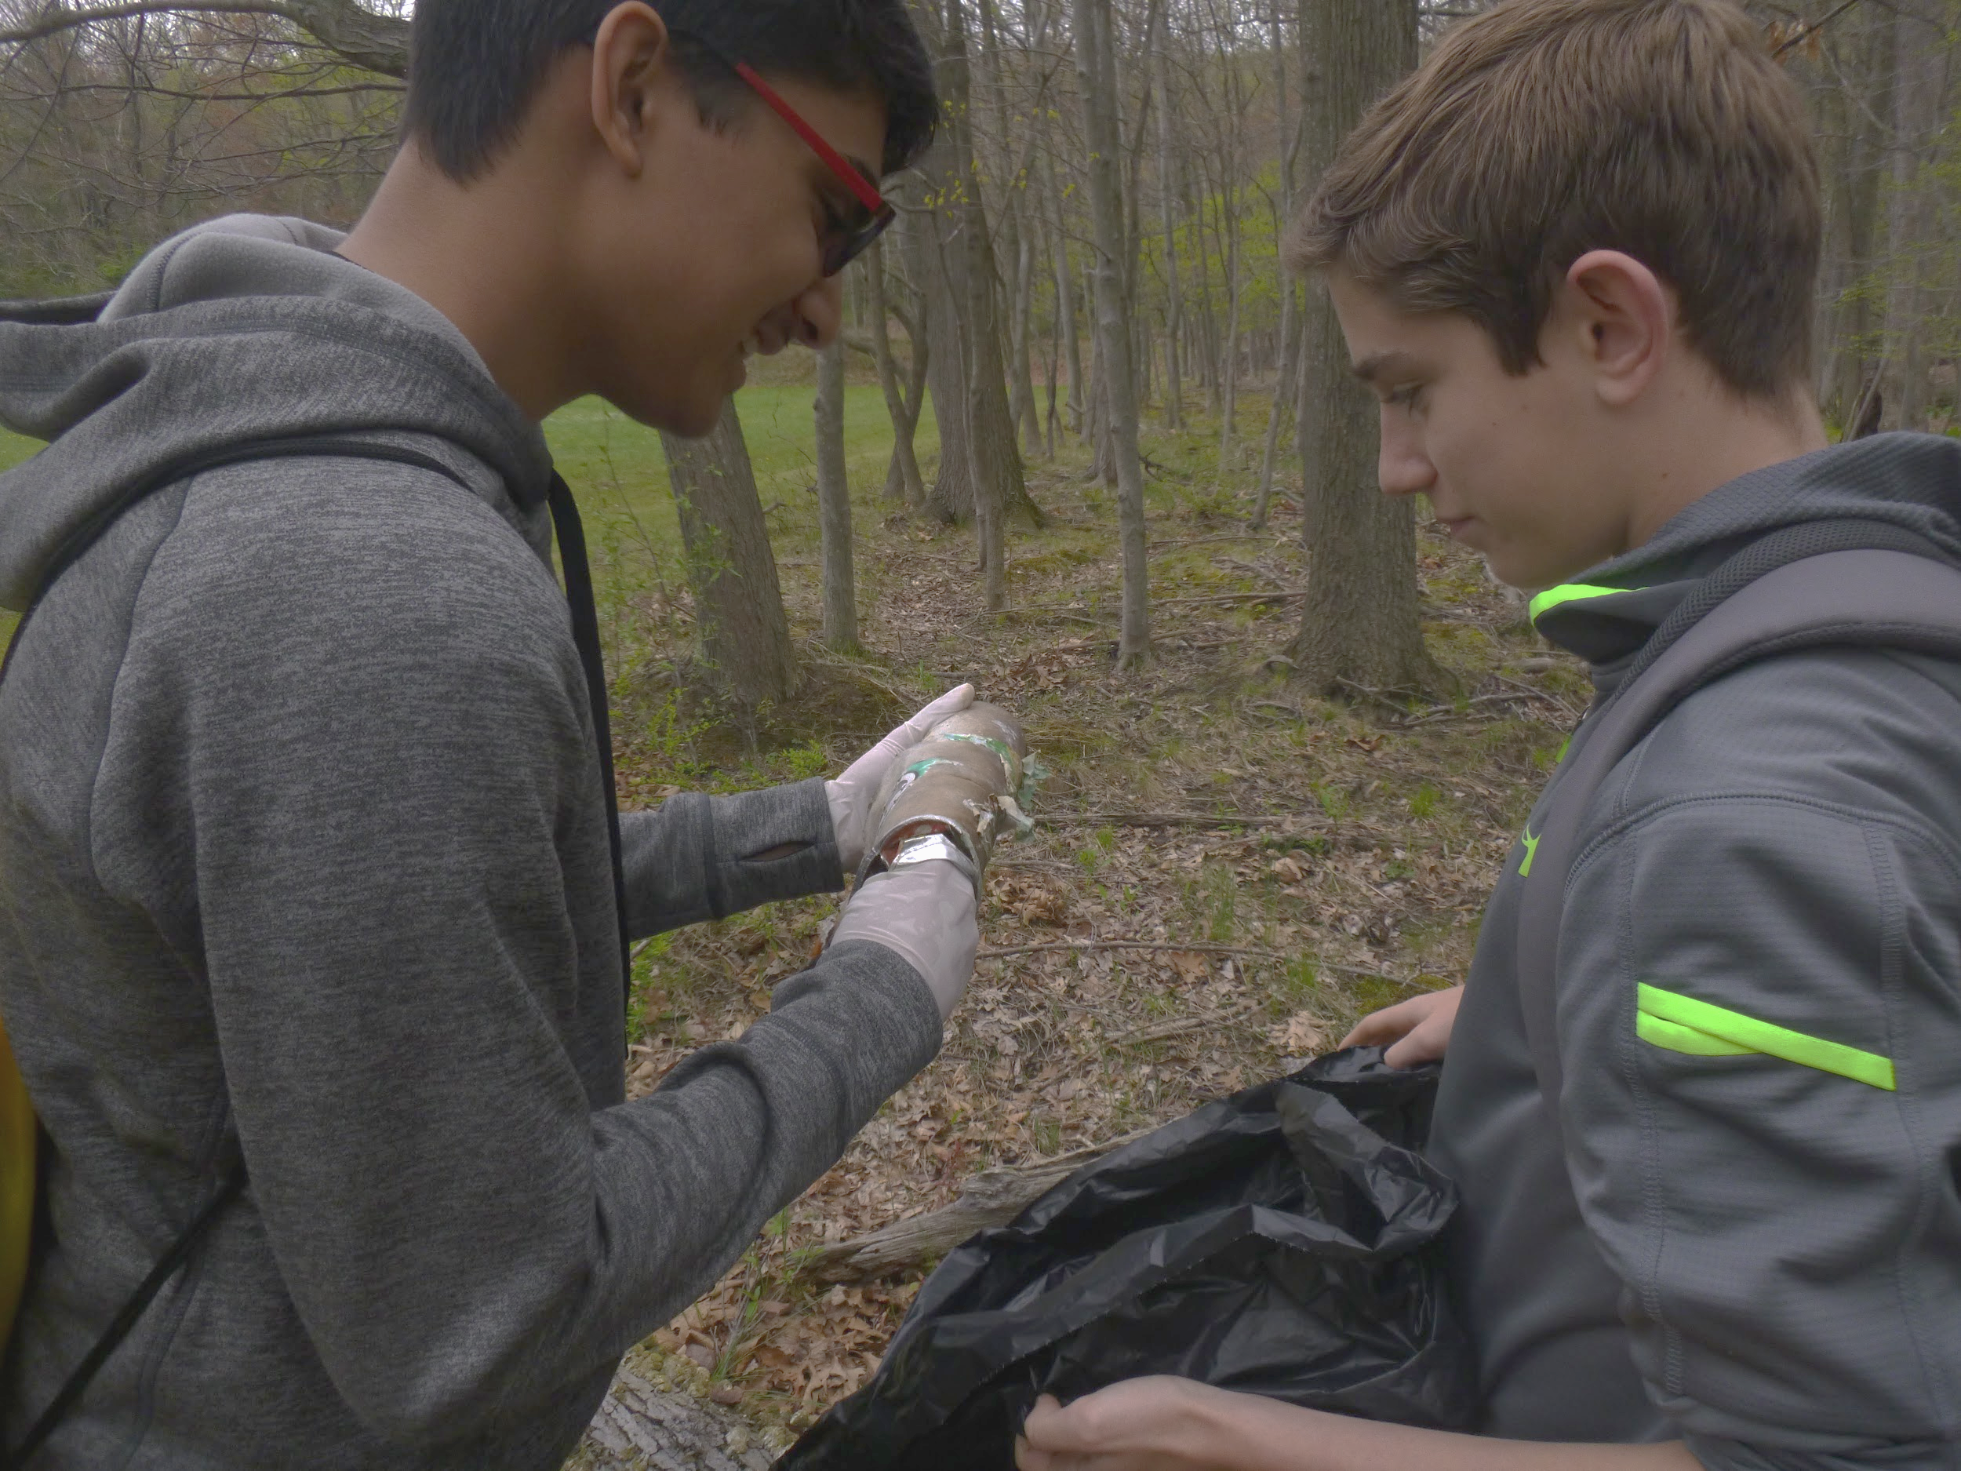
You never know what you will find while picking up garbage!

Slide 11
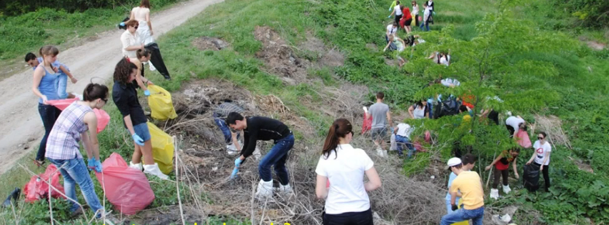
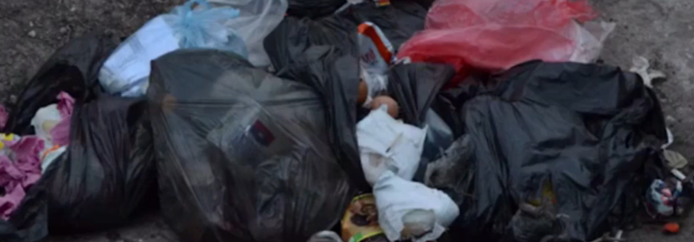
Response of Moldova Part 1
What classifies as trash? What are the different types of trash your country produces?
Household trash.
Production waste.
Livestock trash.
Construction waste.
The food scraps represent 60% of the trash in our country. The metal, wood, and textiles, represent about 3-5%.
How much waste does your country produce every year?
Moldova produces about 8,000 tons of trash yearly. According to studies, each year, the country produces about 1 kg of trash per person in cities and about 0.5kg in villages.

Slide 12
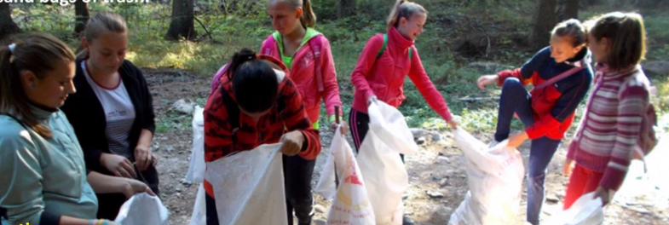
Response of Moldova part 2
What is the most common type of trash you see on the sides of the streets?
The most common type of trash you can see on the sides of the streets are household trash, food scraps like: plastic bags, soda cans, bottles, paper, cigarettes, leftovers, candy wrappers and others.
Does your country, town, school recycle?
Over 90% are being deposited in pits of trash without being recycled. There are few recycling stations in Moldova, and the selective collection isn’t as popular as it should.
What are some products your community does to reduce trash and litter?
The biggest social movement in Moldova is the project “Hai Moldova”. In Moldova the project started on May 11th in 2011 when over 100,000 people participated and collected almost 700,000 bags of trash.

Slide 13
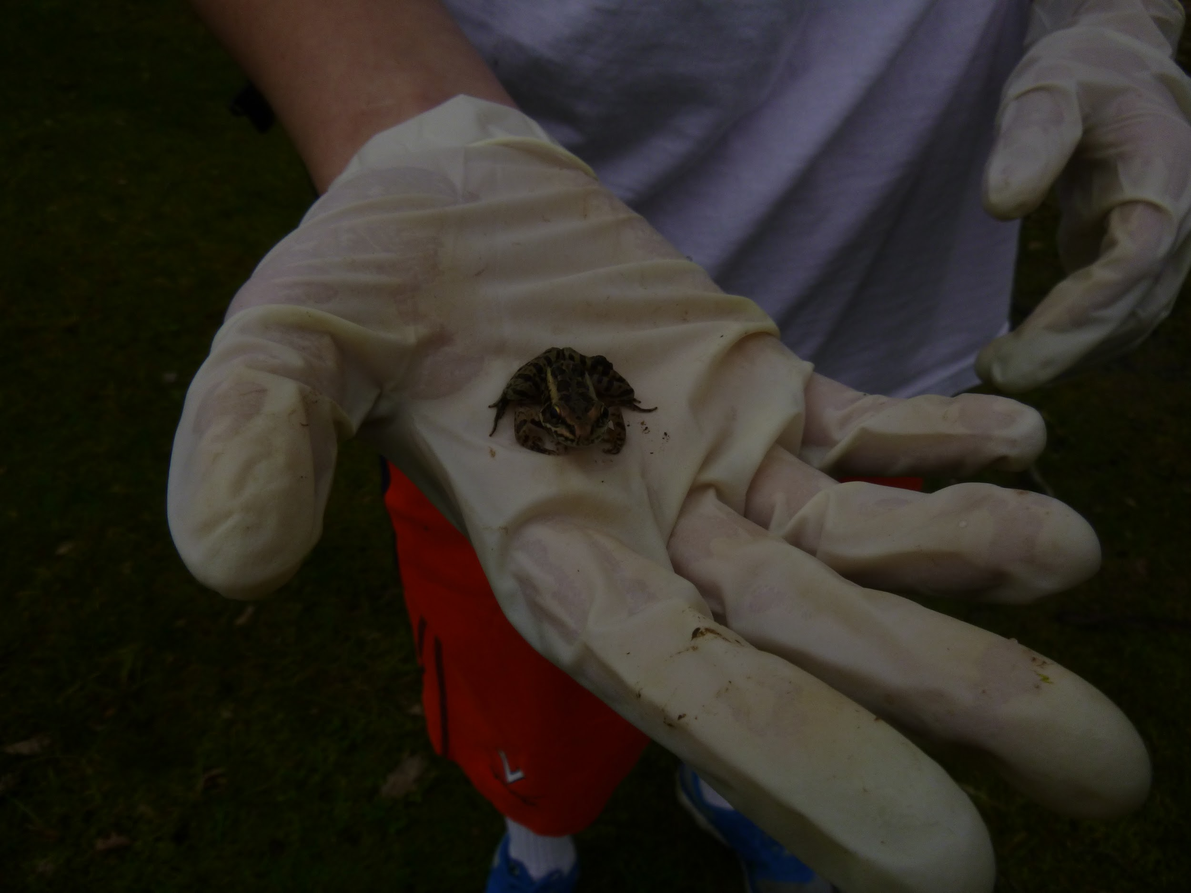
We made new friends!

Slide 14
Our Effort To Recycle
Our school encourages recycling, and bins are in every room of the school. Our community also makes a huge effort to have recycling and compost in our gardens and outdoor parks. We also put our recycled objects on the curb for pick up.

Slide 15
We gathered so much trash in the environment of our community!

Slide 16
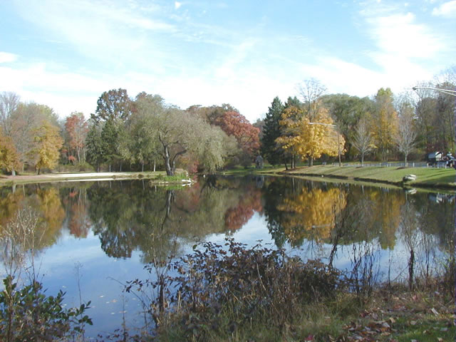
The End
Thanks for watching

