Slide 1
Children Foundation Of Technology School
POWERPOINT “STORYTELLING” PRESENTATION

Slide 2
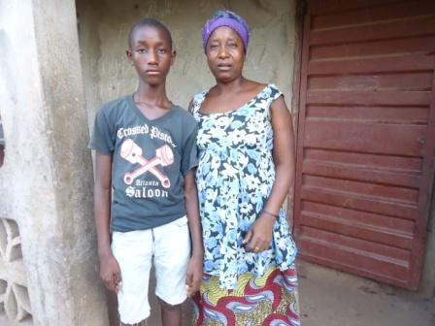
Mohamed Bangura a student at the Children Foundation Of Technology School and his Mother
This is a story about Mohamed Bangura. The only male child in his family and he is 14 years old. Also a students deprived students at the Children Foundation Of Technology School

Slide 3
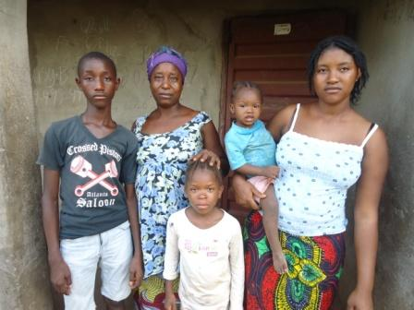
‘Mohamed Bangura Family’

Slide 4
BRIEF STORY ABOUT Mohamed Bangura
Mohamed Bangura is a small boy of 14 years, he is black in complexion, he is the only son in his family. He survive by his mother, father and one big sister. His mother do garden work while his father break stone to survive and they have to do all of this things for them to have food on there table . At first Mohamed Bangura was going to school till grade 4 when his parent cant afford the cost of education for him and also it was very hard to buy learning materials for him, so he have to stop school and join his father for stone breaking. He later join the Children Foundation Of Technology School in Mid 2014 to benefit from the free computer learning and other digital media skills.

Slide 5
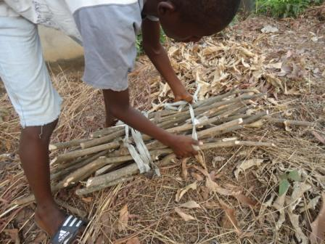
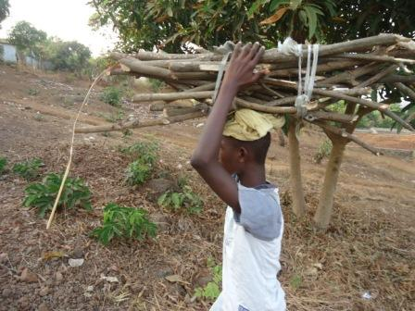
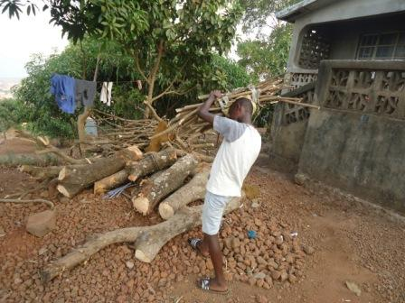
Mohamed always love to help her mother to fetch wood to cook.

Slide 6
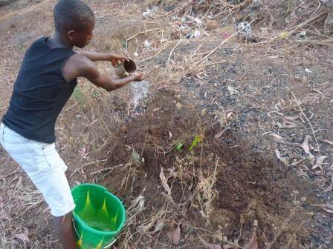
Watering the garden for his mother. Very devoted

Slide 7
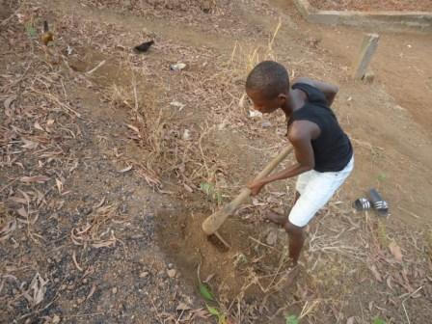
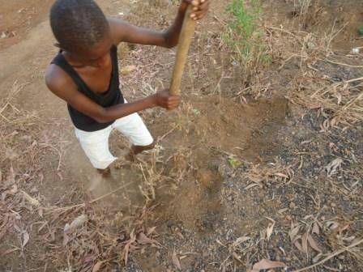
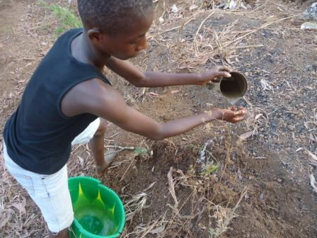

Slide 8
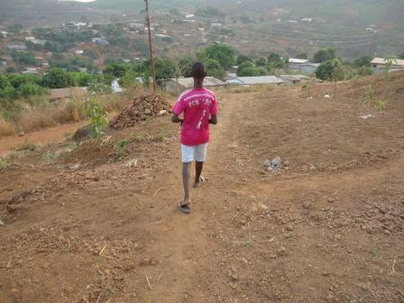
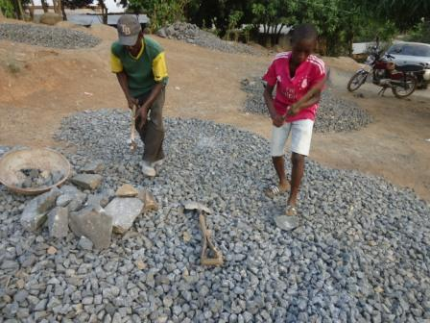
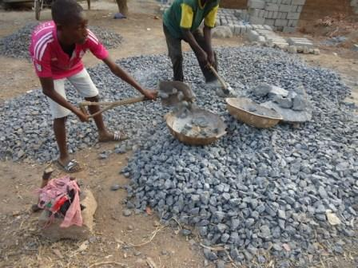
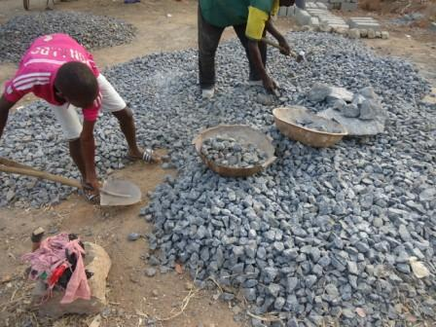
Help his father on stone breaking

Slide 9
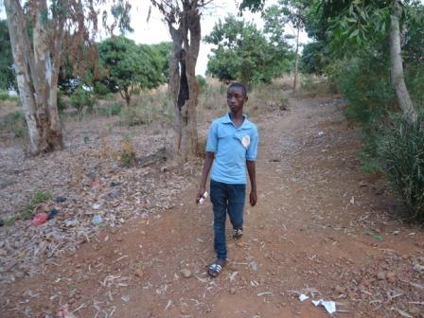
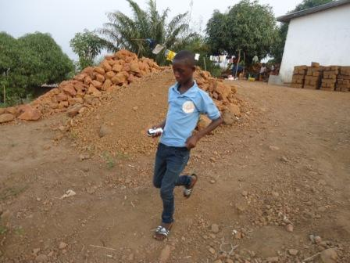
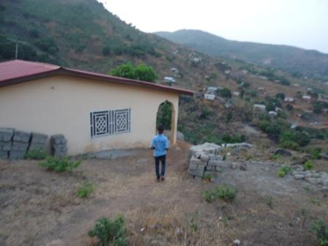
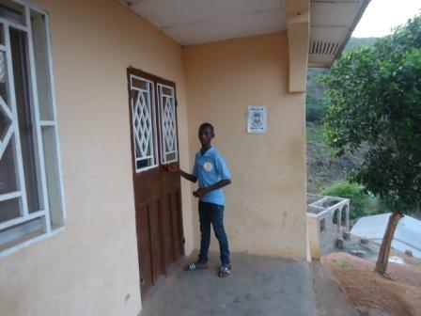
On his way to CFOT School

Slide 10
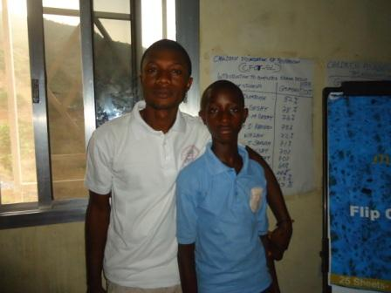
Mr. Kanu and Mohamed Bangura

