Slide 1
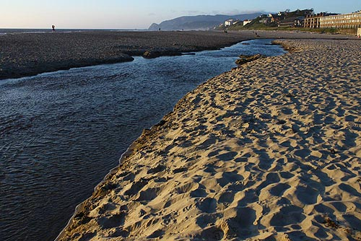
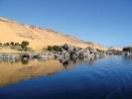
There are many rivers in our world.
The River Nile is the longest river in the world.
It measures 6,695 kilometres from its source in Burundi,
along the White Nile,
to its delta on the Mediterranean Sea.
Officially, the shortest river is the D River,
Oregan, USA, which is just 37 metres long.

Slide 2
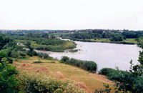
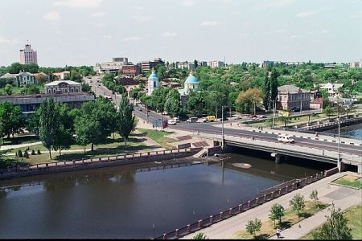
Inhul (Ukrainian: Інгул) is a left tributary of the Southern Bug river of Ukraine.
It rises North of Kirovohrad, flowing South into the Southern Bug at Mykolayiv,
65 kilometers North (up river) from where the Southern Bug River empties into the Black Sea. The Inhul River is about 300 km long. The Greek historian Herodotus mentions the river as the Pantikapes in his Histories (4.54), during his description of the land of Scythia.

Slide 3
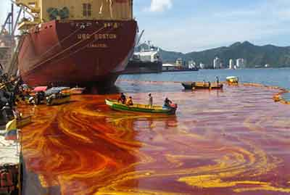
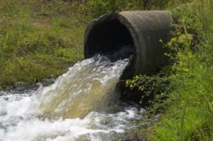
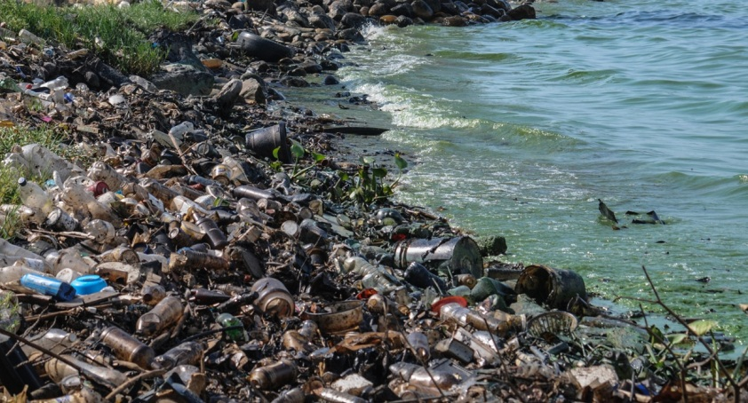
Water pollution is a major global problem.
Many rivers are poisoned. Fish cannot live in them. There is not enough oxygen in the water.
In such places all the birds leave their habitats and many plants die. If people drink this water they can die too.
It happens so because factories produce a lot of waste and pour it into rivers. So they poison water.

Slide 4
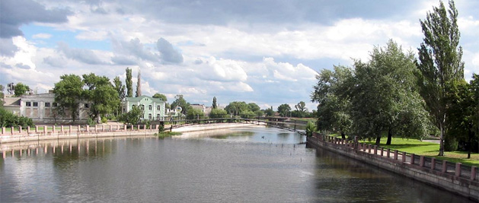
We MUST keep our planet and water of our planet clean.
If we want to live, we should guard our clean water.
We don’t pollute our rivers.
We try to take short shower.
We try to choose non-toxic household products whenever it is possible.
We put litter in a bin or take it home.
Let's keep our water clean!

