Slide 1
Architecture
By:Ellie,Kaleb,Matthew R. -------->,and Ruben

Slide 2
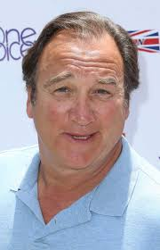
The Holly Theatre
The Holly Theatre is the oldest theatre in Medford Jim Belushi is a movie Star here is Medford and is helping build the theatre back to normal

Slide 3
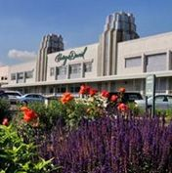
Harry and David’s
We have a store and the supplier plant.
This is a picture of the Harry and David’s supplier plant.

Slide 4
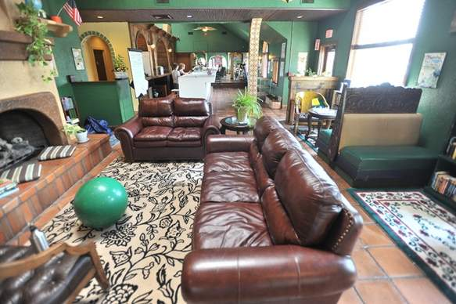
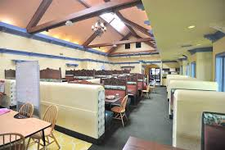
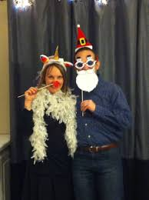
Our Head Master
Our School

Slide 5
U.S Cellular Field
The U.S Cellular fields are the fields that that the Portland Timbers played on when they were in Medford and the Rogues played on and won a championship. This is right next to the Harry and David.

Slide 6
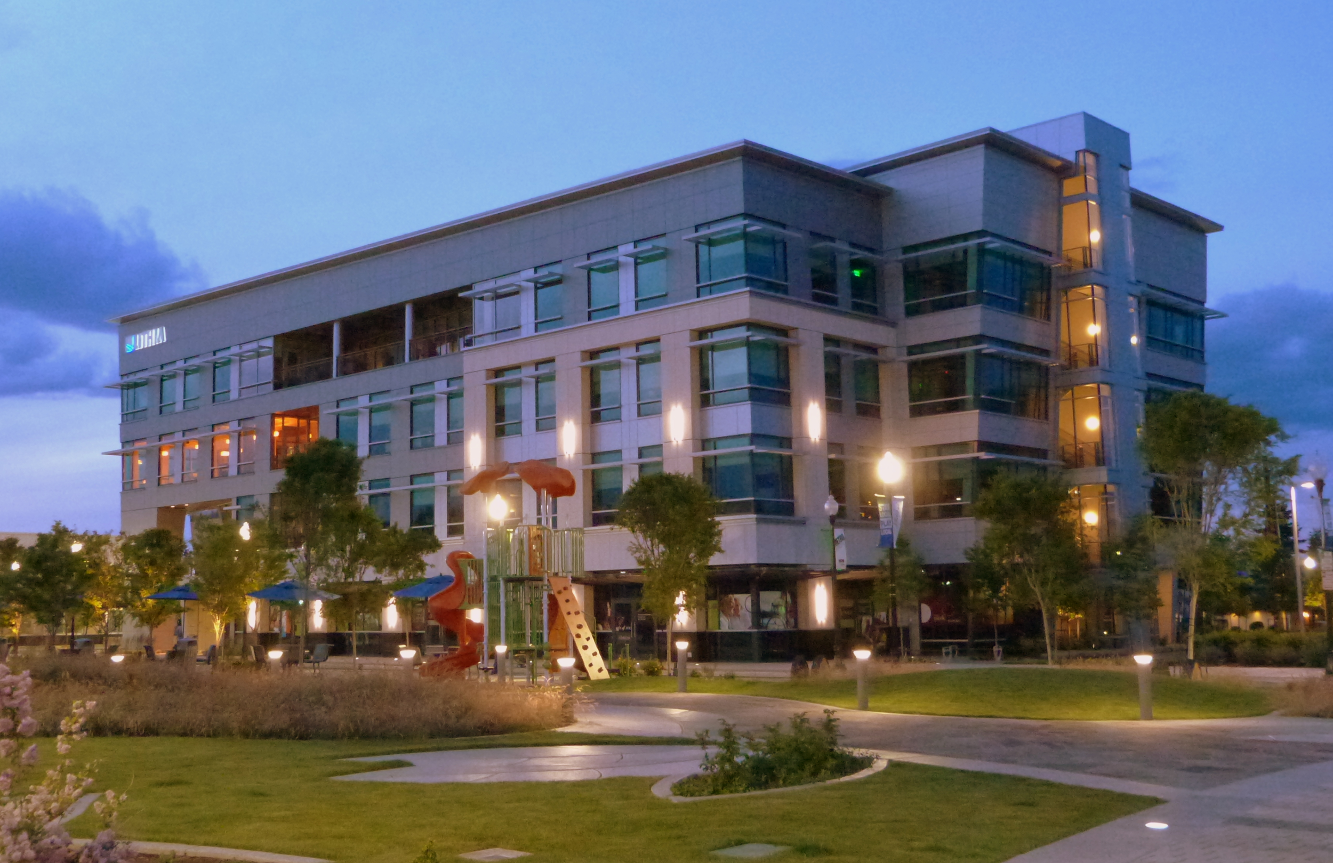
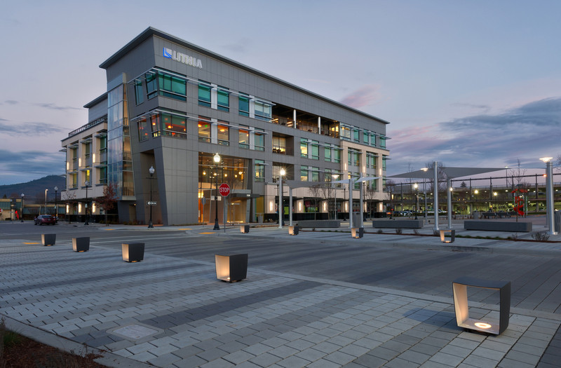
This is the front of the building.

Slide 8
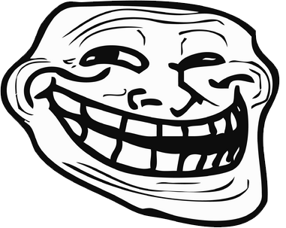
Don’t hate this slideshow we worked hard on it so give us some credit (not really) thanks and have a great day
Trolled la
Notes:
Allways let people get trolled haaaaaaaaaaaaaaaaaaaaaaaaaaaaaaaaaaaaaaaaaaaaaaaaaaaaaaaaaaaaaaaaaaaaaaa (error) (error).(error),(error),(error),(error)(error),(error).

Slide 9
Don’t hate this slideshow we worked hard on it so give us some credit (not really) thanks and have a great day
Trolled la
Notes:
Allways let people get trolled haaaaaaaaaaaaaaaaaaaaaaaaaaaaaaaaaaaaaaaaaaaaaaaaaaaaaaaaaaaaaaaaaaaaaaa (error) (error).(error),(error),(error),(error)(error),(error).

