Slide 1
Survive
YuwenTu、Liling Chen、Yuhan Chen、Haoyu Fang

Slide 2
Outline
1.What factors affect global warming ?(Liling Chen)
2.The impact of natural disasters on the environment and the human ?(YuwenTu)
3. IS Global warming will exacerbate the severity of natural disasters?(Haoyu Fang)
4.We visited New Laiyi on March 29,and we investigated the disaster Typhoon Morakot had brought to the place.(Yuhan Chen)

Slide 3
Preface
With the deterioration of global warming, it also
contributes to the generation of natural disasters, and even impacts on our lives. How to survive on Earth with more and more natural disasters becomes the subject which we should
face now.

Slide 4
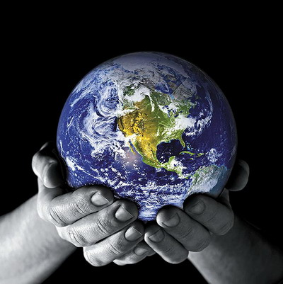
1.What factors affect global warming ?

Slide 5
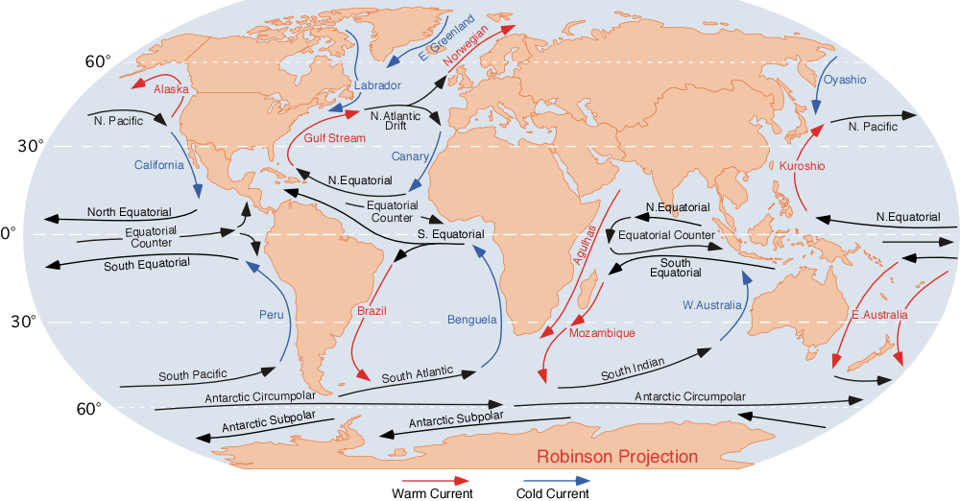
Current
The relation between the climate and current

Slide 6
Climate
The relation between the temperature and the altitude

Slide 7
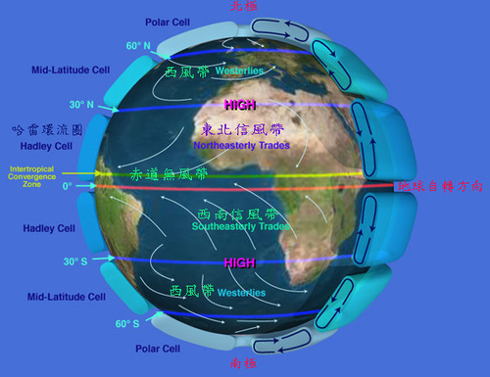
Monsoon
In a day, the wind may come from two different ways, one from the ocean and the other from the inland

Slide 8
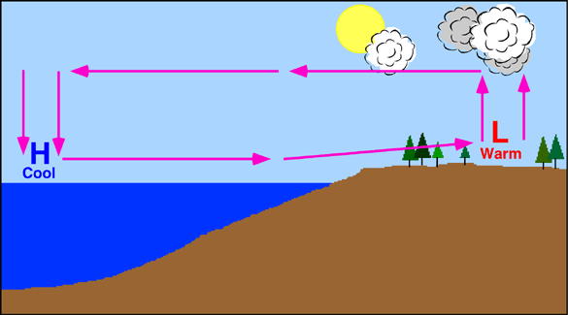
Land-sea distribution
The temperature between the island and the ocean

Slide 9
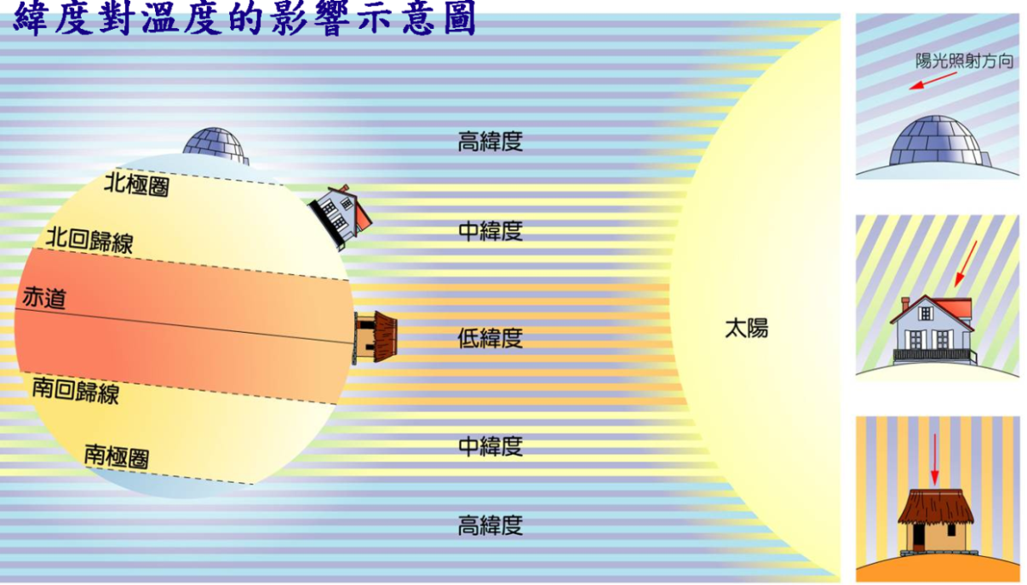
Latitude
The relation between the latitude and, the temperature
Arctic Circle
Antarctic Circle
Tropic of Cancer
Mid-latitudes
Sun
Equatorial
Low latitudes
Tropic of Capricorn
Mid-latitudes
Antarctic Circle
High latitudes

Slide 10
2.The impact of natural disasters on the environment and human

Slide 11
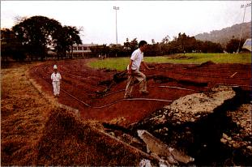
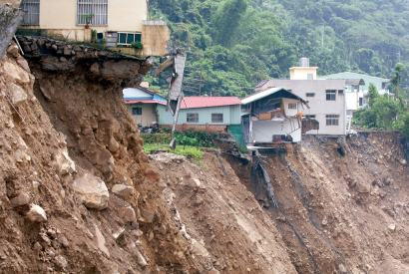
(1)Geological disasters
Earthquakes
Landslides

Slide 12
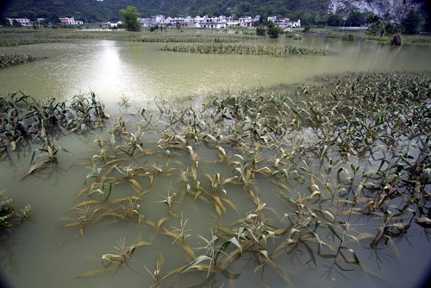
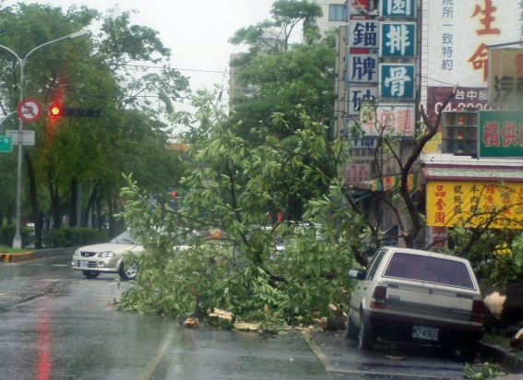
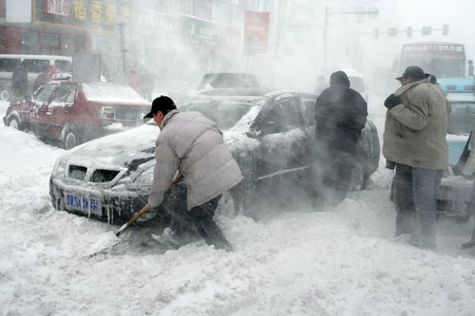
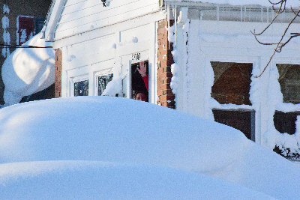
(2)Meteorological disasters
Floods
Typhoons
Heavy snow

Slide 13
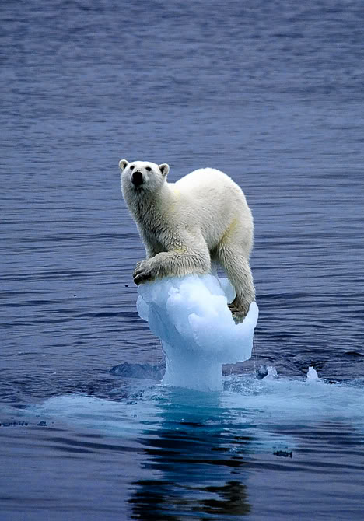
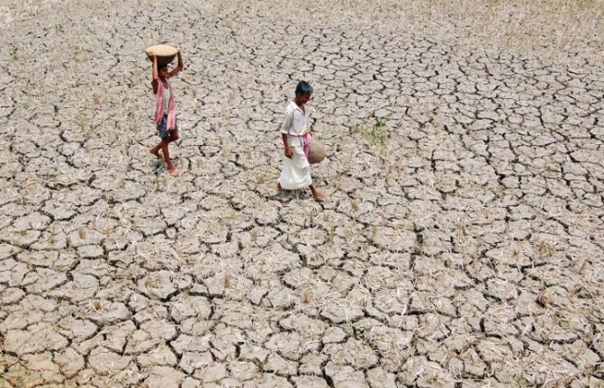
(3)Climate disasters
Global atmospheric warming
Drought

Slide 14
3.IS Global warming will accelerate the severity of natural disasters?

Slide 15
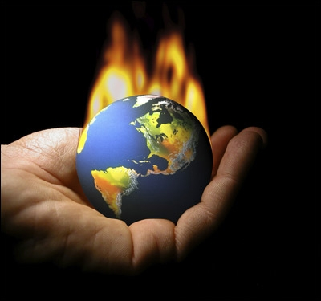
The polar iceberg to melt and collapse.
Heat waves
Extreme weather
Droughts

Slide 16
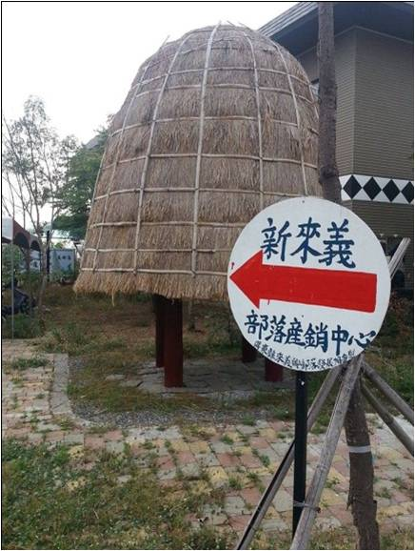
4.We visited New Laiyi on March 29,and we investigated what the disaster Typhoon Morakot had brought to the place.

Slide 17
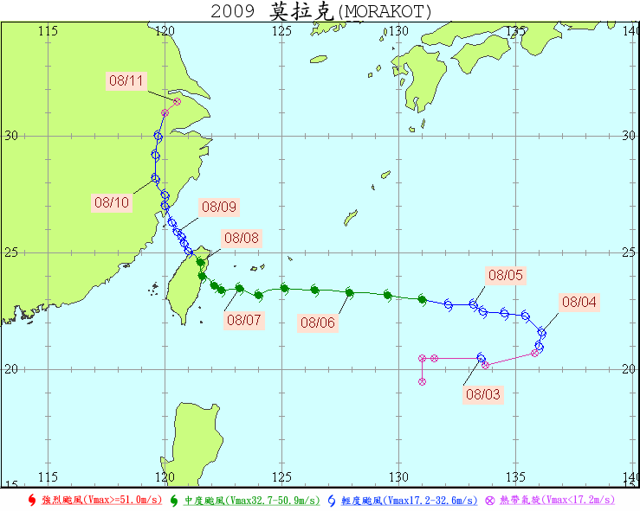
(1)Action
Typhoon Morakot landed the eastern coast and Taoyuan in Taiwan.

Slide 18
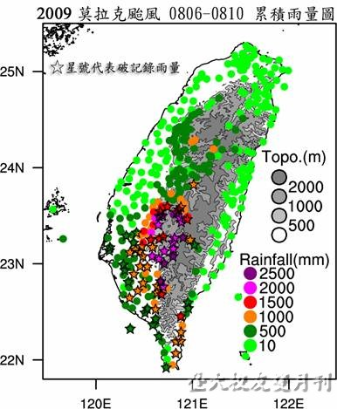
(2)Rainfall
Its rainfall even added up to 60 milliliters per hour , and one of the regions, Mt. Weiliaoin Pingtung , ranked first.

Slide 19
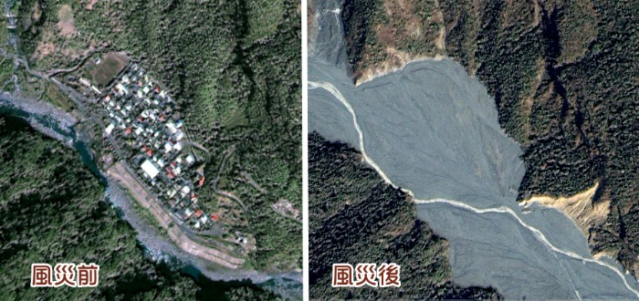
(3)Serious disaster regions:
Jiasian Township , Kaohsiung↑

Slide 20
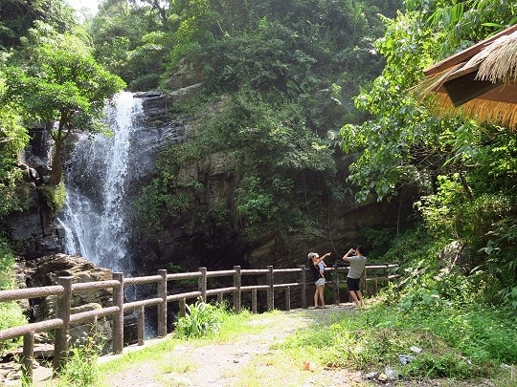
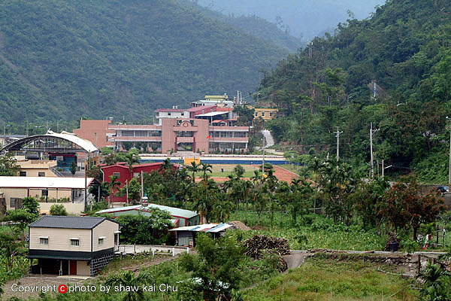
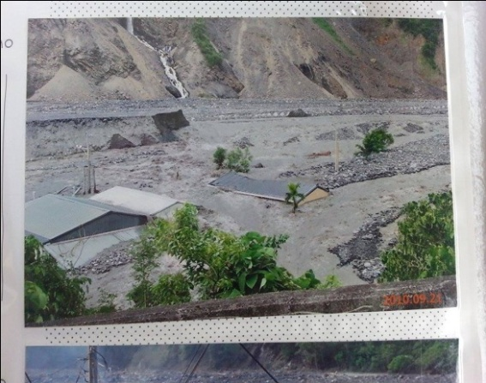
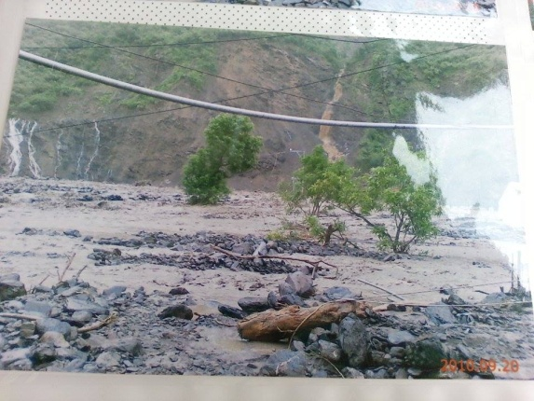
(4)Damage

Slide 21
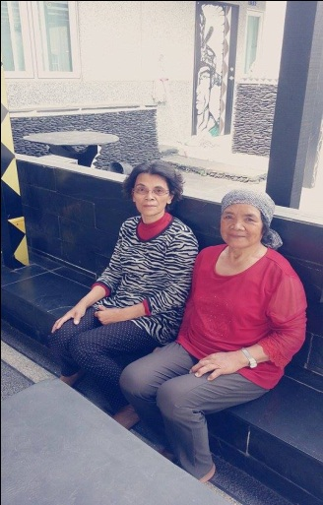
(5)Dictation of an old Vuvu

Slide 22
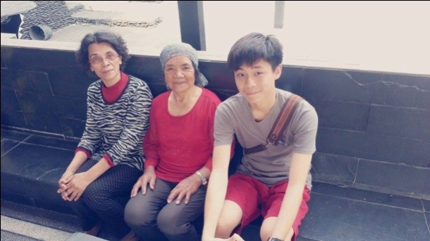
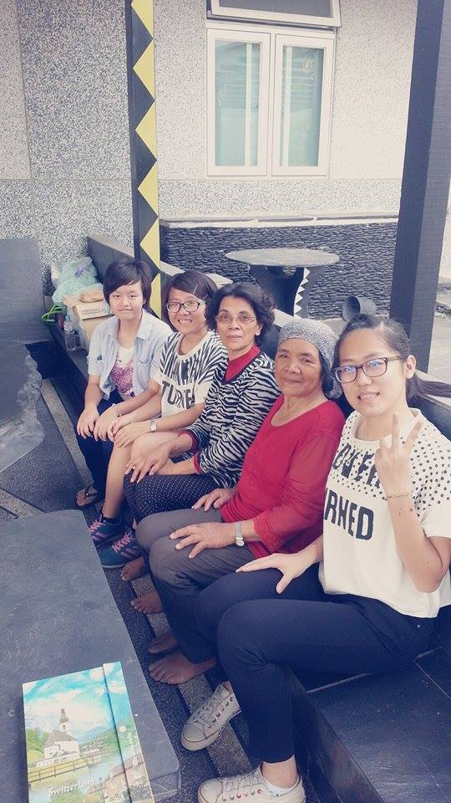
(6)Experience
Through the visit, we learn about many things we don’t know and have a further understanding about the place where we live. It reminds us that we must love and protect our home, and let it be there forever.

Slide 23
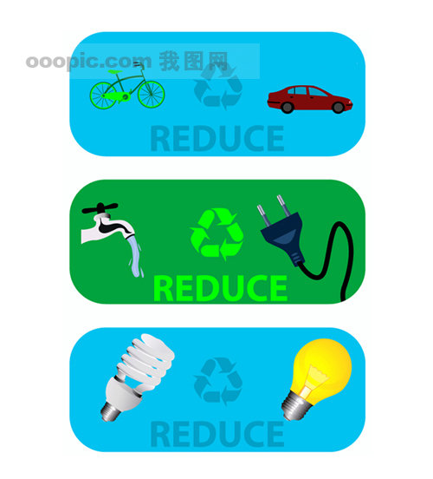

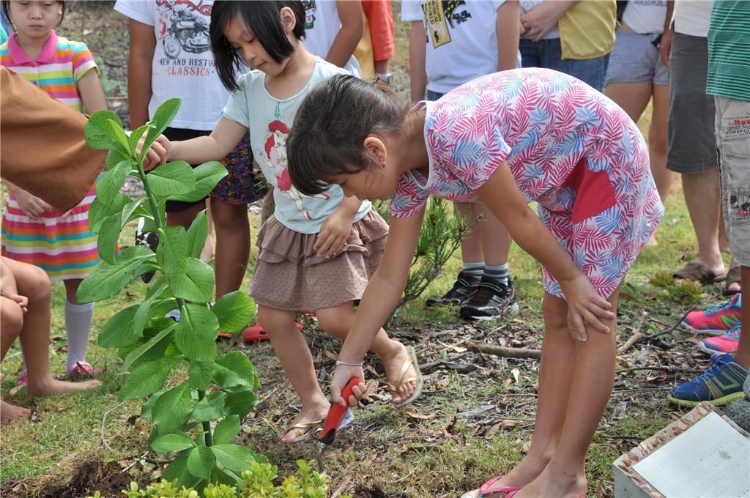
Conclusion
Energy saving
Less air conditioning
Not littering
Plant some trees or grow some houseplants
Eat more organic food

Slide 24
Source
1.http://www.jes.mlc.edu.tw/horngg/climate/factor/factor_2.htm
2.http://www.cwb.gov.tw/V7/knowledge/encyclopedia/me_all.htm
3.https://www.google.com.tw/search?espv=2&biw=1280&bih=619&tbm=isch&sa=1&q=%E4%B9%BE%E6%97%B1&oq=%E4%B9%BE%E6%97%B1&gs_l=img.3..0l4j0i24l6.291593.294258.0.294839.6.6.0.0.0.0.226.707.0j3j1.4.0.msedr...0...1c.1j4.64.img..4.2.378.b1RBm2fP3R4
4.http://web.fg.tp.edu.tw/~earth/learn/eq/sec3.htm
5.Remake from Vuvu’s photo album
6.Speech from ProfessorLiushao Cheng

Slide 25
Thank you for listening.

