Slide 1
Organic agriculture

Slide 2
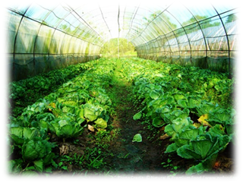
Preface
In order to prevent pests and bacteria from intrusion, pesticides appeared, although it succeeded in curbing the problem, but it also cause the problem of the pollution in the ecological environment.
In order to protect the ecological environment, many people are beginning to invest in organic agriculture, and work out a method with which we will not damage the ecological environment, not only to achieve economic profit growth, but also to improve protection of the natural environment.

Slide 3
Main points
(1) What is organic agriculture?
(2) The impact of organic agriculture on the environment.
(3) The method of organic agriculture production practices and compost.
(4) How can organic agriculture slow down global warming?
(5) The benefits of working in organic agriculture.

Slide 4
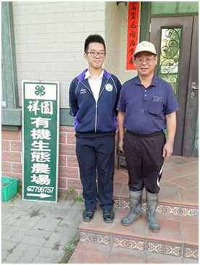
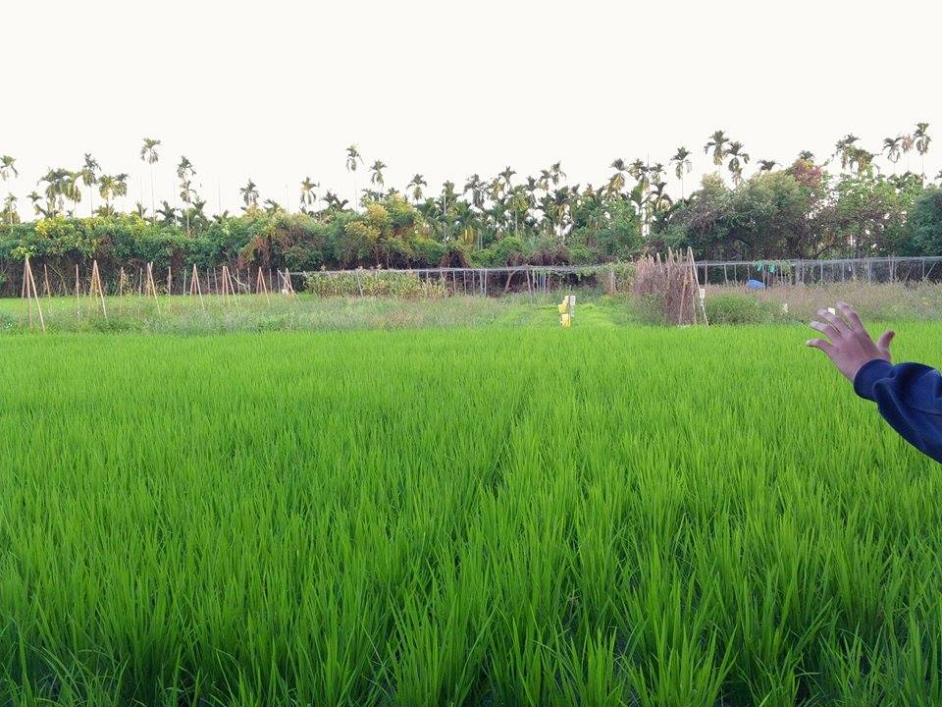
Content

Slide 5
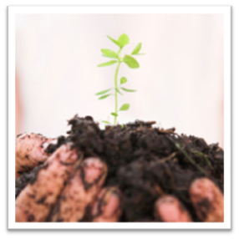
What is organic agriculture?
Organic farming is a form of agriculture that relies on techniques such as crop rotation, green manure, compost, and biological pest control.

Slide 6
(2) The impact of organic agriculture on the environment.
The modern pesticides fertilizer in use, the biodiversity of the agriculture habitat damage very much.
Organic Agriculture not only conserve ecology diversity but decelerate the fertilizer to run off.
The natural enemy set up the groups, the insect pest natural that endangers the crop will not take place.

Slide 7
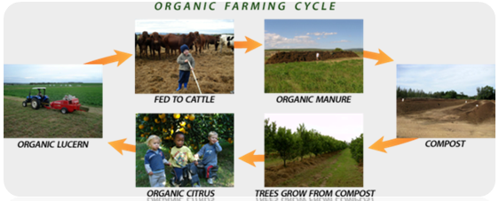
(3) The method of organic agriculture production practices and compost.
The most common organic agriculture production practices is crop rotation.
Other crops planted on both sides of the main crop can reduce the chances of pathogens and pests attacking major crops.
The most common making Compost approach is the use of drug as fertilizer. After it is first crushed,mixed, it is added to
the mix while adding appropriate
moisture.

Slide 8
(4) How can organic agriculture slow down global warming?
Farmers make use of the suitable land and adopt the in-season plantation method to enforce the implementation of the agriculture so that they will decrease the effect on ecosystem due to the overuse of energy. On the agricultural development of the future, they can reduce a lot of energy consumptions and greenhouse gas emissions during food transportation.

Slide 9
(5) The benefit of working in organic agriculture.
Organic farmland has better biodiversity.
Organic agriculture emits less greenhouse gases than chemical agriculture.
Organic agriculture can maintain soil fertility.
Organic agriculture can prevent soil from erosion.
Eating organic produces is better for human health.

Slide 10
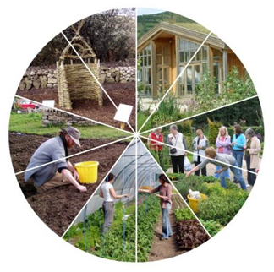
Conclusion
Organic agriculture is very important to the ecology. We should promote it and do it by ourselves. When I did the report, I found it not only let me understand the knowledge about organic agriculture, but also aroused my enthusiasm in ecological environment. Thanks for organic agriculture, we know how to protect our health and that we should cherish the living environment and make it sustainable.

