Slide 1
Monthly Money Expenses
Hsu Gia Ning
Liu Jhih Ling

Slide 2
Here is our Monthly Money Expenses.
We found that we spent more on food more than on the articles for daily use.

Slide 3
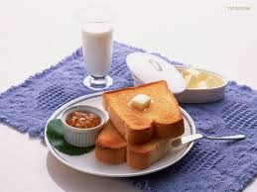
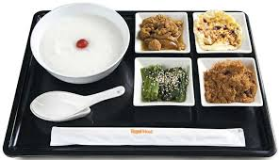
Our Monthly Money Expenses
Date | Item | Expenses
104.04.01---104.04.08 | Breakfast | 45*7
 | Lunch | 60*5(School) 70*2
 | Dinner | 50*7
 | English Word Book | 300
 | Snack | 30*5

Slide 4
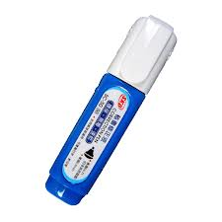
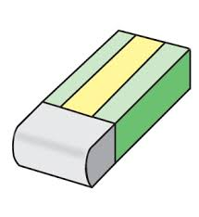
Date | Item | Expenses
104.04.09---104.04.16 | Breakfast | 45*7
 | Lunch | 60*5(School) 70*2
 | Dinner | 50*7
 | Pencil | 15*2
 | Pen | 20*3
 | Eraser | 8*5
 | Correction fluid | 39

Slide 5
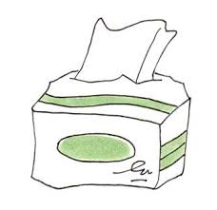
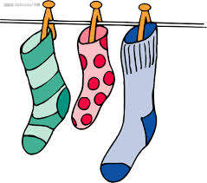
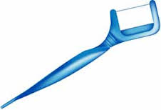
Date | Item | Expenses
104.04.17---104.04.24 | Breakfast | 45*7
 | Lunch | 60*5(School) 70*2
 | Dinner | 50*7
 | A Study Companion | 150*3
 | Tissue | 15
 | Floss | 40
 | Socks | 30

Slide 6
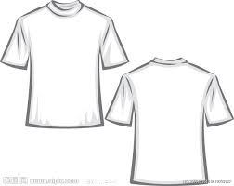
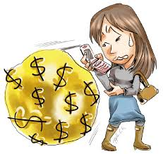
Date | Item | Expenses
104.04.25---104.05.01 | Breakfast | 45*7
 | Lunch | 60*5(School) 70*2
 | Dinner | 50*7
 | Disposable Contact lenses | 400
 | Clothes | 200
 | Pants | 199
 | Cellphone Charge | 300
 | Snack | 30*5
 | Comic Book | 100

Slide 7
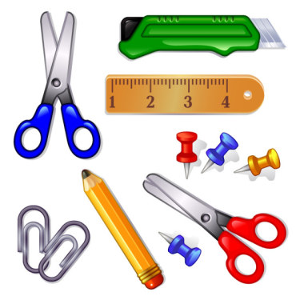
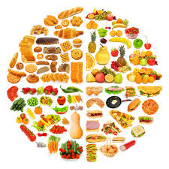
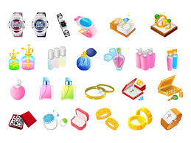
Kind | Expenses
Stationery | 169
Book | 850
The Articles for Daily Use | 1214
Food | 4570

