Slide 1
Bullying
By students in Mrs. Kasler’s English II, block 1
Porter Ridge High School in Indian Trail, North Carolina

Slide 2
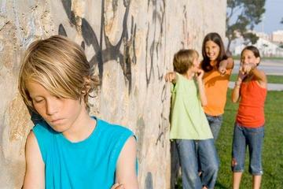
Definition
The definition of a bully is a blustering person who intimidates smaller or weaker people.
Notes:
taylor stedem

Slide 3
Bullying
There are many different types of bullying and people get bullied for many different things. Rather it be for how they look, how they act, their race, or even their religion. But no matter the type of bullying, it isn’t necessary.
Notes:
ryan phillips

Slide 4
Different types of bullying
Bullying doesn't just take place in person. People are often bullied on the internet or through text messages as well. These types of bullying are just as bad.
Notes:
ryan phillips

Slide 5
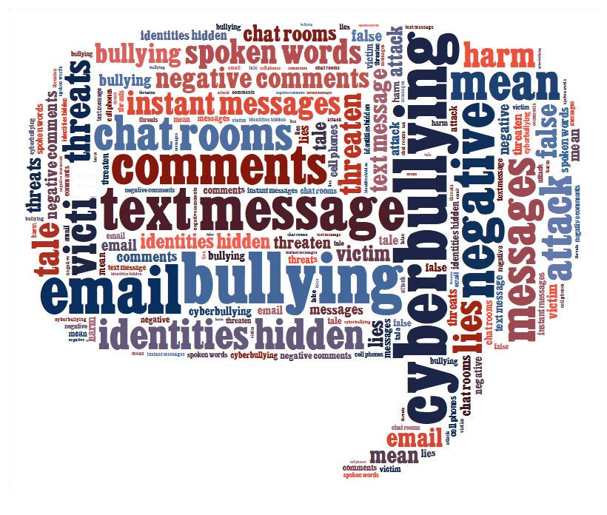
Cyberbullying
Cyberbullying is making fun of, starting rumors, or talking bad about someone behind a computer screen or cell phone.
Notes:
taylor stedem

Slide 6
Why do people bully?
A few reasons why bullies behave the way they do: People can direct frustrations, hurt, anger and difficulty at home or in class to you by bullying. Lack of attention from friends, parents or teachers can make a person bully you, just to feel popular and seen as 'tough' or 'cool' and in charge.
Notes:
logan homesley

Slide 7
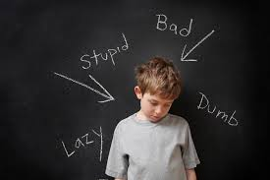
Verbal Bullying
Verbal bullying is when someone makes fun of another person and calls them names. This is one of the most common types of bullying going on in school.
Notes:
damon brown

Slide 8
Sources
"Hiding Behind a Computer Screen: What's up with All the Cyber Bullying?" Nifahlicious Boulevard. N.p., 18 Nov. 2013. Web. 03 June 2015.
Dhar, By Michael. "Bullying Syndrome? How Maltreatment Affects Health." LiveScience. TechMedia Network, 07 Nov. 2013. Web. 03 June 2015.
"Facts and Statistics on Bullying and Cyberbullying." RSS. N.p., n.d. Web. 03 June 2015.
https://mycyberwall.co.za/get-smart/life-skills/grade-6/bullying

