Slide 1
IEARN, LEARNING CIRCLES, CCE1, FALL 2012 Belarus, Baranovichi, Gymnasium №1
«What’s your hobby?»
Russia, the USA, Belarus
Sponsored teacher:
Anna Kolosova

Slide 2
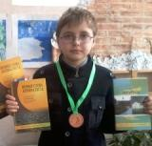
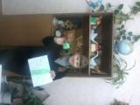
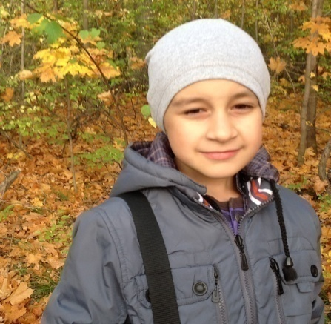
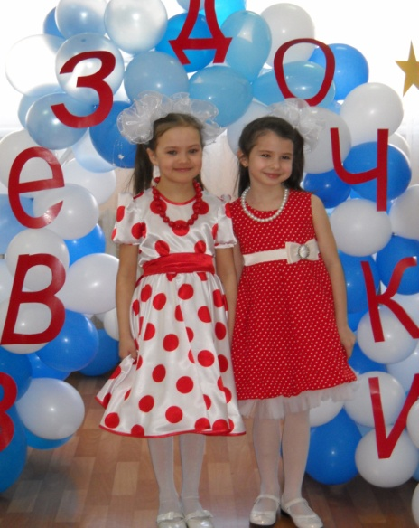
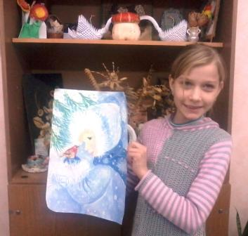
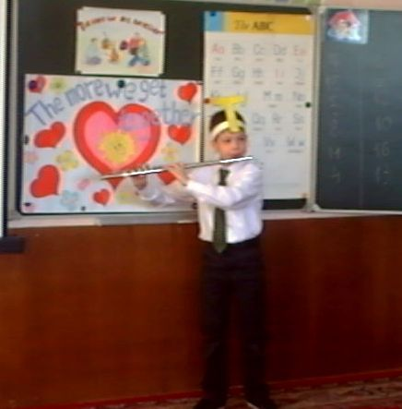
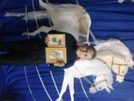
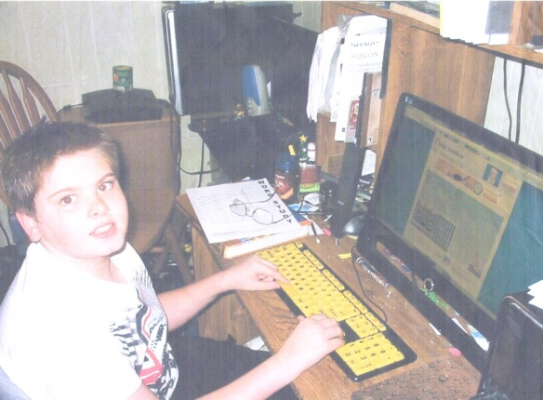
My hobby is…..

Slide 3
My hobby is drawing
About my hobby
This is my picture «Winter»
My name’s Katya. I’m 9 years old. My favorite hobby is drawing. I am good at drawing. In my opinion it is good and interesting to have a hobby because it’s a pleasure for me. When I draw I forget about everything. One can say that drawing is indoor and outdoor activity. It seems to me that it’s both relaxing and intellectual. I spend 2 hours a day on drawing. I think that the most popular hobbies in our class are sport games, in our school dancing, in our country skating and playing sport games

Slide 4
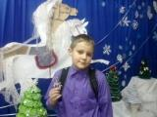
My hobby is embroidery and beading
My name’s Danik. I’m 9 years old. My favorite hobbies are embroidery and beading. I am good at it. I think it interesting to have a hobby because it’s cool. I can say that it is indoor activity. It seems to me that it’s both relaxing and intellectual. I spend 2 hours a day on my hobby. I think that the most popular hobby in our class is drawing, in our school -sport, in our country - playing sport games

Slide 5
My favourite hobby is origami
My names’s Olga. I am 10 years old. My favourite hobby is origami. I enjoy making different things. My hobby is indoor, relaxing and it’s passive. The most popular hobby in our class, school and country is playing sport games.

Slide 6
What’s your hobby? McConnell Elementary School Chattanooga, Tennessee USA Mrs. Hockert & Mrs. Fiddler’s 3rd grade class
By: Anna
I go to McConnell Elementary. My Hobby is reading. I am 9 years old. My free time is mostly spent on reading. My favorite hobby is reading. I am good at reading. I think it’s good to have a hobby because it gives me something to do! My hobby is reading. My hobby is an indoor activity. My hobby is passive because you sit down and read. My hobby is relaxing because it is peaceful and nice. I spend about an hour a day on my hobby.
My name is Jeanna. I am 8 years old. My free time is spent on writing, playing outside, and horseback riding. My favorite hobby is writing. I am good at horseback riding. I think it is good to have a hobby because it’s a fun thing to do. I love to do my hobby
By Aaron
I am 9 years old. My free time is spent on running. My favorite hobby is baseball. I am good at baseball.
I think it is good to have a hobby because you never get bored. My hobby is baseball. My hobby is an
outside activity. I prefer my hobby to be active because it is more fun outdoors. My Hobby is intellectual because you really have to know where to throw the ball. Each week I spend about 2 to 3 hours practicing my hobby. Hobbies that are popular in my country are reading, baseball, board games, and soccer (football). Hobbies that are popular in my school are running, football, and playing on a computer. Reading in my class is our favorite hobby.

Slide 7
What’s your hobby? McConnell Elementary School Chattanooga, Tennessee USA Mrs. Hockert & Mrs. Fiddler’s 3rd grade class
By: Brett
My Hobby is having fun with my. friends I am 9 years old. My free time is spent on hanging out with my friends. My favorite hobby is playing outside. I am good at building Lego’s. I think it is good to have a hobby so you do not waste time. My hobby is playing outside. My hobby is an outside activity
I prefer an outdoor activity because it is fun outdoors. My hobby is relaxing because it helps me forget school. Each week I spend about 25 hours doing my hobby. The hobby that is popular in my country is reading. Learning to read is a popular hobby in my school. Reading is the popular hobby in my class.
By: Emily
I am 8 years old. My free time is spent on creating things. My favorite hobby is creating things
I am good at typing. I think it is good to have a hobby because it keeps you from getting bored.
My hobbies are reading, writing, and drawing. My hobbies are an indoor activity. I prefer that my hobby be passive because I don’t want to get messy. My hobby is relaxing because I get to rest my mind and see what happens. Each week I spend about one hour doing my hobby.
Hobbies that are popular in my country are reading and writing. Hobbies that are in my class are reading and writing.

Slide 8
What’s your hobby? McConnell Elementary School Chattanooga, Tennessee USA Mrs. Hockert & Mrs. Fiddler’s 3rd grade class
My name is Jeanna. I am 8 years old. My free time is spent on writing, playing outside, and horseback riding. My favorite hobby is writing. I am good at horseback riding. I think it is good to have a hobby because it’s a fun thing to do. I love to do my hobby.
By Kamryn
I am 8 years old. My free time is spent on playing softball. My favorite hobby is softball. I am good at softball. I think it is good to have a hobby because you can’t just sit inside and watch TV all day. My hobbies are softball, art, and reading. My hobbies are an indoor and an outdoor hobby. I prefer that my hobbies are active because I love to be active.
Most of my hobbies are relaxing to me because I have a lot of fun with my hobbies. Each week I spend about 2 hours on my hobbies.
My name is Kaylee. I am 9 years old. My free time is spent on playing outside, reading, and writing. My favorite hobby is writing. I am good at reading and writing. I think that it is good to have a hobby because I think that some hobbies can help you learn, hobbies can also give you entertainment when you have nothing else to do, and you can also enjoy having something else to do. My hobbies are typing, reading, and writing. Some of my hobbies are inside, and they can also sometimes be outside. I prefer my hobby to be an active because I am very active so I don’t like to just sit around and watch TV, but if I do watch TV I like to sit on the ground and stretch. I don’t really have an intellectual hobby. Some of my hobbies are relaxing which are reading, and writing. Each week I spend about 1 hour on some of my hobbies.

Slide 9
What’s your hobby? McConnell Elementary School Chattanooga, Tennessee USA Mrs. Hockert & Mrs. Fiddler’s 3rd grade class
By Paul
I am 9 years old. My free time is spent on art. My favorite hobby is art. I am good at art. I think it is good to have a hobby because it is fun. I prefer my hobby to be inside because it is fun inside. My hobby is inside. My hobby is intellectual because you half to draw. Each week I spend 2 to 3 hours
By Katie
I am 8 years old. My free time is spent on gymnastics. My favorite hobby is gymnastics. I am good at gymnastics. I think it is good to have a hobby because it gives you something to do.
My other hobby is swimming.
By Piper
I am 8 years old. My free time is spent on singing and softball. My favorite hobby is singing. I am good at gymnastics. I think it’s good to have a hobby because they give you something to do when you’re bored. My hobbies are singing, softball, gymnastics, basketball, art, reading, dancing, acting, and swimming.
Most of my hobbies are done outdoors. I prefer that my hobbies are active because I am an active girl. Most of my hobbies are relaxing to me because I have fun with my hobbies. Each week I spend about 2 hours or more on my hobby. I love hobbies.

Slide 10
My hobby JASON SCROGGINS – Falling Water Elementary
My Hobby and favorite activity is playing games on the Computer. I like ﬁghting and action games as well as building games. I have somewhere around twenty or thirty games I can play. We have 2 computers. One is mine and the other is myGrandpa’s. I like to hog my Grandpa's computer because it has more stuff installed.I ﬁrst began playing with a computer when l was about 3 years old. I would sit on myGrandpa's lap and try to help him play different games. It wasn‘t long before I was able to take over and play the game by myself. I've gotten pretty good at Command and Conquer. I enjoy playing computer games because you can become anything or anyone you want. Besides playing the games, the computer can be a big help in doing school projects.

Slide 11
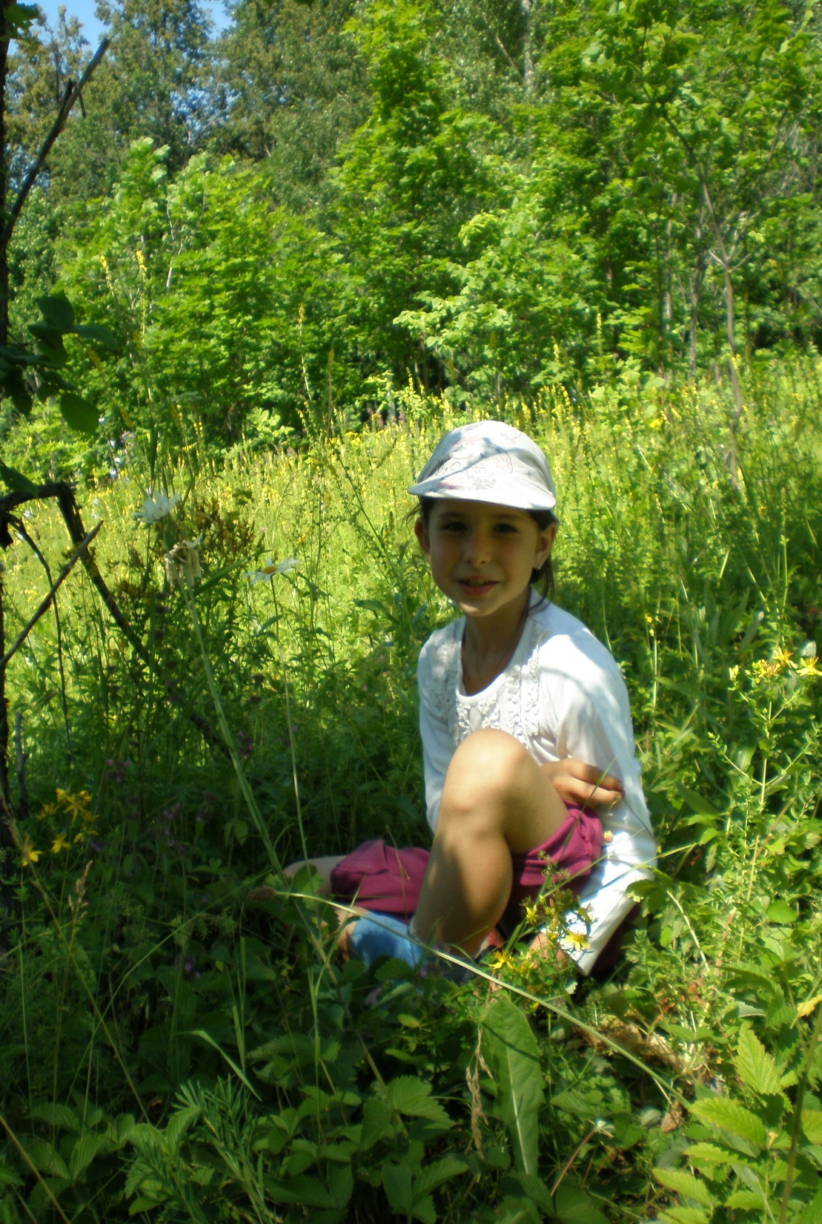
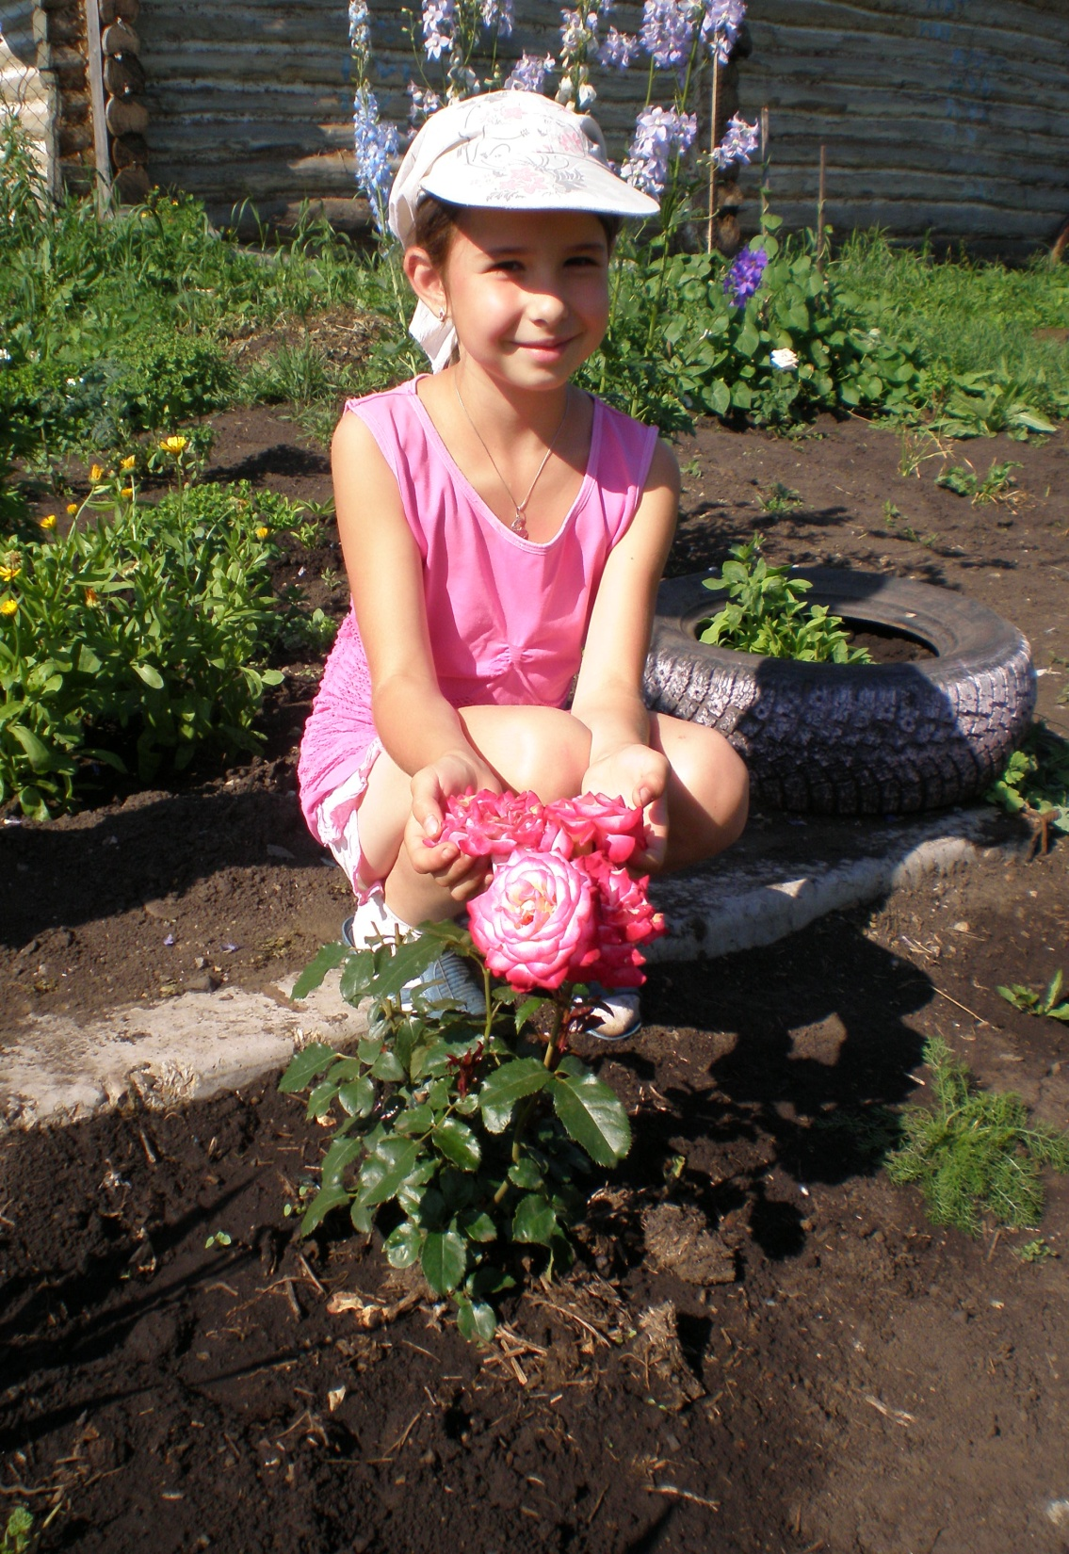
IEARN, Learning Circles, CCE1, Fall2012
School #10, Almetyevsk city, Tatarstan, Russia.
“My Hobby”
Made by student of 3ed Grade KARINA RAHMATULLINA
Sponsor teachers: Nadejda Salikhova,
Elena Zalyalova

Slide 12
Me and my hobbies.
My is name Karina. I am 8 years old. I enjoy reading different books like adventures, fantasy, watching curious films. Besides, I have my favourite hobbies. I am good at active hobbies,
intellectual hobbies.
In my opinion having hobbies is great because it is rather useful when you do something, it broadens mind, imagination.
I have a lot of hobbies.
I prefer playing board games such as chess, checkers, dominoes.
I also like active hobbies. I like skiing, skating, roller skating.
My most favourite hobbies are singing songs and dancing.
It is both outdoor and indoor hobbies. What is more, I prefer intellectual games. They are all very interesting and exciting.
I spend not so much time on my hobbies because I have to do my homework and I also spend my time on my friends and my family.

Slide 13
The most popular hobbies in my school.
Students in my school prefer as intellectual hobbies as sporting. They play basketball, volleyball, football. Students read books, guessing puzzles just like me.
I like singing songs and poems!

Slide 14
What’s your hobby?
Marat Fattahov m.fattahov@yandex.r2003u
School № 10, Lermontov Street 14, Almetyevsk city, Tatarstan, Russia

Slide 15
What’s your hobby?
My name’s Marat I’m eight years old. I prefer enjoy nature.
My favorite hobby is collecting coins.
I’m good at all subjects at my school.
I like my hobby because coins have own history:
Date, portraits of kings, queens, very important people of country and coins can be from precious metal.
It’s indoors hobby. I prefer passive hobbies. In my opinion it’s intellectual. I spend weekends, holidays and all my free time on it.
I think, the most popular hobbies in our country are hockey and football.
I think, the most popular hobbies at our school are wrestling acrobatic.
I think, the most popular hobbies in our class are football and dancing

Slide 16
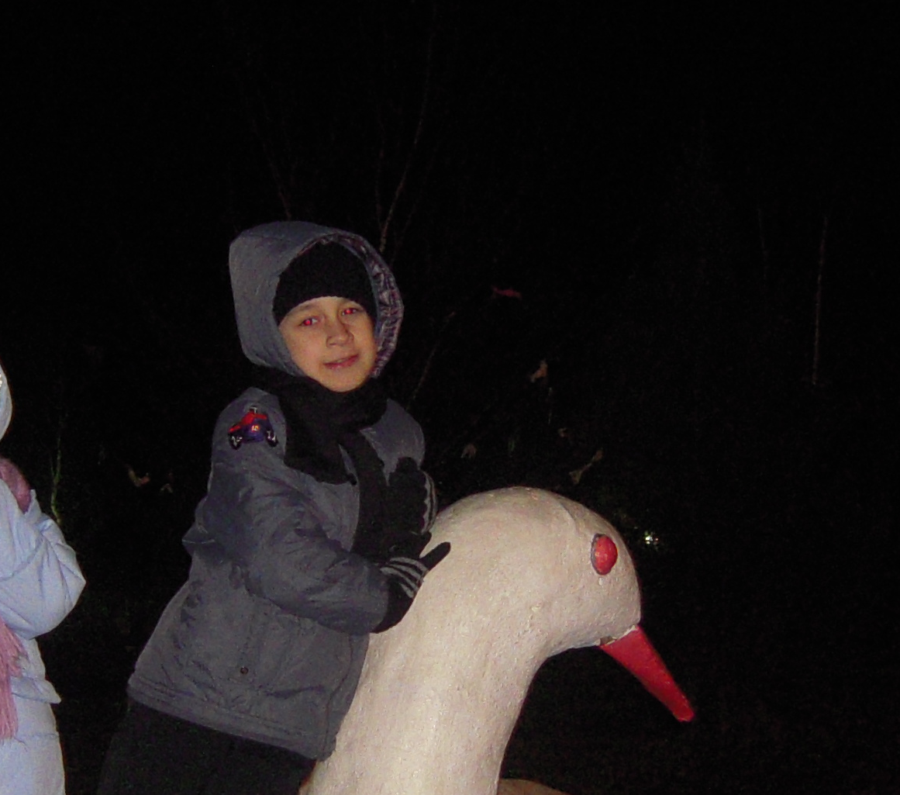
What’s your hobby?
I started to collect coins when I was in kindergarten, now I am a student.
To have a hobby is a very interesting thing!
You can be engaged and enjoy the same time.
Dear friends, find your hobby
enjoy with it and you
will be happy
My name’s Marat I’m eight years old. I prefer enjoy nature.
My favorite hobby is collecting coins.
I’m good at all subjects at my school.
I like my hobby because coins have own history:
Date, portraits of kings, queens, very important people of country and coins can be from precious metal.
It’s indoors hobby. I prefer passive hobbies. In my opinion it’s intellectual. I spend weekends, holidays and all my free time on it.
I think, the most popular hobbies in our country are hockey and football.
I think, the most popular hobbies at our school are wrestling acrobatic.
I think, the most popular hobbies in our class are football and dancing

Slide 17
Hobbies
Donna Roman, Mill Creek Elementary, Illinois USA,
by Ethan, Ian, Josh, Sophia

Slide 18
What we like to do in our free time
Play Minecraft
relax
play ping pong
run
watch tv

Slide 19
Our age numbers
10 Sophia
10 Ethan
10 Ian
11 Josh

Slide 20
Our favorite hobbies
Play football
Play ping pong
Play xbox
watch tv
baseball
run
hang out with friends

Slide 21
We are good at
sports
water skiing
ping pong
pool
dirt biking
air soft wars

Slide 22
It is good to have a hobby.
It encourages you to do something you're good at.
Hobbies are good for you so you never get tired and you never get bored.
It keeps you entertained all the time.
It encourages you to do things you like.

Slide 23
I like My hobby
They are really fun and some of them keep me fit and i'm pretty good at all of them.
Most of my sports are outdoor It allows me to have fun and exercise while being outside.
I like my hobby because I like staying active
with sports.I like my hobby because it is really fun to do what you like to do.

Slide 24
Passive Hobbies
Most of our hobbies are very active like football,baseball,and soccer and we like to use them to pass most of our time. We also like to play them with friends.

Slide 25
Do we spend much time on them?
We spend about three to five days a week on our sports and hobbies.
Plus including our tournaments over the weekend so we spend about even a week on our hobbies and activities.

Slide 26
Most popular hobbies in our country
Playing video games
sports
watching tv
Hang out with friends

