Slide 1
People who write the history
ACCESS Ungheni 2012

Slide 2
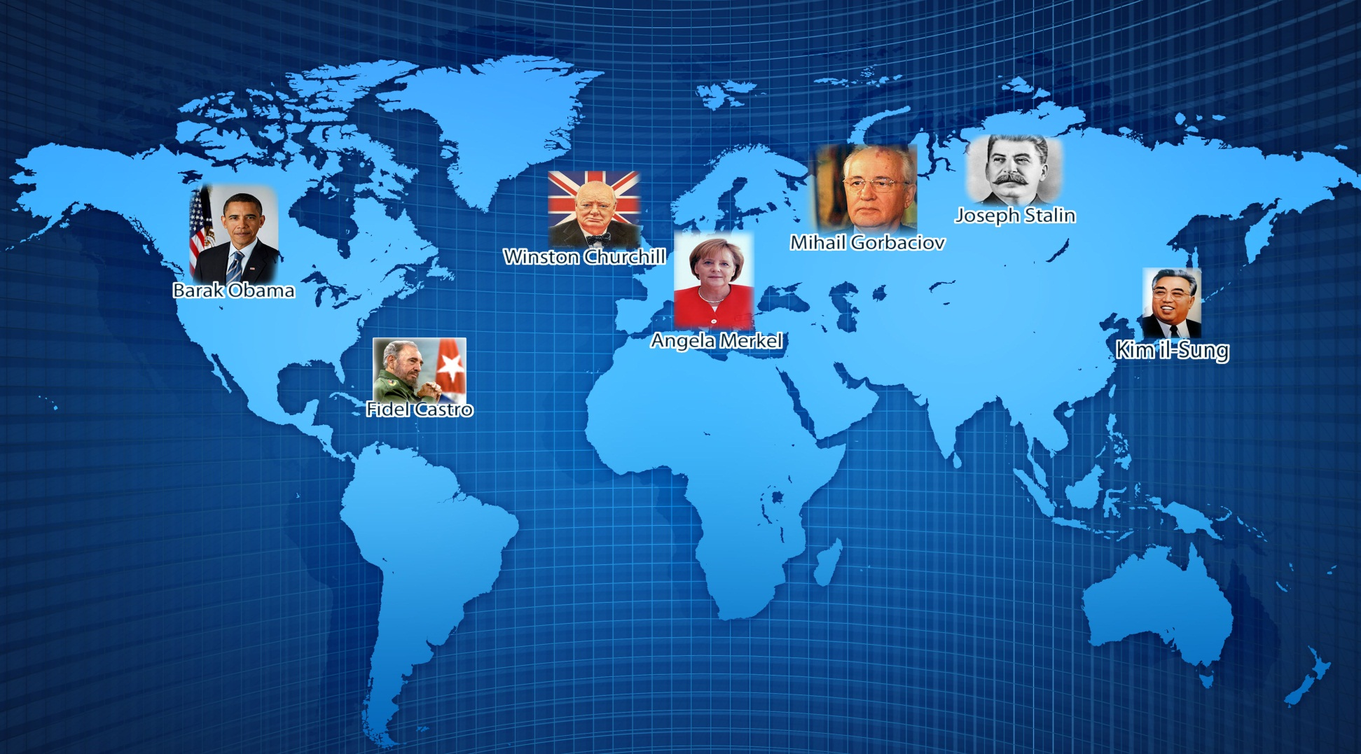

Slide 3
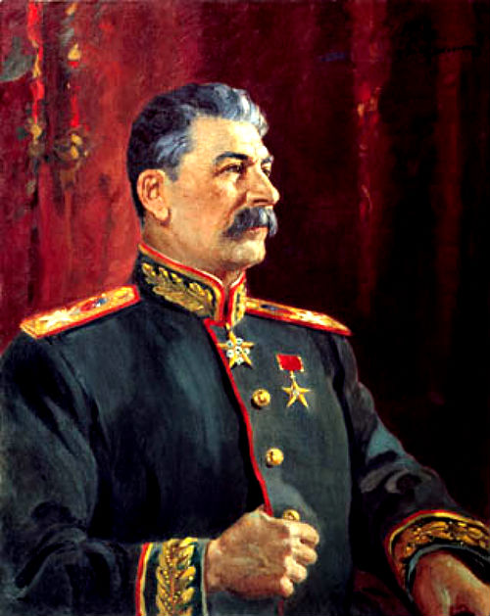
Joseph Stalin
Iosif Vissarionovich Stalin was the leader of the USSR and probably the man who exercised the greatest political power in the world. Stalin had little to no private life because of his engagement in the Second World War, though he managed to rule the Soviet Union with an iron first, his major achievement being the forced collectivization and industrialization. In the war times, the Germans credited his defensive management as incompetent, though, during the Battle of Moscow (1941-1942) he personally commanded his troops directly from the attacked capital, driving the Germans back to Berlin, which led to their capitulation in May 1945. After the war, he continued the terror policy over his political enemies, as well engaging in the economical management and reconstruction of the Soviet Union. Thus, after 1949, the USSR rapidly became the second economical and nuclear power, after the USA. During his terrifying rule, various estimates state that around 30 to 60 million of people were either executed or were the victims of Gulag camps and famine.

Slide 4
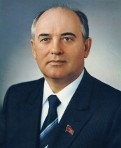
Mikhail Gorbachev
Mikhail Sergeyevich Gorbachev was born on 2 March 1931. He is a former Soviet statesman, having served as General Secretary of the Communist Party of the Soviet Union from 1985 until 1991, and as the last head of state of the Soviet Union, having served from 1988 until its dissolution in 1991. He was the only general secretary in the history of the Soviet Union to have been born during the Communist rule. Gorbachev introduced a lot of reforms. One of the first reforms was the anti-alcohol campaign, begun in May 1985, which was designed to fight widespread alcoholism in the Soviet Union. Prices of vodka, wine, and beer were raised, and their sales were restricted. Gorbachev initiated his new policy of perestroika and its attendant radical reforms in 1986. The policy of "reconstruction" was introduced in an attempt to overcome the economic stagnation by creating a dependable and effective mechanism for accelerating economic and social progress. 1988 would see Gorbachev's introduction of glasnost, which gave new freedoms to the Soviet people, including greater freedom of speech. This was a radical change, as control of speech and suppression of government criticism had previously been a central part of the Soviet system. Gorbachev's goal in undertaking glasnost was to pressure conservatives within the CPSU who opposed his policies of economic restructuring, and he also hoped that through different ranges of openness, debate and participation, the Soviet people would support his reform initiatives.

Slide 5
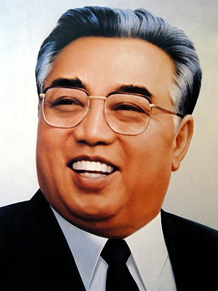
Kim il-Sung
While little is known about him, Kim il-Sung (1912-1994), the leader of the Democratic People’s Republic of Korea was one of the most influential leaders at the time. He and his country were widely remarked to survive a war directly against the USA, a huge famine, an international trade embargo and even the fall of the communist bloc. For 67 years till nowadays, the DPRK is ironically called a “black hole” of the planet, mainly because of the secrecy of its information, thus making it the only country with a stable Stalinist-type regime, a strong personality cult and national indoctrination (Having said that, even his real birth date is unknown). Kim’s private life was rather interesting: It is said that he, his son and grandson (who actually leads the state) had special people engaged in weird jobs, like making sure the rice pieces they are going to eat are completely proportional. After his death, Kim il-Sung was mourned by millions of people, then declared as “the eternal leader”, thus making the DPRK the only country in the world officially led by a dead president.

Slide 6
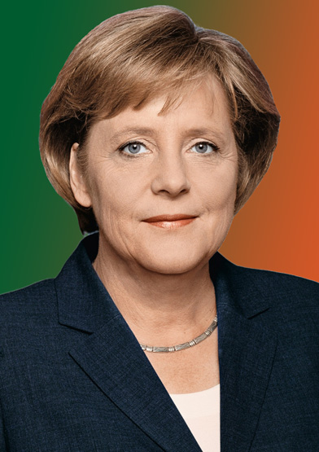
Angela Merkel
Angela Dorothea Merkel, born 17 July 1954 is the Chancellor of Germany and party leader of the Christian Democratic Union (CDU). Merkel is the first woman to have become Chancellor of Germany. After her election as Chancellor following the 2005 federal election, she led a grand coalition consisting of her own CDU party, its Bavarian sister party, the Christian Social Union (CSU), and the Social Democratic Party of Germany (SPD). Until 2009 Angela Merkel was awarded the Vision for Europe Award for her contribution toward greater European integration. Merkel was the President of the European Council and chaired the G8, the second woman (after Margaret Thatcher) to do so. She played a central role in the negotiation of the Treaty of Lisbon and the Berlin Declaration On June 16, 2010, the American Institute for Contemporary German Studies at Johns Hopkins University in Washington D.C. awarded Chancellor Merkel its Global Leadership Award (AICGS) in recognition of her outstanding dedication to strengthening German-American relations. Merkel is seen as playing a crucial role in managing the financial crisis at the European and international level, and has been referred to as "the decider." In domestic policy, health care reform and problems concerning future energy development have been major issues of her tenure. Angela Merkel has been described as "the de facto leader of the European Union" and is currently ranked as the world's second most powerful person.

Slide 7
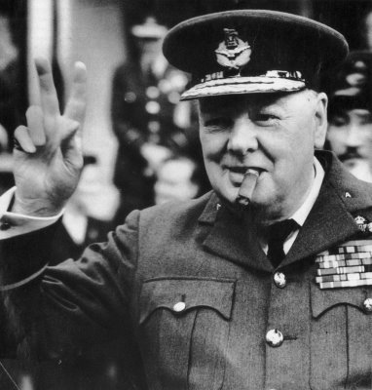
Winston Churchill
Out of office and politically "in the wilderness" during the 1930s, Churchill took the lead in warning about Nazi Germany and in campaigning for rearmament. On the outbreak of the Second World War, he was again appointed First Lord of the Admiralty. Following the resignation of Neville Chamberlain on 10 May 1940, Churchill became Prime Minister. His steadfast refusal to consider defeat, surrender, or a compromise peace helped inspire British resistance, especially during the difficult early days of the War when Britain stood alone in its active opposition to Adolf Hitler. Churchill was particularly noted for his speeches and radio broadcasts, which helped inspire the British people. He led Britain as Prime Minister until victory over Nazi Germany had been secured.

Slide 8
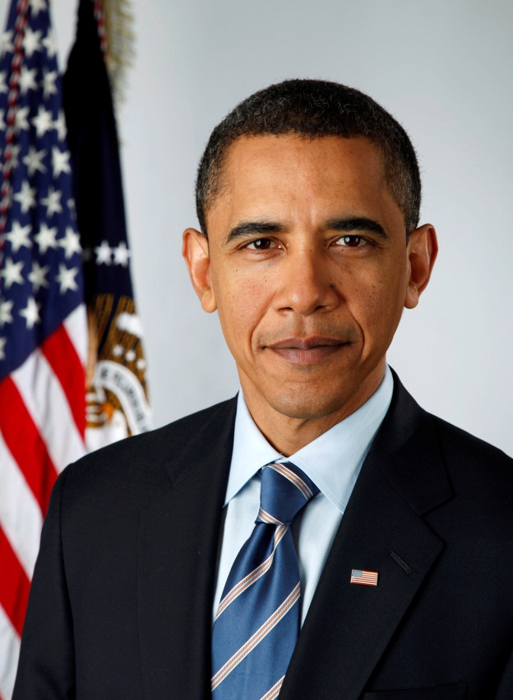
Barack Obama
President Obama was born in Honolulu, Hawaii on August 4th, 1961. In Chicago he worked as an organizer to help rebuild communities devastated by the closure of local steel plants. He went on to Harvard Law School, where he was elected the first African-American president of the Harvard Law Review. After graduating, President Obama went on to lead one of the most successful voter registration drives in state history, and continued his legal work as a civil rights lawyer and a professor teaching constitutional law at the University of Chicago. Barack Obama was first elected to the Illinois State Senate in 1996. During his time in Springfield, he passed the first major ethics reform in 25 years, cut taxes for working families, and expanded health care for children and their parents. Elected to the U.S. Senate in 2004, he reached across the aisle to pass the farthest-reaching lobbyist reform in a generation, lock up the world’s most dangerous weapons, and bring transparency to government by tracking federal spending online. Barack Obama as sworn in as president on January 20th, 2009, being the 44th President of the United States, and the first African-American ever elected to that position. Nine months later, Obama was named the 2009 Nobel Peace Prize laureate. He was reelected to a second term in November 2012. He took office in the middle of the worst economic crisis since the Great Depression. He acted immediately to get our economy back on track. In his first term, the President passed the landmark Affordable Care Act, helping to put quality health care within reach for more Americans. He ended the war in Iraq and is working to responsibly end the war in Afghanistan, passed historic Wall Street reform to make sure taxpayers never again have to bail out big banks, and cut taxes for every American worker. He’s fought for equal rights and a woman’s right to make her own health decisions. And he’s made a college education more affordable for millions of students and their families.

Slide 9
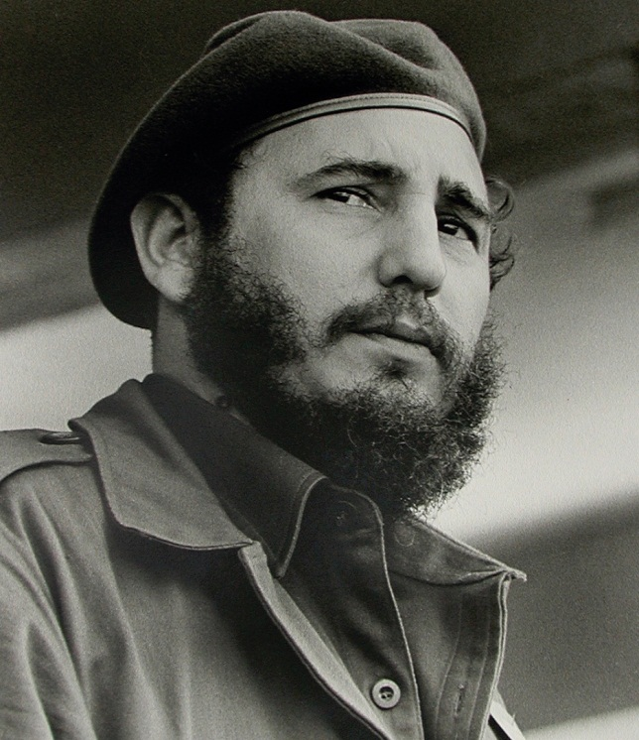
Fidel Castro
Fidel Alejandro Castro Ruz ( born in August 13, 1926) is a Cuban communist revolutionary and politician who was Prime Minister of Cuba from 1959 to 1976, and President from 1976 to 2008. He also served as the Commander in Chief of the country's armed forces and as the First Secretary of the Communist Party of Cuba. Politically a Marxist-Leninist, under his administration the Republic of Cuba became a one-party socialist state: industry and businesses were nationalized, and socialist reforms implemented in all areas of society. Castro was also the Secretary-General of the Non-Aligned Movement. He adopted leftist anti-imperialist politics and planned the overthrow of the United States-backed military junta of Cuban president Fulgencio Batista . He formed a revolutionary group, the 26th of July Movement. Castro led the Cuban Revolution and brought his own assumption of military and political power. Alarmed by his revolutionary credentials and friendly relations with the Soviet Union, the U.S. governments unsuccessfully attempted to remove him in 1961. Countering these threats, Castro formed an economic and military alliance with the Soviets, and allowed them to place nuclear weapons on the island. In 1961 Castro proclaimed the socialist nature of the Cuban revolution, with Cuba becoming a one-party state under Communist Party governance. Abroad, Castro supported foreign revolutionary socialist groups in the hope of toppling world capitalism, sending Cuban troops to fight in the Yom Kippur War, Ogaden War and Angolan Civil War. Following the collapse of the Soviet Union in 1991, Castro led Cuba into its economic "Special Period", before taking the country into the Bolivarian Alliance for the Americas in 2006 and forging alliances with other nations in the Latin American Pink Tide. Amid failing health, in 2006 he transferred his responsibilities to his brother Vice-President Raúl Castro. Fidel Castro is a controversial and divisive world figure, lauded as a champion of anti-imperialism, humanitarianism, socialism and environmentalism by his supporters, but considered by his critics as a dictator who has overseen multiple human rights abuses. Through his actions and his writings he has significantly influenced the politics of various individuals and groups across the world.

Slide 10
“If your actions inspire others to dream more, learn more, do more and become more, you are a leader.”
John Quincy Adams

