Slide 1
ACCESS Bălţi
IN GOD WE TRUST

Slide 2
History
The history of money begins with the first minting of coinage in the seventh century BC.

Slide 3
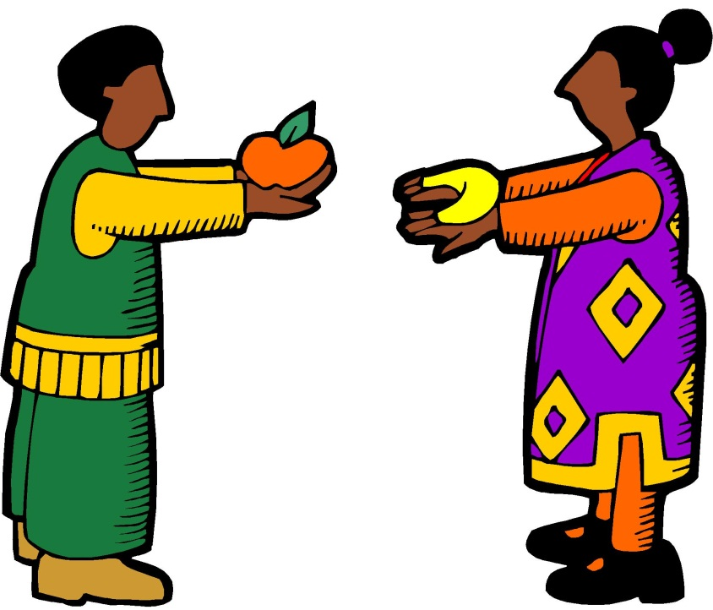
Early history
Money in early history:
blood-money
bride-money
barter
The first people didn't buy goods from other people with money. They used barter. Barter is the exchange of personal possessions of value for other goods that you want.

Slide 4
Early history
This kind of exchange started at the beginning of humankind and is still used today. From 9,000-6,000 B.C., livestock was often used as a unit of exchange.

Slide 5
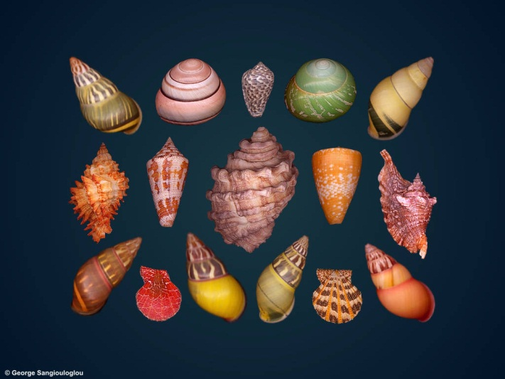
Stone age
Money in stone ages
Shells
Feathers
Pears
(But usings the most rare)
At about 1200 B.C. in China, cowry shells became the first medium of exchange, or money. The cowry has served as money throughout history even to the middle of this century.

Slide 6
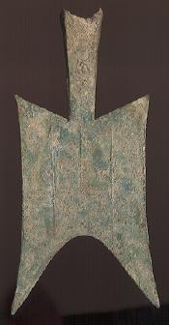
Iron age
China, in 1,000 B.C., produced mock cowry shells at the end of the Stone Age. They can be thought of as the original development of metal currency. In addition, tools made of metal, like knives and spades, were also used in China as money.

Slide 7
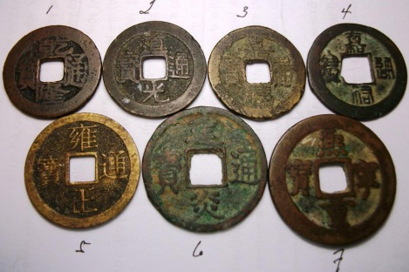
Iron age
From these models, we developed today's round coins that we use daily. The Chinese coins were usually made out base metals which had holes in them so that you could put the coins together to make a chain.

Slide 8
Gradually peoples reach ideas of one form of one universal standard .

Slide 9
Ancient epoch
At about 500 B.C., pieces of silver were the earliest coins. Eventually in time they took the appearance of today and were imprinted with numerous gods and emperors to mark their value.

Slide 10
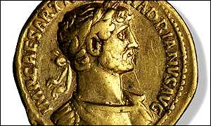
Ancient epoch
These coins were first shown in Libya, or Turkey, during this time, but the methods were used over and over again, and further improved upon by the Greek, Persian, Macedonian, and Roman empires.

Slide 11
Ninth century A.D.
Danes in Ireland using noses with money. Yes yes noses!

Slide 12
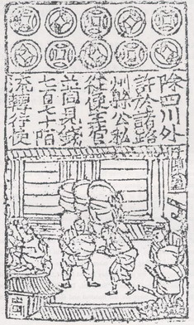
Tenth century A.D.
Genghis Khan was intrigued by the paper money he discovered when he conquered China in the 13th Century.

Slide 13
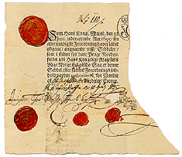
1151
Paper money was adopted in Europe much later than in Asia and the Arab world, primarily because Europe didn't have paper.
This is a norwegian merchant note

Slide 14
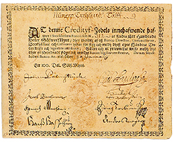
1661
Swedish Stockholm Bank make the first bank in Europe who printed money!

Slide 15
The beginning of Revolutionary War in the U.S.A.
This is an example of early continental currency, issued by the U.S. colonists when they first broke from Britain.

Slide 16
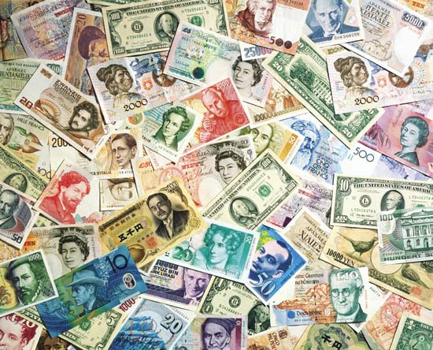
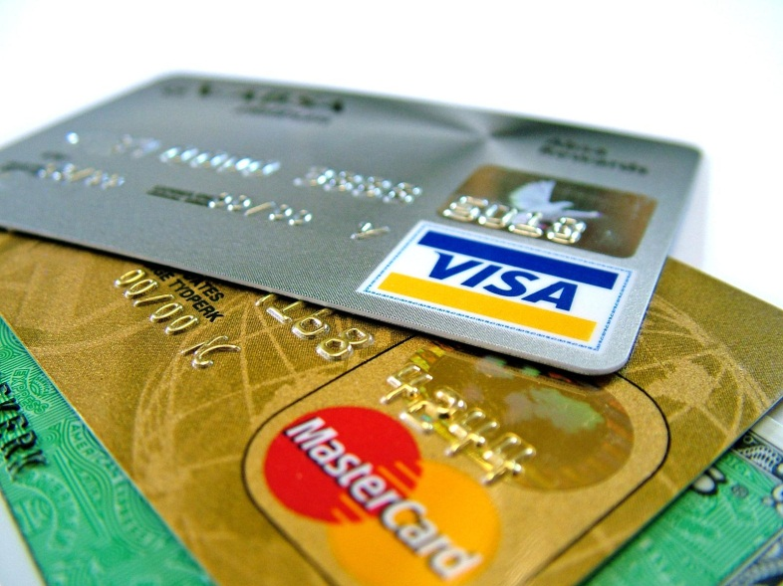
Money today
Today we are using bank notes , electronic money and credit cards.

Slide 17
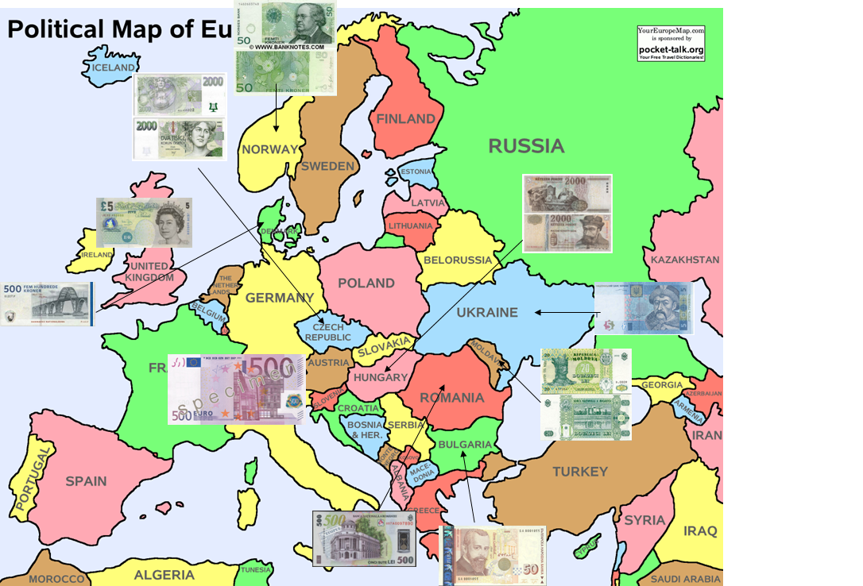
Money map-Europe

Slide 18
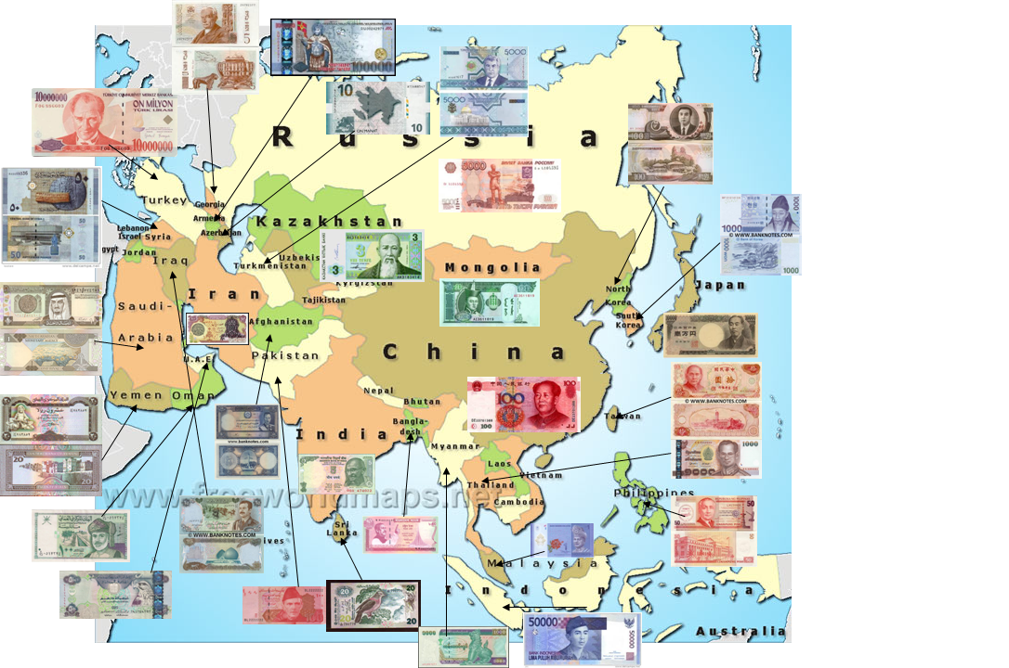
Money map-Asia

Slide 19
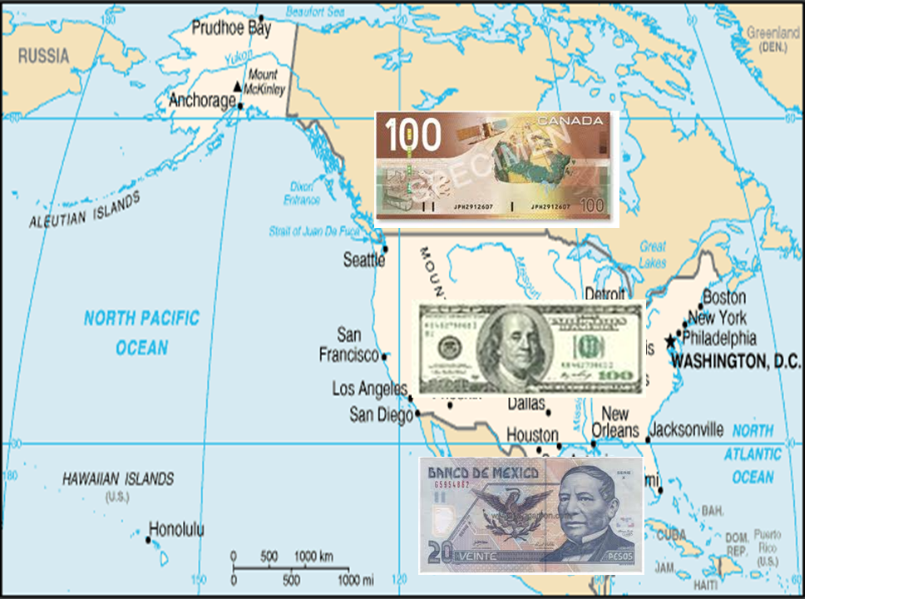
Money map-North America

Slide 20
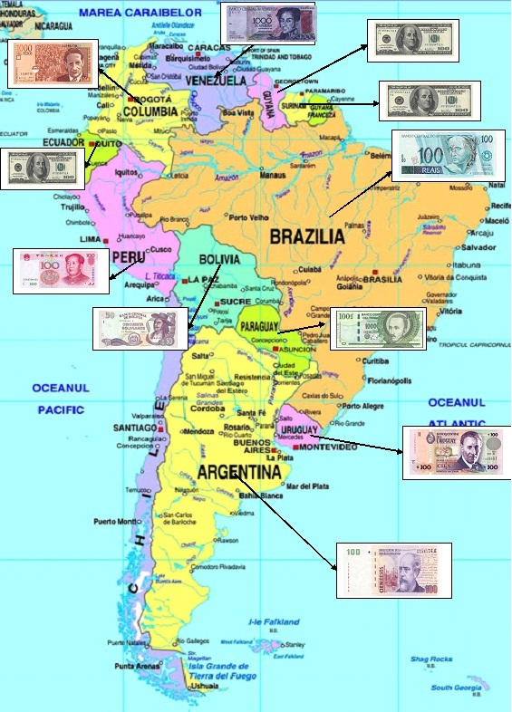
Money map- South America

Slide 21
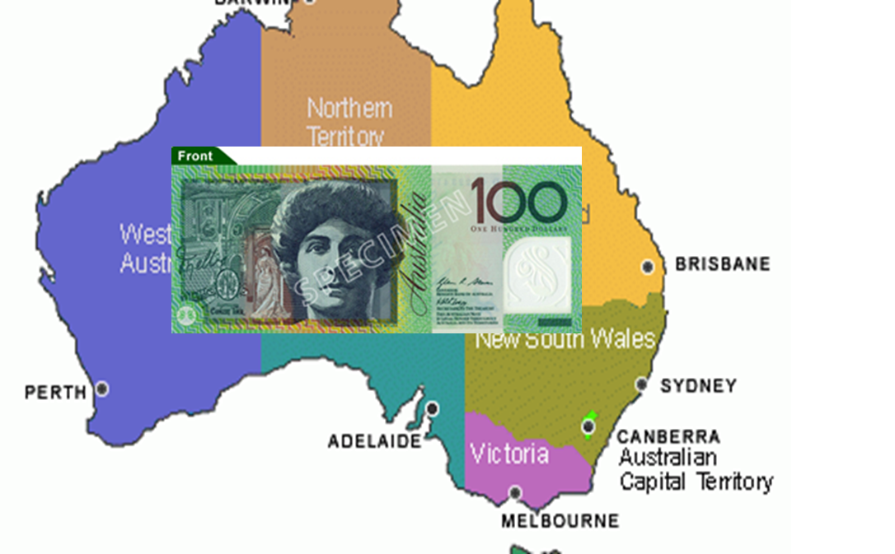
Money map-Australia

