Slide 1
My City and Me A 2012 Learning Circles Project
Grades: 5th and 6th C
Coordinator: Cristina Nenciu

Slide 2
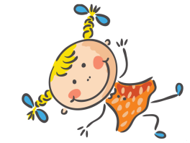
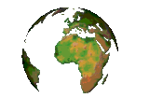
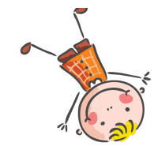
Click on the kids !

Slide 3
Constanta – My City

Slide 4
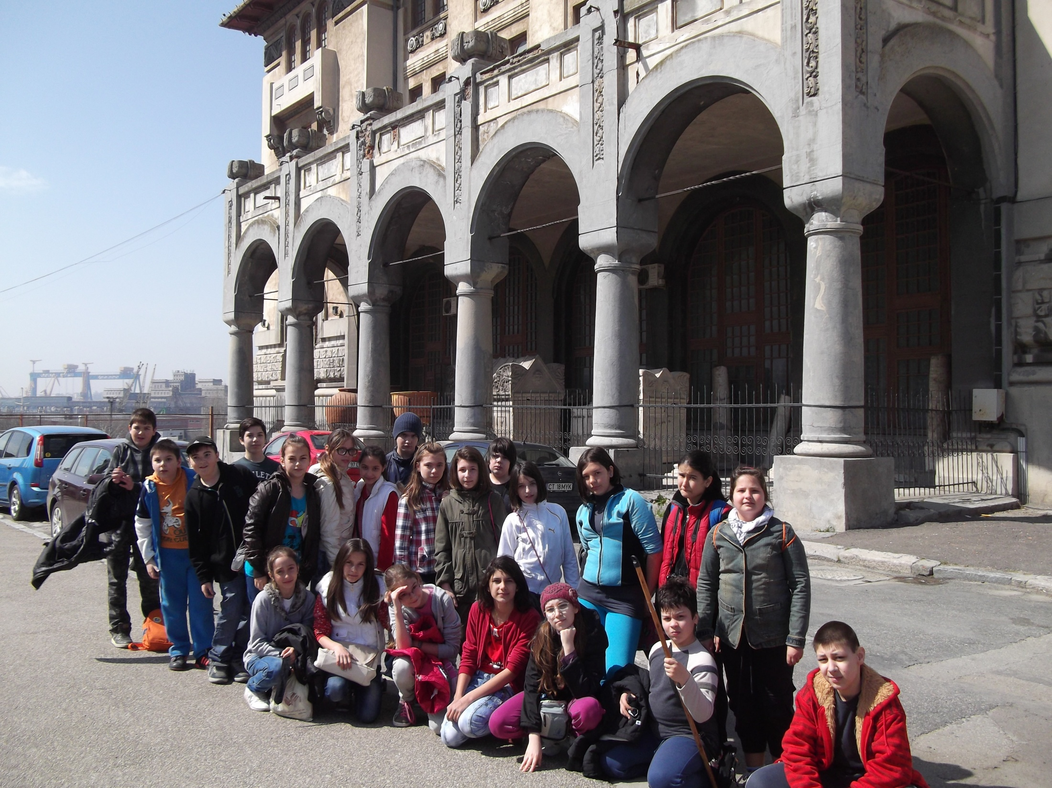

Slide 5
Constanta is located in the eastern part of Romania, in Dobrogea region, on the Black Sea Coast. The city was founded 2600 years ago by the Greeks as a port on the Black Sea coast for trading, under the name of Tomis. The city’s legends say that Jason landed here with the Argonauts, as soon as he had found the Golden Fleece. The city’s name was later changed after Constantiana, the beloved sister of Constantine the Great. It has been flourishing during the centuries and it is now one of the most important cultural and economic centers in Romania, as well as the largest sea port in Romania and the fourth largest port in Europe, as well.

Slide 6
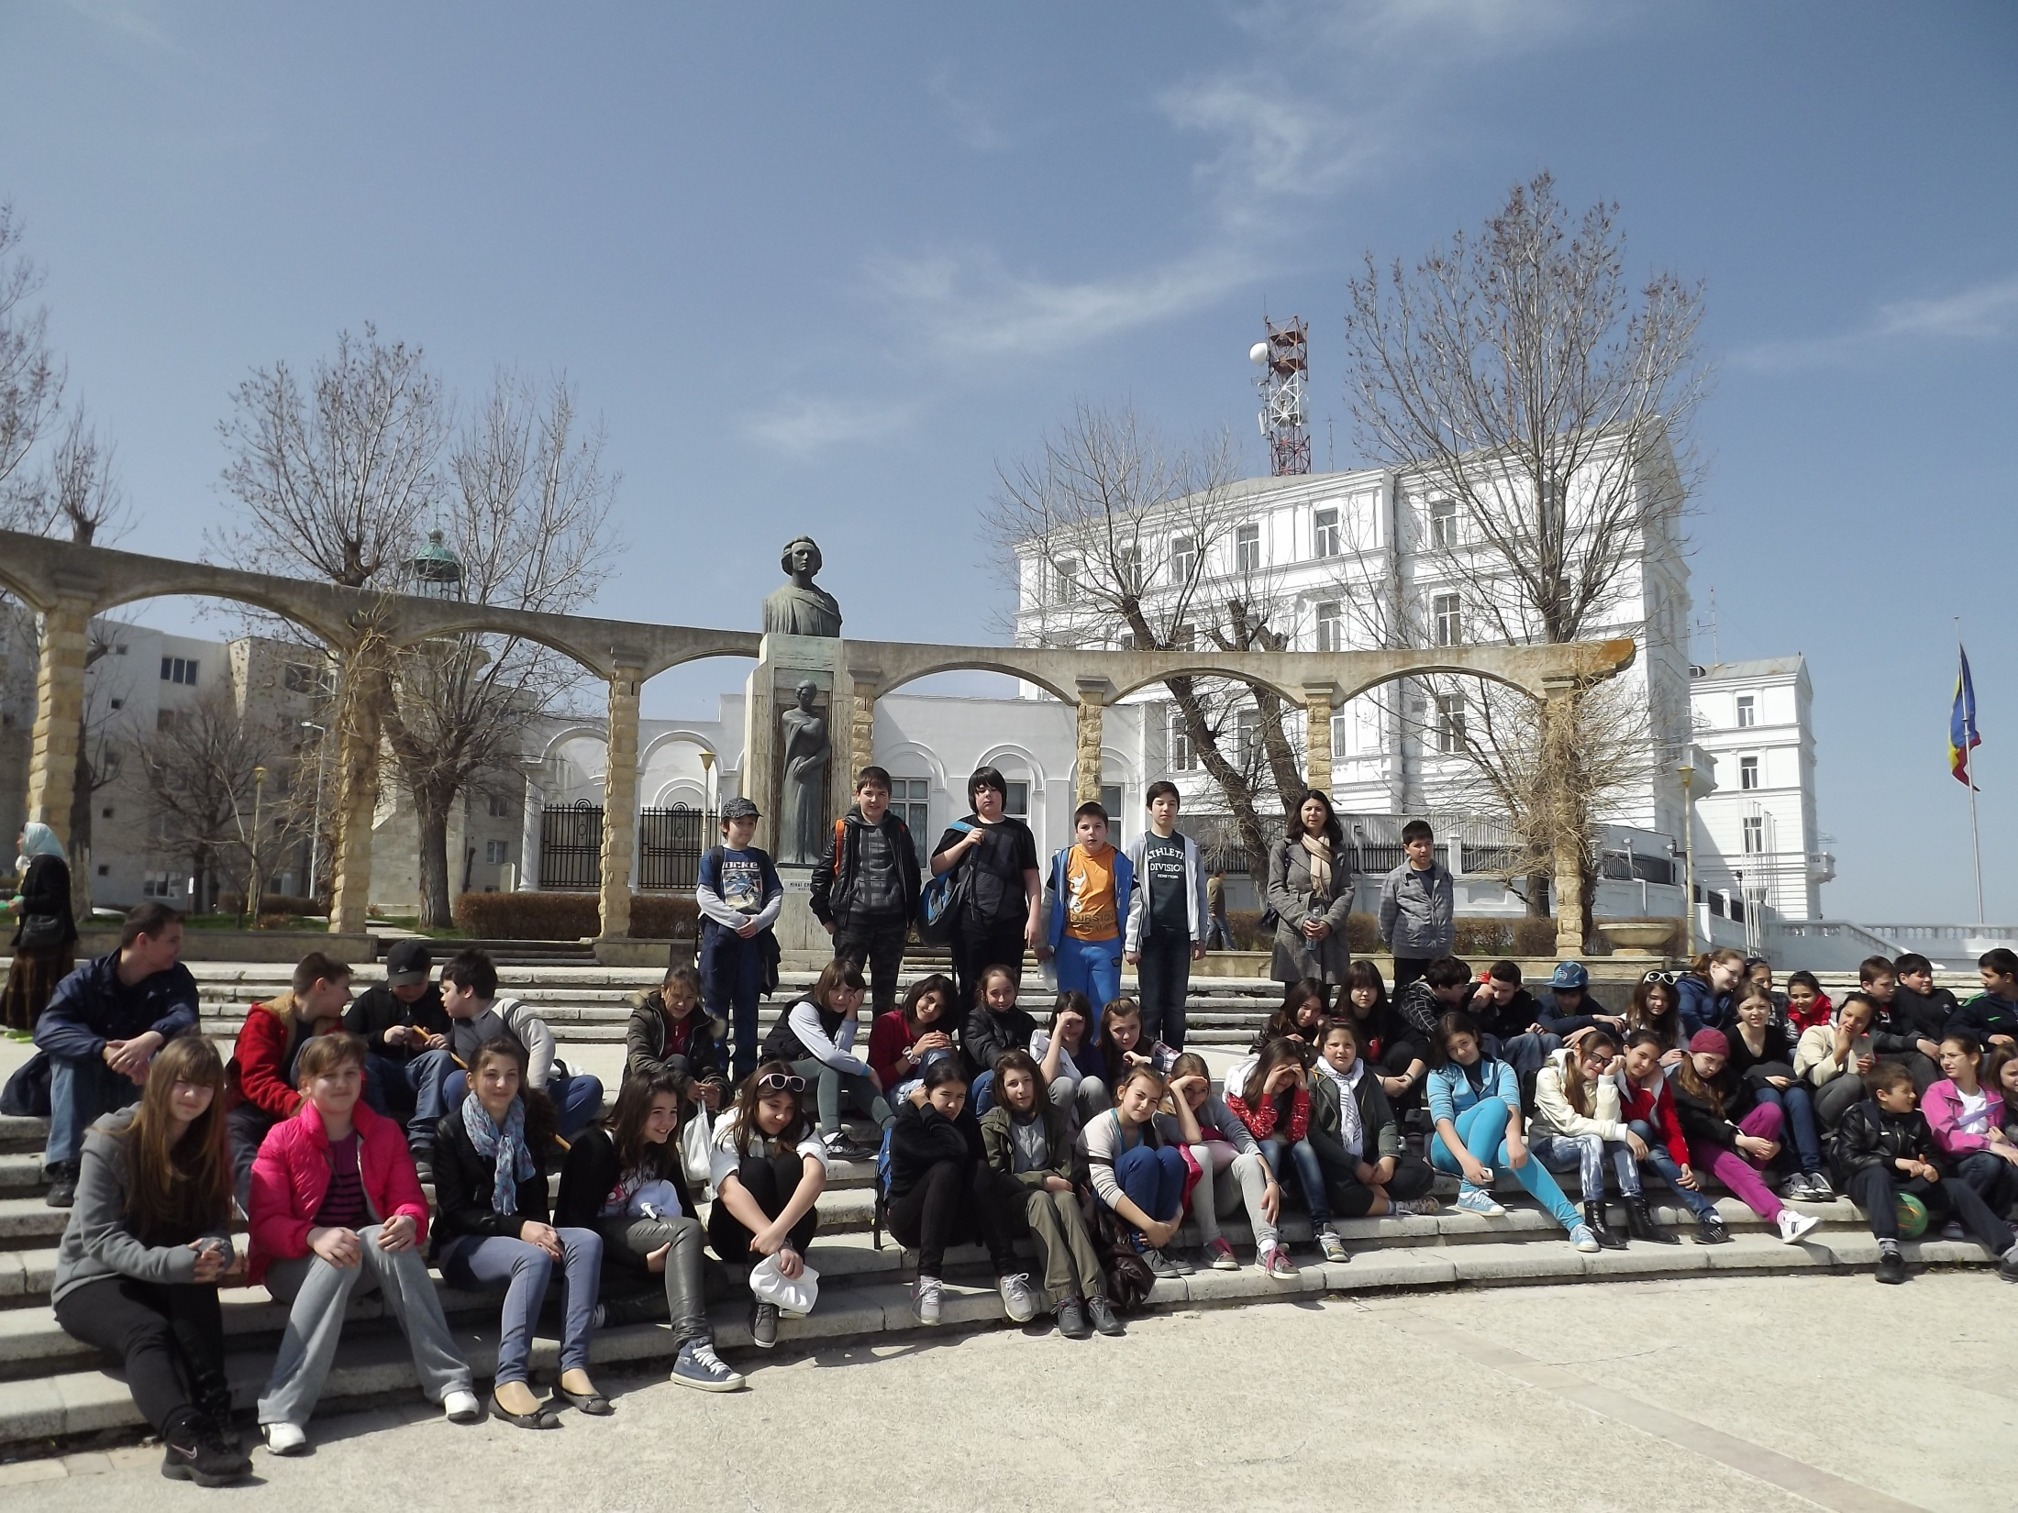

Slide 7
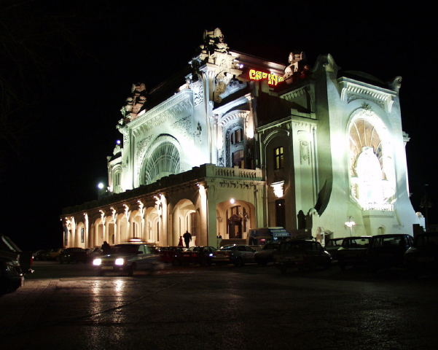
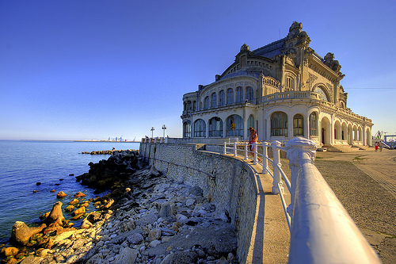
Constanta is an old city which is worth to be explored for its archaeological treasures and its marvelous historical monuments. A quite stroll along the narrow streets of the old city which still preserves its past charm is very relaxing.
Once you have arrived on the promenade
by the sea, while admiring the impressive
building of the grand Casino, the sea
breeze can be easily felt.

Slide 8
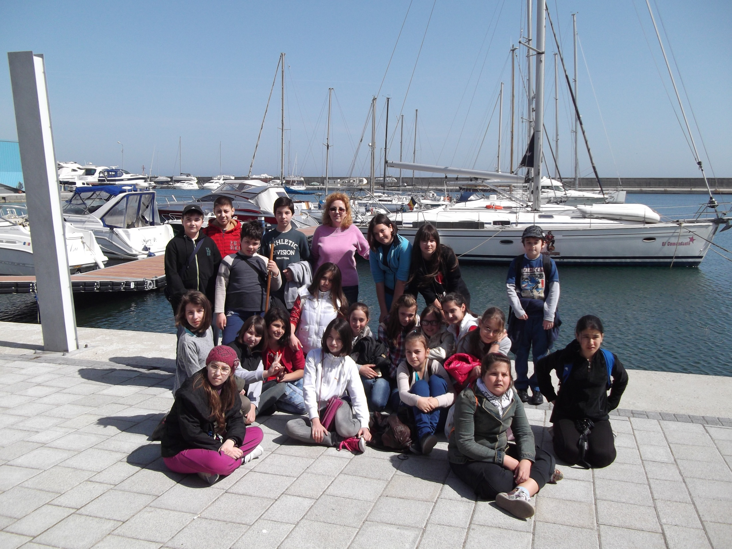

Slide 9
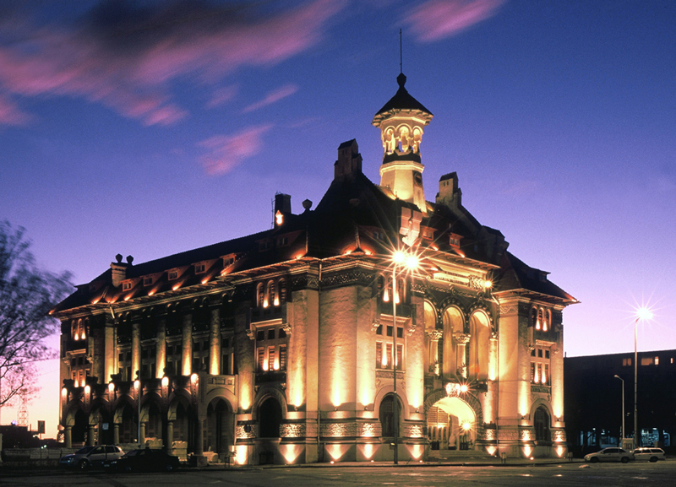
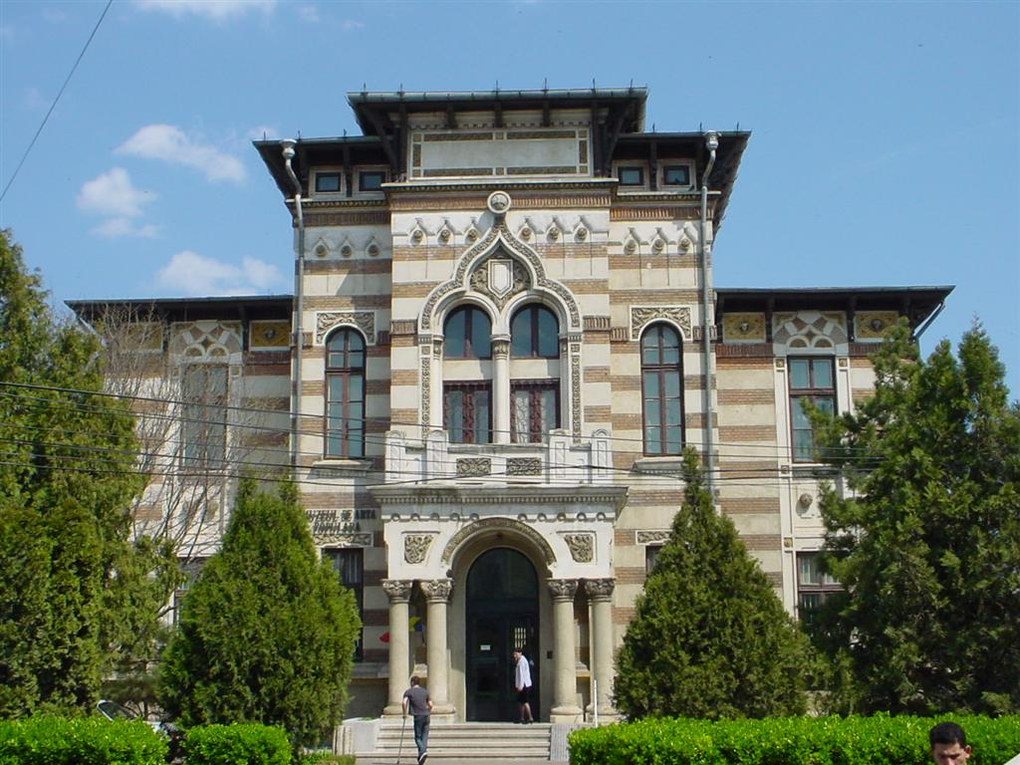
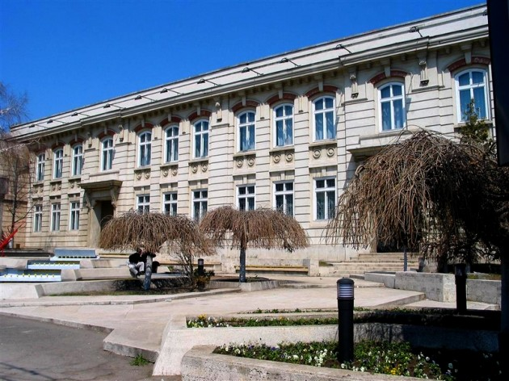
The Traditional Art Museum is also an important place where teens have many interesting things to see.
The History Musem is a place with a heritage of
430 000 objects and arthefacts, which prove the importance of this city on the Black Sea shore.
The Art Museum is another place where kids can see many interesting things about Constantza; here they can find sculptures, paintings and another types of art representative for Romania.

Slide 10
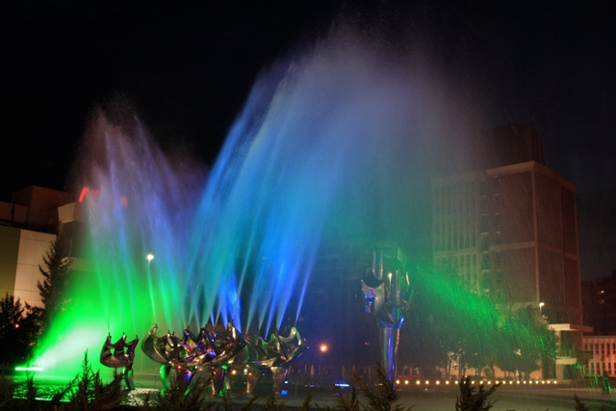
The Railway Station Park, with the only kinetic fountain in Constanta.

Slide 11
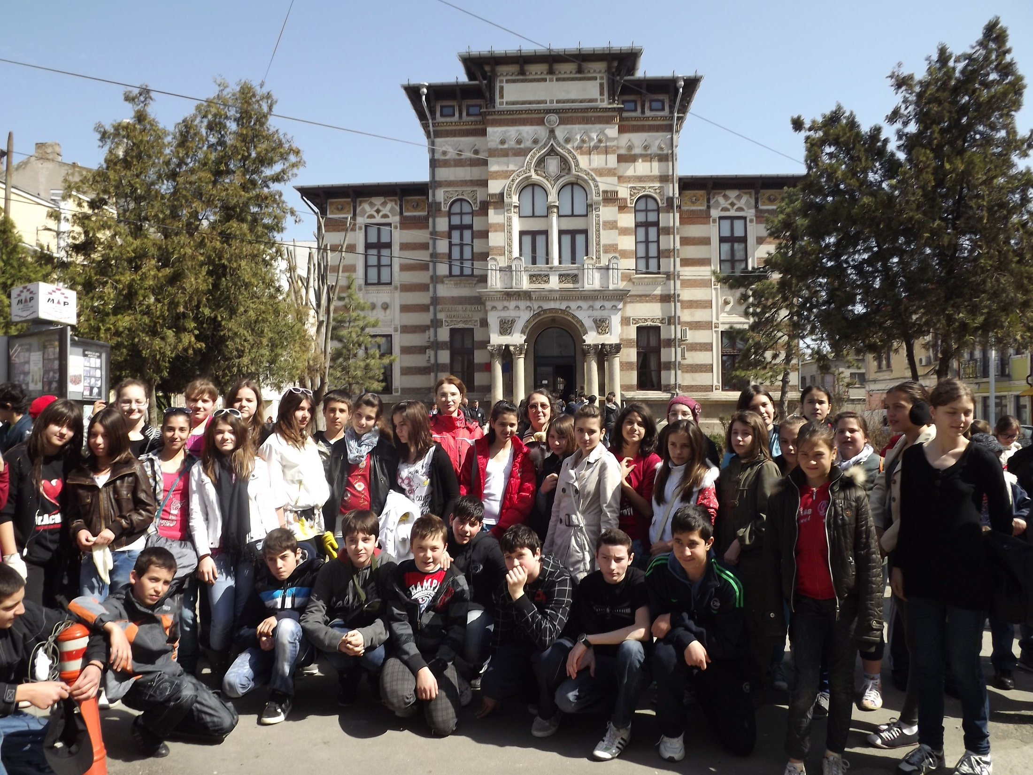

Slide 12
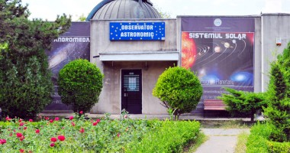
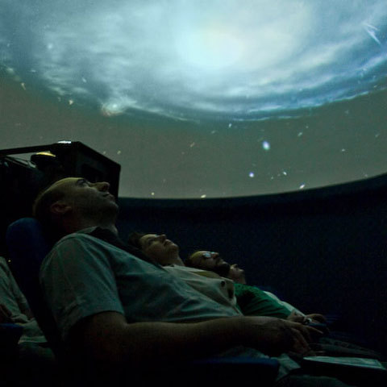
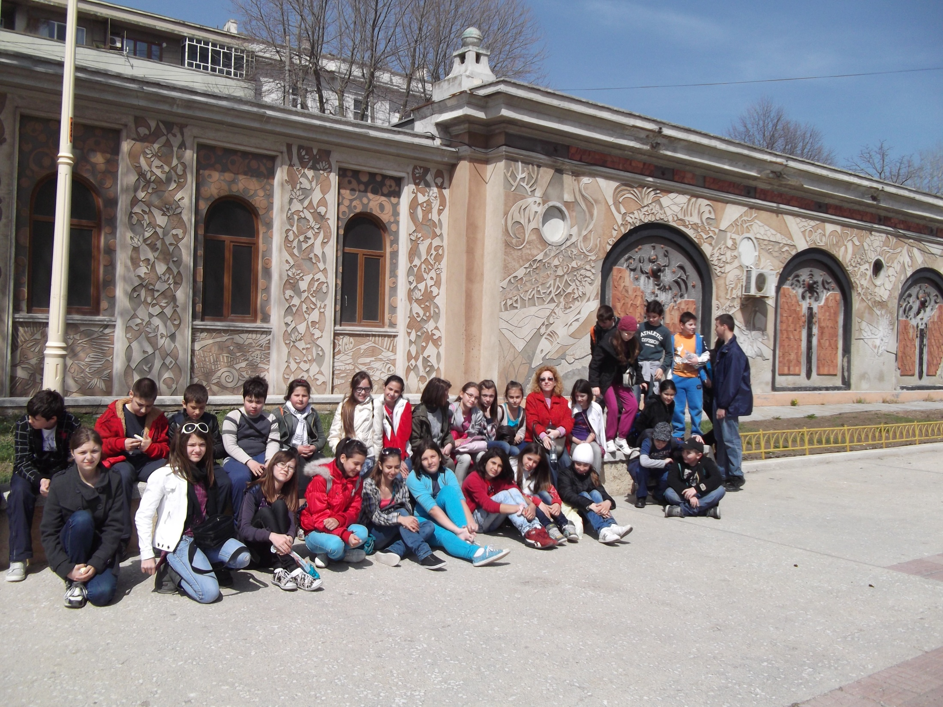
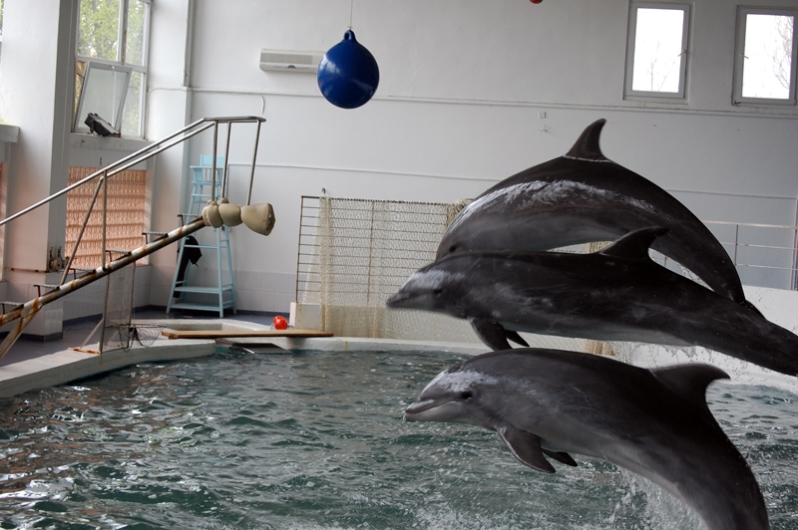
The Planetarium is a place where everybody can see presentations about the sky and the space or the stars, and it is situated in the midlle of the Delfinarium Park.
The Aquarium is the place where children and not only them can see various types of fish in many colours and forms.
Delfinarium is the most visited place from Delfinarium Park in Constanta, because here dolphins have daily shows, where everybody can have a lot of fun.

Slide 13
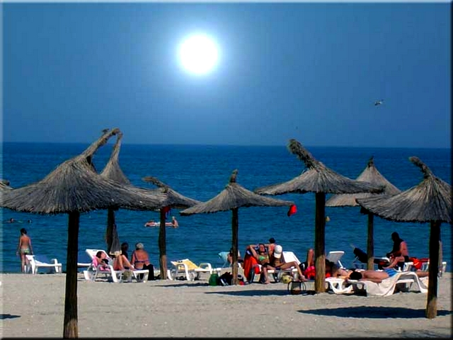
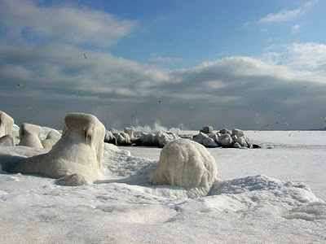
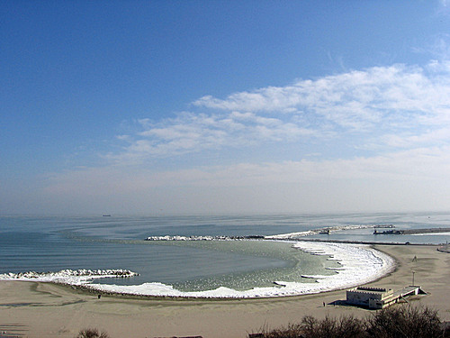
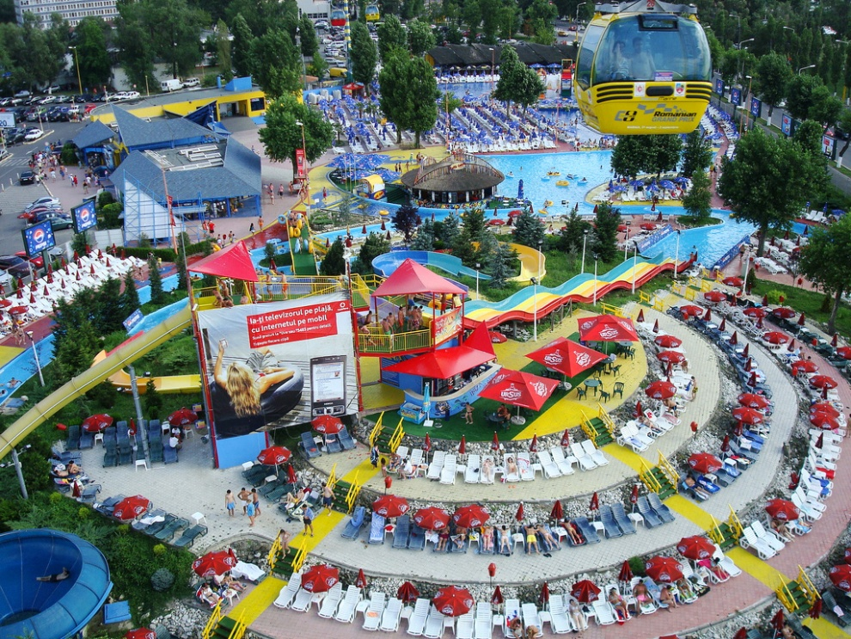
But the most important place for people living in Constanta is the beach !

Slide 14
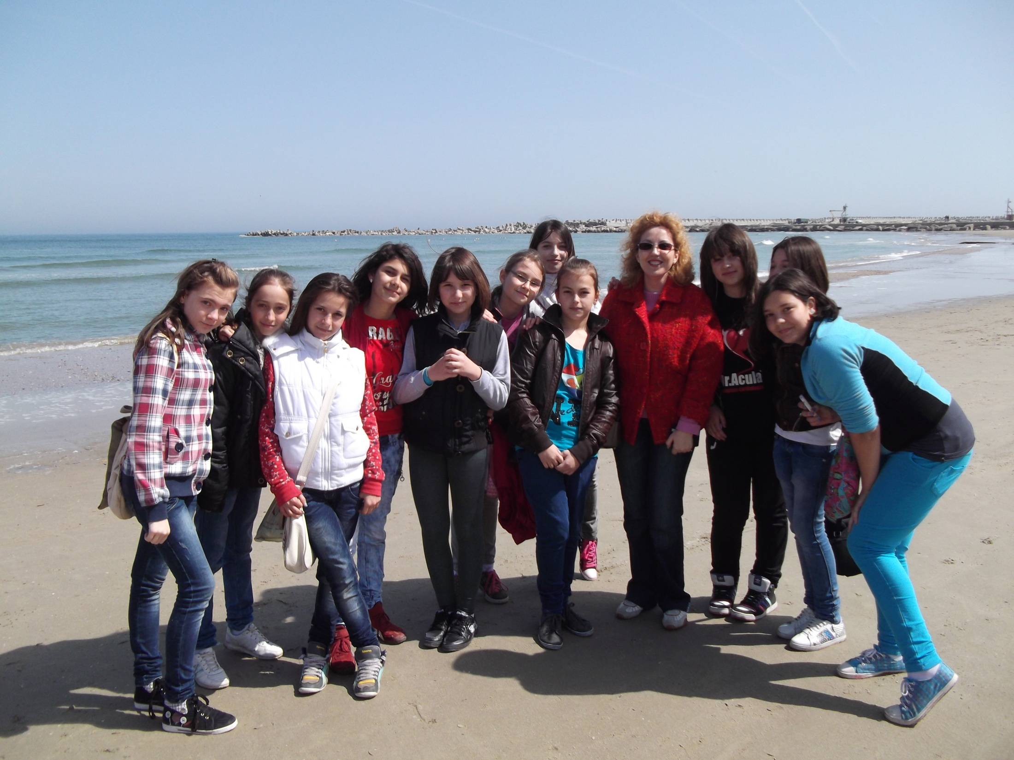

Slide 15
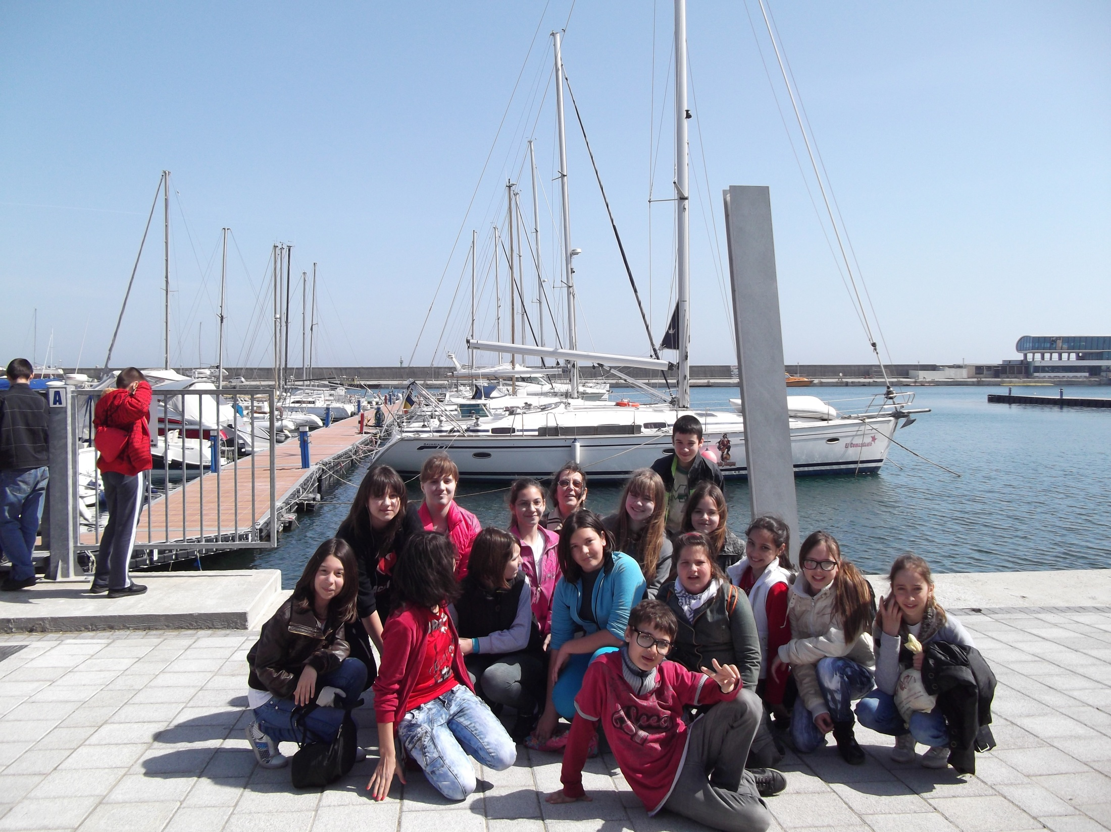

Slide 16
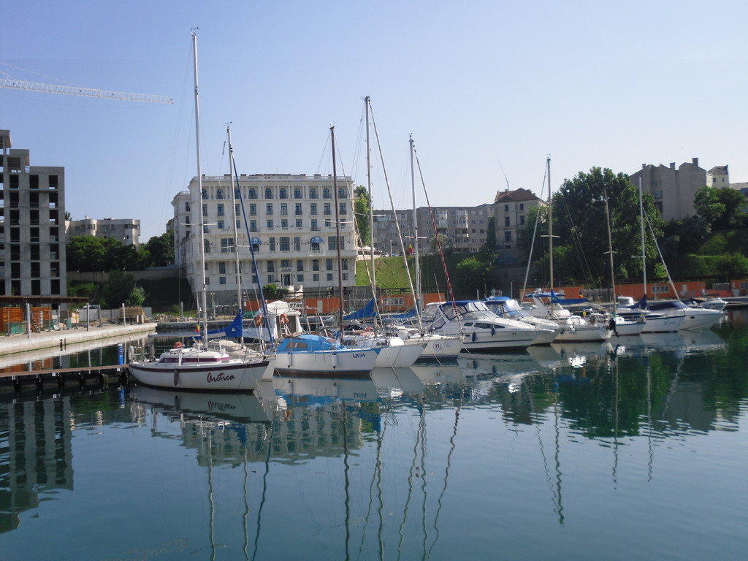
We hope you enjoyed our presentation !
From Constanta, we wish you a beatiful summer !

Slide 17
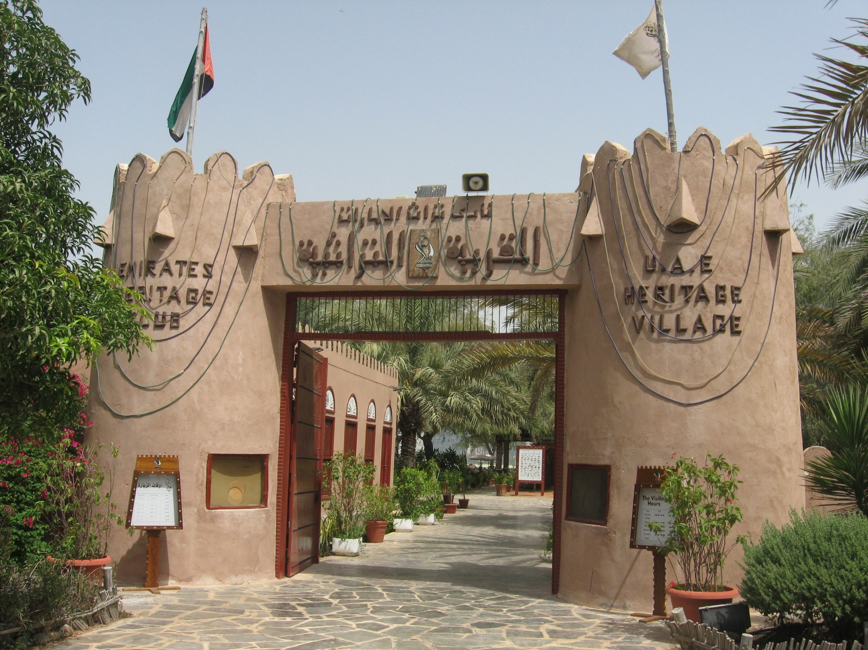
Al Manhal International
Private School
A trip to
Abu Dhabi Heritage Village
Grades 7
April, 2012

Slide 18
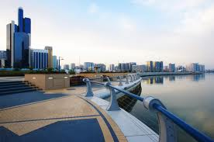
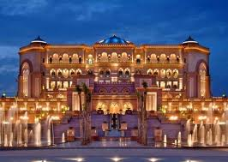
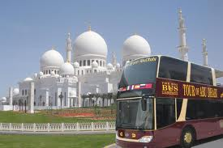
Famous places in Abu Dhabi

Slide 19
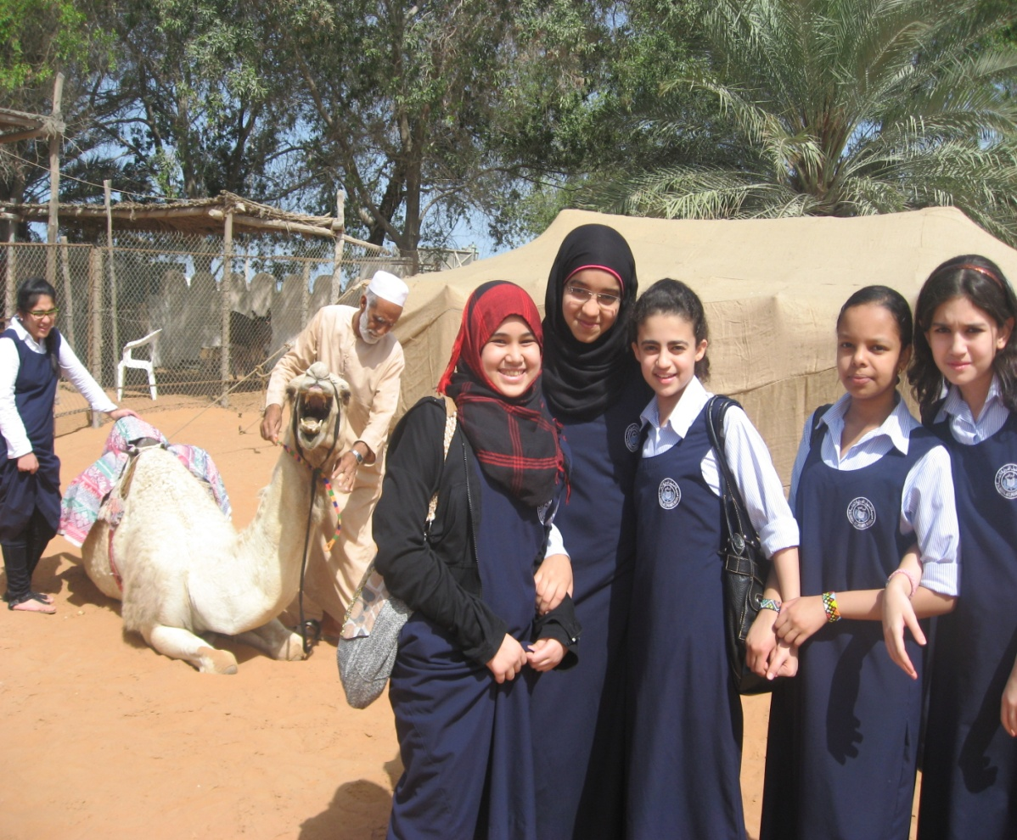
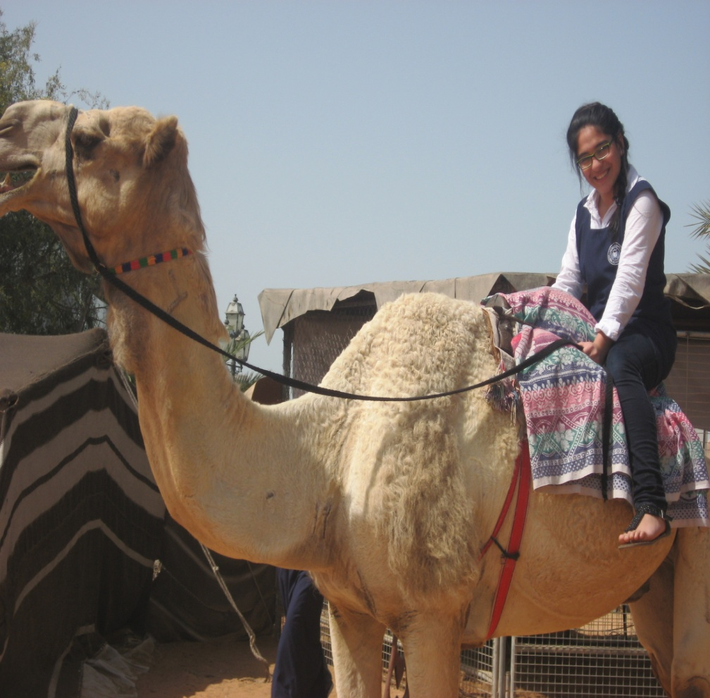
We learnt how Emirati people used to live in tents in the past and used camels. We also enjoyed a camel riding to remember the past.

Slide 20
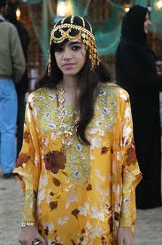
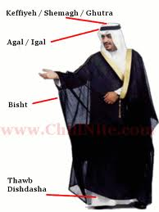
Traditional cloths
For women
For men

Slide 21
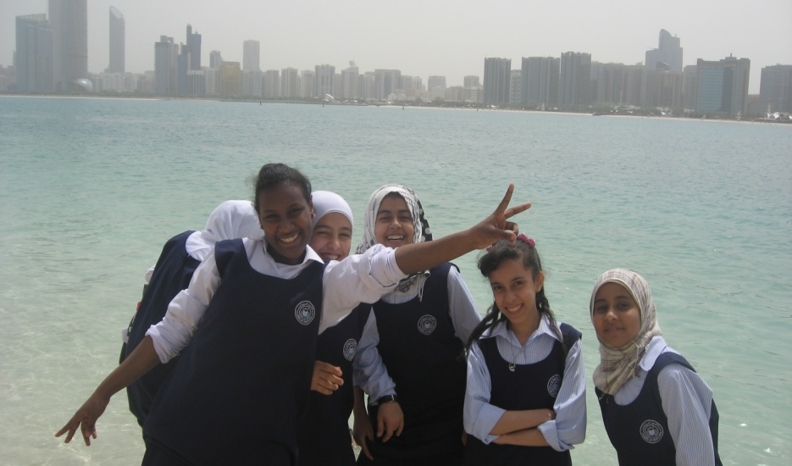
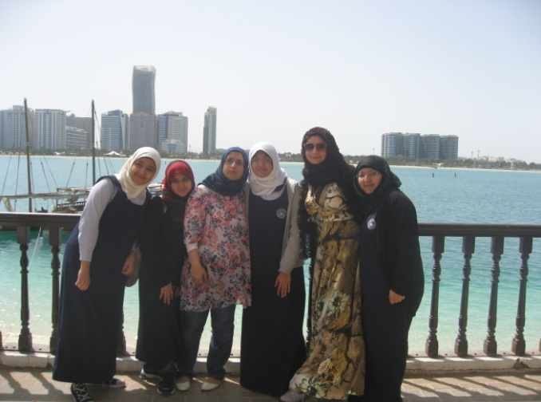
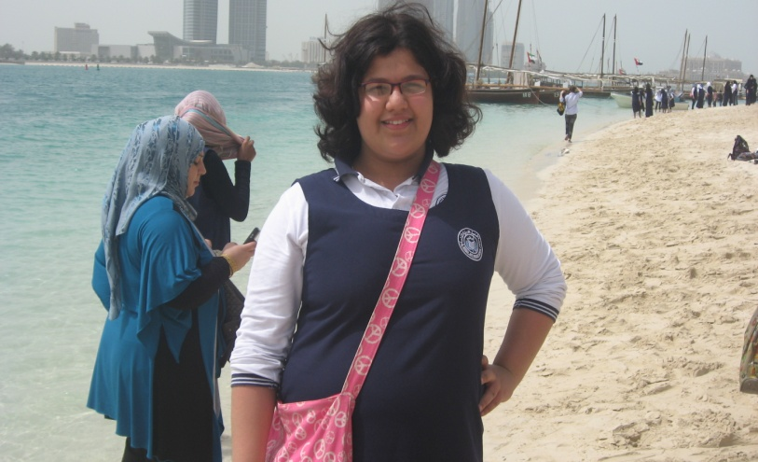
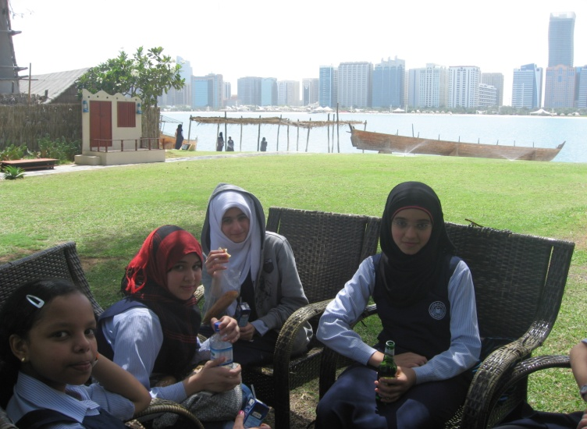
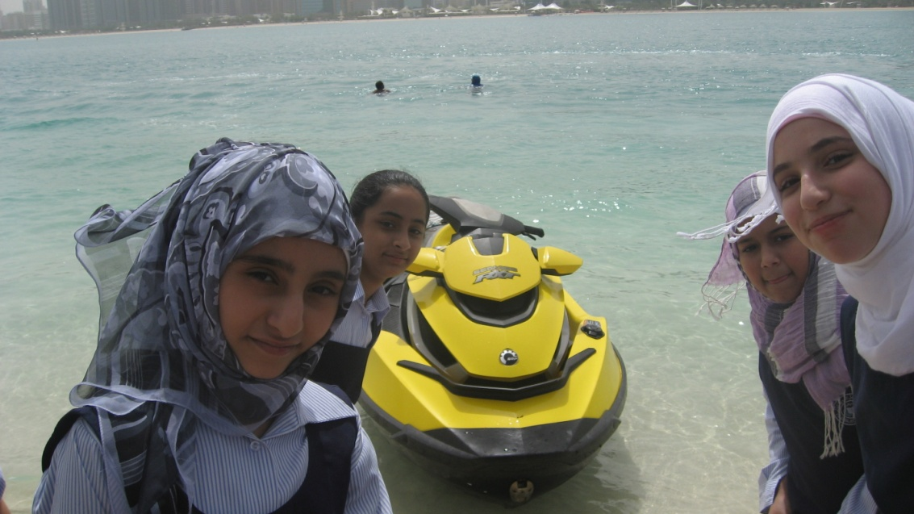
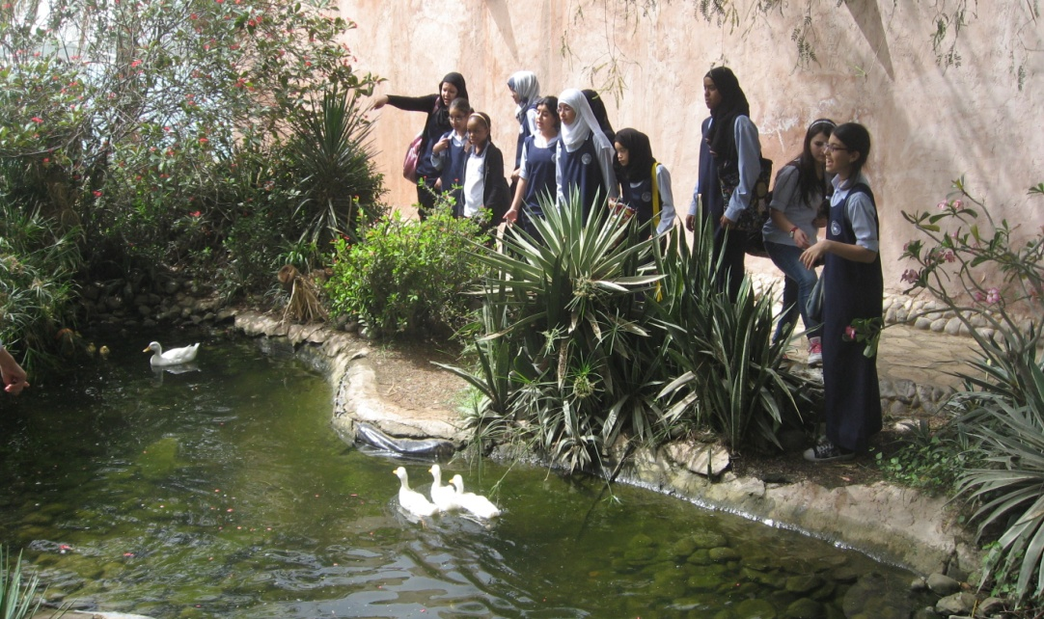
Finally we enjoyed the sea and the fascinating panorama
of
Abu Dhabi.

Slide 22
Some facts about the history of Moscow
RUSSIA
Moscow is one of the oldest Russian cities, it was founded in 1147 by Russian Prince Yuri Dolgoruky. The heart of Moscow is the Kremlin .It was built as an island fortress as it was surrounded by water: by the Moskva River and the Neglinnaya River, which is now under the ground. The first walls were made of wood, but later they were replaced by thick oak logs.
A new white-stone Kremlin was built in the 14th century in the reign of Dmitry Donskoy. In hundred years tsar Ivan III built new walls and towers of red brick, as we see them now.
The Kremlin

Slide 23
Just in front of the Kremlin the Red Square is situated, it is one of the biggest and most beautiful squares in the world. It is 695 metres long and has an average width up to 130 metres.
There are some historical sights on the Red Square; they are St. Basil’s Cathedral and the monument to Minin and Pozharsky. St. Basil Cathedral was erected in the order of Ivan IV to commemorate the annexation of the Kazan and Astrakhan khanates to Russia. It is the masterpiece of Russian architecture .
St. Basil’s Cathedral

Slide 24
Next to the Cathedral stands the monument to Minin and Pozharsky. This monument depicts the heroic meeting of Kozma Minin, the elder of Nizhniy Novgorod, and Prince Dmitry Pozharsky. Under the leadership of these heroes of the 1612 war, the Russian people drove the Polish invaders out of Moscow.
The monument to Minin and Pozharsky

Slide 25
Spasskaya Tower is the part of the Kremlin; it’s famous for its clock. It’s usually referred to as the Kremlin clock, has become the symbol of Russia.The hours are struck by a hammer striking a bell. At noon, midnight, 6 am and 6 pm the national anthem is played, while at 3 am, 9 am, 3 pm and 9 pm it is the melody of the "Glory" chorus from Glinka's opera A Life for the Tsar. The clock is set twice a day.

Slide 26
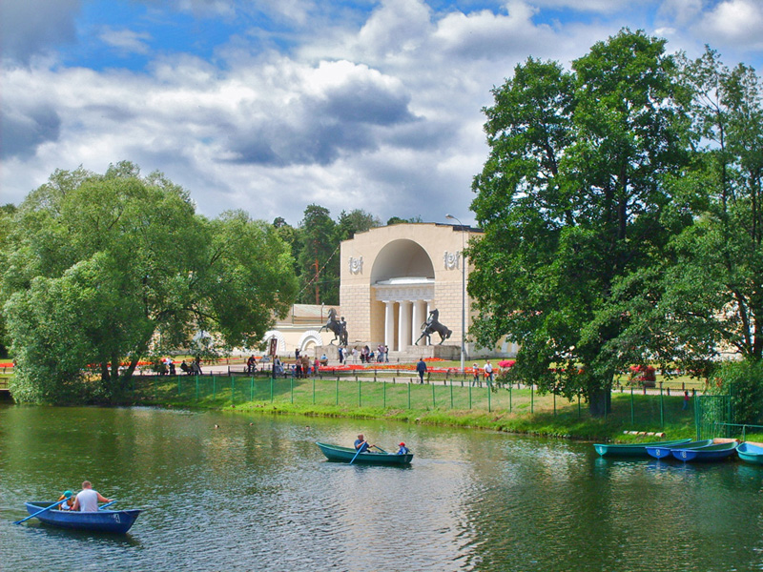
Moscow’s park
All-Russia Exhibition Centre
Moscow is the capital of Russia. It is one of the biggest and most beautiful cities in the world.
Moscow is the pride of Russian people.

Slide 27
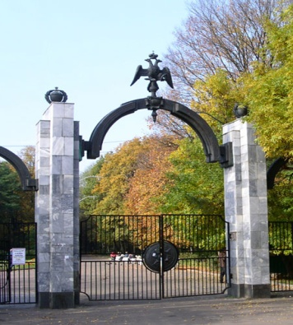
Filevsky Park
We live in the district of Filly. There are a lot of kids’ places in our area , which are interesting for children.
They are…
It is situated in a picturesque place. It stretches along the bank of the Moskva River for 5 km. Its area is about 300 hectares.
It is a very old park. On its territory there is Naryskiny's estate. You can find here a well preserved pond and “Turgenevsky Square” which was mentioned in the novel “On the Eve”.
We often have PE classes in our park. In autumn we are running and in winter we are skiing.
BELARUS

Slide 28
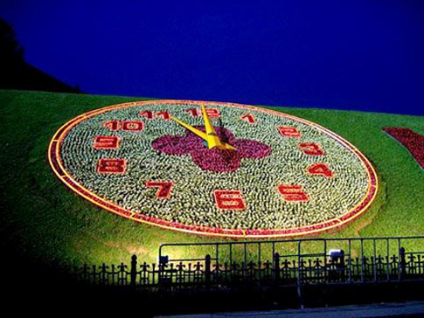
Poklonnaya Gora
It is a very beautiful place. There are monuments , museums, beautiful lawns and fountains. In winter you can visit an exhibition of ice sculptures. In the complex of the fountains there are 15 gushing bowls with 15 vertical streams in each of the bowl. Their total number symbolizes 225 weeks during which the Great Patriotic War lasted.
Most of all children like to visit the Museum of Military Equipment. You can see different types of tanks, planes, guns and other equipment.

Slide 29
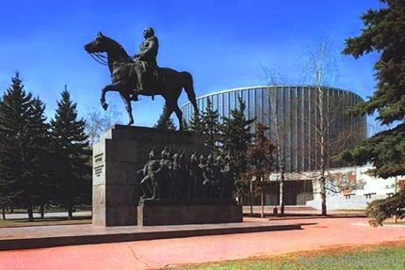
The museum-panorama «Borodinskaya Battle»
The centre of exposition is the panorama «Borodino». It was created by the artist France Rubo in 1912. On the panorama «Borodino» the Borodinskaya Battle was pictured.
While in the museum, do you feel yourself in the centre of the battlefield. The artist with thought accurately depicted the costumes of that time. In the picture we can also see the Emperor of France Napoleon and the Russian commander Kutuzov. Apart from paintings in the museum you can see the cannon-balls, guns, books, crockery. Children like to go on an excursion to this museum.

Slide 30
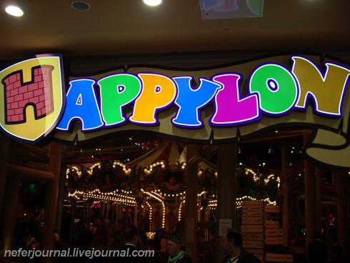
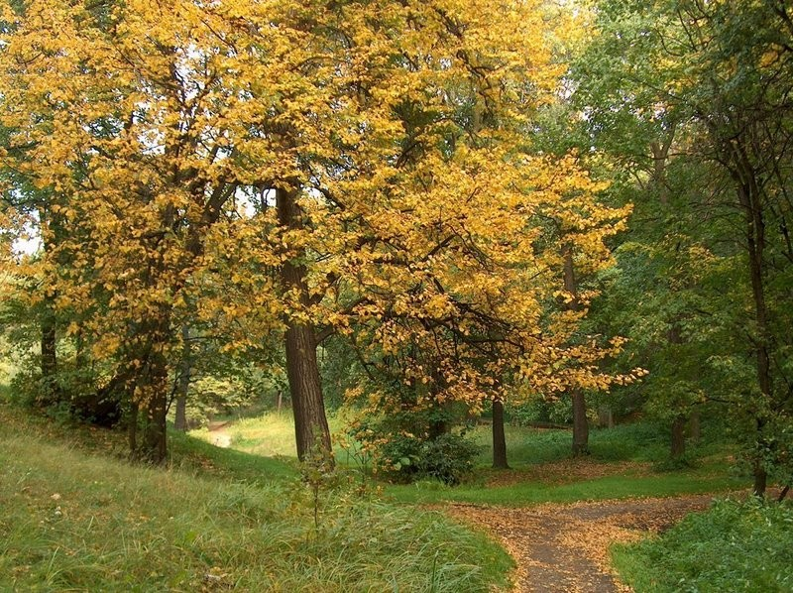
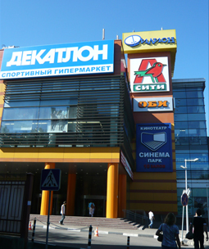
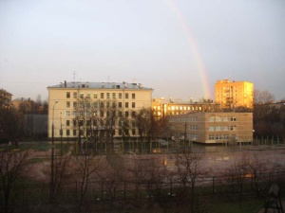

Slide 31
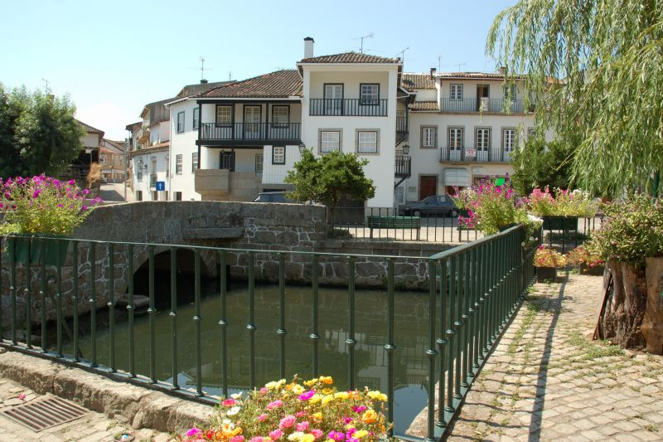
Santa Comba Dao
PORTUGAL

Slide 32
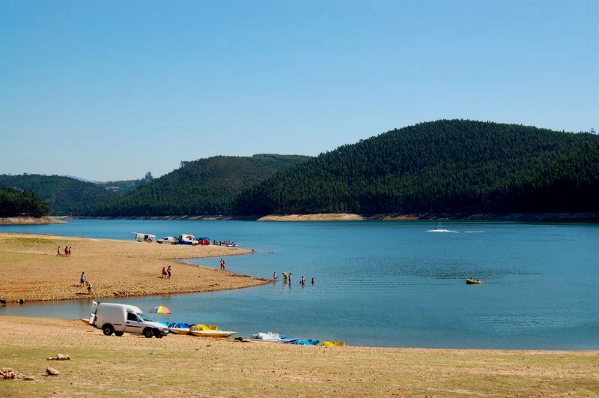
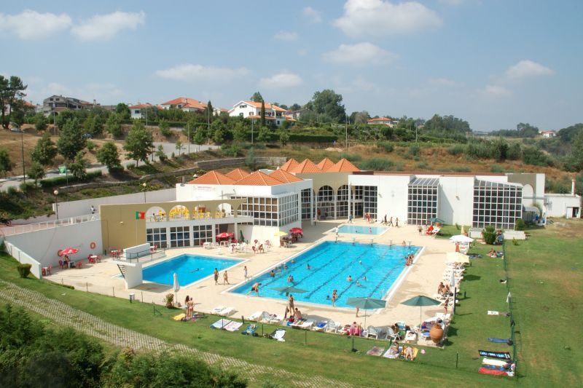

Slide 33
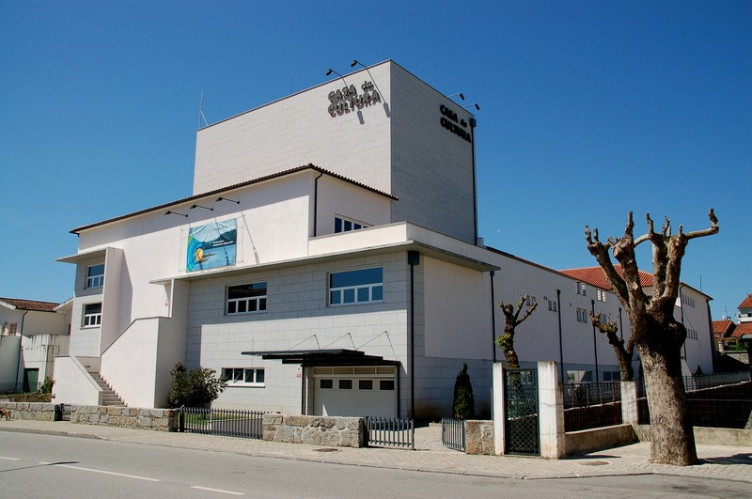
Casa da cultura

