Slide 1
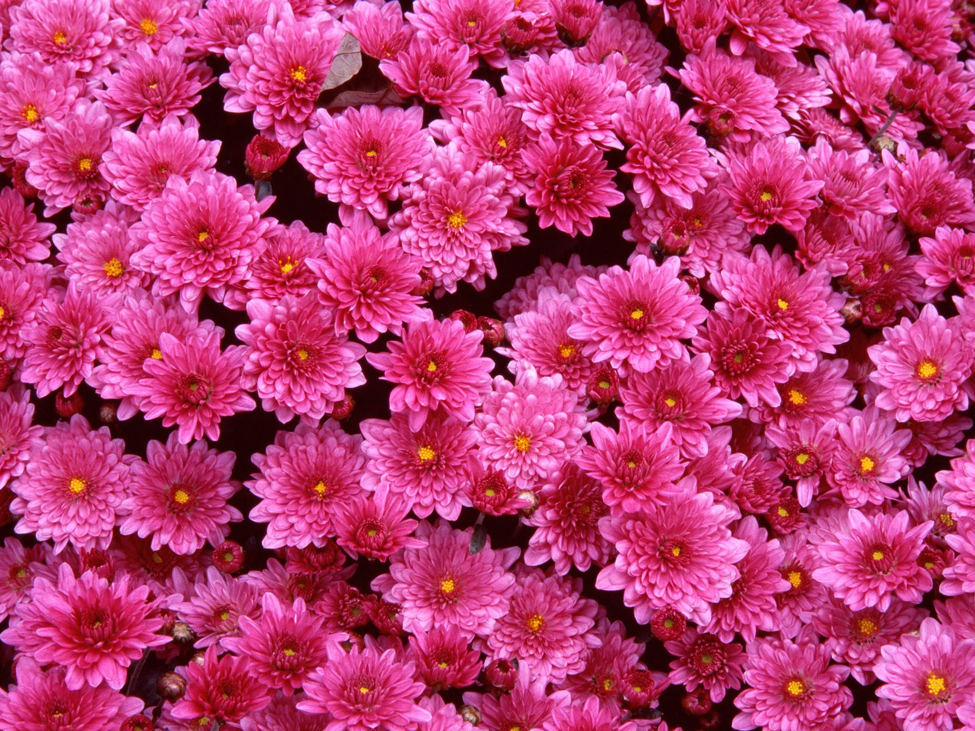
Project Name: “Flowerbed” ACCESS_REZINA

Slide 2
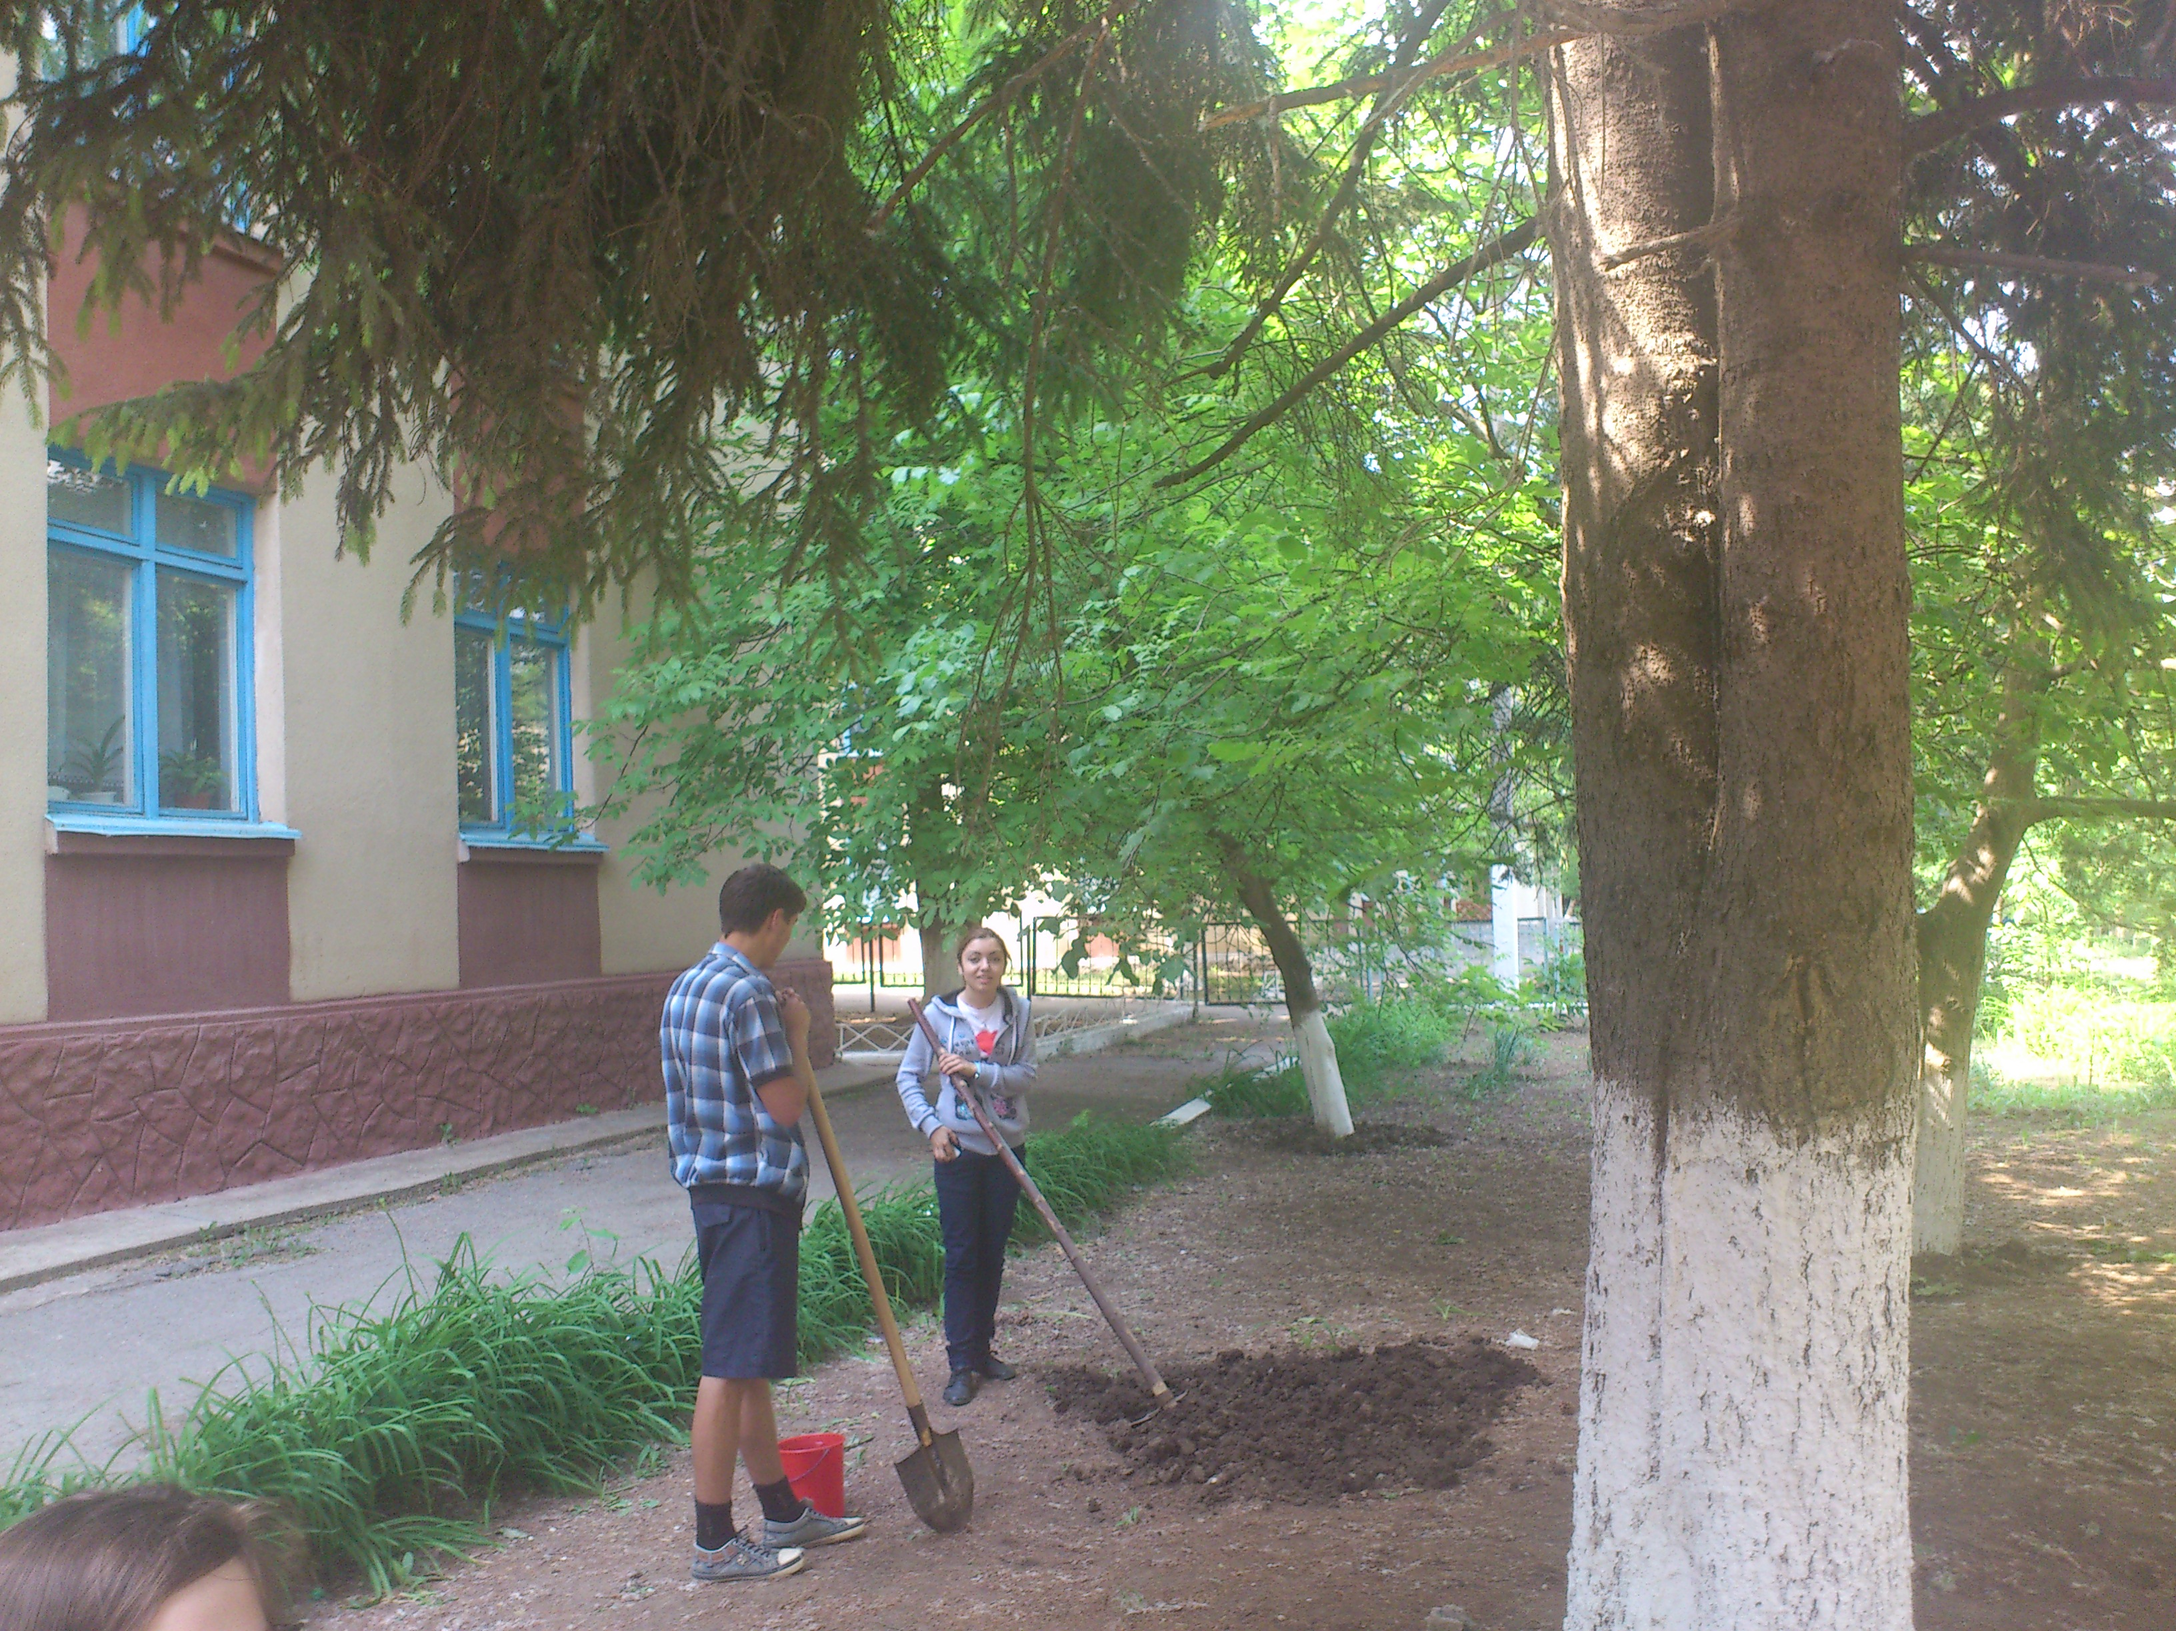
Because we don’t have so many choices in the way we have small place around our school, we decided to make our flowerbed in the front of the school.

Slide 3
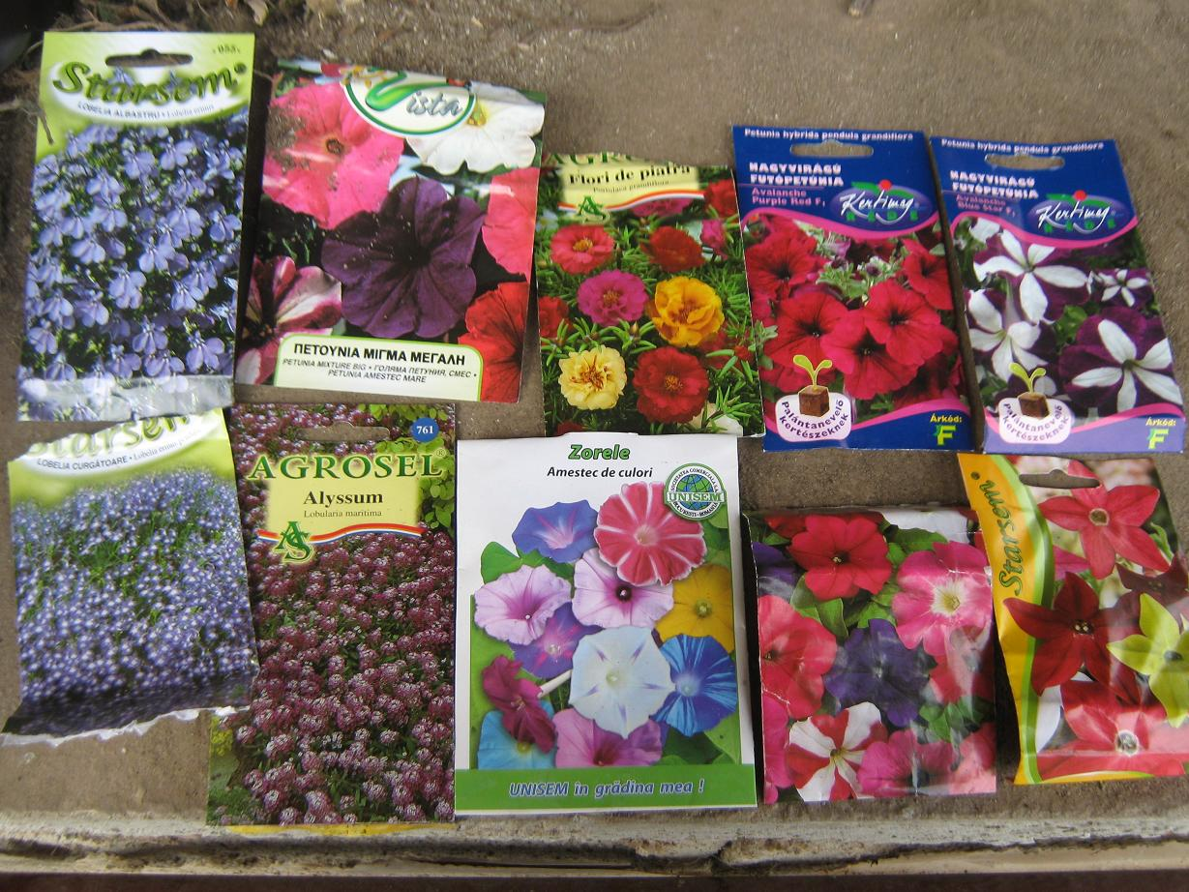
Materials: As materials we needed, 10 packages of flower seeds.

Slide 4
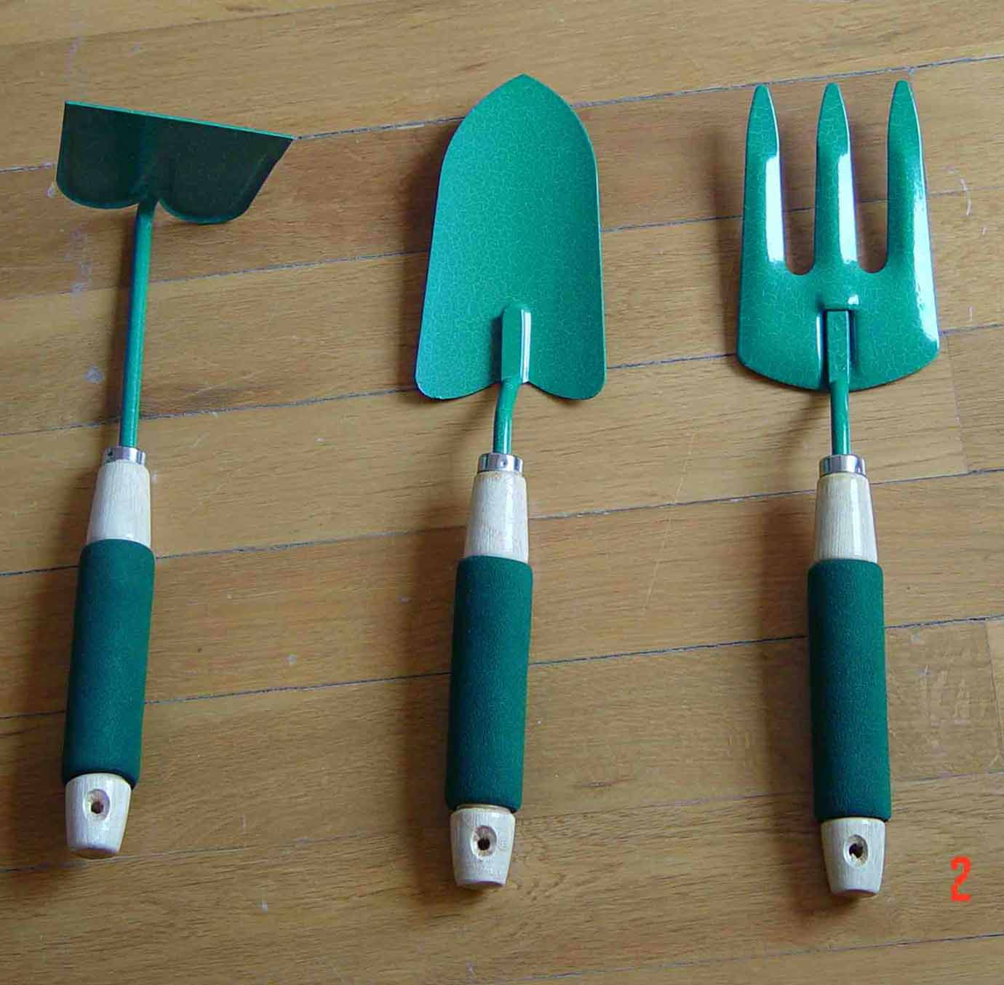
Instruments: As we worked with ground, we used one spade, one dig, one rake, and a lot of water.

Slide 5
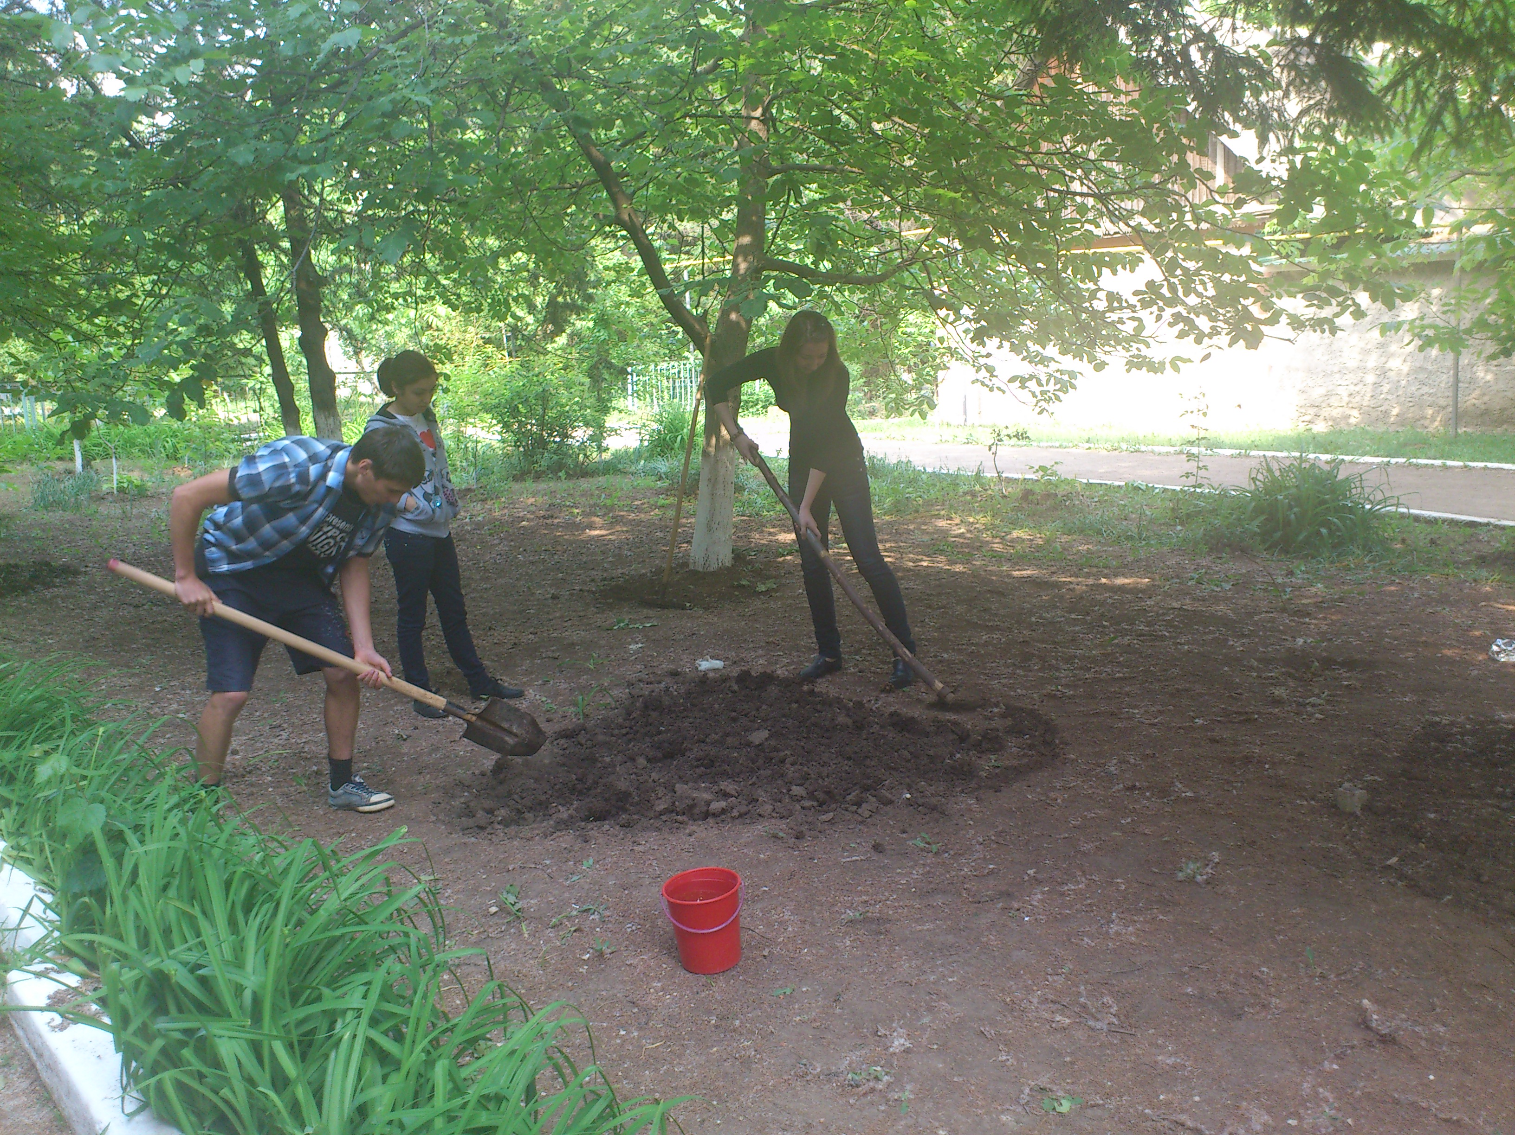
We made our flowerbed in the form of the heart. First we cleaned up all place, then we made our form. After this our boys dug and raked the soil, and took out of heart some soil

Slide 6
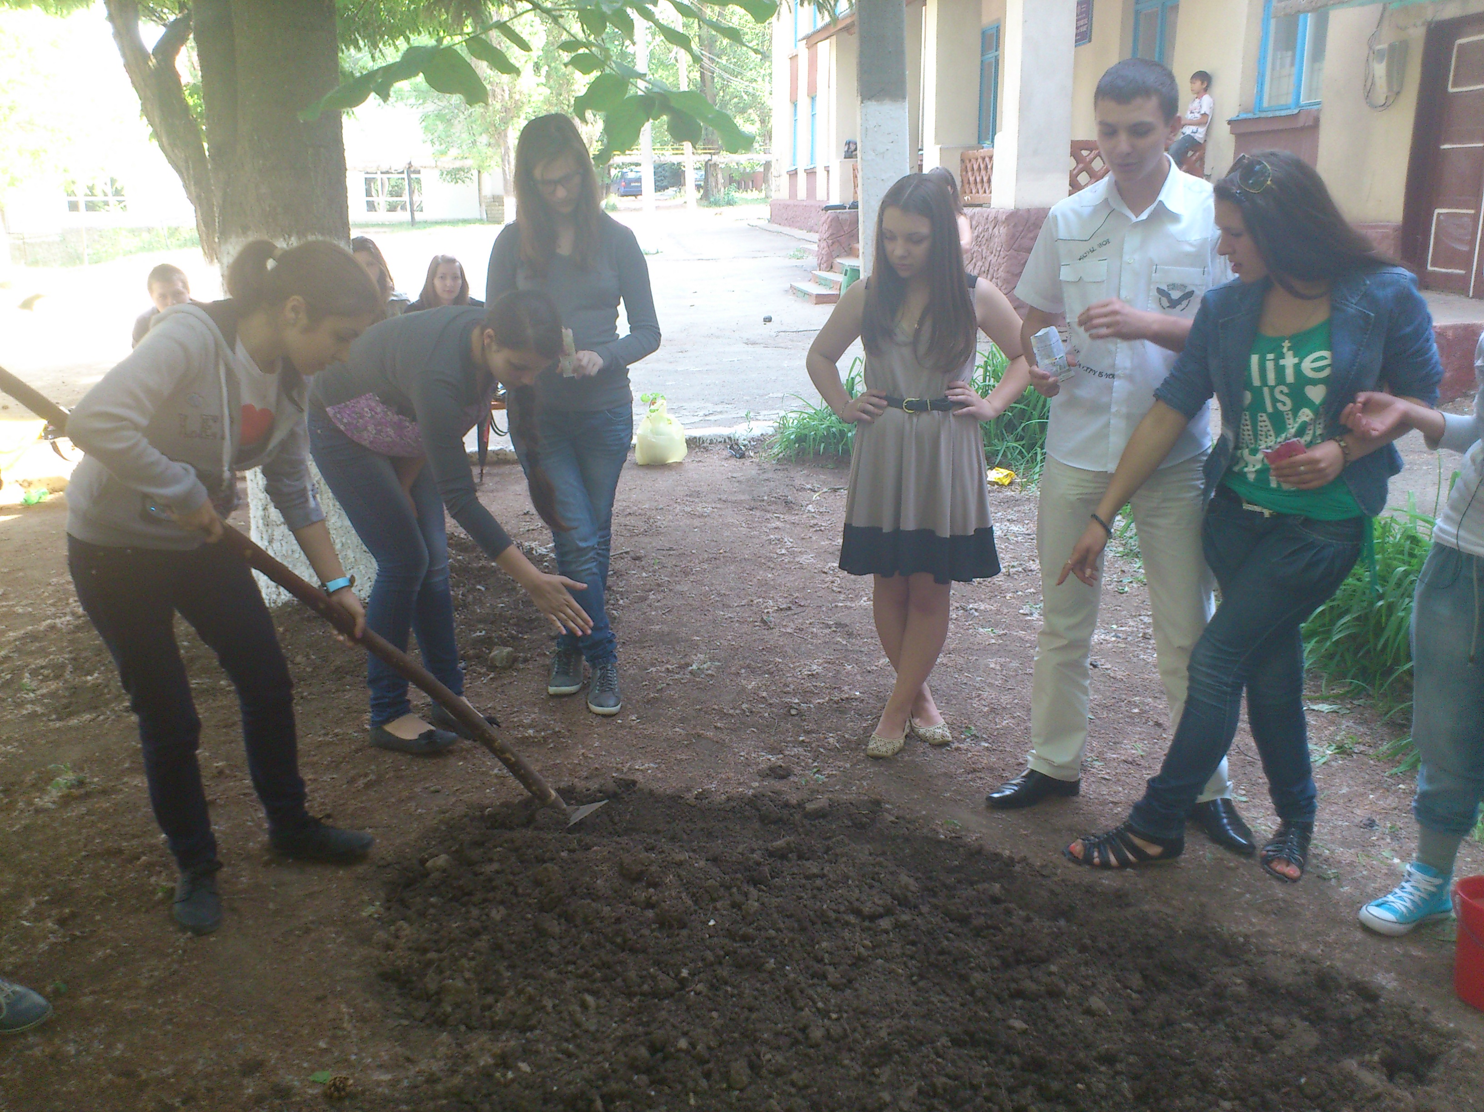
Then girls watered soil , and littered all heart with flower seeds.

Slide 7
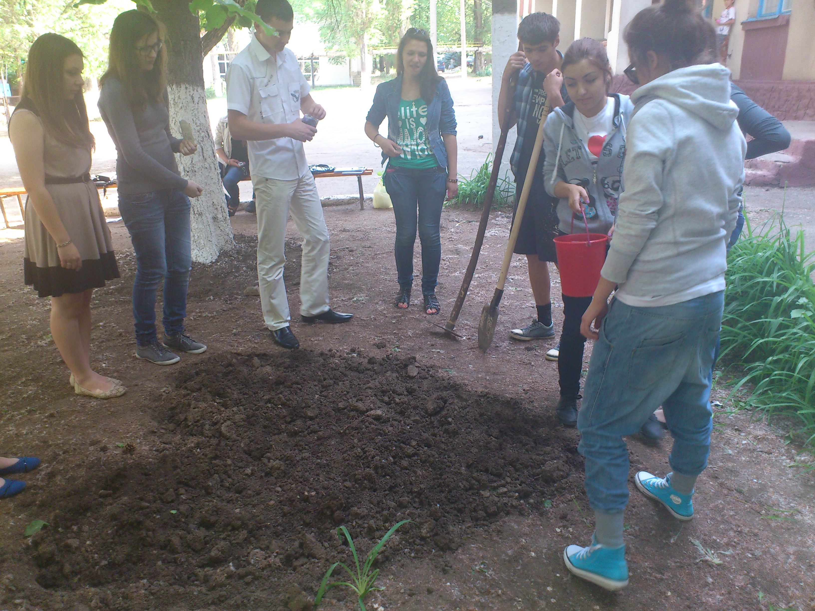
After we watered again our baby flowers, boys covered them with soil that they placed out if the heart.

Slide 8
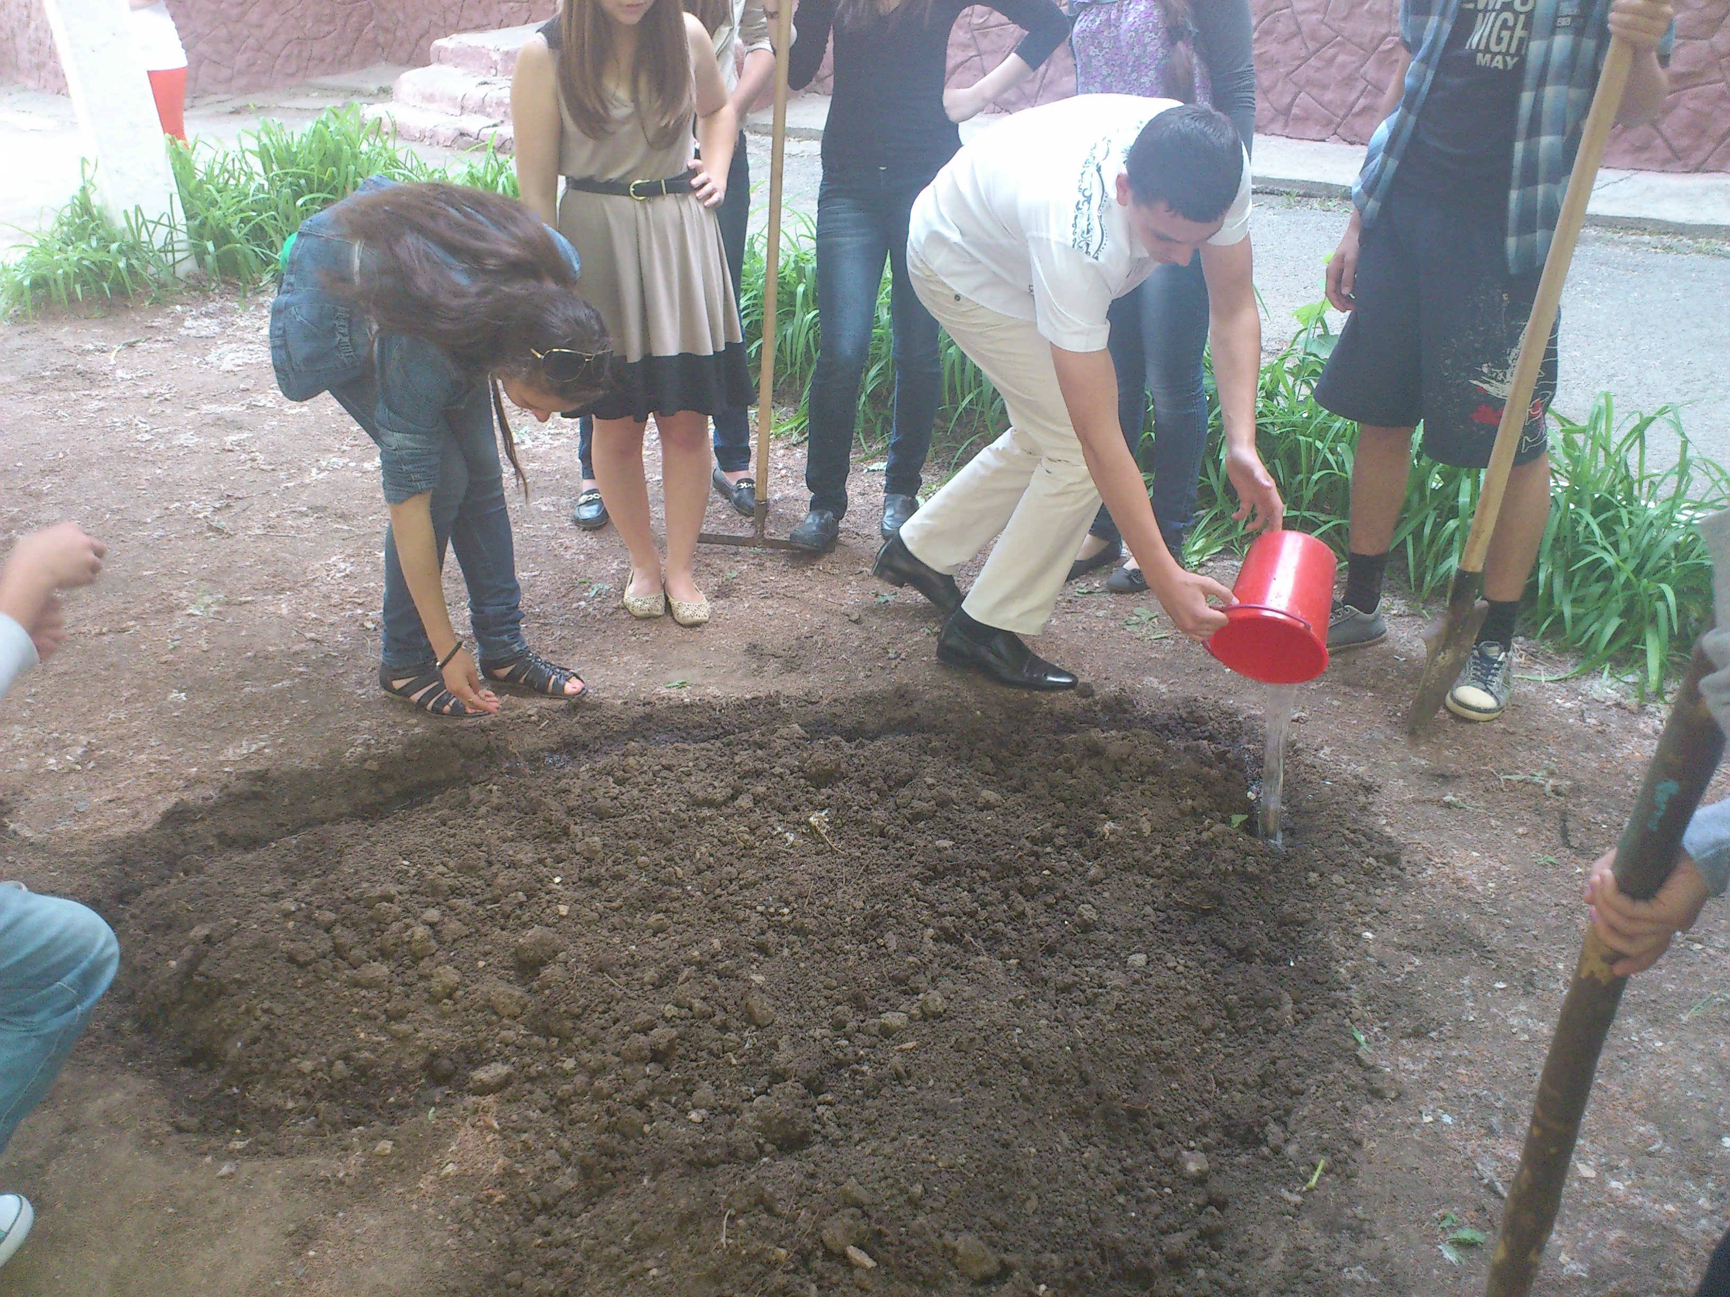
Then we watered again all place. On the next day we watered soil again.

Slide 9
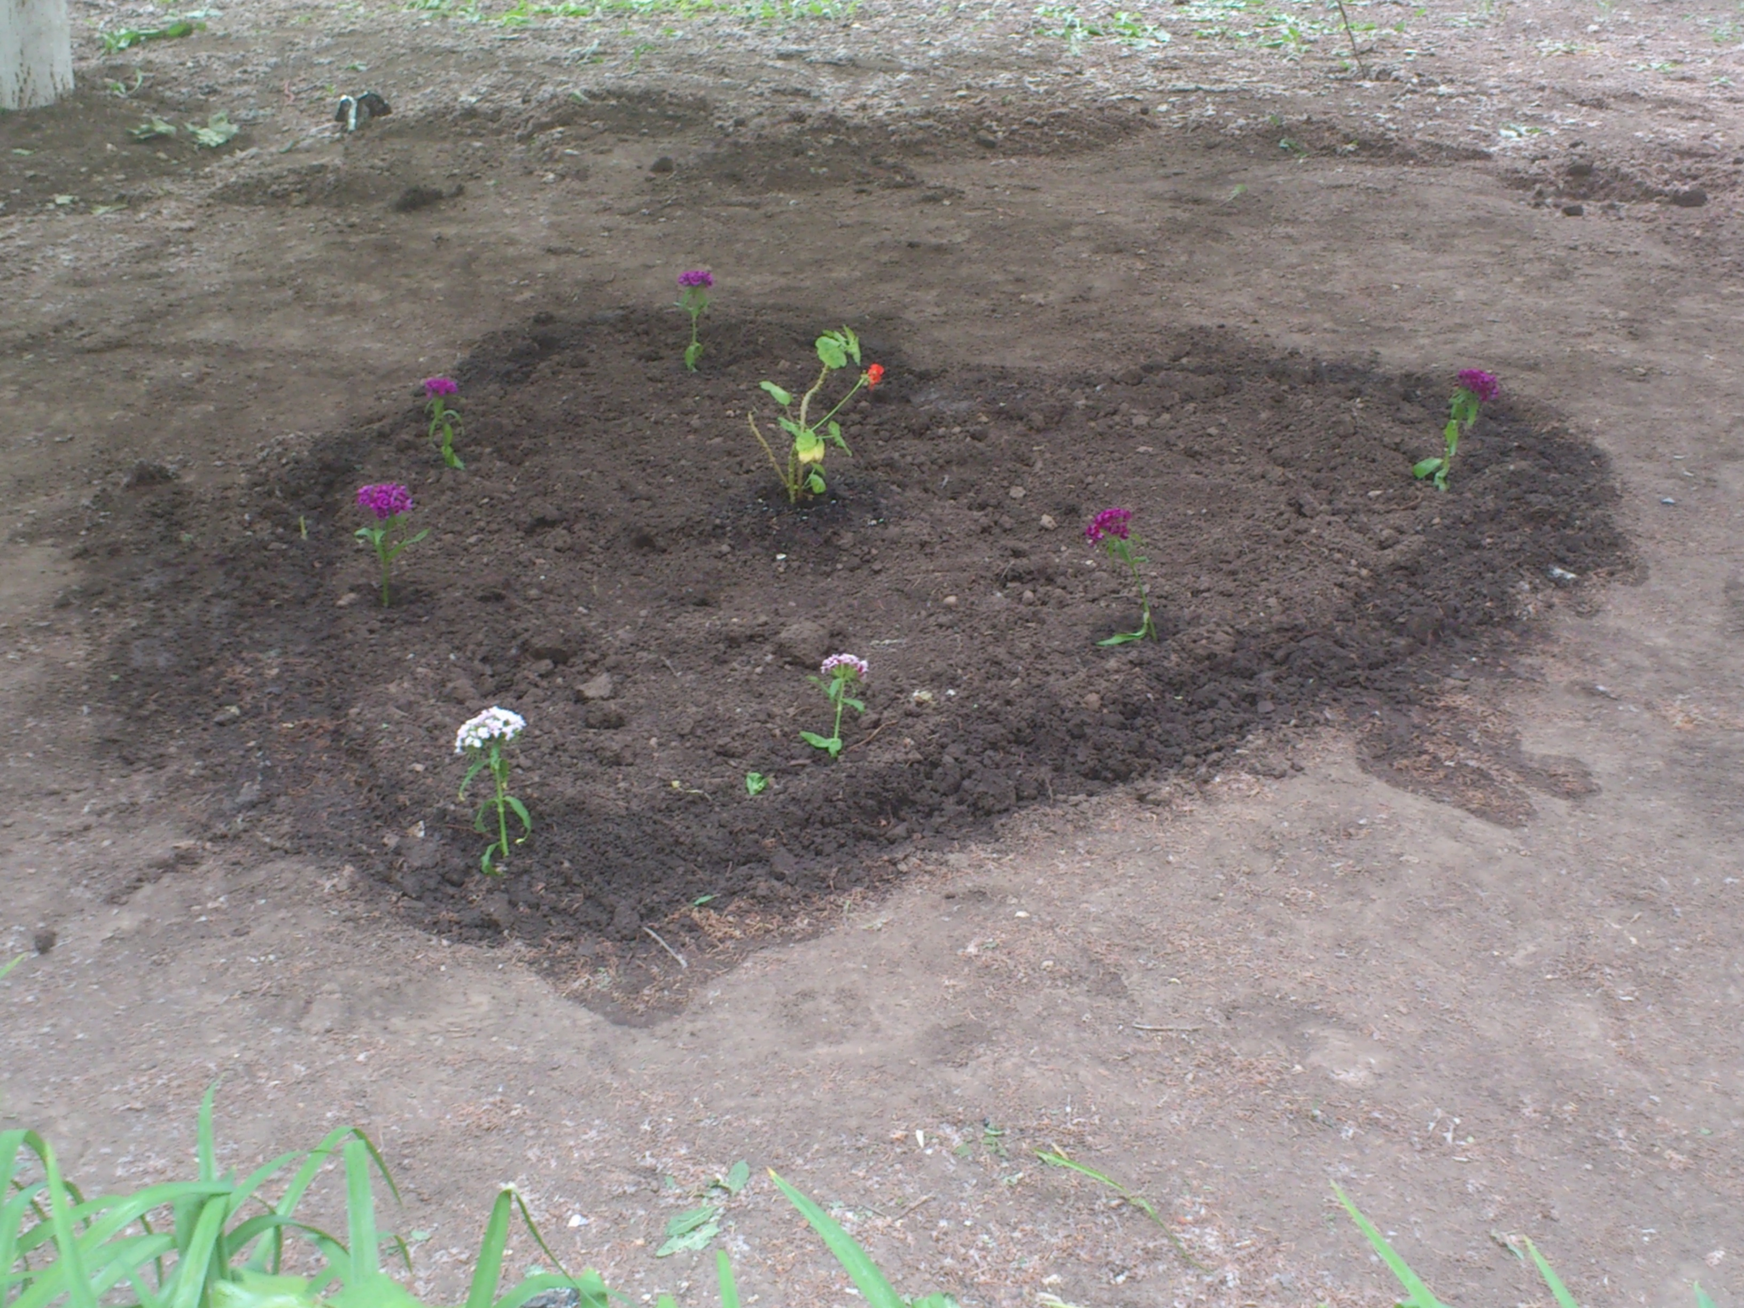
Now we just are waiting for result.
We had a lot of fun, doing our Flower bed.

