Slide 1
Earth Day
Braslav Gymnasium, Belarus
April 22, 2012

Slide 2
We are going to plant trees in in front of our gymnasium.

Slide 3
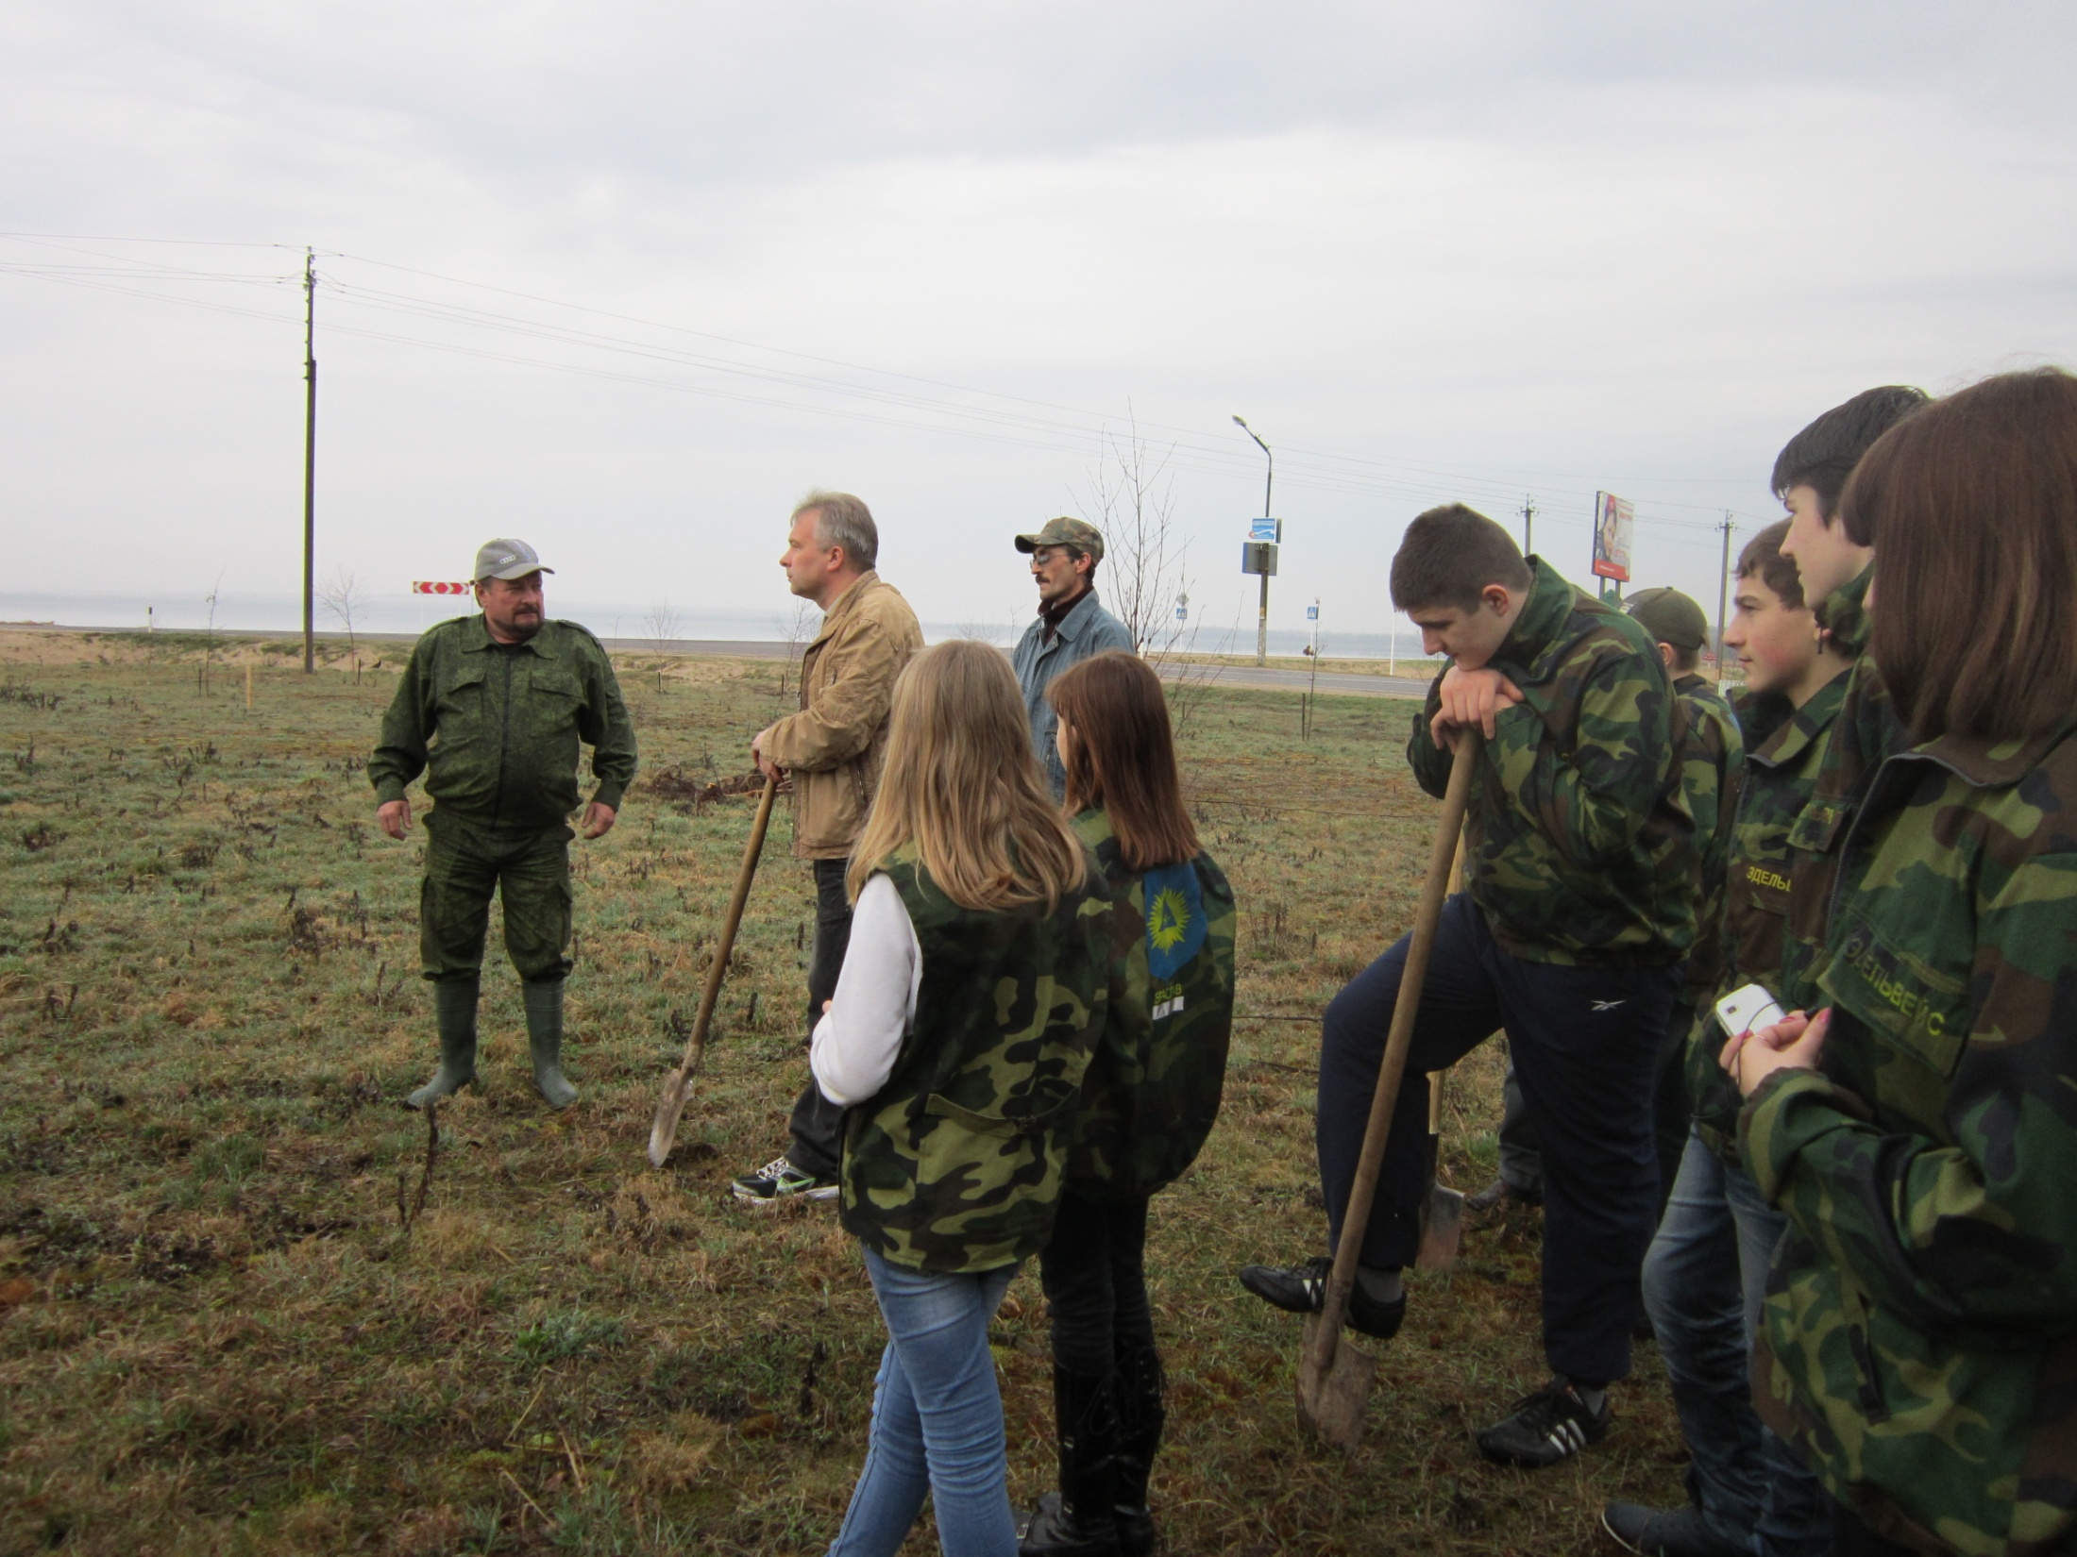
We choose the best place.

Slide 4
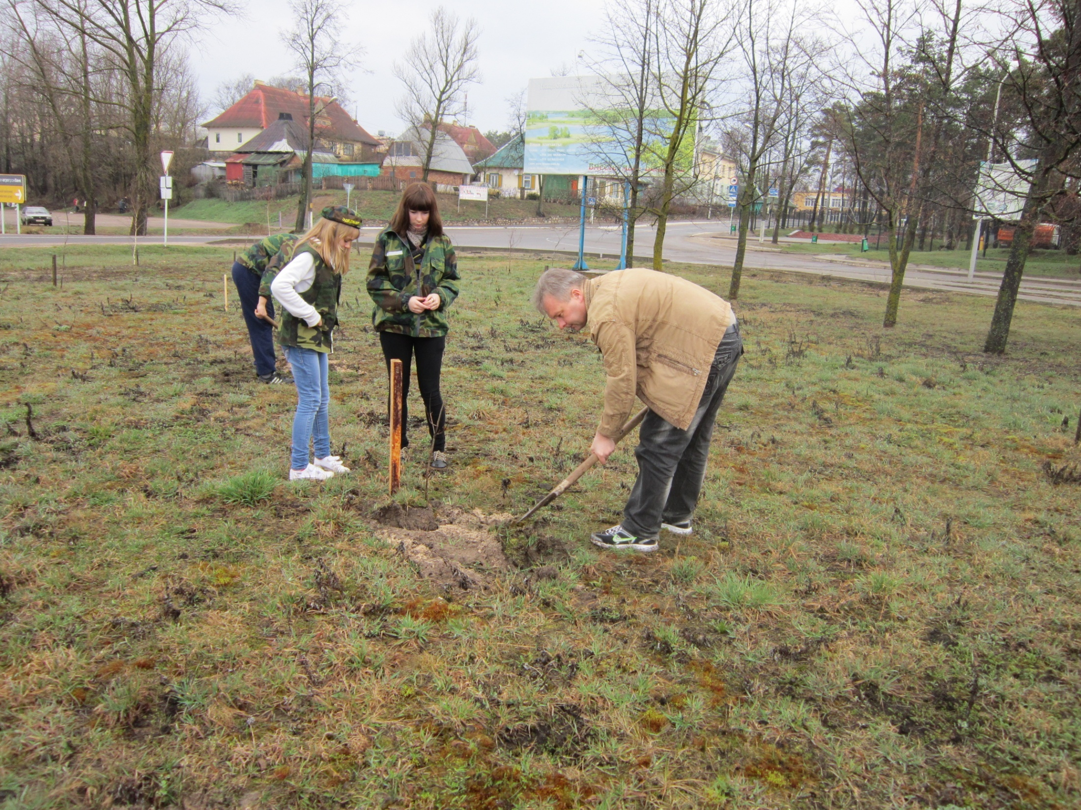
We work together with the chairman of our local Executive Committee

Slide 5
It’s very important to be together with the local authorities on our way to the sustainable development

Slide 6
Why is it necessary to plant trees?

Slide 7
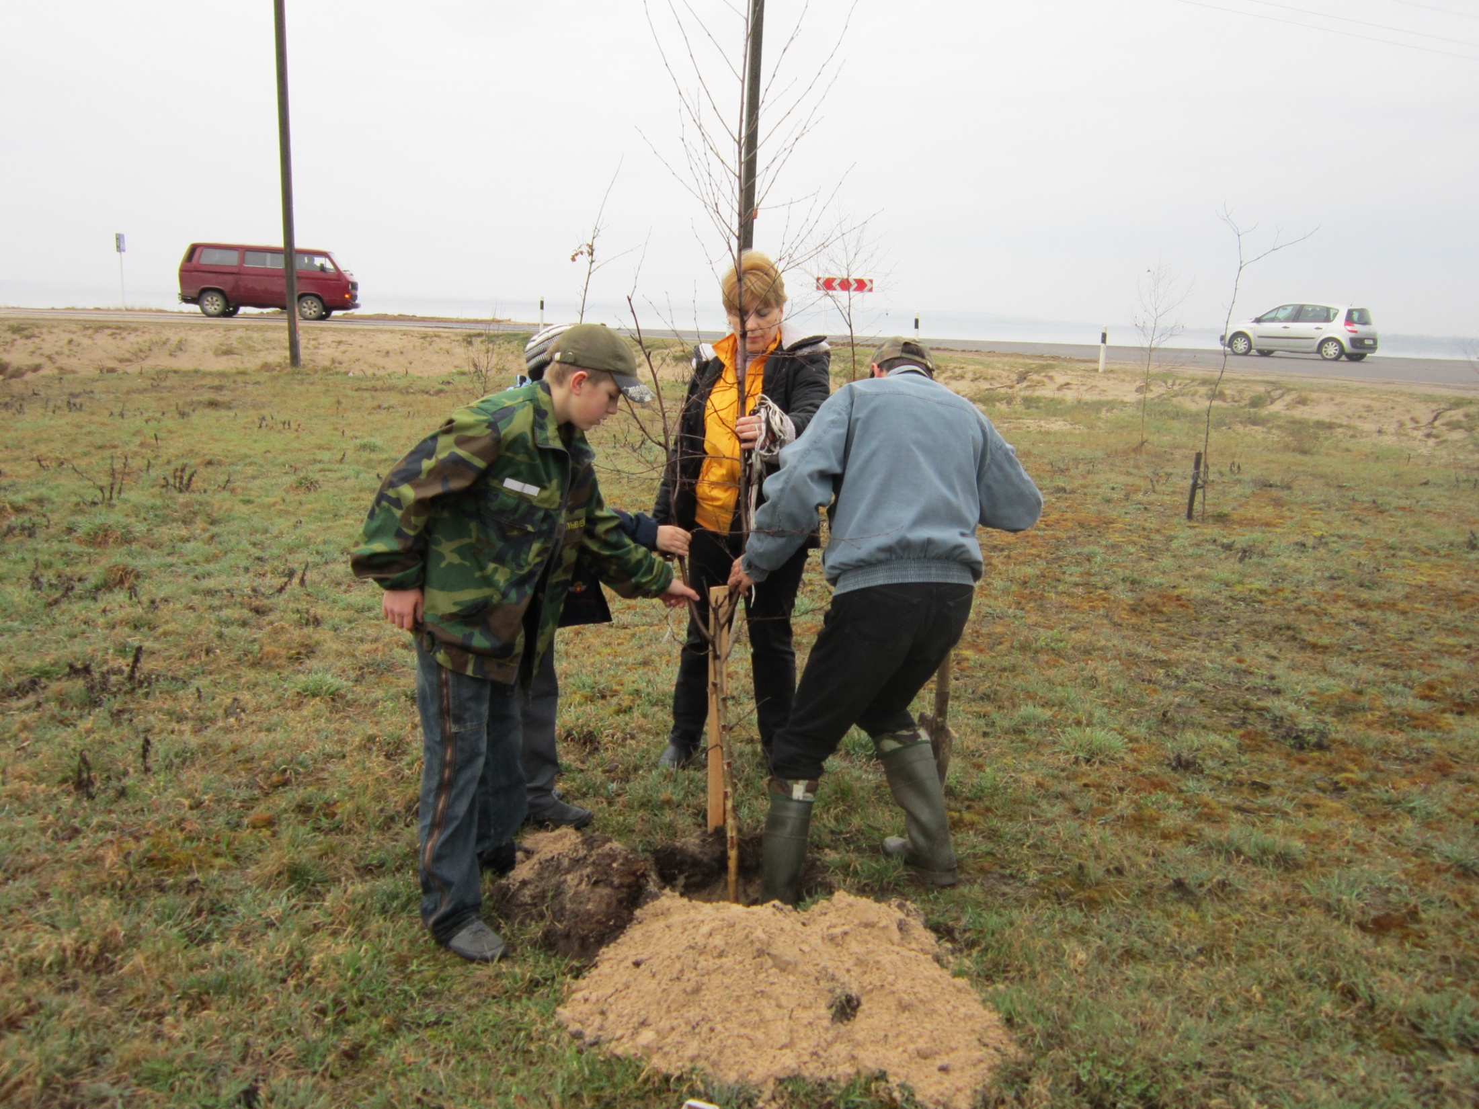
Trees properly placed and cared for on a residential lot can significantly increase property values.

Slide 8
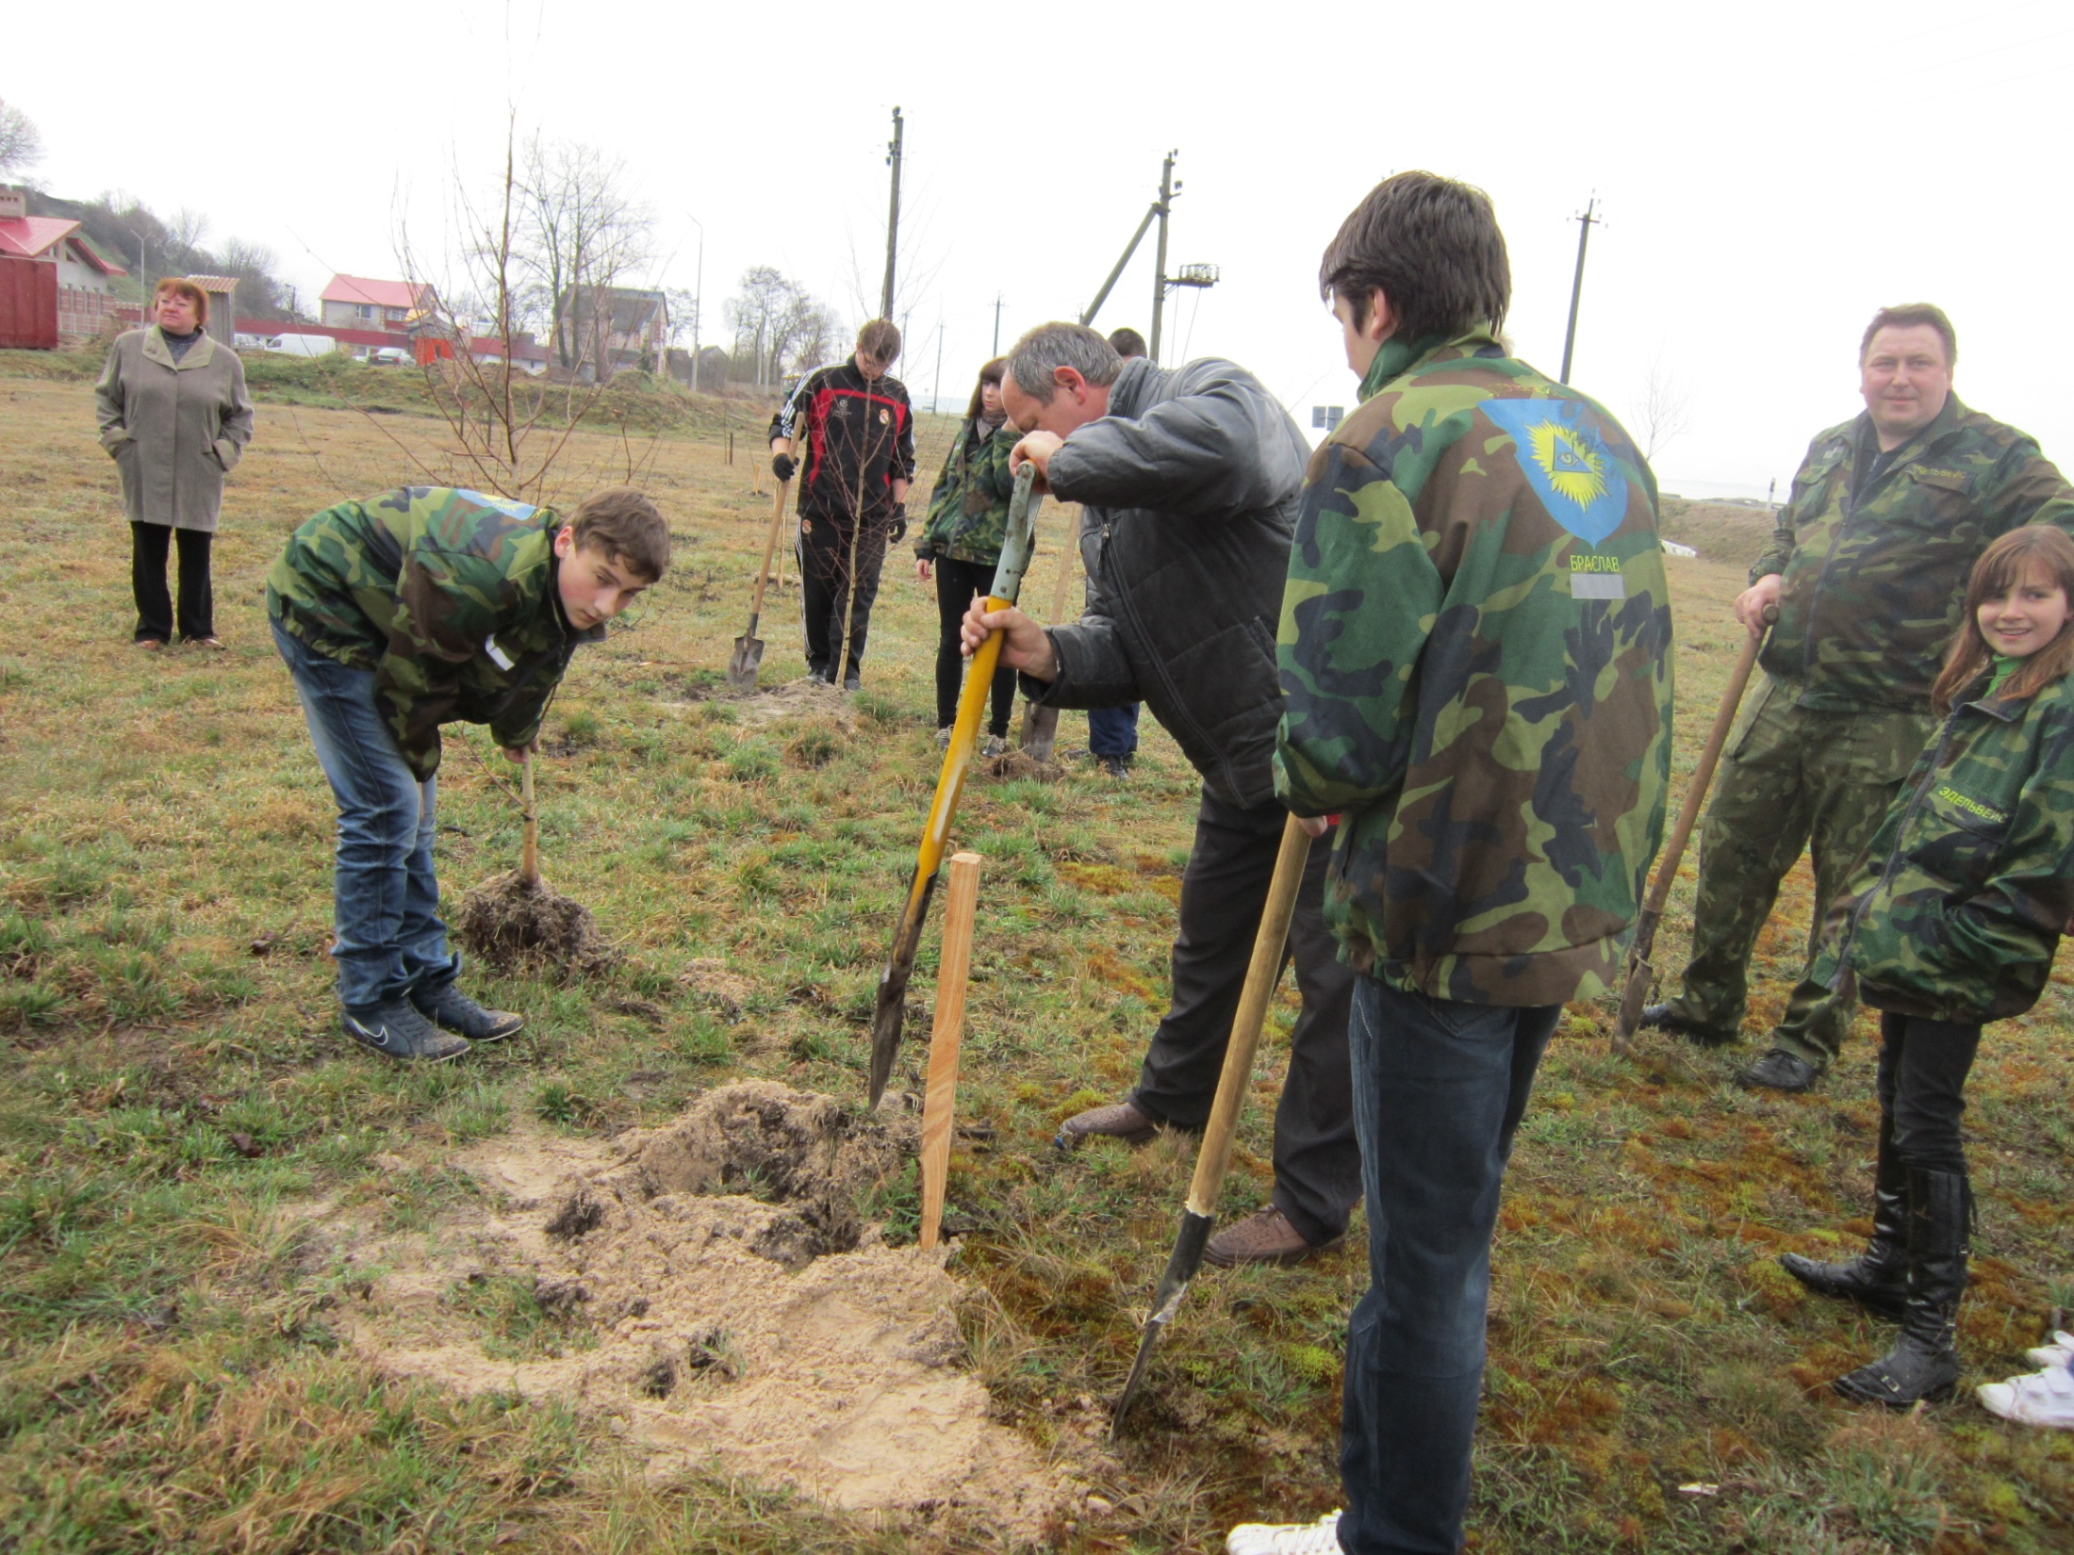
Trees provide brilliant colors to landscapes in the fall.

Slide 9
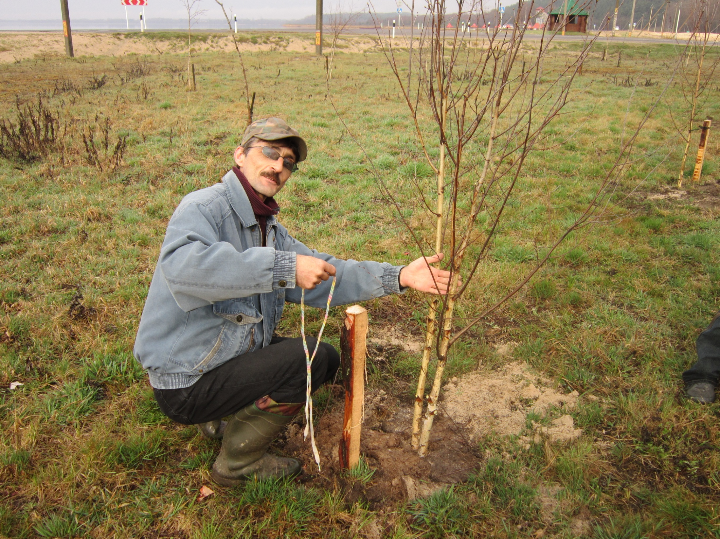
Tree shelters for livestock provide shade for moderating summer heat.

Slide 10
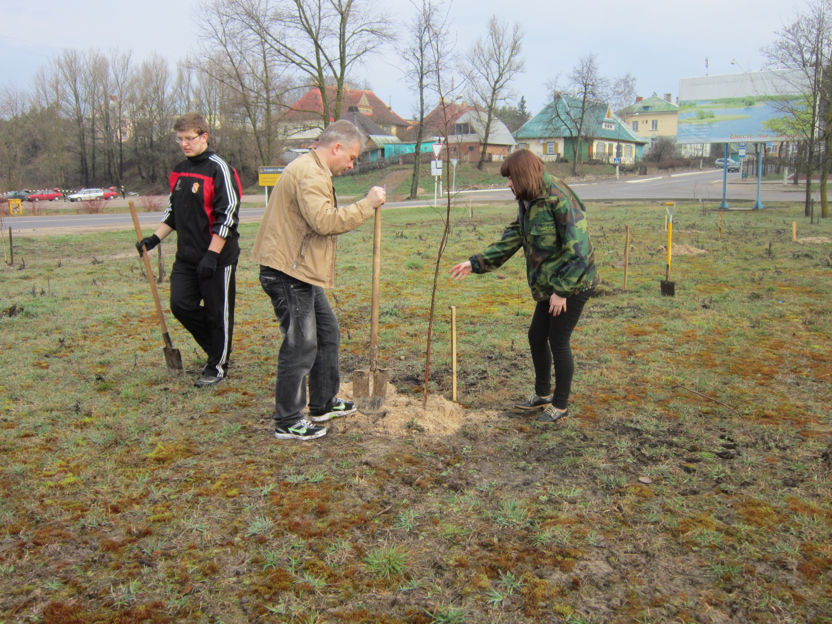
Trees add beauty and grace to any community setting.

Slide 11
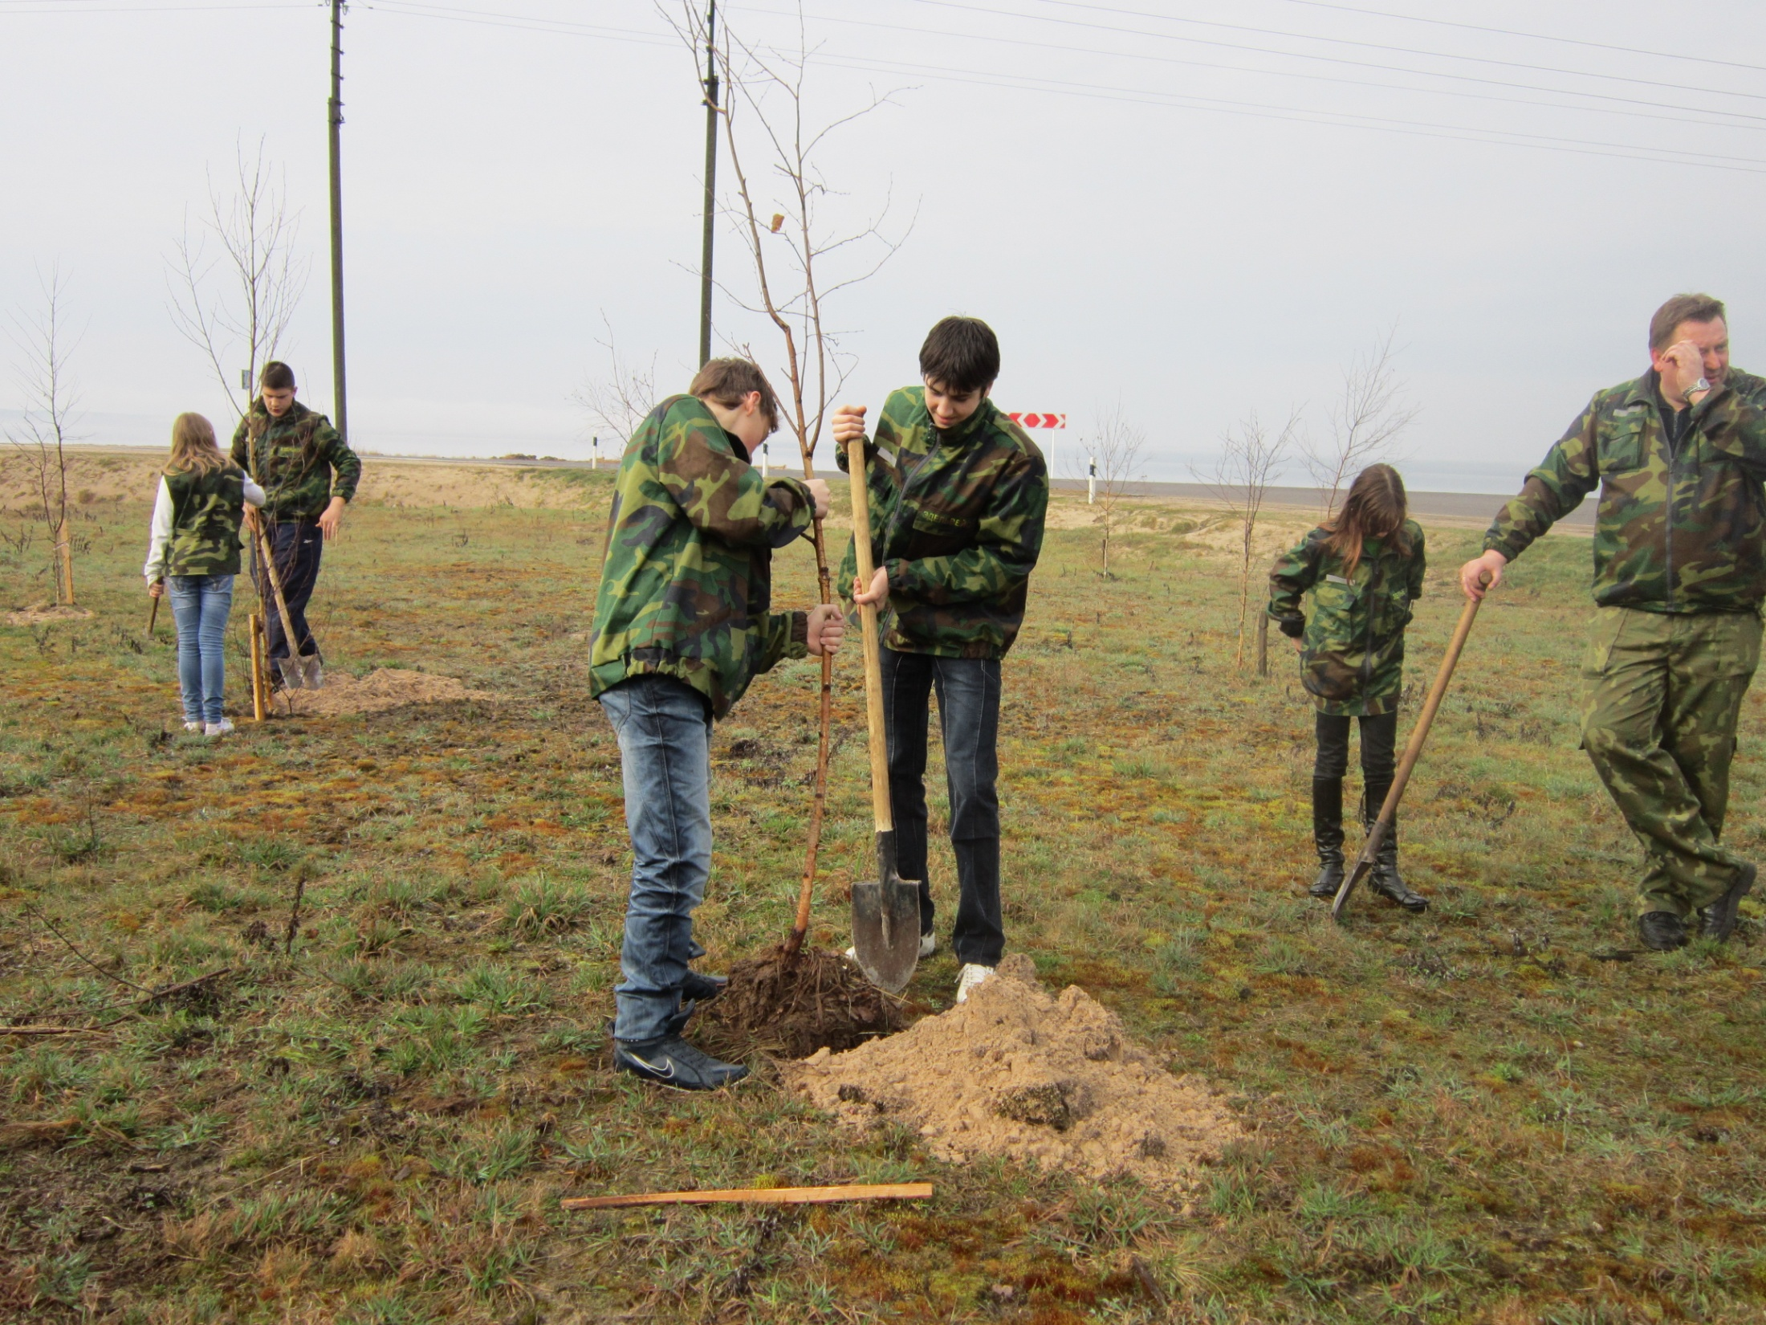
They make life more enjoyable, peaceful, relaxing, and offer a rich inheritance for future generations.

Slide 12
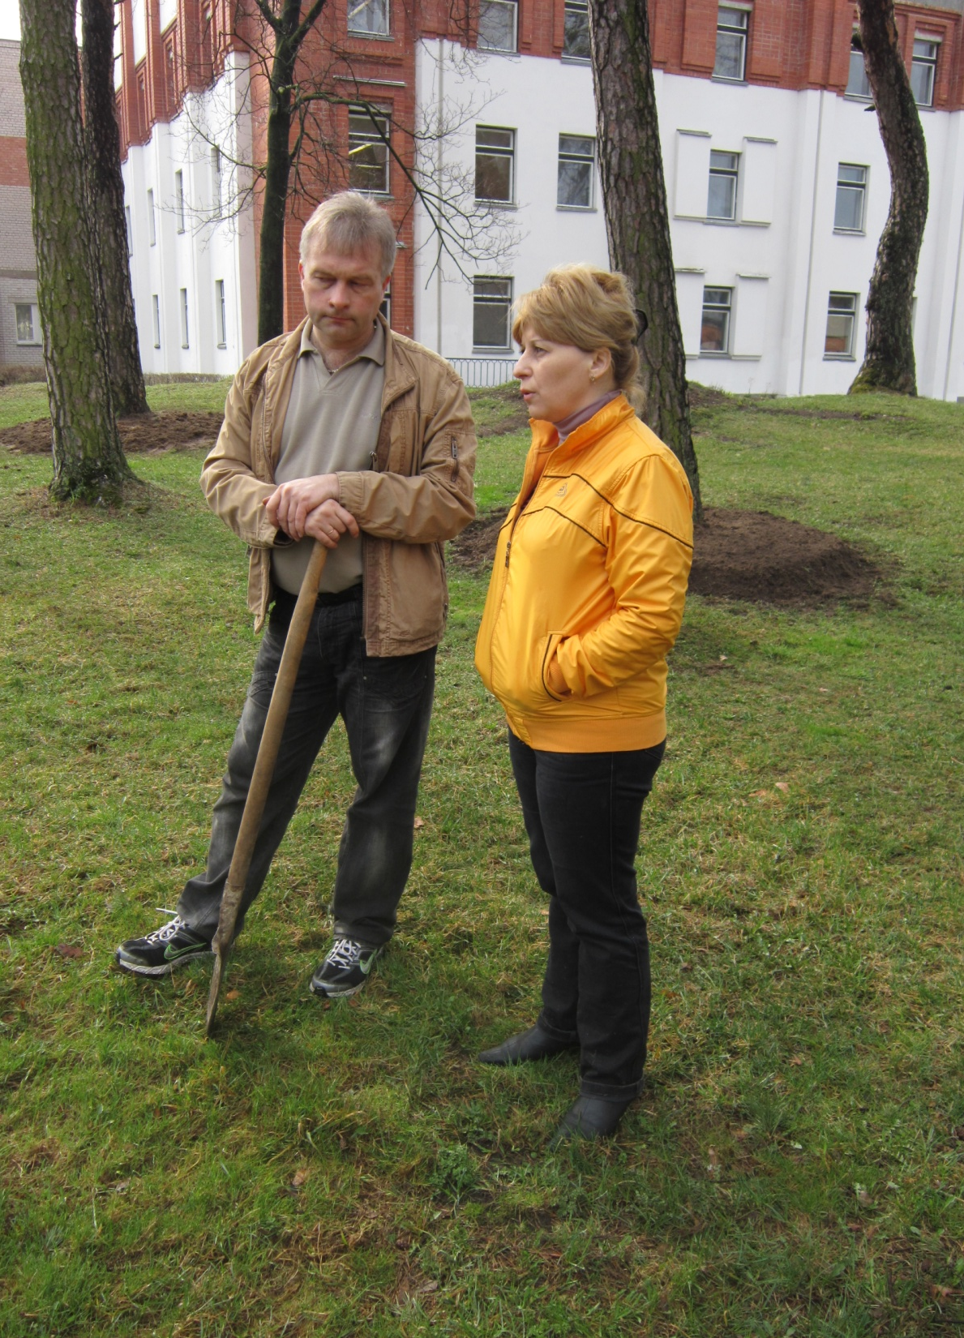
Trees help reduce stress in the workplace

Slide 13
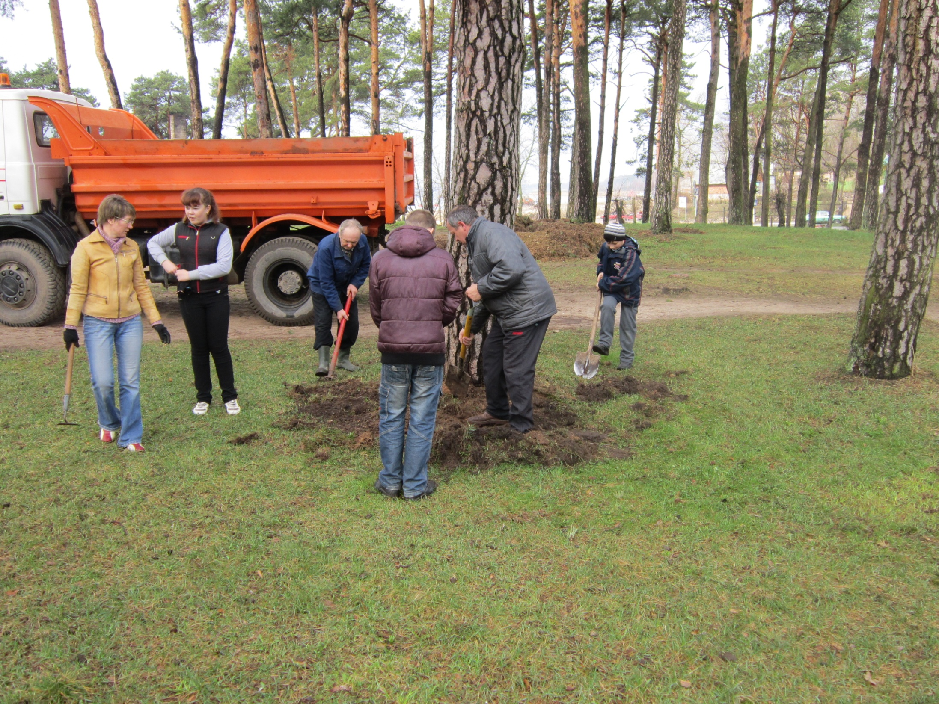
Trees help us experience connections with our natural heritage.

Slide 14
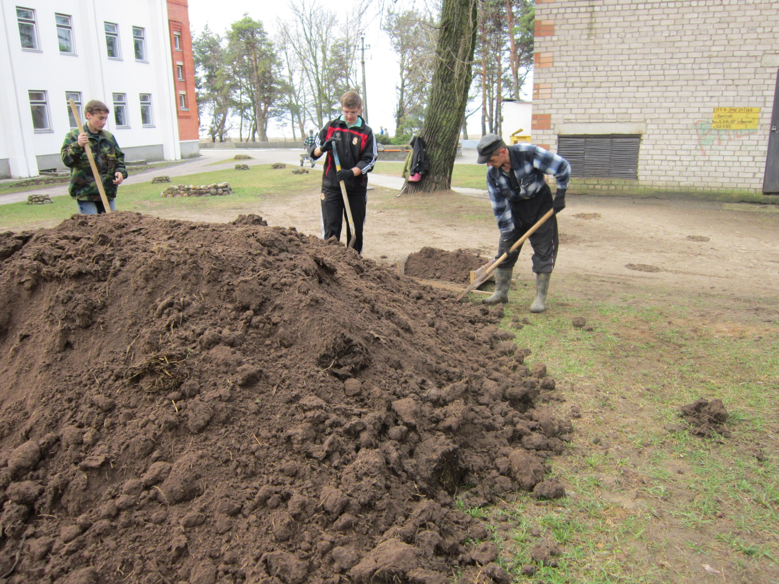

Slide 15
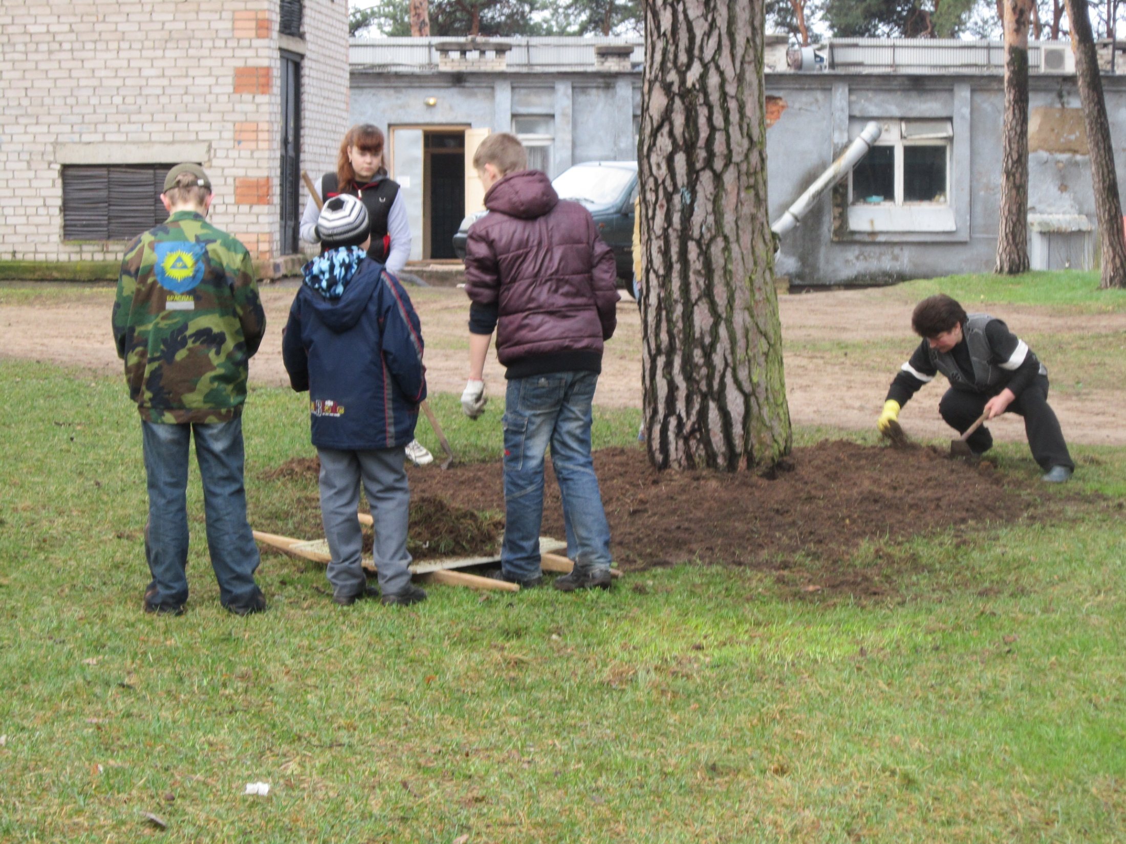
Many people enjoy planting and caring for trees simply because they like to see them grow.

Slide 16
As the result of our action we have planted more than 20 trees and transplanted 20 trees. We have beautified the park and the surroundings, making new flowerbeds and cleaning the ground.

